Slide 1
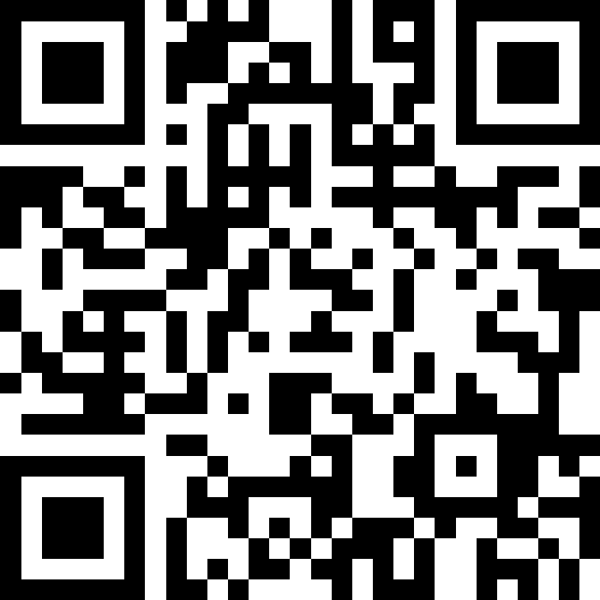
Putting It All Together
BEFORE WE START
Talk to your neighbours:
What’s your current favourite TV show?
LEC 12
Music: 121 25wi lecture playlist ❄️
Instructor:
Matt Wang
TAs:
Ailsa Alice Chloë Christopher
Ethan Hanna Hannah Hibbah
Janvi Judy Julia Kelsey
Lucas Luke Maitreyi Merav
Ruslana Samrutha Sam Shayna
Sushma Vivian

Slide 2
Announcements, Reminders
Quiz 1 is tomorrow!
many resources available! practice quiz (& walkthroughs), starred section problems, PracticeIt, last-minute IPL help
if you’re sick – email me before your quiz time
Quiz 0 grades will be released early tonight (after B lecture)
P2 is out & due next Tuesday, Feb 25th
R3 due tomorrow (eligible: P0, C1, P1, C2)

Slide 3
Quiz Tips
Prepare for the open-book quiz!
consolidate your notes & bookmark helpful resources
clean up desktop & tabs
Budget your quiz time (45 minutes)
Debugging & Programming
grading rubrics are in spec – read and think strategically
Pay special attention to “S” criteria, especially if low on time
Reminder: work must be yours (no communication, no gen AI, …)

Slide 4
Feedback & Closing the Loop: The Good
swofferh's friends:
gbuck21-haleyc22-macy16-mnats-mxw-nwang913-gumball
hibbahk's friends:
janvi26-jvdyfu
juliak24's friends:
qsun05-ldhar-lukel7-parakhm
meravf's friends:
rkorol-samkoro-sbabu23-shay2022-sshan854-vwang2
mxw's friends:
Please please please someone add me back 😭
Your TAs (esp. quiz sections & IPL) :)
Practice Quizzes, problems, videos
Pre-class materials
Lectures (esp. live coding & interaction)
Assignments
Ed discussion board
Classroom vibes & peer engagement
Being funny (sometimes?) & empathetic

Slide 5
Feedback & Closing the Loop: Suggestions
Suggestions that we’re already working on:
time management & pace in lecture
“how to read a spec” (trying this today!)
more video resources*
More structured practice in quiz section
we’re super down! (TAs are thinking…)
unsure about pair/group/all-class; we will ask you (on Ed!)
💖 juliak24's Besties💖
--> qsun05 💫
--> ldhar 💫
--> lukel7 💫
💖 meravf's Besties💖
--> rkorol 💫
--> samkoro 💫
--> sbabu23 💫
--> shay2022 💫
--> sshan854 💫
💖 mxw's Besties💖
--> No Besties 😔

Slide 6
Feedback & Closing the Loop: Practice
╔═══*Bestie List*═══╗
✨ swofferh besties
🤍 gbuck21
🤍 haleyc22
🤍 macy16
🤍 mnats
🤍 mxw
🤍 nwang913
🤍 gumball
╚═══*.·☽✧ ✦ ✧☾·.*═══╝
╔═══*Bestie List*═══╗
✨ hibbahk besties
🤍 janvi26
🤍 jvdyfu
╚═══*.·☽✧ ✦ ✧☾·.*═══╝
Practice can happen…
in structured environments (e.g. quiz section, IPL)
in unstructured environments (e.g. on your own)
Practice problems! (in order of relevance)
Practice quizzes, section problems
“Extra Review” problems
Pre-class & Lecture Problems
PracticeIt

Slide 7
Feedback & Closing the Loop: Transfer
But: what we care about in this class is transfer: how can you use your knowledge on new tasks.
won’t ask you exactly what’s on the practice quiz
more practice quizzes has diminishing returns
what programming in real life looks like!
Find yourself hitting a wall with practice (or on work)?
A sign that you should be doing something different!
Advice: reflect on what’s working & talk to someone (office hours, IPL, or your bestie)
♪ juliak24
♫ qsun05
♫ ldhar
♫ lukel7
♫ parakhm
♪ meravf
♫ rkorol
♫ samkoro
♫ sbabu23
♫ shay2022
♫ sshan854
♫ vwang2
♪ mxw
♫ I am so lonelyyyyyyy ♫

Slide 8
Feedback & Closing the Loop: In Closing…
Reading specifications carefully is a skill!
“Fun” fact: Matt has to read specs too…
Make use of the IPL!
not just for homework help!
some times are busier than others … plan for this!
And finally, please keep giving us feedback!
|- 🩷 - swofferh's friends - 🩷 -
|-=-=-=-=-=-=-=-=-=-=-=-=-=-=-
|~~🧁 gbuck21-haleyc22-macy16-mnats-mxw-nwang913-gumball 🧁~~
|- 💔 - hibbahk's friends - 💔 -
|-=-=-=-=-=-=-=-=-=-=-=-=-=-=-
|~~🍎 janvi26-jvdyfu 🍎~~
|- 💚 - mxw's friends - 💚 -
|-=-=-=-=-=-=-=-=-=-=-=-=-=-=-
|~~🥑 no friends LOSER! LLL 🥑~~

Slide 9
One last C2 Extension
𝔚𝔥𝔢𝔫 𝔴𝔞𝔯 𝔦𝔫𝔢𝔳𝔦𝔱𝔞𝔟𝔩𝔶 𝔠𝔞𝔪𝔢 𝔱𝔬 𝔱𝔥𝔢 𝔨𝔦𝔫𝔤𝔡𝔬𝔪 𝔬𝔣 𝔎𝔞𝔫𝔢ℌ𝔞𝔩𝔩,
𝔎𝔦𝔫𝔤 𝔐𝔞𝔱𝔱 𝔞𝔰𝔰𝔢𝔪𝔟𝔩𝔢𝔡 𝔱𝔥𝔢 𝔪𝔬𝔰𝔱 𝔣𝔬𝔯𝔪𝔦𝔡𝔞𝔟𝔩𝔢 𝔞𝔯𝔪𝔶 𝔨𝔫𝔬𝔴𝔫 𝔱𝔬 𝔪𝔞𝔫𝔨𝔦𝔫𝔡.
𝔏𝔢𝔡 𝔟𝔶 5 𝔬𝔣 𝔥𝔦𝔰 𝔪𝔬𝔰𝔱 𝔠𝔲𝔫𝔫𝔦𝔫𝔤 𝔤𝔢𝔫𝔢𝔯𝔞𝔩𝔰, 𝔥𝔦𝔰 𝔟𝔯𝔞𝔳𝔢 𝔰𝔬𝔩𝔡𝔦𝔢𝔯𝔰 𝔪𝔞𝔯𝔠𝔥𝔢𝔡 𝔦𝔫𝔱𝔬 𝔟𝔞𝔱𝔱𝔩𝔢.
𝔉𝔯𝔬𝔪 𝔱𝔥𝔢 𝔪𝔞𝔰𝔰𝔢𝔰 𝔬𝔣 𝔥𝔦𝔰 𝔞𝔯𝔪𝔶, 𝔞 𝔳𝔬𝔦𝔠𝔢 𝔯𝔞𝔫𝔤 𝔬𝔲𝔱 -
𝔞𝔫𝔫𝔬𝔲𝔫𝔠𝔦𝔫𝔤 𝔱𝔥𝔢 𝔞𝔯𝔯𝔦𝔳𝔞𝔩 𝔬𝔣 𝔥𝔦𝔰 𝔤𝔢𝔫𝔢𝔯𝔞𝔩𝔰 𝔞𝔫𝔡 𝔱𝔥𝔢𝔦𝔯 𝔪𝔬𝔰𝔱 𝔡𝔦𝔰𝔱𝔦𝔫𝔤𝔲𝔦𝔰𝔢𝔡 𝔰𝔬𝔩𝔡𝔦𝔢𝔯𝔰:
✠ swofferh's loyal soldiers ✠
⚔️gbuck21
⚔️haleyc22
⚔️macy16
⚔️mnats
⚔️mxw
⚔️nwang913

Slide 10
Think Pair Share: wrapped (think)
Take a look at the “Spotify Wrapped” spec section on “determining the final message”. Which conditional structure would you use?
if, if, if
if, else
if, else-if
if, else-if, else

Slide 11
Think Pair Share: wrapped (pair)
Take a look at the “Spotify Wrapped” spec section on “determining the final message”. Which conditional structure would you use?
if, if, if
if, else
if, else-if
if, else-if, else
something else!

Slide 12
Reminder (again): Fencepost Pattern
Some task where one piece is repeated n times, and another piece is repeated n-1 times and they alternate
L-a-u-f-e-y-!

Slide 13
Fencepost Pattern … for User Input?
Some task where one piece is repeated n times, and another piece is repeated n-1 times and they alternate
enter an artist
how many listens?
enter an artist
how many listens?
enter an artist
...

Slide 14
Announcements, Reminders (again)
Quiz 1 is tomorrow!
many resources available! practice quiz (& walkthroughs), starred section problems, PracticeIt, last-minute IPL help
if you’re sick – email me before your quiz time
Quiz 0 grades will be released early tonight (after B lecture)
P2 is out & due next Tuesday, Feb 25th
R3 due tomorrow (eligible: P0, C1, P1, C2)

