Slide 1
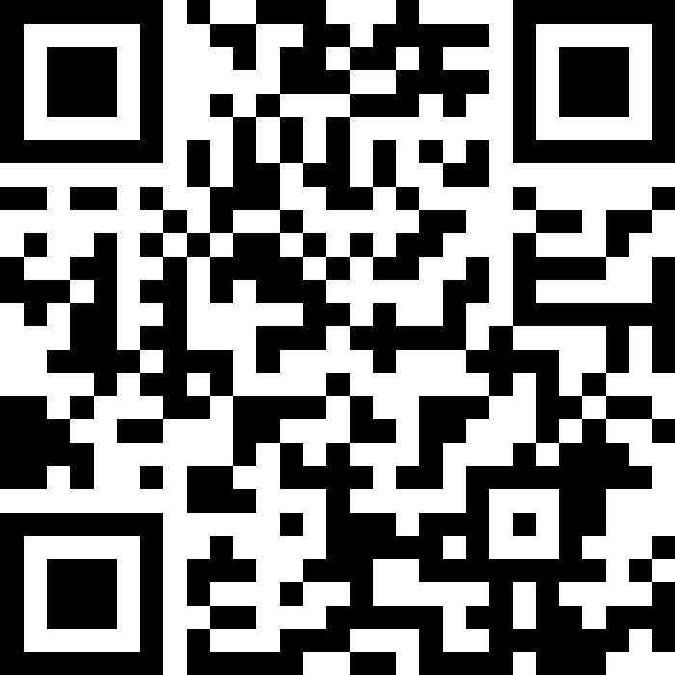
While Loops
BEFORE WE START
Talk to your neighbours:
What’s your favourite spot on the ave?
LEC 10
Music: 121 25wi lecture playlist ❄️
Instructor:
Matt Wang
TAs:
Ailsa Alice Chloë Christopher
Ethan Hanna Hannah Hibbah
Janvi Judy Julia Kelsey
Lucas Luke Maitreyi Merav
Ruslana Samrutha Sam Shayna
Sushma Vivian

Slide 2
Announcements, Reminders
C2 due Thursday, Feb 13th
R2 due Thursday, Feb 13th
note: this is the last time C0 is eligible for resubmission!
Quiz reminders:
Quiz 0: tomorrow Thursday, Feb 13th
Quiz 1: the following Thursday, Feb 20th
sick? do not come to your quiz. instead, email me, before the start of your quiz section.

Slide 3
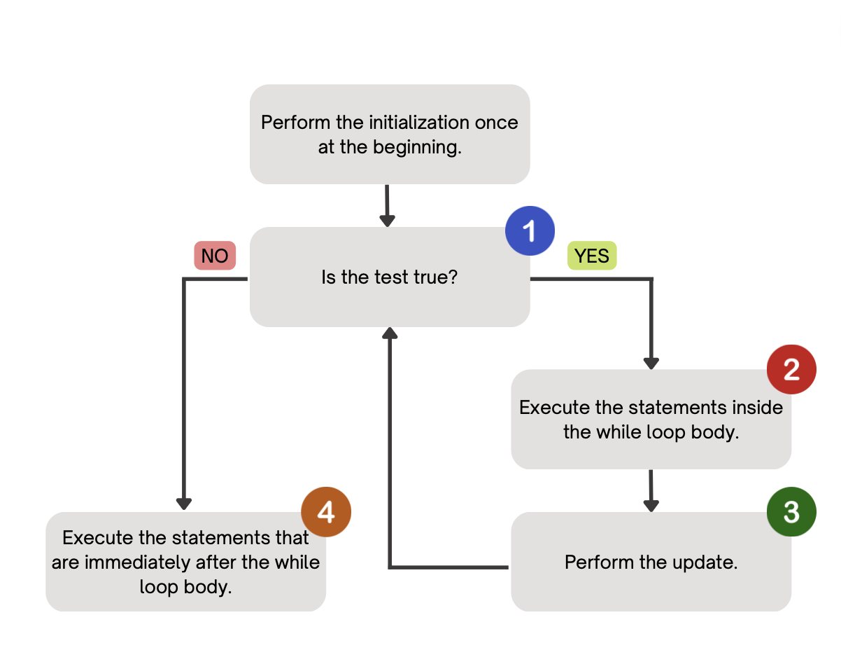
PCM Review: while loops
Repeatedly executes its body as long as the logical test is true.

Slide 4
for loops are while loops?
for (int i = 0; i < bigYikes; i++) {
// ...
}
int i = 0;
while (i < bigYikes) {
// ...
i++;
}

Slide 5
for loops are while loops! (almost*)
for (int i = 0; i < bigYikes; i++) {
// ...
}
int i = 0;
while (i < bigYikes) {
// ...
i++;
}
*as a technical note, these aren’t exactly the same – there are some minor technical details that are different, most notably the scope of i is different in the two loops

Slide 6
for loops vs. while loops ⚔️
For loops and while loops are quite similar! This is the first (but certainly not the last) time where you need to decide which to use!
There’s not always a “correct” answer, but some advice:
is the condition definite or indefinite
phrasing the problem out loud!
“I will do __ X times” or “for each __ I will __” – sounds like for!
“I will do __ until” or “while __ is true, I will” – sounds like while!
it’s okay to change your mind after you try one approach!

Slide 7
Common Problem-Solving Strategies
Analogy – Is this similar to another problem you've seen?
Brainstorming – Consider steps to solve problem before jumping into code
Try to do an example "by hand" → outline steps
Solve sub-problems – Is there a smaller part of the problem to solve?
Debugging – Does your solution behave correctly?
What is it doing?
What do you expect it to do?
What area of your code controls that part of the output?
Iterative Development – Can we start by solving a different problem that is easier?

Slide 8
Think Pair Share: mystery (think)
public static void mystery(Random randy, int lucky) {
int roll = -1; // "priming" the loop
int x = -1;
while (roll != lucky) {
roll = randy.nextInt(20) + 1;
if (x < roll) {
x = roll;
}
}
System.out.println("Lucky number " + roll);
}
How would you describe what the variable x calculates?
The largest value rolled
The smallest value rolled
The last value rolled
The first value rolled
The sum of all values rolled

Slide 9
Think Pair Share: mystery (pair)
public static void mystery(Random randy, int lucky) {
int roll = -1; // "priming" the loop
int x = -1;
while (roll != lucky) {
roll = randy.nextInt(20) + 1;
if (x < roll) {
x = roll;
}
}
System.out.println("Lucky number " + roll);
}
How would you describe what the variable x calculates?
The largest value rolled
The smallest value rolled
The last value rolled
The first value rolled
The sum of all values rolled

Slide 10
Announcements, Reminders (again)
C2 due Thursday, Feb 13th
R2 due Thursday, Feb 13th
note: this is the last time C0 is eligible for resubmission!
Quiz reminders:
Quiz 0: tomorrow Thursday, Feb 13th
Quiz 1: the following Thursday, Feb 20th
sick? do not come to your quiz. instead, email me, before the start of your quiz section.

