Slide 1
String Methods, char, More Variables
BEFORE WE START
Talk to your neighbors:
What is your favorite emoji? 😀
LEC 02
Music: ♣️CSE 121 25su Lecture Tunes ♣️
Instructor:
Hannah Swoffer
TAs:
Abby
Hannah
Julia
Merav
Trey

Slide 2
Agenda
Announcements, Reminders
C0 reflection recap
Datatypes Review
More Variables and Operators!
Strings and Characters Review
Code example!

Slide 3
Announcements, Reminders
C0 due tonight
Expect C0 grades ~1 week from submission (we’ll announce on Ed)
Programming Assignment 0 releases later today
making a receipt generator!
Resub 0 also releases later today
either turn in C0 for the first time or resubmit C0 after receiving feedback for it
Both due Tuesday, July 7th at 11:59 PM
Now on regular “cadence” (Wed release, due following Tue)

Slide 4
Reminder: Resubmissions (or “resubs”)
Each week, you may resubmit one Programming Assignment or Creative Project with no penalty. The grade of your resubmission will completely replace your previous grade.
This is a huge opportunity: you get to resubmit your work after we grade it and give you feedback! Please take advantage of this :)
If you miss an assignment and/or only finish it late – use a resub!
The time in between receiving assignment feedback and each resub cycle due date is short since summer quarter is short, but I wanted to make sure you still got 7 resub cycles like non-summer quarters.

Slide 5
Resub Logistics
Some logistics:
There are 8 total resub cycles this quarter (and 8 assignments)
Assignments eligible to resubmit for 3 cycles max after feedback is out
To resubmit:
Make and submit your changes
Set the submission you want graded as “Final”
Submit a Google Form, with a reflection, to confirm your resub
You must submit the form before the deadline for resub to count

Slide 6
Announcements, Reminders
IPL is open! Schedule & instructions on website.
If you joined late, welcome!
Check out the course website and lecture recordings

Slide 7
Agenda
Announcements, Reminders
C0 reflection recap
Datatypes Review
More Variables and Operators!
Strings and Characters Review
Code example!

Slide 8
On accessibility…
Loved your reflection responses! Some themes:
not knowing how low vision people use computers (or program)
being inspired by the speaker’s perseverance and determination
accessibility really matters, because:
it is important for all people to be able to pursue their passion
everyone should have the opportunity to interact with computer science since it impacts many aspects of our world
every individual brings new perspectives to the world of code

Slide 9
Is C0 accessible?
Broad spectrum of answers, but most of you said no.
When looking at ASCII art:
screenreaders alone aren’t suited for reading ASCII art
the caption is probably not enough context for a blind user
the caption could be low-quality or wrong!
Doing the assignment would be even harder!
have to learn coding alongside new interaction techniques
Ed doesn’t have the same accessibility features

Slide 10
So, what?
Broadly speaking: the digital world is inaccessible (but that’s changing)!
In CSE 121, we don’t have the full knowledge yet to make accessible ASCII art (or Java programs, applications, video games, websites, …)
However, we encourage you to:
think about accessibility when you make things with computers
keep on learning more! UW is a global leader in digital accessibility
e.g. at UW: CSE 493E: Accessibility

Slide 11
Agenda
Announcements, Reminders
C0 reflection recap
Datatypes Review
More Variables and Operators!
Strings and Characters Review
Code example!

Slide 12
Think Pair Share: Datatypes Review (Think)
What does this expression evaluate to? Be sure to indicate the type of the resulting value (e.g. 7.0 rather than 7 for a double, String in quotes).
2 % 5 + (26 % 6) - 5 / 2 + " corgi " + 1.2 + 1
"4 corgi 1.21" B. "2 corgi 2.2"
C. "2 corgi 1.21" D. "4 corgi 2.2"

Slide 13
Think Pair Share: Datatypes Review (Pair)
What does this expression evaluate to? Be sure to indicate the type of the resulting value (e.g. 7.0 rather than 7 for a double, String in quotes).
2 % 5 + (26 % 6) - 5 / 2 + " corgi " + 1.2 + 1
"4 corgi 1.21" B. "2 corgi 2.2"
C. "2 corgi 1.21" D. "4 corgi 2.2"

Slide 14
Worked Out Think-Pair-Share Example
2 % 5 + (26 % 6) - 5 / 2 + " corgi " + 1.2 + 1
2
2
2
4
2
"2 corgi "
"2 corgi 1.2"
"2 corgi 1.21"

Slide 15
Agenda
Announcements, Reminders
C0 reflection recap
Datatypes Review
More Variables and Operators!
Strings and Characters Review
Code example!

Slide 16
PCM: Typecasting
Java will do some type conversions for us
E.g., int to double, double to String, int to String
BUT some conversions Java won't do for us…
Nonsensical conversions (e.g., "Gumball" to int)
Conversions that are "lossy" (e.g., double to int)
We can ask Java to typecast for us
double x = 8.83;
int xAsAnInt = (int) x;

Slide 17
PCM: Variables
Recall: Variables allow us to give a name to a specific value
3 parts: declaration, initialization, usage
Example:
Declaration: int x;
Initialization: x = 30;
Or all in one line: int x = 30;
String theBestBoy = "gumball";
System.out.println(theBestBoy);

Slide 18
New: Manipulating Variables
They’re made to be manipulated, modified, and re-used!
int myFavoriteNumber = 7;
int tripleFavNum = myFavoriteNumber * 3;
myFavoriteNumber = myFavoriteNumber + 3;
Notice – this doesn't really make any mathematical sense!
That's because, in Java, = is assignment, not equality!

Slide 19
New Operator: +=
myFavoriteNumber = myFavoriteNumber + 3;
This pattern is so common, we have a shorthand for it!
myFavoriteNumber += 3;
This works for both numeric addition and string concatenation!

Slide 20
More Shorthand Operators
The shorthands -=, *=, /=, and %= exist too!
myFavoriteNumber /= 3;
Should this work for integers? Doubles? Strings?

Slide 21
Even Shorter Shorthands
There are even shorter operators for “incrementing” and “decrementing”!
myFavoriteNumber++; // myFavoriteNumber += 1;
myFavoriteNumber--; // myFavoriteNumber -= 1;
Should this work for integers? Doubles? Strings?

Slide 22
Think Pair Share: A, B, C Variables (Think)
What do a, b, and c hold after this code is executed?
int a = 10;
int b = 30;
int c = a + b;
c -= 10;
a = b + 5;
b /= 2;
10, 30, 40
35, 15, 30
35, 15.5, 30
20, 15, 30

Slide 23
Think Pair Share: A, B, C Variables (Pair)
What do a, b, and c hold after this code is executed?
int a = 10;
int b = 30;
int c = a + b;
c -= 10;
a = b + 5;
b /= 2;
10, 30, 40
35, 15, 30
35, 15.5, 30
20, 15, 30

Slide 24
Agenda
Announcements, Reminders
C0 reflection recap
Datatypes Review
More Variables and Operators!
Strings and Characters Review
Code example!

Slide 25
PCM: Strings & chars
Recall: String literals are a sequence of characters that are strung together, begin and end with ""
Use zero-based indexing
A char represents a single character
Begin and end with single quotes ( ' )
Strings are made up of chars!
g | u | m | b | a | l | l
0 | 1 | 2 | 3 | 4 | 5 | 6
char letter = 'g';
char anotherLetter = 'b';

Slide 26
PCM: String Methods
Usage: <string_variable>.<method>(…)
Method | Description
length() | Returns the length of the string.
charAt(i) | Returns the character at index i of the string
indexOf(s) | Returns the index of the first occurrence of s in the string; returns -1 if s doesn't appear in the string
substring(i, j) or substring(i) | Returns the characters in this string from i (inclusive) to j (exclusive); if j is omitted, goes until the end of the string
contains(s) | Returns whether or not the string contains s
equals(s) | Returns whether or not the string is equal to s (case-sensitive)
equalsIgnoreCase(s) | Returns whether or not the string is equal to s ignoring case
toUpperCase() | Returns an uppercase version of the string
toLowerCase() | Returns a lowercase version of the string

Slide 27
Think Pair Share: Gumball String (Think)
Suppose s contains the String "bubble gum". Which statement would result in s containing "Gumball" instead?
s.substring(7) + "ball";
s = s.substring(7, 9) + "ball";
s = s.charAt(7).toUpperCase() + "ball";
s = s.substring(7, 8).toUpperCase() + s.substring(8) + "ball";
b | u | b | b | l | e |  | g | u | m
0 | 1 | 2 | 3 | 4 | 5 | 6 | 7 | 8 | 9

Slide 28
Think Pair Share: Gumball String (Pair)
Suppose s contains the String "bubble gum". Which statement would result in s containing "Gumball" instead?
s.substring(7) + "ball";
s = s.substring(7, 9) + "ball";
s = s.charAt(7).toUpperCase() + "ball";
s = s.substring(7, 8).toUpperCase() + s.substring(8) + "ball";
b | u | b | b | l | e |  | g | u | m
0 | 1 | 2 | 3 | 4 | 5 | 6 | 7 | 8 | 9

Slide 29
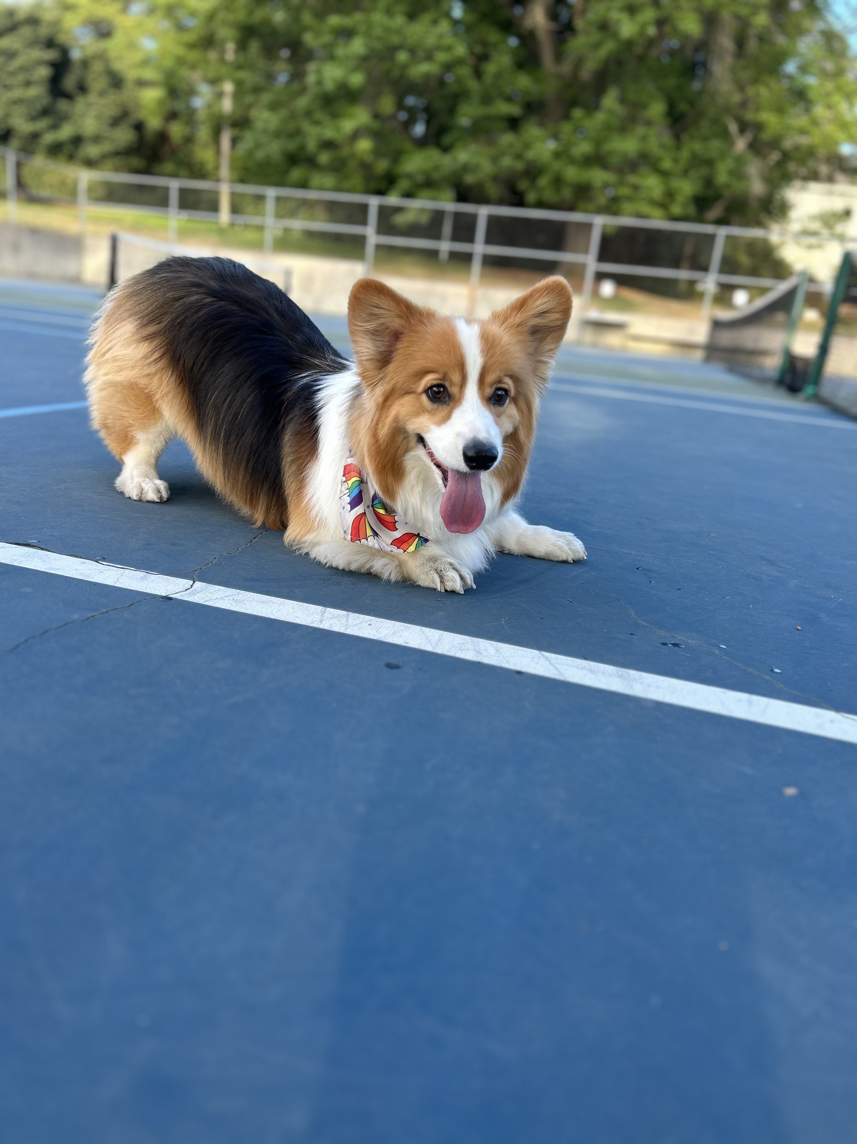
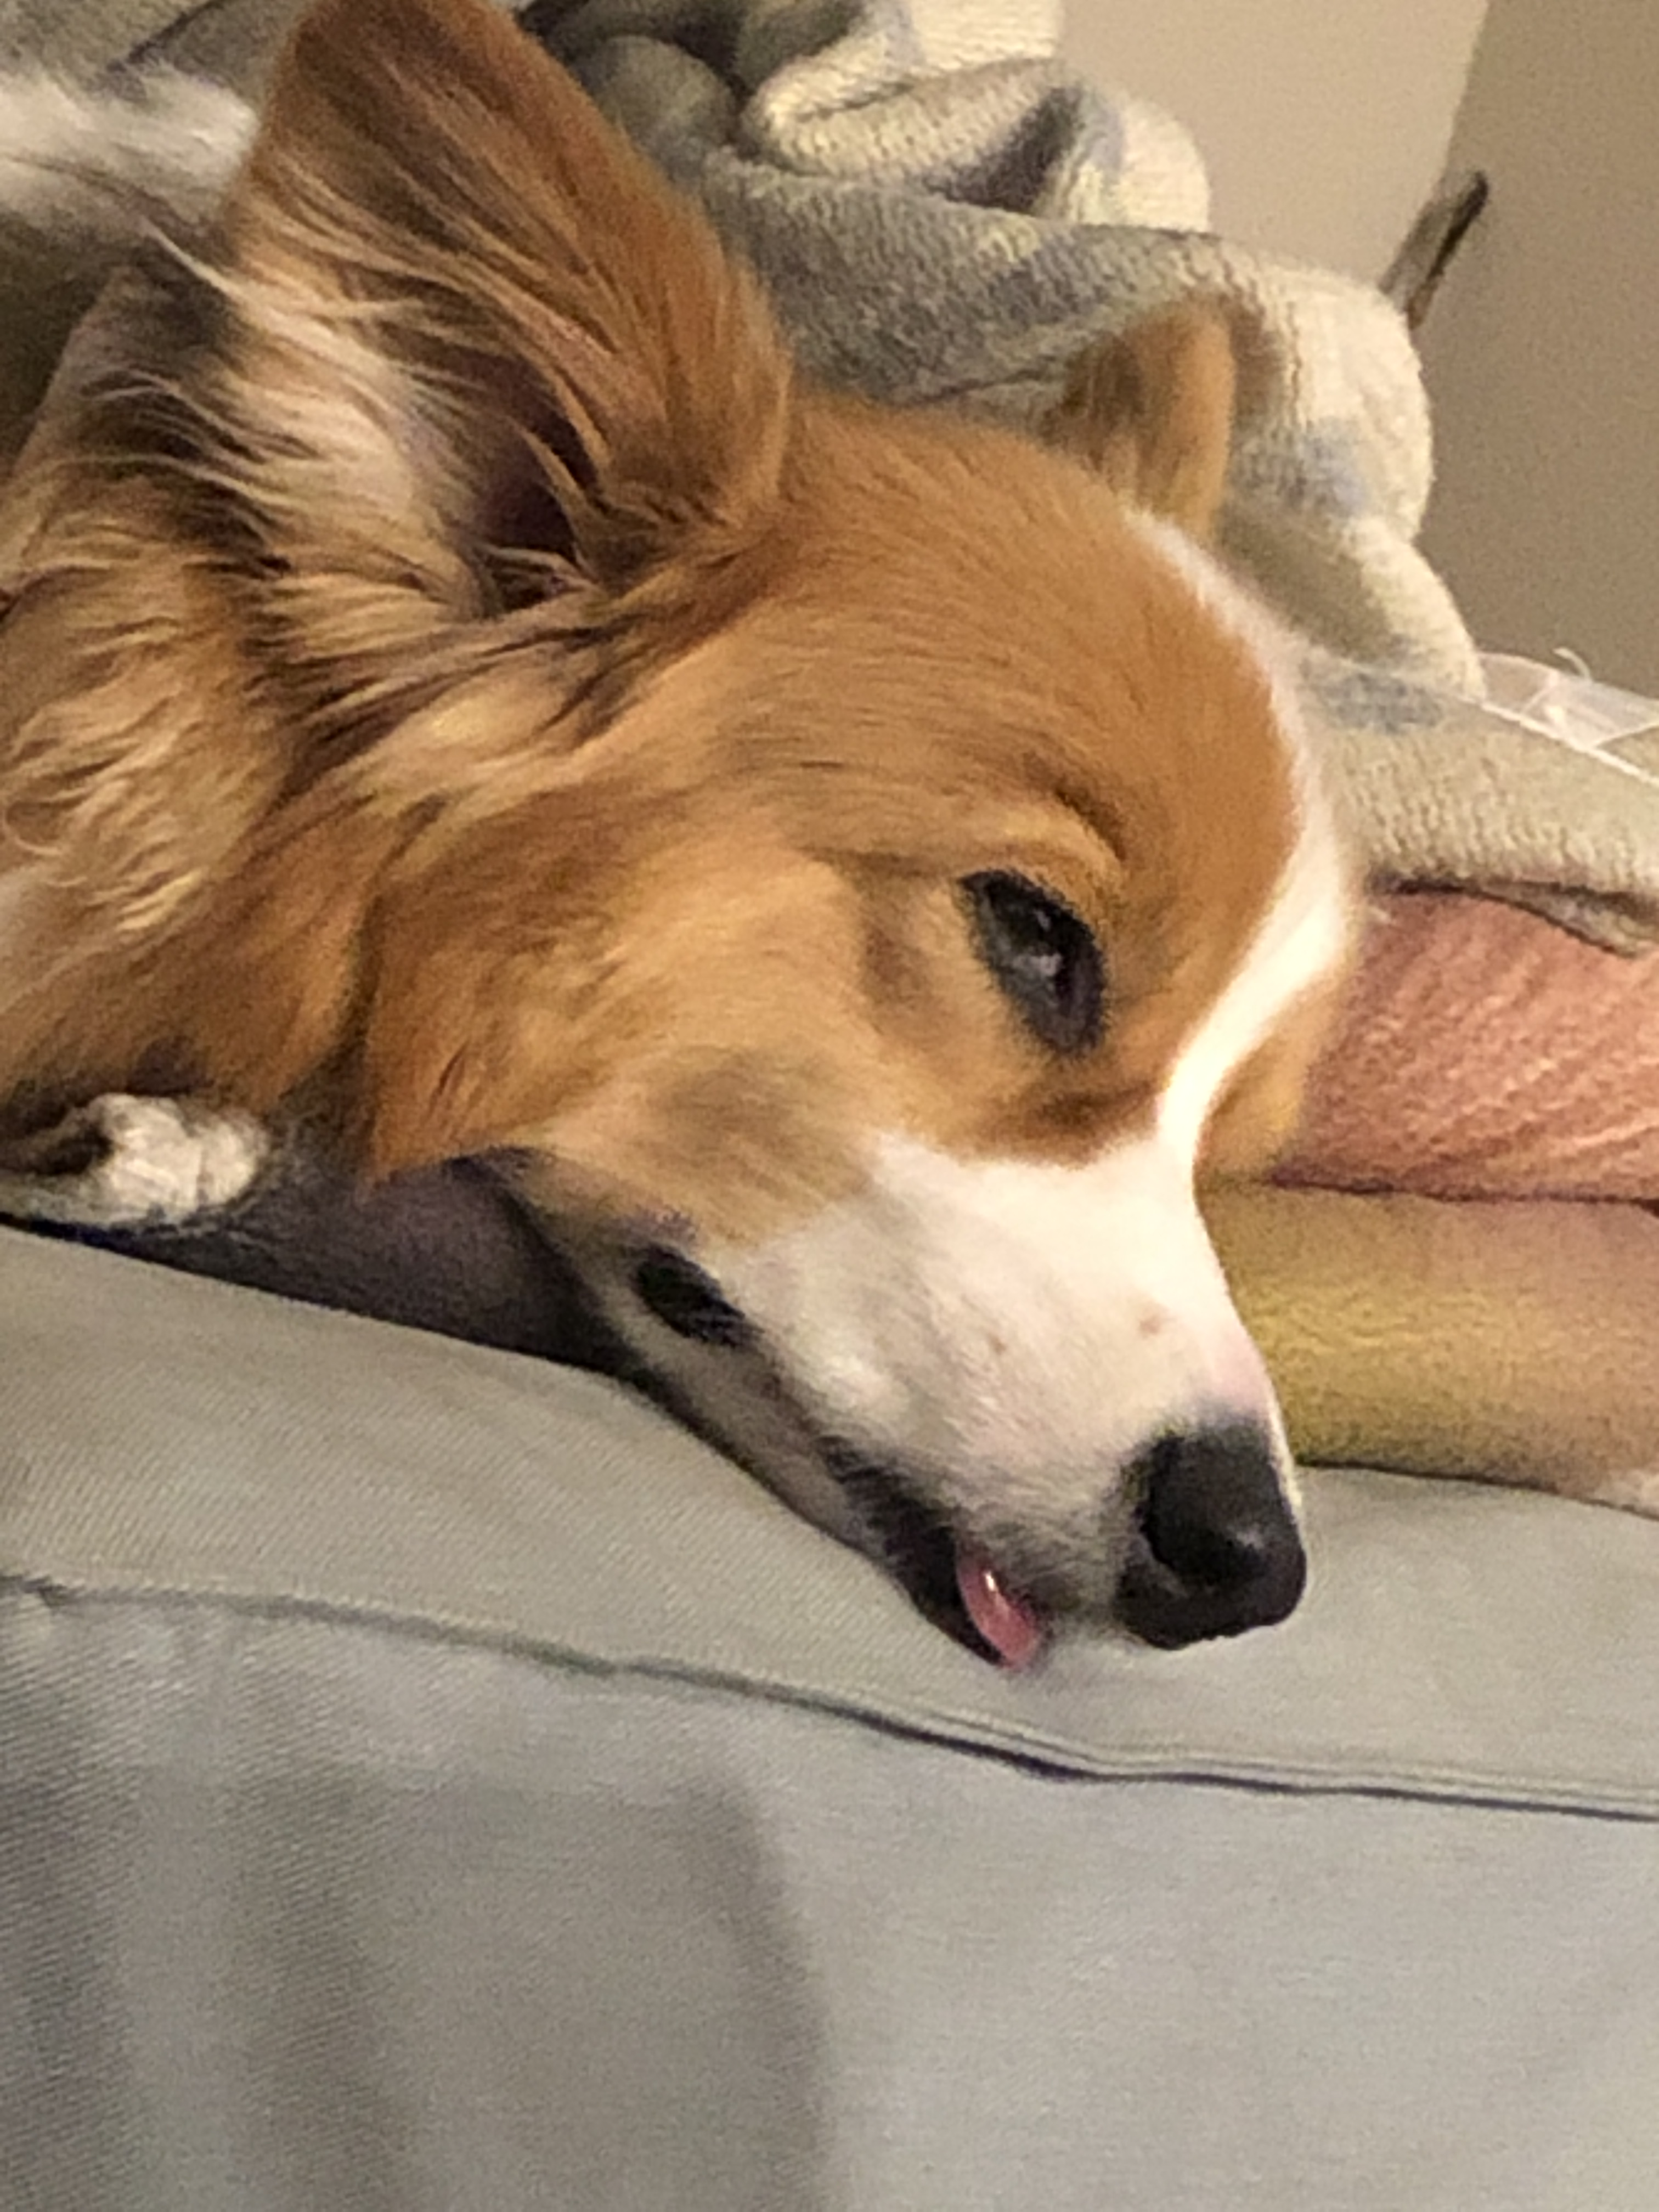
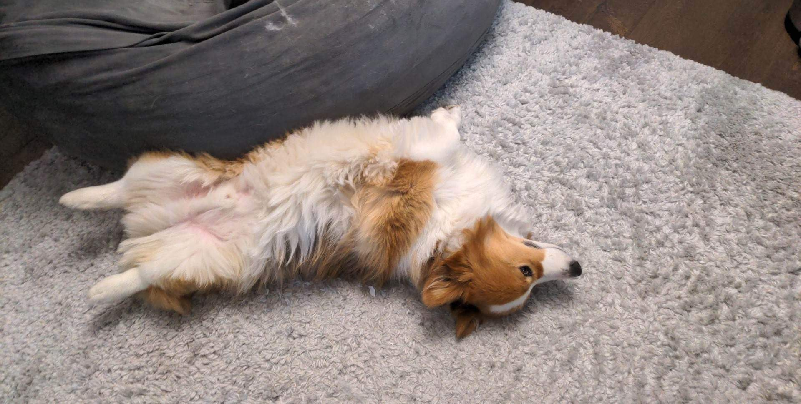
Aside: Gumball

Slide 30
Agenda
Announcements, Reminders
C0 reflection recap
Datatypes Review
More Variables and Operators!
Strings and Characters Review
Code example!

