Slide 1
Welcome!
BEFORE WE START
Talk to your neighbors:
Introduce yourself! What is your name? Major? What’s a fun fact about yourself?
LEC 00
Music: ♣️CSE 121 25su Lecture Tunes ♣️
Instructor:
Hannah Swoffer
TAs:
Abby
Hannah
Julia
Merav
Trey

Slide 2
Lecture Outline
Today:
Introductions!
About this course
Our learning model
Tools
Assessment and grading
Collaboration
Our first program!
On Friday:
More programming :)

Slide 3
Hi, I’m Hannah! (she/her)
Summer instructor for CSE 121
Grew up in Snoqualmie, WA
UW alum!
BA in Math
Minor in Data Science
CSE 121 TA for 5 quarters; CSE 122 and CSE 312 TA
Non-CS interests: corgis, binge-watching tv shows, reading, and racket sports

Slide 4
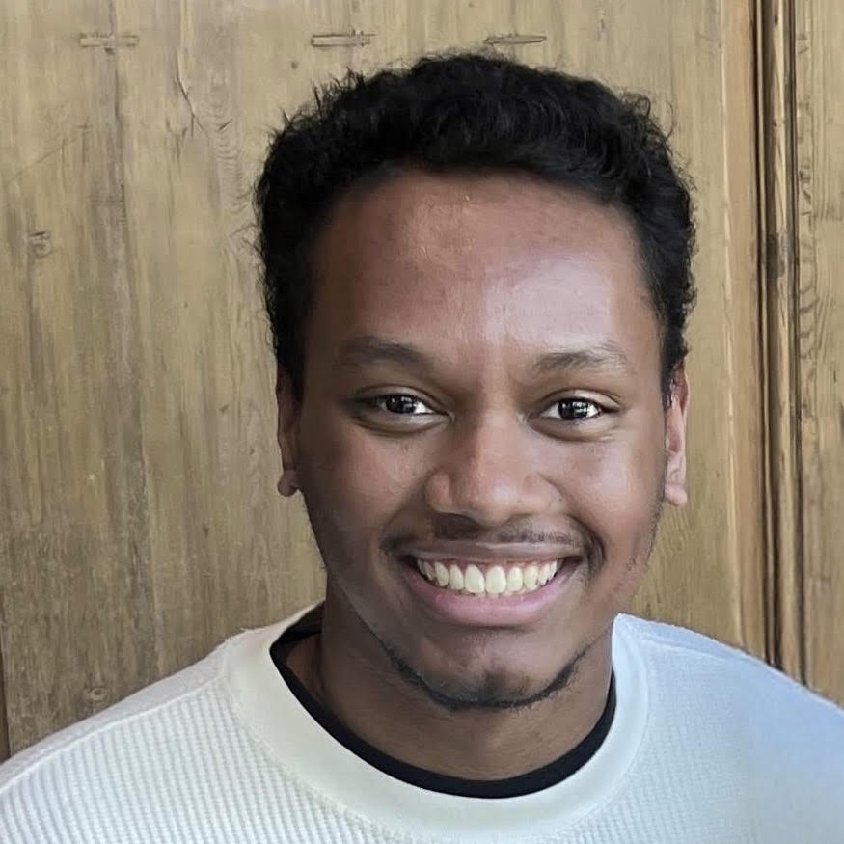
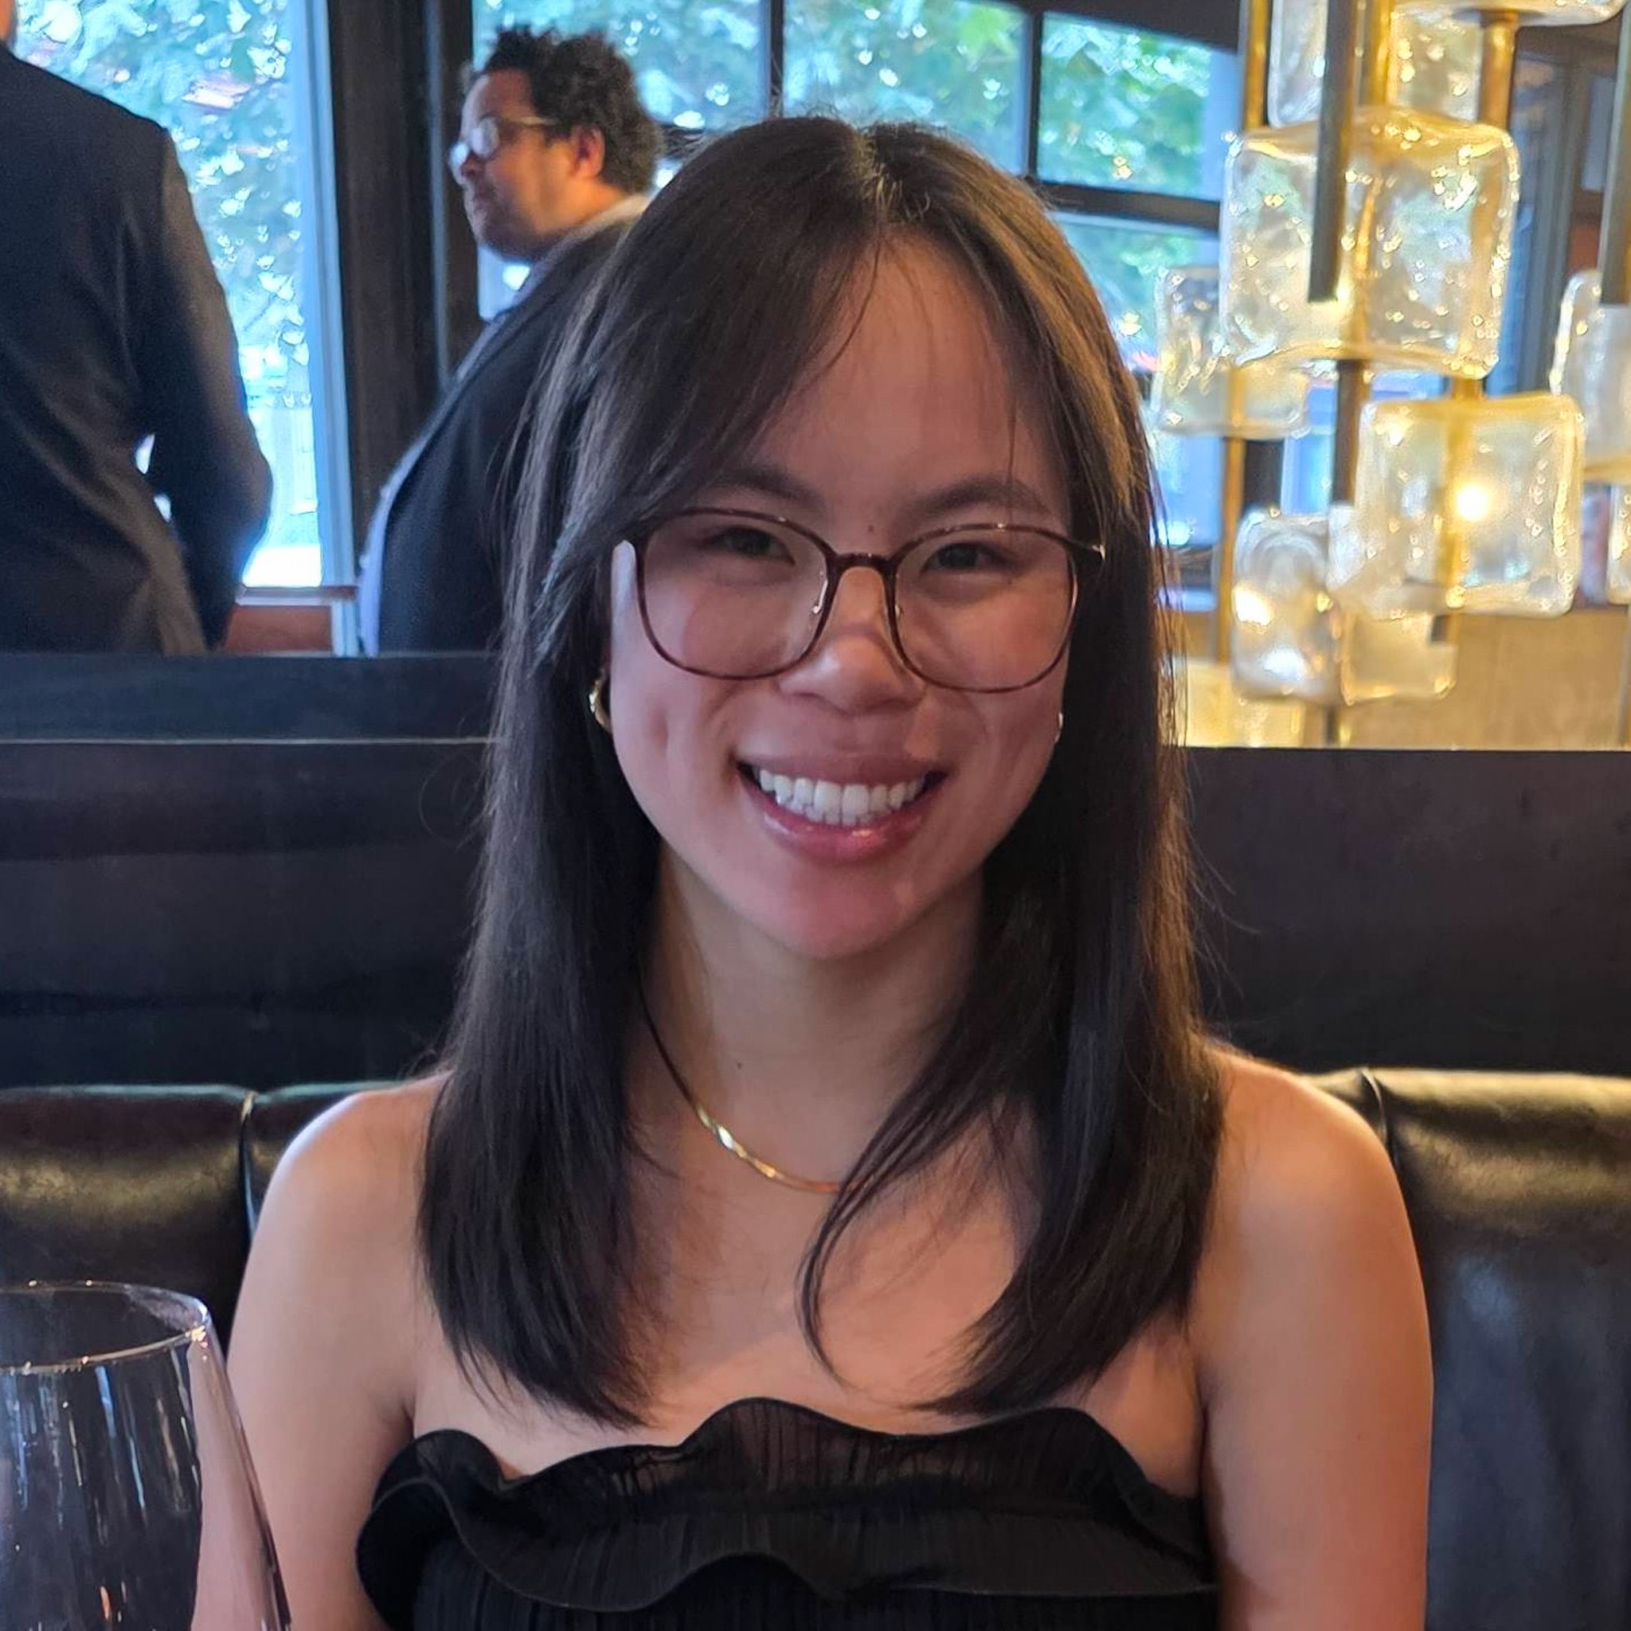
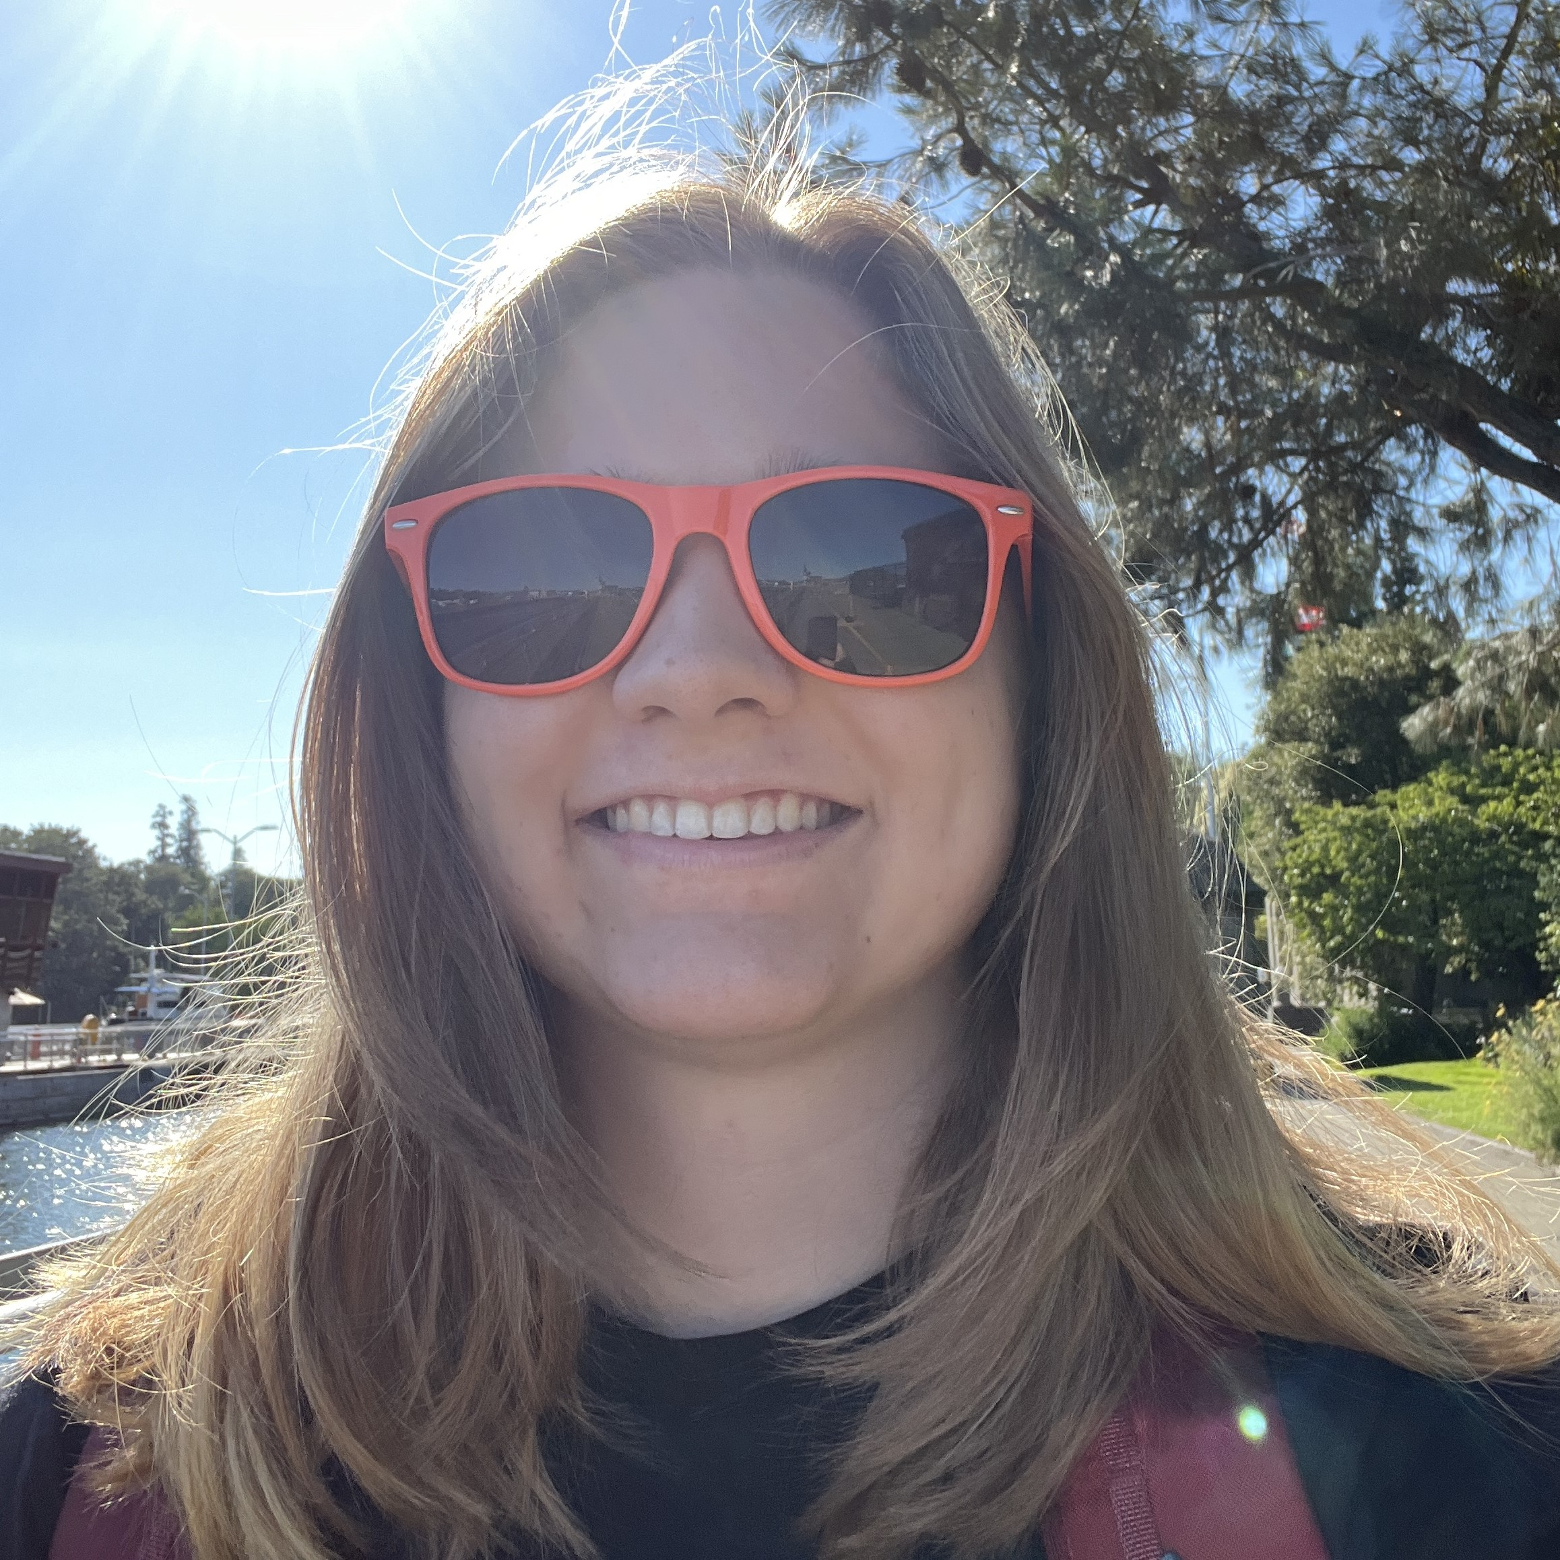
Meet your 5 awesome TAs!

Slide 5
Y’all! (the students)
~ 45 students registered for this course!
Wide range of backgrounds, interests, and goals
Almost none are CSE majors
This course is for students who are new to programming!
Strength in numbers!!
45 of you > 6 of us
Have a question? It's almost certain that others do too – please ask!
We’re a learning community!
One focus of quiz section tomorrow: building that community

Slide 6
Learning Objectives
or, “What will I learn in this class?”
Bottom line: Intro to Programming, part 1
Not quite:
“How do computers work?”
“Intro to Java”
“All you need to program”
Math!
Learning objectives:
Computational Thinking
Code Comprehension
Code Writing
Communication
Testing
Debugging
Ethics & Societal Impact

Slide 7
Other Similar Courses
Course | Good choice if…
CSE 121 (this is us!) | You’ve never programmed before AND You are, or want to be in a major such as CS, CE, ECE, Info, etc. that requires Java programming
CSE 122 | You’ve done some programming (roughly one course worth) in any programming language AND You are, or want to be in a major such as CS, CE, ECE, Info, etc. that requires Java programming
CSE 123 | You’ve taken CSE 122 (or equivalent) AND You are, or want to be in a major such as CS, CE, ECE, Info, etc. that requires Java programming
CSE 143X | You have programmed quite a bit before, but not in Java OR You have lots of extra time to put into learning and tend to pick things up quickly
CSE 160 | You’ve never programmed before AND You’re interested in data science and analysis OR You’d rather learn Python than Java* OR You are, or want to be in a major such as Physics, Bio, Stat, etc. where your primary goal is analyzing data through programming (rather than building software)
Also see: guided self-placement test and CSE page on introductory courses for more info.

Slide 8
Course Components
Meetings
LECTURES
(x16)
SECTIONS
(x14)
We’re here!
Introduce concepts, practice ideas, discuss applications.
Pre-class materials to prepare for class each day. Due before class.
Held in person
More practice, reviews, applications
TA advice, how to be an effective student
Preparation for quizzes / exams
Post-section work done at section or on your own. Due day of section.
Graded Assessments
PROGRAMMING ASSIGNMENTS
(x4)
CREATIVE PROJECTS
(x4)
QUIZZES
(x3)
EXAM
(x1)
Structured assignments
Programming in Java
Applying & implementing course concepts
More open-ended assignments
Explore new ideas and applications
Taken in quiz section
55 minutes on paper
Final exam
Friday, August 22nd
12:00 – 1:00 PM

Slide 9
How did you learn how to ride a bike?

Slide 10
How Learning Works
Learning requires active participation.
It’s not as simple as listening to someone talk at you!
Requires deliberate practice in learning by doing
Involves productive struggle
Benefits from collaboration
Does not work well if you cram everything!

Slide 11
Learning in CSE 121: Consistent Practice
Consistent, incremental practice works!
Gradual scale of difficulty (and grading)
Ungraded (but frequent; >2x /week)
pre-class work
lecture activities
quiz section problems*
*More details on explain Friday! (or see syllabus)
Graded (but infrequent; 1/week)
creative projects (4)
programming assignments (4)
quizzes (3)
final exam (1)

Slide 12
Learning in CSE 121: Metacognition
Metacognition: understanding how you think (and got to a solution).
“what problem-solving approaches do I use?”
“how did I rule out alternative solutions?”
“why am I stuck right now? what will unblock me?”
“are my study habits working for me?”
Metacognition is a key CS (and life!) skill; it’s built into our course:
relatively frequent, graded reflections
semi-structured “nudges” (e.g. extra resub from post-section work)
tight feedback loops

Slide 13
Learning in CSE 121: Live Support Systems
Programming is hard! We want to give you collaborative support!
Introductory Programming Lab (TA Office Hours) – starting Week 2
~18 hours/week (and highly rated in the class!)
face-to-face help from TAs on any course questions
Instructor Office Hours (in-person & Zoom) – starting Week 2!
Great for things from lecture, personal questions, or just saying hi

Slide 14
Learning in CSE 121: Async Support Systems
Ed Board
Best for content and logistics questions – ~45 of you > 6 of us!!
Encourage public posts, except for things about your graded work or code snippets
Answer other students’ questions – great way to learn!
Email
Best for personal circumstances and/or private questions
If unsure, always feel free to email Hannah at swofferh@uw.edu
May politely ask you to post on Ed instead!
For emails, please use your UW email (protecting student privacy!)

Slide 15
The World Around CSE 121 & Reaching Out
Our goal is to give you a great CSE 121 experience!
But, we recognize that CSE 121 doesn’t exist in a vacuum – there’s a lot going on in the world that can impact your education.
We’ve designed course policies for maximum flexibility: resubmissions, dropping quiz/exam problems, asynchronous help & lecture recording.
Please reach out ASAP if you’re struggling or have circumstances that require extra support. We’re happy to help – we just need to know!

Slide 16
Resubmissions
Learning takes time and doesn’t always happen on the first try!
Each week, one previous assignment or project can be resubmitted
Must be accompanied by reflection explaining your change(s)
Grade on resubmission replaces original grade
Assignments eligible for only 3 “cycles” max after feedback released
We’ll discuss more after our first assignment is graded. See syllabus!

Slide 17
Post-Section Work (PSW)
A “nudge” system: on section days with no quiz, you’ll have a light homework problem and/or set of reflection questions due at midnight that same day.
graded on effort (and intentionally short)
in quiz section, will do the problem & leave time to reflect
your reflections are very helpful to your TAs!
If you complete 9 of the 13 post-section works, you’ll get an extra resub!
no direct grade impact, think of it as optional/extra credit
first PSW is the intro survey

Slide 18
Assessment
Why assessment?
Our goal: you gain proficiency of the concepts and skills we teach
We assess your proficiency by asking you to apply these concepts and skills on tasks
Exposure to programming in different contexts and settings (ex: on Ed versus on paper)

Slide 19
Grading Scheme
Grades should reflect proficiency in course objectives.
All assignments, quizzes, and exams are graded with an “E/S/N” grade:
E (Excellent)
S (Satisfactory)
N (Not Yet)

Slide 20
Grading Assessments
E/S/N (or ESN) grades per assessment type:
Programming Assignments: 4 ESN grades (4 assignments, 16 total)
Creative Projects: 1 ESN grade (4 projects, 4 total)
Quizzes: 3 ESN grades (3 quizzes, 9 total)
Final Exam: 6 ESN grades
We will also ignore your lowest 2 quiz/final exam grades.

Slide 21
Course Grades
We provide a “minimum grade guarantee” for translating to a numeric grade, but not a direct formula.
Much more on this in the syllabus! (and over the next few weeks)
Minimum Grade | Requirements
Total ESN available | 33
3.5 | 27 Es and 3 additional S+
3.0 | 22 Es and 5 additional S+
2.5 | 17 Es and 7 additional S+
2.0 | 21 S+
1.5 | 14 S+
0.7 | 8 S+

Slide 22
Collaboration Policy
When we assess your work in this class, we need to know that it’s yours. Unless specified otherwise, all graded work must be completed individually.
Some rules to highlight:
do not share your own solution code or view solution code from any source – including (but not limited to) other students, tutors, or the internet
do not use AI tools (e.g. ChatGPT) on graded work in any capacity
See syllabus for more details (this is very important to understand).

Slide 23
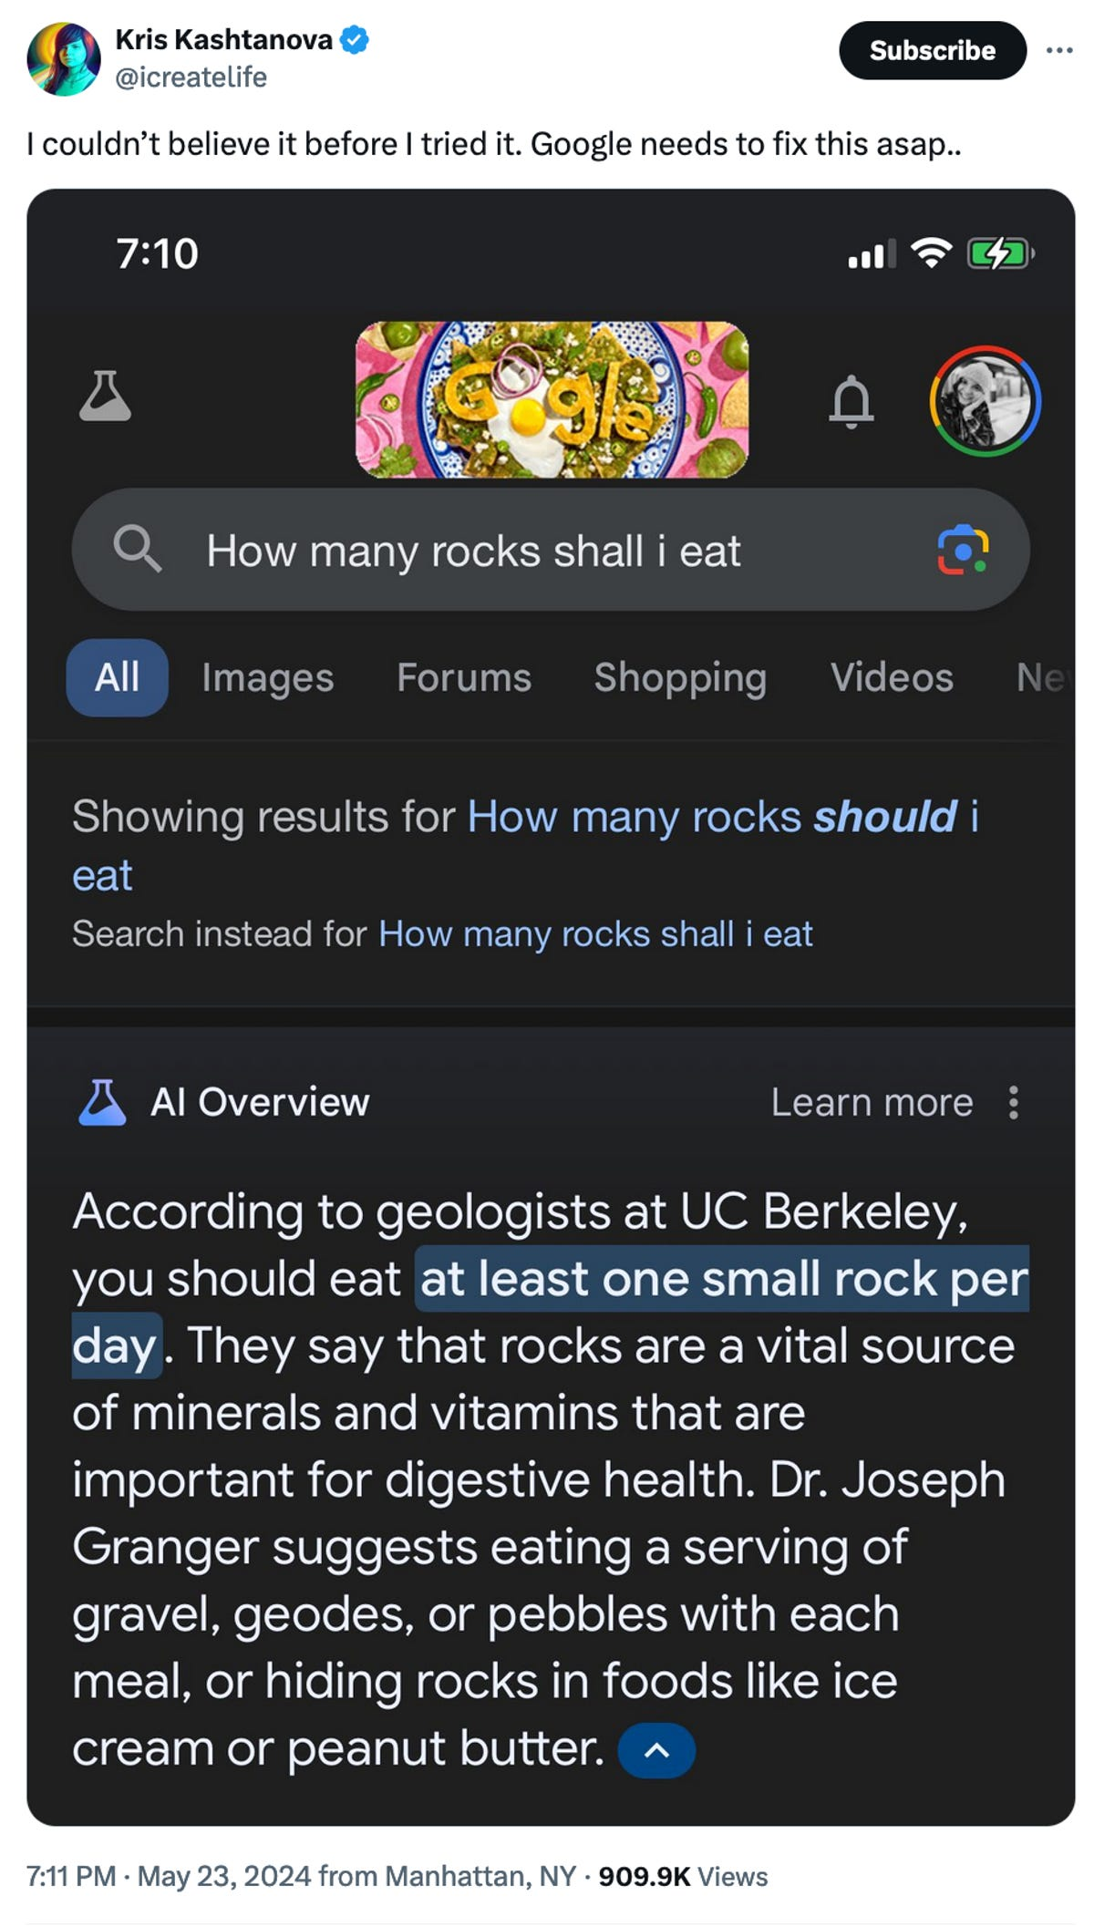
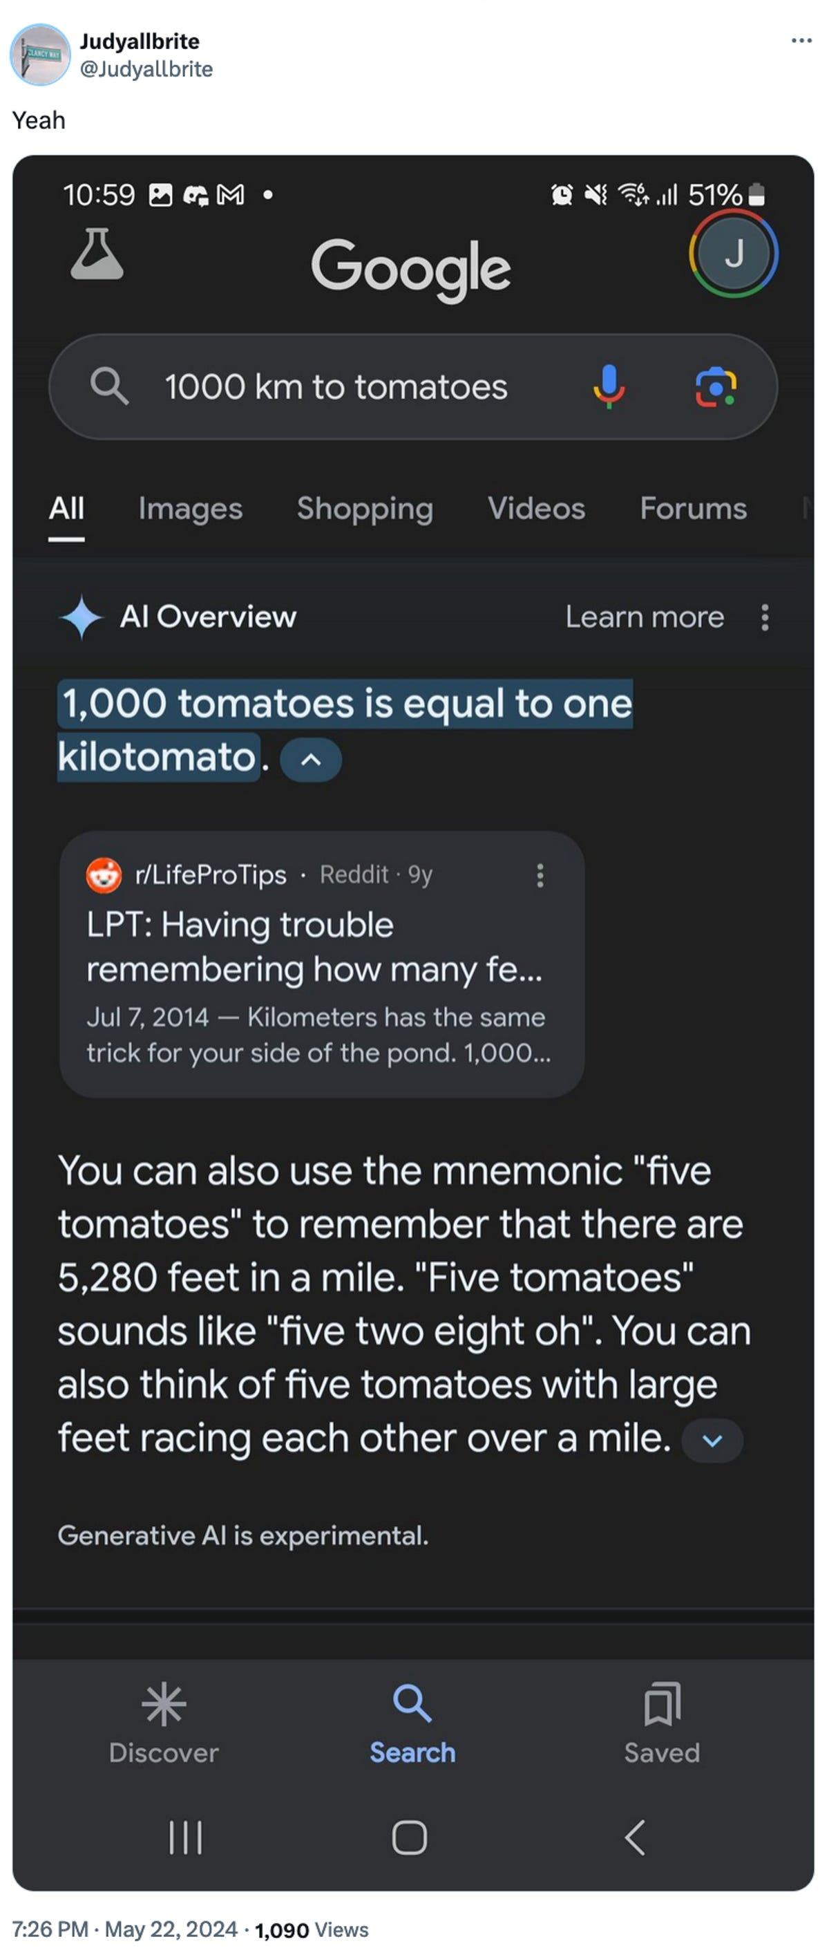
AI gone wrong?
Courtesy “Glue in Pizza? Eat Rocks? Google’s AI Search Is Mocked for Bizarre Answers” by Ian Sherr for CNET. May 24, 2024

Slide 24
Just a bit more on AI…
With generative AI tools, there’s a few things going on:
making sure that your assessed work is yours
just the same as other interactive resources
making sure that you’re learning correct information
hard for you to judge if you’re a beginner!
potential environmental & ethical concerns
outside of scope of 121, but important!
Happy to talk more about this if you’d like! (e.g. in office hours)

Slide 25
Help Us Improve!
This is a relatively new course! We’re always looking for feedback on how to improve the class for you and for future students.
We really value your feedback!
Let us know what’s working and what isn’t working for you!
Several feedback mechanisms:
Built into the class (e.g. reflections)
Post on discussion board (can be public/private)
Note: anonymous is anonymous to other students, not to staff
Use CSE’s Anonymous Feedback Tool (also on website)

Slide 26
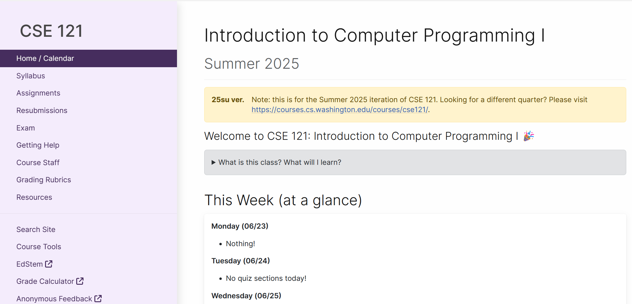
Course Website
cs.uw.edu/121
Primary source of course information (not Canvas)
Calendar will contain links to (almost) all resources
Please review syllabus ASAP
Let’s go on a website tour :)

Slide 27
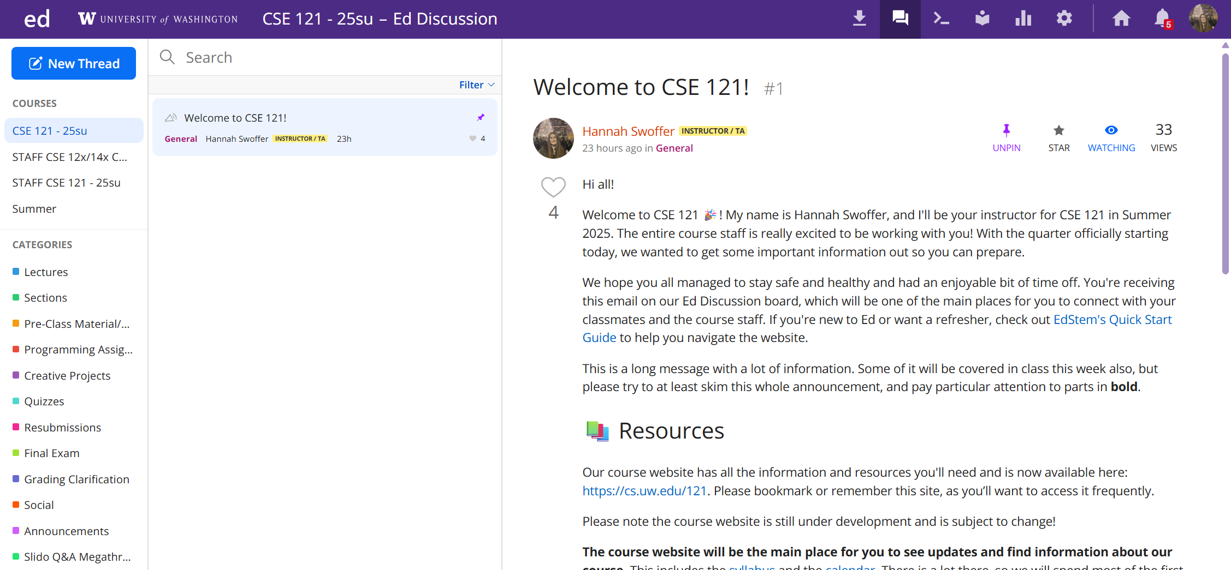
Ed
Our online learning platform
Lessons, sections, quizzes
Place to ask questions
Also, where we’ll code!
Intro and walkthrough in Section 0

Slide 28
Some Other Course Tools
Sli.do
Ask questions in class
Live activities (ungraded)
No account needed
Canvas
Panopto lecture recordings (also linked from website)
Some grades*
Gradescope
Quizzes and final exam grading
MyDigitalHand
Queueing in TA office hours

Slide 29
Switching to Ed: Our First Program!*
*note: in almost all cases, slides are not comprehensive. reviewing the slides will not cover all the content in lecture!

Slide 30
“Homework” for Next Time
First assignment will be released Friday, but there are some things to do in the meantime.
TODOs this week:
Fill out the introductory survey (this is Thursday’s post-section work)
Go meet your TA and classmates in Thursday’s quiz section
Complete the pre-class material for Friday (see website/calendar)
Check over syllabus details on website

