Slide 1
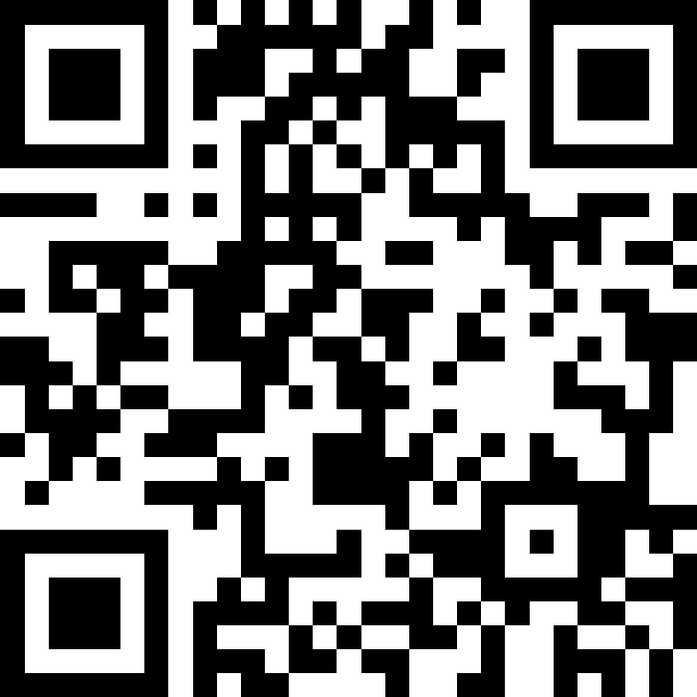
Conditionals
BEFORE WE START
Talk to your neighbors:
How are you doing (like actually)?
LEC 09
Music: 🌸CSE 121 25sp Lecture Tunes 🌸
Instructor:
Miya Natsuhara
TAs:
Chloë
Ailsa
Johnathan
Christian
Merav
Judy
Janvi
Hibbah
Julia Sahej
Ruslana
Hanna
Maitreyi
Ayesha
Sushma
Kelsey
Shayna
Hannah
Zach

Slide 2
Announcements, Reminders
C2 released, due Thursday, May 8th
R2 out yesterday, due Thursday, May 8th
This is the last time C0 is eligible for resubmission
Almost half-way through – feedback wanted!
Next Tue, May 6th – quiz section feedback, during section
Next Wed, May 7th – mid-quarter feedback, during lecture
Quiz reminders:
Quiz 1 is on Thursday, May 15th

Slide 3
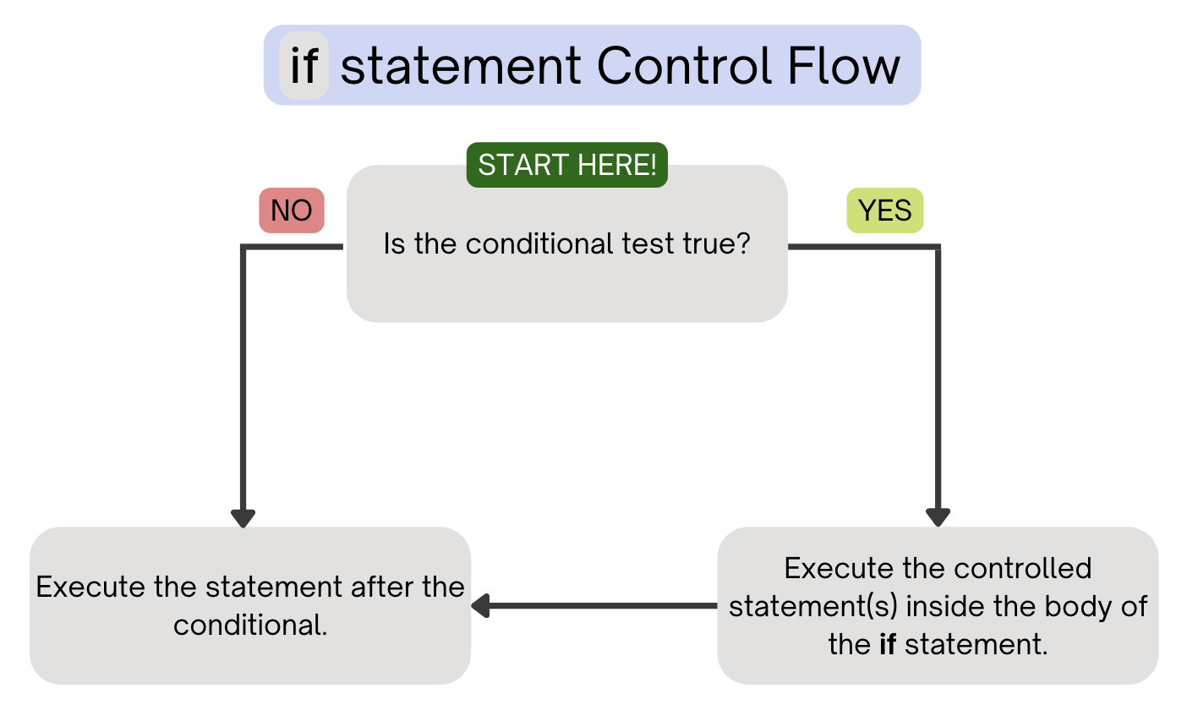
PCM Review: if statements
Executes a block of statements if and only if the test is true

Slide 4
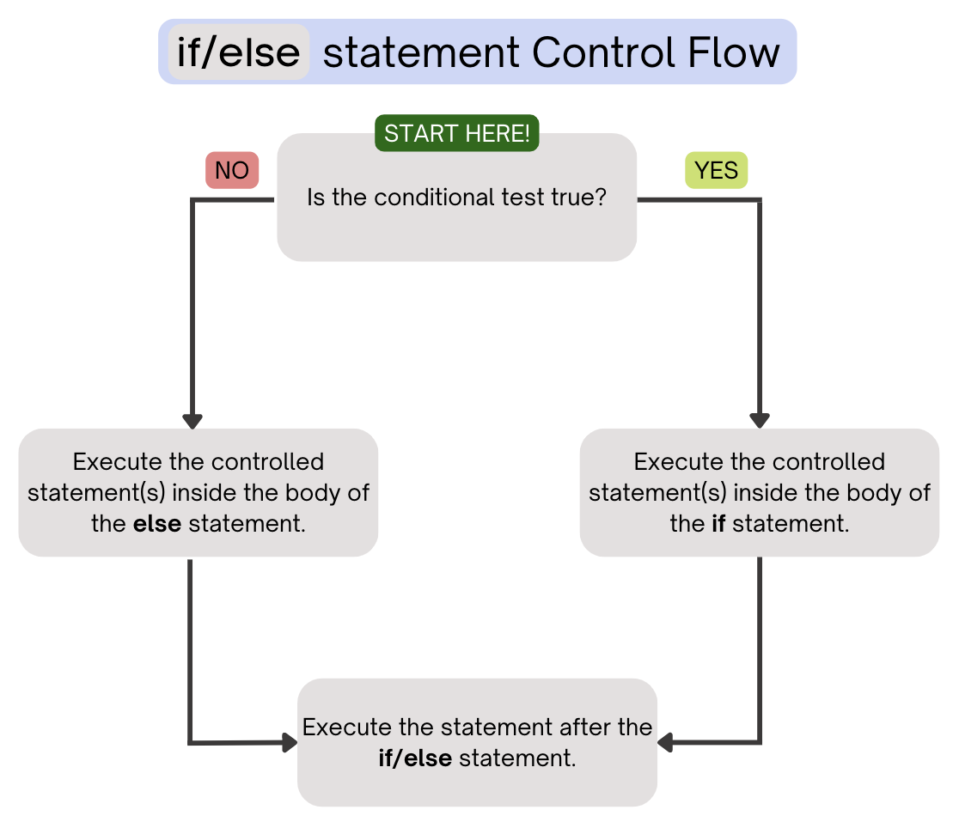
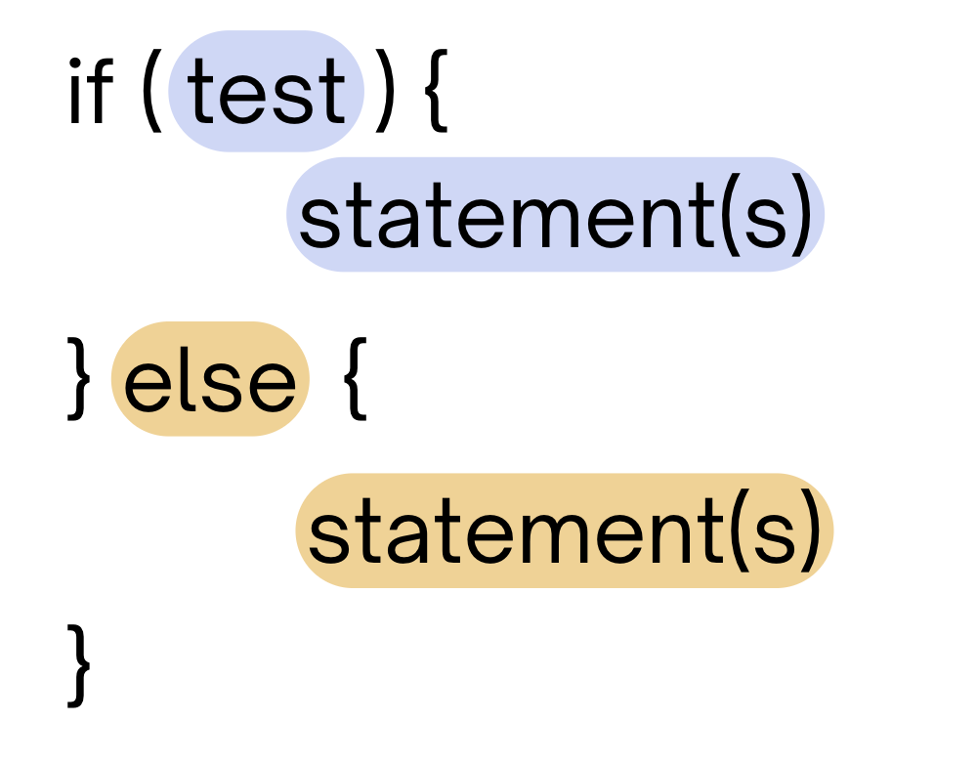
PCM Review: if-else
If the test is true: execute block of statements
If not, execute other block of statements

Slide 5
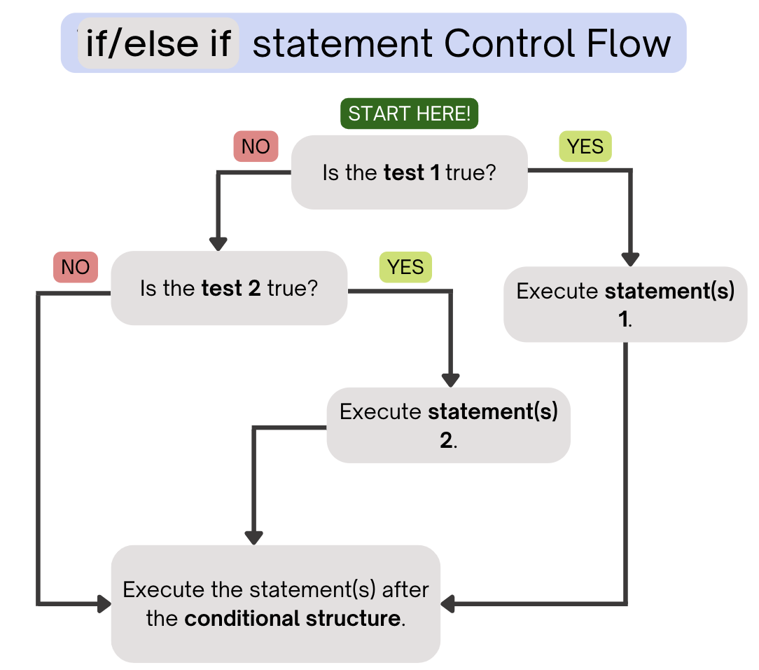
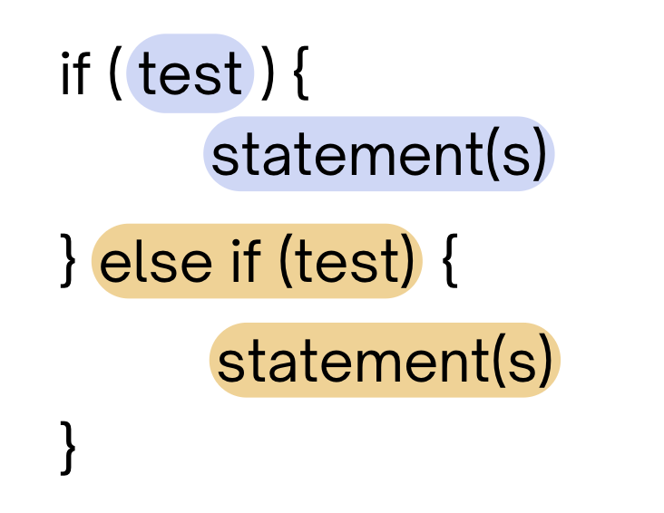
PCM Review: if-else-if
If the first test is true, execute that block
If not, proceed to the next test, and repeat
If none were true, don’t execute any blocks

Slide 6
Think Pair Share: odds and evens (think)
public static void main(String[] args) {
for (int i = 1; i <= 3; i++) {
System.out.print(mystery(i));
}
}
public static String mystery(int n) {
String response = "even ";
if (n % 2 == 1) {
response = "odd ";
} else if (n == 1) {
response = "one ";
}
return response;
}
What does this program output?
A. odd even odd
B. one even odd
C. one even even
D. even even even

Slide 7
Think Pair Share: odds and evens (pair)
public static void main(String[] args) {
for (int i = 1; i <= 3; i++) {
System.out.print(mystery(i));
}
}
public static String mystery(int n) {
String response = "even ";
if (n % 2 == 1) {
response = "odd ";
} else if (n == 1) {
response = "one ";
}
return response;
}
What does this program output?
A. odd even odd
B. one even odd
C. one even even
D. even even even

Slide 8
“Useless” Conditionals
public static void main(String[] args) {
for (int i = 1; i <= 3; i++) {
System.out.print(mystery(i));
}
}
public static String mystery(int n) {
String response = "even ";
if (n % 2 == 1) {
response = "odd ";
} else if (n == 1) {
response = "one ";
}
return response;
}
This else if statement never runs!

Slide 9
Common Problem-Solving Strategies (1/2)
Analogy – Is this similar to another problem you've seen?
Brainstorming – Consider steps to solve problem before jumping into code
Try to do an example "by hand" → outline steps
Solve sub-problems – Is there a smaller part of the problem to solve?
Debugging – Does your solution behave correctly?
What is it doing?
What do you expect it to do?
What area of your code controls that part of the output?
Iterative Development – Can we start by solving a different problem that is easier?

Slide 10
Common Problem-Solving Strategies (2/2)
Analogy – Is this similar to another problem you've seen?
Brainstorming – Consider steps to solve problem before jumping into code
Try to do an example "by hand" → outline steps
Solve sub-problems – Is there a smaller part of the problem to solve?
Debugging – Does your solution behave correctly?
What is it doing?
What do you expect it to do?
What area of your code controls that part of the output?
Iterative Development – Can we start by solving a different problem that is easier?

