Slide 1
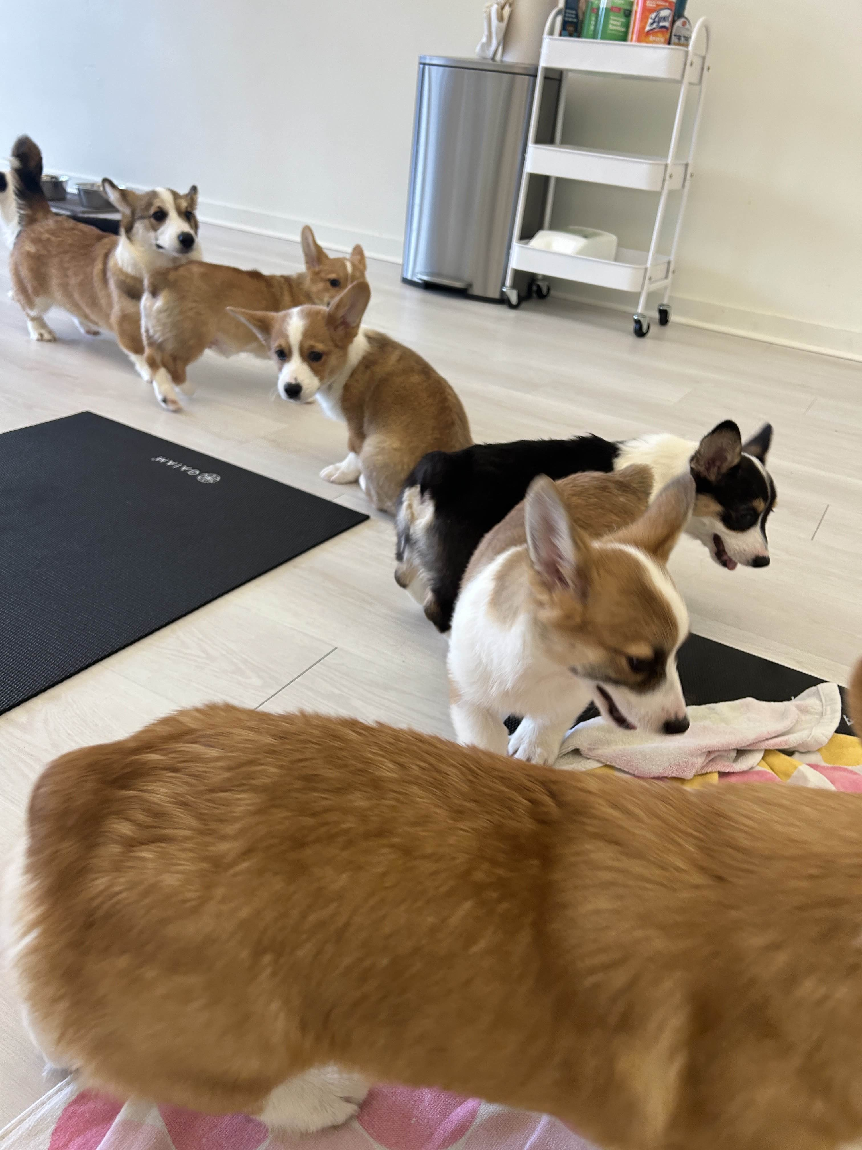
for Loops
BEFORE WE START
Talk to your neighbors:
Have you heard of corgi yoga?
LEC 04
Music: 🌸CSE 121 25sp Lecture Tunes 🌸
Instructor:
Miya Natsuhara
TAs:
Chloë
Ailsa
Johnathan
Christian
Merav
Judy
Janvi
Hibbah
Julia Sahej
Ruslana
Hanna
Maitreyi
Ayesha
Sushma
Kelsey
Shayna
Hannah
Zach

Slide 2
Announcements, Reminders
Feedback for C0 released yesterday!
Please view your feedback – crucial part of learning process
For regrades (not resubs), please make a private Ed post
Grade calculator
C1 releasing later today, due Tuesday, April 22nd
Quiz 0 is on Thursday, April 24th (in your registered quiz section)
Can’t make it? Email Miya ASAP
Resubmission Cycle 0 (R0) opening tomorrow, due Thursday April 24th

Slide 3
Reminder: Resubmissions (or “resubs”)
Each week, you may resubmit one Programming Assignment or Creative Project with no penalty. The grade of your resubmission will completely replace your previous grade.
This is a huge opportunity: you get to resubmit your work after we grade it and give you feedback! Please take advantage of this :)
If you miss an assignment and/or only finish it late – use a resub!

Slide 4
Resub Logistics
Some logistics:
There are 8 total resub cycles this quarter (and 8 assignments)
Assignments eligible to resubmit for 3 cycles after feedback is out
To resubmit:
Make and submit your changes
Set the submission you want graded as “Final”
Submit a Google Form, with a reflection, to confirm your resub
You must submit the form before the deadline for resub to count

Slide 5
Last Time…
Variables
Container that stores a specific data type
Must declare and initialize
int version = 5;
Strings
Sequence of characters treated as one, yet can be indexed as individual parts
char represents a single character
version
5
b | u | b | b | l | e |  | g | u | m
0 | 1 | 2 | 3 | 4 | 5 | 6 | 7 | 8 | 9

Slide 6
Think Pair Share: gumball Variables (Think)
Suppose s contains the String "bubble gum". Which statement would result in s containing "Gumball" instead?
s.substring(7) + "ball";
s = s.substring(7, 9) + "ball";
s = ("" + s.charAt(7)).toUpperCase() + "ball";
s = s.substring(7, 8).toUpperCase() + s.substring(8) + "ball";
b | u | b | b | l | e |  | g | u | m
0 | 1 | 2 | 3 | 4 | 5 | 6 | 7 | 8 | 9

Slide 7
Think Pair Share: gumball Variables (Pair)
Suppose s contains the String "bubble gum". Which statement would result in s containing "Gumball" instead?
s.substring(7) + "ball";
s = s.substring(7, 9) + "ball";
s = ("" + s.charAt(7)).toUpperCase() + "ball";
s = s.substring(7, 8).toUpperCase() + s.substring(8) + "ball";
b | u | b | b | l | e |  | g | u | m
0 | 1 | 2 | 3 | 4 | 5 | 6 | 7 | 8 | 9

Slide 8
Chaining methods in expressions
b | u | b | b | l | e |  | g | u | m
0 | 1 | 2 | 3 | 4 | 5 | 6 | 7 | 8 | 9
s.substring(7, 8).toUpperCase() + s.substring(8) + "ball"
"g".toUpperCase() + s.substring(8) + "ball"
"G" + s.substring(8) + "ball"
"G" + "um" + "ball"

Slide 9
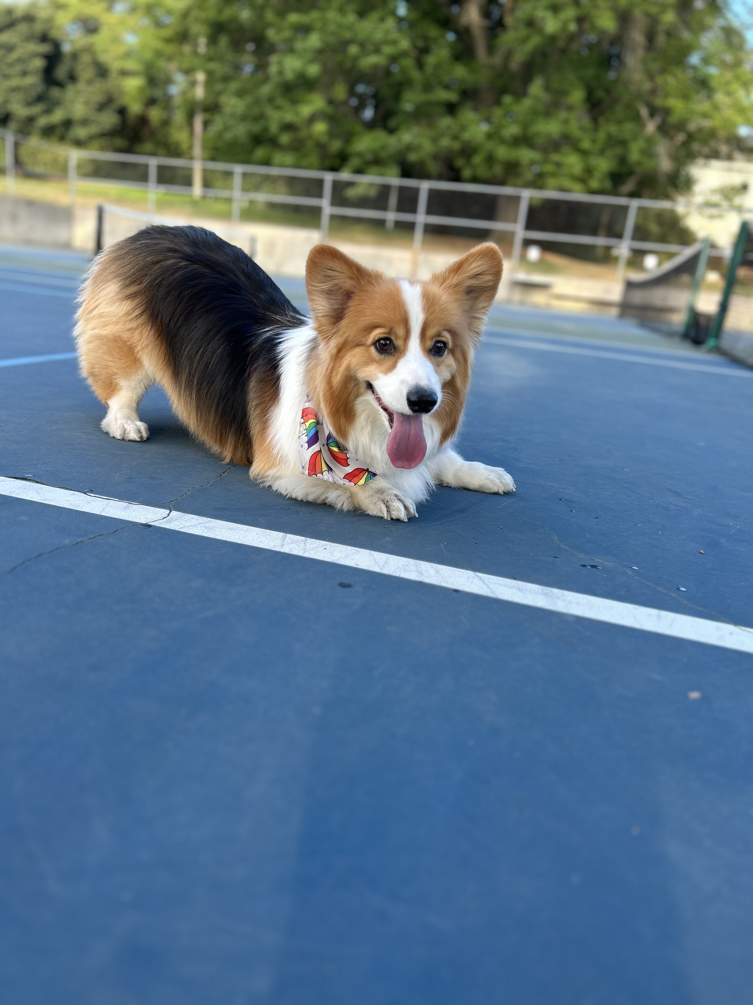
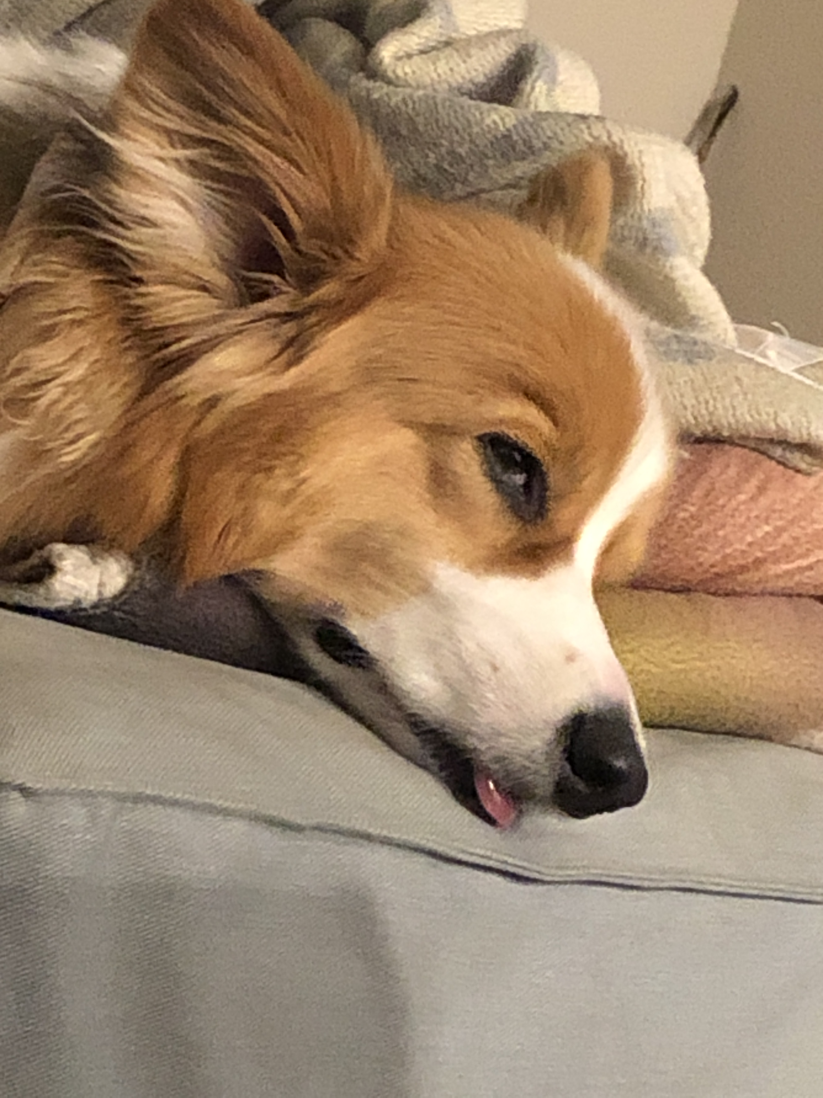
Aside: Gumball

Slide 10
PCM Review: for loops!
For loops are our first control structure: a syntax structure that controls the execution of other statements.

Slide 11
🐞 Debugging – Live!
In C0 & P0, we asked you to do some debugging.
This is arguably the most important skill when programming – especially because programming is a social activity!
Let’s do some live debugging :)

Slide 12
PCM Review: for loops (example)
for (int counter = 1; counter <= 5; counter++) {
System.out.println("I love CSE 121!");
}

Slide 13
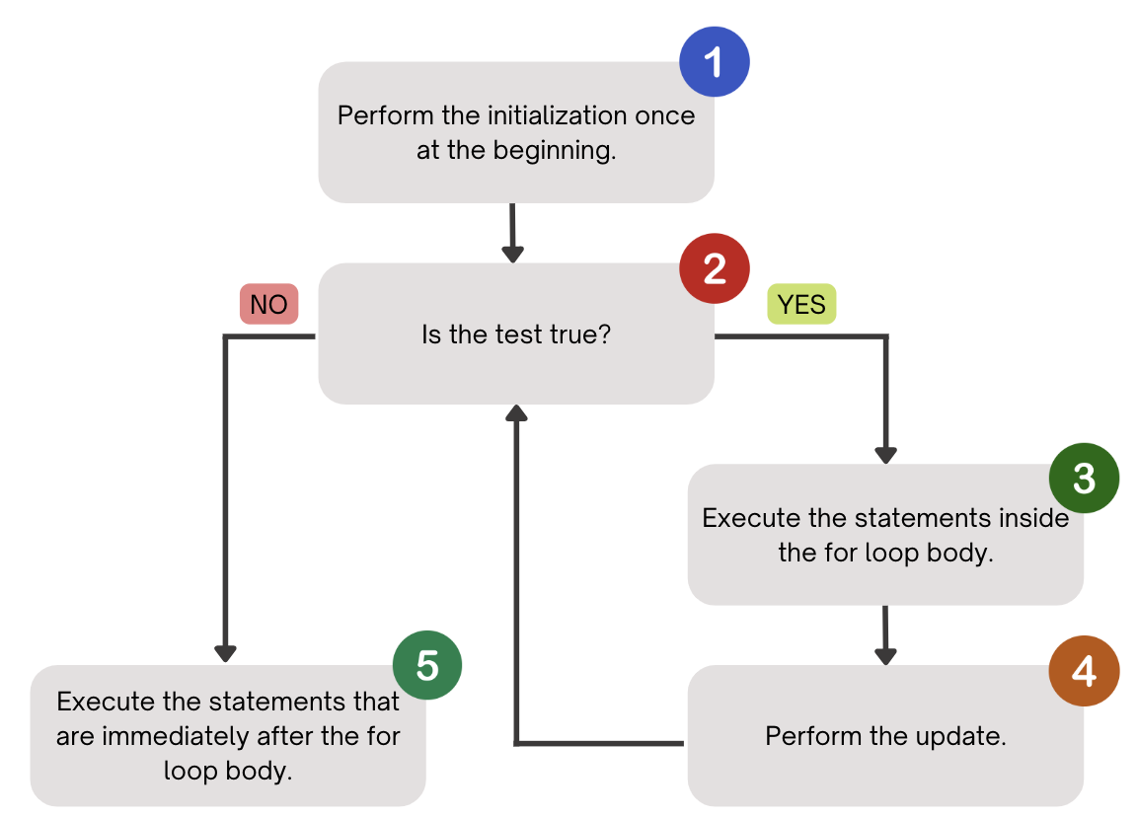
PCM Review: for loops (a helpful flowchart)

Slide 14
Thinking about for loops
counter
1
2
4
1
2
3
4
5
6
for (int counter = 1; counter <= 5; counter++) {
System.out.println("I love CSE 121!");
}
3
5
I love CSE 121!
I love CSE 121!
I love CSE 121!
I love CSE 121!
I love CSE 121!

Slide 15
Think Pair Share: squared loops (Think)
What output does the following code produce?
for (int i = 1; i <= 7; i++) {
System.out.println(i + " squared = " + i * i);
}
A.
i squared = i * i
i squared = i * i
i squared = i * i
i squared = i * i
i squared = i * i
i squared = i * i
B.
i squared = i * i
i squared = i * i
i squared = i * i
i squared = i * i
i squared = i * i
i squared = i * i
i squared = i * i
C.
1 squared = 1
2 squared = 4
3 squared = 9
4 squared = 16
5 squared = 25
6 squared = 36
D.
1 squared = 1
2 squared = 4
3 squared = 9
4 squared = 16
5 squared = 25
6 squared = 36
7 squared = 49

Slide 16
Think Pair Share: squared loops (Pair)
What output does the following code produce?
for (int i = 1; i <= 7; i++) {
System.out.println(i + " squared = " + i * i);
}
A.
i squared = i * i
i squared = i * i
i squared = i * i
i squared = i * i
i squared = i * i
i squared = i * i
B.
i squared = i * i
i squared = i * i
i squared = i * i
i squared = i * i
i squared = i * i
i squared = i * i
i squared = i * i
C.
1 squared = 1
2 squared = 4
3 squared = 9
4 squared = 16
5 squared = 25
6 squared = 36
D.
1 squared = 1
2 squared = 4
3 squared = 9
4 squared = 16
5 squared = 25
6 squared = 36
7 squared = 49

Slide 17
PCM Review: String Traversals
// For some String s
for (int i = 0; i < s.length(); i++) {
// do something with s.charAt(i)
}
b | u | b | b | l | e |  | g | u | m
0 | 1 | 2 | 3 | 4 | 5 | 6 | 7 | 8 | 9

Slide 18
Go Huskies?
h-u-s-k-i-e-s

Slide 19
The Fencepost Pattern
Some task where one piece is repeated n times, and another piece is repeated n-1 times and they alternate
h-u-s-k-i-e-s

