Slide 1
Characters, Strings, Variables, Debugging
BEFORE WE START
Talk to your neighbors:
What is your favorite emoji? 😀
LEC 03
Music: 🌸CSE 121 25sp Lecture Tunes 🌸
Instructor:
Miya Natsuhara
TAs:
Chloë
Ailsa
Johnathan
Christian
Merav
Judy
Janvi
Hibbah
Julia Sahej
Ruslana
Hanna
Maitreyi
Ayesha
Sushma
Kelsey
Shayna
Hannah
Zach

Slide 2
Agenda
Announcements, Reminders
C0 reflection recap
More Variables and Operators!
Strings and Characters Review
Code example!

Slide 3
Announcements, Reminders
P0 was released on Wednesday and is due Tuesday, April 15th
Expect C0 grades ~ 1 week from submission (we’ll announce on Ed)
Shortly after, your first resubmission cycle will open!
Guest lecture on Wednesday: Hannah!

Slide 4
Agenda
Announcements, Reminders
C0 reflection recap
More Variables and Operators!
Strings and Characters Review
Code example!

Slide 5
On accessibility…
Loved your reflection responses! Some themes:
not knowing how blind people use computers (or program)
being inspired by the speaker’s perseverance and determination
accessibility really matters, because:
“I think that it is incredibly important for people to be able to pursue their passion, and I'm very glad that the speaker was able to become a professional developer.”
“Accessibility in computer science is important because computer science has become such a large thing that it effects almost everything in the modern world. Therefore it is extremely important that everyone has the opportunity to interact with computer science because computer science directly effects everyone.”
“This accessibility is important in computer science because every individual brings new perspectives to the world of code.”

Slide 6
Is C0 accessible?
Broad spectrum of answers, but most of you said no.
When looking at ASCII art:
screenreaders alone aren’t suited for reading ASCII art
the caption is probably not enough context for a blind user
the caption could be low-quality or wrong!
Doing the assignment would be even harder!
have to learn coding alongside new interaction techniques
Ed doesn’t have the same accessibility features

Slide 7
So, what?
Broadly speaking: the digital world is inaccessible (but that’s changing)!
In CSE 121, we don’t have the full knowledge yet to make accessible ASCII art (or Java programs, applications, video games, websites, …)
However, we encourage you to:
think about accessibility when you make things with computers
keep on learning more! UW is a global leader in digital accessibility
e.g. at UW: CSE 493E: Accessibility, CREATE, AccessComputing

Slide 8
Agenda
Announcements, Reminders
C0 reflection recap
More Variables and Operators!
Strings and Characters Review
Code example!

Slide 9
PCM: Typecasting
Java will do some type conversions for us
E.g., int to double, double to String, int to String
BUT some conversions Java won't do for us…
Nonsensical conversions (e.g., "Gumball" to int)
Conversions that are "lossy" (e.g., double to int)
We can ask Java to typecast for us
double x = 8.83;
int xInt = (int) x;

Slide 10
PCM: Variables
Recall: Variables allow us to give a name to a specific value
3 parts: declaration, initialization, usage
Example:
Declaration: int x;
Initialization: x = 30;
Or all in one line: int x = 30;
String theBestBoy = "gumball";
System.out.println(theBestBoy);

Slide 11
New: Manipulating Variables
They’re made to be manipulated, modified, and re-used!
int myFavoriteNumber = 7;
int tripleFavNum = myFavoriteNumber * 3;
myFavoriteNumber = myFavoriteNumber + 3;
Notice – this doesn't really make any mathematical sense!
That's because, in Java, = is assignment, not equality!

Slide 12
New Operator: +=
myFavoriteNumber = myFavoriteNumber + 3;
This pattern is so common, we have a shorthand for it!
myFavoriteNumber += 3;
This works for both numeric addition and string concatenation!

Slide 13
More Shorthand Operators
The shorthands -=, *=, /=, and %= exist too!
myFavoriteNumber /= 3;
Should this work for integers? Doubles? Strings?

Slide 14
Even Shorter Shorthands
There are even shorter operators for “incrementing” and “decrementing”!
myFavoriteNumber++; // myFavoriteNumber += 1;
myFavoriteNumber--; // myFavoriteNumber -= 1;
Should this work for integers? Doubles? Strings?

Slide 15
Think Pair Share: A, B, C Variables (Think)
What do a, b, and c hold after this code is executed?
int a = 10;
int b = 30;
int c = a + b;
c -= 10;
a = b + 5;
b /= 2;
10, 30, 40
35, 15, 30
35, 15.5, 30
20, 15, 30

Slide 16
Think Pair Share: A, B, C Variables (Pair)
What do a, b, and c hold after this code is executed?
int a = 10;
int b = 30;
int c = a + b;
c -= 10;
a = b + 5;
b /= 2;
10, 30, 40
35, 15, 30
35, 15.5, 30
20, 15, 30

Slide 17
Agenda
Announcements, Reminders
C0 reflection recap
More Variables and Operators!
Strings and Characters Review
Code example!

Slide 18
PCM: Strings & chars
Recall: String literals are a sequence of characters that are strung together, begin and end with ""
Use zero-based indexing
A char represents a single character
Begin and end with single quotes ( ' )
Strings are made up of chars!
g | u | m | b | a | l | l
0 | 1 | 2 | 3 | 4 | 5 | 6
char letter = 'g';
char anotherLetter = 'b';

Slide 19
PCM: String Methods
Usage: <string_variable>.<method>(…)
Method | Description
length() | Returns the length of the string.
charAt(i) | Returns the character at index i of the string
indexOf(s) | Returns the index of the first occurrence of s in the string; returns -1 if s doesn't appear in the string
substring(i, j) or substring(i) | Returns the characters in this string from i (inclusive) to j (exclusive); if j is omitted, goes until the end of the string
contains(s) | Returns whether or not the string contains s
equals(s) | Returns whether or not the string is equal to s (case-sensitive)
equalsIgnoreCase(s) | Returns whether or not the string is equal to s ignoring case
toUpperCase() | Returns an uppercase version of the string
toLowerCase() | Returns a lowercase version of the string

Slide 20
Think Pair Share: A, B, C Variables (Think)
Suppose s contains the String "bubble gum". Which statement would result in s containing "Gumball" instead?
s.substring(7) + "ball";
s = s.substring(7, 9) + "ball";
s = s.charAt(7).toUpperCase() + "ball";
s = s.substring(7, 8).toUpperCase() + s.substring(8) + "ball";
b | u | b | b | l | e |  | g | u | m
0 | 1 | 2 | 3 | 4 | 5 | 6 | 7 | 8 | 9

Slide 21
Think Pair Share: A, B, C Variables (Pair)
Suppose s contains the String "bubble gum". Which statement would result in s containing "Gumball" instead?
s.substring(7) + "ball";
s = s.substring(7, 9) + "ball";
s = s.charAt(7).toUpperCase() + "ball";
s = s.substring(7, 8).toUpperCase() + s.substring(8) + "ball";
b | u | b | b | l | e |  | g | u | m
0 | 1 | 2 | 3 | 4 | 5 | 6 | 7 | 8 | 9

Slide 22
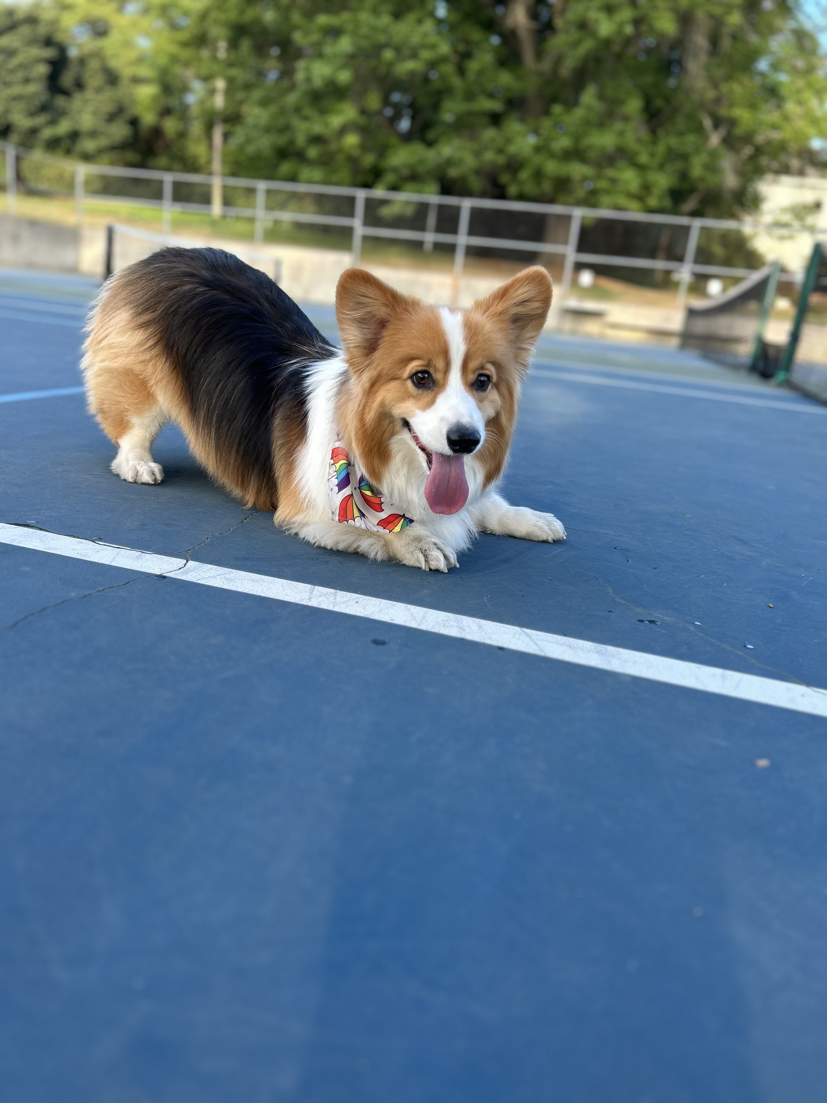
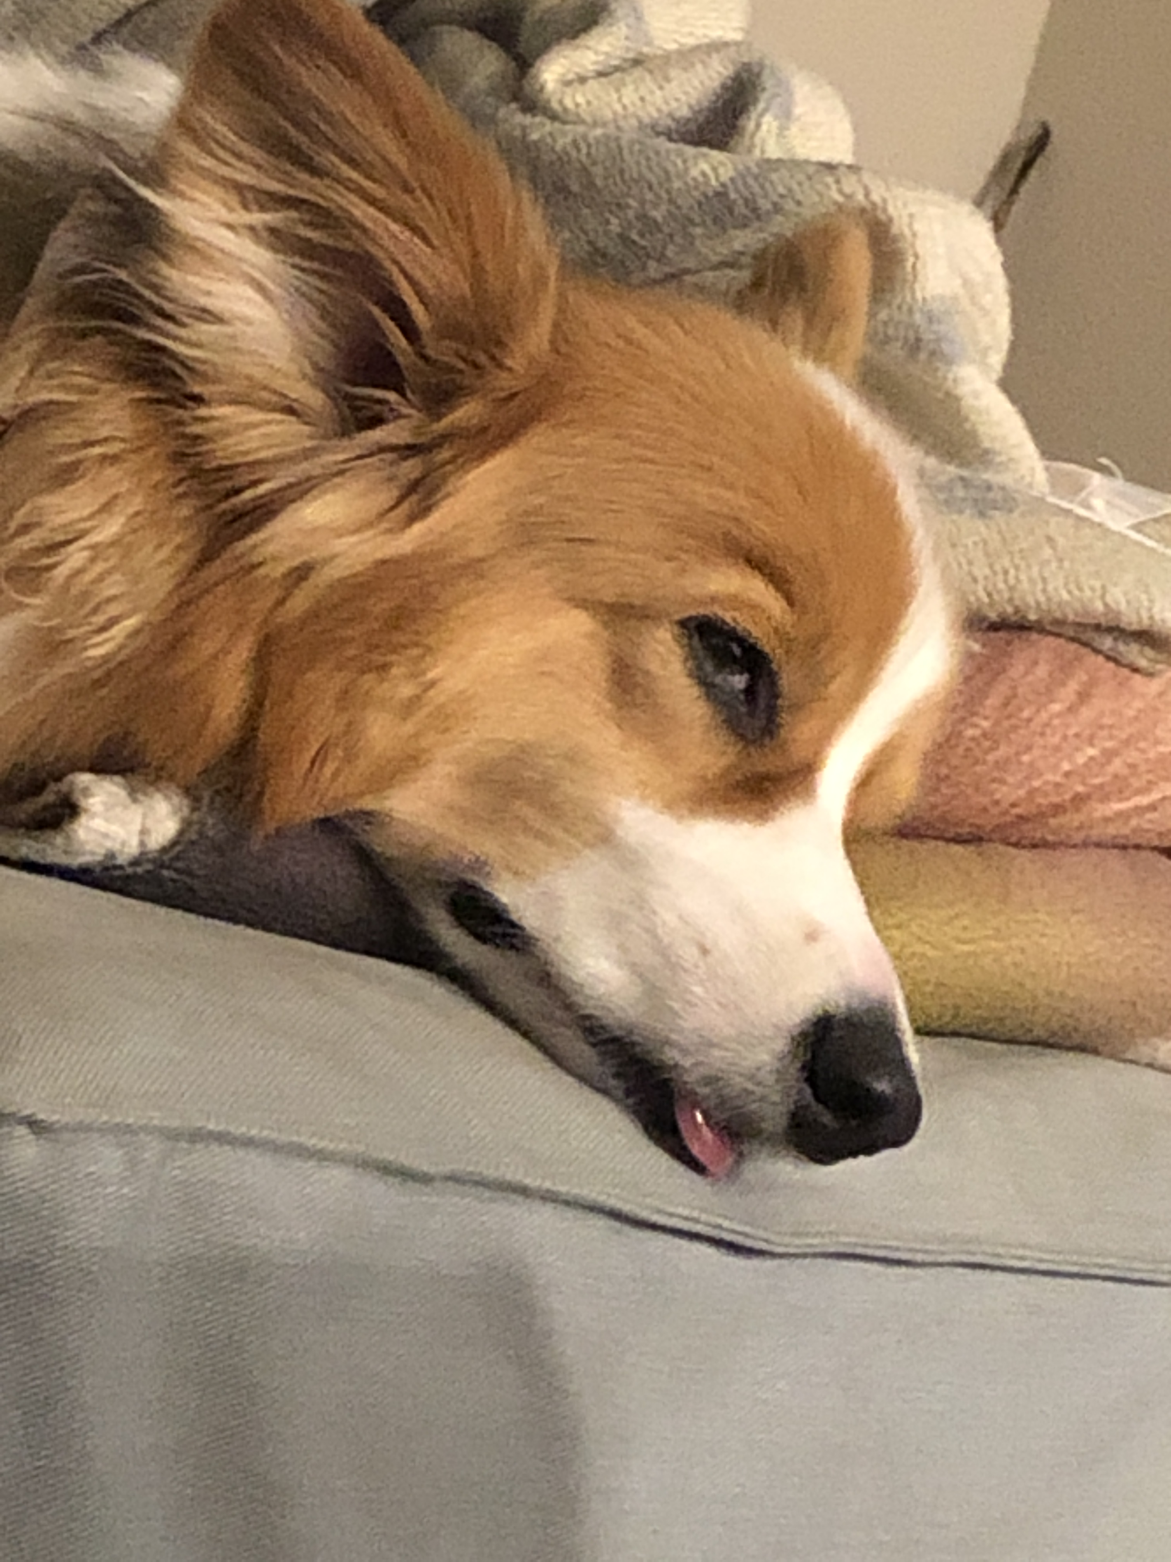
Aside: Gumball

