Slide 1
Victory Lap!
BEFORE WE START
Talk to your neighbours:
What are your spring break plans?
LEC 18
Music: 🌸CSE 121 25sp Lecture Tunes 🌸
Instructor:
Miya Natsuhara
TAs:
Chloë
Ailsa
Johnathan
Christian
Merav
Judy
Janvi
Hibbah
Julia Sahej
Ruslana
Hanna
Maitreyi
Ayesha
Sushma
Kelsey
Shayna
Hannah
Zach

Slide 2
Announcements, Reminders (general)
This week:
Programming Assignment 3 deadline extended to Thursday, June 5!
Last day of IPL is Friday, June 6 (last day of instruction)
Friday's class will be TA-led final exam review
Miya's Friday office hours cancelled
Next week:
Gumball & friends visit on Monday, June 9 1:00-2:30pm around Drumheller Fountain
TA-led review session: Tuesday, June 10th from 3:30-6:20pm, JHN 075
R7 (+ extra resub) due Thu, June 12th – all assignments eligible
Final Exam: Thursday, June 12th from 2:30 - 4:20pm in KNE 120
look at seating charts and let me know ASAP if you’re not there!
review Exam page of website (with policies & resources)

Slide 3
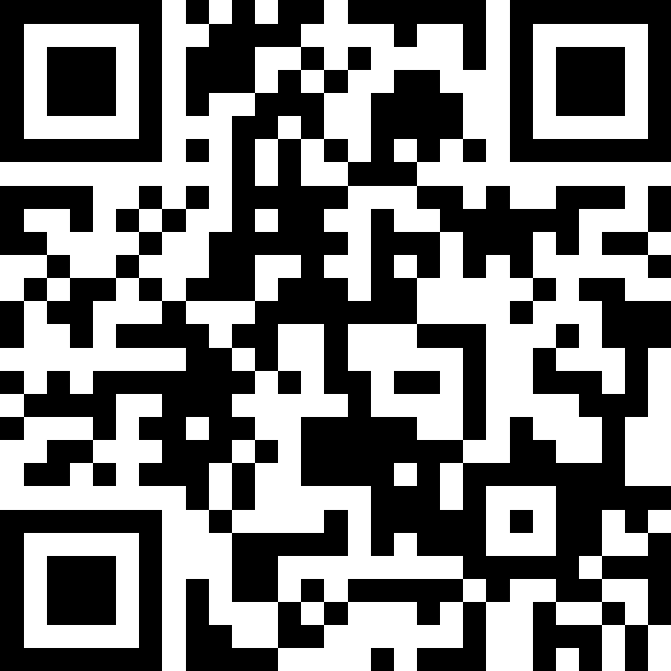
Pause: Exam Questions?
Will answer some live, and put the rest in the class megathread for today!
sli.do
#cse121

Slide 4
Evaluations and Awards
Please give us feedback!
Course Evals are due Sunday, June 8th at 11:59 PM
TA Evals are also due Sunday, June 8th at 11:59 PM
Bob Bandes TA award nominations open!
thought your TA was the goat? write them a nomination!
fun fact: some of our faculty won the award when they were TAs!
fun fact #2: a 121 TA won the award last year :)

Slide 5
(Optional) Using String[] args!
String[] args is just a parameter to our main method…but we never call main, so how do we pass anything to args?
When we run our program from the terminal, we can pass "command-line arguments" to the main method, and they become the contents of args
javac MyProgram.java
java MyProgram these 7 words will go in args
4

Slide 6
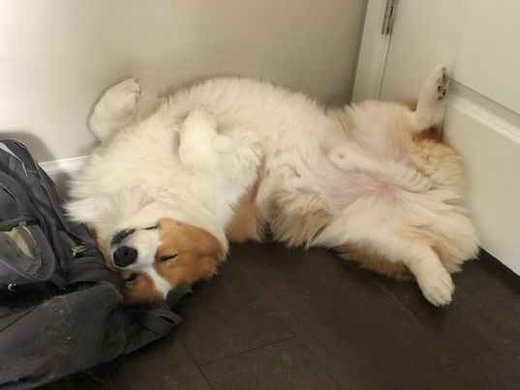
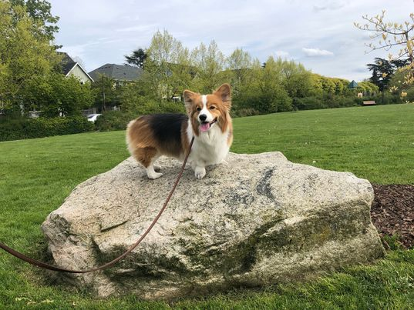
You did it!

Slide 7
Applications of CS
or “What can I do with what I learned?” – outside of just “write code”:
Detect and prevent toxicity online & recognize disinformation
Help deaf & hard-of-hearing people identify sounds
Develop a programming language that celebrates the world’s languages
Build battery-free robots & put them on insects (and... track murder hornets?)
Computational knitting & carpentry
Create an interactive atlas of millions of refugee experiences
Fix Olympic badminton & identify cheating in chess
and so much more!

Slide 8
… including our assignments! (1/2)
Computational Biology & Medicine (P2, P3)
in CSE: Chris Thachuk, Linda Shapiro, Sara Mostafavi, Su-In Lee, Luis Ceze
Computational Art (C0, C1)
UW CSE has many unique intersections of CS + art!
“Cultural-Centric Computational Embroidery” (CSE + iSchool)
“Computational Illusion Knitting”, “How to Knit Objects Weird”
“WasteBanned: Supporting zero waste fashion design”

Slide 9
… including our assignments! (2/2)
Games & Graphics (C1, C3)
at UW: many labs in CSE and iSchool’s GAMER group
fun fact: Foldit is a crowd-sourced game for protein folding
David Baker shared this year’s Nobel Prize in Chemistry, in part for this!!
Social Computing (P1, C2)
at UW: Amy Zhang’s Social Futures Lab + so much of iSchool
and many side quests (in lecture, section, PCM): accessibility (e.g. UW CREATE), weather forecasting, chatbots, and lots of math

Slide 10
Future Courses
More 12X!
or “What can I do next?”
Course | Overview
CSE 122 | Data structures, object-oriented programming
CSE 123 | More OOP, recursion
Non-majors
Course | Overview
CSE 154 | Intro. to web programming (several languages)
CSE 160 | Intro programming, data analysis (Python)
CSE 163 | Intermediate programming, data analysis (Python)
CSE 180 | Introduction to data science (Python)
CSE 373 | Data structures and algorithms (in Java)
CSE 374 | Low-level programming and tools (C/C++)
CSE 412 | Intro to Data Visualization
CSE 416 | Intro. to Machine Learning
CSE 493E | Accessibility
Majors
Course | Overview
CSE 311 | Mathematical foundations
CSE 331 | Software design/implementation
CSE 340 | Interaction programming (mobile apps)
CSE 341 | Programming languages (!!)
CSE 351 | Hardware / Software Interface
Other tech-related majors: Informatics, ACMS, HCDE, Electrical & Computer Engineering, …
See: https://www.cs.washington.edu/academics/ugrad/current-students and https://www.cs.washington.edu/academics/ugrad/nonmajor-options/nonmajor-courses

Slide 11
Generalizing beyond CS
Some of you said, ”I’m glad I took this class, but no more CS for me”
That’s totally valid!
Some lessons from this class that could apply more broadly:
how to break big problems into smaller subproblems
how to isolate what part of a system is broken
attention to detail
how to learn (and reflect) effectively

Slide 12
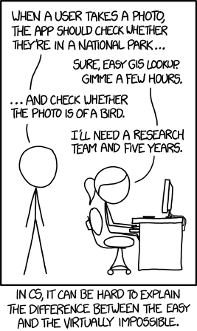
Frequently Asked Questions
How can I get better at programming?
Practice!
How can I learn to X?
Classes, books, videos, or self-learn!
CS (as a field) has lots of free resources :)
What should I do next?
Anything you’re interested in!
but: hard to tell what’s easy and what’s hard
Should I learn another language? Which one?
That depends – what do you want to do?

Slide 13
Spring Break Project: Tic Tac Toe
Build your own Tic Tac Toe game + “AI”! (one of the TA’s choice ideas)
How would you represent a Tic Tac Toe game in Java? (hint: arrays will be very, very helpful!)
Write a method that tells you if a Tic Tac Toe game is won.
Write a method that gets input from the user and “makes” a move.
Wrap it all up – into a nice two-player game!

Slide 14
Spring Break Project: Tic Tac Toe++
Make some “AI” that…
just makes a random valid move (you should be able to beat this!)
tries to make a “good” move (~ some if statements)
never loses
Tic Tac Toe is a “solved game”: a perfect player will never lose.
Or, extend this idea to other grid-based games!
similar-ish: connect four, checkers, battleship
much harder: sudoku, chess, go, othello

Slide 15
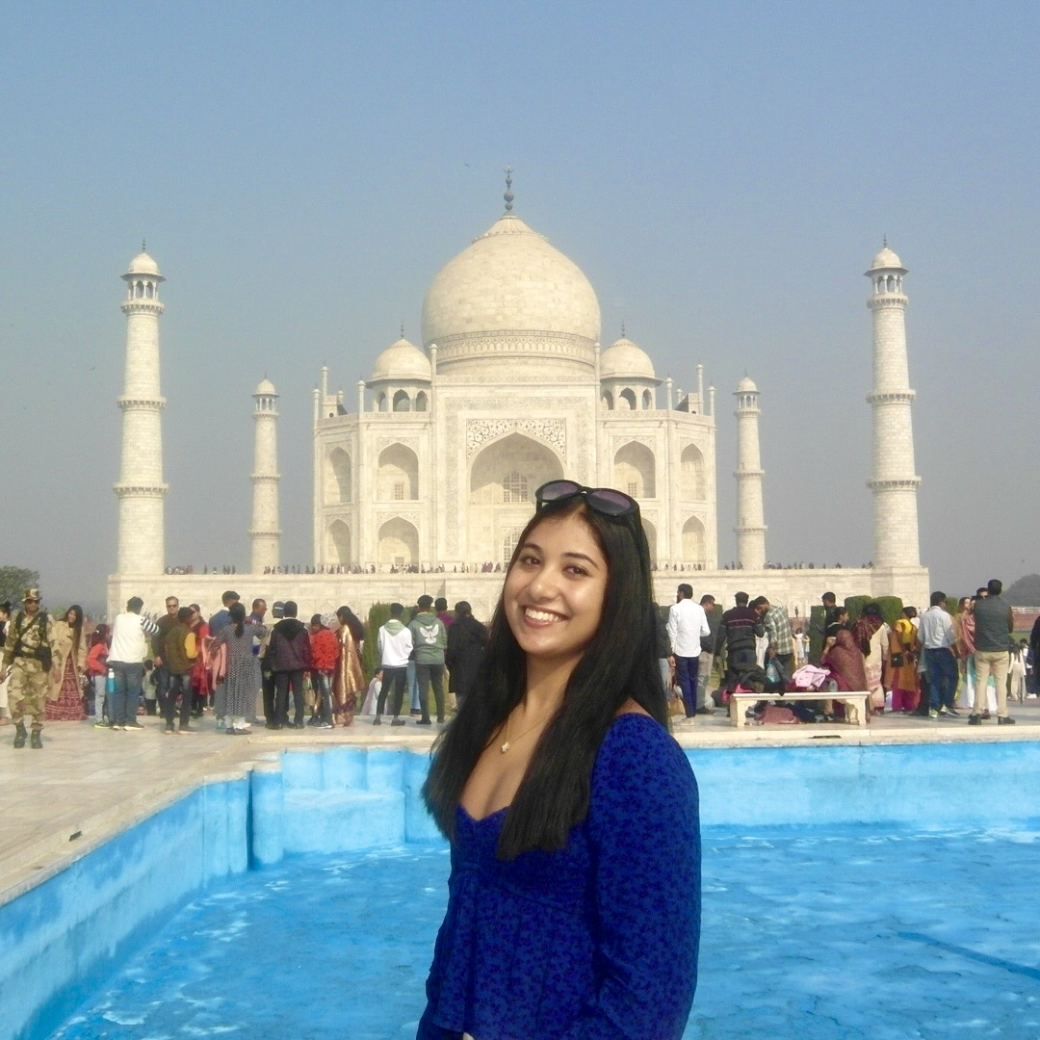
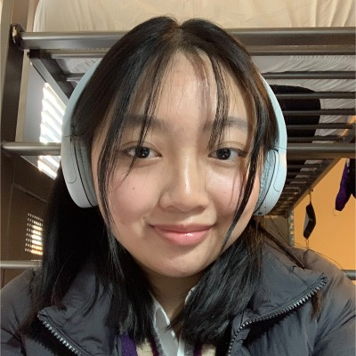
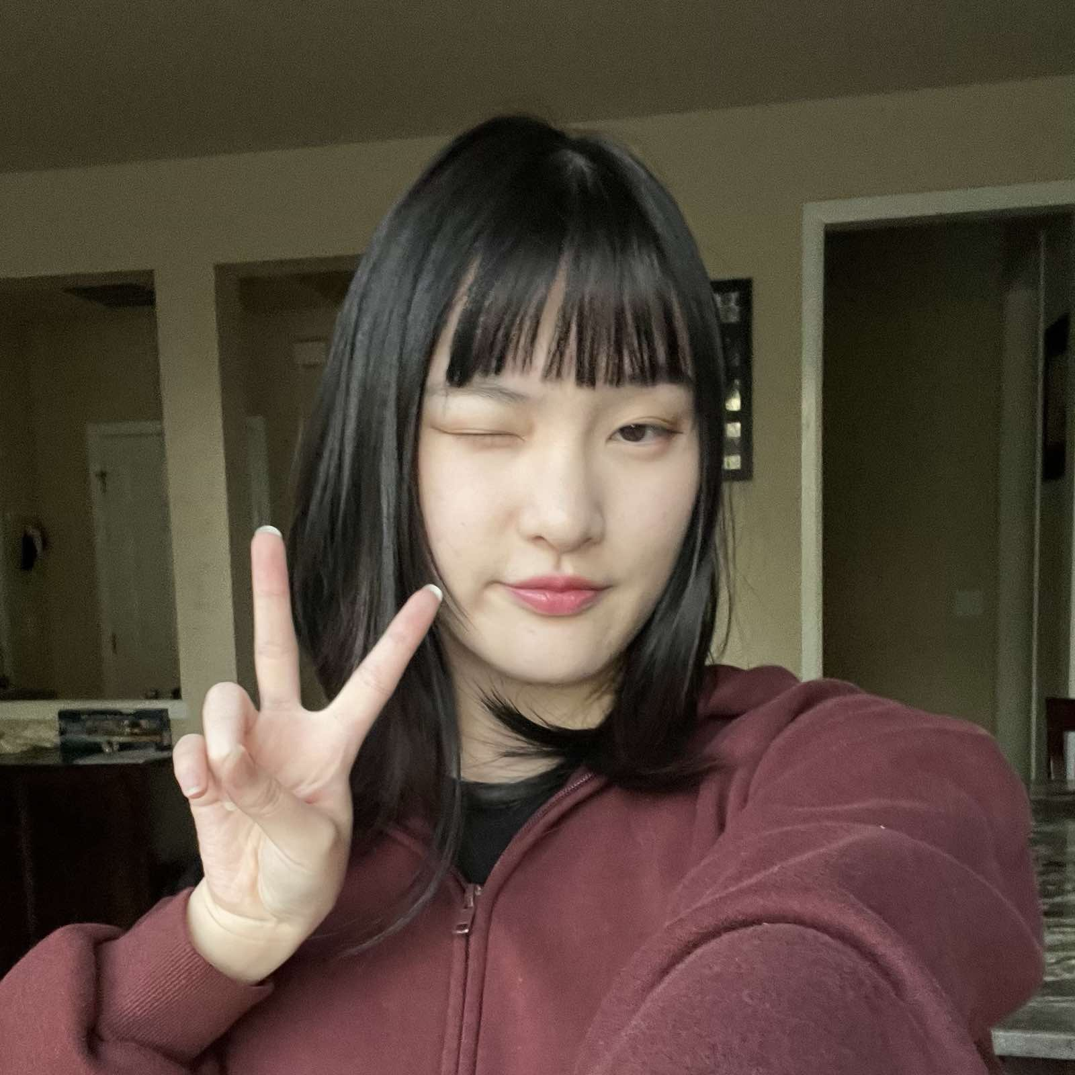
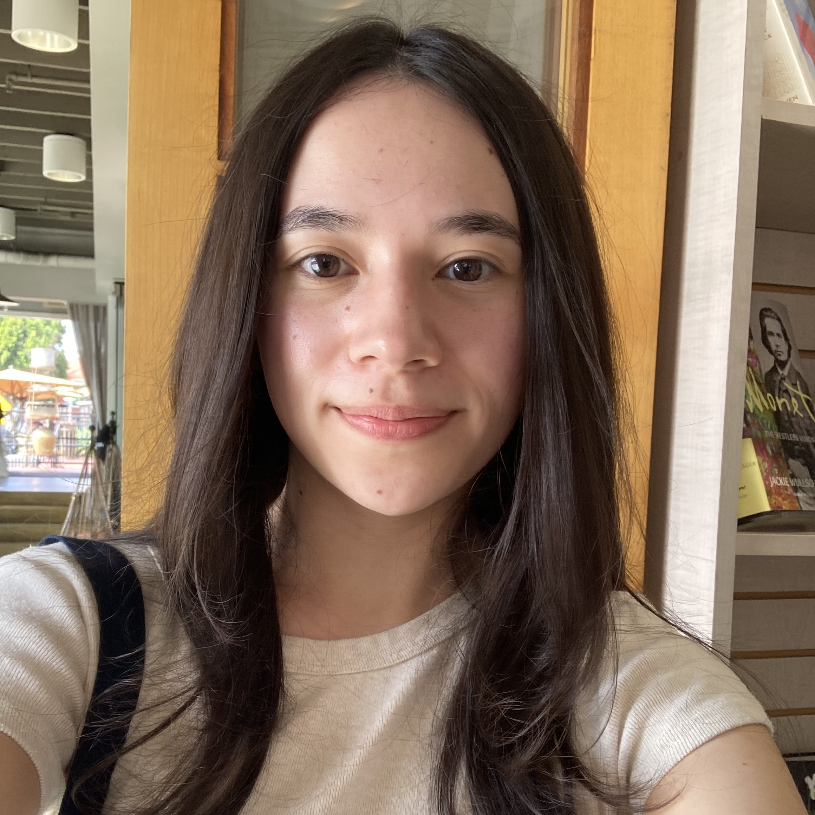
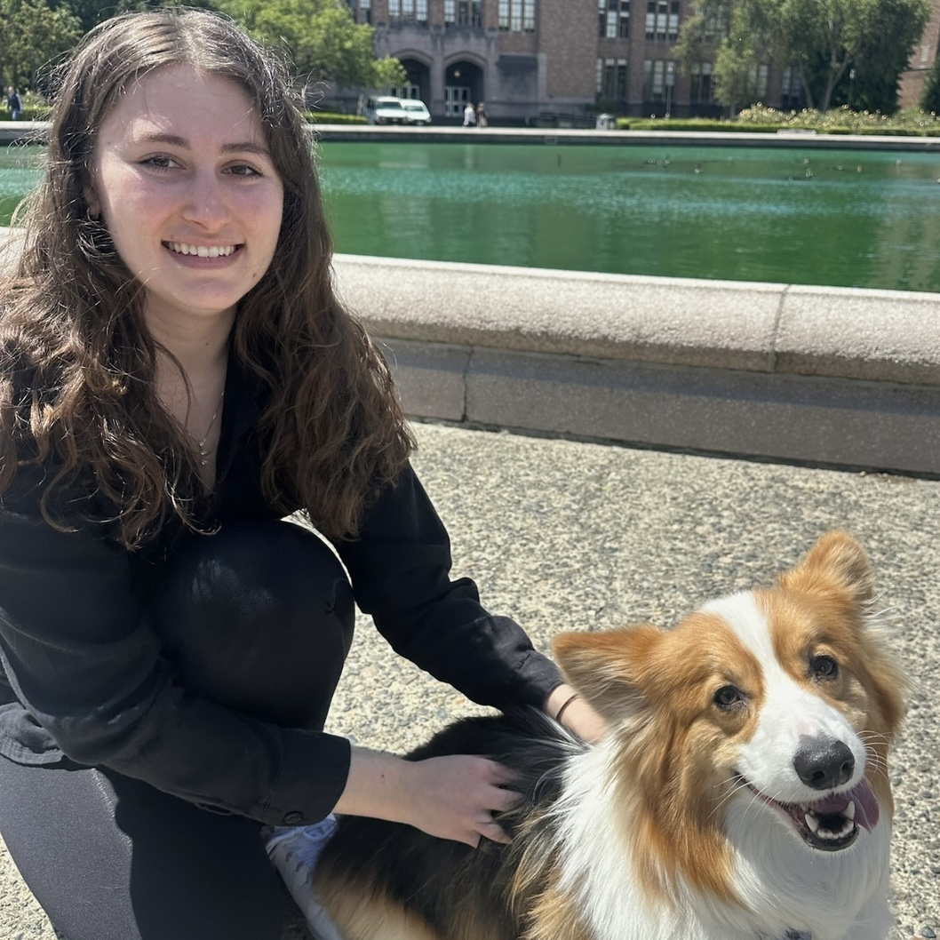
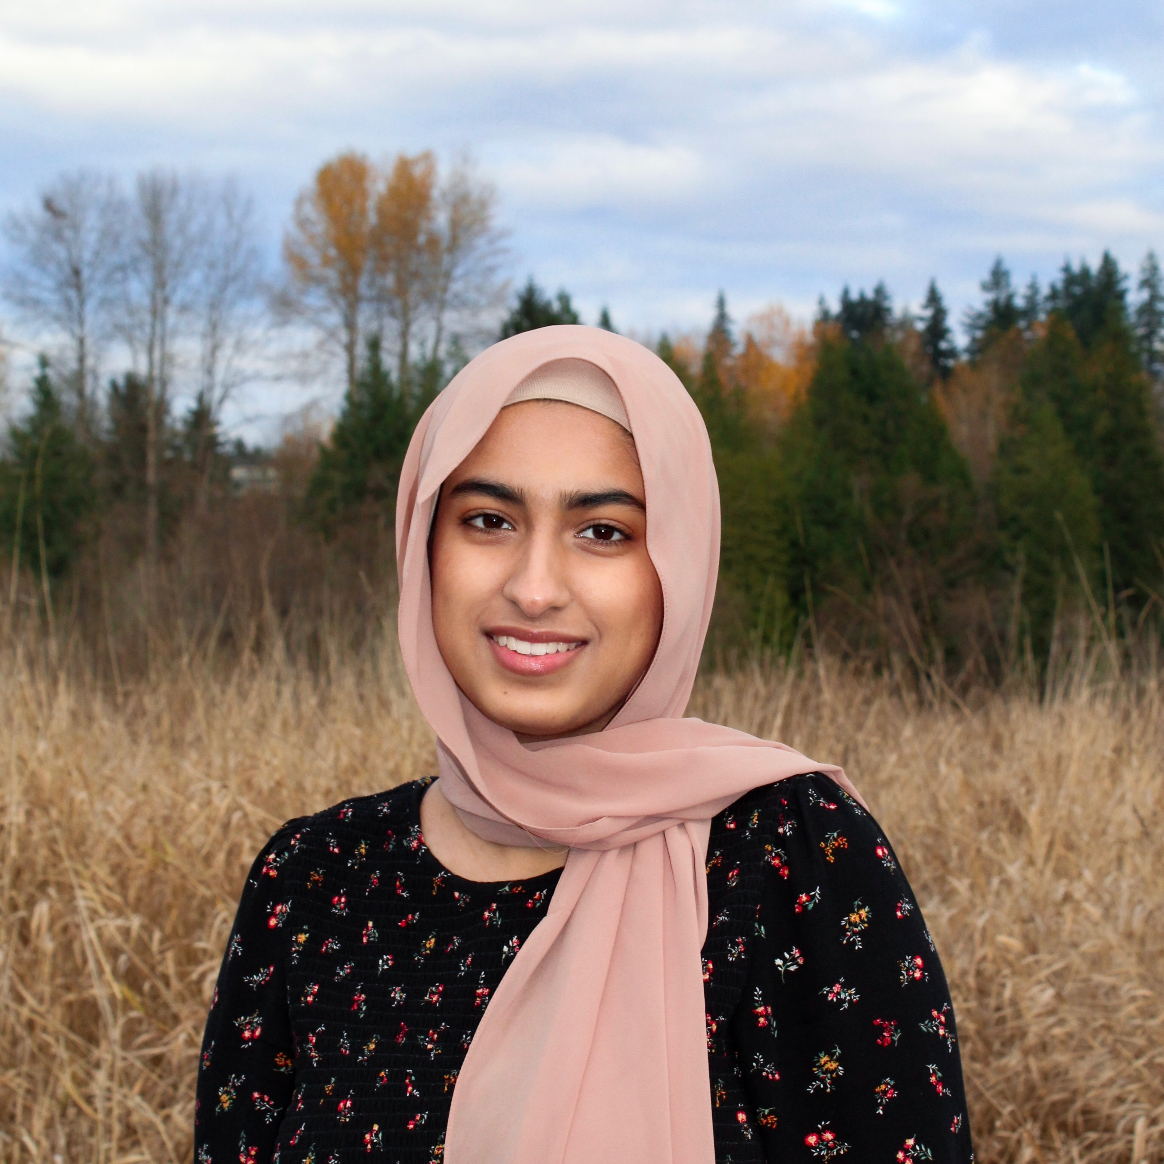
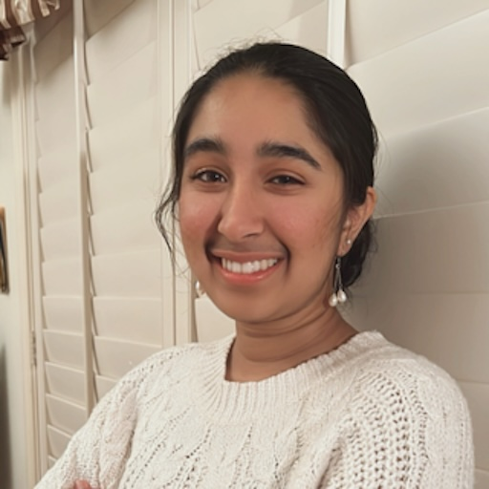
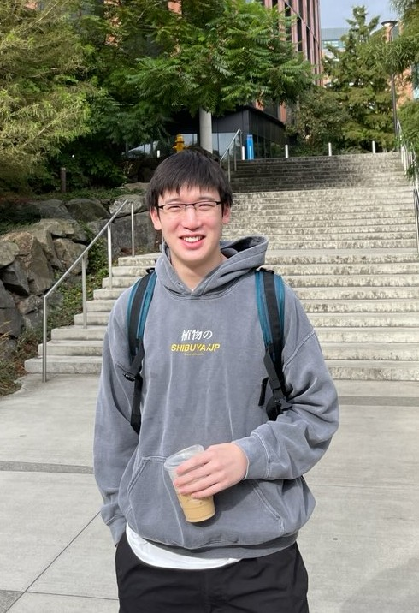
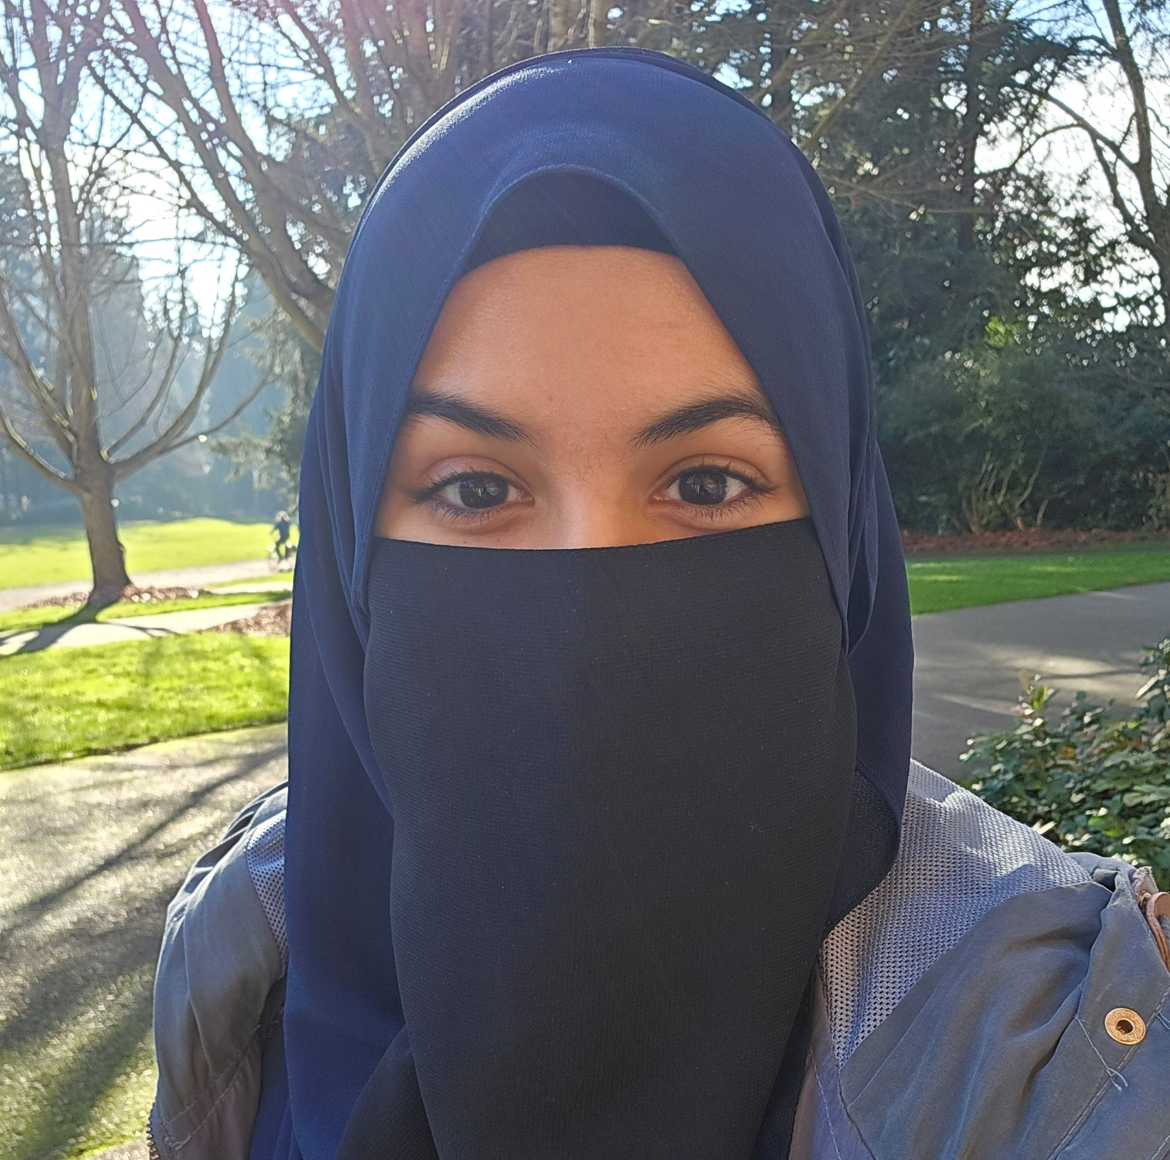
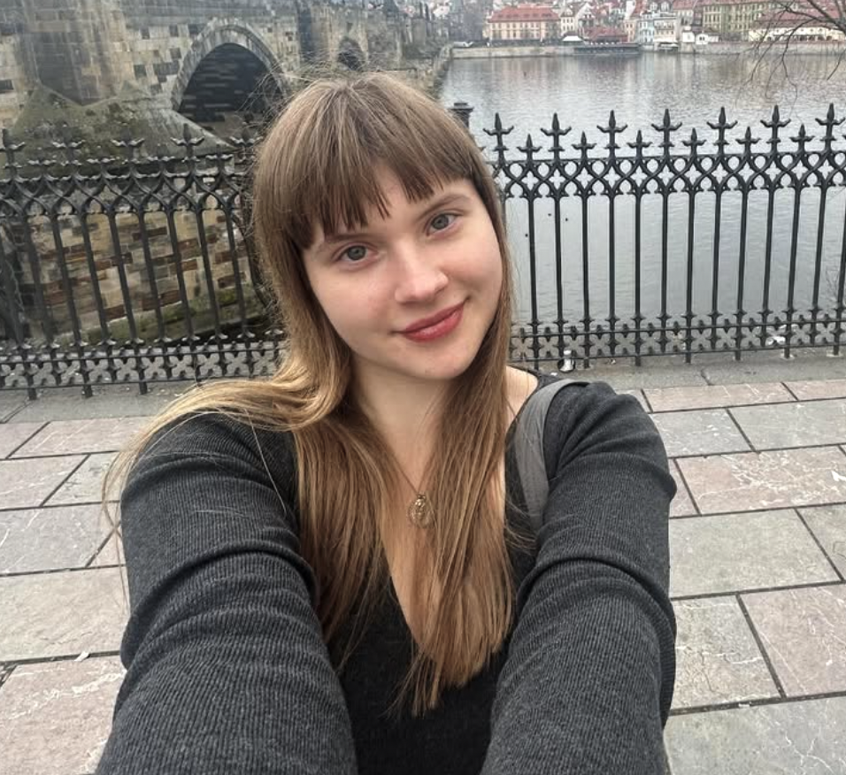
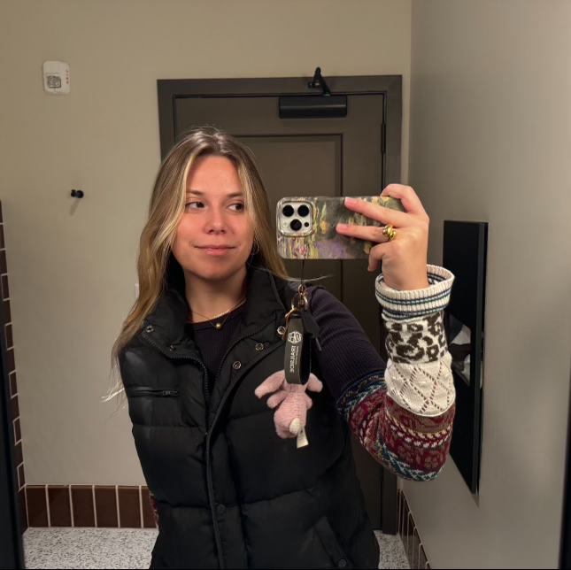
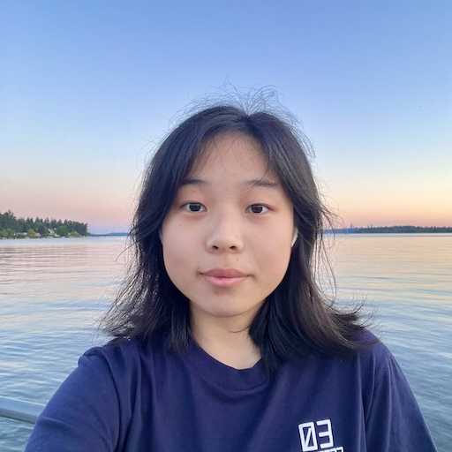
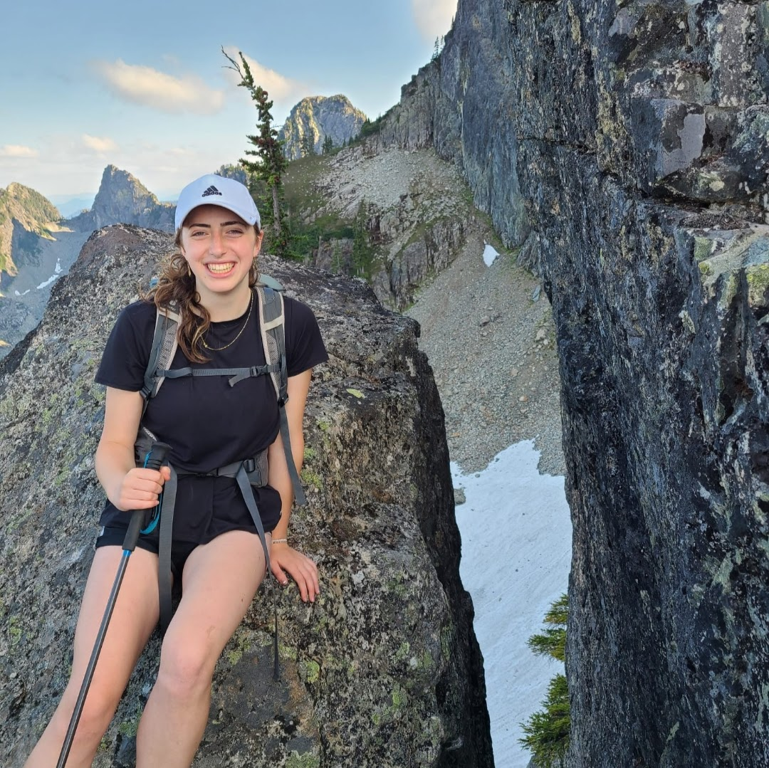
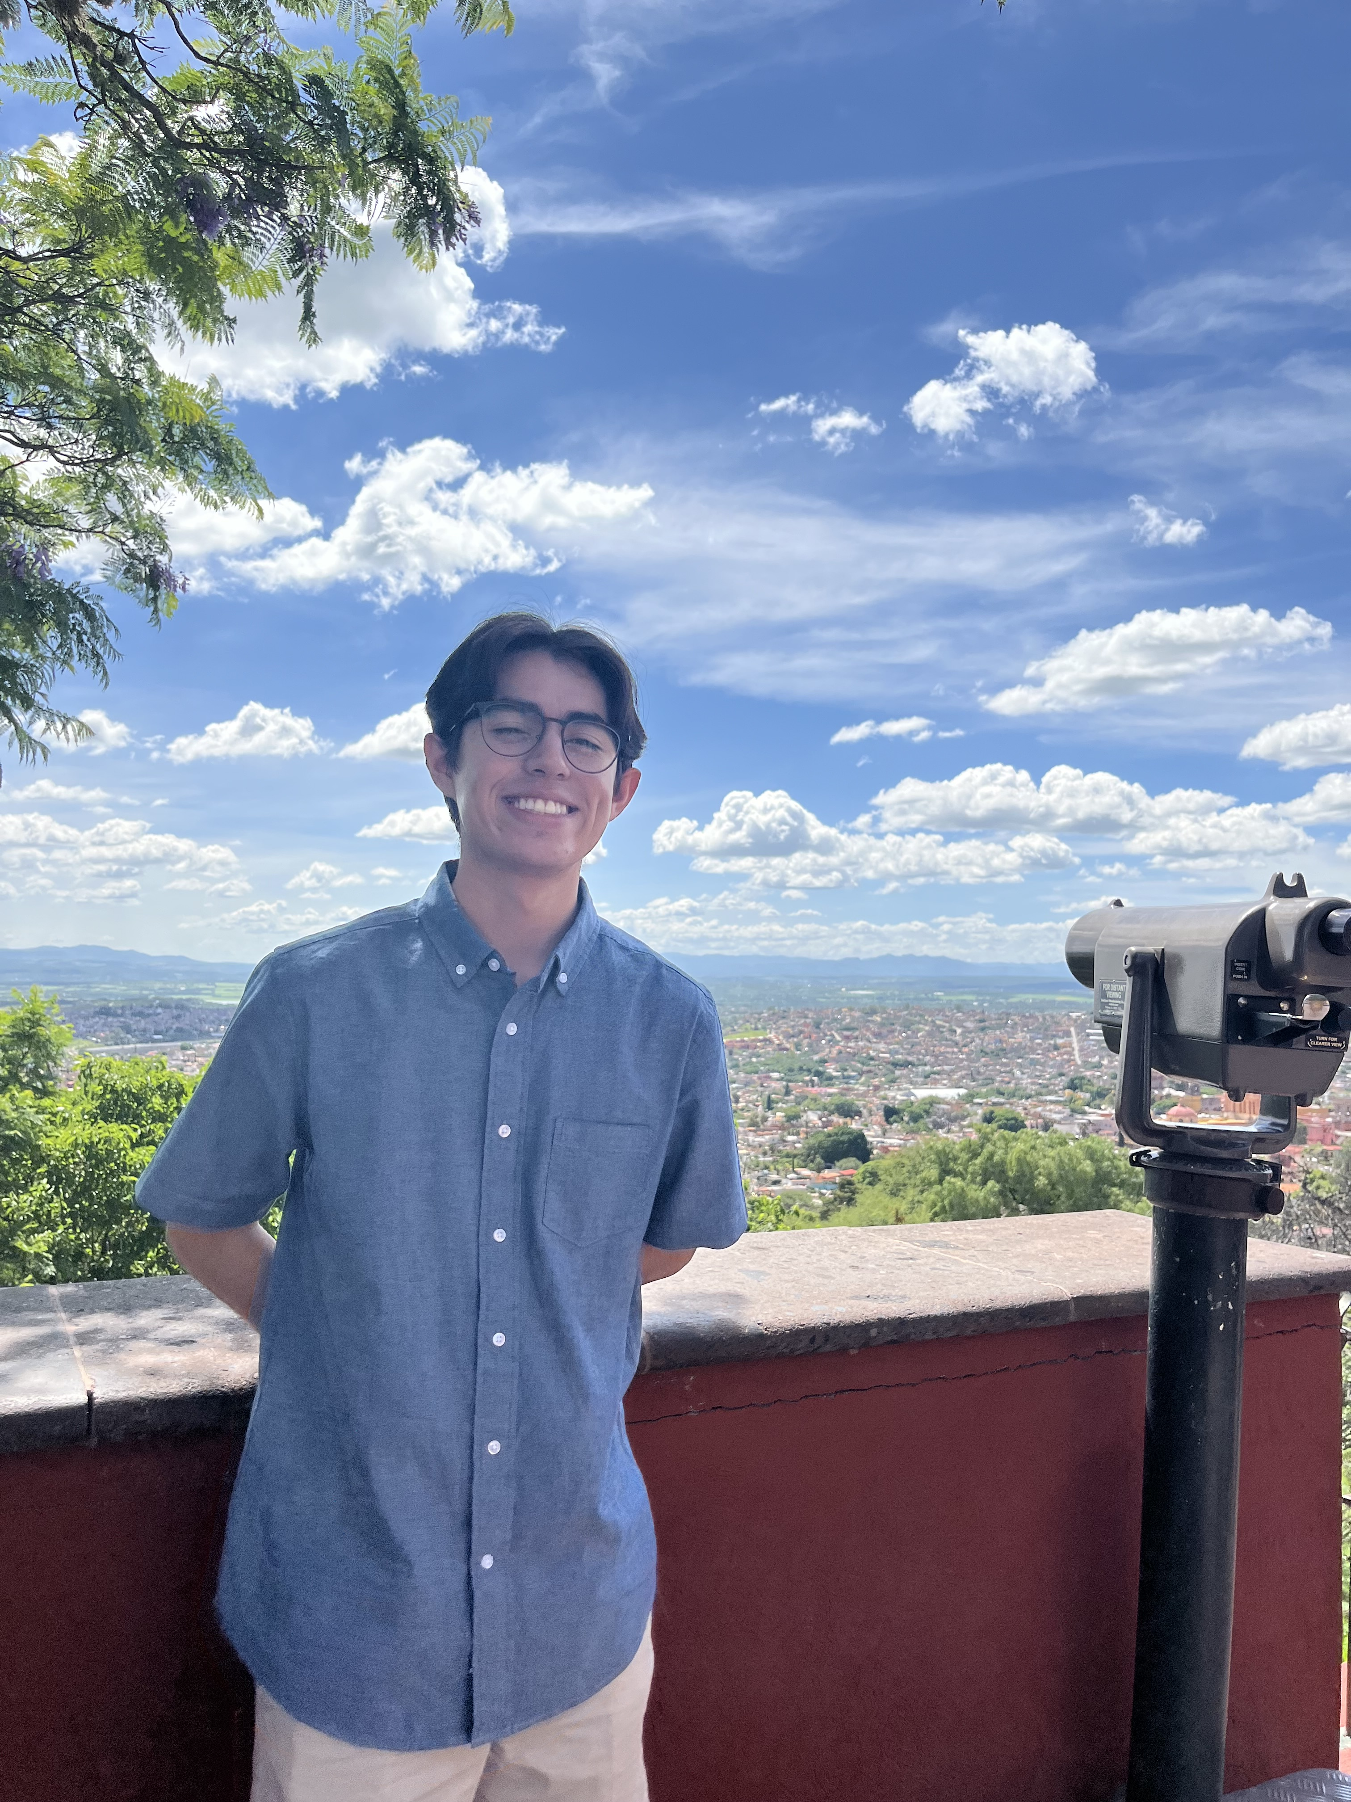
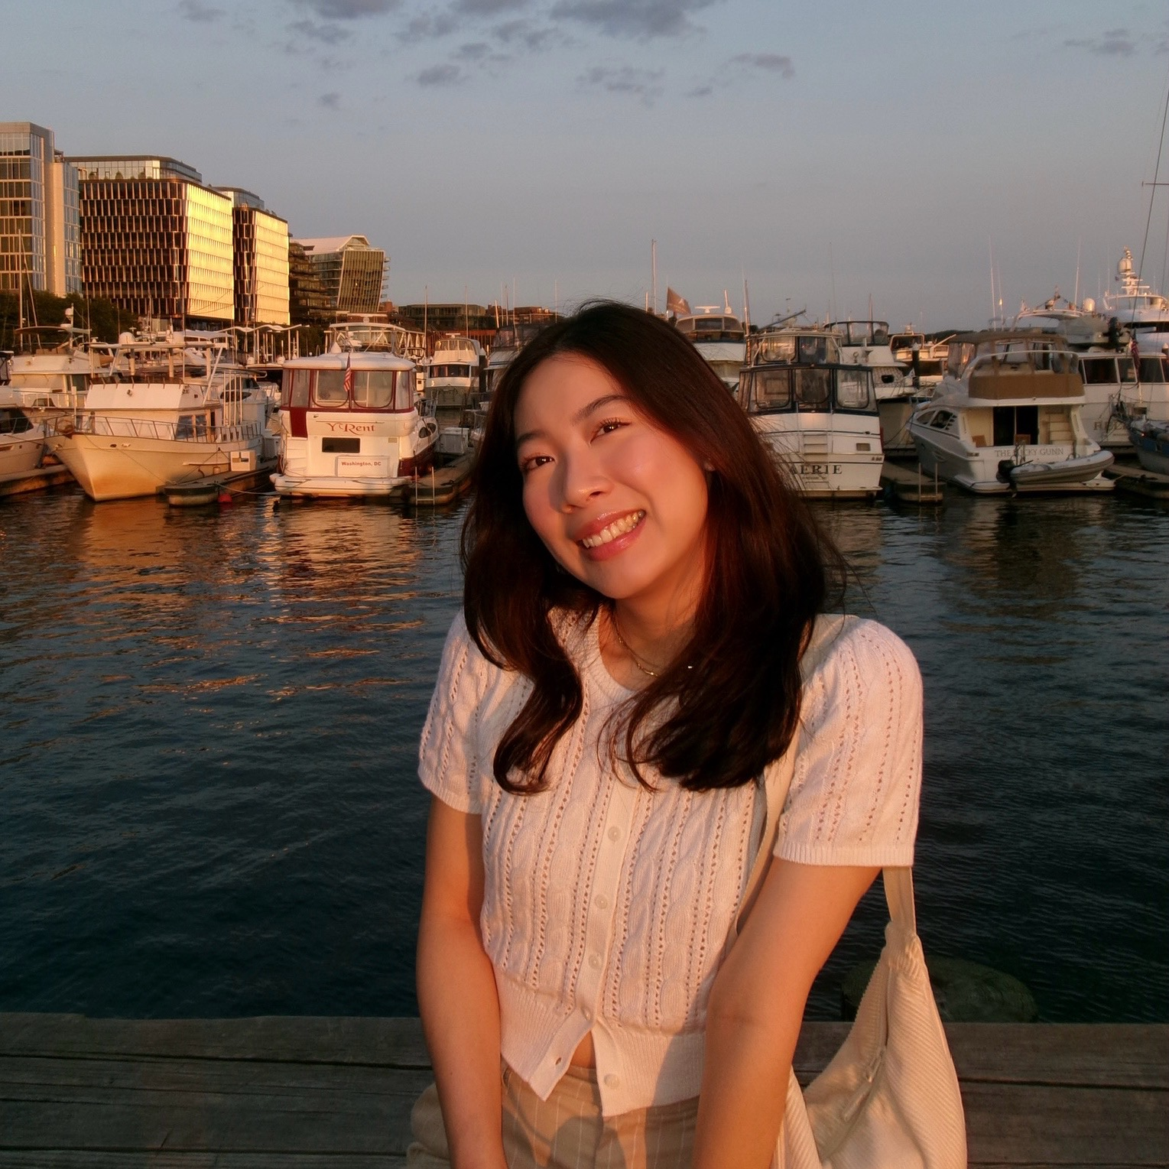
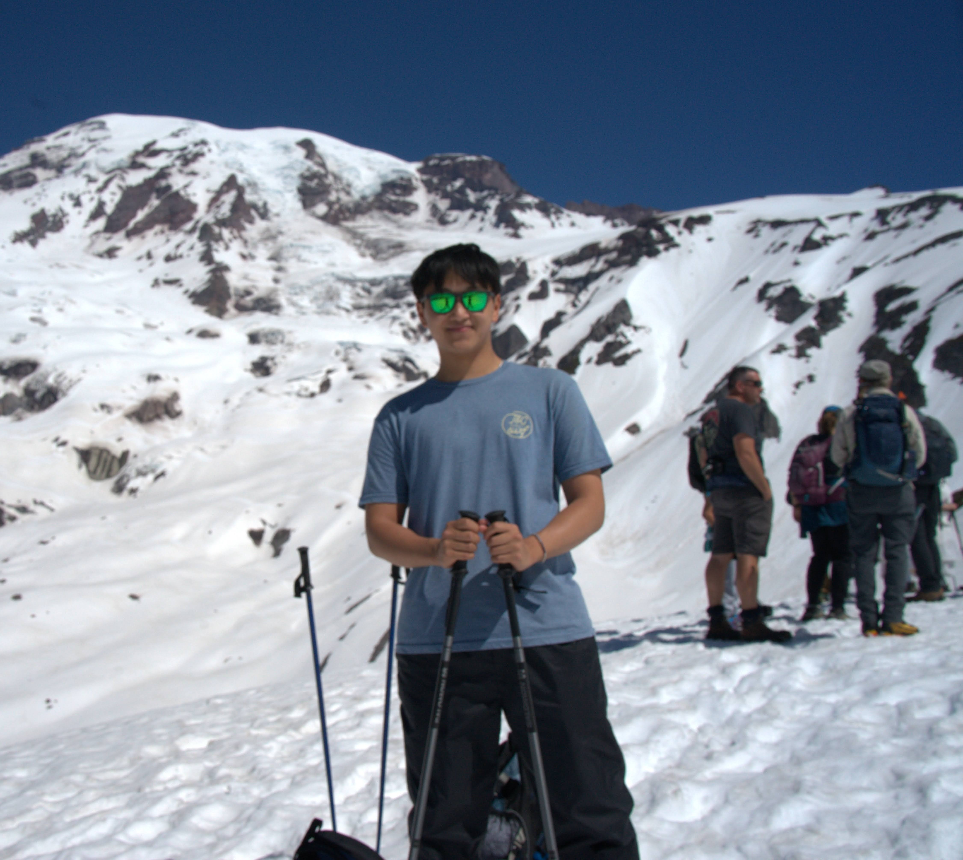
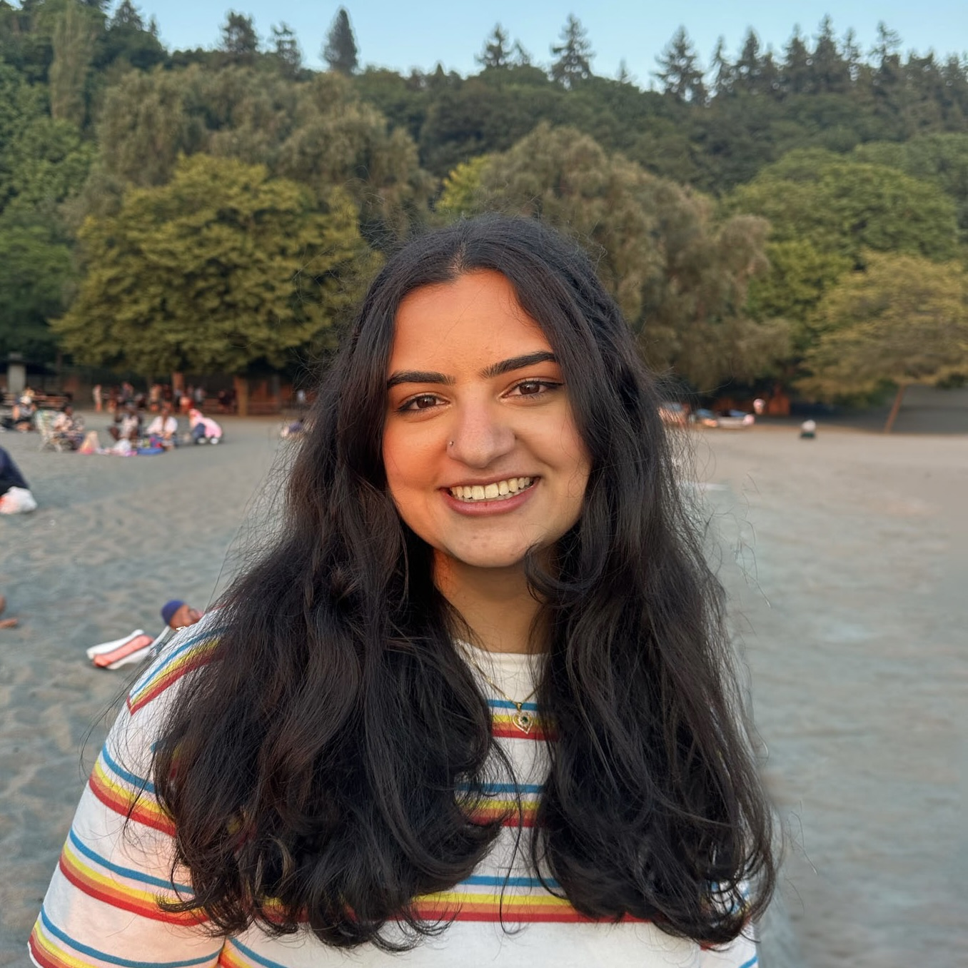
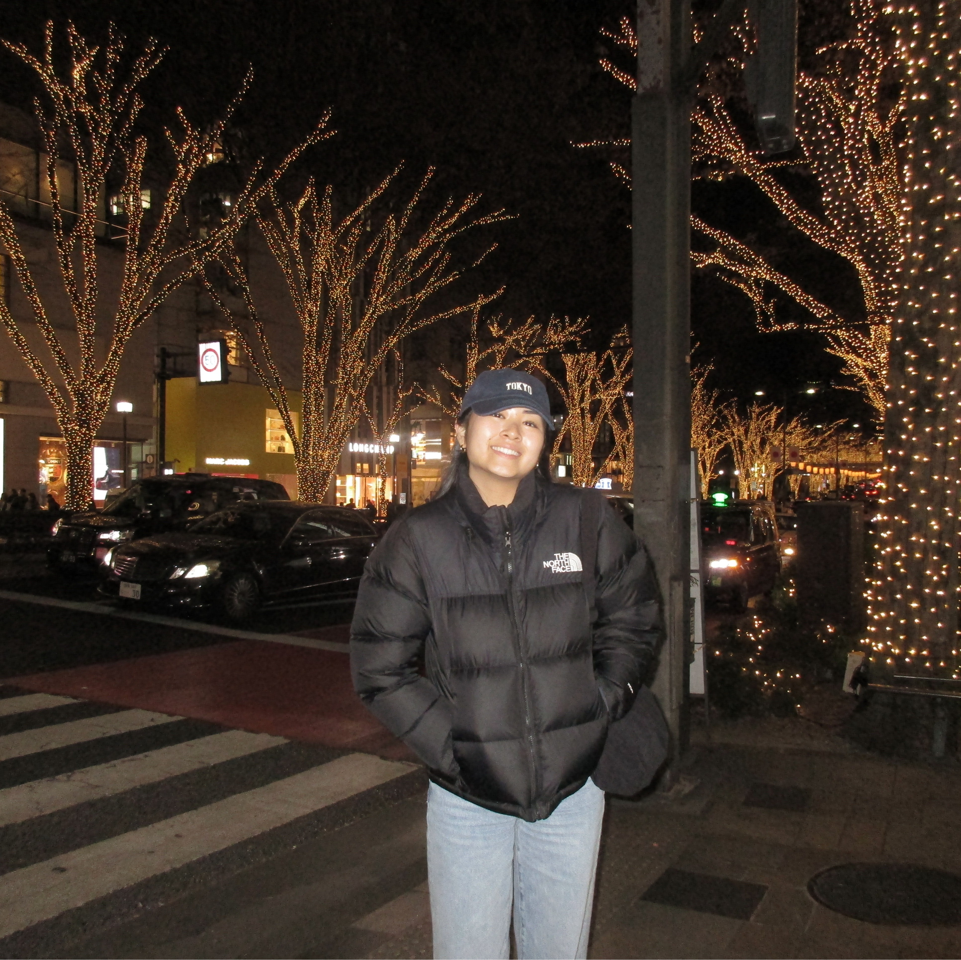
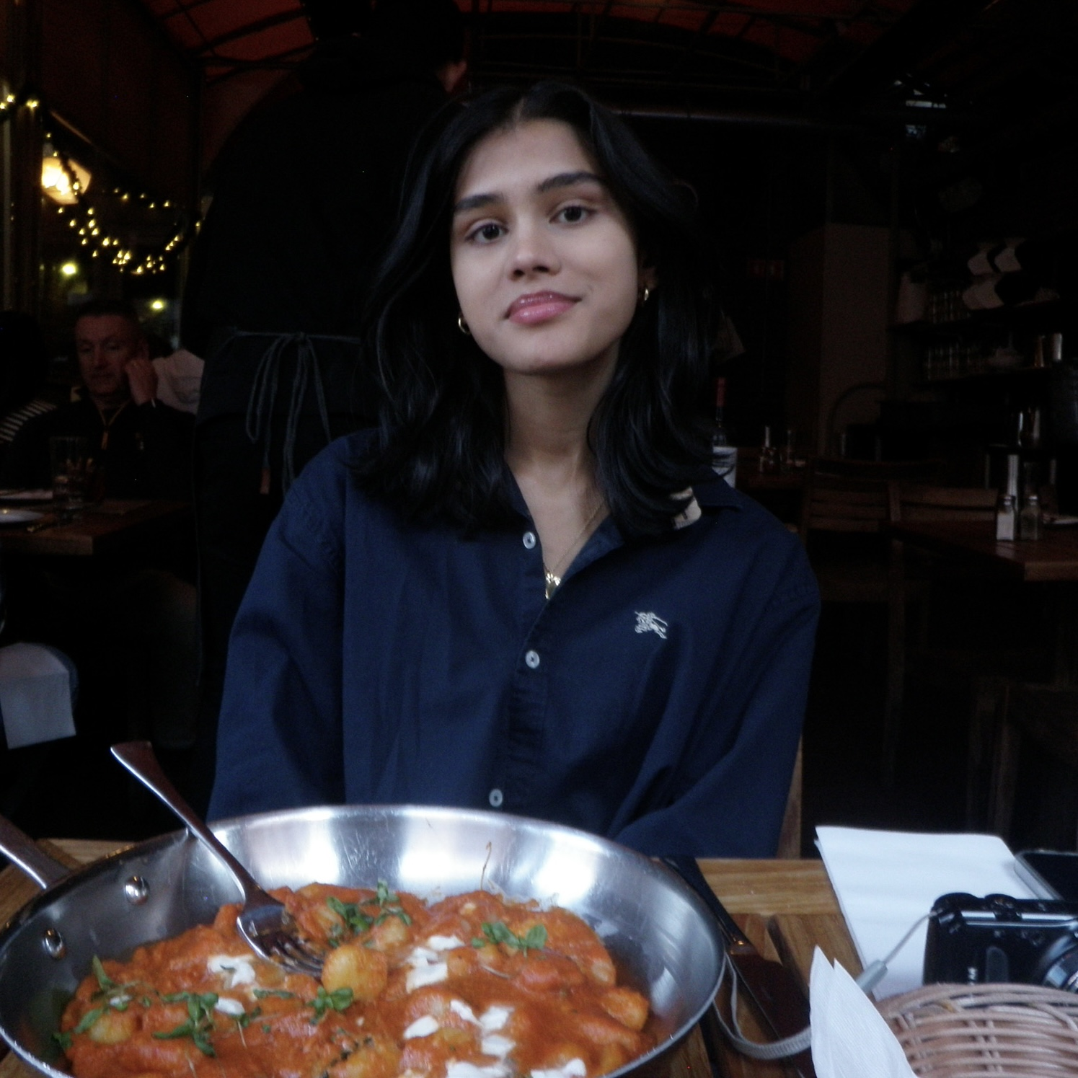
Thank your lovely TAs!

Slide 16
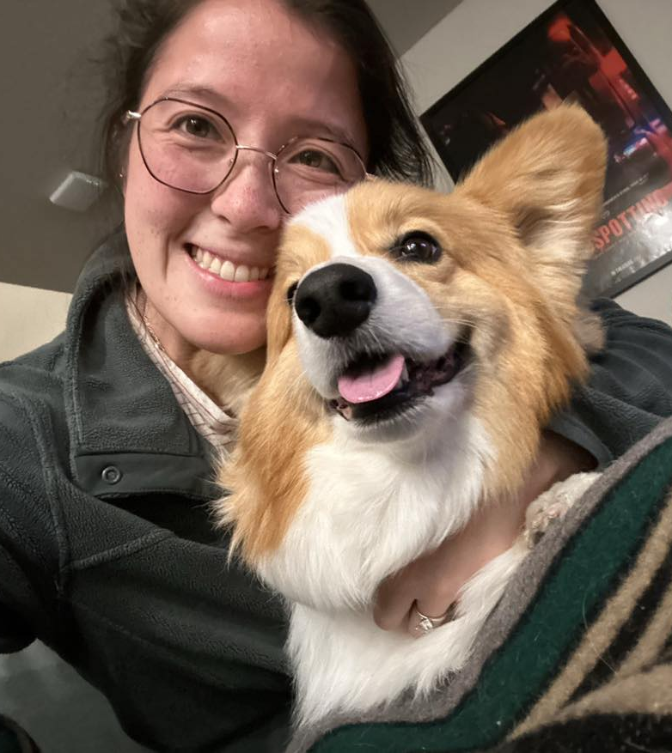
Thank you!
Ask Me (Almost) Anything!
sli.do #cse121
https://app.sli.do/event/eFdfh6UeGMUsiokyvNLYJo

