Slide 1
Putting It All Together (Again)!
BEFORE WE START
Talk to your neighbours:
Do you have a favourite park or outdoor space?
LEC 17
Music: 🌸CSE 121 25sp Lecture Tunes 🌸
Instructor:
Miya Natsuhara
TAs:
Chloë
Ailsa
Johnathan
Christian
Merav
Judy
Janvi
Hibbah
Julia Sahej
Ruslana
Hanna
Maitreyi
Ayesha
Sushma
Kelsey
Shayna
Hannah
Zach

Slide 2
Announcements, Reminders (general)
P3 due Tuesday, June 3rd at 11:59pm
note: you will get feedback after R7 & extra resub is due
R6 released, due Thursday, June 5th (eligible: C2, P2, C3)
reminder: all assignments eligible for resubmission on R7!
section 17 next Tuesday: TA’s Choice!! (more details on Monday)
Final Exam: Thursday, June 12th from 2:30 - 4:20
Gumball & friends visit on Monday, June 9 1:00pm – 2:30pm around Drumheller Fountain
Miya will be off campus Thursday-Friday next week
No Miya office hours on Friday, June 7
TA-led review session in class on Friday, June 7

Slide 3
The “Core” of the Final Exam
In-person, with assigned seating (more on that next week!)
Same general logistics as quizzes:
On paper
We will provide you with one reference sheet, and
You may bring one double-sided 8.5 x 11-inch page of notes
Will have 6 problems, all similar in style to the quizzes
Focus is on behavior (not code style); minor syntax errors allowed (when unambiguous)
A bit more time per-problem than the quiz!

Slide 4
121’s “Exam Review Systems”
Entire last week is focused on final exam review and prep
next Wed & Fri lecture: some strategies & live practice, on paper
next Thu quiz section: even more practice
Final exam review session will happen Tuesday, June 10 3:30pm – 6:20pm in JHN 075, will be recorded
IPL will not be open during finals week, so plan ahead!
Several async resources, including:
multiple previous actual finals
many existing programming problems (~ section, “Extra Review”)
more resources soon (stay tuned for an announcement!)

Slide 5
Some Miscellaneous Exam Thoughts
Be very careful about how you use the previous actual finals
Great study resource (and matched difficulty), but…
Hard to “unsee” solutions after looking & too easy to “overfit”
Use for targeted study, mimic the actual test-taking environment
Make your own cheatsheet, don’t use someone else’s!
Making the cheatsheet is studying
It is your responsibility to know the policies & procedures
Let’s take a quick spin of the website page right now :)

Slide 6
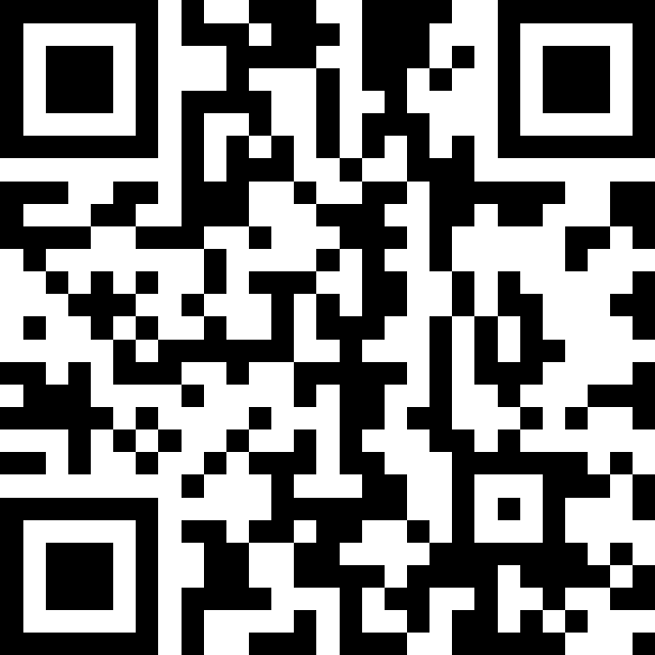
Pause: Exam Questions?
Will answer some live, and put the rest in the class megathread for today!
sli.do
#cse121

Slide 7
scratchwork

Slide 8
(PCM) Array of Counters
LEC 16: Array Patterns
0 1 2 2 0 2
public static int[] numCount(Scanner input, int numPrompts) {
int[] counts = ;
for (int i = 0; i < numPrompts; i++) {
int num = input.nextInt();
; }
return counts;
}

Slide 9
ed time :)
(for those looking at just the slides – the rest of this lecture was doing the in-class lesson!)

