Slide 1
2D Arrays
BEFORE WE START
Talk to your neighbors:
What’s left on your 2024-25 academic year bucket list?
LEC 15
Music: 🌸CSE 121 25sp Lecture Tunes 🌸
Instructor:
Miya Natsuhara
TAs:
Chloë
Ailsa
Johnathan
Christian
Merav
Judy
Janvi
Hibbah
Julia Sahej
Ruslana
Hanna
Maitreyi
Ayesha
Sushma
Kelsey
Shayna
Hannah
Zach

Slide 2
Announcements, Reminders
Monday, May 26 is a University Holiday
No Miya office hours
IPL will be closed
Response times on the message board may be a bit slower
C3 released, due Tuesday, May 27th
R5 due next Thursday, May 29th (eligible: P1, C2, P2)
P1 cycling out of eligibility after R5
Quiz 2 on Thursday, May 29th
can’t make it? email me before your quiz!
In the future: final exam on Tue, March 18th from 12:30-2:20 PM
Optionally in the future: Gumball & friends campus visit on Monday, June 9 1:00pm – 2:30pm around Drumheller Fountain

Slide 3
Reference Mystery: think
public static void main(String[] args) {
int x - 0;
int[] a = new int[4];
x++;
mystery(x, a);
System.out.println(x + " " + Arrays.toString(a));
x++;
mystery(x, a);
System.out.println(x + " " + Arrays.toString(a));
}
public static void mystery(int x, int[] a) {
x++;
a[x]++;
System.out.println(x + " " + Arrays.toString(a));
}
Four lines of output are produced by this code. What would those four lines be?

Slide 4
Reference Mystery: pair
public static void main(String[] args) {
int x - 0;
int[] a = new int[4];
x++;
mystery(x, a);
System.out.println(x + " " + Arrays.toString(a));
x++;
mystery(x, a);
System.out.println(x + " " + Arrays.toString(a));
}
public static void mystery(int x, int[] a) {
x++;
a[x]++;
System.out.println(x + " " + Arrays.toString(a));
}
Four lines of output are produced by this code. What would those four lines be?

Slide 5
PCM Review: 2D Arrays
An array of arrays!
The type of each individual element is another array!
Your first example of “nested data structures”
There will be more if you take CSE 122!
int[][]
double[][]
String[][]
boolean[][]
char[][]

Slide 6
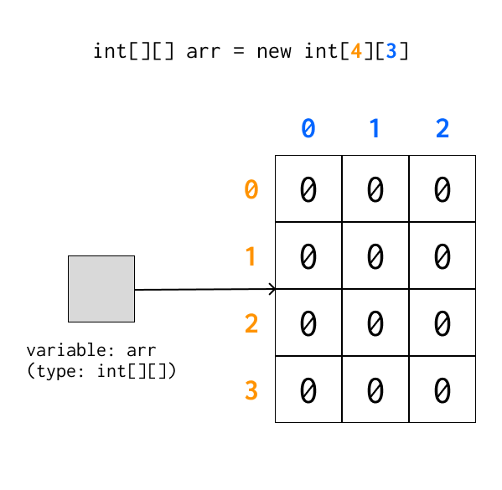
PCM Review: 2D Arrays as Rows and Columns
Can think of the two dimensions as “rows” and “columns”.
Individual elements are row-first, then column (“row-major”)
arr[2][1]

Slide 7
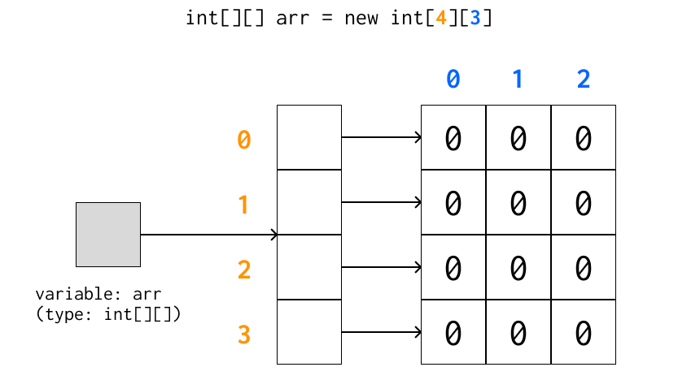
A more accurate view (reference semantics)

Slide 8
PCM Review: 2D Array Traversals
for each row…
for (int i = 0; i < list.length; i++) {
for (int j = 0; j < list[i].length; j++) {
// do something with list[i][j]
}
}
for each element within a row…

Slide 9
Arrays Utility Class (and methods)
Method | Description
Arrays.toString(array); | Returns a String representing the array, such as "[10, 30, -25, 17]"
Arrays.equals(array1, array2); | Returns true if the two arrays contain the same elements in the same order
Arrays.deepToString(array); | Returns a String representing the array; if the array contains other arrays as elements, the String represents their contents, and so on. For example, "[[99, 151], [30, 5]]"
Arrays.deepEquals(array1, array2); | Returns true if the two arrays contain the same elements in the same order; if the array(s) contain other arrays as elements, their contents are tested for equality, and so on.

Slide 10
Applications of 2D Arrays
Matrices
Useful in so many applications in math, engineering, and statistics
Fundamental to machine learning & AI
P3 is one real-life application of this! (bioinformatics)
Board games
e.g. chess, checkers, tic-tac-toe, sudoku
Tabular or grid-like data
e.g. scorekeeping, gradebook, census data
Image processing

Slide 11
matrixAdd
23 | 96 | 18 | 4 | 64
45 | 40 | 18 | 44 | 34
92 | 13 | 77 | 71 | 12
93 | 169 | 84 | 83 | 103
136 | 115 | 91 | 143 | 81
119 | 77 | 98 | 105 | 13
70 | 73 | 66 | 79 | 39
91 | 75 | 73 | 99 | 47
27 | 64 | 21 | 34 | 1

Slide 12
matrixAdd: first row
23 | 96 | 18 | 4 | 64
45 | 40 | 18 | 44 | 34
92 | 13 | 77 | 71 | 12
i: 0
j: 0
93 | 169 | 84 | 83 | 103
136 | 115 | 91 | 143 | 81
119 | 77 | 98 | 105 | 13
70 | 73 | 66 | 79 | 39
91 | 75 | 73 | 99 | 47
27 | 64 | 21 | 34 | 1

Slide 13
matrixAdd: 0,0
23 | 96 | 18 | 4 | 64
45 | 40 | 18 | 44 | 34
92 | 13 | 77 | 71 | 12
i: 0
j: 0
93
70 | 73 | 66 | 79 | 39
91 | 75 | 73 | 99 | 47
27 | 64 | 21 | 34 | 1

Slide 14
matrixAdd: 0,1
23 | 96 | 18 | 4 | 64
45 | 40 | 18 | 44 | 34
92 | 13 | 77 | 71 | 12
i: 0
j: 1
93 | 169
70 | 73 | 66 | 79 | 39
91 | 75 | 73 | 99 | 47
27 | 64 | 21 | 34 | 1

Slide 15
matrixAdd: 0,2
23 | 96 | 18 | 4 | 64
45 | 40 | 18 | 44 | 34
92 | 13 | 77 | 71 | 12
i: 0
j: 2
93 | 169 | 84
70 | 73 | 66 | 79 | 39
91 | 75 | 73 | 99 | 47
27 | 64 | 21 | 34 | 1

Slide 16
matrixAdd: 0,3
23 | 96 | 18 | 4 | 64
45 | 40 | 18 | 44 | 34
92 | 13 | 77 | 71 | 12
i: 0
j: 3
93 | 169 | 84 | 83
70 | 73 | 66 | 79 | 39
91 | 75 | 73 | 99 | 47
27 | 64 | 21 | 34 | 1

Slide 17
matrixAdd: 0,4
23 | 96 | 18 | 4 | 64
45 | 40 | 18 | 44 | 34
92 | 13 | 77 | 71 | 12
i: 0
j: 4
93 | 169 | 84 | 83 | 103
70 | 73 | 66 | 79 | 39
91 | 75 | 73 | 99 | 47
27 | 64 | 21 | 34 | 1

Slide 18
matrixAdd: 1,0
23 | 96 | 18 | 4 | 64
45 | 40 | 18 | 44 | 34
92 | 13 | 77 | 71 | 12
i: 1
j: 0
93 | 169 | 84 | 83 | 103
136
70 | 73 | 66 | 79 | 39
91 | 75 | 73 | 99 | 47
27 | 64 | 21 | 34 | 1

Slide 19
matrixAdd: 1,1
23 | 96 | 18 | 4 | 64
45 | 40 | 18 | 44 | 34
92 | 13 | 77 | 71 | 12
i: 1
j: 1
93 | 169 | 84 | 83 | 103
136 | 115
70 | 73 | 66 | 79 | 39
91 | 75 | 73 | 99 | 47
27 | 64 | 21 | 34 | 1

Slide 20
matrixAdd: 1,2
23 | 96 | 18 | 4 | 64
45 | 40 | 18 | 44 | 34
92 | 13 | 77 | 71 | 12
i: 1
j: 2
93 | 169 | 84 | 83 | 103
136 | 115 | 91
70 | 73 | 66 | 79 | 39
91 | 75 | 73 | 99 | 47
27 | 64 | 21 | 34 | 1

Slide 21
matrixAdd: 1,3
23 | 96 | 18 | 4 | 64
45 | 40 | 18 | 44 | 34
92 | 13 | 77 | 71 | 12
i: 1
j: 3
93 | 169 | 84 | 83 | 103
136 | 115 | 91 | 143
70 | 73 | 66 | 79 | 39
91 | 75 | 73 | 99 | 47
27 | 64 | 21 | 34 | 1

Slide 22
matrixAdd: 1,4
23 | 96 | 18 | 4 | 64
45 | 40 | 18 | 44 | 34
92 | 13 | 77 | 71 | 12
i: 1
j: 4
93 | 169 | 84 | 83 | 103
136 | 115 | 91 | 143 | 81
70 | 73 | 66 | 79 | 39
91 | 75 | 73 | 99 | 47
27 | 64 | 21 | 34 | 1

Slide 23
matrixAdd: 2,0
23 | 96 | 18 | 4 | 64
45 | 40 | 18 | 44 | 34
92 | 13 | 77 | 71 | 12
i: 2
j: 0
93 | 169 | 84 | 83 | 103
136 | 115 | 91 | 143 | 81
119
70 | 73 | 66 | 79 | 39
91 | 75 | 73 | 99 | 47
27 | 64 | 21 | 34 | 1

Slide 24
matrixAdd: 2,1
23 | 96 | 18 | 4 | 64
45 | 40 | 18 | 44 | 34
92 | 13 | 77 | 71 | 12
i: 2
j: 1
93 | 169 | 84 | 83 | 103
136 | 115 | 91 | 143 | 81
119 | 77
70 | 73 | 66 | 79 | 39
91 | 75 | 73 | 99 | 47
27 | 64 | 21 | 34 | 1

Slide 25
matrixAdd: 2,2
23 | 96 | 18 | 4 | 64
45 | 40 | 18 | 44 | 34
92 | 13 | 77 | 71 | 12
i: 2
j: 2
93 | 169 | 84 | 83 | 103
136 | 115 | 91 | 143 | 81
119 | 77 | 98
70 | 73 | 66 | 79 | 39
91 | 75 | 73 | 99 | 47
27 | 64 | 21 | 34 | 1

Slide 26
matrixAdd: 2,3
23 | 96 | 18 | 4 | 64
45 | 40 | 18 | 44 | 34
92 | 13 | 77 | 71 | 12
i: 2
j: 3
93 | 169 | 84 | 83 | 103
136 | 115 | 91 | 143 | 81
119 | 77 | 98 | 105
70 | 73 | 66 | 79 | 39
91 | 75 | 73 | 99 | 47
27 | 64 | 21 | 34 | 1

Slide 27
matrixAdd: 2,4
23 | 96 | 18 | 4 | 64
45 | 40 | 18 | 44 | 34
92 | 13 | 77 | 71 | 12
i: 2
j: 4
93 | 169 | 84 | 83 | 103
136 | 115 | 91 | 143 | 81
119 | 77 | 98 | 105 | 13
70 | 73 | 66 | 79 | 39
91 | 75 | 73 | 99 | 47
27 | 64 | 21 | 34 | 1

Slide 28
matrixAdd: finished!
23 | 96 | 18 | 4 | 64
45 | 40 | 18 | 44 | 34
92 | 13 | 77 | 71 | 12
93 | 169 | 84 | 83 | 103
136 | 115 | 91 | 143 | 81
119 | 77 | 98 | 105 | 13
70 | 73 | 66 | 79 | 39
91 | 75 | 73 | 99 | 47
27 | 64 | 21 | 34 | 1

Slide 29
readData: processing input
How many days' data would you like to input? 3
Next day's data:
Temperature in Seattle? 44
Temperature in Tacoma? 40
Temperature in Bothell? 43
Next day's data:
Temperature in Seattle? 42
Temperature in Tacoma? 40
Temperature in Bothell? 44
Next day's data:
Temperature in Seattle? 42
Temperature in Tacoma? 41
Temperature in Bothell? 43
...

Slide 30
readData: days
How many days' data would you like to input? 3
Next day's data:
Temperature in Seattle?
Temperature in Tacoma?
Temperature in Bothell?
Next day's data:
Temperature in Seattle?
Temperature in Tacoma?
Temperature in Bothell?
Next day's data:
Temperature in Seattle?
Temperature in Tacoma?
Temperature in Bothell?
...
 | Seattle | Tacoma | Bothell
1
2
3

Slide 31
readData: 1, Seattle
How many days' data would you like to input? 3
Next day's data:
Temperature in Seattle? 44
Temperature in Tacoma?
Temperature in Bothell?
Next day's data:
Temperature in Seattle?
Temperature in Tacoma?
Temperature in Bothell?
Next day's data:
Temperature in Seattle?
Temperature in Tacoma?
Temperature in Bothell?
...
 | Seattle | Tacoma | Bothell
1 | 44
2
3

Slide 32
readData: 1, Tacoma
How many days' data would you like to input? 3
Next day's data:
Temperature in Seattle? 44
Temperature in Tacoma? 40
Temperature in Bothell?
Next day's data:
Temperature in Seattle?
Temperature in Tacoma?
Temperature in Bothell?
Next day's data:
Temperature in Seattle?
Temperature in Tacoma?
Temperature in Bothell?
...
 | Seattle | Tacoma | Bothell
1 | 44 | 40
2
3

Slide 33
readData: 1, Bothell
How many days' data would you like to input? 3
Next day's data:
Temperature in Seattle? 44
Temperature in Tacoma? 40
Temperature in Bothell? 43
Next day's data:
Temperature in Seattle?
Temperature in Tacoma?
Temperature in Bothell?
Next day's data:
Temperature in Seattle?
Temperature in Tacoma?
Temperature in Bothell?
...
 | Seattle | Tacoma | Bothell
1 | 44 | 40 | 43
2
3

Slide 34
readData: 2, Seattle
How many days' data would you like to input? 3
Next day's data:
Temperature in Seattle? 44
Temperature in Tacoma? 40
Temperature in Bothell? 43
Next day's data:
Temperature in Seattle? 42
Temperature in Tacoma?
Temperature in Bothell?
Next day's data:
Temperature in Seattle?
Temperature in Tacoma?
Temperature in Bothell?
...
 | Seattle | Tacoma | Bothell
1 | 44 | 40 | 43
2 | 42
3

Slide 35
readData: 2, Tacoma
How many days' data would you like to input? 3
Next day's data:
Temperature in Seattle? 44
Temperature in Tacoma? 40
Temperature in Bothell? 43
Next day's data:
Temperature in Seattle? 42
Temperature in Tacoma? 40
Temperature in Bothell?
Next day's data:
Temperature in Seattle?
Temperature in Tacoma?
Temperature in Bothell?
...
 | Seattle | Tacoma | Bothell
1 | 44 | 40 | 43
2 | 42 | 40
3

Slide 36
readData: 2, Bothell
How many days' data would you like to input? 3
Next day's data:
Temperature in Seattle? 44
Temperature in Tacoma? 40
Temperature in Bothell? 43
Next day's data:
Temperature in Seattle? 42
Temperature in Tacoma? 40
Temperature in Bothell? 44
Next day's data:
Temperature in Seattle?
Temperature in Tacoma?
Temperature in Bothell?
...
 | Seattle | Tacoma | Bothell
1 | 44 | 40 | 43
2 | 42 | 40 | 44
3

Slide 37
readData: 2, Seattle
How many days' data would you like to input? 3
Next day's data:
Temperature in Seattle? 44
Temperature in Tacoma? 40
Temperature in Bothell? 43
Next day's data:
Temperature in Seattle? 42
Temperature in Tacoma? 40
Temperature in Bothell? 44
Next day's data:
Temperature in Seattle? 42
Temperature in Tacoma?
Temperature in Bothell?
...
 | Seattle | Tacoma | Bothell
1 | 44 | 40 | 43
2 | 42 | 40 | 44
3 | 42

Slide 38
readData: 2, Tacoma
How many days' data would you like to input? 3
Next day's data:
Temperature in Seattle? 44
Temperature in Tacoma? 40
Temperature in Bothell? 43
Next day's data:
Temperature in Seattle? 42
Temperature in Tacoma? 40
Temperature in Bothell? 44
Next day's data:
Temperature in Seattle? 42
Temperature in Tacoma? 41
Temperature in Bothell?
...
 | Seattle | Tacoma | Bothell
1 | 44 | 40 | 43
2 | 42 | 40 | 44
3 | 42 | 41

Slide 39
readData: 2, Bothell
How many days' data would you like to input? 3
Next day's data:
Temperature in Seattle? 44
Temperature in Tacoma? 40
Temperature in Bothell? 43
Next day's data:
Temperature in Seattle? 42
Temperature in Tacoma? 40
Temperature in Bothell? 44
Next day's data:
Temperature in Seattle? 42
Temperature in Tacoma? 41
Temperature in Bothell? 43
...
 | Seattle | Tacoma | Bothell
1 | 44 | 40 | 43
2 | 42 | 40 | 44
3 | 42 | 41 | 43

Slide 40
computeAverages
How many days' data would you like to input? 3
…
The average values for each location were [42.666666666666664, 40.333333333333336, 43.333333333333336]
 | Seattle | Tacoma | Bothell
1 | 44 | 40 | 43
2 | 42 | 40 | 44
3 | 42 | 41 | 43
42.667 | 40.333 | 43.333
Average of Seattle temperatures
(44 + 42 + 42) / 3

