Slide 1
Putting It All Together
BEFORE WE START
Talk to your neighbors:
What’s your current favorite TV show?
LEC 12
Music: 🌸CSE 121 25sp Lecture Tunes 🌸
Instructor:
Miya Natsuhara
TAs:
Chloë
Ailsa
Johnathan
Christian
Merav
Judy
Janvi
Hibbah
Julia Sahej
Ruslana
Hanna
Maitreyi
Ayesha
Sushma
Kelsey
Shayna
Hannah
Zach

Slide 2
Announcements, Reminders
Quiz 1 is tomorrow!
Quiz 1 reference sheet linked from Quiz 1 Practice Quizzes :) post
Email Miya before your quiz section if you're not able to attend!
Do not come to section if you're sick! 😷
Quiz 0 grades were released last week
If you want your physical Quiz 0 and notesheet, come by my office hours or stop by after class today!
P2 is out & due next Tuesday, May 20th
R3 due tomorrow
P0, C1, P1, C2 eligible
P0 cycling out of eligibility after R3!

Slide 3
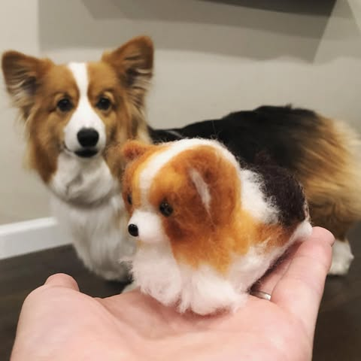
Feedback & Closing the Loop: The Good
Pre-class materials & walkthrough videos
Quiz sections and your TAs! (esp. walking through code)
Project-based assignments
Including feedback!
Lectures and interactive activities!

Slide 4
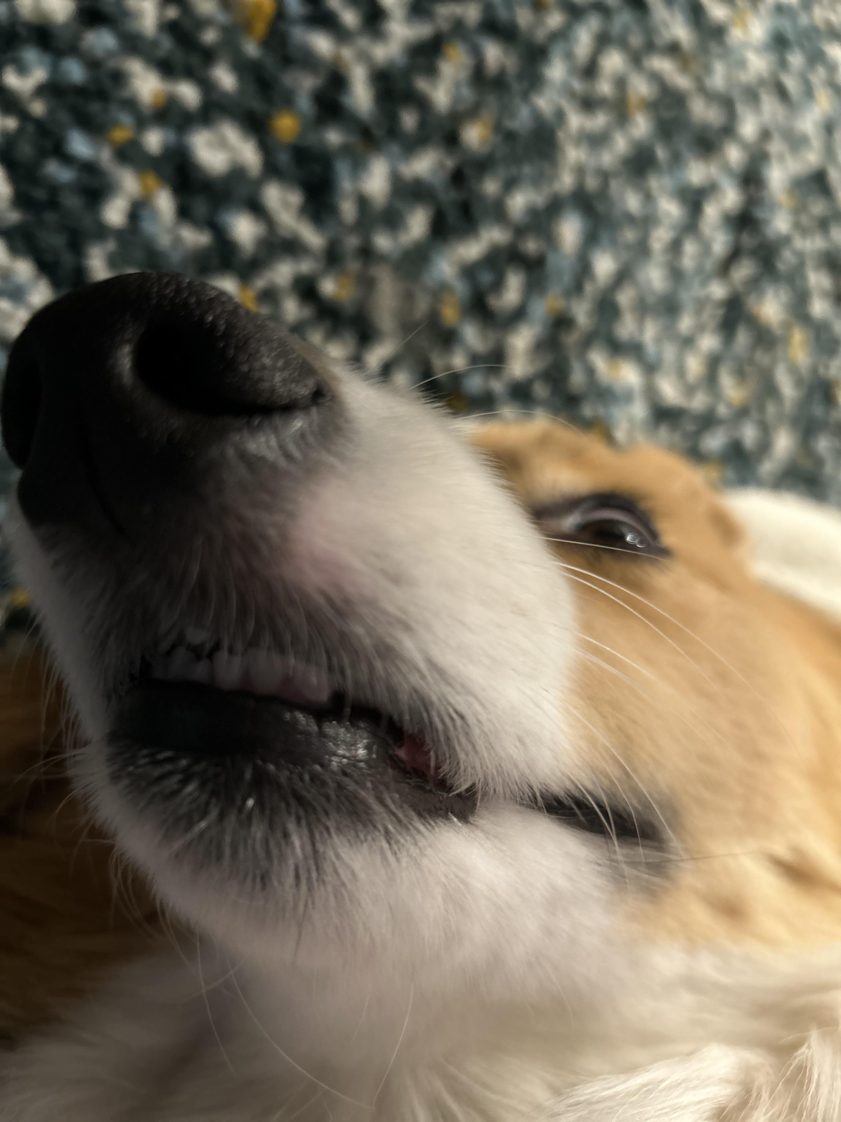
Feedback & Closing the Loop: Suggestions
Suggestions that we’re already working on:
Time management & pace in lecture
More motivated examples in class
Other suggestions…
Canvas instead of course website
Both more and less time on in-class activities?

Slide 5
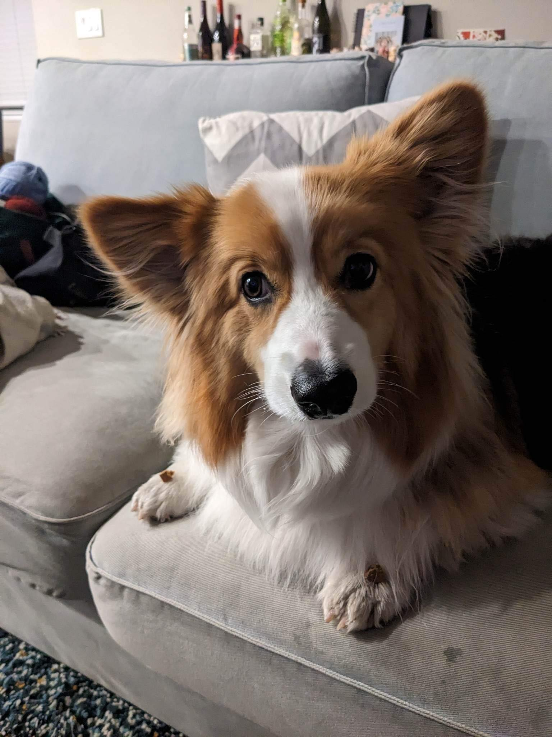
Feedback & Closing the Loop: Transfer
Transfer: how can you use your knowledge on new tasks (not ones that you've seen before)
There's a balance here – we want you to be able to to transfer knowledge to new problems, but we also want alignment between lessons, practice, and assessment.

Slide 6
Think Pair Share: cornbear (think)
When calling the following method, which of these user inputs would not cause an error? (choose multiple)
public static void cornbear() {
Scanner console = new Scanner(System.in);
int amt = console.nextInt();
String firstName = console.next();
String secondName = console.next();
double price = console.nextDouble();
}
6 Gumball’s Treats $12.48
3 Sesame Latte 16.47
2 The Hunger Games 21.98
4 Gumballs 900.24
2 Grammy Awards 90095

Slide 7
Think Pair Share: cornbear (pair)
When calling the following method, which of these user inputs would not cause an error? (choose multiple)
public static void cornbear() {
Scanner console = new Scanner(System.in);
int amt = console.nextInt();
String firstName = console.next();
String secondName = console.next();
double price = console.nextDouble();
}
6 Gumball’s Treats $12.48
3 Sesame Latte 16.47
2 The Hunger Games 21.98
4 Gumballs 900.24
2 Grammy Awards 90095

Slide 8
Think Pair Share: wrapped (think)
Take a look at the “Spotify Wrapped” spec section on “determining the final message”. Which conditional structure would you use?
if, if, if
if, else
if, else-if
if, else-if, else

Slide 9
Think Pair Share: wrapped (pair)
Take a look at the “Spotify Wrapped” spec section on “determining the final message”. Which conditional structure would you use?
if, if, if
if, else
if, else-if
if, else-if, else
something else!

Slide 10
Reminder (again): Fencepost Pattern
Some task where one piece is repeated n times, and another piece is repeated n-1 times and they alternate
h-u-s-k-i-e-s

Slide 11
Fencepost Pattern … for User Input?
Some task where one piece is repeated n times, and another piece is repeated n-1 times and they alternate
enter an artist
how many listens?
enter an artist
how many listens?
enter an artist
...

