Slide 1
While Loops
BEFORE WE START
Talk to your neighbors:
What’s your favorite spot on the ave?
LEC 10
Music: 🌸CSE 121 25sp Lecture Tunes 🌸
Instructor:
Miya Natsuhara
TAs:
Chloë
Ailsa
Johnathan
Christian
Merav
Judy
Janvi
Hibbah
Julia Sahej
Ruslana
Hanna
Maitreyi
Ayesha
Sushma
Kelsey
Shayna
Hannah
Zach

Slide 2
Agenda
Announcements, Reminders
While loop review
Revisiting dice rolls
Flipping coins!

Slide 3
Announcements, Reminders
C2 due Thursday, May 8th
R2 due Thursday, May 8th
Eligible: C0, P0, C1
Note: C0 is cycling out of eligibility for resubmission
Quiz reminders:
Quiz 0 feedback coming later today!
Quiz 1: Thursday, May 15th
sick? do not come to your quiz. instead, email me, before the start of your quiz section.

Slide 4
Agenda
Announcements, Reminders
While loop review
Revisiting dice rolls
Flipping coins!

Slide 5
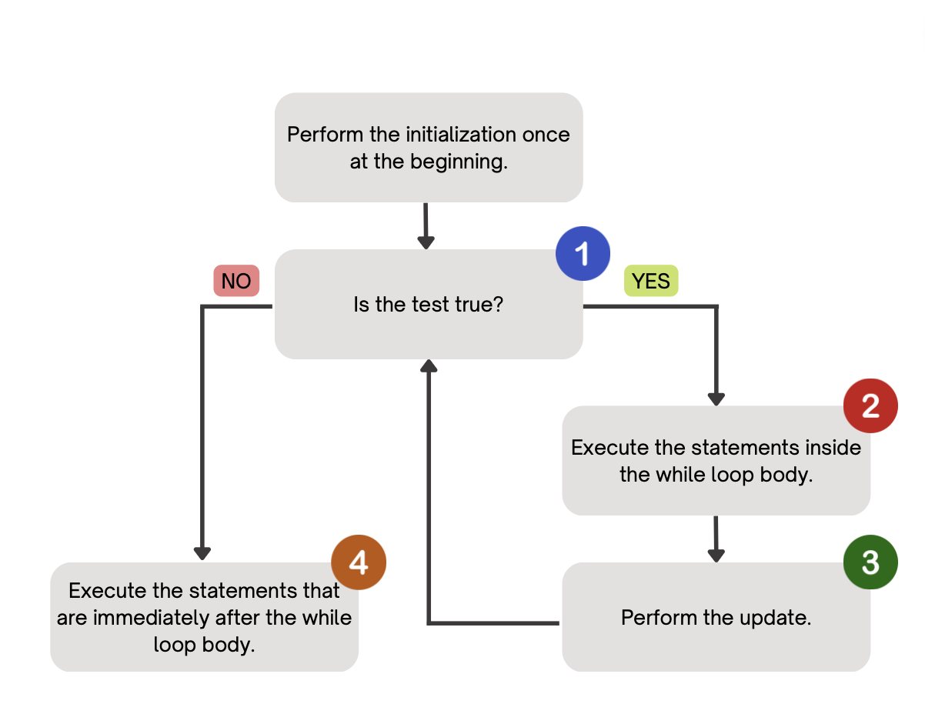
PCM Review: while loops
Repeatedly executes its body as long as the logical test is true.

Slide 6
for loops are while loops?
for (int i = 0; i < bigYikes; i++) {
// ...
}
int i = 0;
while (i < bigYikes) {
// ...
i++;
}

Slide 7
for loops are while loops! (almost*)
for (int i = 0; i < bigYikes; i++) {
// ...
}
int i = 0;
while (i < bigYikes) {
// ...
i++;
}
*as a technical note, these aren’t exactly the same – there are some minor technical details that are different, most notably the scope of i is different in the two loops

Slide 8
Agenda
Announcements, Reminders
While loop review
Revisiting dice rolls
Flipping coins!

Slide 9
for loops vs. while loops ⚔️
For loops and while loops are quite similar! This is the first (but certainly not the last) time where you need to decide which to use!
There’s not always a “correct” answer, but some advice:
is the condition definite or indefinite
Describing the problem!
“I will do __ X times” or “for each __ I will __” – sounds like for!
“I will do __ until” or “while __ is true, I will” – sounds like while!
it’s okay to change your mind after you try one approach!

Slide 10
Common Problem-Solving Strategies
Analogy – Is this similar to another problem you've seen?
Brainstorming – Consider steps to solve problem before jumping into code
Try to do an example "by hand" → outline steps
Solve sub-problems – Is there a smaller part of the problem to solve?
Debugging – Does your solution behave correctly?
What is it doing?
What do you expect it to do?
What area of your code controls that part of the output?
Iterative Development – Can we start by solving a different problem that is easier?

Slide 11
Think Pair Share: mystery (think)
public static void mystery(Random randy, int lucky) {
int roll = -1; // "priming" the loop
int x = -1;
while (roll != lucky) {
roll = randy.nextInt(20) + 1;
if (x < roll) {
x = roll;
}
}
System.out.println("Lucky number " + roll);
}
How would you describe what the variable x calculates?
The largest value rolled
The smallest value rolled
The last value rolled
The first value rolled
The sum of all values rolled

Slide 12
Think Pair Share: mystery (pair)
public static void mystery(Random randy, int lucky) {
int roll = -1; // "priming" the loop
int x = -1;
while (roll != lucky) {
roll = randy.nextInt(20) + 1;
if (x < roll) {
x = roll;
}
}
System.out.println("Lucky number " + roll);
}
How would you describe what the variable x calculates?
The largest value rolled
The smallest value rolled
The last value rolled
The first value rolled
The sum of all values rolled

