Slide 1
Printing, Strings, and Variables
BEFORE WE START
Talk to your neighbors:
What’s your favourite YouTube or Twitch channel to watch?
LEC 01
Music: 🌸CSE 121 25sp Lecture Tunes 🌸
Instructor:
Miya Natsuhara
TAs:
Chloë
Ailsa
Johnathan
Christian
Merav
Judy
Janvi
Hibbah
Julia Sahej
Ruslana
Hanna
Maitreyi
Ayesha
Sushma
Kelsey
Shayna
Hannah
Zach

Slide 2
Agenda
Announcements, Reminders
Finish up syllabus overview:
Assessments, Grading, Academic Honesty & Collaboration
HelloWorld Review
Printing, Strings, Variables Review
Code Example
C0 Overview

Slide 3
Announcements, Reminders
Check out website for links to all activities & materials
Creative Project 0 will be out tonight, due Wednesday, April 9th
Please do the intro survey by Sunday, Jan 12th
gives us valuable insight!
part of “post-section work” (will explain in a moment!)
important that Google Forms works in CSE 121
New Ed tool: Sandbox (write all the code you want!)

Slide 4
Aside: office hours as a resource!
The IPL (TA office hours) will open on Monday (April 7) at 12:30 PM.
one of the best parts of the course!
but, TAs are instructed to not just give you the answer!
why not? you wouldn’t be learning!
e.g. “my code doesn’t work” versus “I tried X, expected Y, but got Z. Thoughts on what to try next?”
also true for Miya's office hours too ;)
Expect an announcement on Ed with a detailed schedule soon!

Slide 5
Agenda
Announcements, Reminders
Finish up syllabus overview:
Assessments, Grading, Academic Honesty & Collaboration
HelloWorld Review
Printing, Strings, Variables Review
Code Example
C0 Overview

Slide 6
Assessment
Why assessment?
Our goal: you gain proficiency of the concepts and skills we teach
We assess your proficiency by asking you to apply these concepts and skills on tasks
By necessity, we are assessing your work as a proxy for proficiency

Slide 7
Resubmissions
Learning takes time and doesn’t always happen on the first try!
Each week, one previous assignment or project can be resubmitted
Must be accompanied by reflection explaining your change(s)
Grade on resubmission replaces original grade
Assignments eligible for only 3 “cycles” after feedback released
We’ll discuss more after our first assignment is graded. See syllabus!

Slide 8
Post-Section Work (PSW)
A “nudge” system: on section days with no quiz, you’ll have a light homework problem and/or set of reflection questions due at midnight that same day.
graded on effort (and intentionally short)
in quiz section, will do the problem & leave time to reflect
your reflections are very helpful to your TAs!
If you complete 12 of the 16 post-section works, you’ll get an extra resub!
no direct grade impact, think of it as optional/extra credit
first PSW is the intro survey (as a special exception for this first PSW, it's due on Sunday April 6th)

Slide 9
Grading Scheme
Grades should reflect proficiency in course objectives.
All assignments, quizzes, and exams are graded with an “E/S/N” grade:
E (Excellent)
S (Satisfactory)
N (Not Yet)

Slide 10
Grading Assessments
E/S/N (or ESN) grades per assessment type:
Programming Assignments: 4 ESN grades (4 assignments, 16 total)
Creative Projects: 1 ESN grade (4 projects, 4 total)
Quizzes: 3 ESN grades (3 quizzes, 9 total)
Final Exam: 6 ESN grades
We will also ignore your lowest 2 quiz/final exam grades.

Slide 11
Course Grades
We provide a “minimum grade guarantee” for translating to a numeric grade, but not a direct formula.
Much more on this in the syllabus! (and over the next few weeks)
Minimum Grade | Requirements
Total ESN available | 33
3.5 | 27 Es and 3 additional S+
3.0 | 22 Es and 5 additional S+
2.5 | 17 Es and 7 additional S+
2.0 | 21 S+
1.5 | 14 S+
0.7 | 8 S+

Slide 12
Collaboration Policy
When we assess your work in this class, we need to know that it’s yours. Unless specified otherwise, all graded work must be completed individually.
Some rules to highlight:
do not share your own solution code or view solution code from any source – including (but not limited to) other students, tutors, or the internet
do not use AI tools (e.g. ChatGPT) on graded work in any capacity
See syllabus for more details (this is very important to understand).

Slide 13
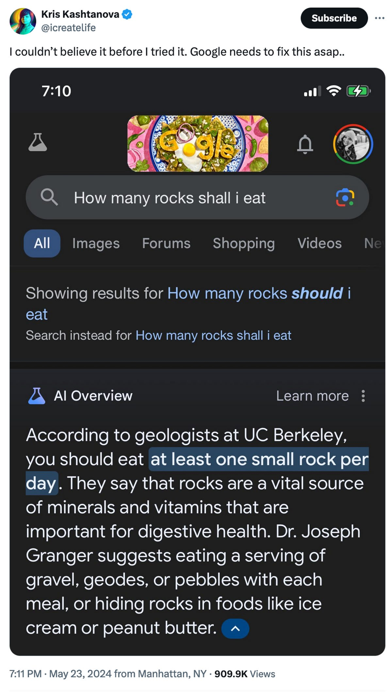
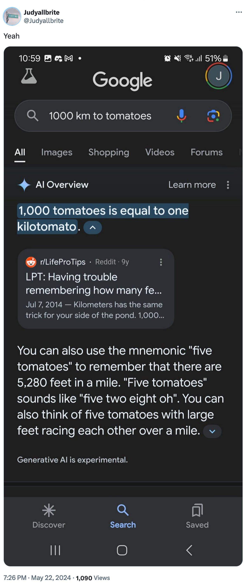
AI gone wrong?
Courtesy “Glue in Pizza? Eat Rocks? Google’s AI Search Is Mocked for Bizarre Answers” by Ian Sherr for CNET. May 24, 2024

Slide 14
Just a bit more on AI…
With generative AI tools, there’s a few things going on:
making sure that your assessed work is yours
just the same as other interactive resources
making sure that you’re learning correct information
hard for you to judge if you’re a beginner!
potential environmental & ethical concerns
outside of scope of 121, but important!
Happy to talk more about this if you’d like! (e.g. in office hours)

Slide 15
Agenda
Announcements, Reminders
Finish up syllabus overview:
Assessments, Grading, Academic Honesty & Collaboration
HelloWorld Review
Printing, Strings, Variables Review
Code Example
C0 Overview

Slide 16
Code Quality
"Programs are meant to be read by humans and only incidentally for computers to execute." –Abelson & Sussman, SICP
Code is about communication. Writing code with good code quality is important to communicate effectively.
Different organizations have different standards for code quality.
Doesn't mean that any one standard is wrong! (e.g., APA, MLA, Chicago, IEEE, …)
Consistency is very helpful within a project
See our Code Quality Guide for the standards we will all use in CSE 122

Slide 17
Agenda
Announcements, Reminders
Finish up syllabus overview:
Assessments, Grading, Academic Honesty & Collaboration
HelloWorld Review
Printing, Strings, Variables Review
Code Example
C0 Overview

Slide 18
PCM: Printing, Strings, Variables
System.out.print(…)
Prints the given text to the console
System.out.println(…)
Prints the given text to the console, and then moves to the next line
String literals: a sequence of characters that are strung together, begin and end with ""
Example: "hello"
Variables allow us to give a name to a specific value
3 parts: declaration, initialization, usage
Example:
String theBestBoy = "gumball";
System.out.println(x);

Slide 19
Think Pair Share: different hello worlds (think)
1
2
3
4
5
6
How many lines of output would the following code produce?
System.out.println("hello");
System.out.print("moi");
System.out.print("bonjour");
System.out.println("pryvit");
System.out.print("nihao");
System.out.println("hola");

Slide 20
Think Pair Share: different hello worlds (Pair)
1
2
3
4
5
6
How many lines of output would the following code produce?
System.out.println("hello");
System.out.print("moi");
System.out.print("bonjour");
System.out.println("pryvit");
System.out.print("nihao");
System.out.println("hola");

Slide 21
Escape sequences
escape sequence: a special sequence of characters used to represent certain special characters in a String.
\" to produce " in a String
\\ to produce \ in a String
\n to produce a new line character (or line break) in a String
note: in our class, we will ask you not to use this
and many more!

Slide 22
Agenda
Announcements, Reminders
Finish up syllabus overview:
Assessments, Grading, Academic Honesty & Collaboration
HelloWorld Review
Printing, Strings, Variables Review
Code Example
C0 Overview

Slide 23
Agenda
Announcements, Reminders
Finish up syllabus overview:
Assessments, Grading, Academic Honesty & Collaboration
HelloWorld Review
Printing, Strings, Variables Review
Code Example
C0 Overview

Slide 24
Creative Project 0 (“C0”): Hello Bugs?! (1/2)
By release date of assignment, all the relevant content will be covered.
e.g. C0 is just about printing, strings, and escape characters
Assignments are partially about “does your program work”, but also:
tests your ability to read a specification
is graded on code quality
includes a graded reflection (don’t leave this to the last minute)
some metacognition, some societal impact & ethics content

Slide 25
Creative Project 0 (“C0”): Hello Bugs?! (2/2)
This specific assignment…
has two parts: “Basic Task” and “Creative Extension” (do both!)
has an optional set of code quality slides (to help you practice)
intentional gentle onboarding to computer programming
is not meant to be time-consuming or stressful
but also, not representative of all assignments (or programs)
We look forward to seeing your bugs!!

