Slide 1
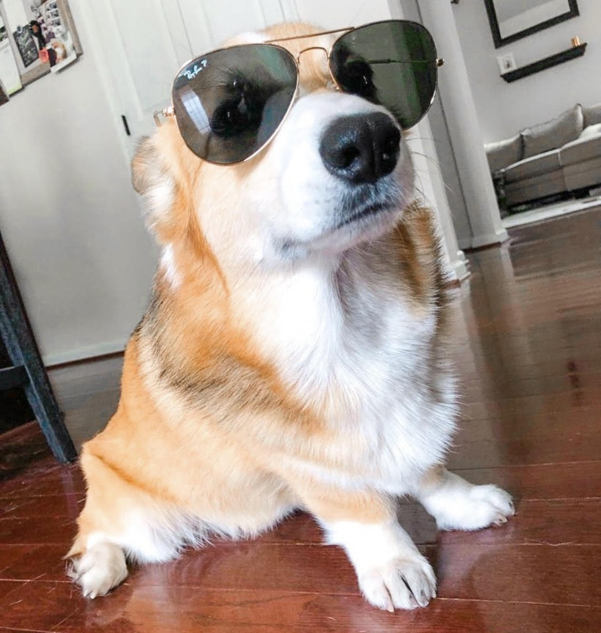
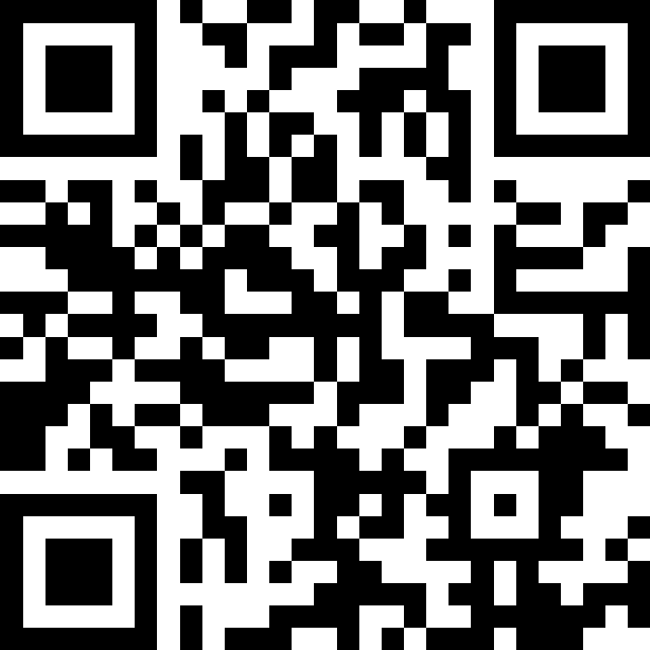
Conditionals
BEFORE WE START
LEC 09
Talk to your neighbors:
How are you doing? (like, actually)
Music: 🎷CSE 121 25au Lecture Tunes 🎵
Instructors:
Brett Wortzman & James Weichert
TAs:
Trey
Amogh
Samrutha
Dalton
Ailsa
Ryan
Anant
Ava
Reese
Hayden
Aki
Spencer
Savannah
Tamsyn
Caleb
Anum
Abdul
Janvi
Navya
Sam Jessica
Elden
Suyash
Sthiti
Paul
Shayna
Jesse
Nhan
Anya
Minh
TJ
Zach
Cayden
Johnathan

Slide 2
Announcements, Reminders
C2 released, due Thursday, October 30th
R2 out yesterday, due Thursday, October 30th
  this is the last time C0 is eligible for resubmission
Quiz reminders:
  Quiz 0 grades will be released end of next week at the earliest
  Quiz 1 is on Thursday, November 6th

Slide 3
More Reminders
Getting help and support — needing help is expected!
  TAs are awesome and very helpful in the IPL!
  Instructor office hours
    we love when students come to office hours!
    James has special “coffee chats” on Mondays — come talk about 121 or anything else
  Asynchronously via Ed and email
Course expectations
  Copying anything from AI into assignments is academic dishonesty
    results in: student conduct case, “U” grade (can’t resubmit)

Slide 4
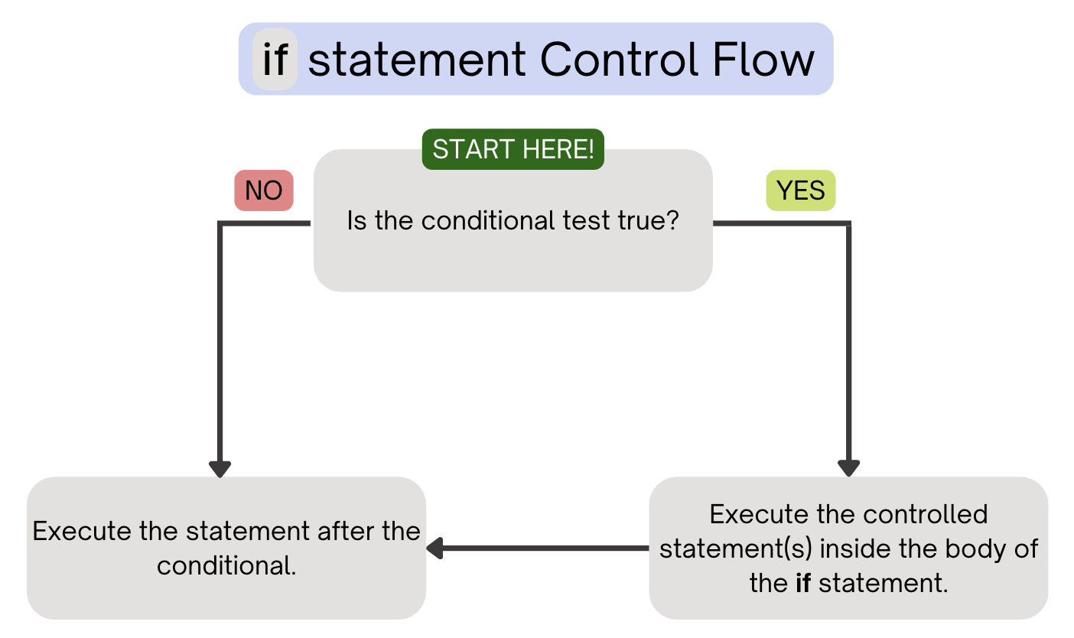
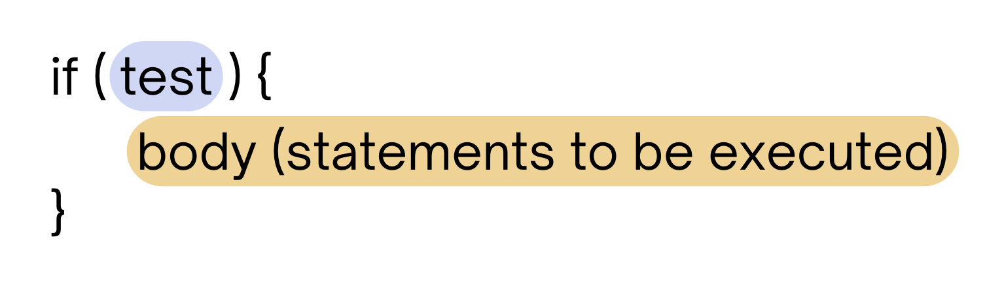
PCM Review: if Statements
Executes a block of statements if and only if the test is true

Slide 5
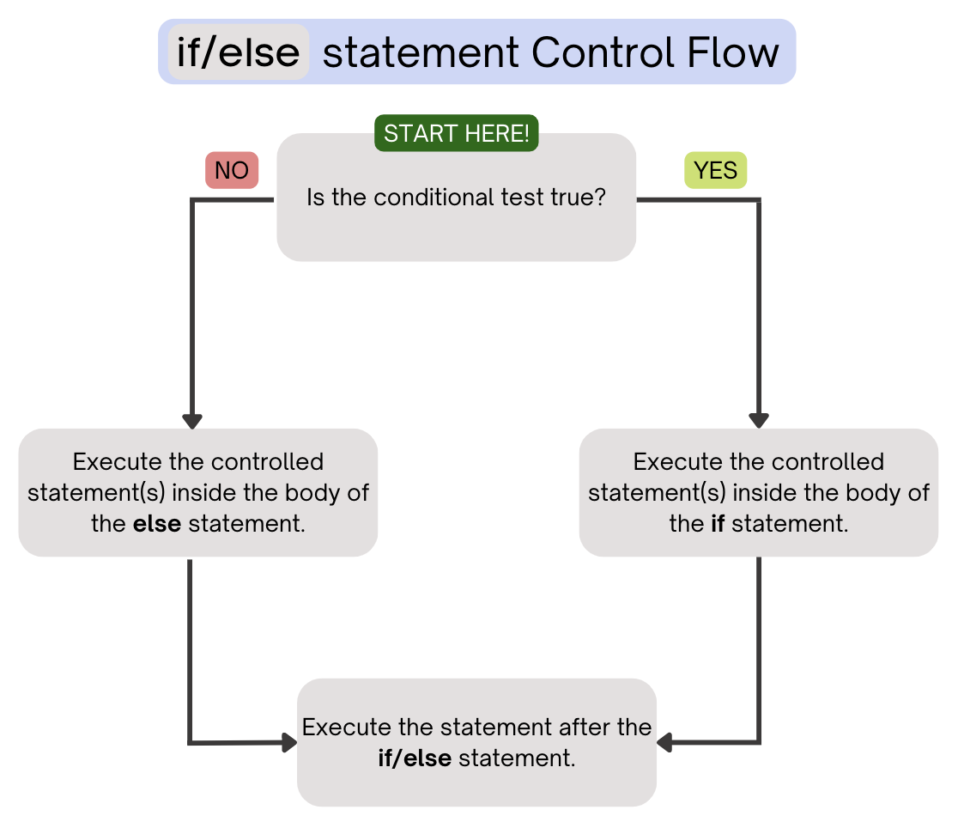
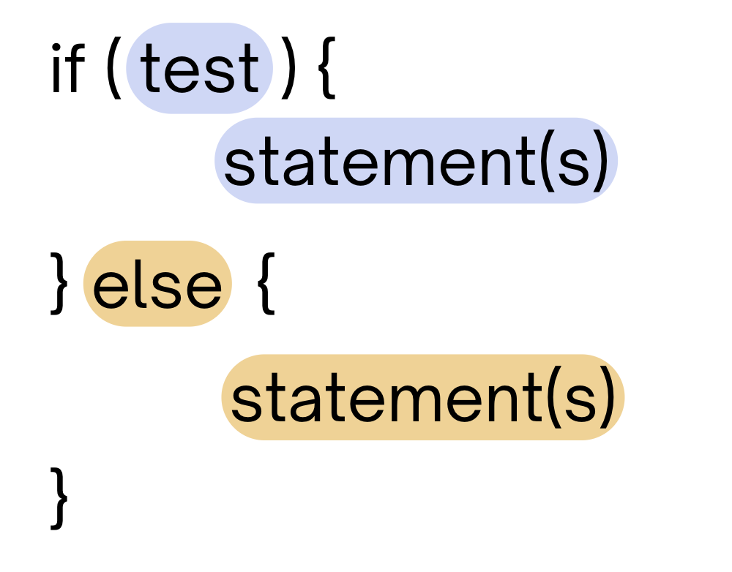
PCM Review: if-else
If the test is true: execute block of statements
If false, execute other block of statements

Slide 6
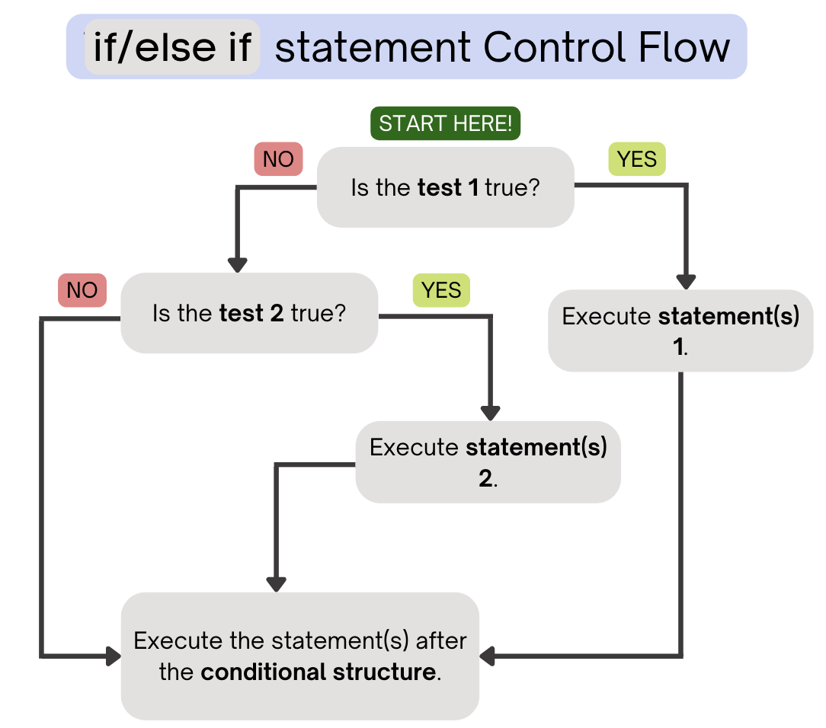
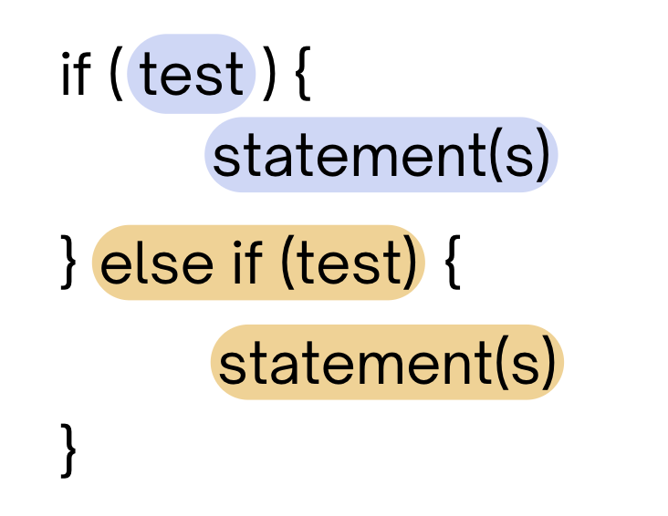
PCM Review: if-else if
If the first test is true, execute that block
If not, proceed to the next test, and repeat
If none were true, don’t execute any blocks
Note After entering an if /else if
block, skip all remaining blocks.

Slide 7
Think Pair Share: Odds and Evens (Think)
public static void main(String[] args) {
for (int i = 1; i <= 3; i++) {
System.out.print(mystery(i));
}
}
public static String mystery(int n) {
String response = "even ";
if (n % 2 == 1) {
response = "odd ";
} else if (n == 1) {
response = "one ";
}
return response;
}
What does this program output?
A. odd even odd
B. one even odd
C. one even even
D. even even even

Slide 8
Think Pair Share: Odds and Evens (Pair)
public static void main(String[] args) {
for (int i = 1; i <= 3; i++) {
System.out.print(mystery(i));
}
}
public static String mystery(int n) {
String response = "even ";
if (n % 2 == 1) {
response = "odd ";
} else if (n == 1) {
response = "one ";
}
return response;
}
What does this program output?
A. odd even odd
B. one even odd
C. one even even
D. even even even

Slide 9
“Useless” Conditionals
public static void main(String[] args) {
for (int i = 1; i <= 3; i++) {
System.out.print(mystery(i));
}
}
public static String mystery(int n) {
String response = "even ";
if (n % 2 == 1) {
response = "odd ";
} else if (n == 1) {
response = "one ";
}
return response;
}
This else if statement never runs!

Slide 10
Common Problem-Solving Strategies (1/2)
Analogy – Is this similar to another problem you've seen?
Brainstorming – Consider steps to solve problem before jumping into code
  Try to do an example "by hand”, then outline steps
Solve sub-problems – Is there a smaller part of the problem to solve?
Debugging – Does your solution behave correctly?
  What is it doing?
  What do you expect it to do?
  What area of your code controls that part of the output?
Iterative Development – Can we start by solving a different problem that is easier?

Slide 11
Common Problem-Solving Strategies (2/2)
Analogy – Is this similar to another problem you've seen?
Brainstorming – Consider steps to solve problem before jumping into code
  Try to do an example "by hand”, then outline steps
Solve Sub-Problems – Is there a smaller part of the problem to solve?
Debugging – Does your solution behave correctly?
  What is it doing?
  What do you expect it to do?
  What area of your code controls that part of the output?
Iterative Development – Can we start by solving a different problem that is easier?

