Slide 1
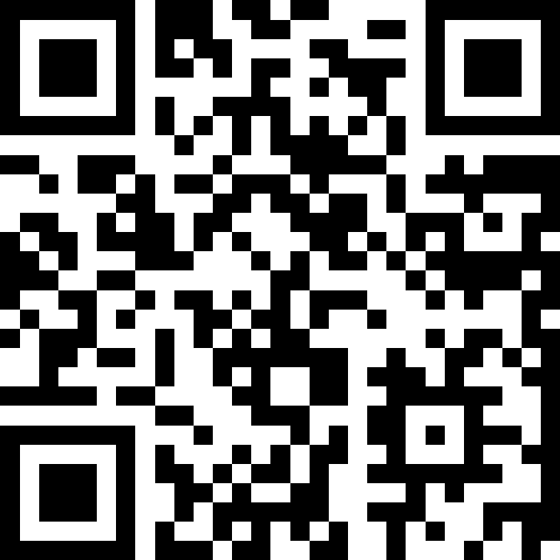
More Methods, Parameters, and Returns
BEFORE WE START
LEC 08
Talk to your neighbors:
What’s your favorite book?
Respond on sli.do!
Music: 🎷CSE 121 25au Lecture Tunes 🎵
Instructors:
Brett Wortzman & James Weichert
TAs:
Trey
Amogh
Samrutha
Dalton
Ailsa
Ryan
Anant
Ava
Reese
Hayden
Aki
Spencer
Savannah
Tamsyn
Caleb
Anum
Abdul
Janvi
Navya
Sam Jessica
Elden
Suyash
Sthiti
Paul
Shayna
Jesse
Nhan
Anya
Minh
TJ
Zach
Cayden
Johnathan

Slide 2
Agenda
Announcements, Reminders
Methods, Parameters, Returns Warmup
Random Characters Example
Math Problems

Slide 3
Announcements, Reminders
C2 (Password Protector) releasing later today, due Thursday October 30th
  involves conditionals (Friday’s topic)
R1 due tomorrow; R2 opens tomorrow, due Thursday, October 30th
Quiz 1: Thursday, November 6th
  Quiz 0 grades expected out early next week

Slide 4
Agenda
Announcements, Reminders
Methods, Parameters, Returns Warmup
Random Characters Example
Math Problems

Slide 5
Think Pair Share: mystery example (think)
What is the output of this program?
A. 2 and 4
9 and 3
B. 5 and -7
5 and -7
C. 9 and -3
5 and -7
D. I’m not sure
public static void main(String[] args) {
int x = 9;
int y = 2;
int z = 5;
mystery(z, y, x);
mystery(y, x, z);
}
public static void mystery(int x, int z, int y) {
System.out.println(z + " and " + (y - x));
}

Slide 6
Think Pair Share: mystery example (pair)
What is the output of this program?
A. 2 and 4
9 and 3
B. 5 and -7
5 and -7
C. 9 and -3
5 and -7
D. I’m not sure
public static void main(String[] args) {
int x = 9;
int y = 2;
int z = 5;
mystery(z, y, x);
mystery(y, x, z);
}
public static void mystery(int x, int z, int y) {
System.out.println(z + " and " + (y - x));
}

Slide 7
Think Pair Share: return example (think)
A. -1
B. 0
C. 4
D. 5
What value is returned from this method?
public static int returnExample() {
for (int i = 0; i < 5; i++) {
return i;
}
return -1;
}

Slide 8
Think Pair Share: return example (pair)
A. -1
B. 0
C. 4
D. 5
What value is returned from this method?
public static int returnExample() {
for (int i = 0; i < 5; i++) {
return i;
}
return -1;
}

Slide 9
New: Method Comments
Each method you write (except main) should have a short comment!
// Behavior:
// - Calculates net profit using monthly income and daily spending.
// Parameters:
// - income: user's income this month (non-negative)
// - spending: amount spent each day this month (non-negative)
// Returns:
// - int: the net profit or loss. Positive if profit, negative if loss.
public static int calculateNetExpenses(int income, int spending) {
return income - (spending * DAYS_IN_MONTH);
}

Slide 10
Agenda
Announcements, Reminders
Methods, Parameters, Returns Warmup
Random Characters Example
Math Problems

Slide 11
Agenda
Announcements, Reminders
Methods, Parameters, Returns Warmup
Random Characters Example
Math Problems

Slide 12
Common Problem-Solving Strategies
Analogy – Is this similar to another problem you've seen?
Brainstorming – Consider steps to solve problem before jumping into code
  Try to do an example "by hand" → outline steps
Solve sub-problems – Is there a smaller part of the problem to solve?
Debugging – Does your solution behave correctly?
  What is it doing?
  What do you expect it to do?
  What area of your code controls that part of the output?
Iterative Development – Can we start by solving a different problem that is easier?

