Slide 1

Methods, Parameters, Returns
BEFORE WE START
LEC 07
Talk to your neighbors:
Is cereal a soup?
Music: 🎷CSE 121 25au Lecture Tunes 🎵
Instructors:
Brett Wortzman & James Weichert
TAs:
Trey
Amogh
Samrutha
Dalton
Ailsa
Ryan
Anant
Ava
Reese
Hayden
Aki
Spencer
Savannah
Tamsyn
Caleb
Anum
Abdul
Janvi
Navya
Sam Jessica
Elden
Suyash
Sthiti
Paul
Shayna
Jesse
Nhan
Anya
Minh
TJ
Zach
Cayden
Johnathan

Slide 2
Agenda
Announcements, Reminders
P1 Preview
Revisiting Class Constants
More Methods!

Slide 3
Announcements, Reminders
P1 is out, due next Tuesday, October 21st
start early – this one is tough!
R1 released yesterday, due Thursday October 23rd
Quiz 0 was yesterday
grades will be out before Quiz 1

Slide 4
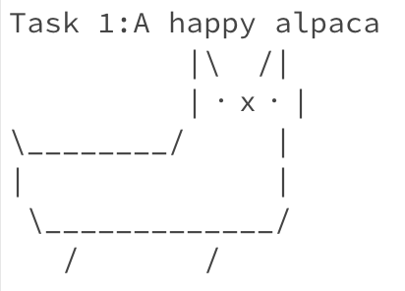
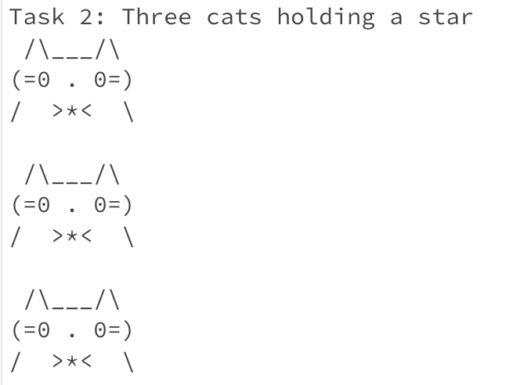
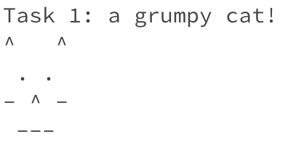
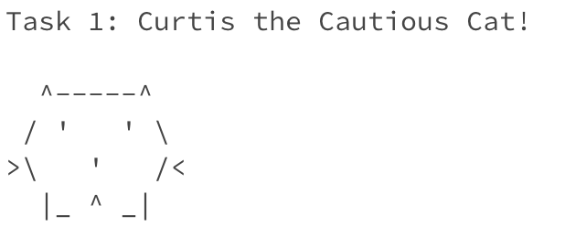
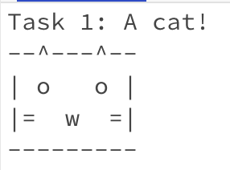
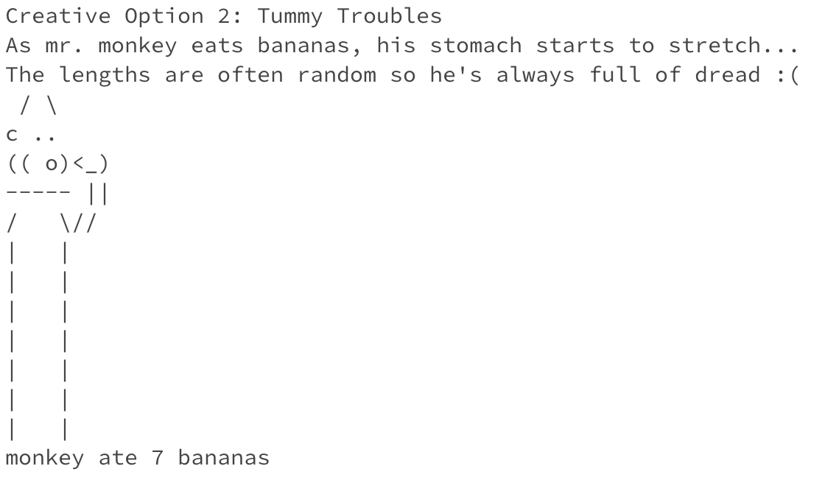
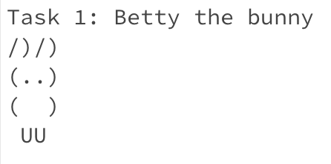
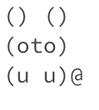
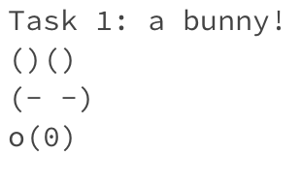
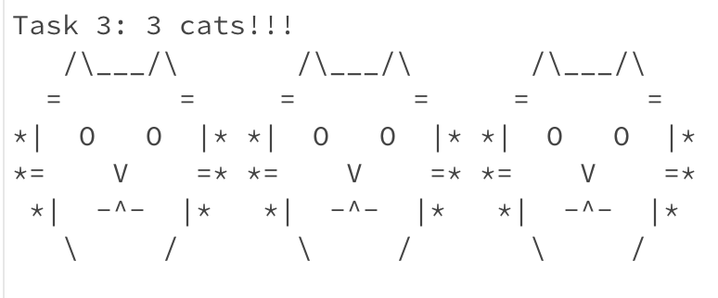
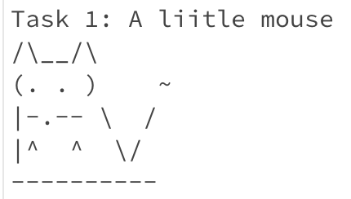
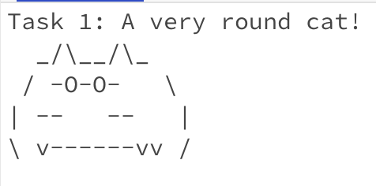
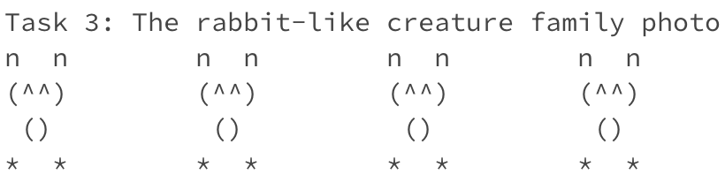
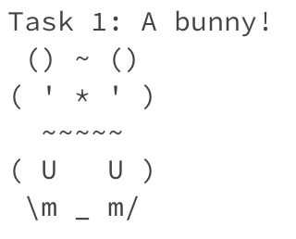
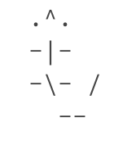
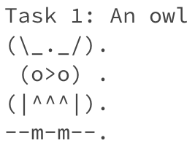
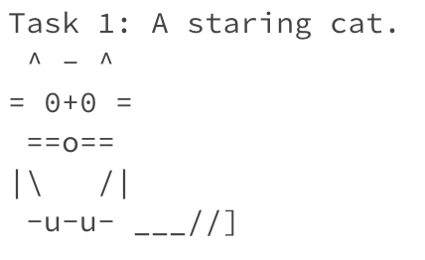
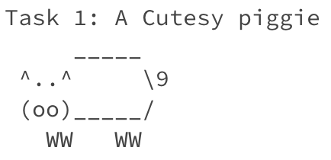
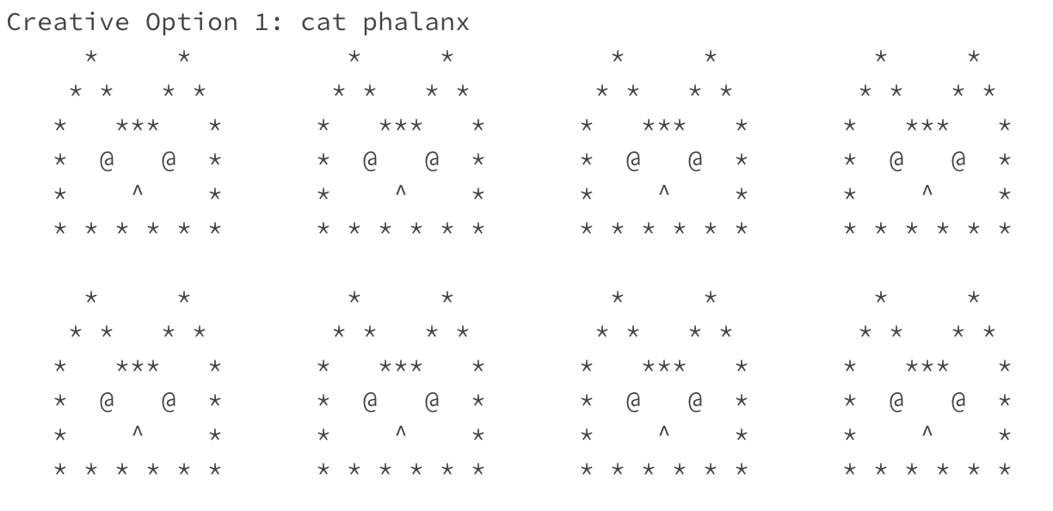
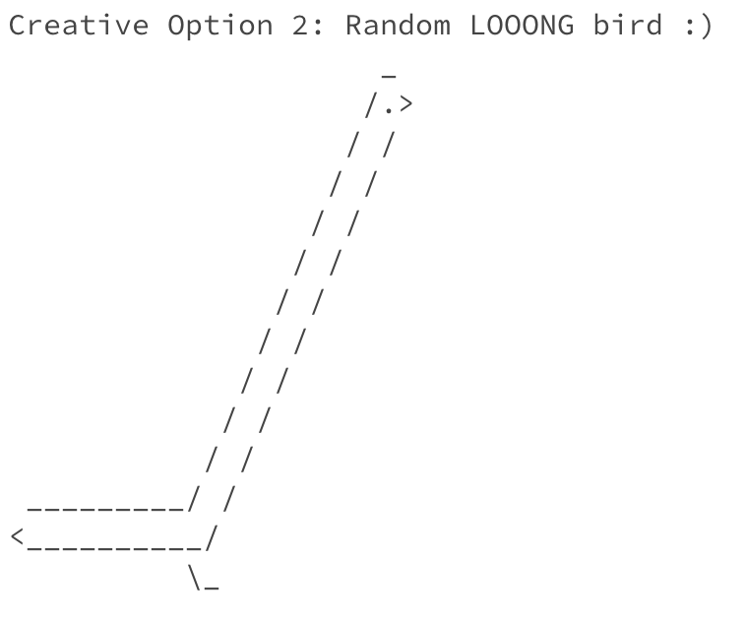
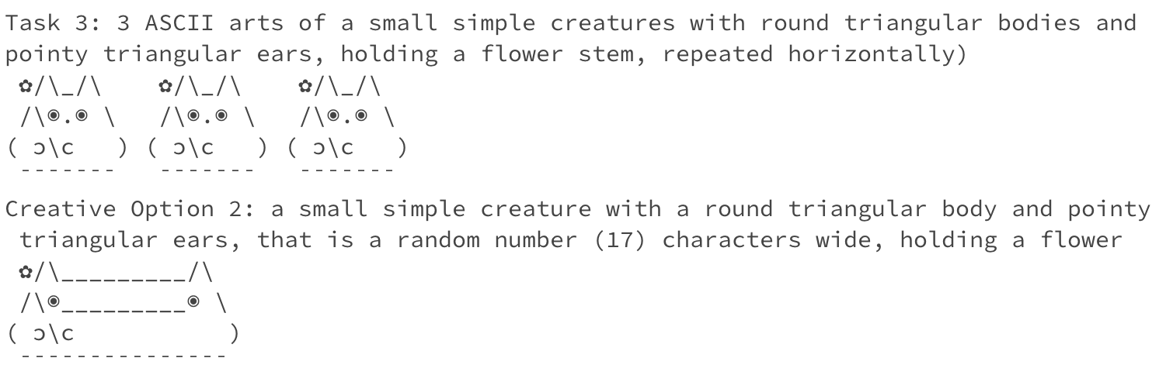
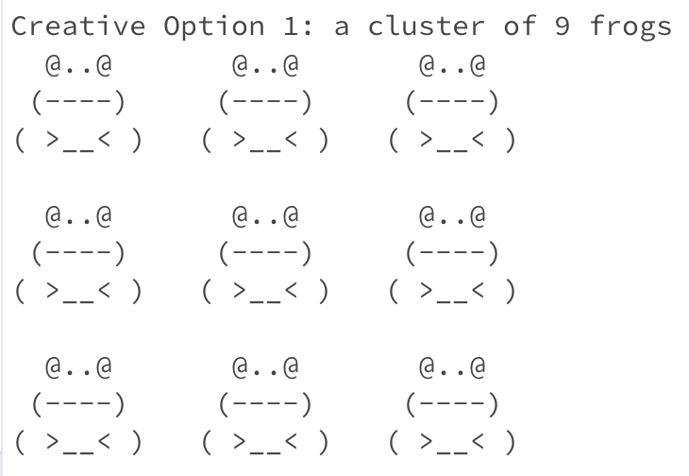
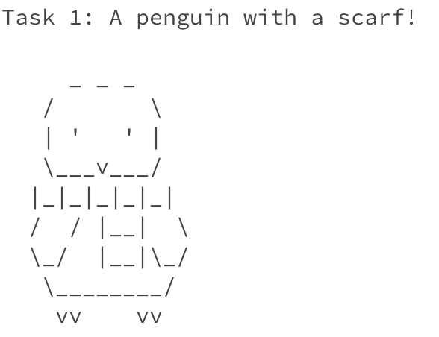
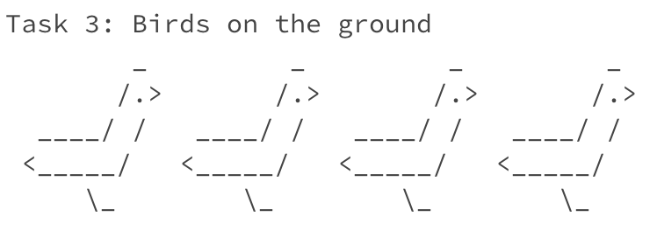
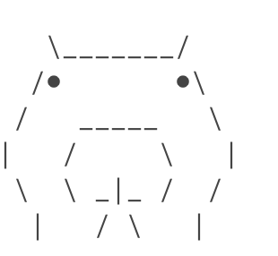
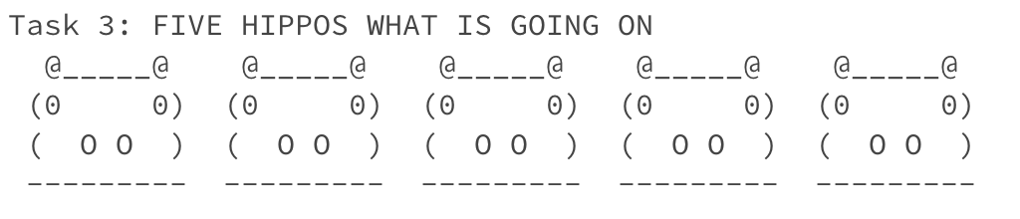
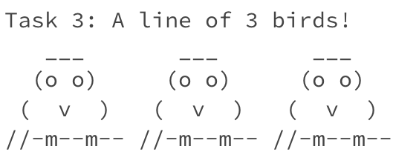
C1 ASCII Art Creations: Cats (+ Friends)

Slide 5
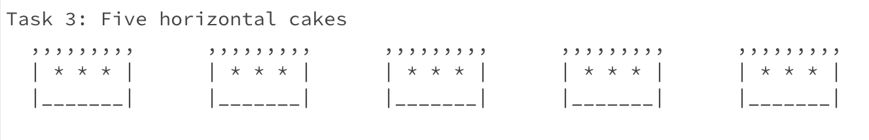
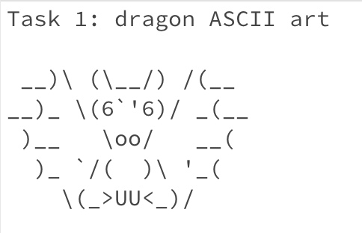
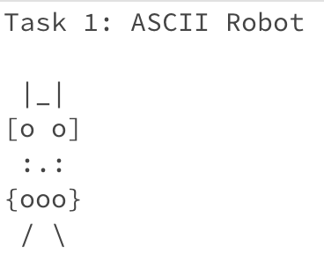
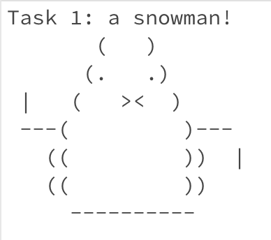
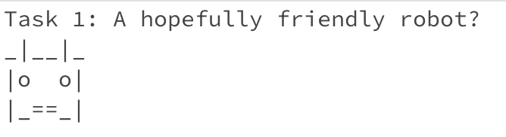
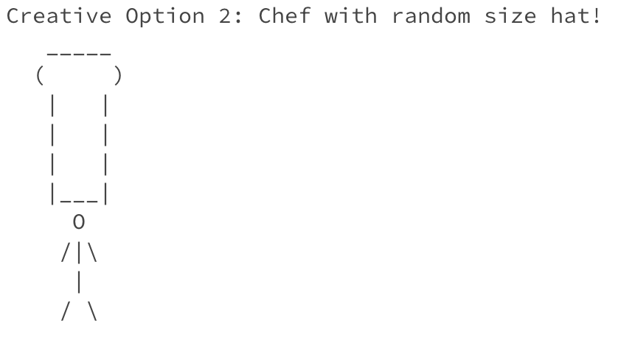
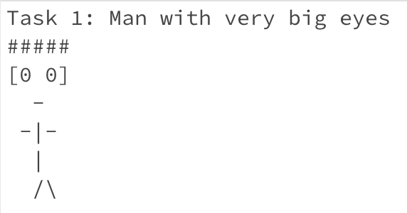
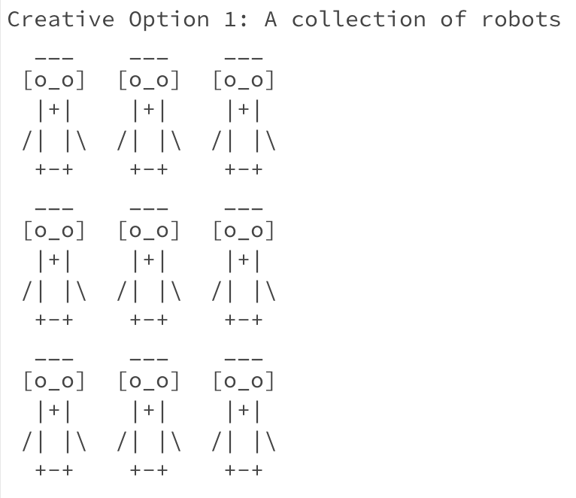
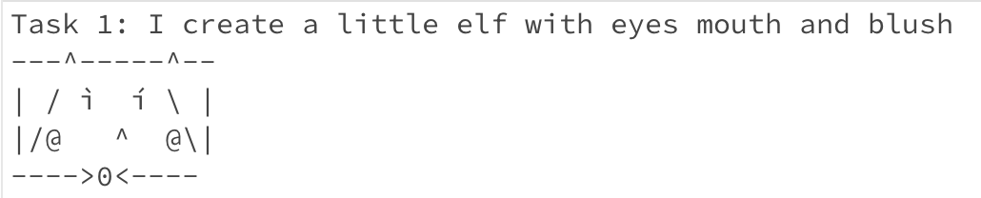
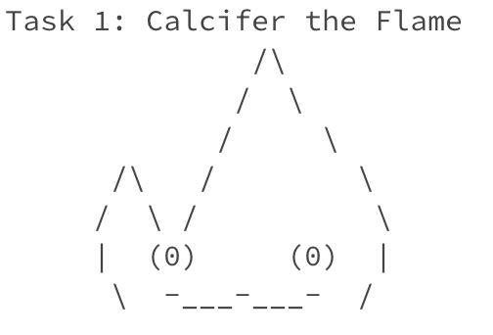
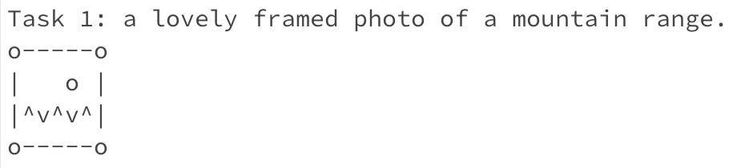
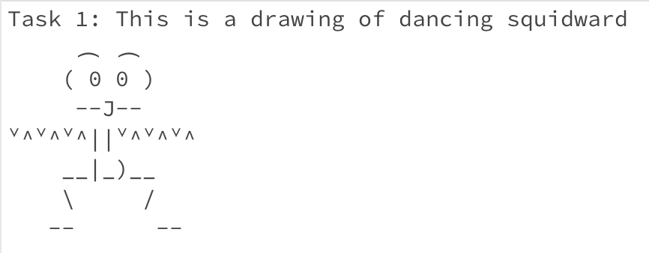
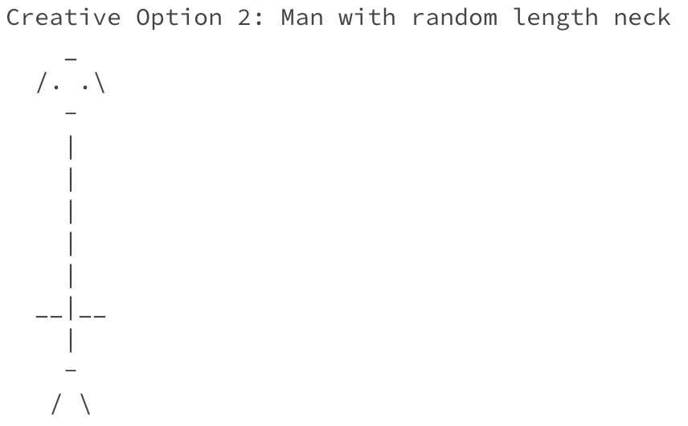
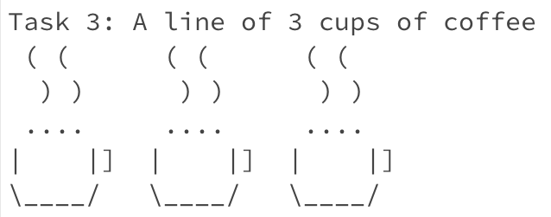
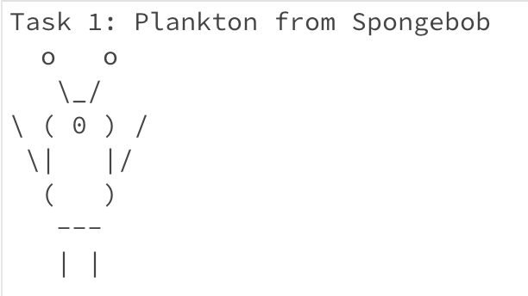
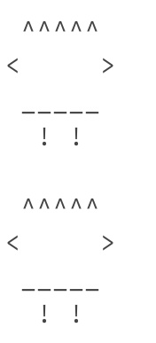
C1 ASCII Art Creations: Robots (+ Friends)

Slide 6
Up Next: P1 Preview
Announcements, Reminders
P1 Preview
Revisiting Class Constants
More Methods!

Slide 7
Up Next: Class Constants
Announcements, Reminders
P1 Preview
Revisiting Class Constants
More Methods!

Slide 8
New: Class Constants
A fixed value visible (in-scope) to the whole program (the entire class).
Value is set at declaration, cannot be reassigned – value is constant.
public static final type NAME_OF_CONSTANT = expression;

Slide 9
Think Pair Share: Count (Think)
What will be the last line of output from this code?
public static final int COUNT = 7;
public static void main(String[] args) {
int count = 5;
line(count);
System.out.println("COUNT is: " + COUNT);
System.out.println("count is: " + count);
}
public static void line(int count) {
for (int i = 1; i <= count; i++) {
System.out.print("*");
}
count++;
System.out.println();
}
A. count is: 1
B. count is: 5
C. count is: 6
D. count is: 7

Slide 10
Think Pair Share: Count (Pair)
What will be the last line of output from this code?
public static final int COUNT = 7;
public static void main(String[] args) {
int count = 5;
line(count);
System.out.println("COUNT is: " + COUNT);
System.out.println("count is: " + count);
}
public static void line(int count) {
for (int i = 1; i <= count; i++) {
System.out.print("*");
}
count++;
System.out.println();
}
A. count is: 1
B. count is: 5
C. count is: 6
D. count is: 7

Slide 11
Walkthrough: Counting Counts
public static final int COUNT = 7;
public static void main(String[] args) {
int count = 5;
line(count);
System.out.println("COUNT is: " + COUNT);
System.out.println("count is: " + count);
}
public static void line(int count) {
for (int i = 1; i <= count; i++) {
System.out.print("*");
}
count++;
System.out.println();
}
5
count
5
COUNT
7
count
6
5

Slide 12
Up Next: More Methods!
Announcements, Reminders
P1 Preview
Revisiting Class Constants
More Methods!

Slide 13
PCM: Returns
Returns allow us to send values out of a method
public static <type> myMethod(int num) {
System.out.print(num + " is the best!");
... return <value of correct type>
}
Calling a method that returns a value…
<type> result = myMethod(42);
return does 3 things:
Evaluate the expression
Return this value to where the method was called
Exit the method

Slide 14
Recall: Math
Method | Description
Math.abs(value) | Returns the absolute value of value
Math.ceil(value) | Returns value rounded up
Math.floor(value) | Returns value rounded down
Math.max(value1, value2) | Returns the larger of the two values
Math.min(value1, value2) | Returns the smaller of the two values
Math.round(value) | Returns value rounded to the nearest whole number* note: need to cast result to int (it’s complicated!)
Math.sqrt(value) | Returns the square root of value
Math.pow(base, exp) | Returns base raised to the exp power

Slide 15
Recall: String Methods
Method | Description
length() | Returns the length of the string.
charAt(i) | Returns the character at index i of the string
indexOf(s) | Returns the index of the first occurrence of s in the string; returns -1 if s doesn't appear in the string
substring(i, j) or substring(i) | Returns the characters in this string from i (inclusive) to j (exclusive); if j is omitted, goes until the end of the string
contains(s) | Returns whether or not the string contains s
equals(s) | Returns whether or not the string is equal to s (case-sensitive)
equalsIgnoreCase(s) | Returns whether or not the string is equal to s ignoring case
toUpperCase() | Returns an uppercase version of the string
toLowerCase() | Returns a lowercase version of the string

