Slide 1

for Loops
BEFORE WE START
LEC 04
Talk to your neighbors:
What’s your favorite TV show right now?
Respond on sli.do!
Music: 🎷CSE 121 25au Lecture Tunes 🎵
Instructors:
Brett Wortzman & James Weichert
TAs:
Trey
Amogh
Samrutha
Dalton
Ailsa
Ryan
Anant
Ava
Reese
Hayden
Aki
Spencer
Savannah
Tamsyn
Caleb
Anum
Abdul
Janvi
Navya
Sam Jessica
Elden
Suyash
Sthiti
Paul
Shayna
Jesse
Nhan
Anya
Minh
TJ
Zach
Cayden
Johnathan

Slide 2
Announcements, Reminders
Feedback for C0 released yesterday!
Please view your feedback – crucial part of learning process
For regrades (not resubs), please make a private Ed post
C1 releasing later today, due Tuesday, October 14th
Quiz 0 is next Thursday, October 16th (in your registered quiz section)
Can’t make it? Email Brett and James ASAP
Resubmission Cycle 0 (R0) opening tomorrow, due Thursday October 16th

Slide 3
Reminder: Resubmissions (or “resubs”)
Each week, you may resubmit one Programming Assignment or Creative Project with no penalty. The grade of your resubmission will completely replace your previous grade.
This is a huge opportunity: you get to resubmit your work after we grade it and give you feedback! Please take advantage of this :)
If you miss an assignment and/or only finish it late – use a resub!

Slide 4
Resub Logistics
Some logistics:
There are 7* total resub cycles this quarter (and 8 assignments)
Assignments eligible to resubmit for 3 cycles after feedback is out
To resubmit:
Make and submit your changes
Set the submission you want graded as “Final”
Submit a Google Form, with a reflection, to confirm your resub
You must submit the form before the deadline for resub to count

Slide 5
Chaining methods in expressions
Suppose s contains the String "bubble gum". Which statement would result in s containing "Gumball" instead?
s.substring(7) + "ball";
s = s.substring(7, 9) + "ball";
s = ("" + s.charAt(7)).toUpperCase() + "ball";
s = s.substring(7, 8).toUpperCase() + s.substring(8) + "ball";
b | u | b | b | l | e |  | g | u | m
0 | 1 | 2 | 3 | 4 | 5 | 6 | 7 | 8 | 9

Slide 6
Chaining methods in expressions
b | u | b | b | l | e |  | g | u | m
0 | 1 | 2 | 3 | 4 | 5 | 6 | 7 | 8 | 9
s.substring(7, 8).toUpperCase() + s.substring(8) + "ball"
"g".toUpperCase() + s.substring(8) + "ball"
"G" + s.substring(8) + "ball"
"G" + "um" + "ball"

Slide 7
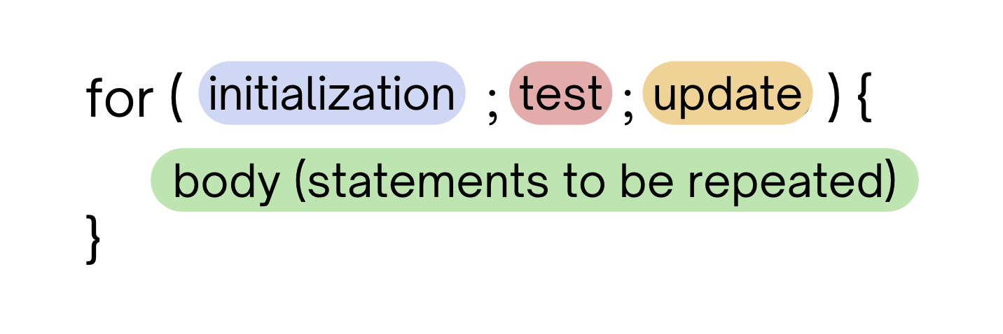
PCM Review: for loops!
For loops are our first control structure: a syntax structure that controls the execution of other statements.

Slide 8
PCM Review: for loops (example)
for (int counter = 1; counter <= 5; counter++) {
System.out.println("I love CSE 121!");
}

Slide 9
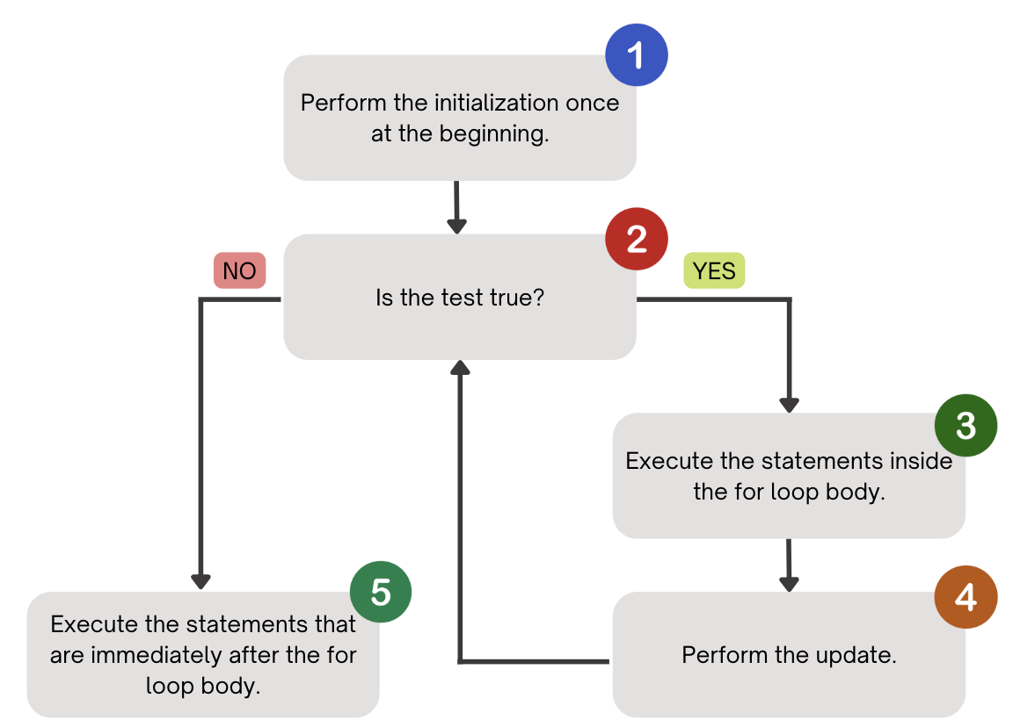
PCM Review: for loops (a helpful flowchart)

Slide 10
Thinking about for loops
counter
1
2
4
1
2
3
4
5
6
for (int counter = 1; counter <= 5; counter++) {
System.out.println("I love CSE 121!");
}
3
5
I love CSE 121!
I love CSE 121!
I love CSE 121!
I love CSE 121!
I love CSE 121!

Slide 11
Think Pair Share: squared loops (Think)
What output does the following code produce?
for (int i = 1; i <= 7; i++) {
System.out.println(i + " squared = " + i * i);
}
A.
i squared = i * i
i squared = i * i
i squared = i * i
i squared = i * i
i squared = i * i
i squared = i * i
B.
i squared = i * i
i squared = i * i
i squared = i * i
i squared = i * i
i squared = i * i
i squared = i * i
i squared = i * i
C.
1 squared = 1
2 squared = 4
3 squared = 9
4 squared = 16
5 squared = 25
6 squared = 36
D.
1 squared = 1
2 squared = 4
3 squared = 9
4 squared = 16
5 squared = 25
6 squared = 36
7 squared = 49

Slide 12
Think Pair Share: squared loops (Pair)
What output does the following code produce?
for (int i = 1; i <= 7; i++) {
System.out.println(i + " squared = " + i * i);
}
A.
i squared = i * i
i squared = i * i
i squared = i * i
i squared = i * i
i squared = i * i
i squared = i * i
B.
i squared = i * i
i squared = i * i
i squared = i * i
i squared = i * i
i squared = i * i
i squared = i * i
i squared = i * i
C.
1 squared = 1
2 squared = 4
3 squared = 9
4 squared = 16
5 squared = 25
6 squared = 36
D.
1 squared = 1
2 squared = 4
3 squared = 9
4 squared = 16
5 squared = 25
6 squared = 36
7 squared = 49

Slide 13
PCM Review: String Traversals
// For some String s
for (int i = 0; i < s.length(); i++) {
// do something with s.charAt(i)
}
b | u | b | b | l | e |  | g | u | m
0 | 1 | 2 | 3 | 4 | 5 | 6 | 7 | 8 | 9

Slide 14
Go Huskies?
h-u-s-k-i-e-s

Slide 15
The Fencepost Pattern
Some task where one piece is repeated n times, and another piece is repeated n-1 times and they alternate
h-u-s-k-i-e-s

