Slide 1
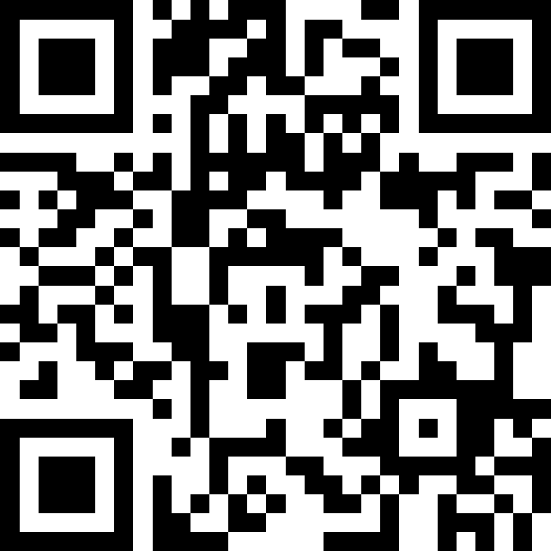
Revisiting Strings and Variables
BEFORE WE START
LEC 03
Talk to your neighbors:
What is your favorite emoji? 😀
Respond on sli.do!
Music: 🎷CSE 121 25au Lecture Tunes 🎵
Instructors:
Brett Wortzman & James Weichert
TAs:
Trey
Amogh
Samrutha
Dalton
Ailsa
Ryan
Anant
Ava
Reese
Hayden
Aki
Spencer
Savannah
Tamsyn
Caleb
Anum
Abdul
Janvi
Navya
Sam Jessica
Elden
Suyash
Sthiti
Paul
Shayna
Jesse
Nhan
Anya
Minh
TJ
Zach
Cayden
Johnathan

Slide 2
Agenda
Announcements, Reminders
C0 Reflection Recap
Typecasting
More Variables and Operators!
Strings and Characters Review
code example!

Slide 3

Announcements, Reminders
P0: Cornbear’s Café released!
due Tuesday, October 7th
Expect C0 grades ~ 1 week from submission (we’ll announce on Ed)
shortly after, your first resubmission cycle will open!

Slide 4
Agenda
Announcements, Reminders
C0 Reflection Recap
Typecasting
More Variables and Operators!
Strings and Characters Review
code example!

Slide 5
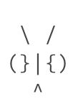
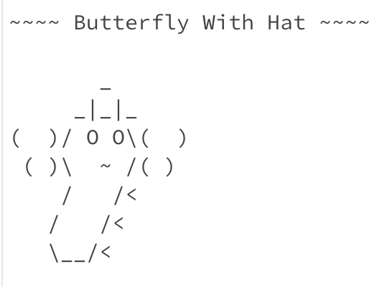
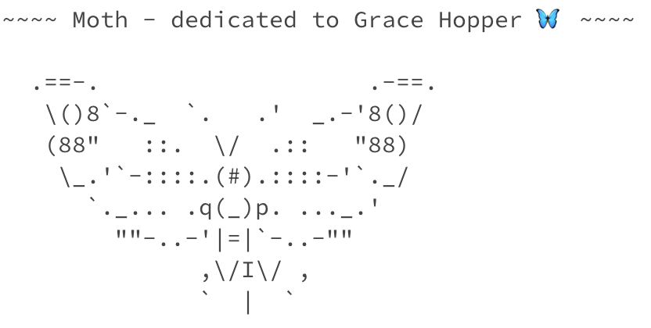
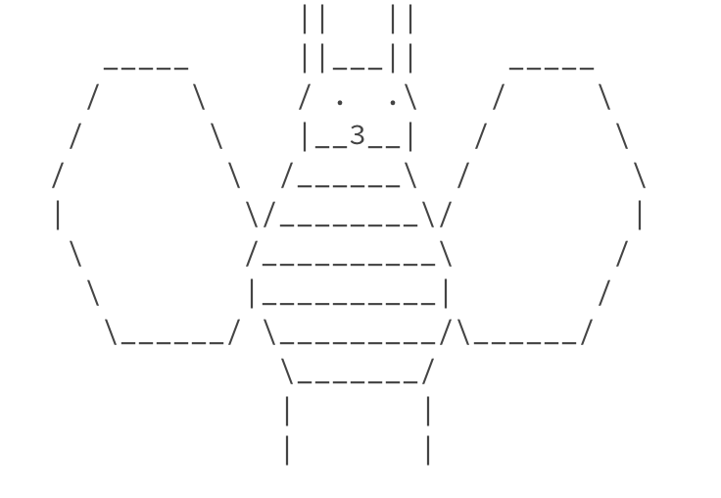
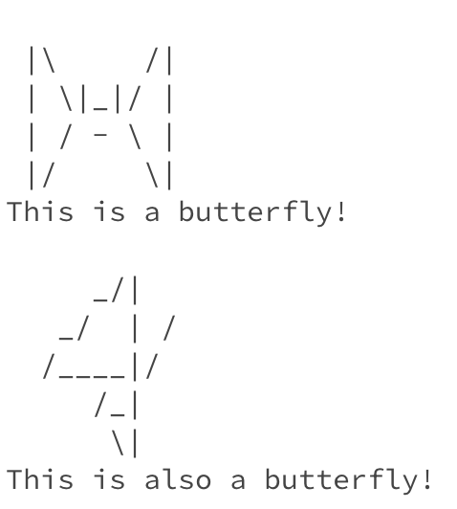
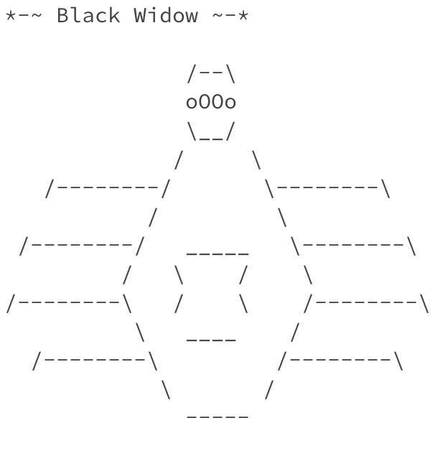
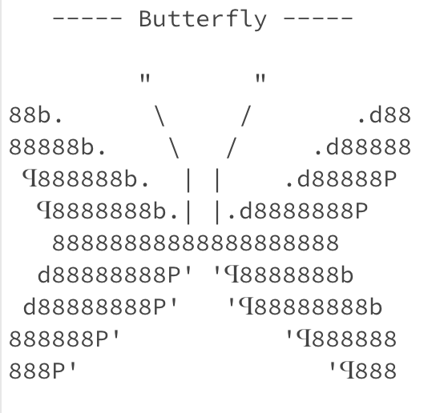
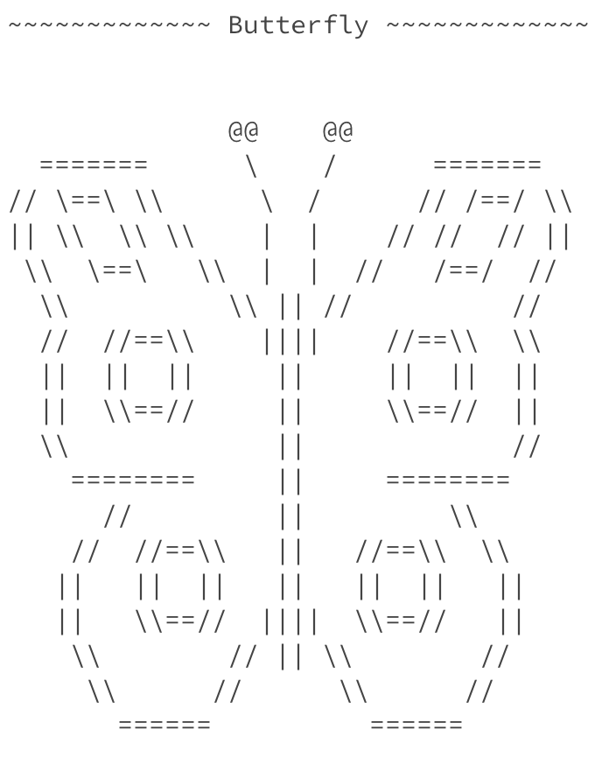
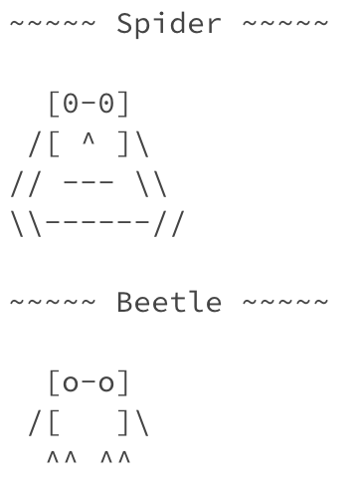
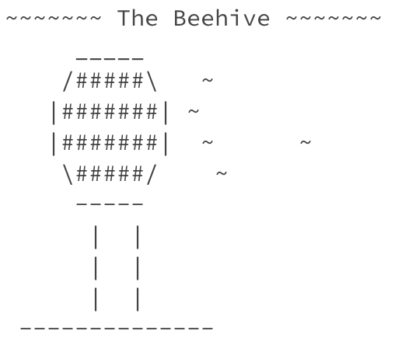
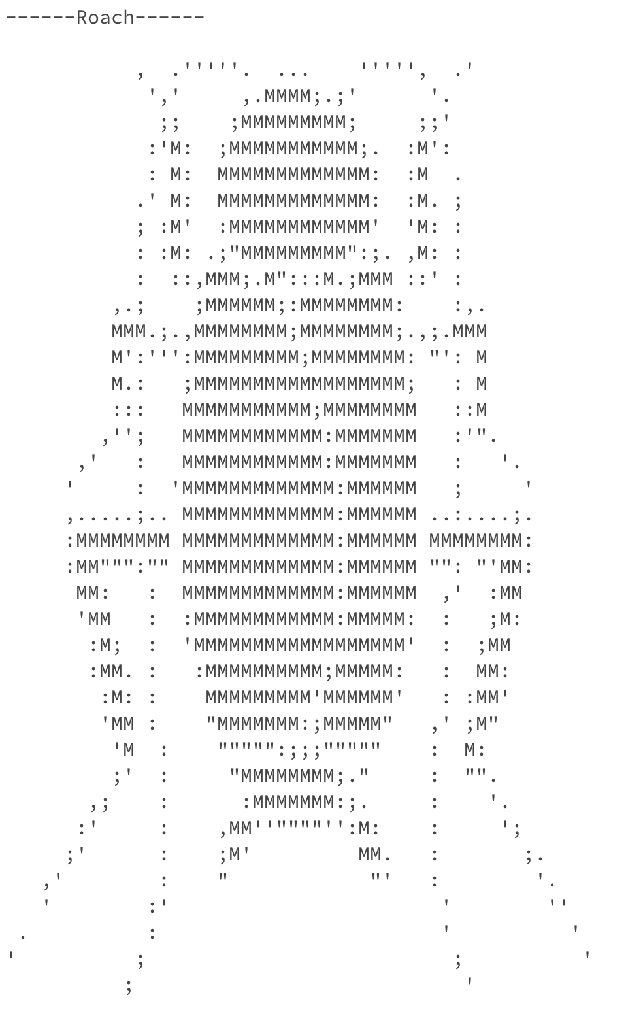
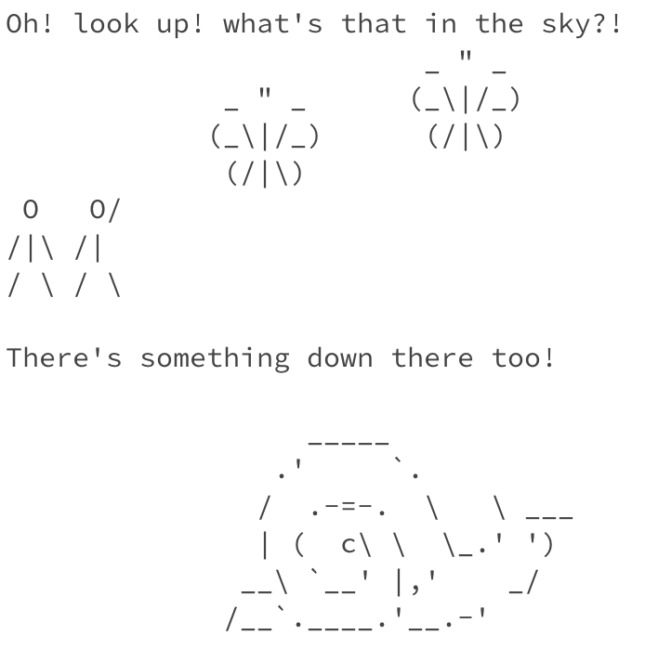
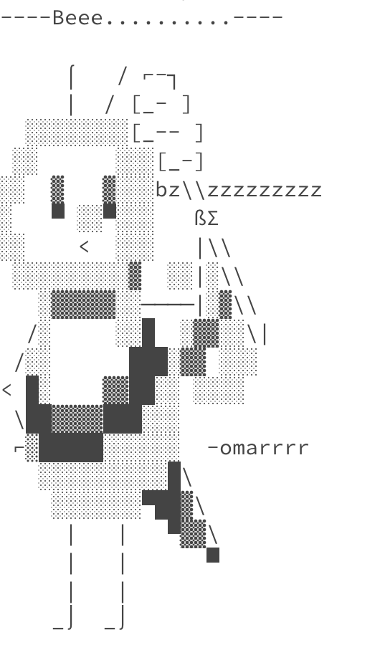
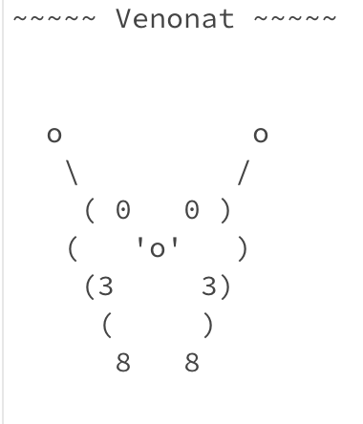
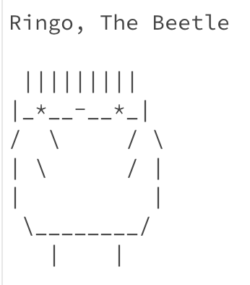
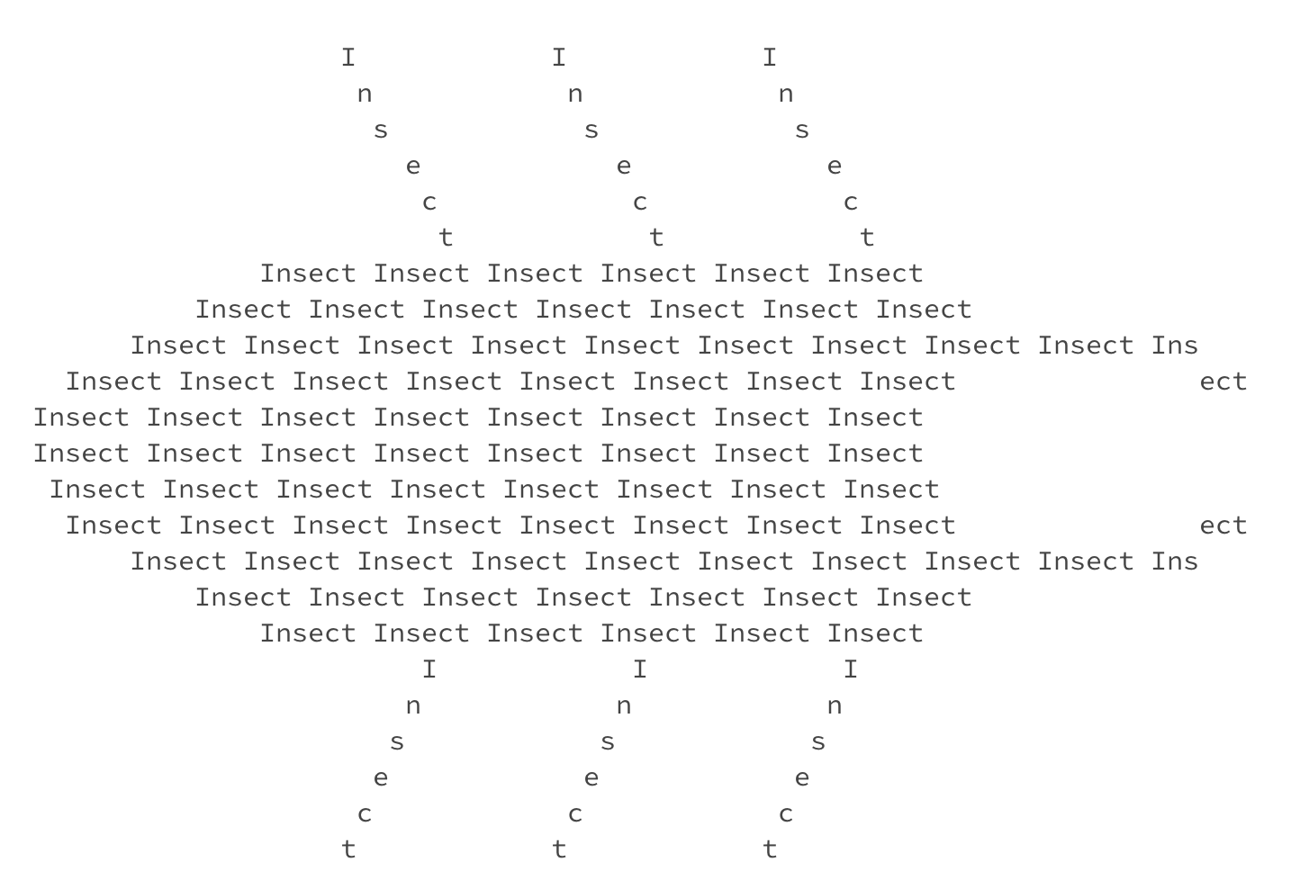
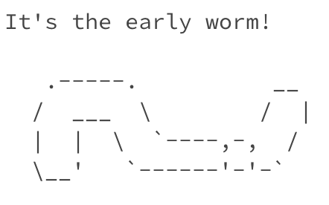
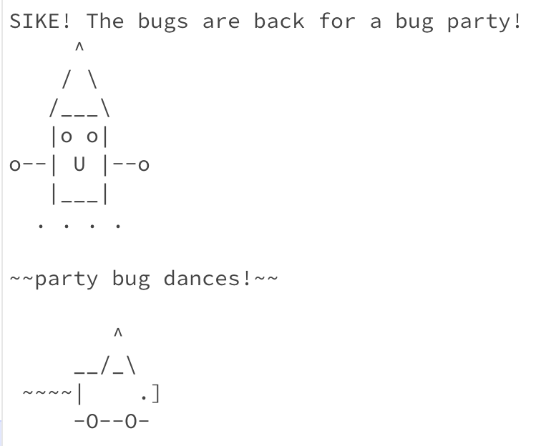
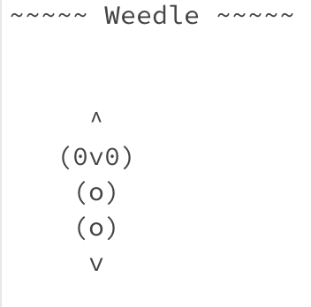
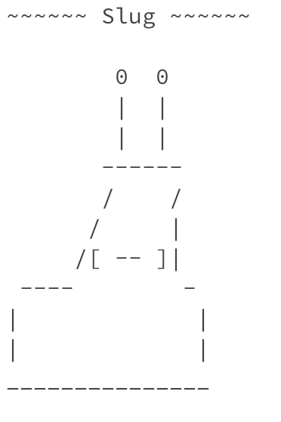
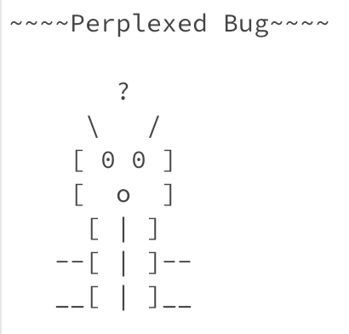
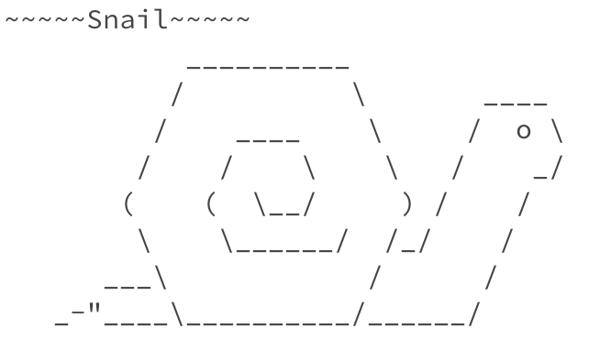
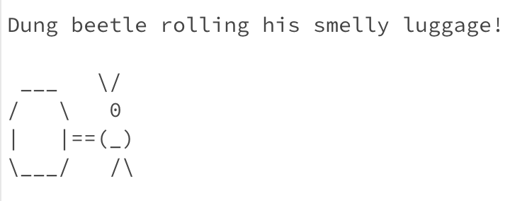
Some Bugs!

Slide 6
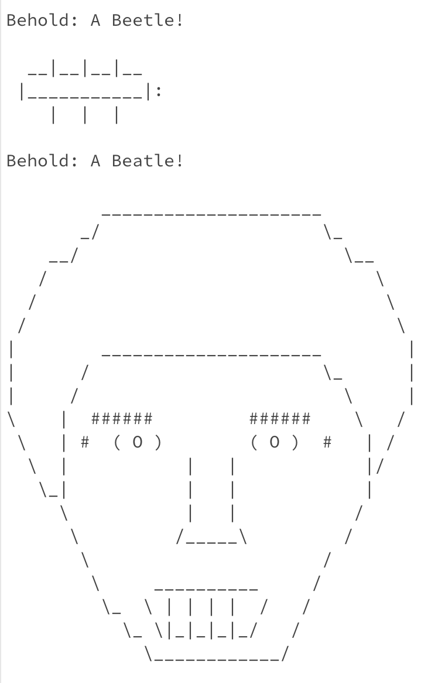
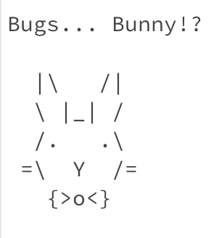
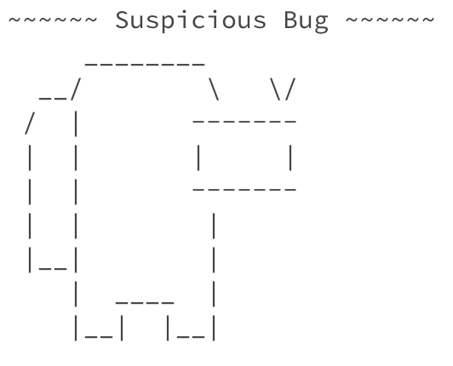
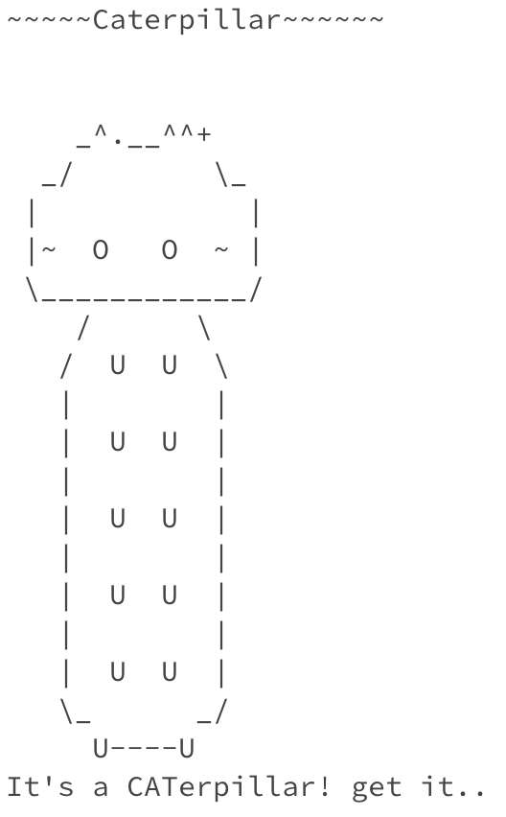
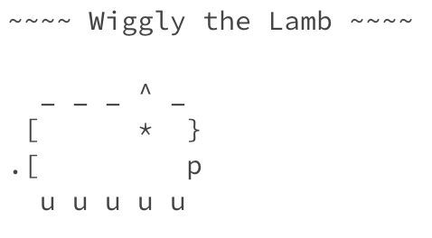
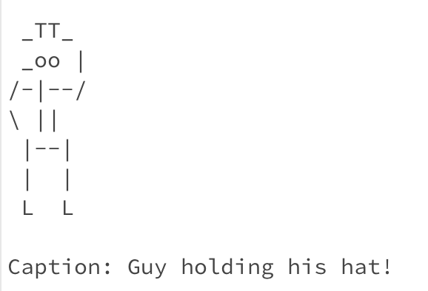
Some Bugs?

Slide 7
On Accessibility…
Great engagement with the C0 reflection! Some themes:
It was inspiring and eye-opening to learn how blind programmers code
“This shifted my perspective from seeing accessibility as a special accommodation to recognizing it as a smart design”
Little ‘quality of life’ changes can make a big difference!
It was “surprising how easy it was to make the debugger more accessible”
Accessibility matters because…
“Good accessibility brings in more diverse developers with different perspectives and ideas, which can help with creating robust programs”

Slide 8
Is C0 Accessible?
Probably not…or at least not yet.
When looking at ASCII art:
Screenreaders alone aren’t suited for reading ASCII art
“The caption can help…somewhat”
…but the caption could be low-quality or wrong!
Some ideas for improvement:
Incorporating auditory elements
Printing out the ASCII art and embossing it
”Accessibility, in my mind, means that someone would be able to enjoy or create the same products using a different interaction”

Slide 9
So, What?
Broadly speaking: the digital world is inaccessible
but that’s changing!
and we have the power to change it!
In CSE 121, we don’t have the full knowledge yet to make accessible ASCII art (or Java programs, applications, video games, websites, …)
However, we encourage you to:
think about accessibility when you make things with computers
keep on learning more! UW is a global leader in digital accessibility
e.g. at UW: CSE 493E: Accessibility, CREATE, AccessComputing

Slide 10
Agenda
Announcements, Reminders
C0 Reflection Recap
Typecasting
More Variables and Operators!
Strings and Characters Review
code example!

Slide 11
PCM: Casting
Java will do some type conversions for us
E.g., int to double, double to String, int to String
BUT some conversions Java won't do for us…
Nonsensical conversions (e.g., "Gumball" to int)
Conversions that are "lossy" (e.g., double to int)
We can ask Java to typecast for us
double x = 8.83;
int xInt = (int) x;

Slide 12
Agenda
Announcements, Reminders
C0 Reflection Recap
Typecasting
More Variables and Operators!
Strings and Characters Review
code example!

Slide 13
PCM: Variables
Recall: Variables allow us to give a name to a specific value
3 parts: declaration, initialization, usage
Example:
Declaration: int x;
Initialization: x = 30;
Or all in one line: int x = 30;
String theBestBoy = "gumball";
System.out.println(theBestBoy);

Slide 14
New: Manipulating Variables
They’re made to be manipulated, modified, and re-used!
int myFavoriteNumber = 7;
int tripleFavNum = myFavoriteNumber * 3;
myFavoriteNumber = myFavoriteNumber + 3;
Note! This doesn’t really make any mathematical sense. That’s because in Java, = is assignment, not equality!

Slide 15
New Operator: +=
myFavoriteNumber = myFavoriteNumber + 3;
This pattern is so common, we have a shorthand for it!
myFavoriteNumber += 3;
This works for both numeric addition and string concatenation!

Slide 16
More Shorthand Operators
The shorthands -=, *=, /=, and %= exist too!
myFavoriteNumber /= 3;
Should this work for integers? Doubles? Strings?

Slide 17
Even Shorter Shorthands
There are even shorter operators for “incrementing” and “decrementing”!
myFavoriteNumber++; // myFavoriteNumber += 1;
myFavoriteNumber--; // myFavoriteNumber -= 1;
Should this work for integers? Doubles? Strings?

Slide 18
Think Pair Share: A, B, C Variables (Think)
What values do a, b, and c hold after this code is executed?
int a = 10;
int b = 30;
int c = a + b;
c -= 10;
a = b + 5;
b /= 2;
10, 30, 40
35, 15, 30
35, 15.5, 30
20, 15, 30

Slide 19
Think Pair Share: A, B, C Variables (Pair)
What values do a, b, and c hold after this code is executed?
int a = 10;
int b = 30;
int c = a + b;
c -= 10;
a = b + 5;
b /= 2;
10, 30, 40
35, 15, 30
35, 15.5, 30
20, 15, 30

Slide 20
Agenda
Announcements, Reminders
C0 Reflection Recap
Typecasting
More Variables and Operators!
Strings and Characters Review
code example!

Slide 21
PCM: Strings & chars
Recall: String literals are a sequence of characters that are strung together, begin and end with ""
Use zero-based indexing
A char represents a single character
Begin and end with single quotes ( ' )
Strings are made up of chars!
g | u | m | b | a | l | l
0 | 1 | 2 | 3 | 4 | 5 | 6
char letter = 'g';
char anotherLetter = 'b';

Slide 22
PCM: String Methods
Usage: <string_variable>.<method>(…)
Method | Description
length() | Returns the length of the string.
charAt(i) | Returns the character at index i of the string
indexOf(s) | Returns the index of the first occurrence of s in the string; returns -1 if s doesn't appear in the string
substring(i, j) or substring(i) | Returns the characters in this string from i (inclusive) to j (exclusive); if j is omitted, goes until the end of the string
contains(s) | Returns whether or not the string contains s
equals(s) | Returns whether or not the string is equal to s (case-sensitive)
equalsIgnoreCase(s) | Returns whether or not the string is equal to s ignoring case
toUpperCase() | Returns an uppercase version of the string
toLowerCase() | Returns a lowercase version of the string

Slide 23
Think Pair Share: A, B, C Variables (Think)
Suppose s contains the String "bubble gum". Which statement would result in s containing "Gumball" instead?
s.substring(7) + "ball";
s = s.substring(7, 9) + "ball";
s = s.charAt(7).toUpperCase() + "ball";
s = s.substring(7, 8).toUpperCase() + s.substring(8) + "ball";
b | u | b | b | l | e |  | g | u | m
0 | 1 | 2 | 3 | 4 | 5 | 6 | 7 | 8 | 9

Slide 24
Think Pair Share: A, B, C Variables (Pair)
Suppose s contains the String "bubble gum". Which statement would result in s containing "Gumball" instead?
s.substring(7) + "ball";
s = s.substring(7, 9) + "ball";
s = s.charAt(7).toUpperCase() + "ball";
s = s.substring(7, 8).toUpperCase() + s.substring(8) + "ball";
b | u | b | b | l | e |  | g | u | m
0 | 1 | 2 | 3 | 4 | 5 | 6 | 7 | 8 | 9

Slide 25
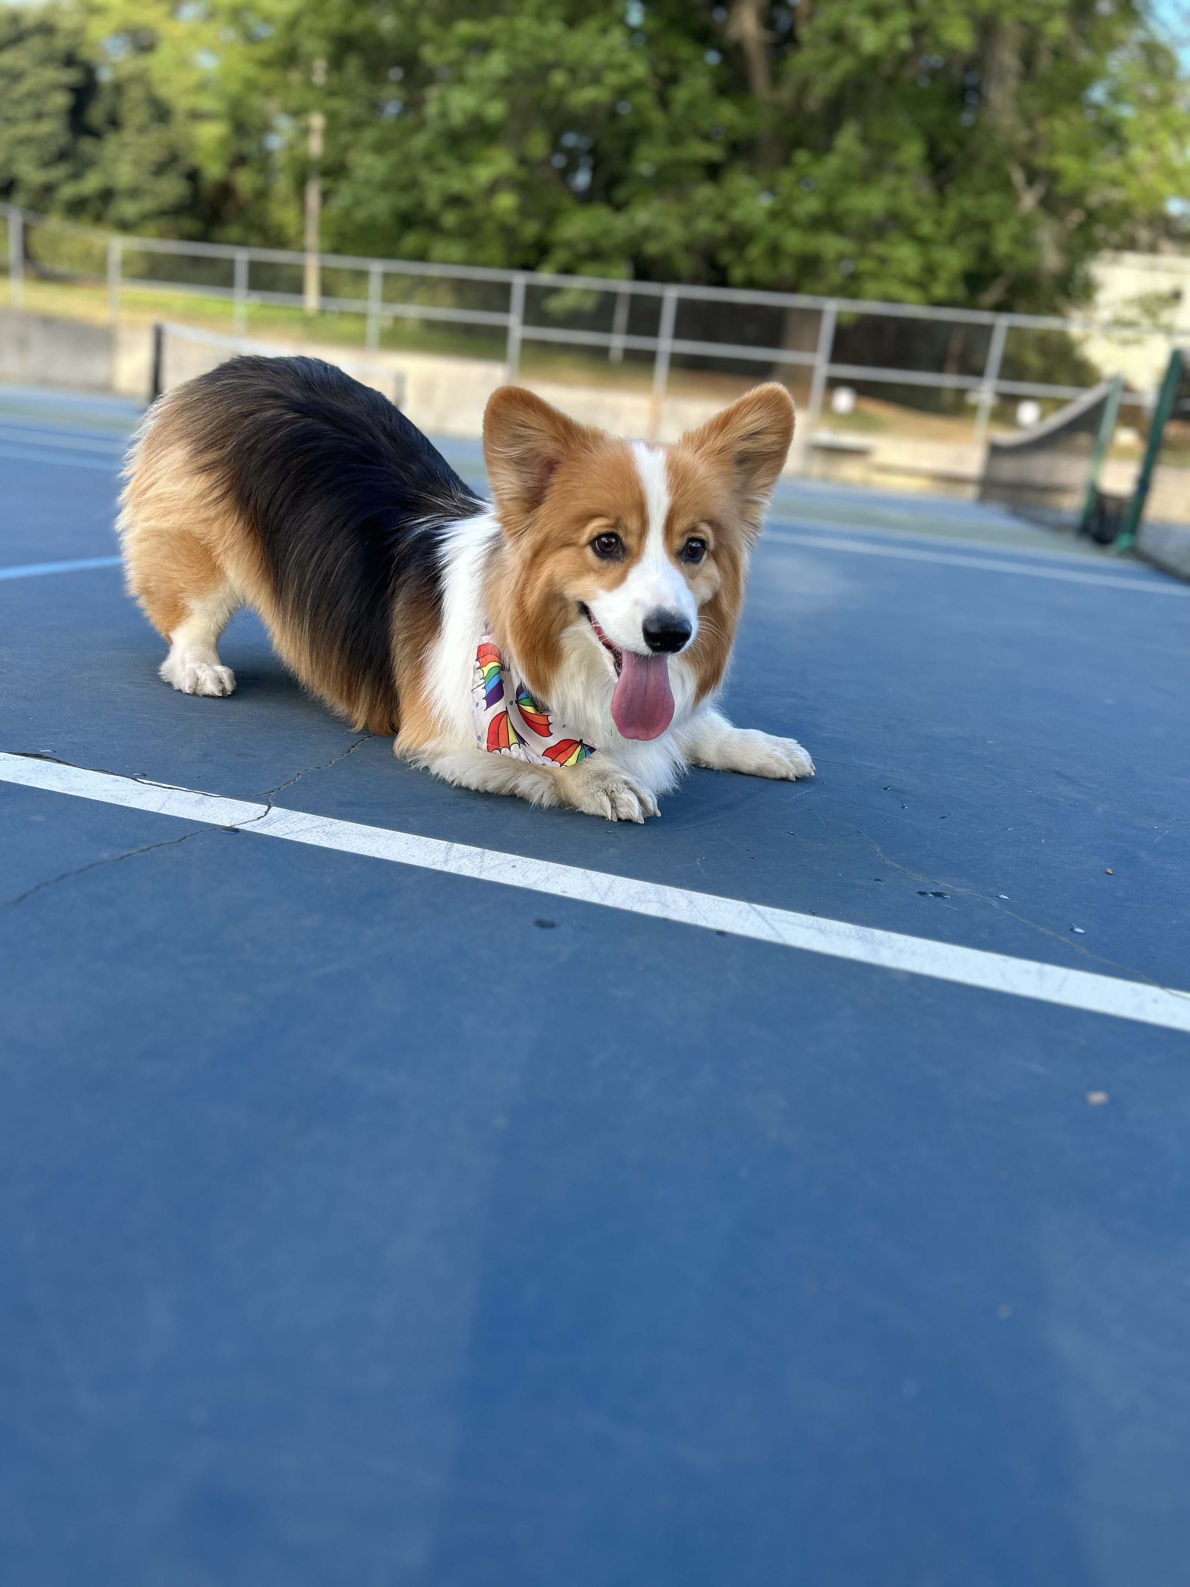
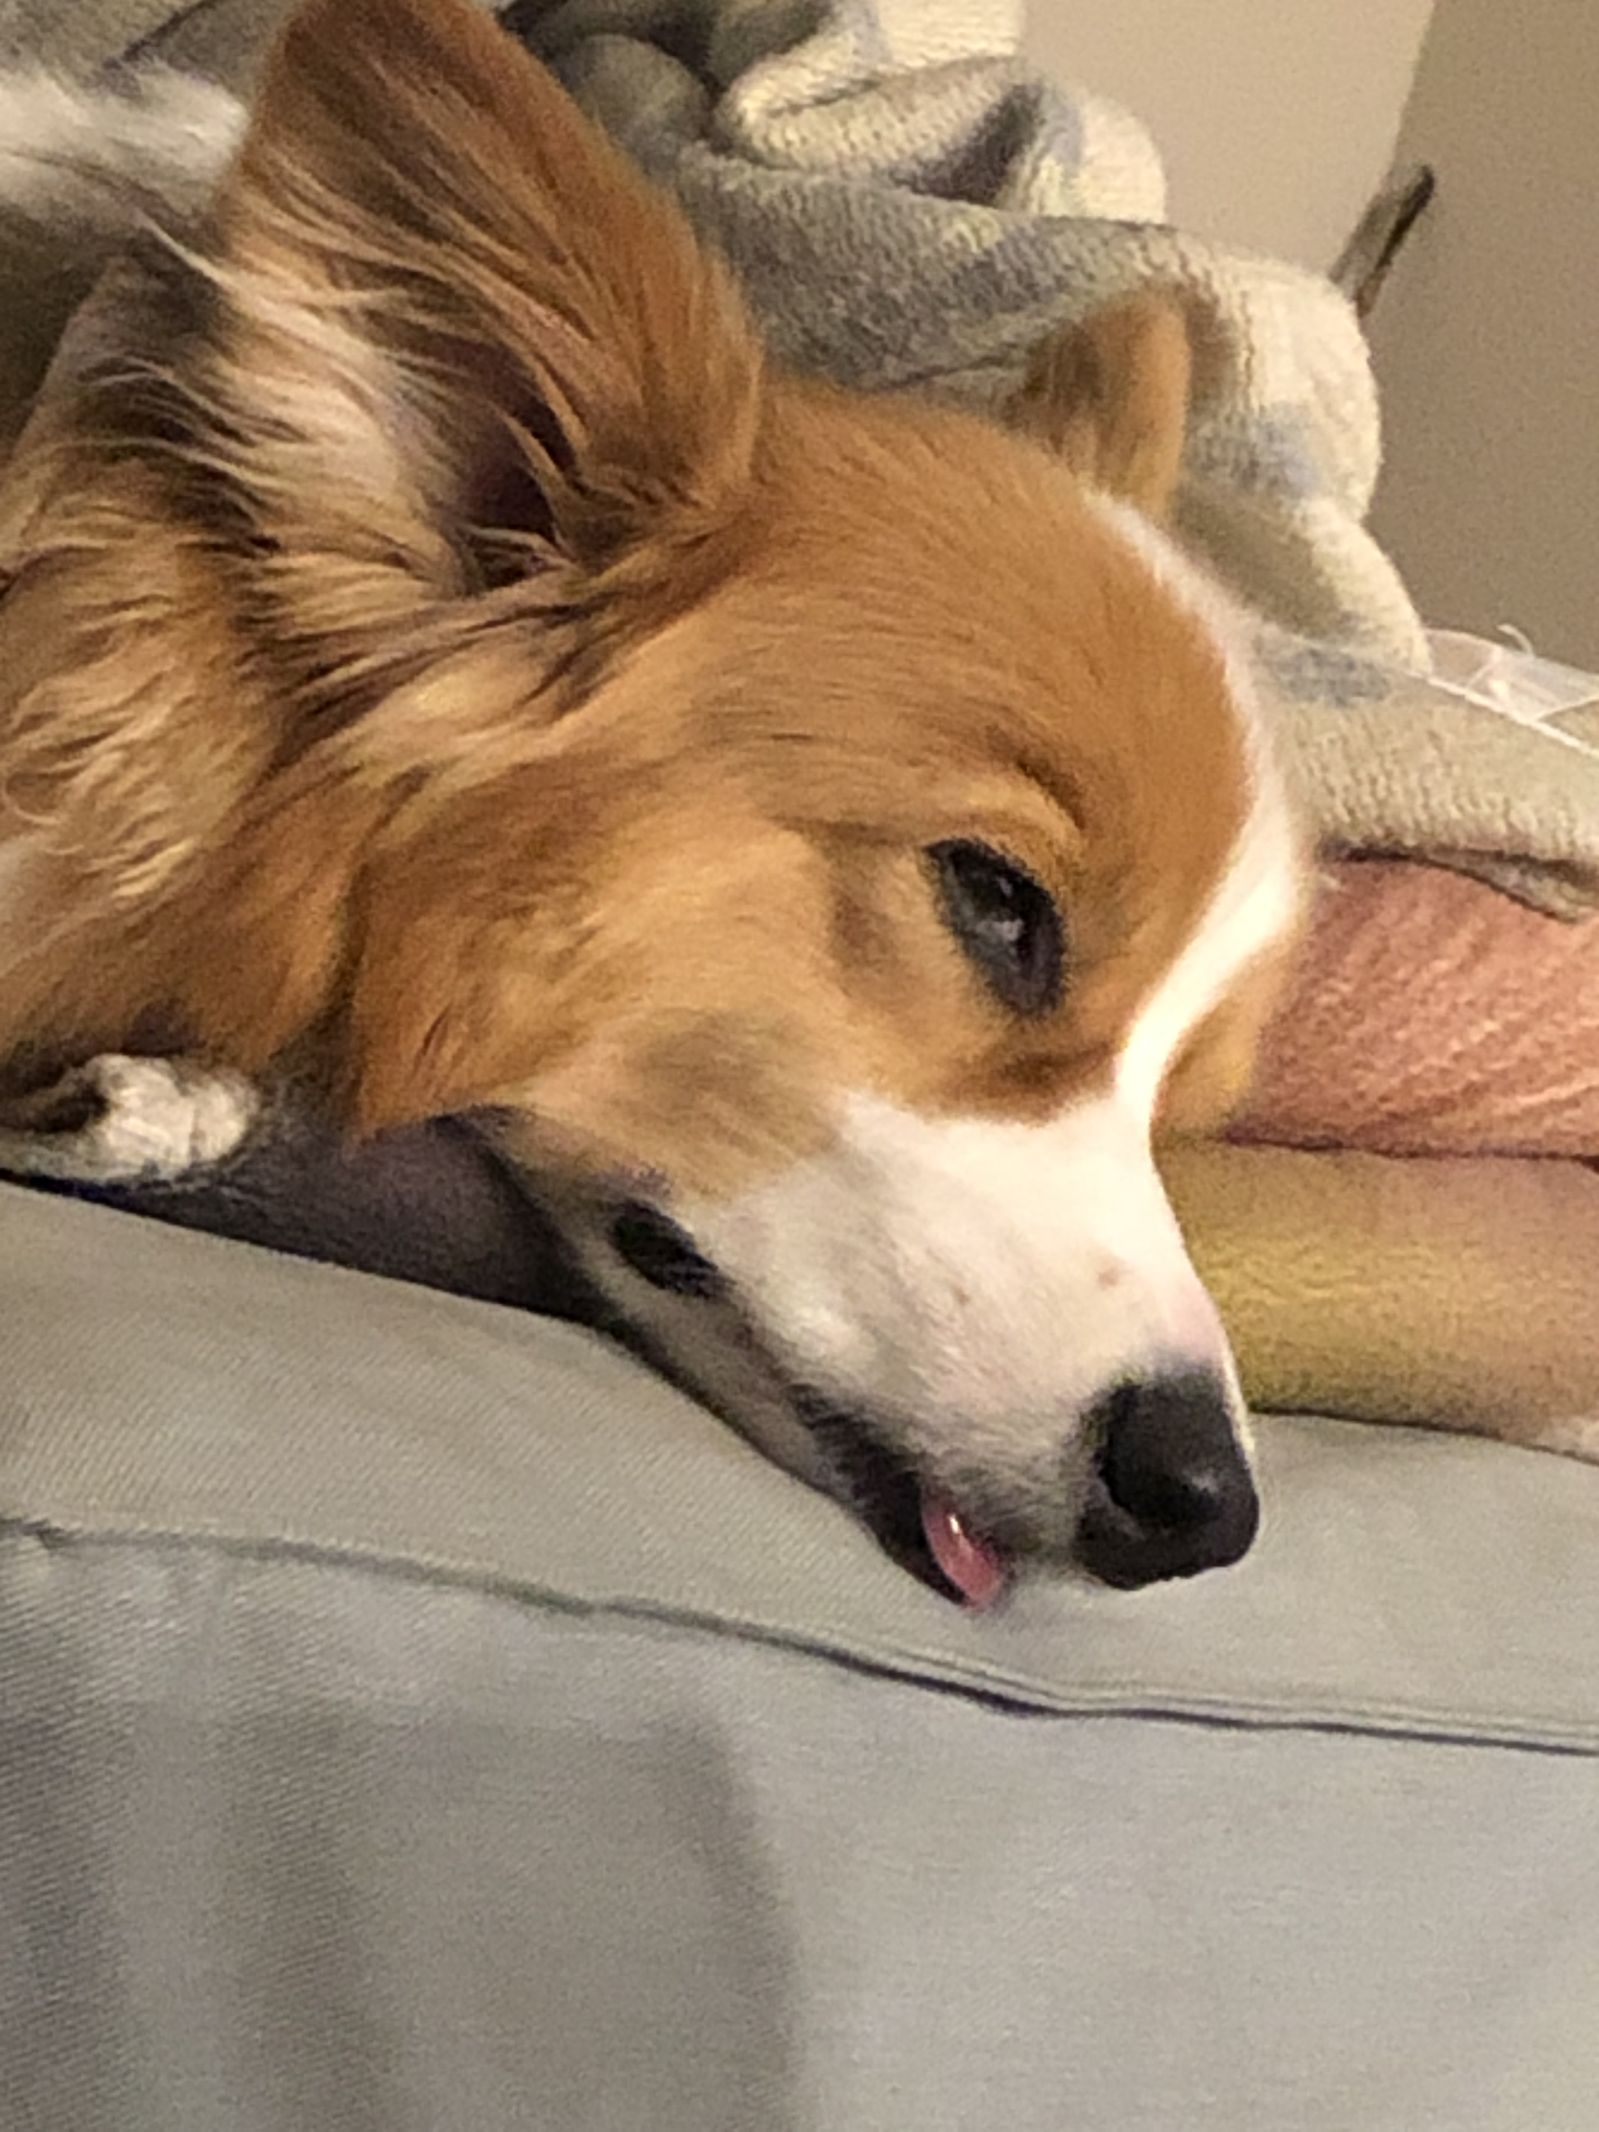


Aside: Gumball

