Slide 1
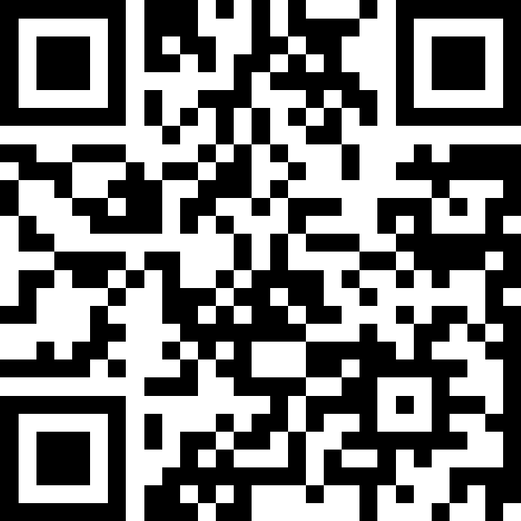
Datatypes and Expressions
BEFORE WE START
LEC 02
Talk to your neighbors:
What’s your favorite song right now?
Respond on sli.do!
Music: 🎷 CSE 121 25au Lecture Tunes 🎵
Instructors:
Brett Wortzman & James Weichert
TAs:
Trey
Amogh
Samrutha
Dalton
Ailsa
Ryan
Anant
Ava
Reese
Hayden
Aki
Spencer
Savannah
Tamsyn
Caleb
Anum
Abdul
Janvi
Navya
Sam Jessica
Elden
Suyash
Sthiti
Paul
Shayna
Jesse
Nhan
Anya
Minh
TJ
Zach
Cayden
Johnathan

Slide 2
Agenda
Announcements, Reminders
Intro Survey Recap
Variables Example
Datatypes and Expressions Review
Expressions Practice
Combining Variables and Expressions

Slide 3
Announcements, Reminders
Creative Project 0 due tonight by 11:59 PM
Programming Assignment 0 releases later today
  making a receipt generator!
  due Tuesday, April 15st at 11:59 PM
  now on regular “cadence” (Wed release, due following Tue)
IPL is open! Schedule & instructions on website.
If you joined late, welcome!
  Check out the course website and lecture recordings
  Resubmissions are your friend!

Slide 4
Agenda
Announcements, Reminders
Intro Survey Recap
Variables Example
Datatypes and Expressions Review
Expressions Practice
Combining Variables and Expressions

Slide 5
Intro Survey – things we’re excited for!
“Learning programming” / “Learning how to code”
“Meeting new people with similar interests”
“Creative projects!”
“Learning java”
“Having peers (a community) and resources for this course!”
“That [121] is open to people with no experience”

Slide 6
Intro Survey – things we’re nervous about
“Learning how to code” 🤔
“Everything being new”
  You’re all in the same boat…and in the right place!
“Coding does not come naturally”
  Everyone struggles (“coming naturally” is a myth)
“Debugging”/“When my program doesn’t work”
  Debugging is part of programming, and learning requires mistakes
  Make ugly penguins!
Workload/“Getting stuck and having to turn to AI for help”
  Utilize support systems (section, IPL, Ed, resubs, etc.)
  Reach out early!

Slide 7
Agenda
Announcements, Reminders
Intro Survey Recap
Variables Example
Datatypes and Expressions Review
Expressions Practice
Combining Variables and Expressions

Slide 8
Agenda
Announcements, Reminders
Intro Survey Recap
Variables Example
Datatypes and Expressions Review
Expressions Practice
Combining Variables and Expressions

Slide 9
PCM: Datatypes & Expressions
Programming is about data; we tell Java what type of data we have!
Datatypes (so far): int, double, String, boolean
  note: only String is capitalized!
All values in a (Java) program have a type!
  some are “obvious”, e.g. 42 or "hello world"
    aside: these are called “literals”
  some are more complicated expressions!

Slide 10
PCM: Operators
We learned a ton of operators!
Numerical:
+ Addition
- Subtraction
* Multiplication
/ Division (tricky!)
% Modulo (or “mod”)
<, >, <=, >=, ==, != Relational
Strings:
+ Concatenation (not addition!)
Booleans:
! Logical Not
&& Logical And
|| Logical Or
== and != Relational

Slide 11
PCM: Precedence
Operators have precedence (an order of operations).
In Math:
Parentheses
Exponent
Multiplication
Division
Addition
Subtraction
In Java:
Parentheses
Logical not
Multiplication, Modulo, Division
Addition (and concatenation), Subtraction
Relational operators
Equality operators
Logical AND
Logical OR

Slide 12
Expressions in “little steps”
5 + 2 * 4
1 + 2 / 3
6 * 5 % 7
8
0
30
13
1
2

Slide 13
PCM: Conversions
When mixing types in an expression, Java will convert one type to the other and then perform the operation “normally”.
Some conversions are straightforward:
ints can be converted to doubles (add .0)
ints and doubles can be converted to Strings (add "")
So, Java does these for you! (is this good? controversial!)

Slide 14
New: Conversions (Gone Wrong!!)
Other conversions are “lossy”, because you lose data.
e.g. to make 3.14 an int, you’d probably pick either 3 or 4 – but either one loses data
Java won’t do this automatically for you – you need to “ask”.
  called a type cast: you’ll see this in Friday’s PCM + in P0
Some conversions don’t make sense.
how would you convert "Beyoncé" to an int? double?
Java really doesn’t let you do these…

Slide 15
What does this expression evaluate to?
2 + 2 + "hello" + 3 * 5 + 10 a. "22hello3510" b. "22hello1510" c. "4hello1510" d. "4hello25" e. This will cause an error

Slide 16
What does this expression evaluate to?
2 + 2 + "hello" + 3 * 5 + 10 a. "22hello3510" b. "22hello1510" c. "4hello1510" d. "4hello25" e. This will cause an error

Slide 17
Expression example with mixing types
2 + 2 + "hello" + 3 * 5 + 10
" "
15
4
" "
" "
"4hello"
"4hello15"
"4hello1510"

Slide 18
Agenda
Announcements, Reminders
Intro Survey Recap
Variables Example
Datatypes and Expressions Review
Expressions Practice
Combining Variables and Expressions

Slide 19
Work on Expressions and Types Practice (1)
Ed lesson linked from course calendar
Work with folks around you!
TAs & I will walk around and help!
5 * 3 + 1.0
8 / 3 * 2.0
8.0 / 3 * 2
"Hello" + "world"
1 + "2" + 3
1 + 2 + "3"
1 + "2" + (3 + 4)

Slide 20
Part 1 Walkthrough

Slide 21
Part 1 Walkthrough (steps)
"Hello" + "world"
"Helloworld"
5 * 3 + 1.0
8 / 3 * 2.0
8.0 / 3 * 2
.0
.0
2
15
.0
2.666…
.0
16.0
4.0
5.333…
1 + "2" + 3
1 + 2 + "3"
1 + "2" + (3 + 4)
" "
" "
" "
" "
"12"
" "
"12"
7
3
"123"
"33"
"127"

Slide 22
Work on Expressions and Types Practice (2)
Ed lesson linked from course calendar
Work with folks around you!
TAs & I will walk around and help!
5 * 3 < 12
10 % 3 == 10 / 3
5 < 9 || (7 != 7)
!(1 + 2 == 3 && 10 % 4 > 2)

Slide 23
Part 2 Walkthrough

Slide 24
Part 2 Walkthrough (1)
5 * 3 < 12
10 % 3 == 10 / 3
5 < 9 || (7 != 7)
15
1
false
1 == 10 / 3
15 < 12
5 < 9 || false
false
3
1 == 3
true
true || false
false
true

Slide 25
Part 2 Walkthrough (2)
!(1 + 2 == 3 && 10 % 4 > 2)
!(1 + 2 == 3 && 2 > 2)
!( 3 == 3 && 2 > 2)
!( 3 == 3 && false )
!( true && false )
!( false )
true

Slide 26
Agenda
Announcements, Reminders
Intro Survey Recap
Variables Example
Datatypes and Expressions Review
Expressions Practice
Combining Variables and Expressions

Slide 27
Ed time :)
Applying what we learned to variables!

Slide 28
What’s in a (variable) name or String?
Switch over to Ed and do some experiments (with a partner), then report back on sli.do.
What types of characters are “allowed” in Strings?
What types of characters are “allowed” in variable names?
sli.do #cse121

Slide 29
Food for Thought!
This is the beginning of a very interesting rabbit hole!
(but also, a decision made by the Java designers)
Whether or not you program for a career,
you will also make decisions like these!
for example, what’s a “valid name”?
a theme we’ll revisit (and something to continuously reflect on!)

