Slide 1
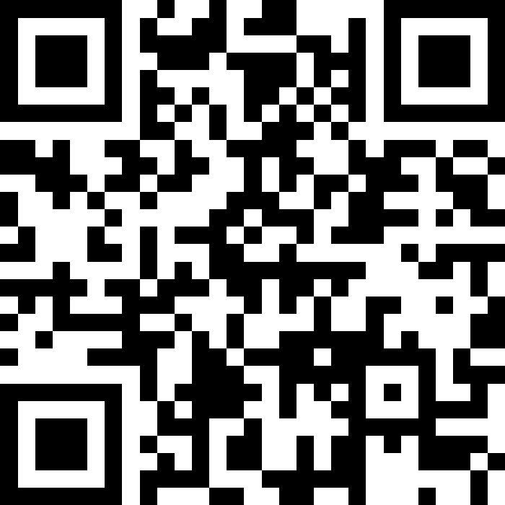
Victory Lap!
BEFORE WE START
LEC 19
Talk to your neighbors:
What are your winter break plans?
Music: 🎷CSE 121 25au Lecture Tunes 🎵
Instructors:
Brett Wortzman & James Weichert
TAs:
Trey
Amogh
Samrutha
Dalton
Ailsa
Ryan
Anant
Ava
Reese
Hayden
Aki
Spencer
Savannah
Tamsyn
Caleb
Anum
Abdul
Janvi
Navya
Sam Jessica
Elden
Suyash
Sthiti
Paul
Shayna
Jesse
Nhan
Anya
Minh
TJ
Zach
Cayden
Johnathan

Slide 2
Announcements, Reminders
R7 (and R-Extra) due Wednesday, December 10th
all assignments are eligible for resubmission!
Today is the last day for IPL and instructor office hours
Final Exam: Wednesday, December 10th from 12:30 - 2:20pm
review the Exam page of website (with policies & resources)
TA-led review session: Monday, December 8th from 4:30-7:00pm in ARC 147

Slide 3
Evaluations and Awards
Please give us feedback!
Course Evaluations are due Sunday, December 7th at 11:59 PM
Lecture A Eval
Lecture B Eval
TA Evaluations are also due Sunday, December 7th at 11:59 PM
Bob Bandes TA Award nominations open!
thought your TA was goated? write them a nomination!
fun fact: some of our faculty won the award when they were TAs!

Slide 4
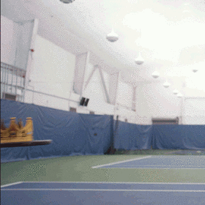






You Made It!

Slide 5
Applications of Computer Science
or “What can I do with what I learned?” – outside of just “write code”:
Help deaf & hard-of-hearing people identify sounds
Develop a programming language that celebrates the world’s languages
Build battery-free robots & put them on insects (and... track murder hornets?)
Detect and prevent toxicity online & recognize disinformation
Computational knitting & carpentry
Create an interactive atlas of millions of refugee experiences
Fix Olympic badminton & identify cheating in chess
and so much more!

Slide 6
… including our assignments! (1/2)
Computational Biology & Medicine (P2, P3)
in CSE: Chris Thachuk, Linda Shapiro, Sara Mostafavi, Su-In Lee, Luis Ceze
Computational Art (C0, C1)
UW CSE has many unique intersections of CS + art!
“Cultural-Centric Computational Embroidery” (CSE + iSchool)
“Computational Illusion Knitting”, “How to Knit Objects Weird”
“WasteBanned: Supporting zero waste fashion design”

Slide 7
… including our assignments! (2/2)
Games & Graphics (C1, C3)
at UW: many labs in CSE and iSchool’s GAMER group
fun fact: Foldit is a crowd-sourced game for protein folding
David Baker shared this year’s Nobel Prize in Chemistry, in part for this!!
Social Computing (P1)
at UW: Amy Zhang’s Social Futures Lab + so much of iSchool
Computer Security (C2)
in CSE: Franzi Roesner, David Kohlbrenner, Nirvan Tyagi
and many side quests (in lecture, section, PCM): accessibility (e.g. UW CREATE), weather forecasting, chatbots, and lots of math

Slide 8
Closing the Loop (1/5)
Other applications and intersections of computer science:
Economics and Finance
predicting stock market trends
Environmental and Climate Science
forecasting climate change
impact of energy use and e-waste from computers
Biology and Medicine
detecting cancer

Slide 9
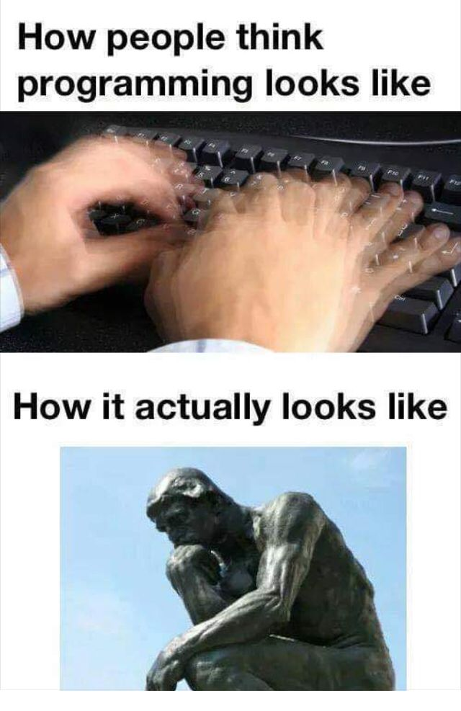
Closing the Loop (2/5)
Expectations vs. reality of CS
Not (just) writing and debugging code
“Now I see [coding] more as step-by-step problem solving, breaking tasks into smaller parts, testing, and writing clear code”
“coding is a little like creating art, you get to implement your own creativity”
“[CS] is also about thinking clearly and breaking big problems into small steps”

Slide 10
Closing the Loop (3/5)
Expectations vs. reality of CS
Who codes (and uses code):
“computer science felt kind of intimidating and ‘only for tech people.’ Now I see it more as step-by-step problem solving”
“I have now learned and realized that the concepts and skills that I have learned in this class has helped me better understand my own field that I am interested in”

Slide 11
Closing the Loop (4/5)
Reflecting on your journey (so far) learning CS!
Some good surprises…
“I came into this course not expecting too much, but as the quarter ends, I'm realizing just how much I've learned, and I'm pretty proud of myself”
“it taught me a lot about persistence and opened my mind to the different possibilities”
“This course was a lot more fun than I thought it'd be”
This course gives me a new perspective on coding. That was amazing”
…and challenged expectations
“Computer science is much harder than I thought it would be.”

Slide 12
Closing the Loop (5/5)
Some responses that made us chuckle:
“I should check my code and output more carefully in each homework, reduce the resubmission times.”
“Honestly, I really hated coding and CS in general since both of my parents are software engineers and they pushed it on me. This course took my opinion and switched it completely”
“Before this course, I was the #1 coding hater…even though I still don’t see coding as my strongest skill, I’ve become more comfortable and less afraid of it.”

Slide 13
Future Courses
More 12X!
or “What can I do next?”
Course | Overview
CSE 122 | Data structures, object-oriented programming
CSE 123 | More OOP, recursion
Non-majors
Course | Overview
CSE 154 | Intro to web programming (several languages)
CSE 160 | Intro programming, data analysis (Python)
CSE 163 | Intermediate programming, data analysis (Python)
CSE 180 | Introduction to data science (Python)
CSE 373 | Data structures and algorithms (in Java)
CSE 374 | Low-level programming and tools (C/C++)
CSE 412 | Intro to Data Visualization
CSE 416 | Intro. to Machine Learning
CSE 493E | Accessibility
Majors
Course | Overview
CSE 311 | Mathematical foundations
CSE 331 | Software design/implementation
CSE 340 | Interaction programming (mobile apps)
CSE 341 | Programming languages
CSE 351 | Hardware / Software Interface
CSE 480 | Social impacts of computing
Related majors: Informatics, ACMS, HCDE, ECE, …
See: https://www.cs.washington.edu/academics/ugrad/current-students and https://www.cs.washington.edu/academics/ugrad/nonmajor-options/nonmajor-courses

Slide 14
Generalizing beyond Computer Science
Some of you said, ”I’m glad I took this class, but no more CS for me”
That’s totally valid!
Some lessons from this class that could apply more broadly:
how to break big problems into smaller subproblems
how to isolate what part of a system is broken
attention to detail
understanding basics of how software works
how to learn (and reflect) effectively

Slide 15
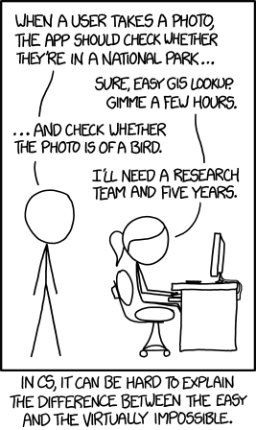
Frequently Asked Questions
How can I get better at programming?
Practice!
How can I learn to X?
Classes, books, videos, or self-learn!
CS (as a field) has lots of free resources :)
What should I do next?
Anything you’re interested in!
but: hard to tell what’s easy and what’s hard
Should I learn another language? Which one?
That depends – what do you want to do?

Slide 16
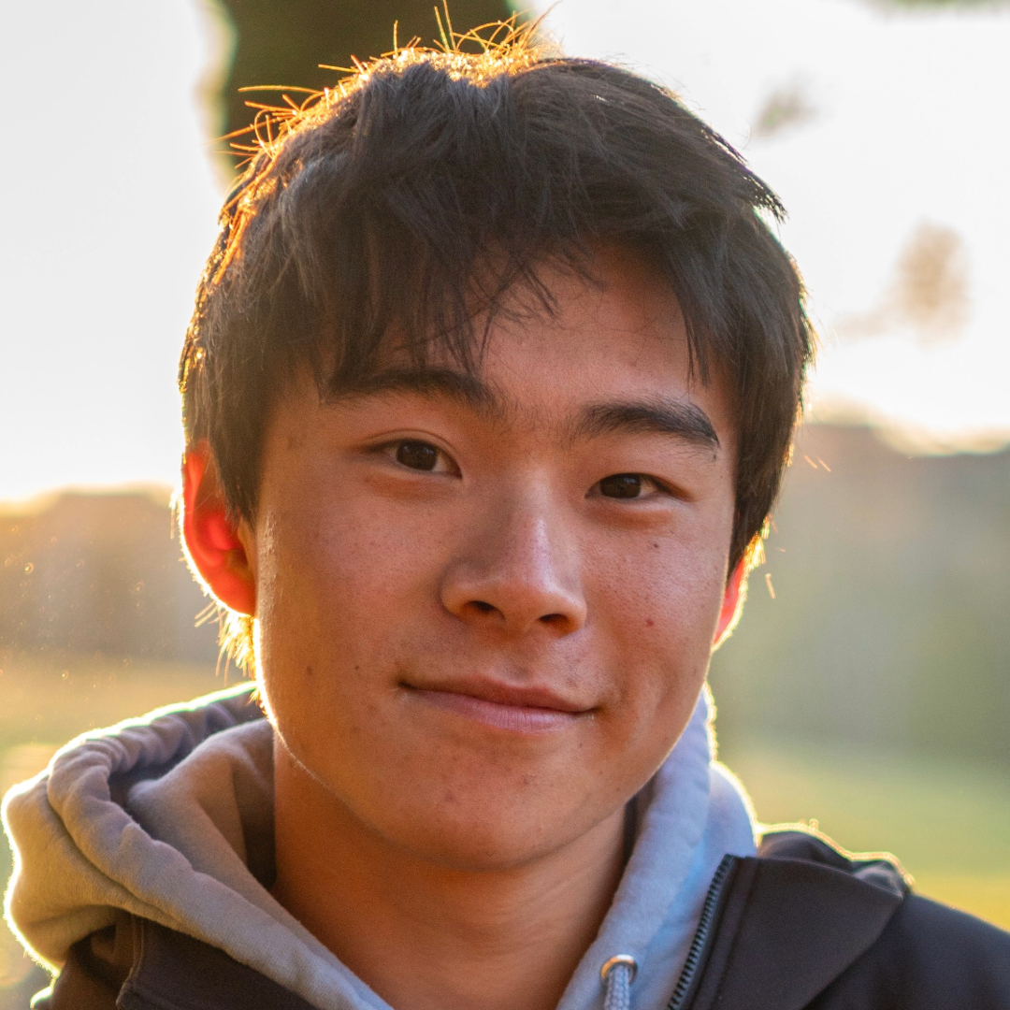
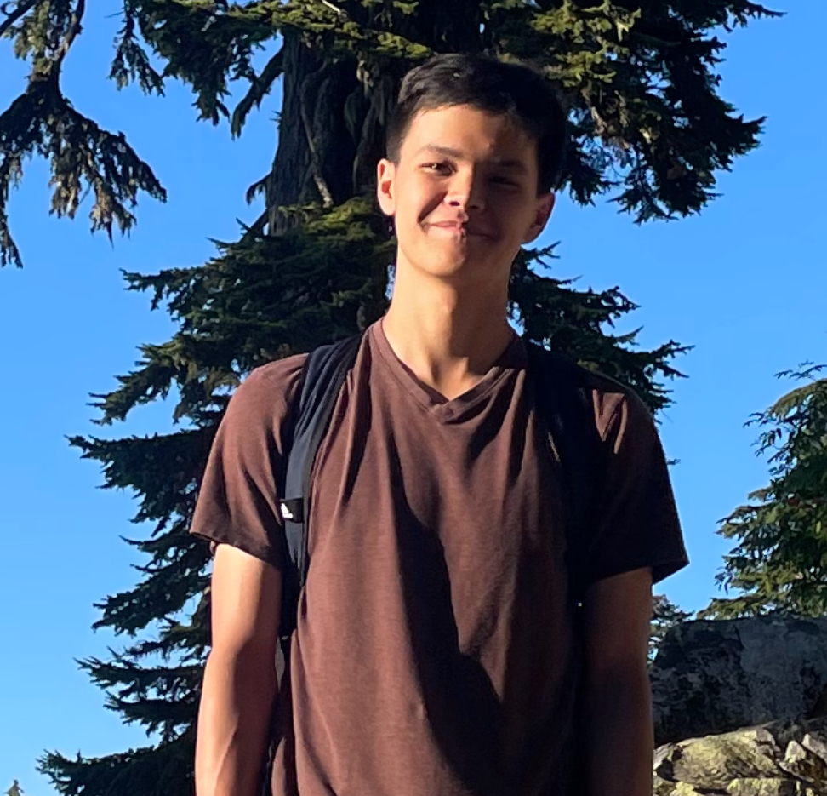
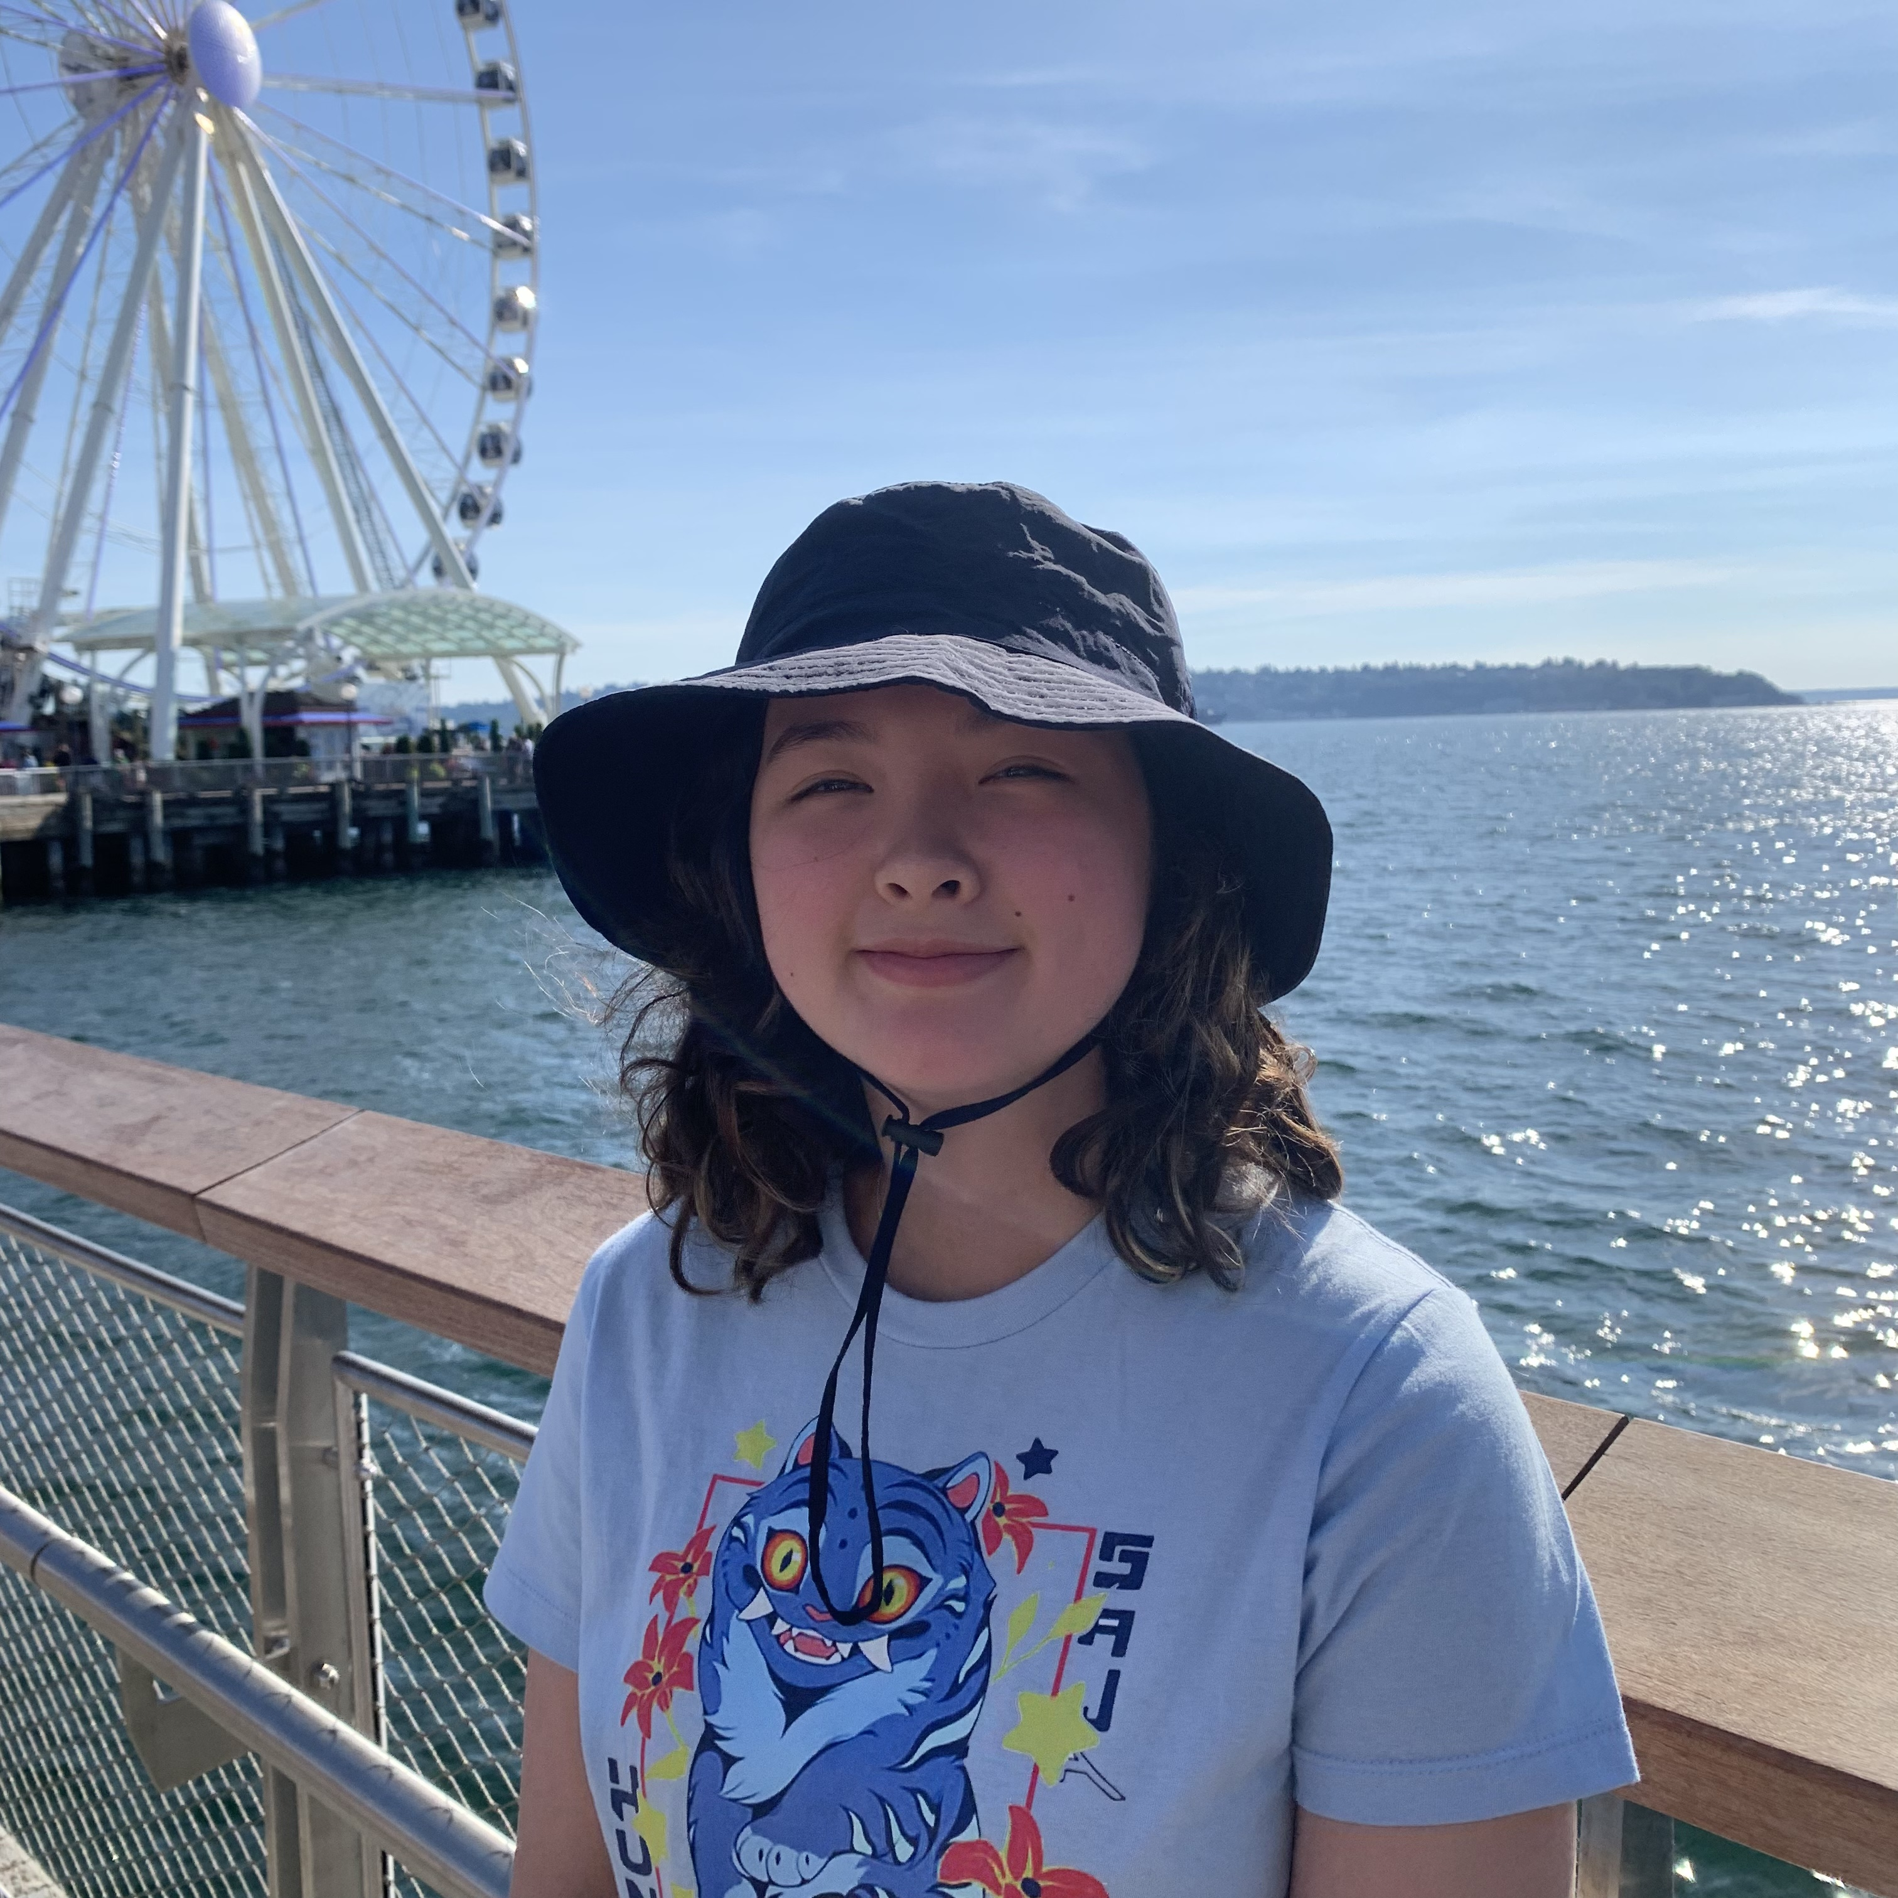

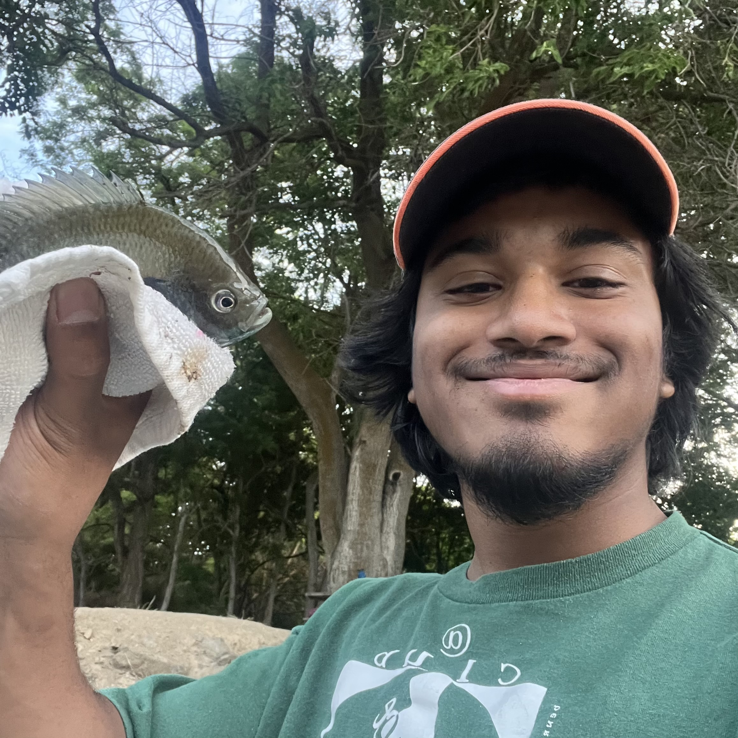
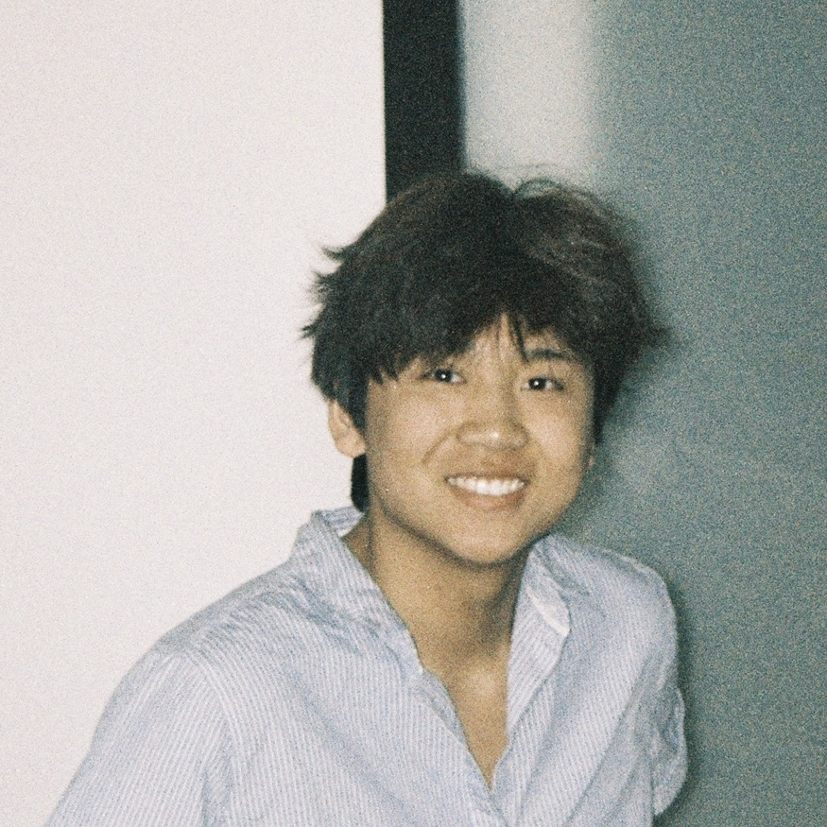
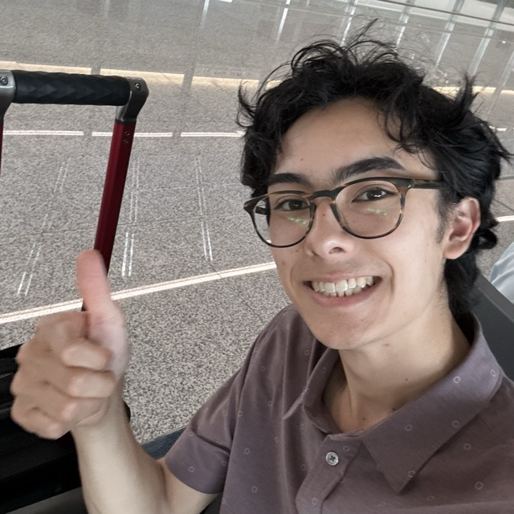
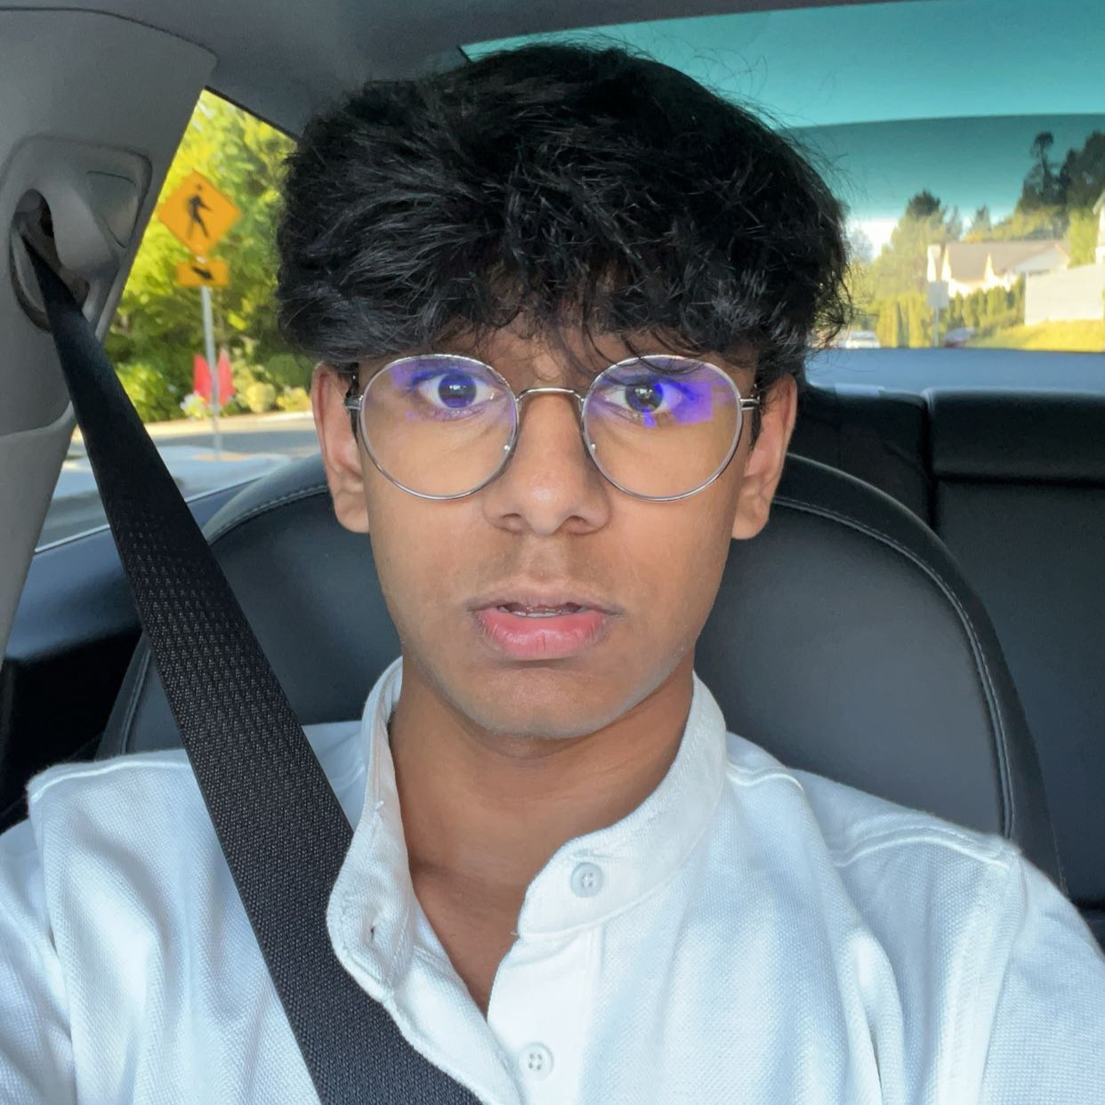
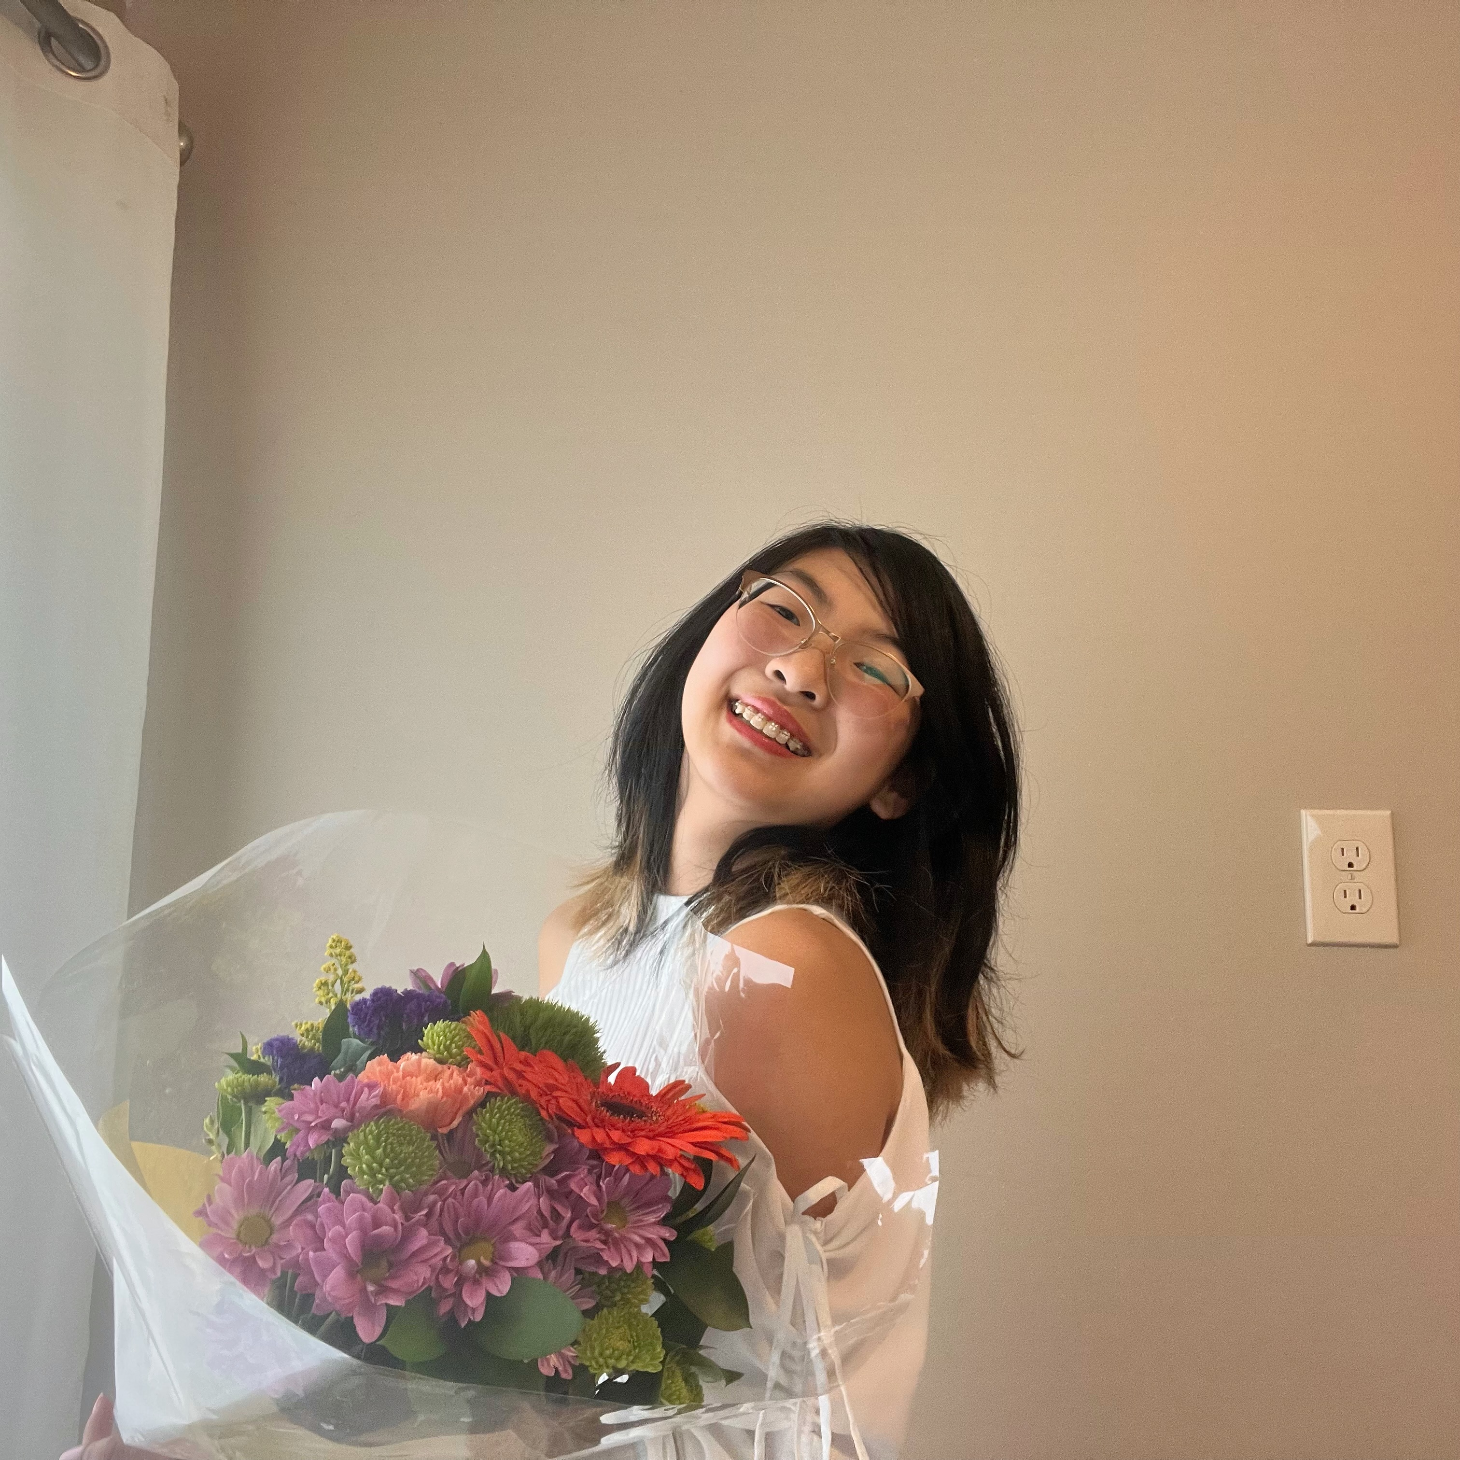
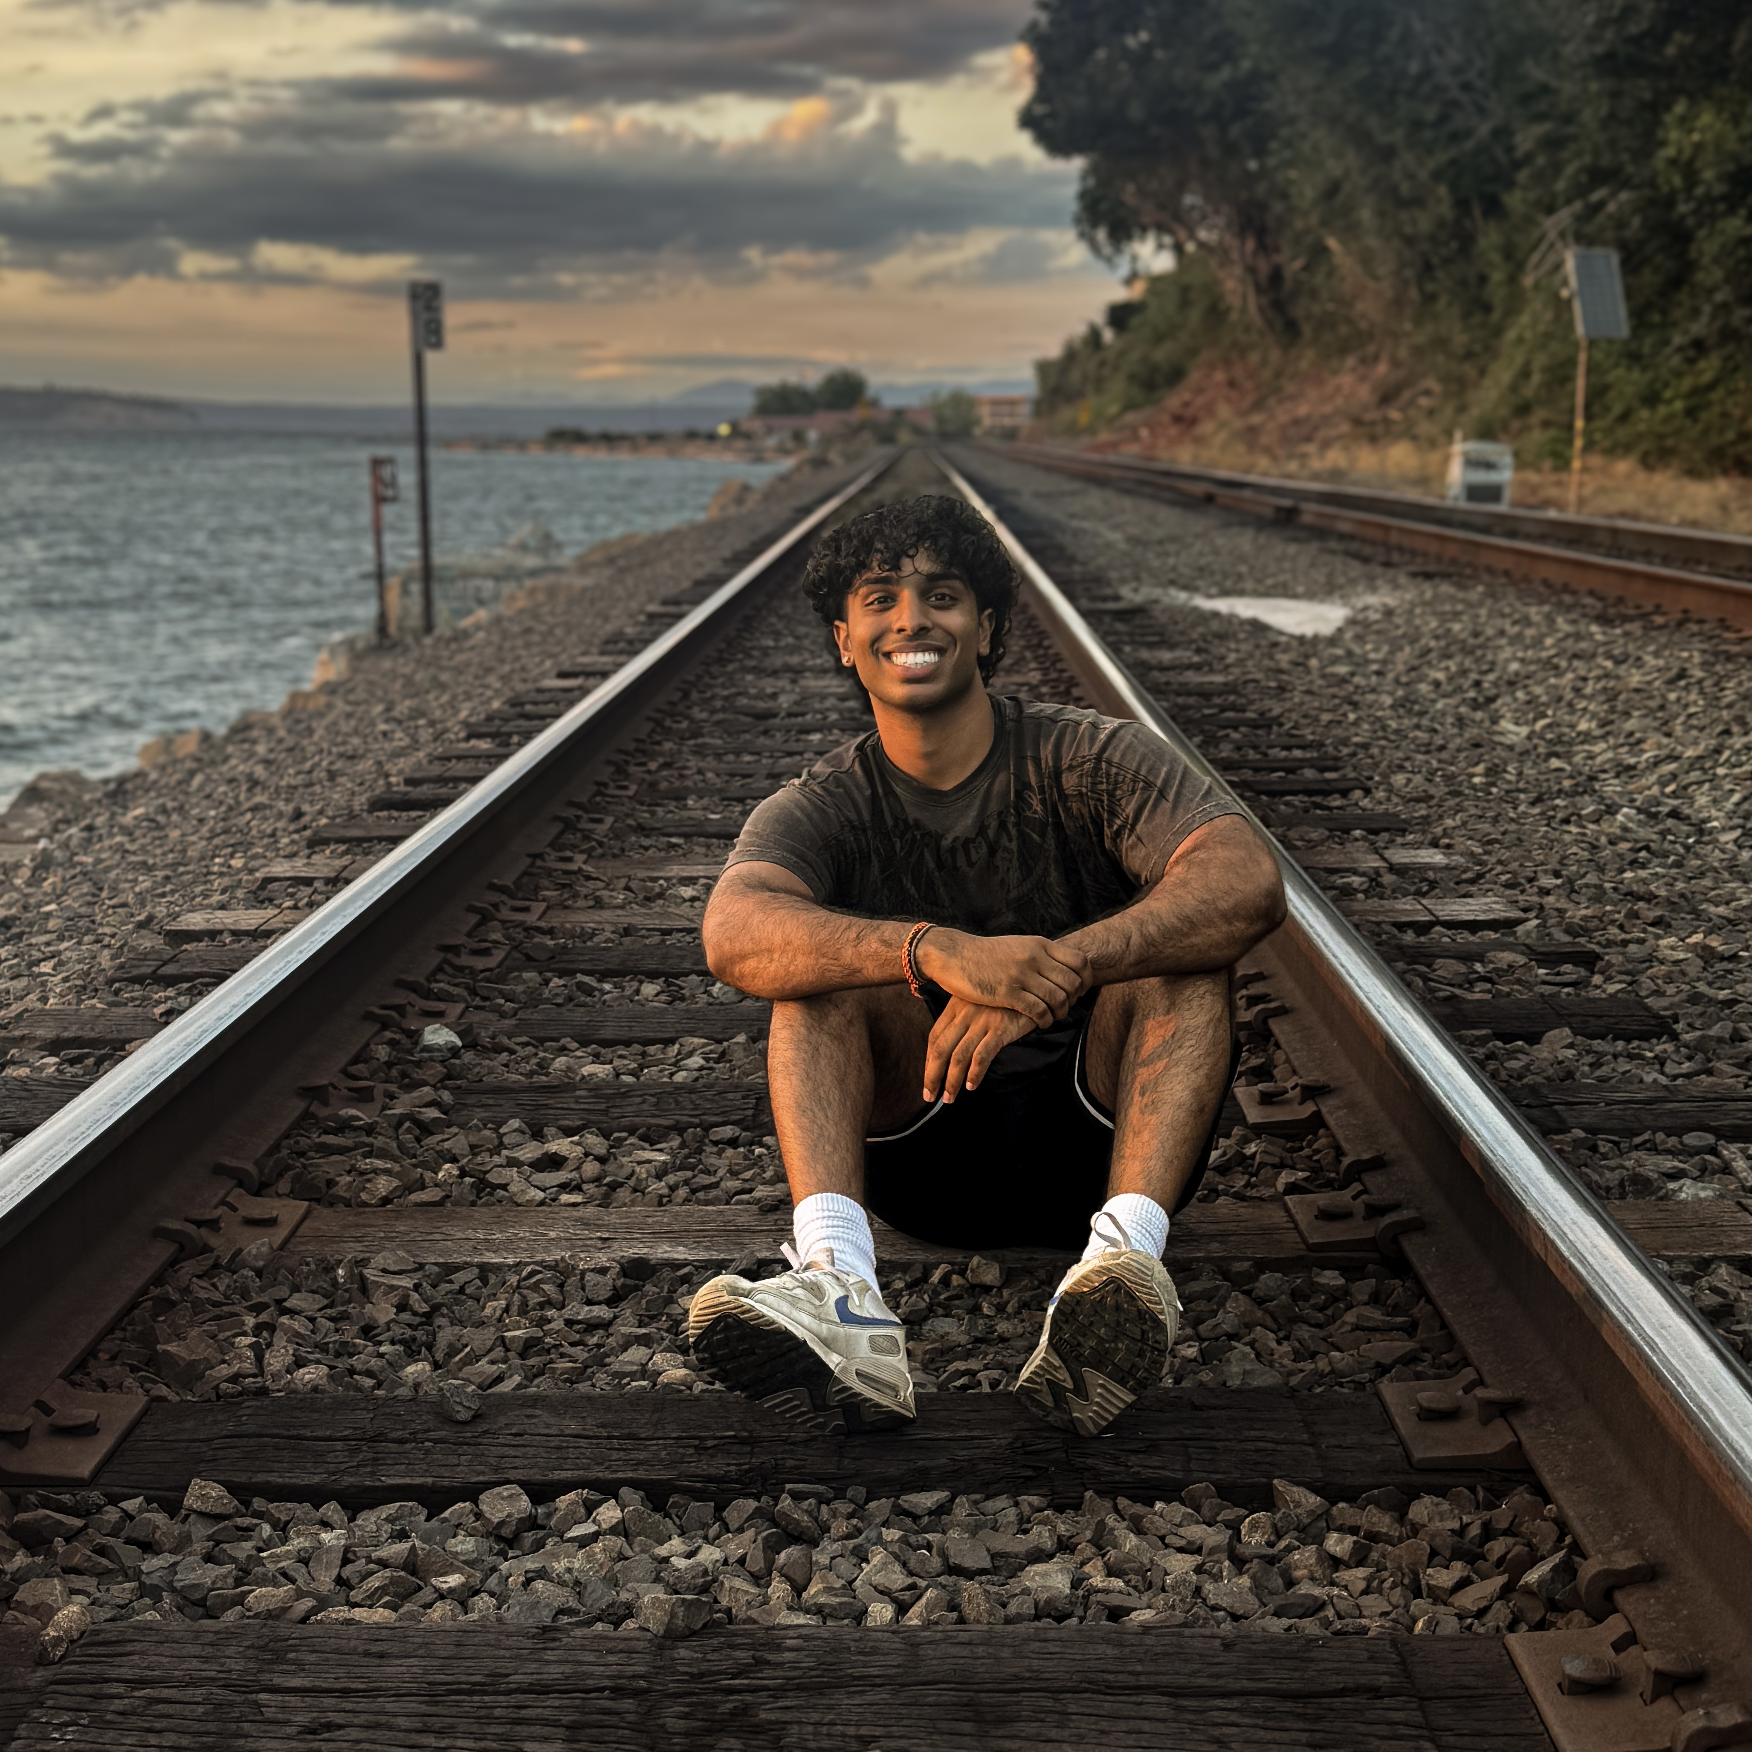
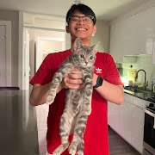
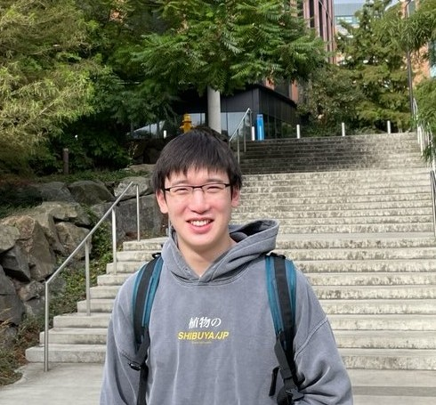
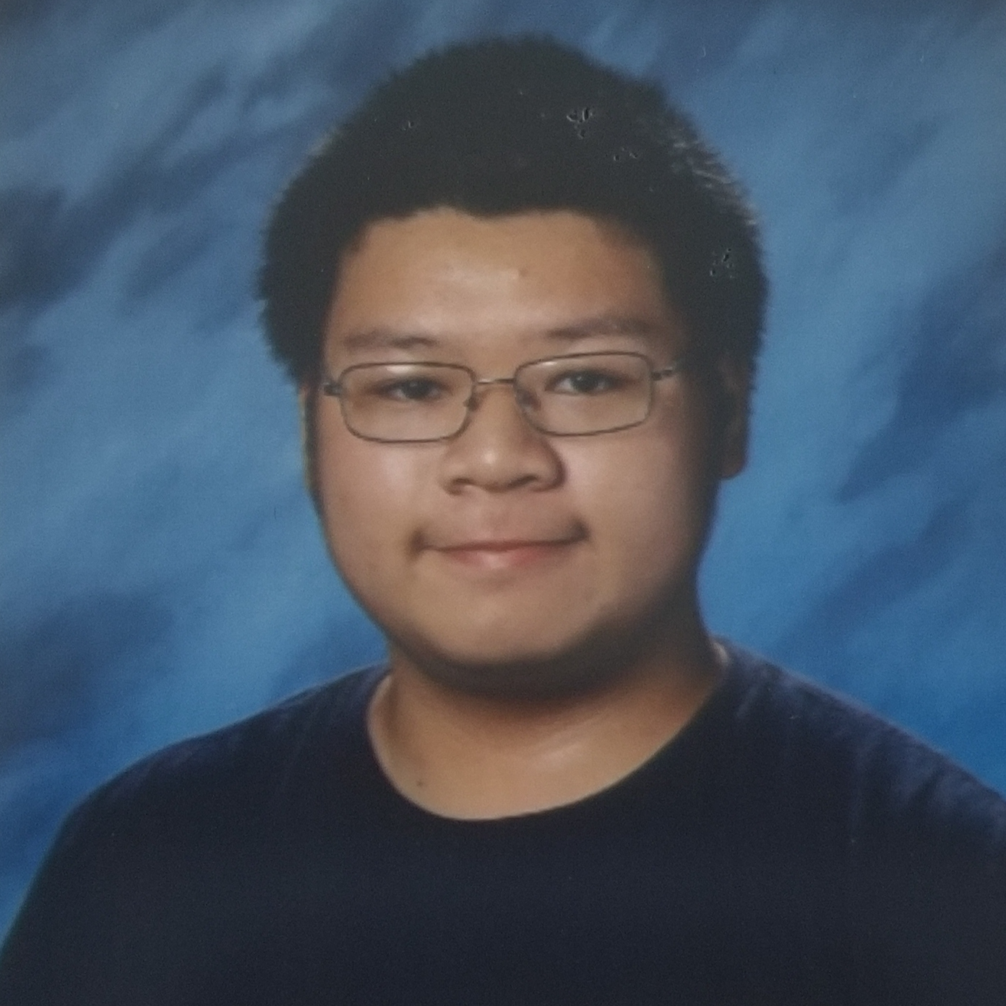
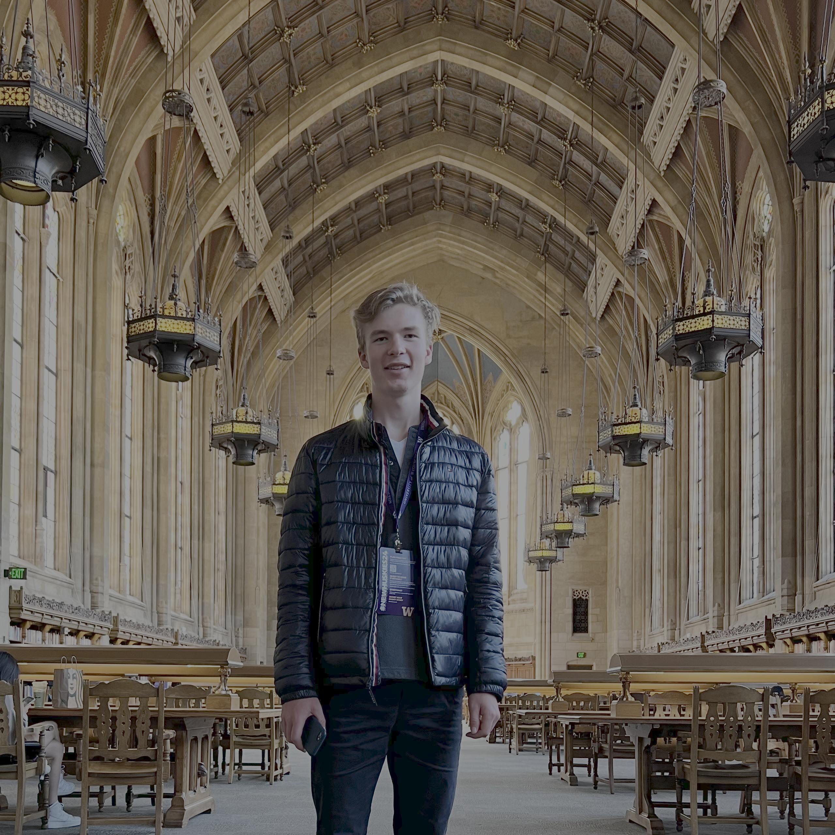
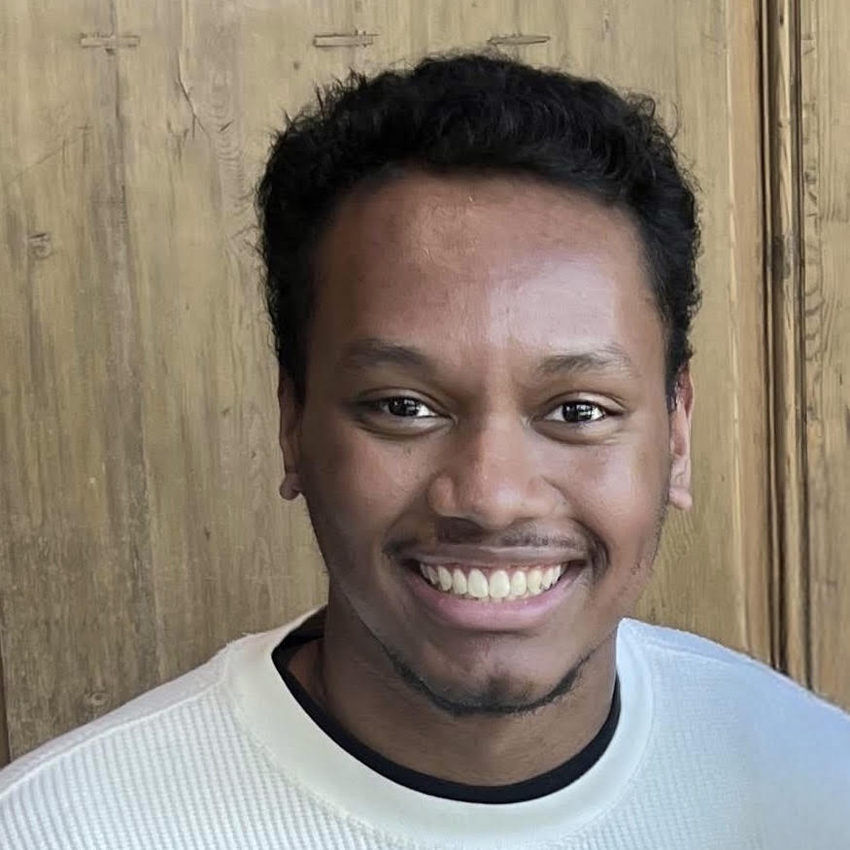
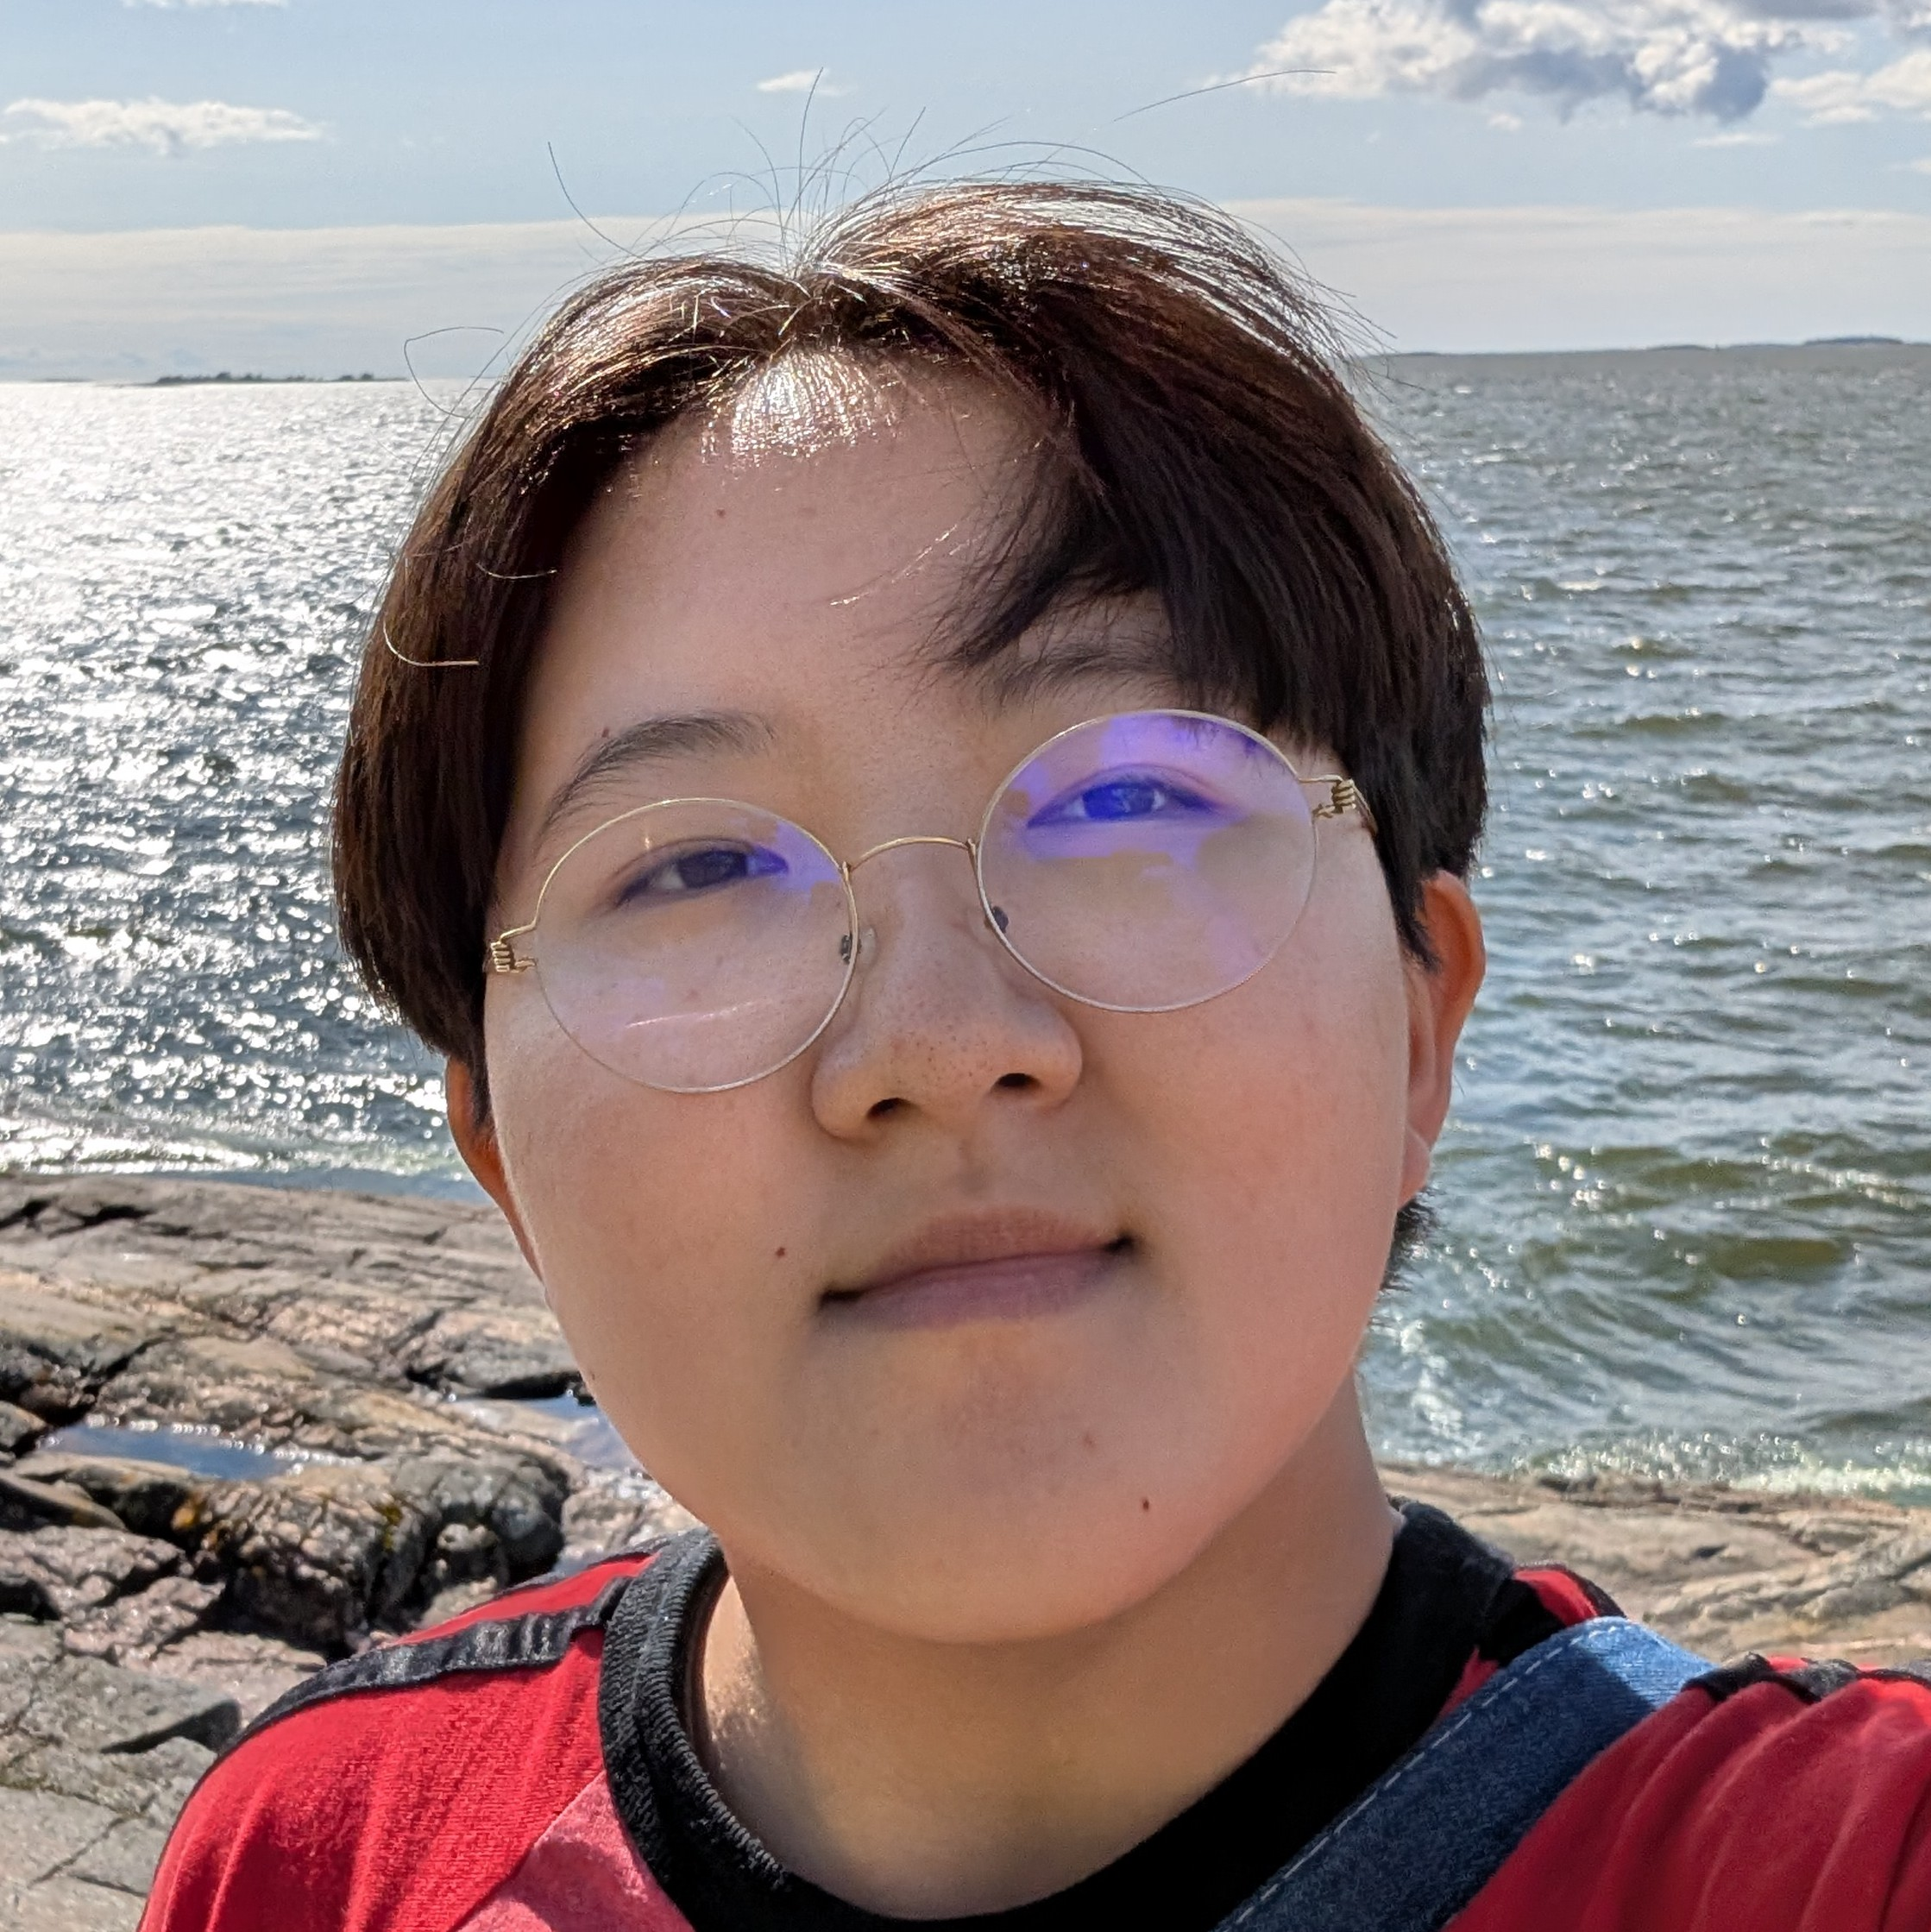
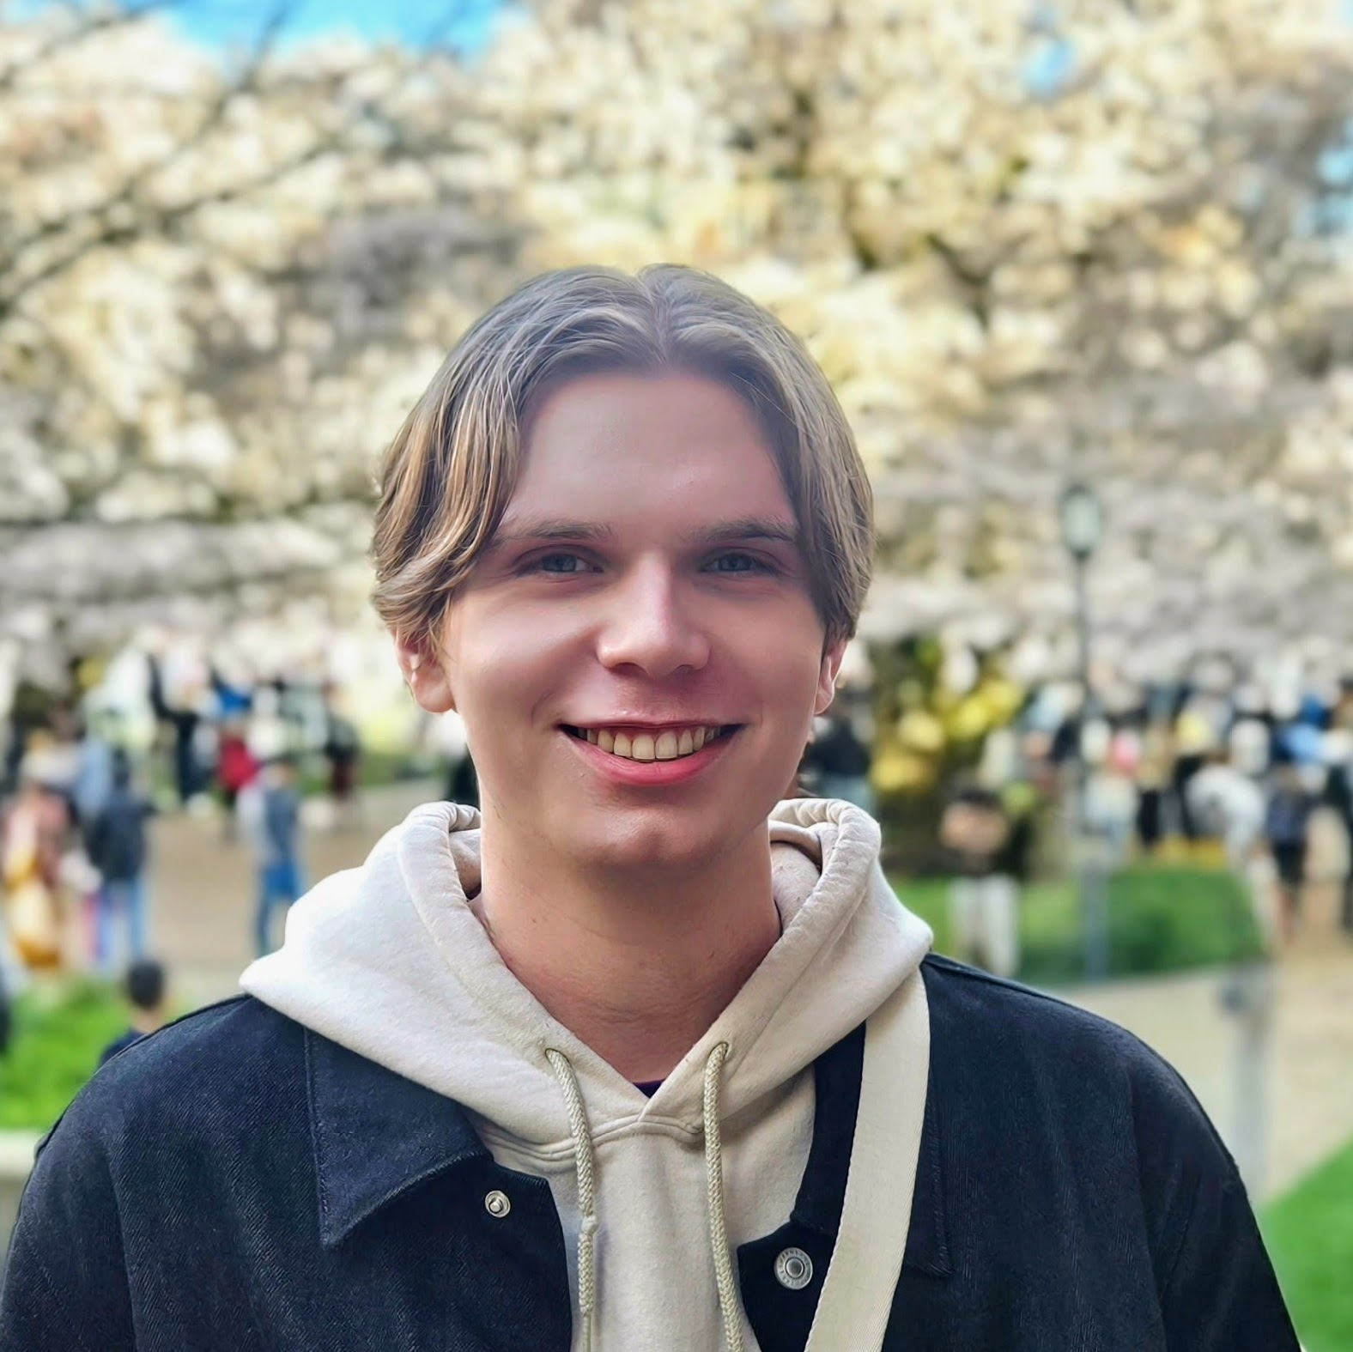
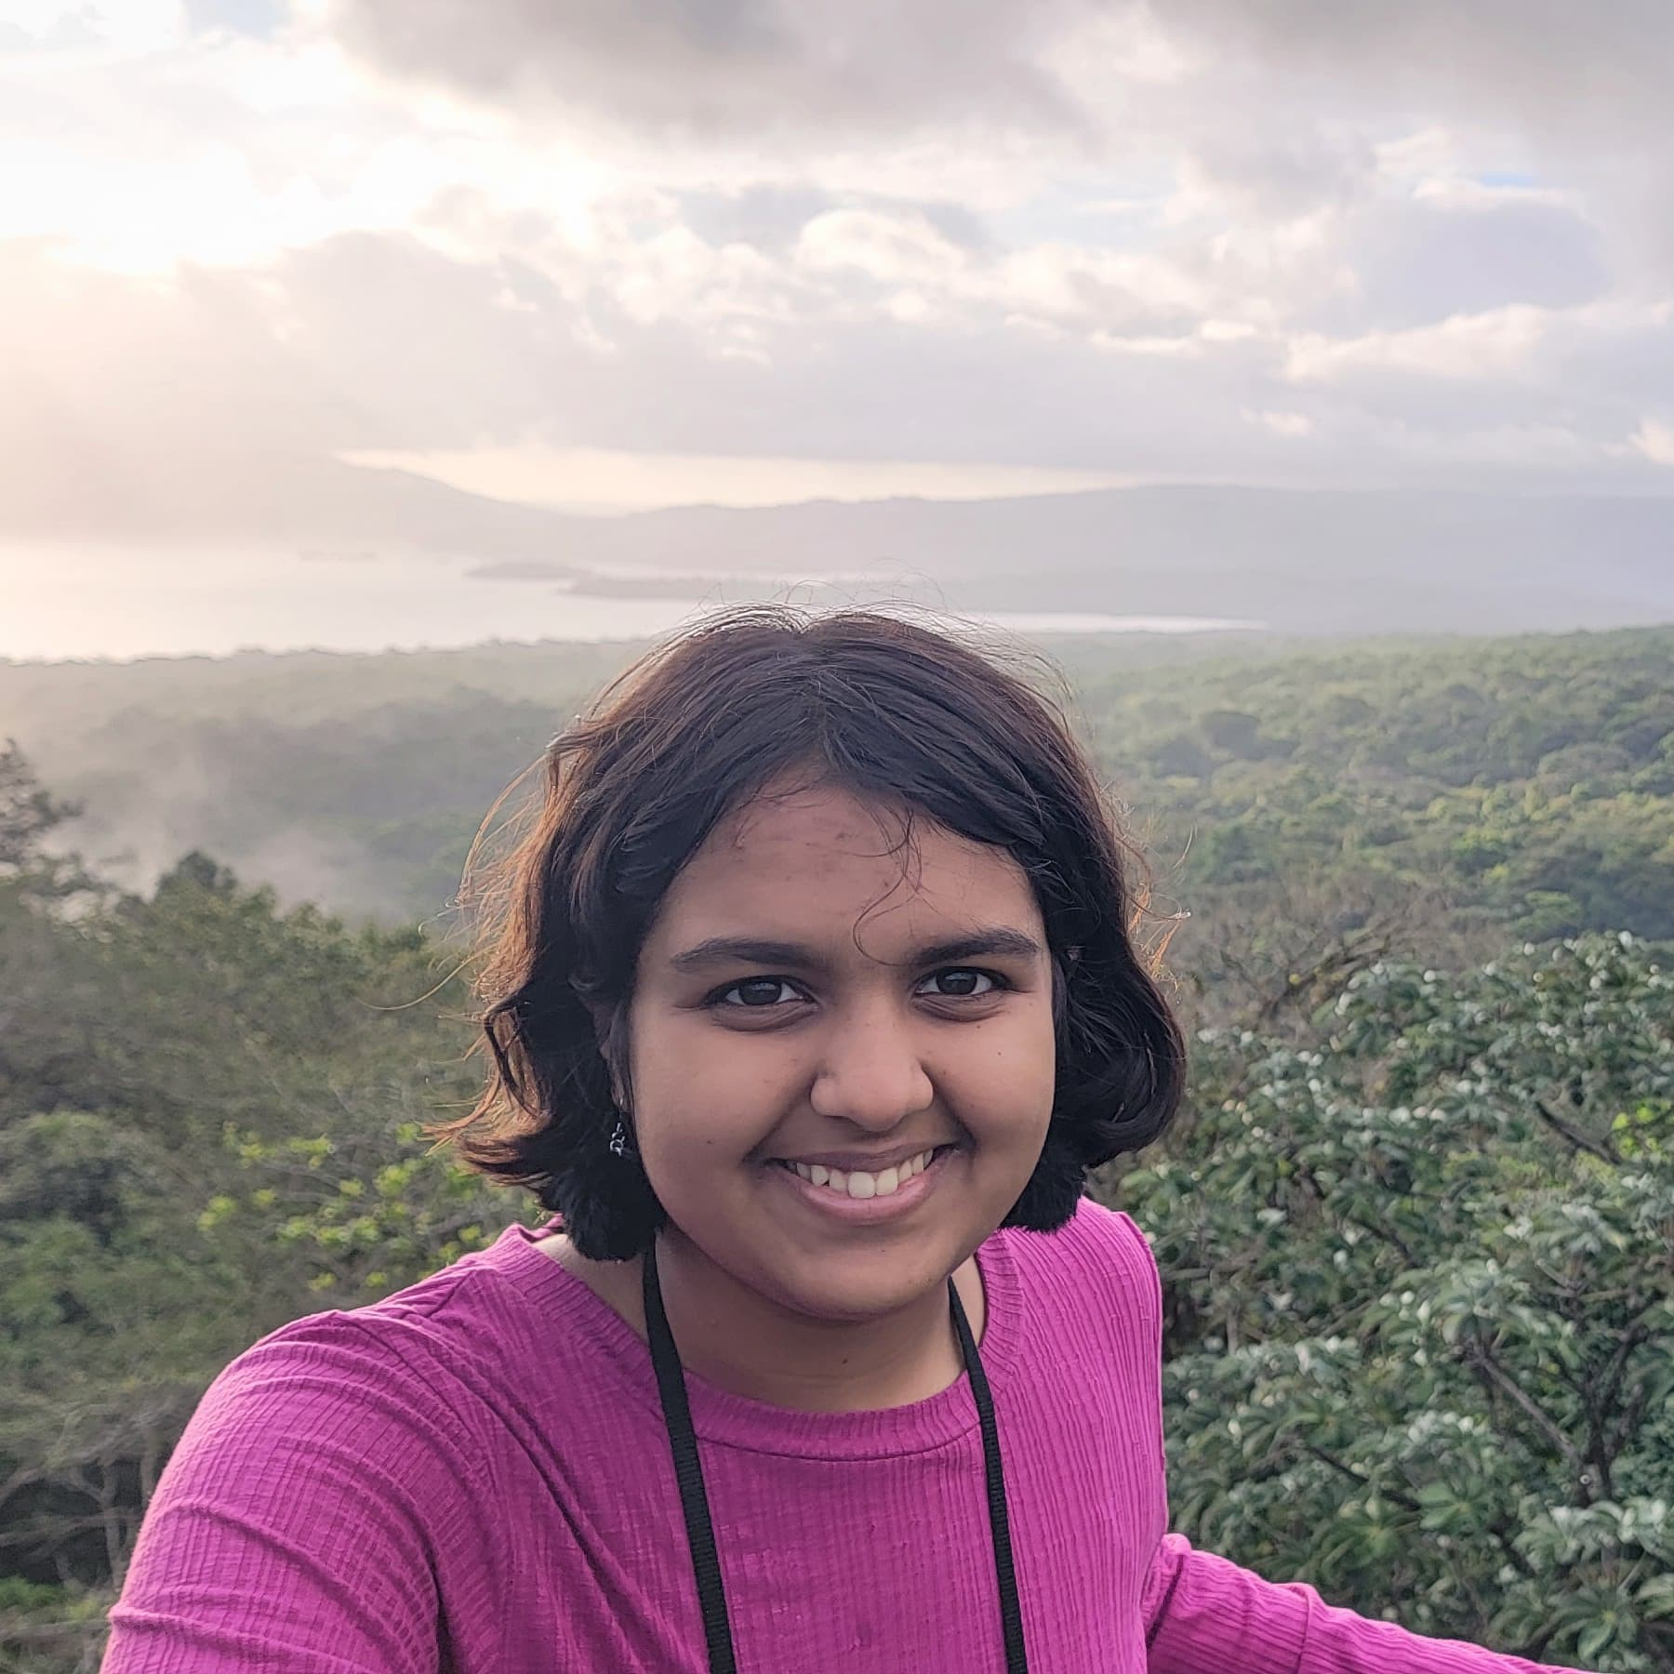
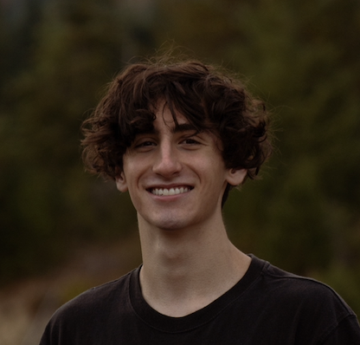
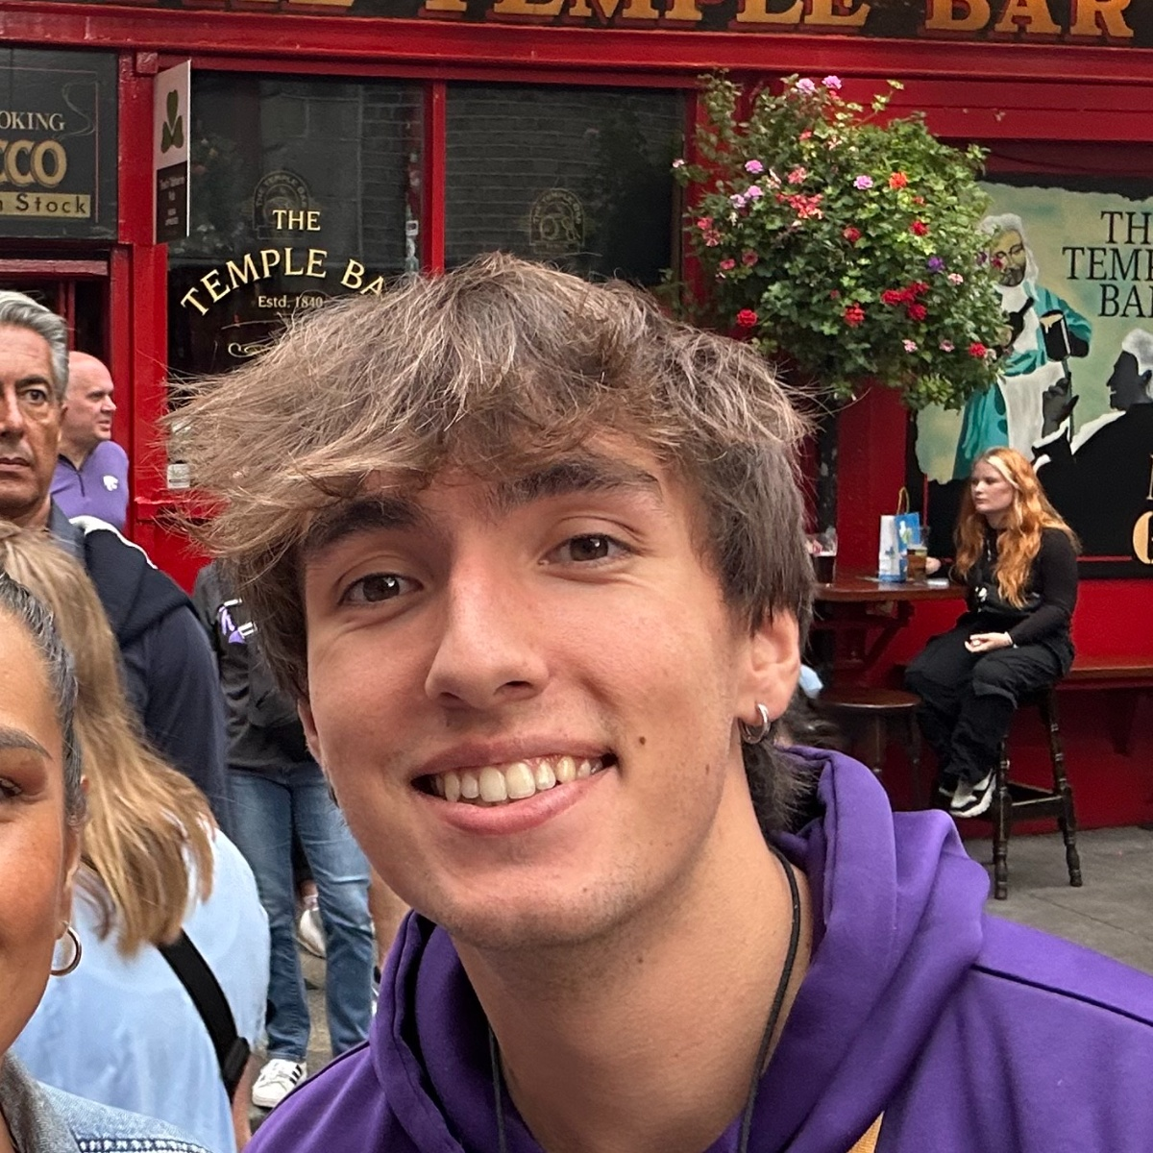
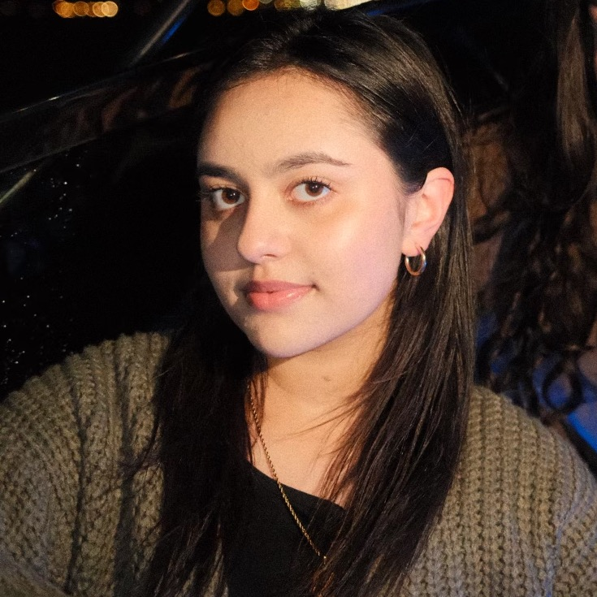
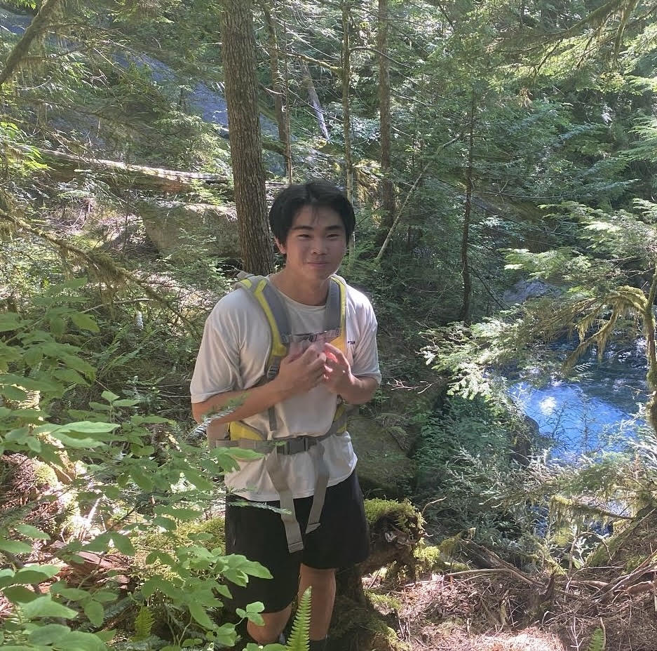
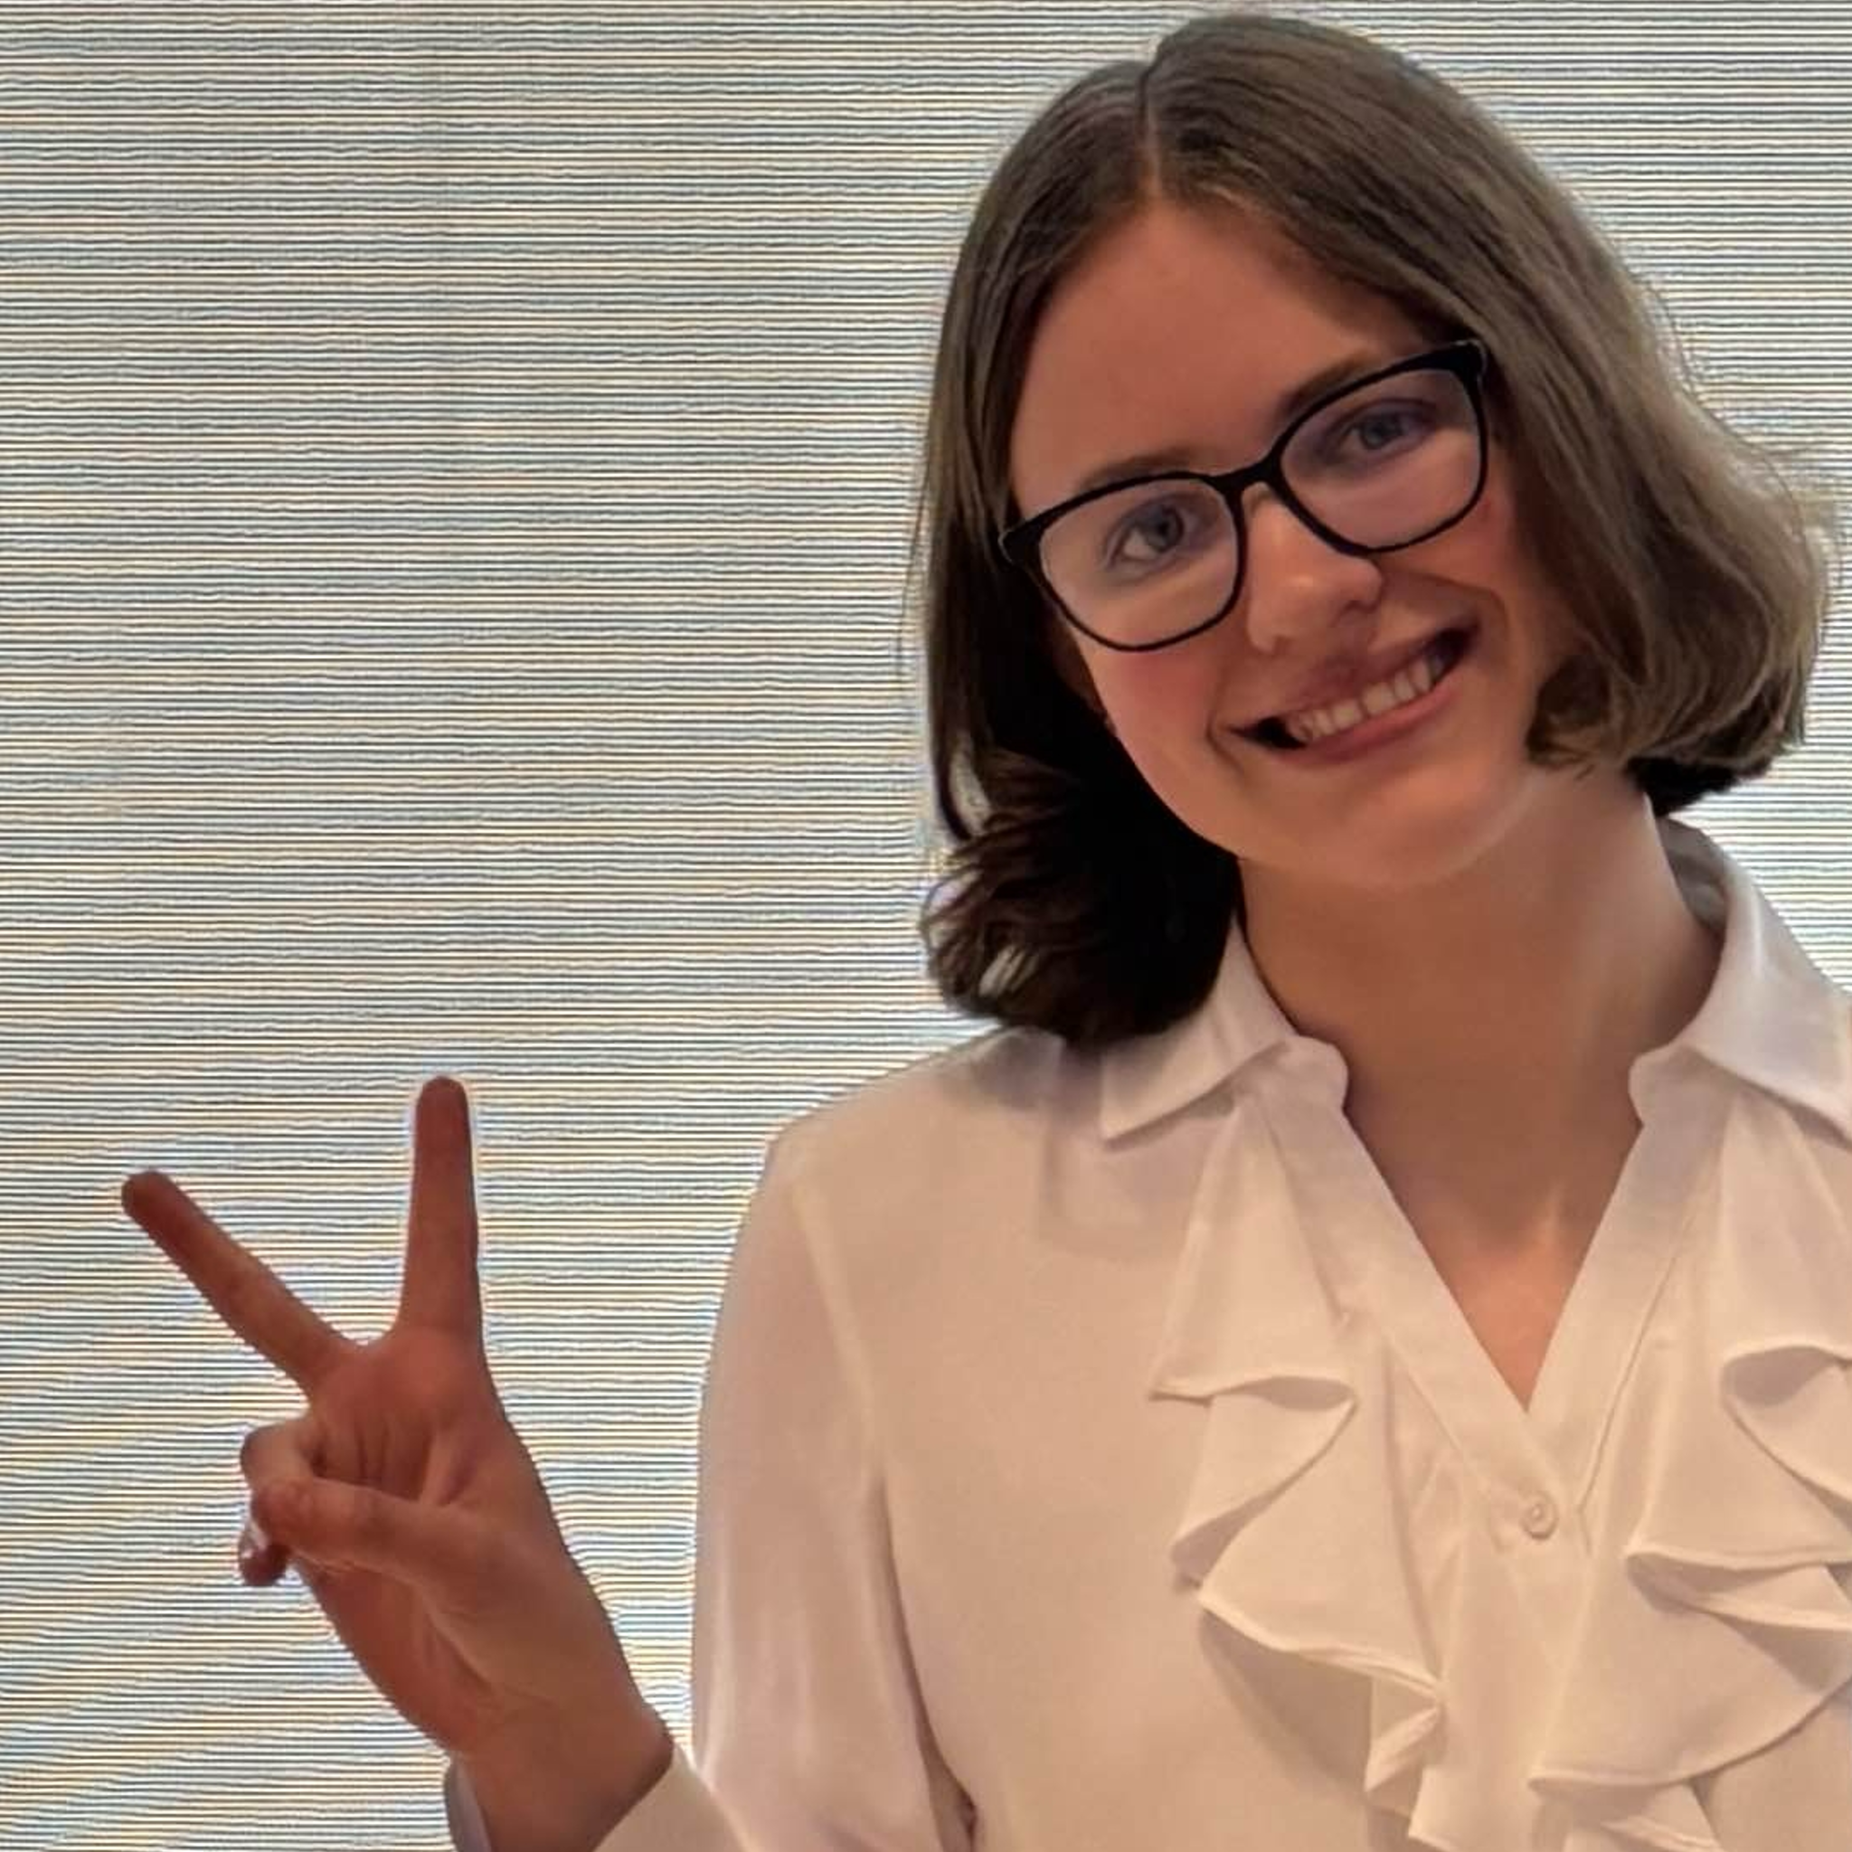
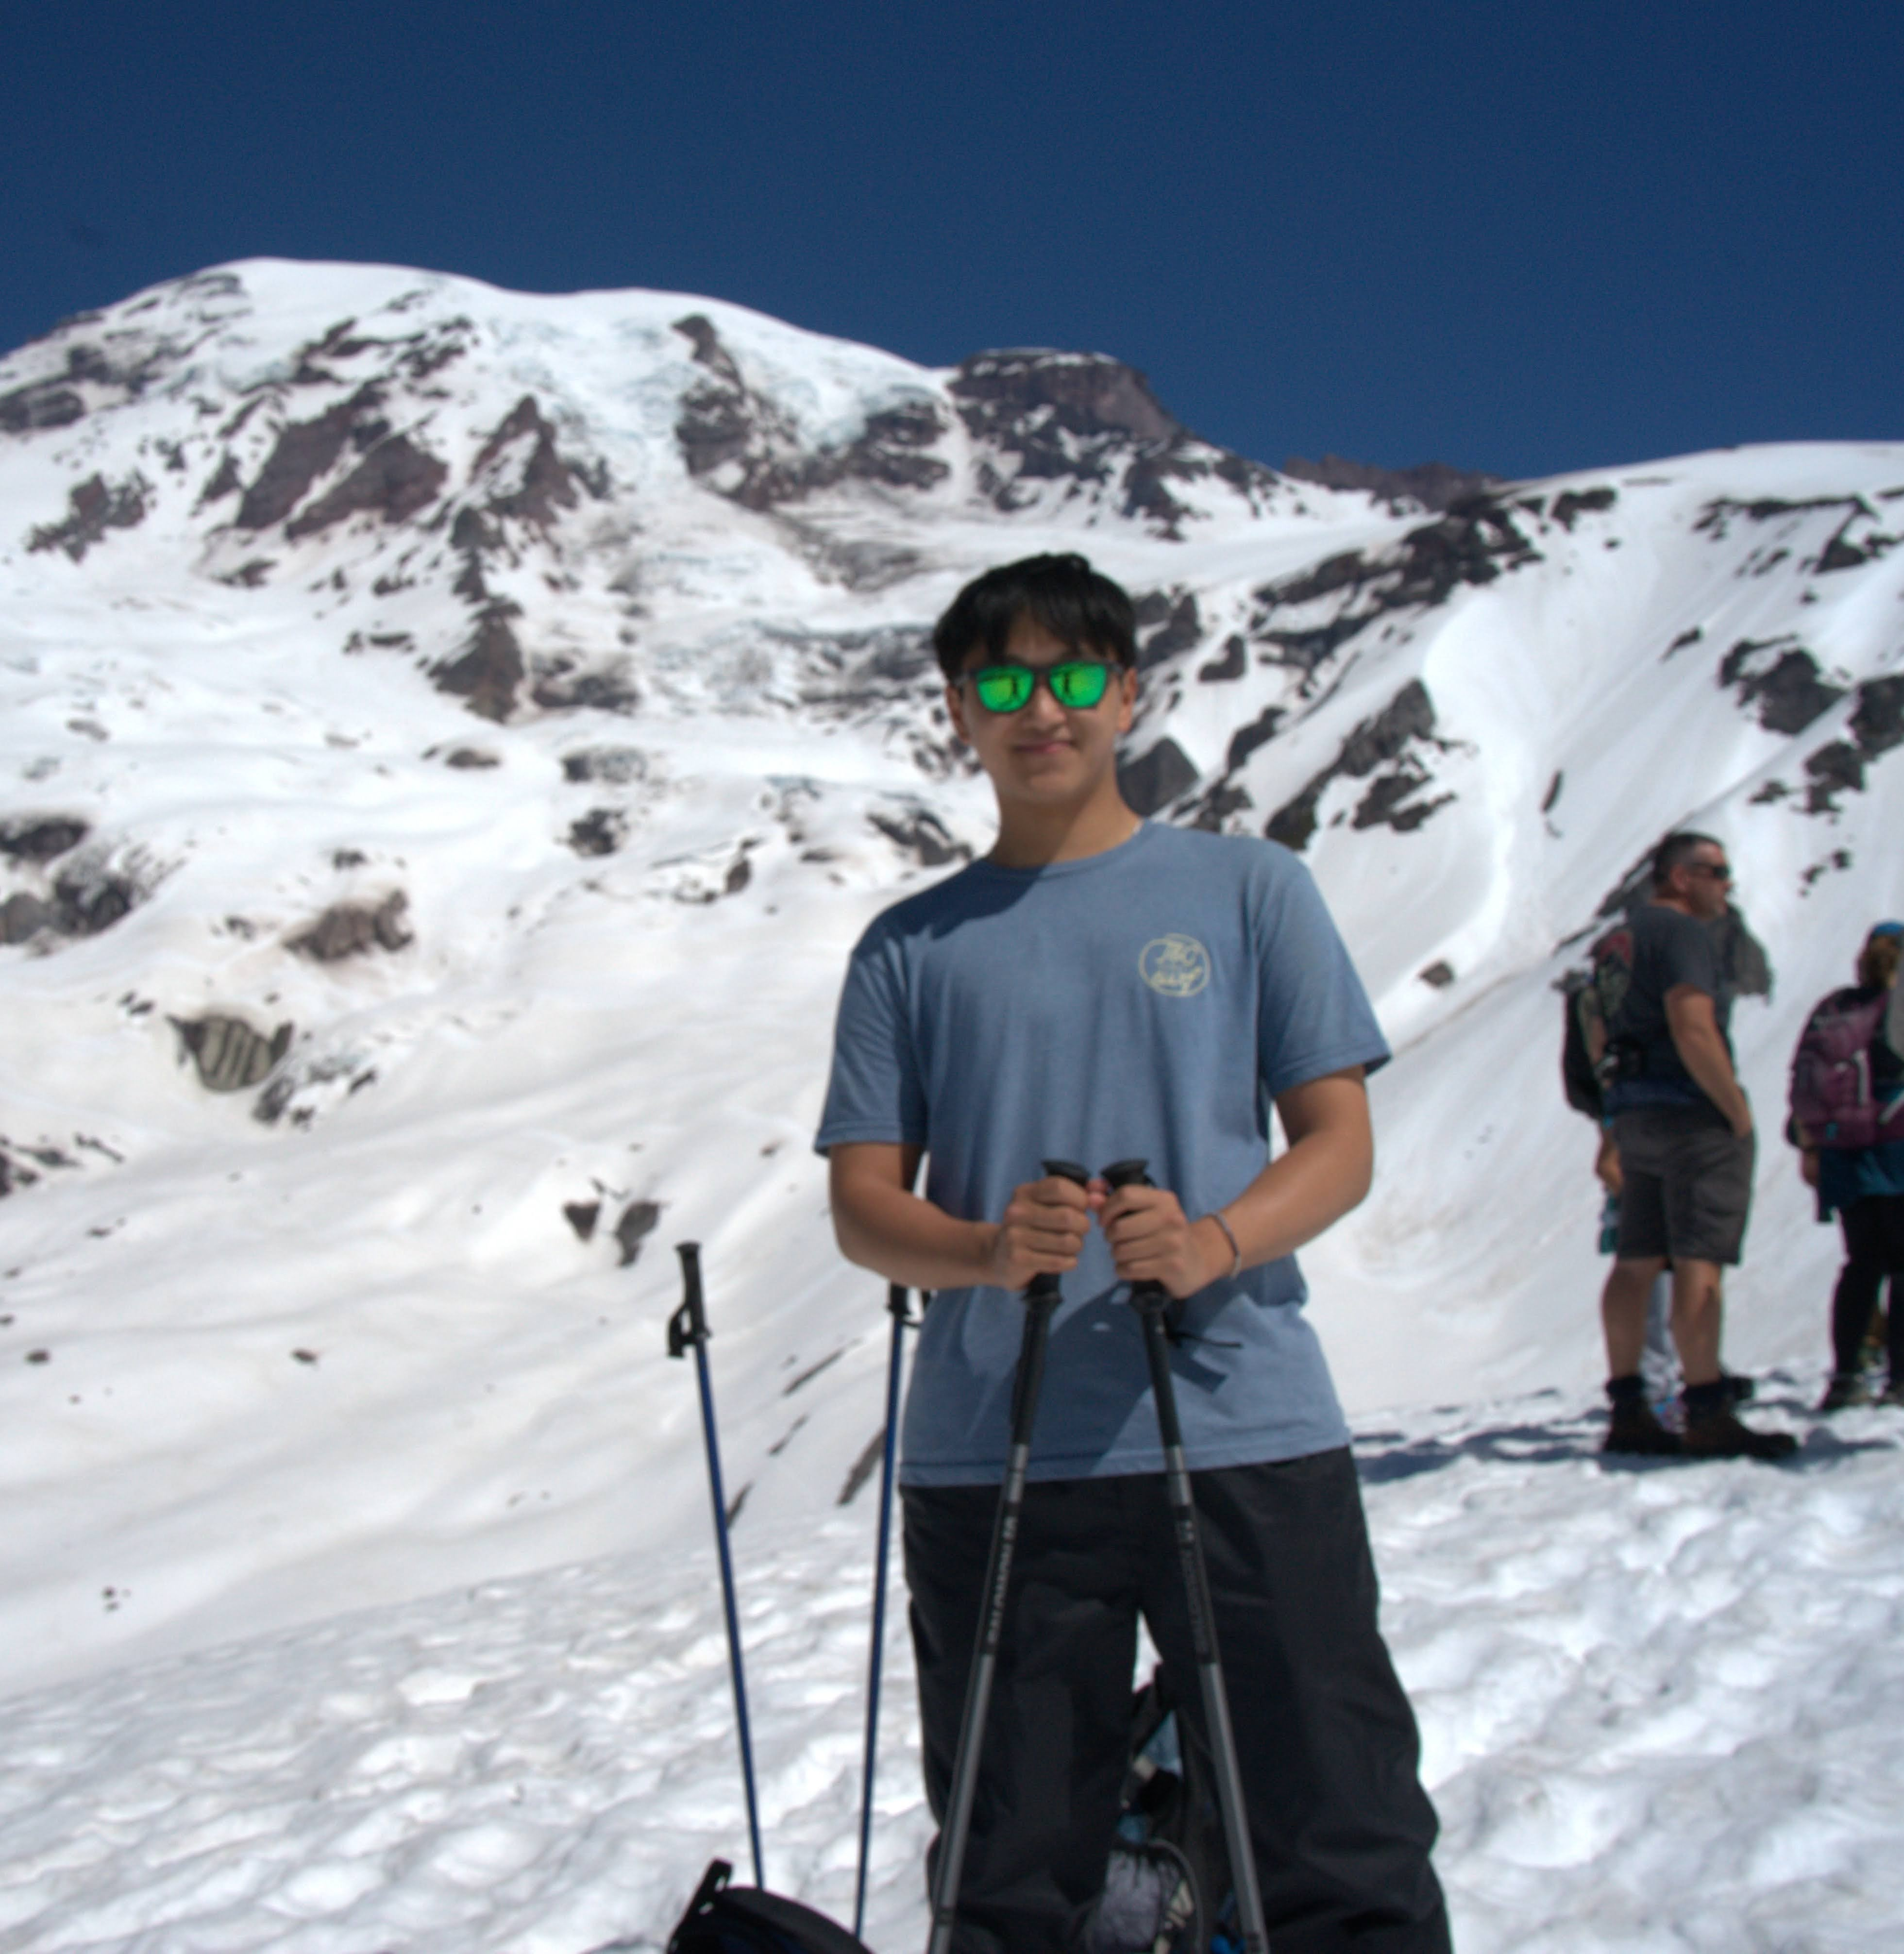
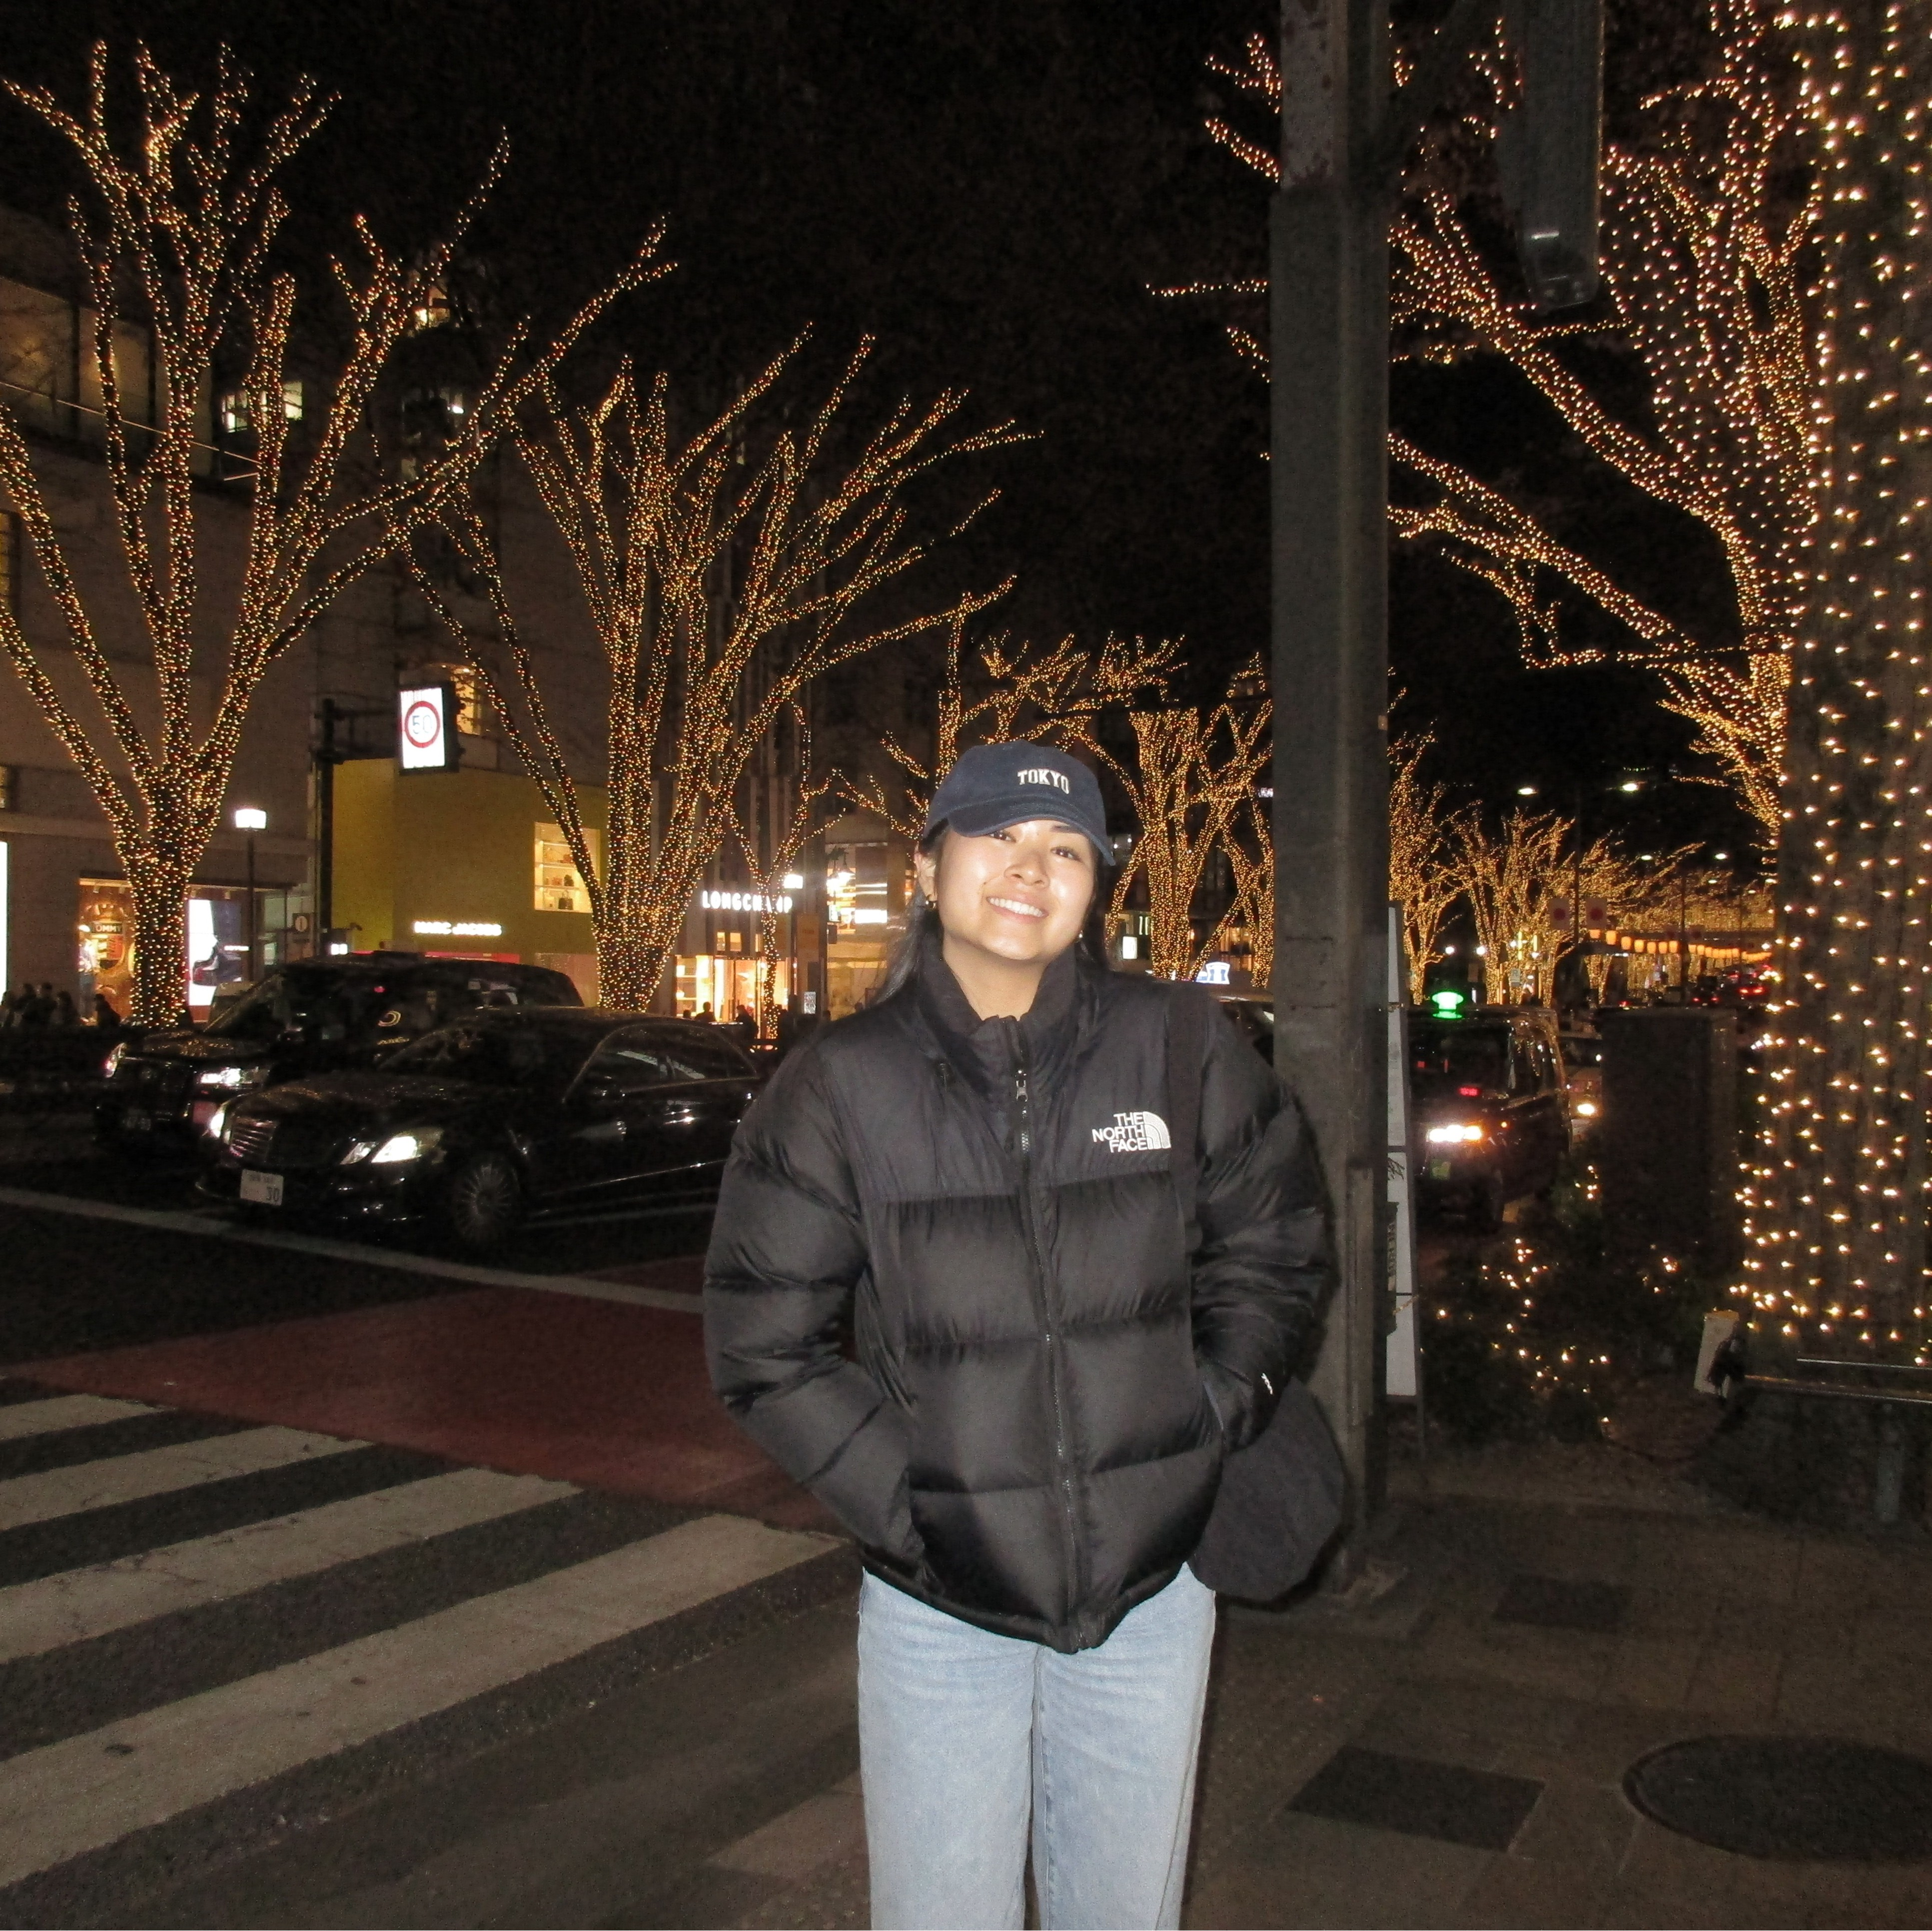
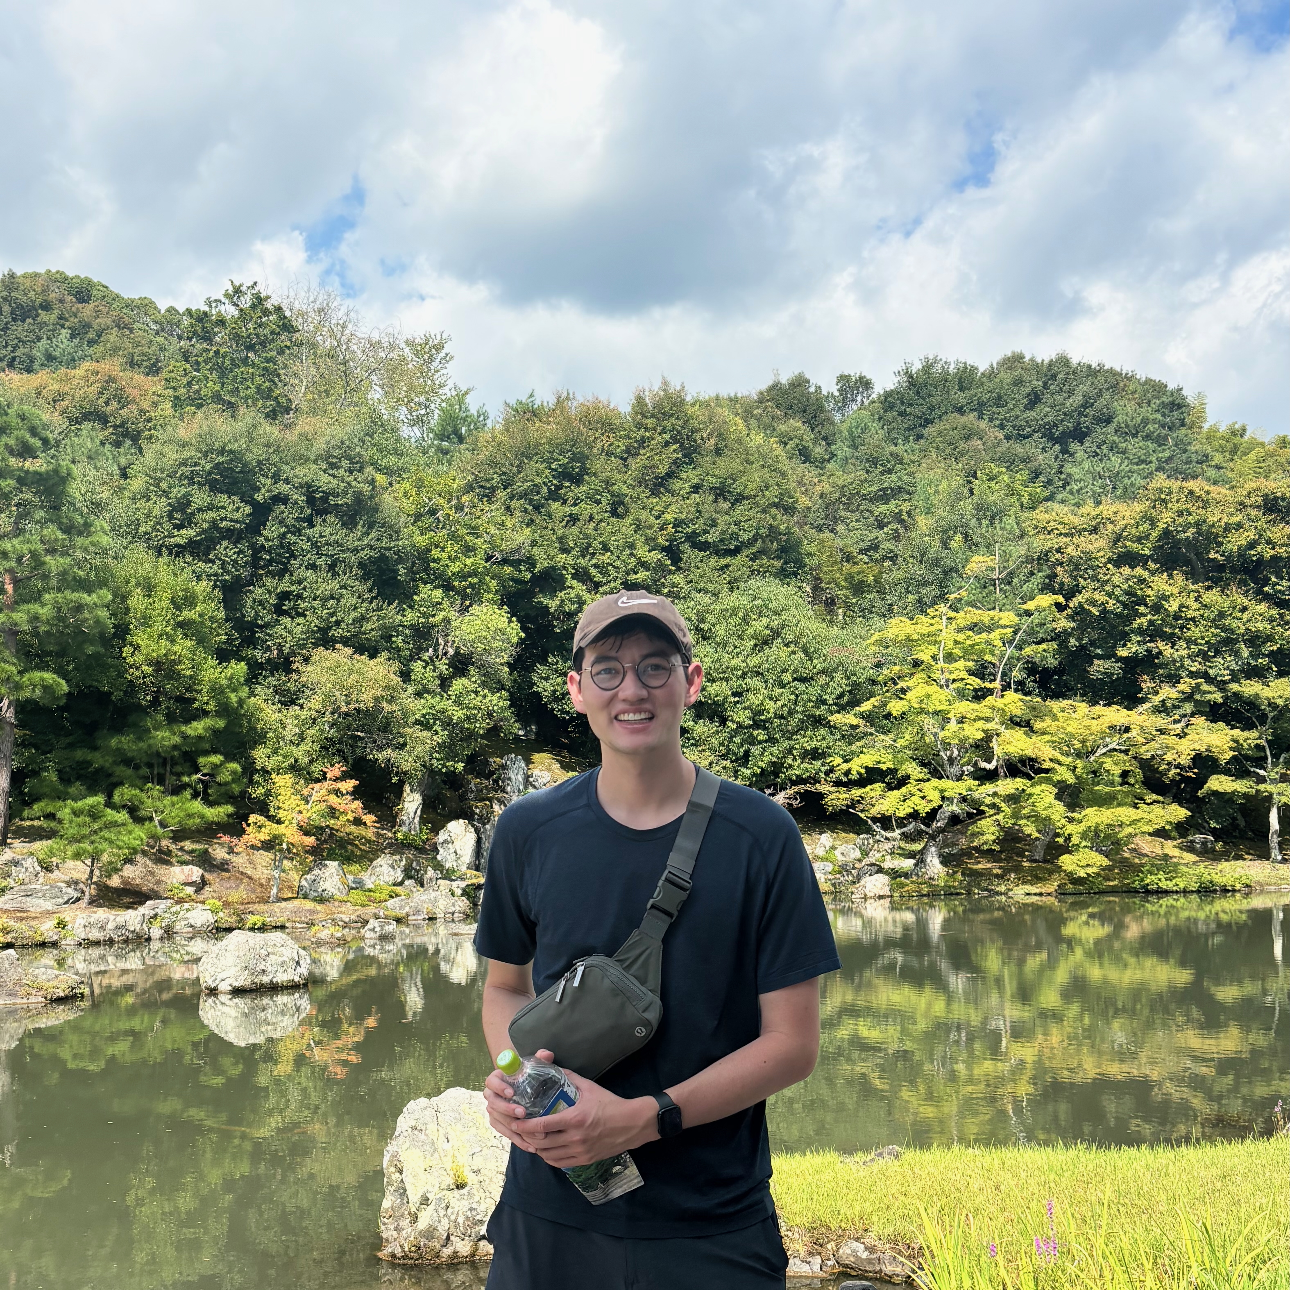
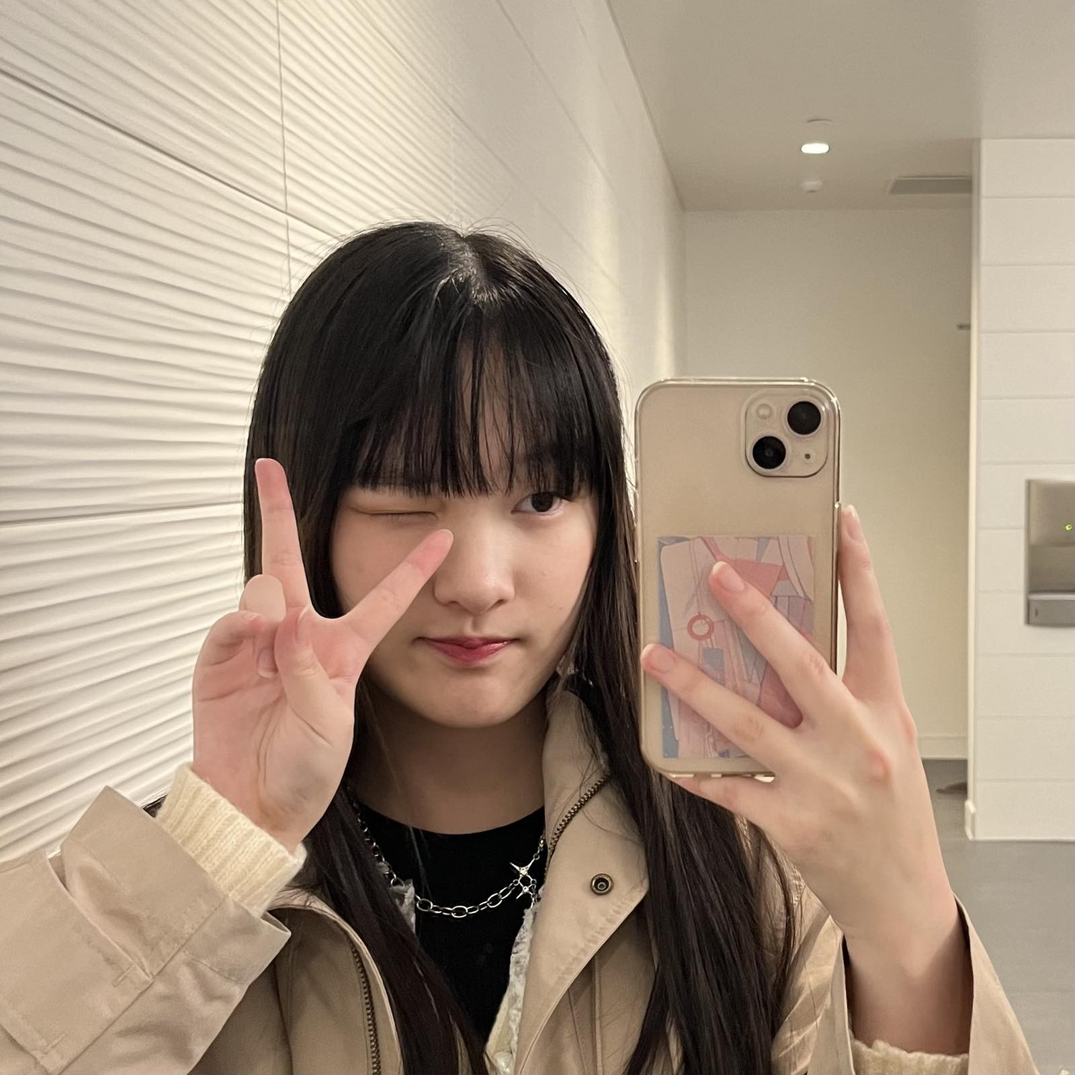
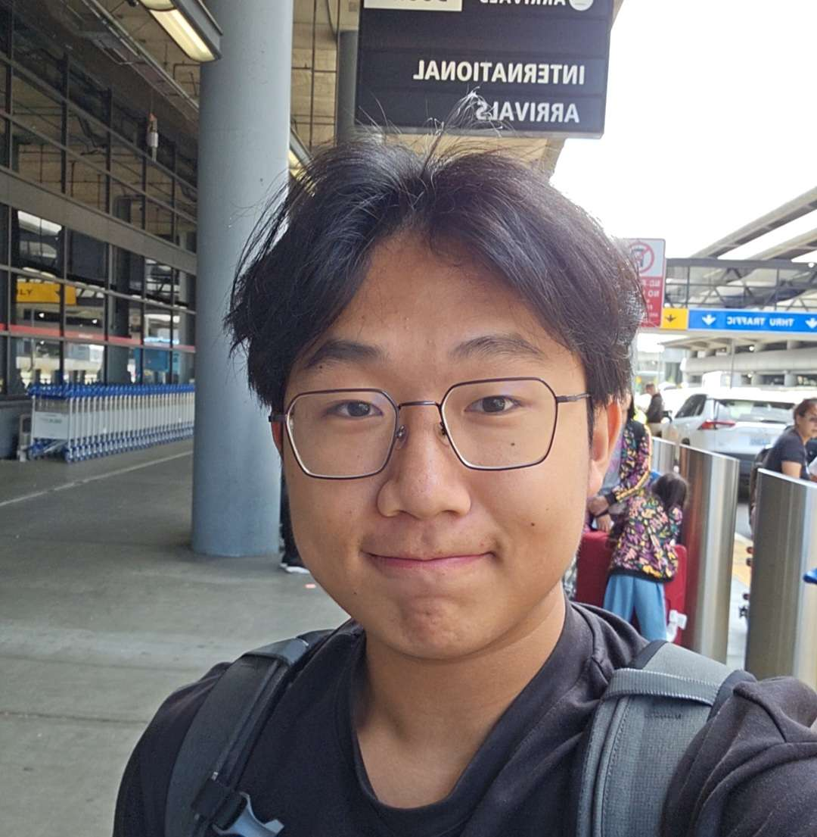
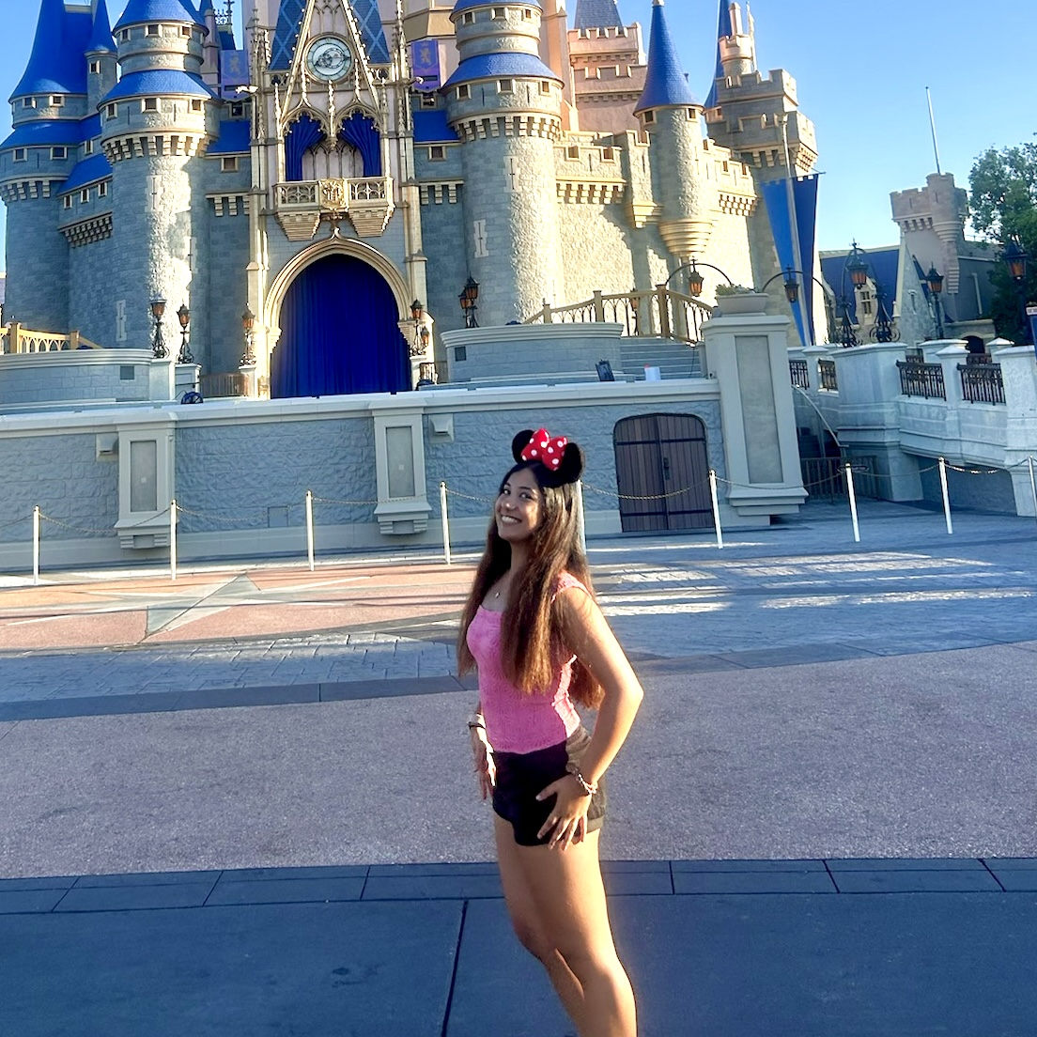
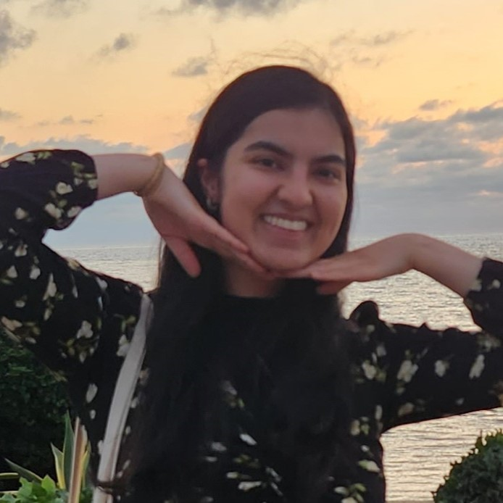
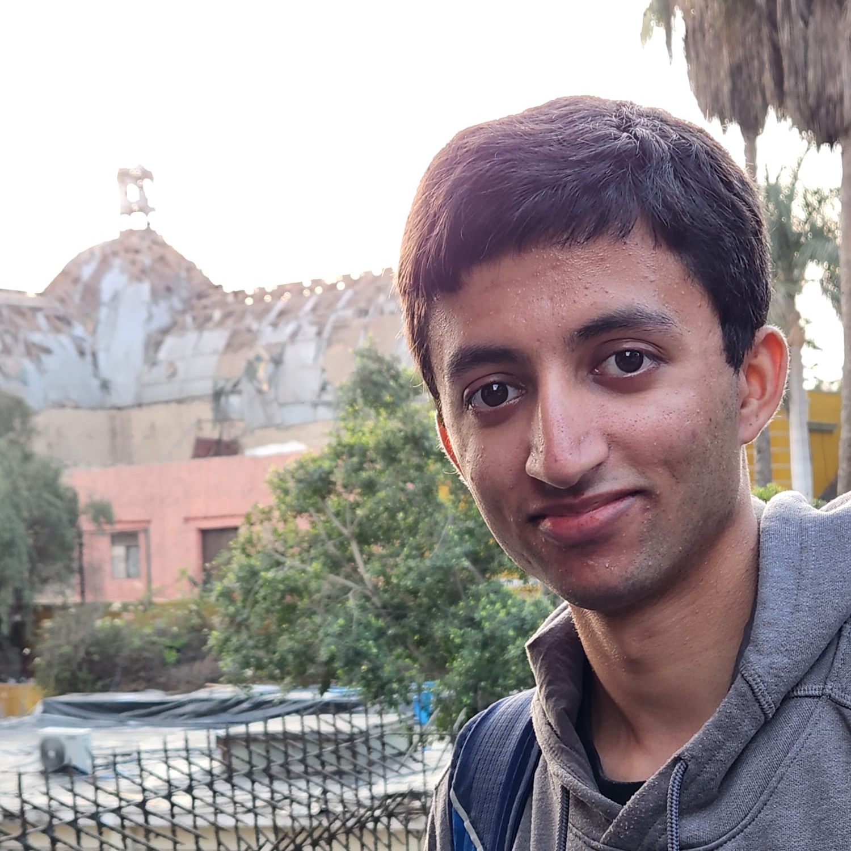
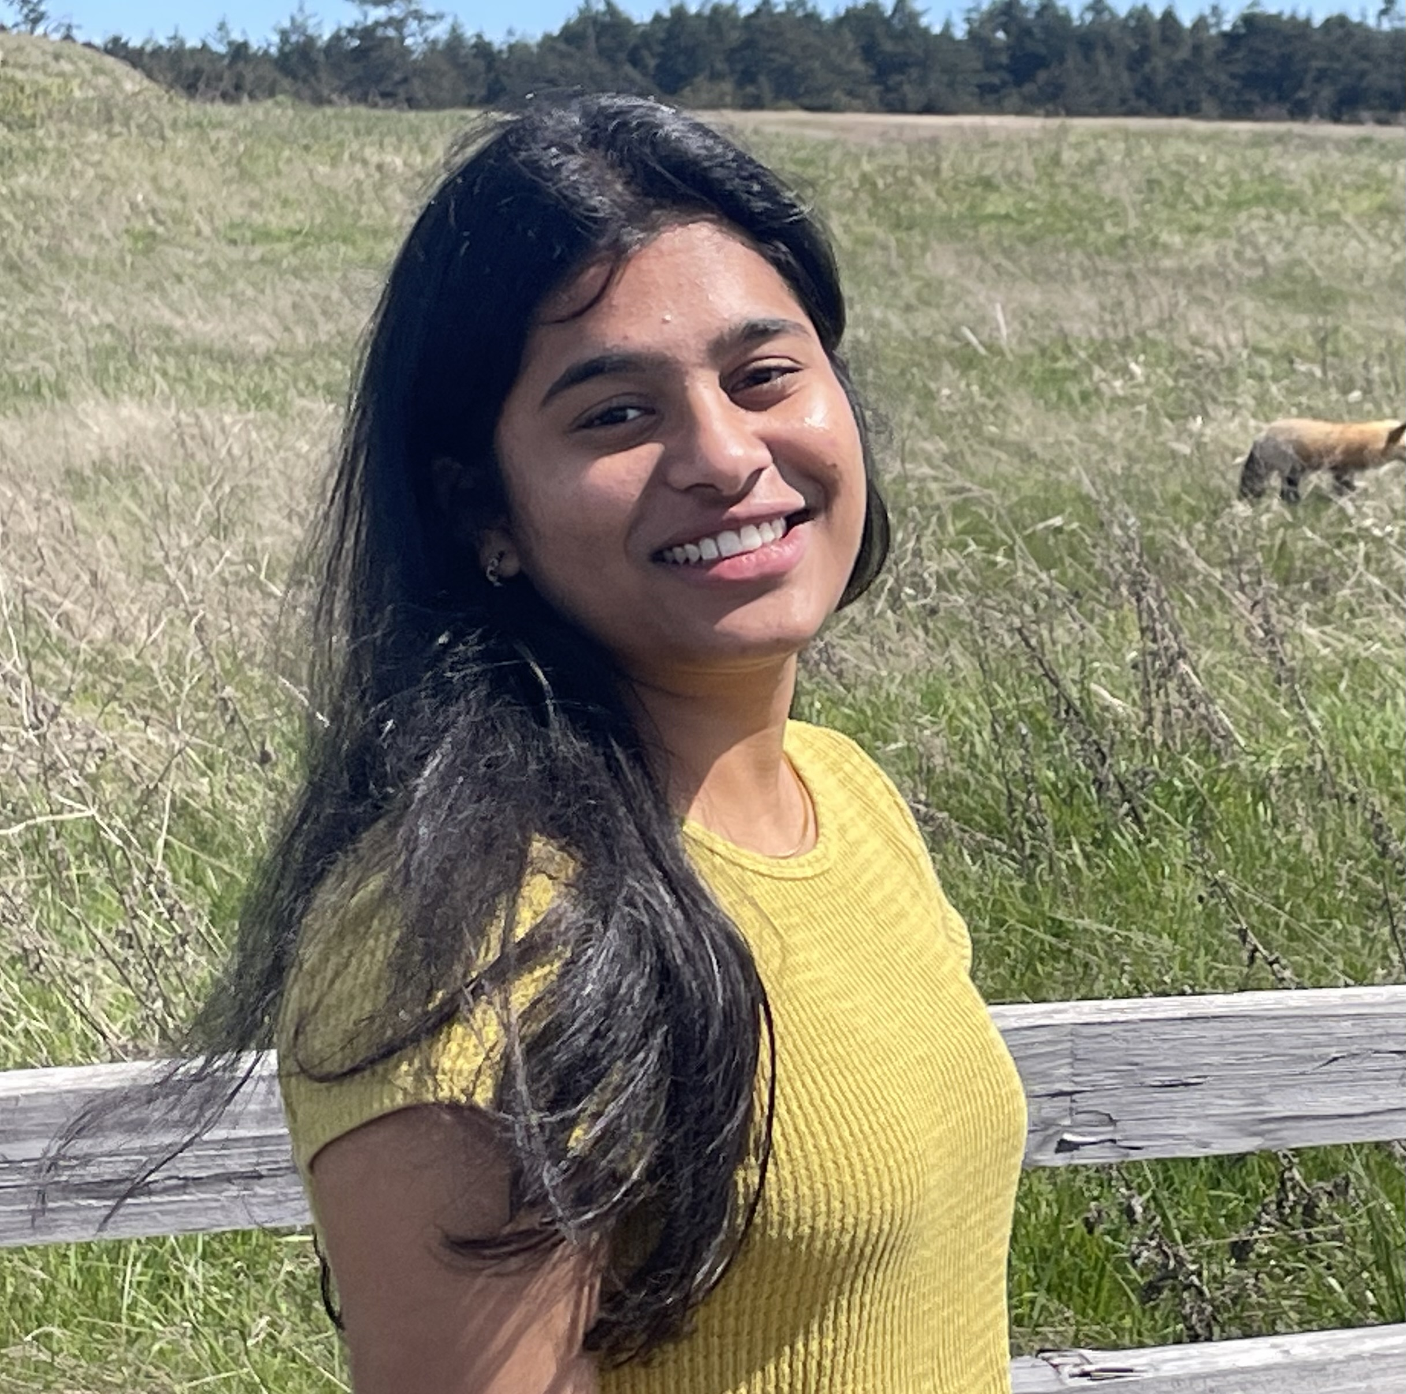
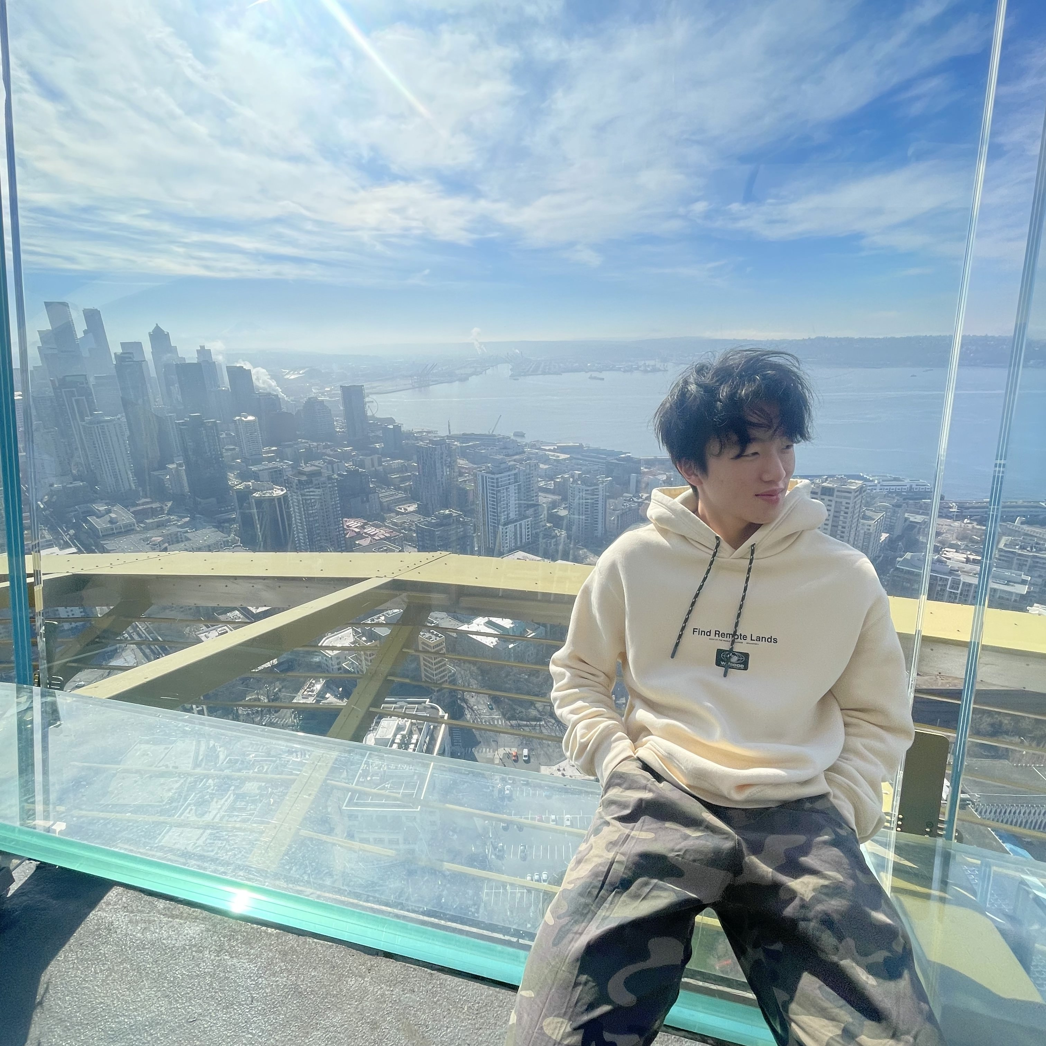

Thank your fabulous TAs!
Notes:
Brett

Slide 17
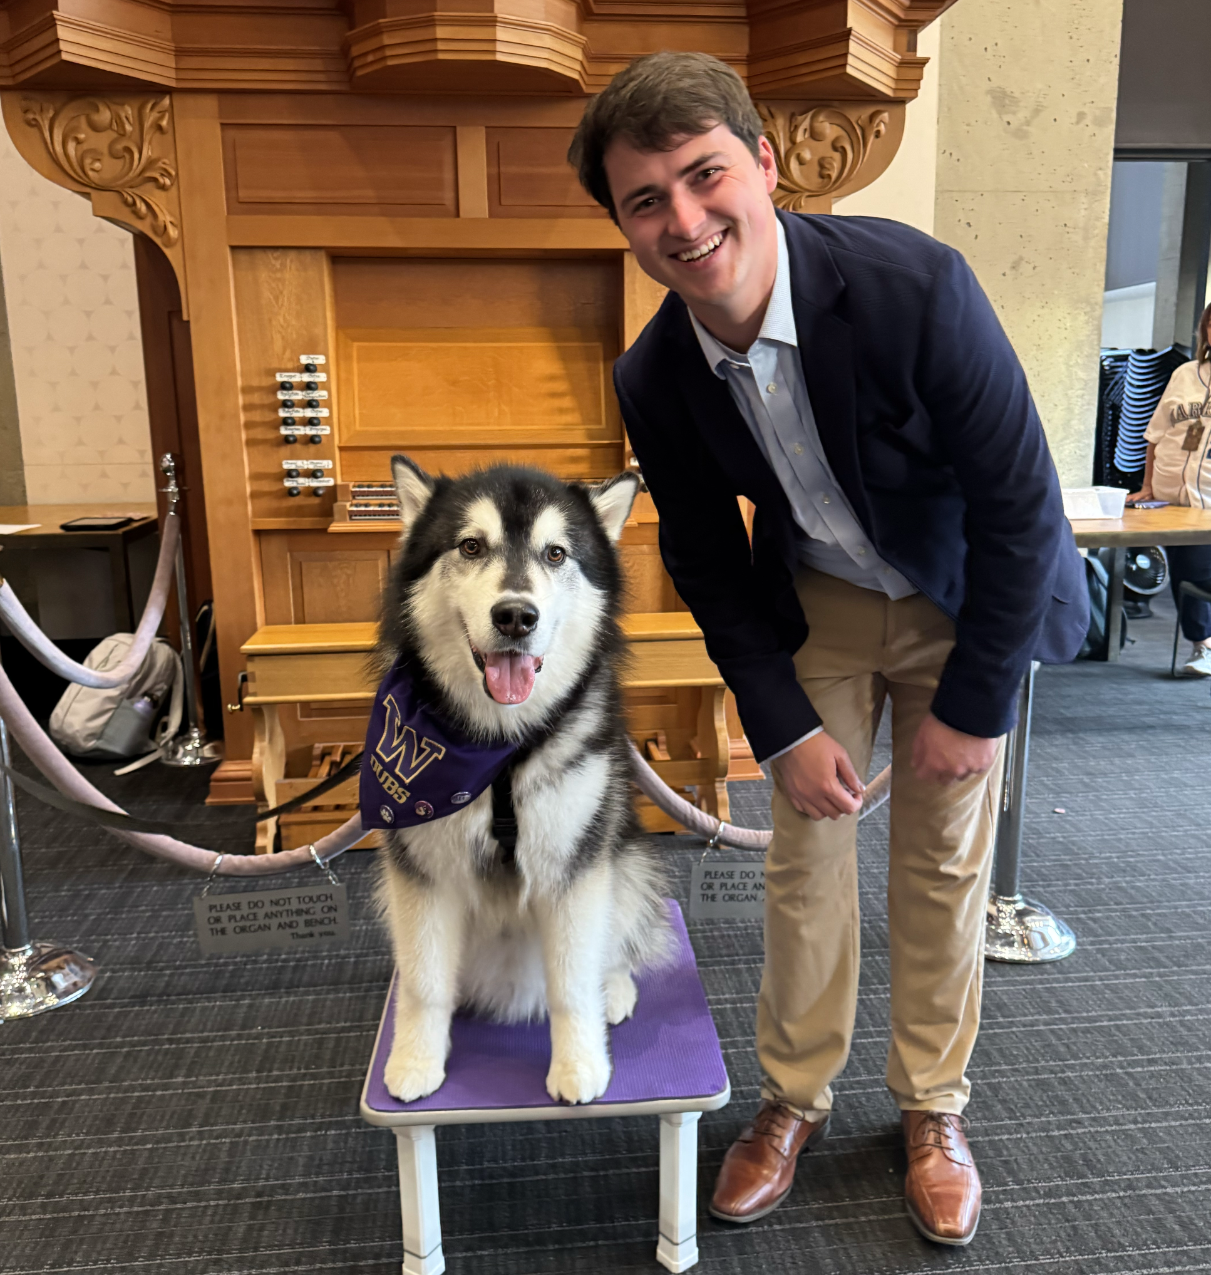
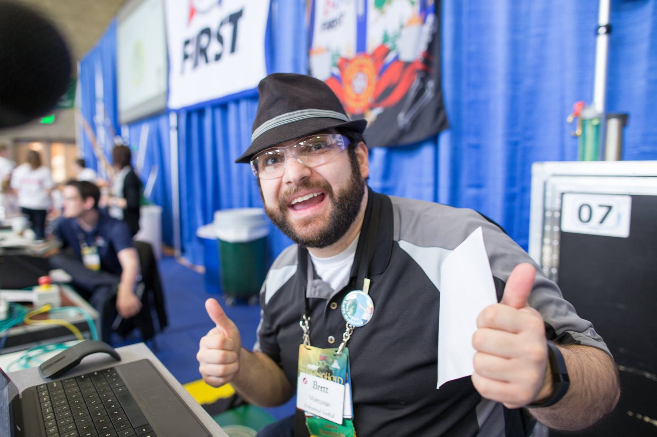
Thank you!
Ask Us (Almost) Anything!
sli.do #cse121

