Slide 1

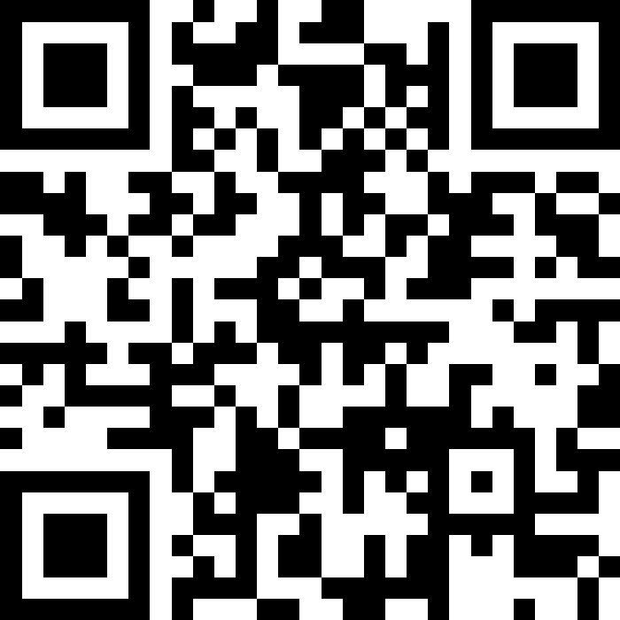
Final Exam Review
BEFORE WE START
LEC 19
Talk to your neighbors:
What will you miss from autumn?
What are you excited to leave behind?
Music: 🎷CSE 121 25au Lecture Tunes 🎵
Instructors:
Brett Wortzman & James Weichert
TAs:
Trey
Amogh
Samrutha
Dalton
Ailsa
Ryan
Anant
Ava
Reese
Hayden
Aki
Spencer
Savannah
Tamsyn
Caleb
Anum
Abdul
Janvi
Navya
Sam Jessica
Elden
Suyash
Sthiti
Paul
Shayna
Jesse
Nhan
Anya
Minh
TJ
Zach
Cayden
Johnathan

Slide 2

Announcements, Reminders (general)
P3 and R6 due Thursday, December 4th
R7 (and R-EXTRA) closes Wednesday, December 10th
IPL closes Friday, December 5th
Final Exam: Wednesday, December 10th from 12:30 - 2:20pm
  Review the Exam page of website (with policies & resources)
TA-led review session: Monday, December 8th from 4:30-7:00pm in ARC 147
  This will be very similar to today’s lecture but with a full practice exam

Slide 3
In-Class Exam Review
Mini-exam overview
  This mini-final does not reflect the difficulty and length of the actual final
  Opportunity to try exam-style problems on paper
3 problems
  Code comprehension
  Debugging
  Programming
Task for today:
  Work through each problem (one at a time) independently or with peers
  Then, your lovely TAs will walk through their solutions and thought processes for each problem

Slide 4
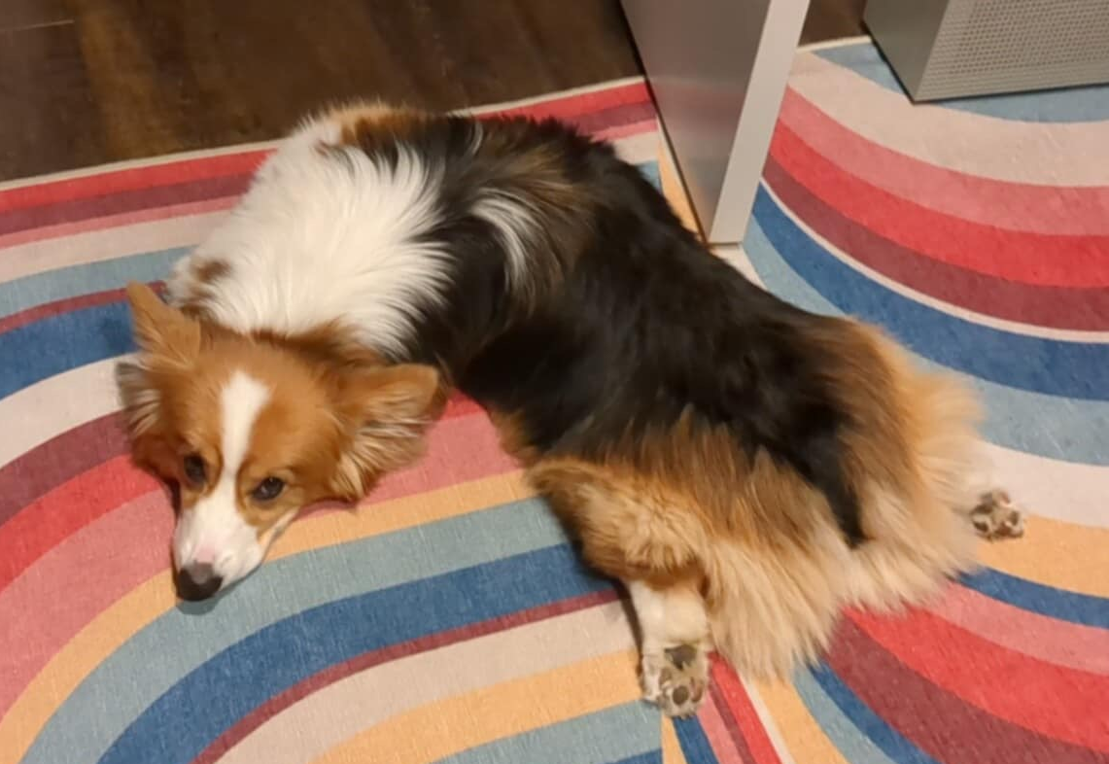
Best of luck on the exam!

