Slide 1
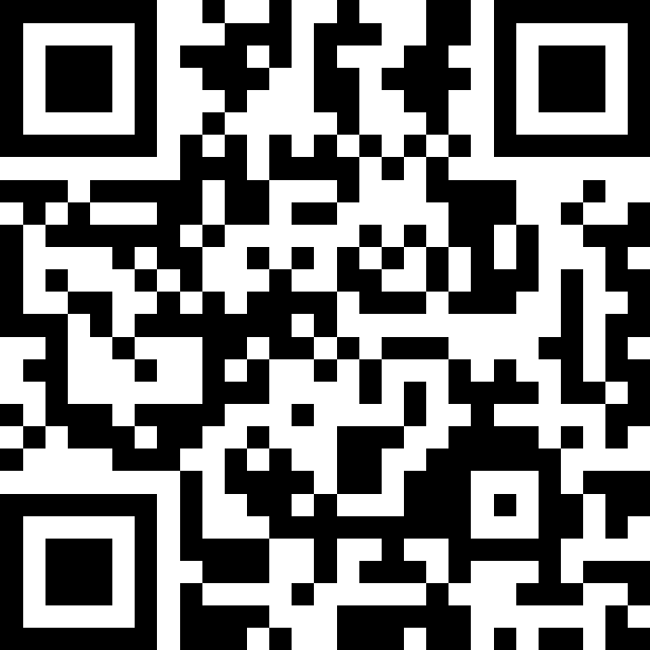
Putting It All Together (Again)!
BEFORE WE START
LEC 17
Talk to your neighbors:
If you could be any marine animal, what would you be? 🐬
Music: 🎷CSE 121 25au Lecture Tunes 🎵
Instructors:
Brett Wortzman & James Weichert
TAs:
Trey
Amogh
Samrutha
Dalton
Ailsa
Ryan
Anant
Ava
Reese
Hayden
Aki
Spencer
Savannah
Tamsyn
Caleb
Anum
Abdul
Janvi
Navya
Sam Jessica
Elden
Suyash
Sthiti
Paul
Shayna
Jesse
Nhan
Anya
Minh
TJ
Zach
Cayden
Johnathan

Slide 2
Announcements, Reminders
P3 due Thursday, December 4th at 11:59pm
note: you will get feedback after R7 is due
Resubmissions!
R6 released, due Thursday, December 4th (eligible: C2, P2, C3)
[NEW] R7: All assignments eligible for resubmission!
[NEW] R Extra: Extra resubmission for 12+ sections attended
Next week:
no section
no lecture
limited OH, Ed availability
Final Exam: Wednesday, December 10th from 12:30 - 2:20

Slide 3
The “Core” of the Final Exam
In-person, with assigned seating (more on that next week!)
Same general logistics as quizzes:
on paper
we will provide you with one reference sheet, and
you may bring one double-sided 8.5 x 11-inch page of notes
Will have 6 problems, all similar in style to the quizzes
Focus is on behavior (not code style); minor syntax errors allowed (when unambiguous)
A bit more time per-problem than the quiz!

Slide 4
CSE 121 “Exam Review Systems”
Entire last week is focused on final exam review and prep
Lecture 18: some strategies & live practice
Section 17 and 18: even more practice
Lecture 19: a few last tips, words of encouragement
Final exam review session will happen 12/8 @ 4:30, will be recorded
IPL will not be open during finals week, so plan ahead!
Several asynchronous resources, including:
multiple previous actual finals
many existing programming problems
more resources soon (stay tuned for an announcement!)

Slide 5
Some Miscellaneous Exam Thoughts
Be very careful about how you use the previous actual finals
Great study resource (and matched difficulty), but…
Hard to “unsee” solutions after looking & too easy to “overfit”
Use for targeted study, mimic the actual test-taking environment
Make your own cheatsheet, don’t use someone else’s!
Making the cheatsheet is studying
It is your responsibility to know the policies & procedures
Let’s take a quick spin of the website page right now :)

Slide 6
Exam Questions?
We will answer some live and put the rest in the class megathread for today!
sli.do #cse121

Slide 7
Scratchwork

Slide 8
readData
How many days' data would you like to input? 3
Next day's data:
Temperature in Seattle? 44
Temperature in Tacoma? 40
Temperature in Bothell? 43
Next day's data:
Temperature in Seattle? 42
Temperature in Tacoma? 40
Temperature in Bothell? 44
Next day's data:
Temperature in Seattle? 42
Temperature in Tacoma? 41
Temperature in Bothell? 43
...
 | Seattle | Tacoma | Bothell
1 | 44 | 40 | 43
2 | 42 | 40 | 44
3 | 42 | 41 | 43

Slide 9
computeAverages
How many days' data would you like to input? 3
…
The average values for each location were [42.666666666666664, 40.333333333333336, 43.333333333333336]
 | Seattle | Tacoma | Bothell
1 | 44 | 40 | 43
2 | 42 | 40 | 44
3 | 42 | 41 | 43
42.667 | 40.333 | 43.333
Average of Seattle temperatures
(44 + 42 + 42) / 3

Slide 10
computeAverages
How many days' data would you like to input? 3
…
The average values for each location were [42.666666666666664, 40.333333333333336, 43.333333333333336]
 | Seattle | Tacoma | Bothell
1 | 44 | 40 | 43
2 | 42 | 40 | 44
3 | 42 | 41 | 43
42.667 | 40.333 | 43.333
Average of Tacoma temperatures
(40 + 40 + 41) / 3

Slide 11
computeAverages
How many days' data would you like to input? 3
…
The average values for each location were [42.666666666666664, 40.333333333333336, 43.333333333333336]
 | Seattle | Tacoma | Bothell
1 | 44 | 40 | 43
2 | 42 | 40 | 44
3 | 42 | 41 | 43
42.667 | 40.333 | 43.333
Average of Seattle temperatures
(43 + 44 + 43) / 3

Slide 12
PCM: Array of Counters
LEC 16: Array Patterns
0 1 2 2 0 2
public static int[] numCount(Scanner input, int numPrompts) {
int[] counts = ;
for (int i = 0; i < numPrompts; i++) {
int num = input.nextInt();
; }
return counts;
}

Slide 13
Ed Time :)
(for those looking at just the slides – the rest of this lecture was doing the in-class lesson!)

