Slide 1
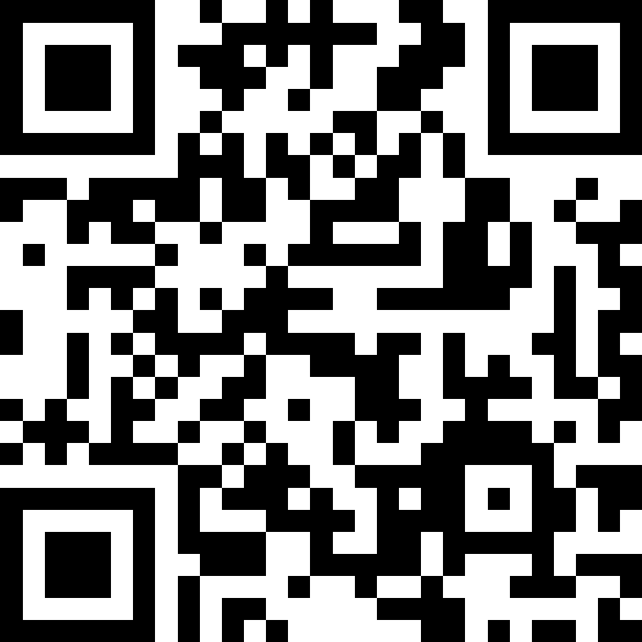
Reference Semantics
BEFORE WE START
LEC 14
Talk to your neighbors:
What’s your favorite sport or competition to watch?
Music: 🎷CSE 121 25au Lecture Tunes 🎵
Instructors:
Brett Wortzman & James Weichert
TAs:
Trey
Amogh
Samrutha
Dalton
Ailsa
Ryan
Anant
Ava
Reese
Hayden
Aki
Spencer
Savannah
Tamsyn
Caleb
Anum
Abdul
Janvi
Navya
Sam Jessica
Elden
Suyash
Sthiti
Paul
Shayna
Jesse
Nhan
Anya
Minh
TJ
Zach
Cayden
Johnathan

Slide 2
Announcements, Reminders
C3 released tonight, due Tuesday, November 18th
R4 due tomorrow (eligible: C1, P1, C2)
  C1 cycling out of eligibility after R4
Quiz 2 on Thursday, November 20th
  Conditionals, while loops, User Input (Scanner), Arrays, Reference Semantics
  can’t make it? email Brett and James before your quiz!
In the future: Thanksgiving week November 24-28
  Almost all class activities cancelled

Slide 3

Feedback & Closing the Loop: The Good
Pre-class materials and walkthrough videos
Quiz sections and your TAs! (esp. practice problems)
Project-based assignments
  Including feedback!
In-class active learning!
Ed message board and IPL!

Slide 4

Feedback & Closing the Loop: Suggestions
Section and exit ticket solutions
  Already available!
One place to view all grades
  In progress; maybe this week? 🤞
More paper practice in section
  On it’s way!
Other suggestions…
More and less instruction in section
More practice quizzes

Slide 5

Feedback & Closing the Loop: Transfer
Transfer: how can you use your knowledge on new tasks (not ones that you've seen before)
Tricky to balance alignment (lessons, practice, assignments connecting to each other) and transfer (assessing your ability to apply skills to novel problems).
But some transfer is always necessary.

Slide 6
What would the array arr store at the end of this arrayMystery method if {-20, 20, 26, 32, 50, 3} was passed in?
public static void arrayMystery(int[] arr) {
for (int i = arr.length - 1; i >= 1; i--) {
if (arr[i] > arr[i - 1] + 10) {
arr[i - 1] = arr[i - 1] + 5;
}
}
}
{-20, 20, 26, 32, 50, 3}
{-15, 25, 31, 37, 55, 8}
{-15, 25, 31, 37, 50, 3}
{-15, 20, 26, 37, 50, 3}

Slide 7
What would the array arr store at the end of this arrayMystery method if {-20, 20, 26, 32, 50, 3} was passed in?
public static void arrayMystery(int[] arr) {
for (int i = arr.length - 1; i >= 1; i--) {
if (arr[i] > arr[i - 1] + 10) {
arr[i - 1] = arr[i - 1] + 5;
}
}
}
{-20, 20, 26, 32, 50, 3}
{-15, 25, 31, 37, 55, 8}
{-15, 25, 31, 37, 50, 3}
{-15, 20, 26, 37, 50, 3}

Slide 8
Tracing through arrayMystery
i
{-20, 20, 26, 32, 50, 3}
public static void arrayMystery(int[] a) {
for (int i = a.length - 1; i >= 1; i--) {
if (a[i] > a[i - 1] + 10) {
a[i - 1] = a[i - 1] + 5;
}
}
}
a

Slide 9
PCM Review: Value Semantics vs. Reference Semantics
Value Semantics
Applies when working with primitive types
Variables/parameters hold a copy of the actual value
Reference Semantics
Applies when working with objects
Variables/parameters hold a reference to the object
int a = 3;
int[] list1 = {4, 8, 15};
3
4
8
15
int a
int[] list1

Slide 10
PCM Review: Value Semantics
int a
Applies when working with primitive types
Variables/parameters hold a copy of the actual value
3
99
int b
3
int a = 3;
int b = a;
a = 99;

Slide 11
PCM Review: Reference Semantics
int[] list1
Applies when working with objects
  Including arrays!
Variables/parameters hold a reference to the object
99
4
8
15
int[] list1 = {4, 8, 15};
int[] list2 = list1;
list1[0] = 99;
int[] list2

Slide 12
Value Semantics & Methods
boolean test = true;
flipValue(test);
public static void flipValue(boolean b) {
b = !b;
}

Slide 13
Reference Semantics & Methods
boolean[] tests = {true, false, false, false};
flipValues(tests);
public static void flipValues(boolean[] b) {
for (int i = 0; i < b.length; i++) {
b[i] = !b[i];
}
}

Slide 14
PCM Review: null
null is the absence of a reference!
sort of the “zero” for references
default value for object types (e.g. Random, Scanner, and String)
A NullPointerException is an error that happens
when you ask null to “do something”, which includes:
calling .toUpperCase() on null? NullPointerException!
calling .nextInt() on null? NullPointerException!
many, many more

Slide 15
PCM Review: avoiding NullPointerException
if (strs[i] != null) {
System.out.println(strs[i].toUpperCase());
} else {
System.out.println("element " + i + " is null.");
}

