Slide 1
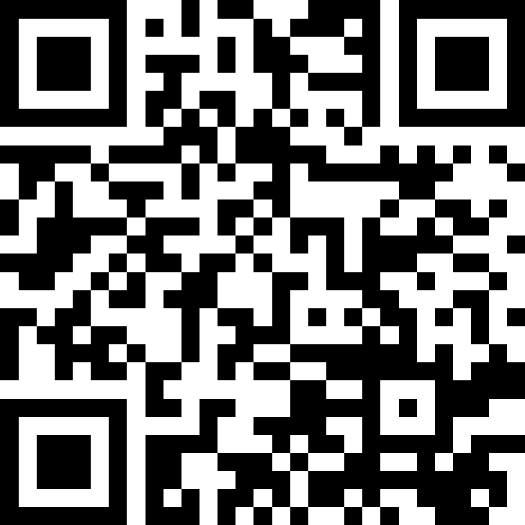
Putting It All Together
BEFORE WE START
LEC 12
Talk to your neighbors:
How do you feel about the weather changing?
Respond on sli.do!
Music: 🎷CSE 121 25au Lecture Tunes 🎵
Instructors:
Brett Wortzman & James Weichert
TAs:
Trey
Amogh
Samrutha
Dalton
Ailsa
Ryan
Anant
Ava
Reese
Hayden
Aki
Spencer
Savannah
Tamsyn
Caleb
Anum
Abdul
Janvi
Navya
Sam Jessica
Elden
Suyash
Sthiti
Paul
Shayna
Jesse
Nhan
Anya
Minh
TJ
Zach
Cayden
Johnathan

Slide 2
Announcements, Reminders
Quiz 1 is tomorrow!
Quiz 1 reference sheet linked from Quiz 1 Practice Resources post
Email Brett and James before your section if you're not able to attend!
Do not come to section if you're sick! 😷
Quiz 0 grades were released last week
If you want your physical Quiz 0 and/or notesheet, come by James or my office hours
P2 is out & due next Tuesday, November 11th
No new assignment this week
R3 closes tomorrow
P0, C1, P1, C2 eligible
P0 cycling out of eligibility after R3!

Slide 3
Reminder (again): Fencepost Pattern
Some task where one piece is repeated n times, and another piece is repeated n-1 times and they alternate
h-u-s-k-i-e-s

Slide 4
Fencepost Pattern … for User Input?
Some task where one piece is repeated n times, and another piece is repeated n-1 times and they alternate
enter an artist
how many listens?
enter an artist
how many listens?
enter an artist
...

