Slide 1
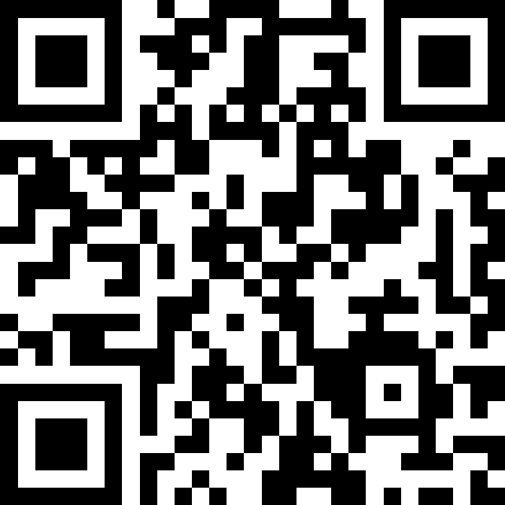
User Input (Scanner)
BEFORE WE START
LEC 11
Talk to your neighbors:
What’s your (current or favorite) Halloween costume? 🎃
Music: 🎷CSE 121 25au Lecture Tunes 🎵
Instructors:
Brett Wortzman & James Weichert
TAs:
Trey
Amogh
Samrutha
Dalton
Ailsa
Ryan
Anant
Ava
Reese
Hayden
Aki
Spencer
Savannah
Tamsyn
Caleb
Anum
Abdul
Janvi
Navya
Sam Jessica
Elden
Suyash
Sthiti
Paul
Shayna
Jesse
Nhan
Anya
Minh
TJ
Zach
Cayden
Johnathan

Slide 2
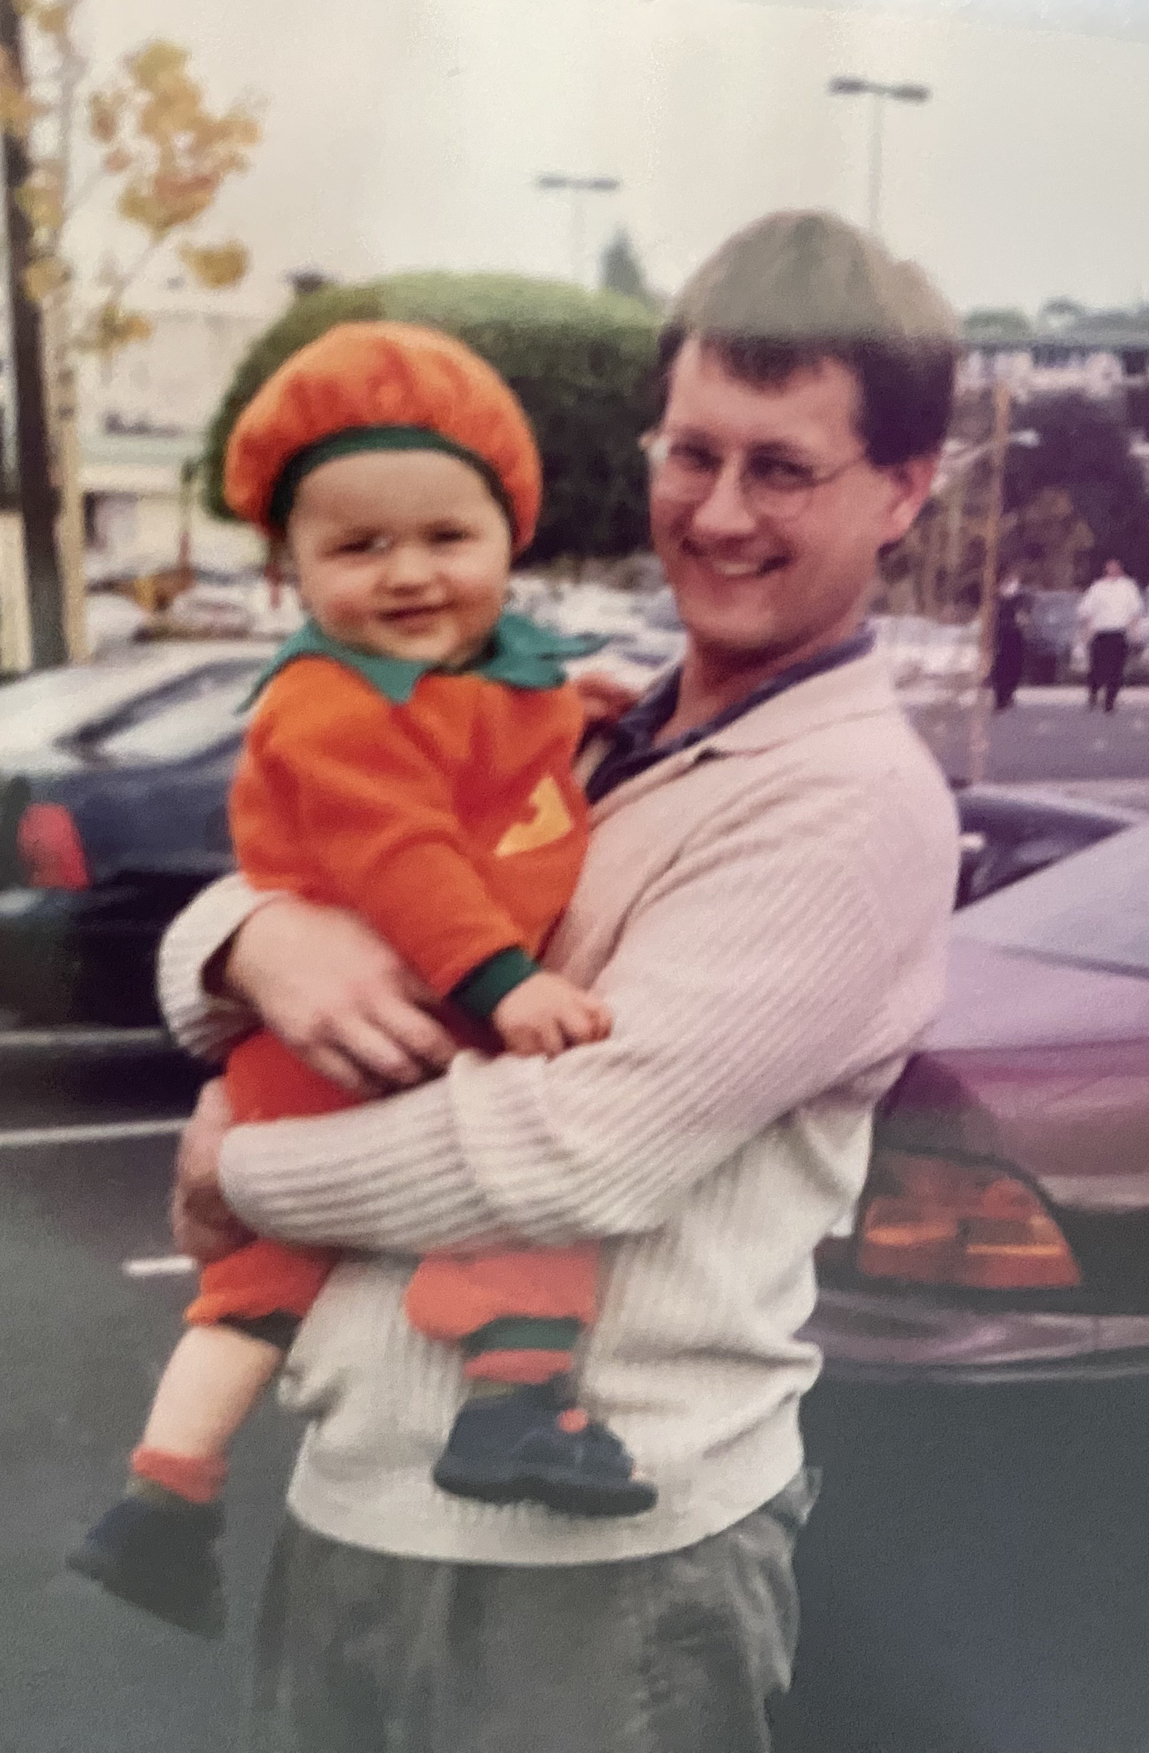
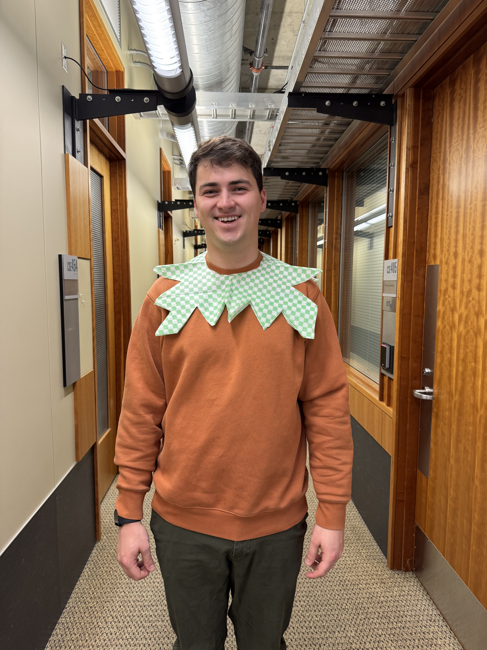
👻 Happy Halloween! 🎃

Slide 3
Announcements, Reminders
P2 due Tuesday, November 11th
R3 out yesterday and due Thursday, November 6th
  P0, C1, P1, C2 eligible
  last opportunity to resubmit P0
Quiz 1 is Thursday, November 6th, in your registered quiz section
  practice quizzes, reference sheet posted on Ed
  for loops, nested for loops, Random, Math, methods, parameters, returns, conditionals, while loops
James’ OH changes next week:
  No coffee chats on Monday (11/3)
  No Wednesday (11/5) OH, 1-3 PM on Friday (11/7) instead

Slide 4
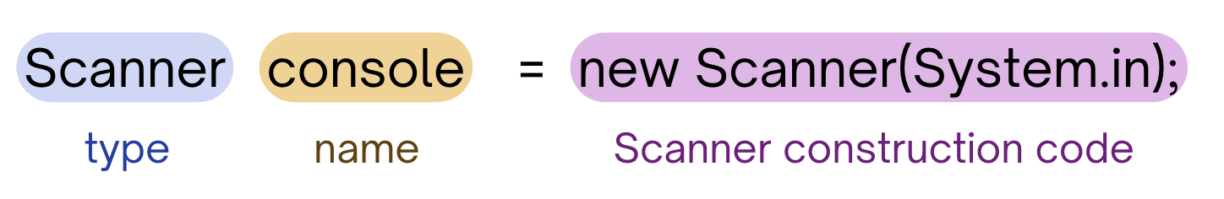
PCM Review: Scanner
An object that we can use to read in input
In the java.util “package”!
Methods | Description
nextInt() | Reads the next token from the user as an int and returns it.
nextDouble() | Reads the next token from the user as a double and returns it.
next() | Reads the next token from the user as a String and returns it.
nextLine() | Reads an entire line from the user as a String and returns it.

Slide 5
PCM Review: Tokens
A unit of user input, as read by the Scanner
Tokens are separated by whitespace (spaces, tabs, new lines)
23 John Smith
42.0 "Hello world" $2.50 " 19

Slide 6
PCM Review: InputMismatchException
Exceptions are errors that occur while a program is running that stops the program from running.
There are different types of exceptions that can occur, and the name of the exception can help you understand what caused the error!
An InputMismatchException occurs when the Scanner tries to read input in as a specific type, but the input cannot be interpreted as that type.
(e.g., trying to read in "hello" as an int)

Slide 7
Think Pair Share: Cornbear (Think)
When calling the following method, which of these user inputs would not cause an error? (choose multiple)
public static void cornbear() {
Scanner console = new Scanner(System.in);
int amt = console.nextInt();
String firstName = console.next();
String secondName = console.next();
double price = console.nextDouble();
}
6 Gumball’s Treats $12.48
3 Sesame Latte 16.47
2 The Hunger Games 21.98
4 Gumballs 900.24
2 Grammy Awards 90095

Slide 8
Think Pair Share: Cornbear (Pair)
When calling the following method, which of these user inputs would not cause an error? (choose multiple)
public static void cornbear() {
Scanner console = new Scanner(System.in);
int amt = console.nextInt();
String firstName = console.next();
String secondName = console.next();
double price = console.nextDouble();
}
6 Gumball’s Treats $12.48
3 Sesame Latte 16.47
2 The Hunger Games 21.98
4 Gumballs 900.24
2 Grammy Awards 90095

Slide 9
Reminder (again): Fencepost Pattern
Some task where one piece is repeated n times, and another piece is repeated n-1 times and they alternate
L-a-u-f-e-y-!

Slide 10
Fencepost Pattern … for User Input?
Some task where one piece is repeated n times, and another piece is repeated n-1 times and they alternate
enter
an artist
how many
listens?
enter
an artist
how many
listens?
enter
an artist
...

