Slide 1
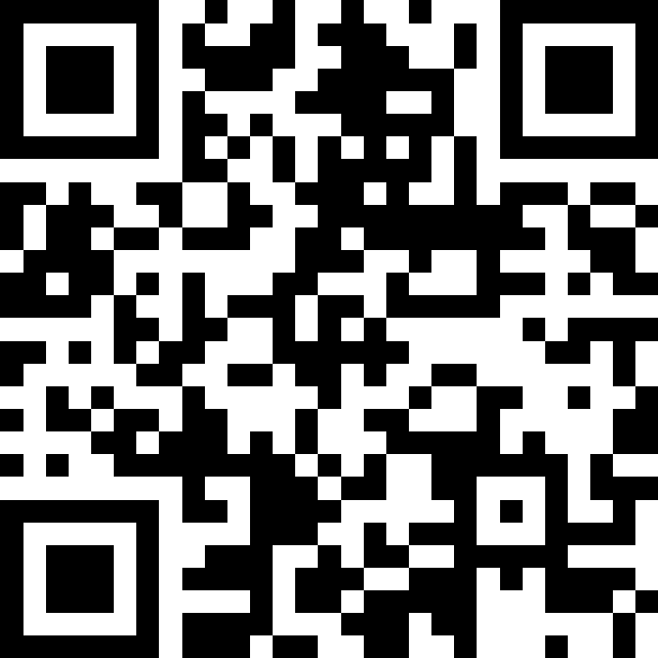
While Loops
BEFORE WE START
LEC 10
Talk to your neighbors:
What’s your favorite spot
on the Ave?
Music: 🎷CSE 121 25au Lecture Tunes 🎵
Instructors:
Brett Wortzman & James Weichert
TAs:
Trey
Amogh
Samrutha
Dalton
Ailsa
Ryan
Anant
Ava
Reese
Hayden
Aki
Spencer
Savannah
Tamsyn
Caleb
Anum
Abdul
Janvi
Navya
Sam Jessica
Elden
Suyash
Sthiti
Paul
Shayna
Jesse
Nhan
Anya
Minh
TJ
Zach
Cayden
Johnathan

Slide 2
Agenda
Announcements, Reminders
while loop review
Flipping coins and rolling dice!

Slide 3
Announcements, Reminders
C2 due Thursday, October 30th
R2 due Thursday, October 30th
  Eligible: C0, P0, C1, P1
  Note: C0 is cycling out of eligibility for resubmission
P2 out tonight, due Tuesday, November 11th
Quiz reminders:
  Quiz 0 feedback coming this week!
  Quiz 1: Thursday, November 6th

Slide 4
Agenda
Announcements, Reminders
while loop review
Flipping coins and rolling dice!

Slide 5
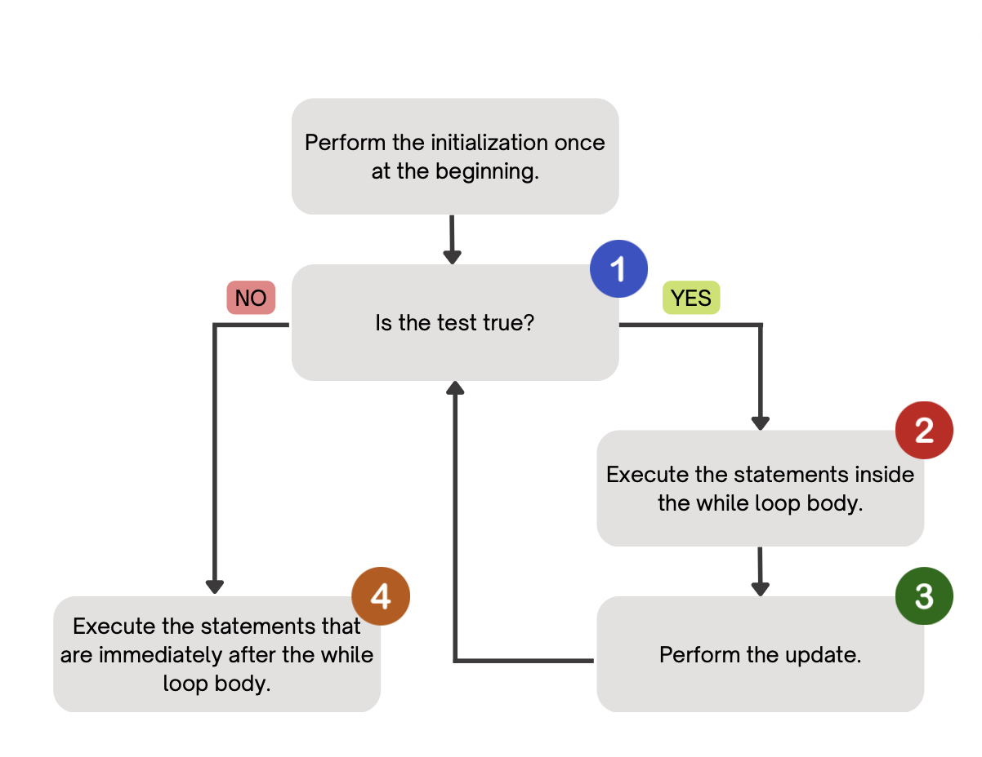
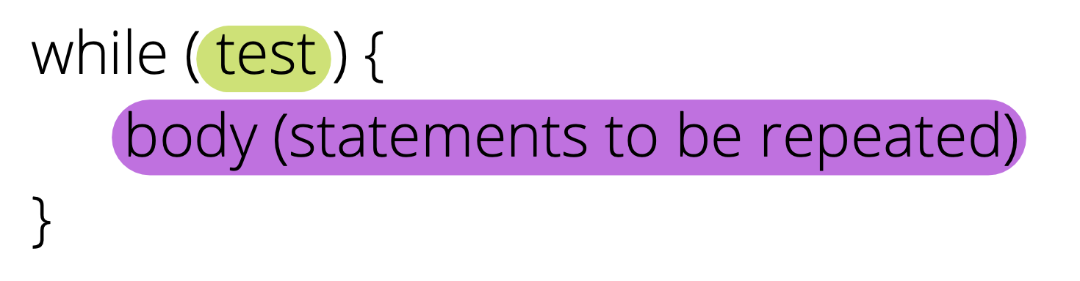
PCM Review: while loops
Repeatedly executes its body as long as the logical test is true.

Slide 6
Think Pair Share: mystery (think)
public static void mystery(Random randy,
int lucky) {
int roll = -1; // "priming" the loop
int x = -1;
while (roll != lucky) {
roll = randy.nextInt(20) + 1;
if (x < roll) {
x = roll;
}
}
System.out.println("Lucky number "
+ x);
}
How would you describe what the variable x calculates?
The largest value rolled
The smallest value rolled
The first value rolled
The last value rolled
The sum of all values rolled

Slide 7
public static void mystery(Random randy,
int lucky) {
int roll = -1; // "priming" the loop
int x = -1;
while (roll != lucky) {
roll = randy.nextInt(20) + 1;
if (x < roll) {
x = roll;
}
}
System.out.println("Lucky number "
+ x);
}
How would you describe what the variable x calculates?
The largest value rolled
The smallest value rolled
The last value rolled
The first value rolled
The sum of all values rolled

Slide 8
for loops are while loops?
for (int i = 0; i < bigYikes; i++) {
// ...
}
int i = 0;
while (i < bigYikes) {
// ...
i++;
}

Slide 9
for loops are while loops! (almost*)
for (int i = 0; i < bigYikes; i++) {
// ...
}
int i = 0;
while (i < bigYikes) {
// ...
i++;
}
*as a technical note, these aren’t exactly the same – there are some minor technical details that are different, most notably the scope of i is different in the two loops

Slide 10
for loops vs. while loops ⚔️
For loops and while loops are quite similar! This is the first (but certainly not the last) time where you need to decide which to use!
There’s not always a “correct” answer, but some advice:
is the condition definite or indefinite
Describing the problem!
  “I will do __ X times” or “for each __ I will __” – sounds like for!
  “I will do __ until” or “while __ is true, I will” – sounds like while!
it’s okay to change your mind after you try one approach!

Slide 11
Agenda
Announcements, Reminders
while loop review
Flipping coins and rolling dice!

