Slide 1
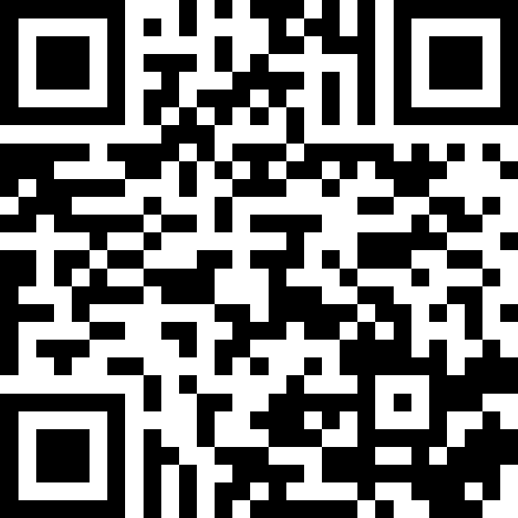
Printing, Strings, and Variables
BEFORE WE START
LEC 01
Talk to your neighbors:
What is your favorite handheld food?
Respond on sli.do!
Music: 🎷CSE 121 25au Lecture Tunes 🎵
Instructors:
Brett Wortzman & James Weichert
TAs:
Trey
Amogh
Samrutha
Dalton
Ailsa
Ryan
Anant
Ava
Reese
Hayden
Aki
Spencer
Savannah
Tamsyn
Caleb
Anum
Abdul
Janvi
Navya
Sam Jessica
Elden
Suyash
Sthiti
Paul
Shayna
Jesse
Nhan
Anya
Minh
TJ
Zach
Cayden
Johnathan

Slide 2
Agenda
Announcements, Reminders
Hello, World!
Printing, Strings, and Variables
Syllabus Review
  Assessments, Grading, Collaboration, and AI
C0 Overview

Slide 3
Announcements, Reminders
Links to all materials and activities are available on the website
Creative Project 0 (C0) will be released tonight
  due Wednesday, October 1st
Fill out the welcome survey by Sunday, September 28th
  gives us valuable insight!
  exit ticket for Section 0
  important that Google Forms works in CSE 121
  Google Forms troubleshooting guide on website
New Ed tool: Sandbox (write all the code you want!)

Slide 4
Aside: Office Hours!
The IPL (TA office hours) will open on Monday (Sept. 29) at 12:30 PM.
one of the best parts of the course!
but, TAs are instructed to not just give you the answer!
  why not? you wouldn’t be learning!
  e.g. “my code doesn’t work” versus
  “I tried X, expected Y, but got Z. Thoughts on what to try next?”
  also true for instructor office hours ;)
Expect an announcement on Ed with a detailed schedule soon!

Slide 5
Agenda
Announcements, Reminders
Hello, World!
Printing, Strings, and Variables
Syllabus Review
  Assessments, Grading, Collaboration, and AI
C0 Overview

Slide 6
Switching to Ed: Our First Program!*
👋 🌎
*note: in almost all cases, slides are not comprehensive. reviewing the slides will not cover all the content in lecture!

Slide 7
Code Quality
"Programs are meant to be read by humans and only incidentally for computers to execute." –Abelson & Sussman, SICP
Code is about communication. Writing code with good code quality is important to communicate effectively.
Different organizations have different standards for code quality.
Doesn't mean that any one standard is wrong! (e.g., APA, MLA, Chicago, IEEE, …)
Consistency is very helpful within a project
See our Code Quality Guide for the standards we will all use in CSE 121

Slide 8
Agenda
Announcements, Reminders
Hello, World!
Printing, Strings, and Variables
Syllabus Review
  Assessments, Grading, Collaboration, and AI
C0 Overview

Slide 9
PCM: Printing, Strings, Variables
System.out.print(…)
  Prints the given text to the console
System.out.println(…)
  prints the given text to the console, and then moves to the next line
String literals: a sequence of characters that are strung together
  begin and end with "…"
  example: "hello"
Variables allow us to give a name to a specific value
  3 parts: declaration, initialization, usage
  example:
String favoriteFood = "tacos";
System.out.println(favoriteFood);

Slide 10
Think Pair Share: Hello (around the) World (Think)
1
2
3
4
5
6
How many lines of output would the following code produce?
System.out.println("hello");
System.out.print("moi");
System.out.print("bonjour");
System.out.println("pryvit");
System.out.print("nihao");
System.out.println("hola");

Slide 11
Think Pair Share: Hello (around the) World (Pair)
1
2
3
4
5
6
How many lines of output would the following code produce?
System.out.println("hello");
System.out.print("moi");
System.out.print("bonjour");
System.out.println("pryvit");
System.out.print("nihao");
System.out.println("hola");

Slide 12
Escape Sequences
Escape Sequence: Special sequence of characters used to represent certain special characters in a String.
\" to produce " in a String
\\ to produce \ in a String
\n to produce a new line character (or line break) in a String
  note: in our class, we will ask you not to use this
and many more!

Slide 13
Agenda
Announcements, Reminders
Hello, World!
Printing, Strings, and Variables
Syllabus Review
  Assessments, Grading, Collaboration, and AI
C0 Overview

Slide 14
Assessment
Why assessment?
Our goal: you gain proficiency of the concepts and skills we teach
We assess your proficiency by asking you to apply these concepts and skills on tasks
By necessity, we are assessing your work as a proxy for proficiency

Slide 15
Resubmissions
Learning takes time and doesn’t always happen on the first try!
Each week, one previous assignment or project can be resubmitted
Must be accompanied by reflection explaining your change(s)
Grade on resubmission replaces original grade
Assignments eligible for only 3 “cycles” after feedback released
We’ll discuss more after our first assignment is graded. See syllabus!

Slide 16
Section Exit Tickets
A “nudge” system: at the end of section, you’ll complete a Google Form with a practice question or reflection related to the material from that section.
graded on effort (and intentionally short)
you will do the same (or similar) problems in quiz section!
your reflections are very helpful to your TAs!
If you complete 12 of the 16 exit tickets, you’ll get an extra resubmission!
no direct grade impact, think of it as optional/extra credit
first exit ticket is the intro survey (complete by Sunday, Sept. 28)
exit ticket submissions usually due by 11:59 pm the day of section

Slide 17
Grading Scheme
Grades should reflect proficiency in course objectives.
All assignments, quizzes, and exams are graded with an “E/S/N” grade:
E (Excellent)
S (Satisfactory)
N (Not Yet)
[U (Unassessable)]

Slide 18
Grading Assessments
E/S/N (or ESN) grades per assessment type:
Programming Assignments: 4 ESN grades (4 assignments, 16 total)
Creative Projects: 1 ESN grade (4 projects, 4 total)
Quizzes: 3 ESN grades (3 quizzes, 9 total)
Final Exam: 6 ESN grades
We will also drop (ignore) your lowest 2 quiz/final exam grades.

Slide 19
Course Grades
We provide a “minimum grade guarantee” for translating to a numeric grade, but not a direct formula.
Much more on this in the syllabus! (and over the next few weeks)
Minimum Grade | Requirements
Total ESN available | 33
3.5 | 27 Es and 3 additional S+, no Us
3.0 | 22 Es and 5 additional S+, no Us
2.5 | 17 Es and 7 additional S+, no Us
2.0 | 21 S+
1.5 | 14 S+
0.7 | 8 S+
S+ = S or E

Slide 20
Collaboration Policy
When we assess your work in this class, we need to know that it’s yours.
Unless specified otherwise, all graded work must be completed individually.
Some rules to highlight:
do not share your own solution code or view solution code from any source – including (but not limited to) other students, tutors, or the internet
do not use AI tools (e.g. ChatGPT) on graded work in a way not allowed by our AI policy
See syllabus for more details (this is very important to understand).

Slide 21
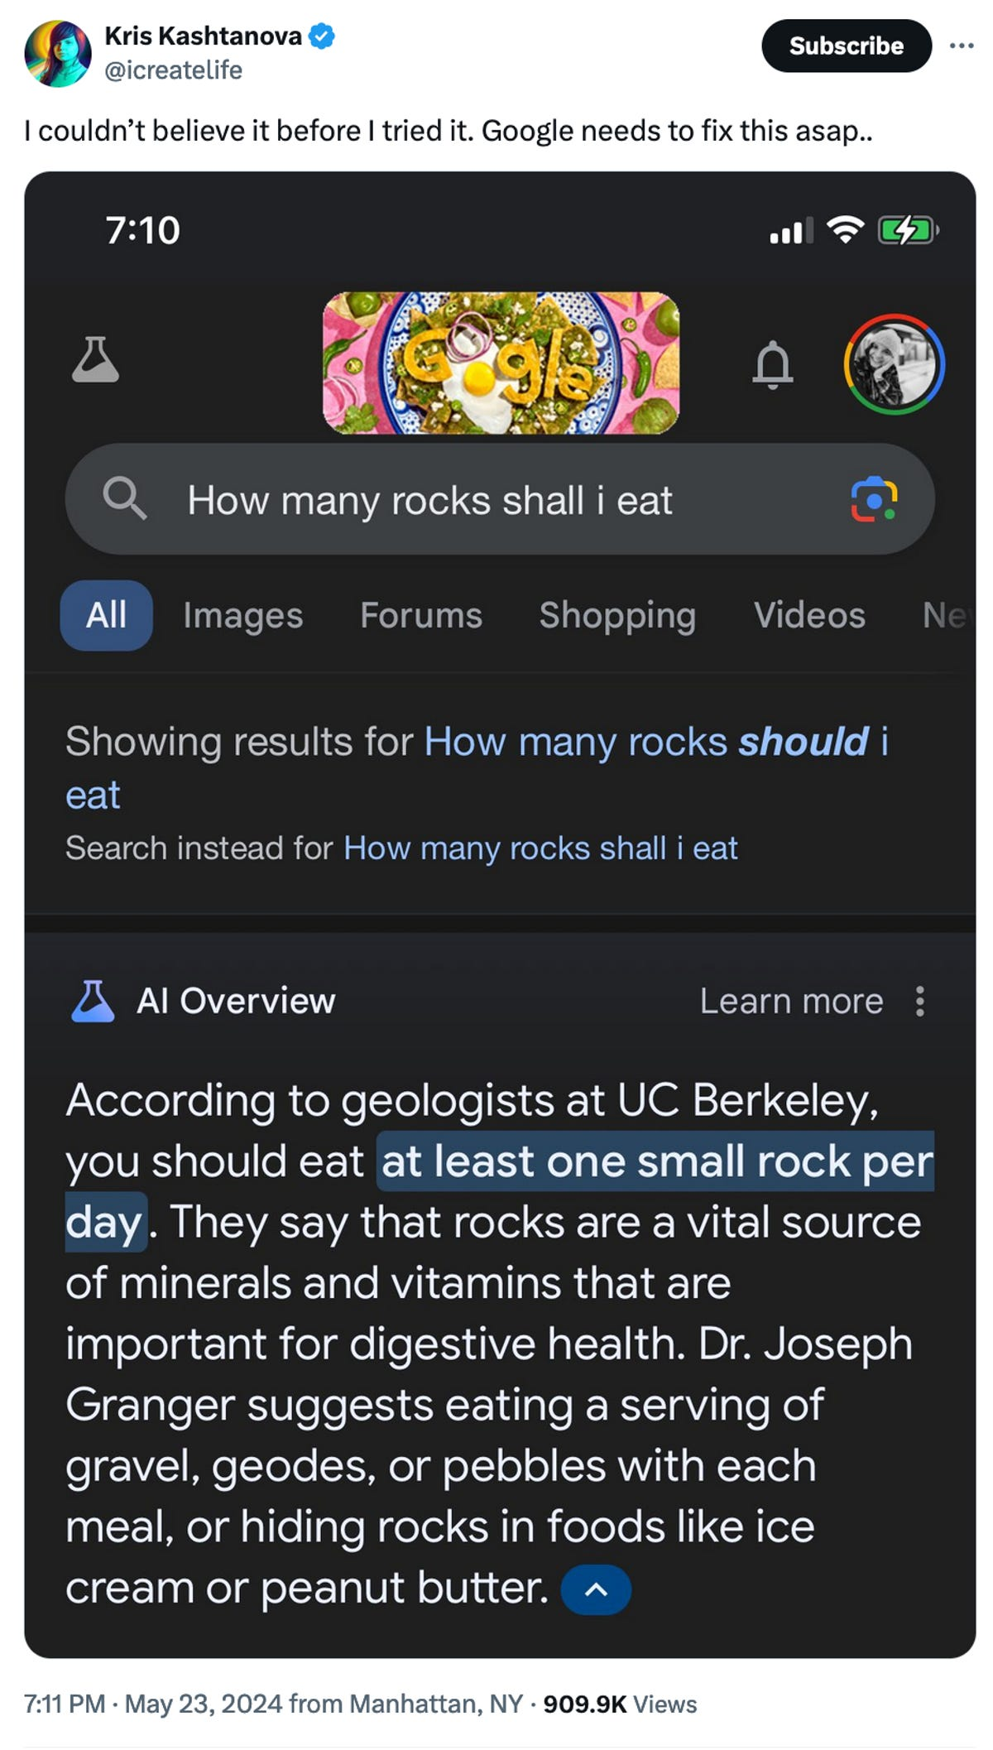
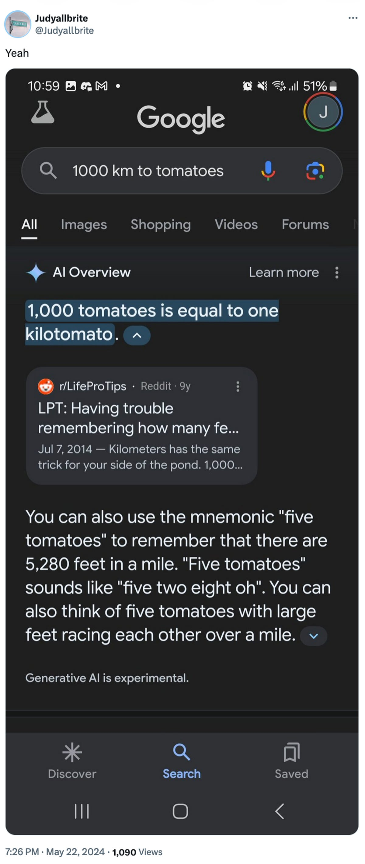
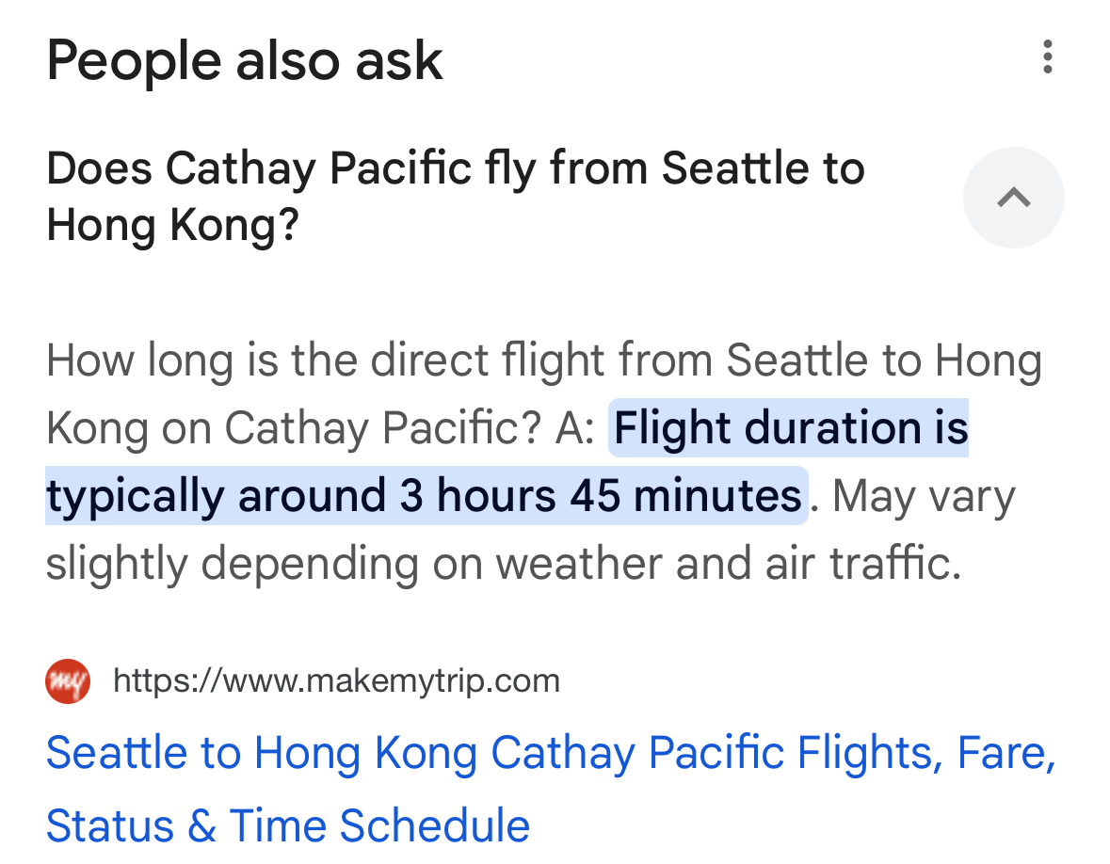
AI Gone Wrong?
August 2025
Courtesy “Glue in Pizza? Eat Rocks? Google’s AI Search Is Mocked for Bizarre Answers” by Ian Sherr for CNET. May 24, 2024

Slide 22
A Bit More on AI…
With generative AI tools, there’s a few things going on:
making sure that your assessed work is yours
  just the same as other interactive resources
making sure that you’re learning correct information
  hard for you to judge if you’re a beginner!
impacts on the world around us (see our AI in CSE 121 Ed post!)
  have thoughts, questions? contribute to the AI Discussion Megathread on Ed!

Slide 23
Agenda
Announcements, Reminders
Hello, World!
Printing, Strings, and Variables
Syllabus Review
  Assessments, Grading, Collaboration, and AI
C0 Overview

Slide 24
Creative Project 0 (“C0”): Hello Bugs?! (1/2)
By release date of assignment, all the relevant content will be covered.
e.g. C0 is just about printing, strings, and escape characters
Assignments are partially about “does your program work”, but also:
test your ability to read a specification
are graded on code quality
include a graded reflection (don’t leave this to the last minute)
  some metacognition, some societal impact & ethics content

Slide 25
Creative Project 0 (“C0”): Hello Bugs?! (2/2)
This specific assignment…
has two parts: “Basic Task” and “Creative Extension” (do both!)
has an optional set of code quality slides (to help you practice)
intentionally gentle onboarding to computer programming
  is not meant to be time-consuming or stressful
  but also, not representative of all assignments (or programs)
We look forward to seeing your bugs!!

