Slide 1

Welcome!
BEFORE WE START
LEC 00
Talk to your neighbors:
Introduce yourself! What is your name? Major? What did you do over summer break?
Music: 🎷 CSE 121 25au Lecture Tunes 🎵
Instructors:
Brett Wortzman & James Weichert
TAs:
Trey
Amogh
Samrutha
Dalton
Ailsa
Ryan
Anant
Ava
Reese
Hayden
Aki
Spencer
Savannah
Tamsyn
Caleb
Anum
Abdul
Janvi
Navya
Sam Jessica
Elden
Suyash
Sthiti
Paul
Shayna
Jesse
Nhan
Anya
Minh
TJ
Zach
Cayden
Johnathan
Notes:
James

Slide 2
Lecture Outline
Today:
Introductions :)
About this course
Our learning model
Culture and community
Tools
On Friday:
Our first program!
Assessment and grading
Collaboration
Notes:
James

Slide 3

Hi, I’m James! (he/him)
New Assistant Teaching Professor in the Allen School
I’ve lived in California, North Carolina, Georgia, Virginia, and now Washington!
Studied computer science and data science in college at UC Berkeley
M.S. in computer science at Virginia Tech
Computer science interests: CS education; AI ethics, policy, and education
Free time activities: traveling, cooking, reading, skiing, and playing Minecraft!
Notes:
James

Slide 4
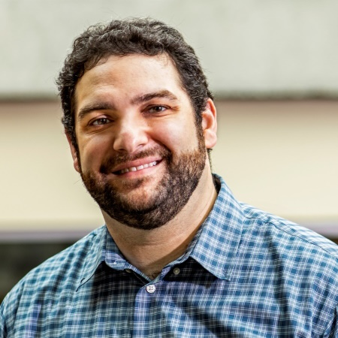
Hi, I’m Brett! (he/him)
Associate Teaching Professor
Frequent intro CS instructor
Lead designer/developer of new 12X curriculum
Also interested in CS education/pedagogy
Previously:
trained CS teachers (and still!)
developed CS curriculum
taught high school CS
worked as a software engineering
Non-CS hobbies: board games/RPGs, officiating football, announcing robotics competitions
Notes:
Brett

Slide 5


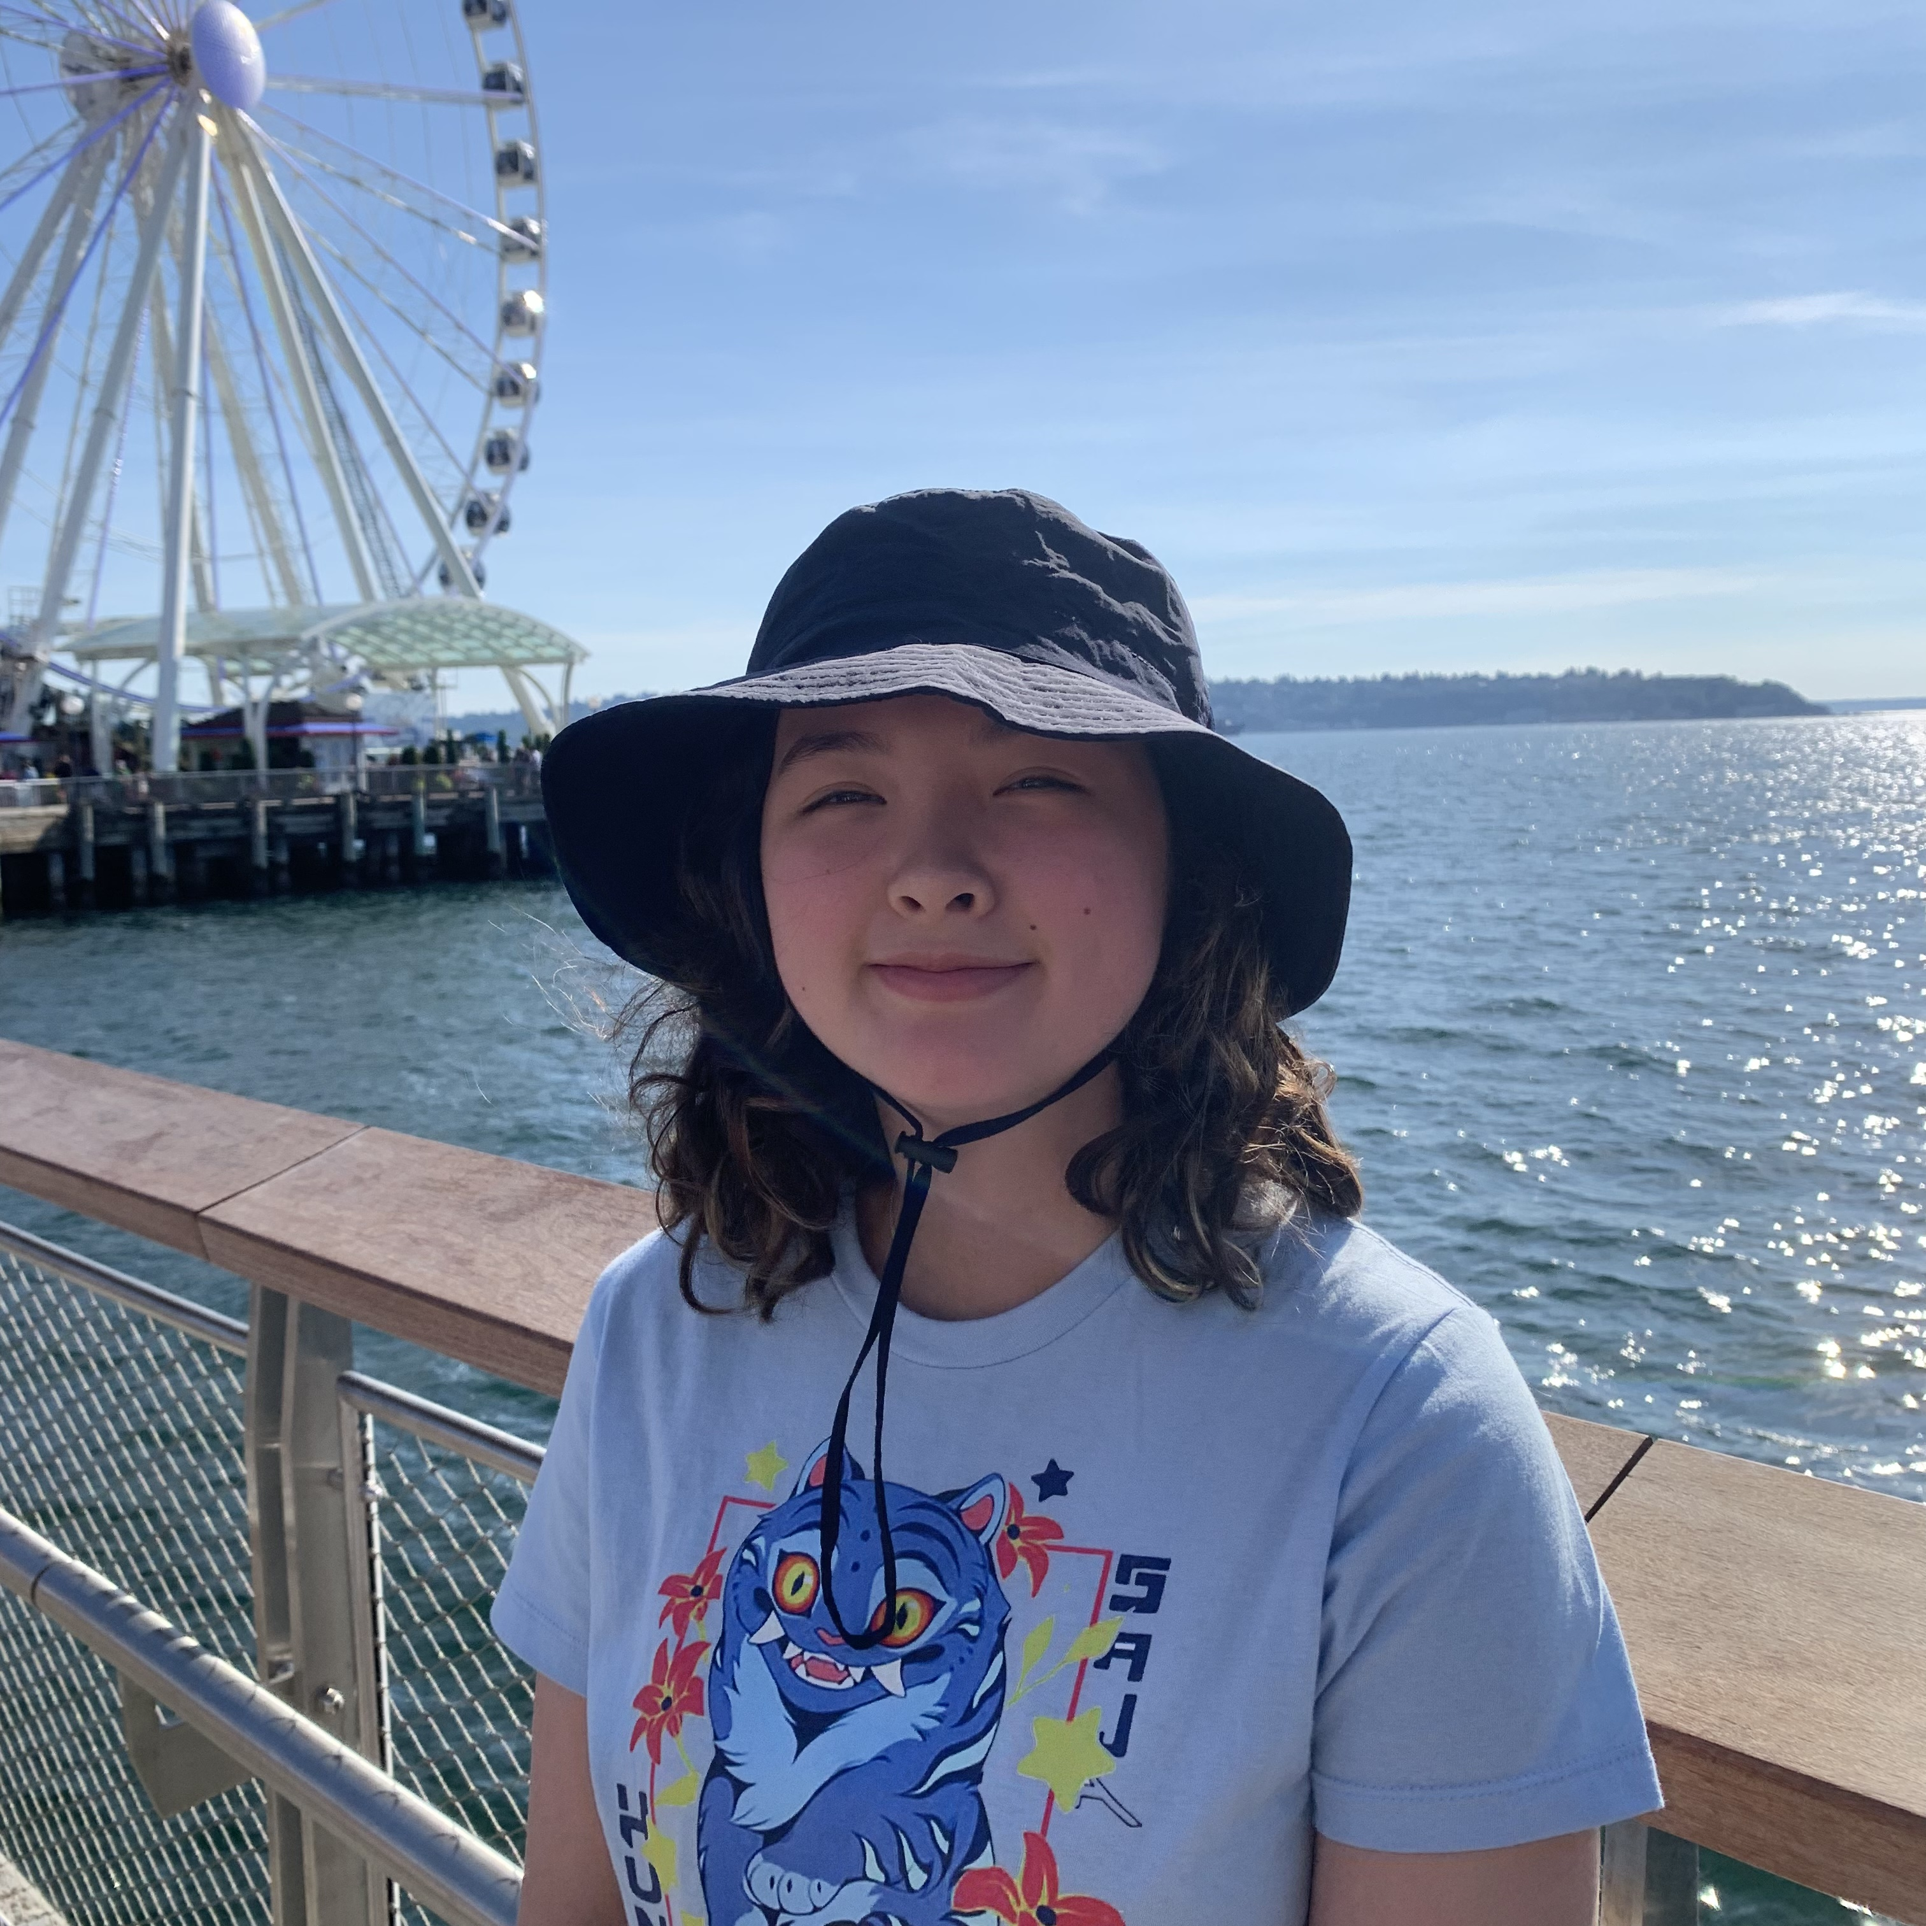


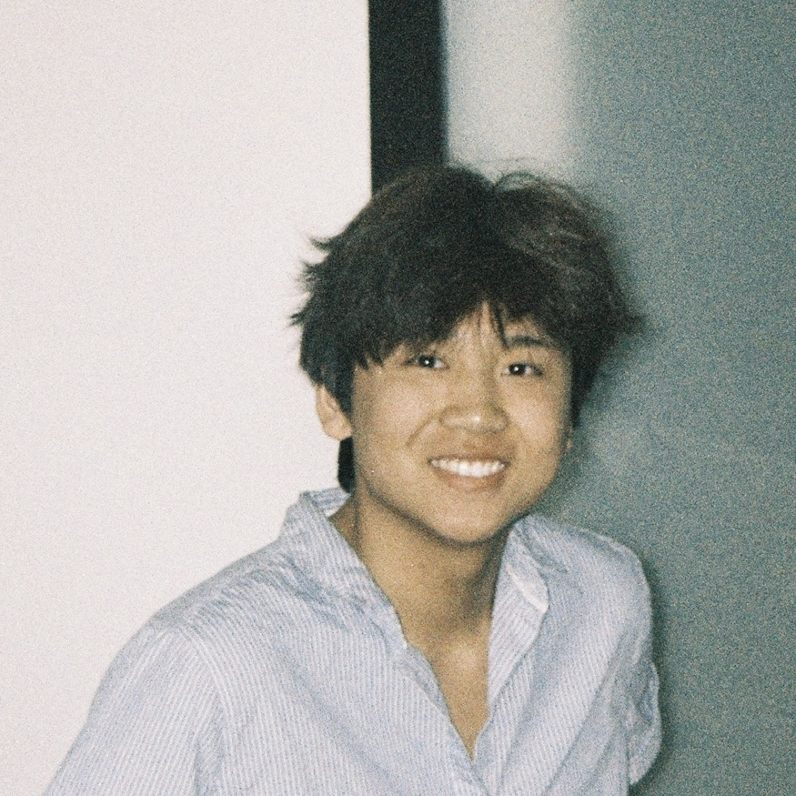

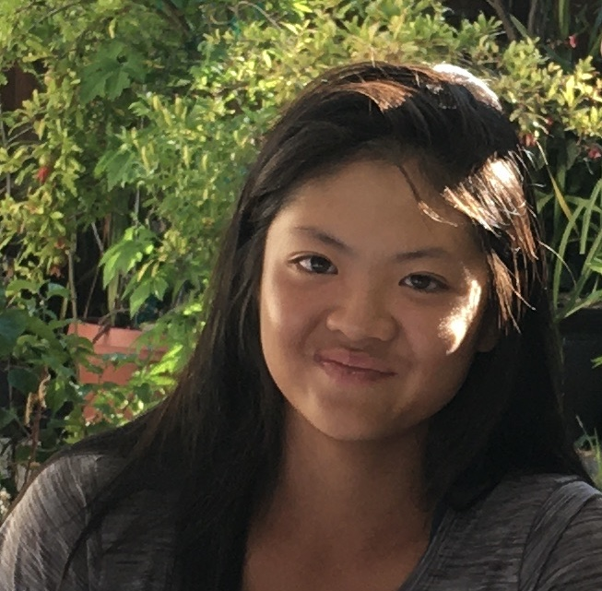


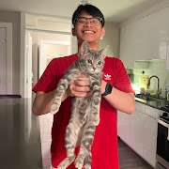
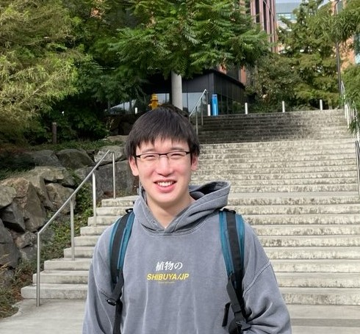
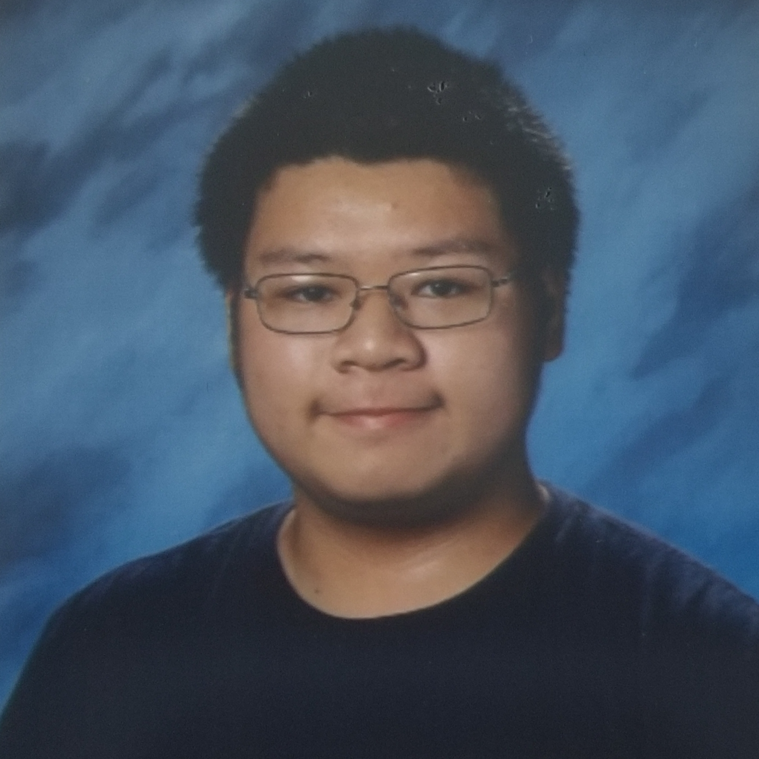

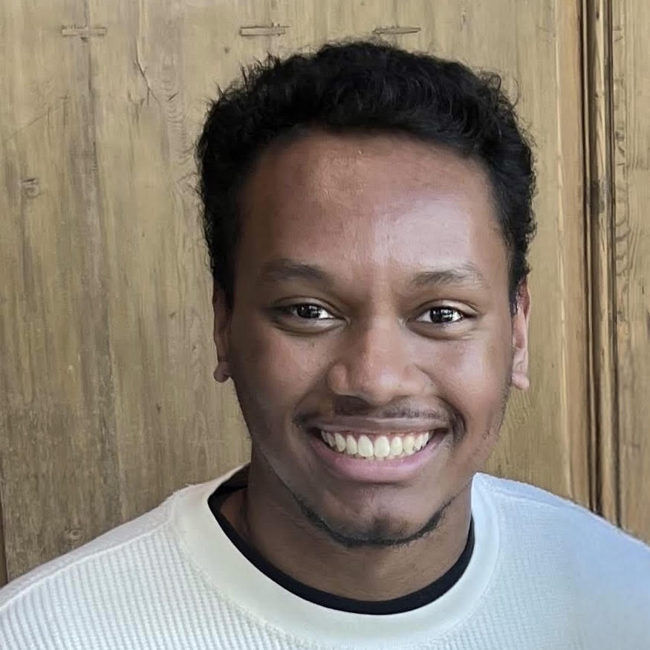




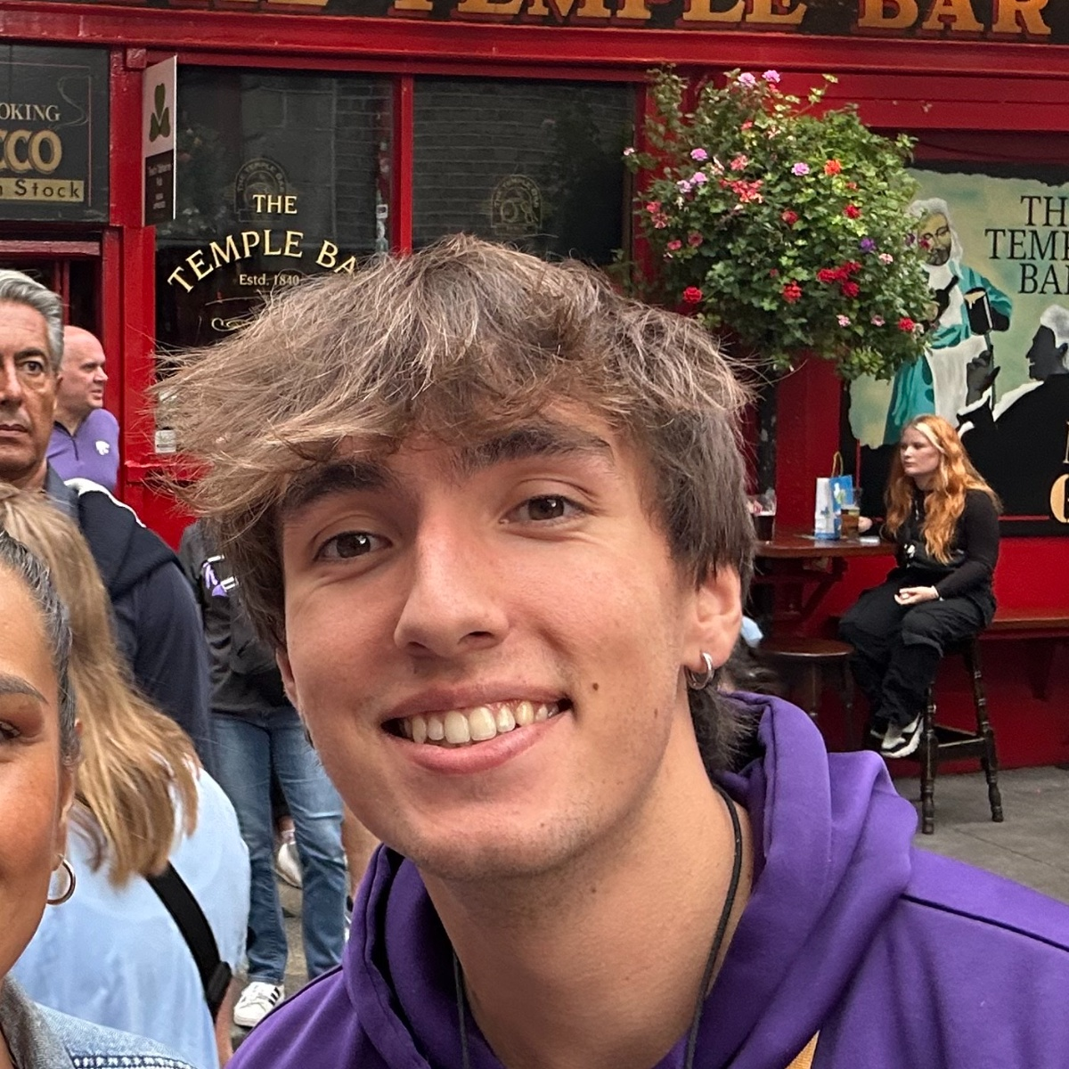







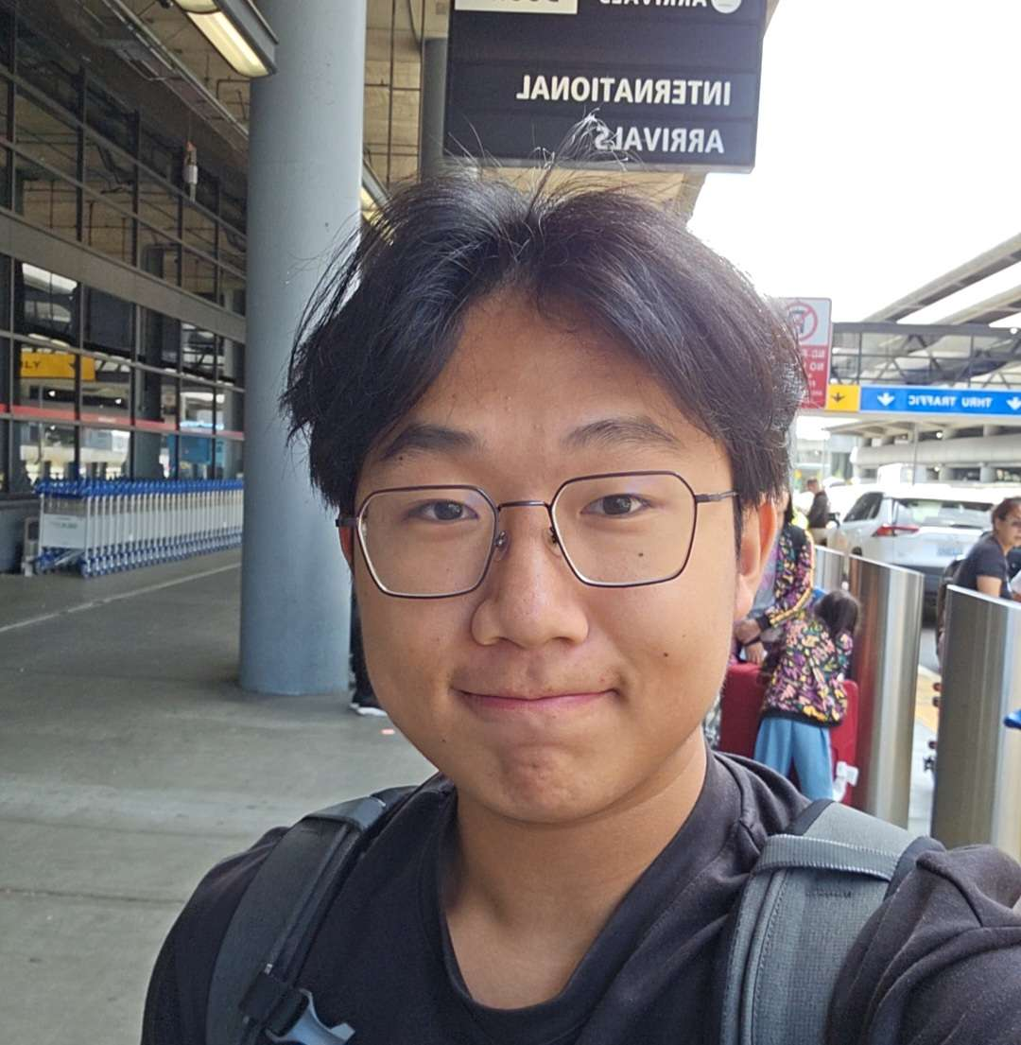
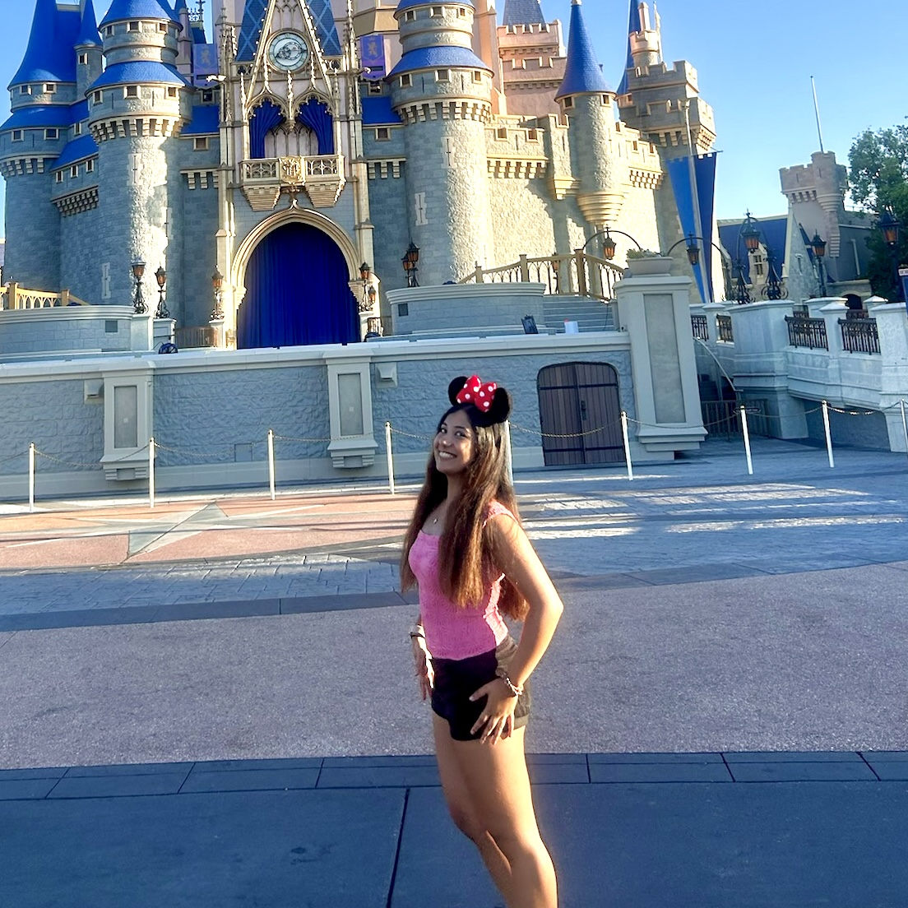


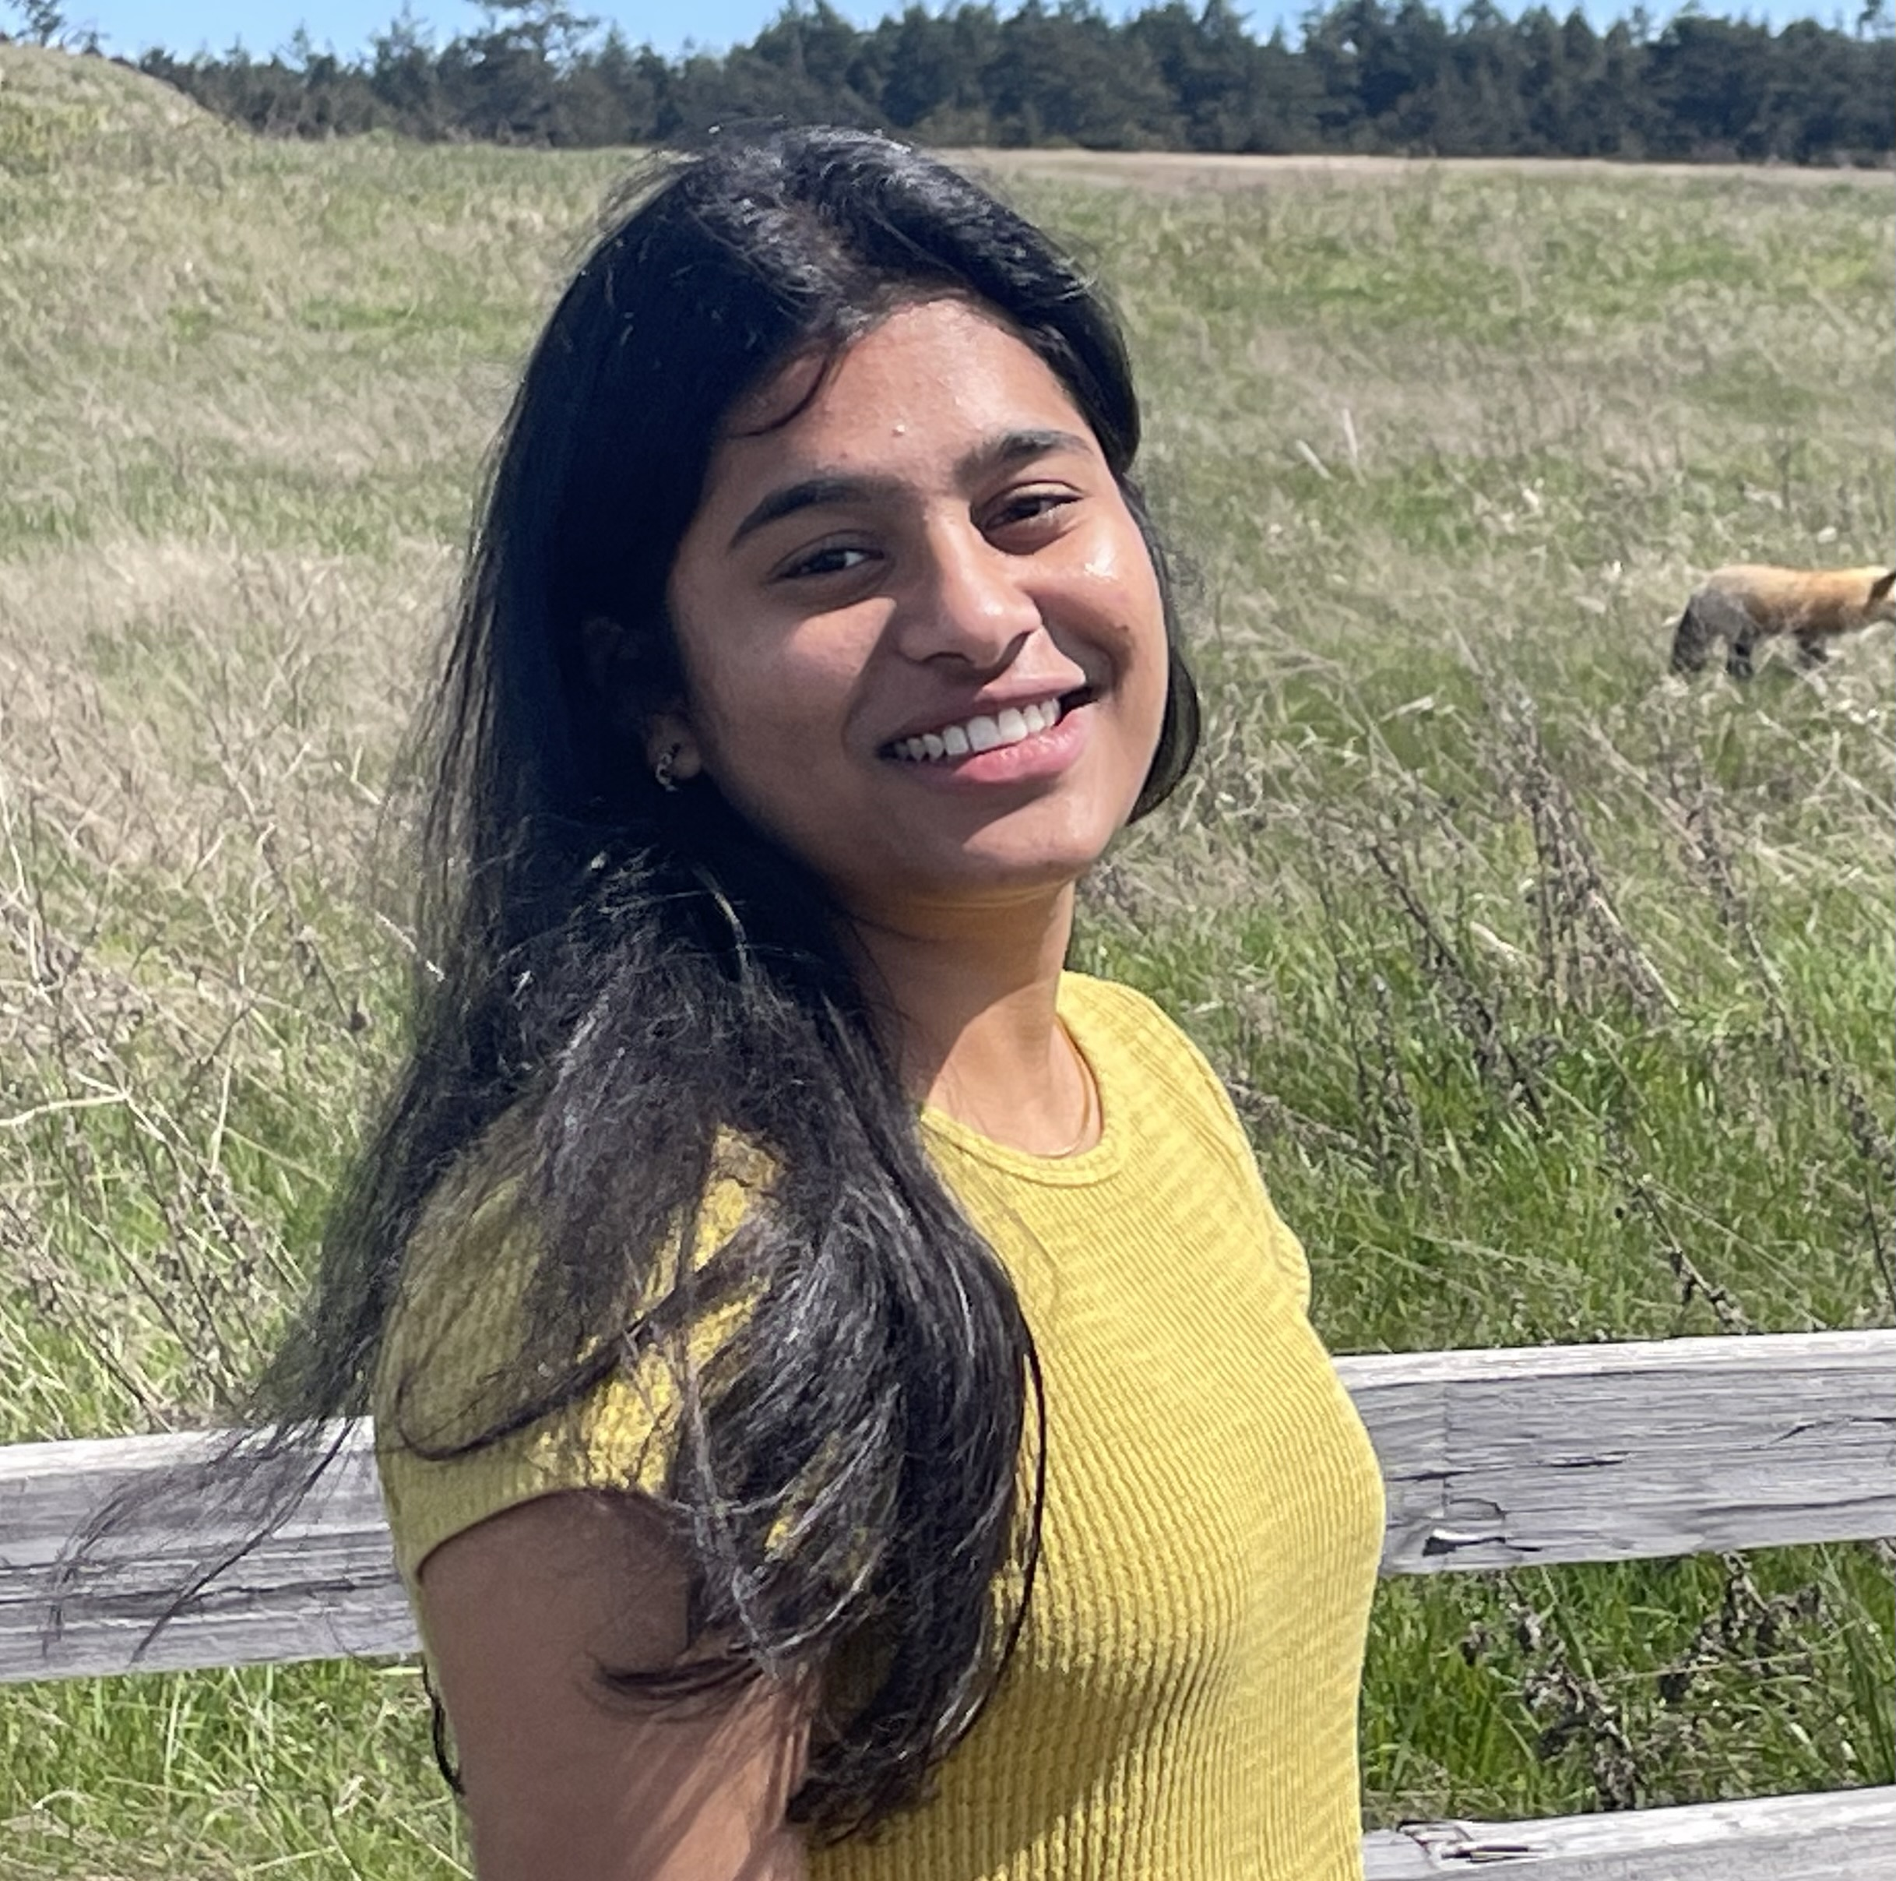

Meet your 34 fabulous TAs!
Notes:
Brett

Slide 6
Agenda
Today:
Introductions :)
About this course
Learning objectives
Similar courses
Course components
Our learning model
Culture and community
Tools
On Friday:
Our first program!
Assessment and grading
Collaboration
Notes:
Brett

Slide 7
Learning Objectives
or, “What will I learn in this class?”
Bottom line: Intro to Programming, part 1
Not quite:
“How do computers work?”
“Intro to Java”
“All you need to program”
Math!
Learning Objectives:
Computational Thinking
Code Comprehension
Code Writing
Communication
Testing
Debugging
Ethics & Societal Impact
Notes:
Brett

Slide 8
Other Similar Courses
Course | Good choice if…
CSE 121 (this is us!) | You’ve never programmed before AND You are, or want to be in a major such as CS, CE, ECE, Info, etc. that requires Java programming
CSE 122 | You’ve done some programming (roughly one course worth) in any programming language AND You are, or want to be in a major such as CS, CE, ECE, Info, etc. that requires Java programming
CSE 123 | You’ve taken CSE 122 (or equivalent) AND You are, or want to be in a major such as CS, CE, ECE, Info, etc. that requires Java programming
CSE 143 | You took CSE 142 (at UW, through UWHS, or at community college) OR You took AP CS A (or similar) and feel confident in all the material
CSE 143X | You have programmed quite a bit before, but not in Java OR You have lots of extra time to put into learning and tend to pick things up quickly
CSE 160 | You’ve never programmed before AND You’re interested in data science and analysis OR You’d rather learn Python than Java* OR You are, or want to be in a major such as Physics, Bio, Stat, etc. where your primary goal is analyzing data through programming (rather than building software)
Also see: guided self-placement and CSE page on introductory courses for more info.
Notes:
Brett

Slide 9
Course Components
LECTURES
x20
PROGRAMMING ASSIGNMENTS
x4
CREATIVE PROJECTS
x4
We’re here!
Introduce concepts, practice ideas, discuss applications.
Pre-class materials to prepare for class each day. Due before class.
Structured assignments
Programming in Java
Applying & implementing course concepts
More open-ended assignments
Explore new ideas and applications
SECTIONS
x16
QUIZZES
x3
EXAM
x1
Held in person
More practice, reviews, applications
TA advice, how to be an effective student
Preparation for quizzes / exams
Exit ticket done at end of section
Taken in quiz section
45 minutes on paper
Culminating exam
Wed, Dec. 10th
12:30 – 2:20 PM
Graded Assignments
Meetings
Notes:
James

Slide 10
Agenda
Today:
Introductions :)
About this course
Our learning model
Learning objectives
Similar courses
Course components
Culture and community
Tools
On Friday:
Our first program!
Assessment and grading
Collaboration
Notes:
Brett

Slide 11

How did you learn how to ride a bike?
Notes:
Brett

Slide 12

Digression: My Pandemic Hobby
Amigurumi: Japanese art of creating crocheted or knitted stuffed toys
Notes:
Brett
I learned to crochet! I bought a kit, read the instructions, and watched a bunch of videos. This is what I was supposed to make.

Slide 13
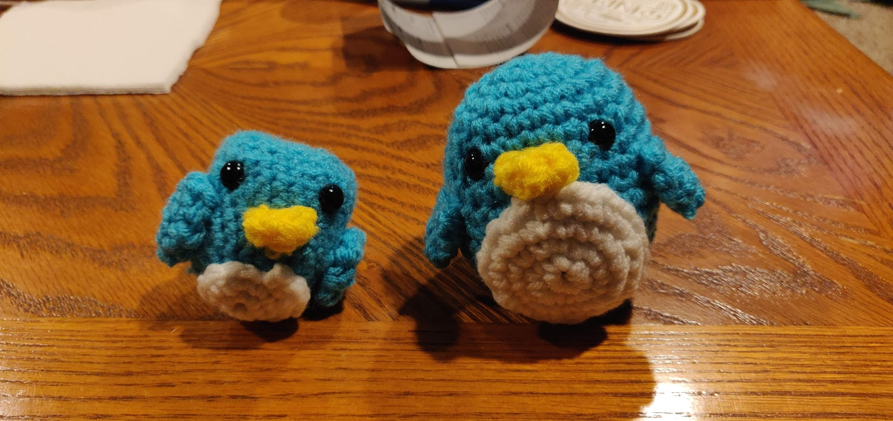
Digression: My Pandemic Hobby
Amigurumi: Japanese art of creating crocheted or knitted stuffed toys
Notes:
Brett
This is what I actually made!
Except that wasn’t my first penguin– it was my second…

Slide 14
Digression: My Pandemic Hobby
Amigurumi: Japanese art of creating crocheted or knitted stuffed toys
Notes:
Brett
THIS was my first penguin.
I did everything “right”: followed instructions, looked for resources, paid attention. But I still made mistakes.
We don’t learn by watching, listening, or reading; we learn by DOING! And we almost always make mistakes along the way. Don’t expect to just show up to class, watch and listen, and get things exactly right the first time. Plan to engage, practice, and make mistakes.

Slide 15

How Learning Works
Learning requires active participation in the process. It’s not as simple as sitting and listening to someone talk at you!
Requires deliberate practice in learning by doing
Benefits from collaborative learning
Does not work well if you cram everything!
Notes:
Brett

Slide 16
Pre-Class Materials
PRE-CLASS MATERIALS
PCMs are a core element of the course
Prepare for each lecture with readings & practice problems
Should take ~30 minutes per lecture (why we don’t have Monday lectures!)
Class will start with a brief recap, then pick off where we left off
Notes:
James

Slide 17
Pre-Class Materials
PRE-CLASS MATERIALS
PCMs are a core element of the course
Prepare for each lecture with readings & practice problems
Should take ~30 minutes per lecture (why we don’t have Monday lectures!)
Class will start with a brief recap, then pick off where we left off
This means…
We can spend lecture diving deeper, answering questions, and think-pair-share
You can ask about pre-lecture material in class or section!
Notes:
James

Slide 18
Pre-Class Materials
PRE-CLASS MATERIALS
PCMs are a core element of the course
Prepare for each lecture with readings & practice problems
Should take ~30 minutes per lecture (why we don’t have Monday lectures!)
Class will start with a brief recap, then pick off where we left off
This means…
We can spend lecture diving deeper, answering questions, and think-pair-share
You can ask about pre-lecture material in class or section!
Pre-class materials are ungraded, which means…
It’s okay if you find them challenging – that means you’re learning!
But you should do them, and we will assume you’ve done them
Notes:
James

Slide 19
Consistent and Active Participation
ATTENDANCE
Attendance is not graded, but it’s strongly encouraged!
Lectures and sections are not going to be just us talking at you!
Instead: live in-class coding, debugging, think-pair-share, and problem—solving
Spending ~1-2 hours each day over Tuesday - Friday is much more effective than cramming before the assignment is due!
Notes:
Brett

Slide 20
Consistent and Active Participation
ATTENDANCE
Attendance is not graded, but it’s strongly encouraged!
Lectures and sections are not going to be just us talking at you!
Instead: live in-class coding, debugging, think-pair-share, and problem—solving
Spending ~1-2 hours each day over Tuesday - Friday is much more effective than cramming before the assignment is due!
Catching up:
All lectures are recorded on Panopto; slides are on our website.
Section materials are on Ed, but section will not be recorded
Notes:
Brett

Slide 21
Metacognition
Metacognition: asking questions about your solution process.
Examples:
While debugging: explain to yourself why you’re trying this change.
Before running your program: make an explicit prediction of what you expect.
When working: be aware when you’re not making progress, so you can take a break or try a different strategy
When designing:
Explain the tradeoffs with using a different data structure or algorithm.
If one or more requirements change, how would the solution change as a result?
Reflect on how you ruled out alternative ideas along the way to a solution.
When studying: what is the relationship of this topic to other ideas in the course?
Notes:
Brett

Slide 22
Agenda
Today:
Introductions :)
About this course
Our learning model
Culture and community
Tools
On Friday:
Our first program!
Assessment and grading
Collaboration
Notes:
James

Slide 23
Think-Pair-Share: Inclusive Environments
CSE 121 will have many think-pair-share activities. Let’s practice! Today’s think:
What was an experience you had that made you feel welcome or included in a learning environment?
Think on your own, in silence for about ~ 30 seconds
Pair with your neighbor about it (and introduce yourself!!)
Share in sli.do & in class (I’ll take a few volunteers from both)
Notes:
James

Slide 24
Think-Pair-Share: Exclusive Environments
CSE 121 will have many think-pair-share activities. Let’s practice! Today’s think:
What was an experience you had that made you feel unwelcome or excluded in a learning environment?
Think on your own, in silence for about ~ 30 seconds
Pair with your neighbor about it (and introduce yourself!!)
Share in sli.do & in class (I’ll take a few volunteers from both)
Notes:
James

Slide 25
The CSE 121 Community
ABOUT US
OUR GOALS
Currently 562 students enrolled!
Very few are CSE majors
Wide range of backgrounds, interests, and goals
Everyone is new to programming
Foster an inclusive and supportive environment for all students to thrive by:
being respectful
being kind and understanding
being honest
being ourselves
Notes:
James

Slide 26
The World Around Us
College is challenging and CSE 121 isn’t your only class.
Life is unpredictable and things happen.
We can’t leave the impacts of the world around us at the classroom door.
OUR POLICIES
SUPPORT
Our course policies are designed for flexibility:
Resubmissions
Dropping quiz/exam problems
Asynchronous help
Lecture recordings
We’re here to support you as a student and as a person.
Please reach out if you’re struggling or have circumstances that require extra support.
Notes:
James

Slide 27
Learning in CSE 121: Live Support Systems
Programming is hard! We want to give you collaborative support!
Introductory Programming Lab (TA Office Hours) – starting Week 2
> 40 hours/week (and highly rated in the class!)
Face-to-face help from TAs on any course questions
Instructor Office Hours – starting today!
We don’t byte!
Great for things from lecture, personal questions, or just saying hi
Notes:
Brett

Slide 28
Learning in CSE 121: Async Support Systems
Ed Board
Best for content and logistics questions – 562 of you >> 36 of us!!
Encourage public posts, except for things about your graded work
Answer other students’ questions – great way to learn!
Email
Best for personal circumstances and/or private questions
If unsure, always feel free to email Brett and James
(cse121-instructors@cs.washington.edu)
May politely ask you to post on Ed instead!
For emails, please use your UW email (protecting student privacy!)
Notes:
Brett

Slide 29
Help Us Improve!
This is still a relatively new course! We’re always looking for feedback on how to improve the class for you and for future students.
We really value your feedback!
Let us know what’s working and what isn’t working for you!
Several feedback mechanisms:
Built into the class (e.g. reflections, mid-quarter feedback sessions)
Post on discussion board (can be public/private)
Note: anonymous is anonymous to other students, not to staff
Use CSE’s Anonymous Feedback Tool (also on website)
Notes:
Brett

Slide 30
Agenda
Today:
Introductions :)
About this course
Our learning model
Culture and community
Tools
Course website
Ed
AI in CSE 121
On Friday:
Our first program!
Assessment and grading
Collaboration
Notes:
James

Slide 31
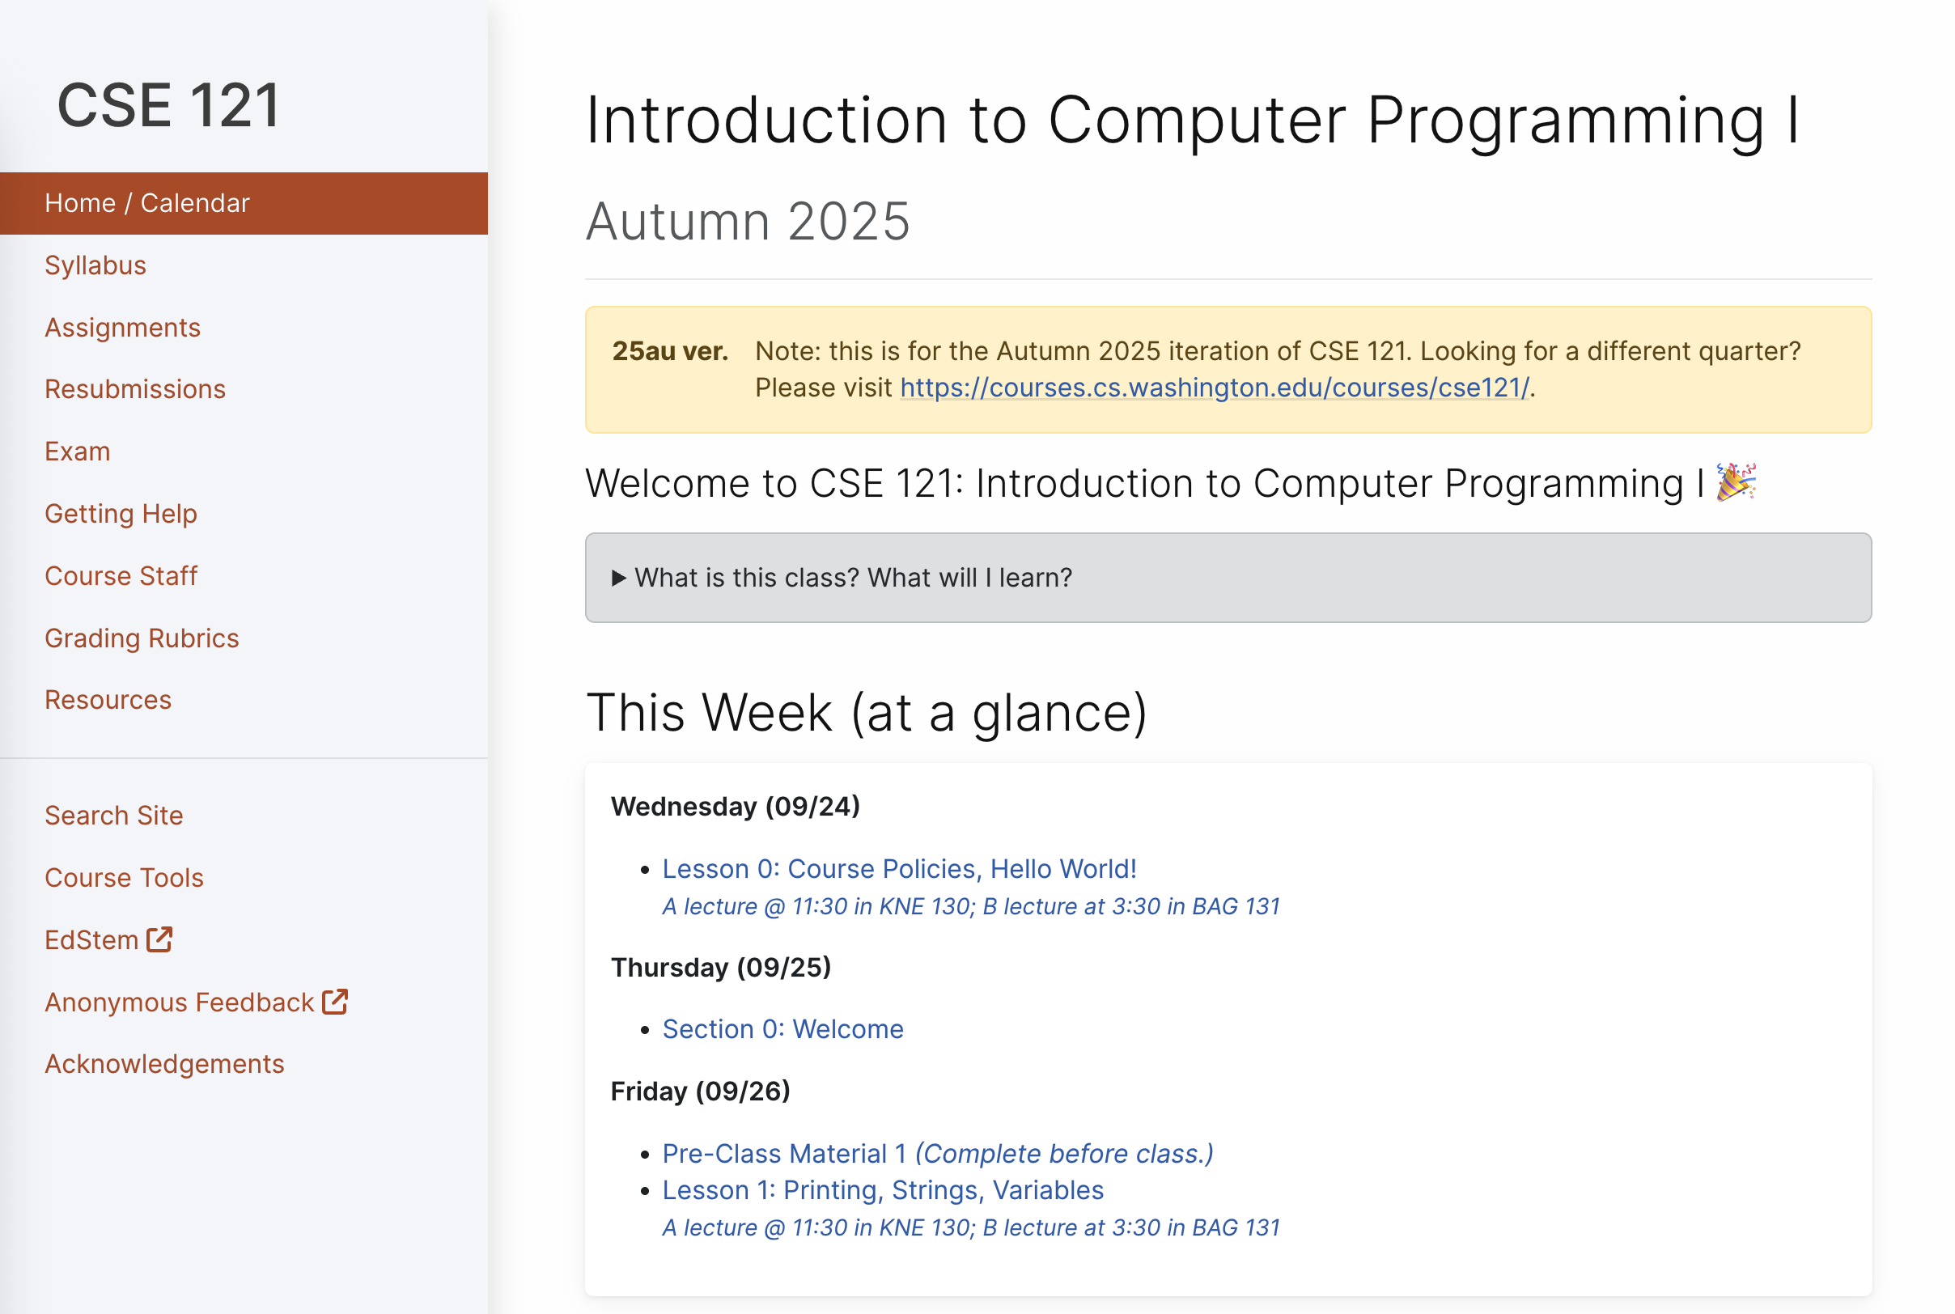
Course Website
cs.uw.edu/121
Primary source of course information (not Canvas)
Calendar will contain links to (almost) all resources
Please review syllabus ASAP
Let’s go on a website tour :)
Notes:
James

Slide 32
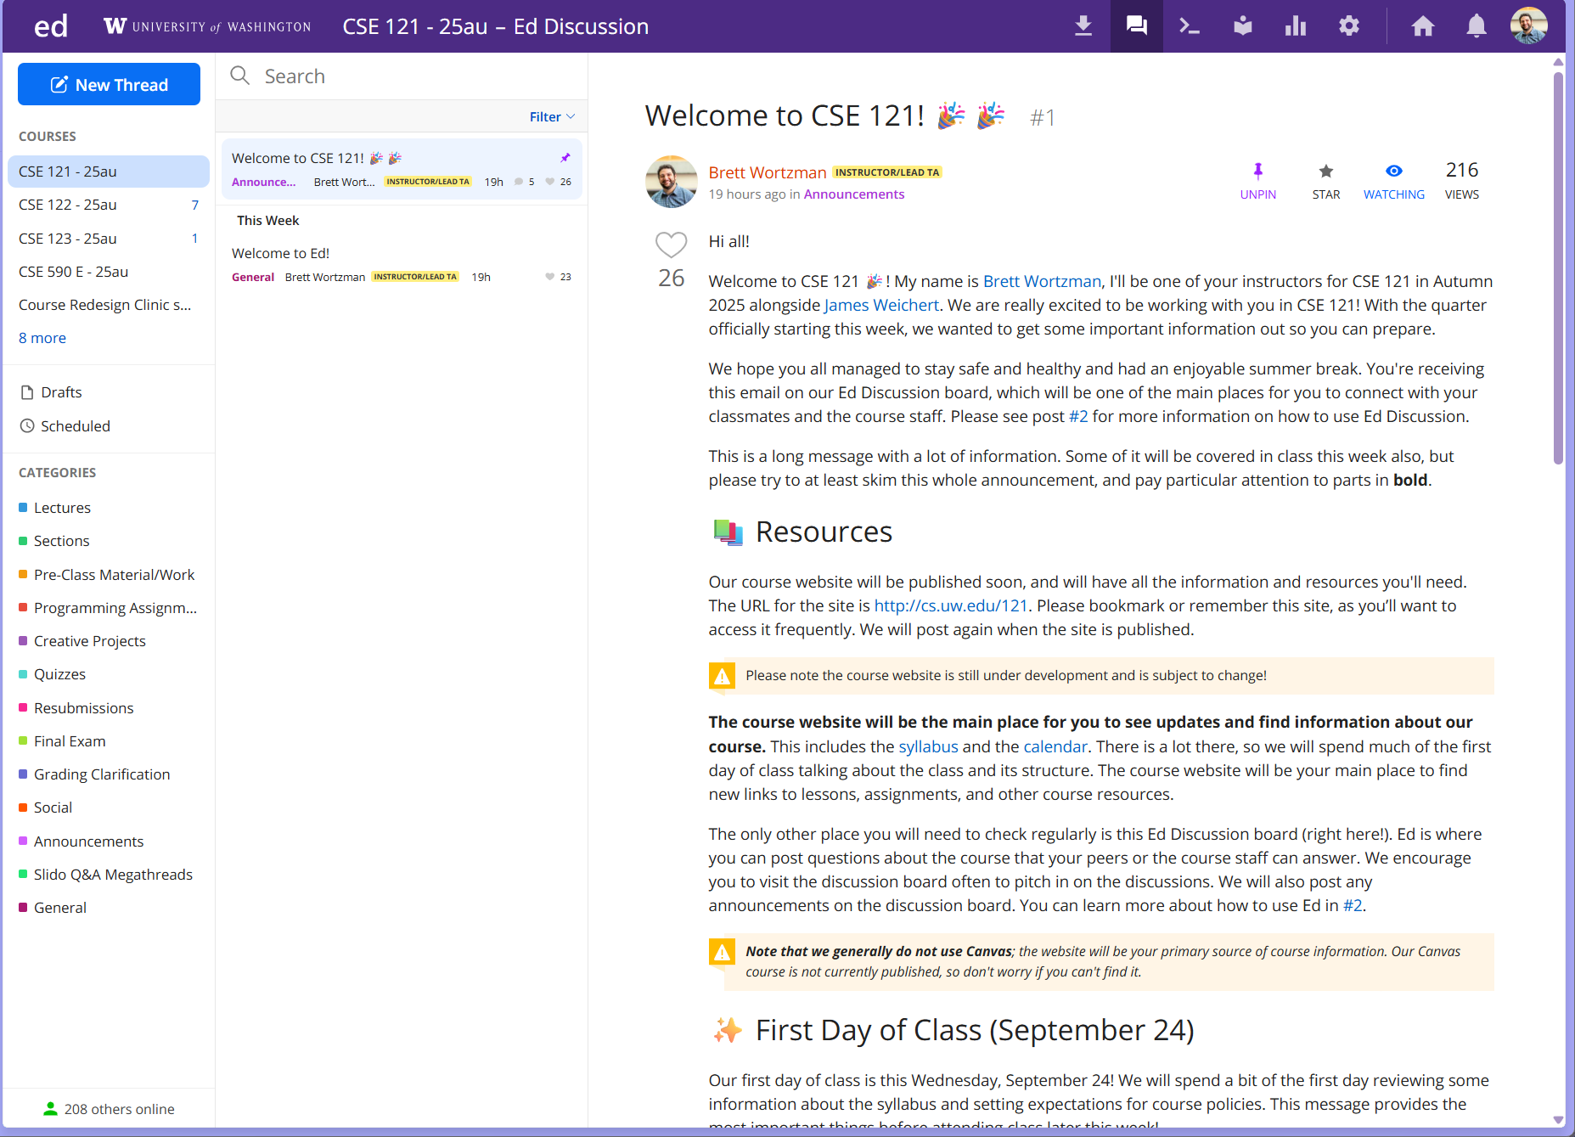
Ed
Our online learning platform
Lessons, sections, announcements
Place to ask questions
Also, where we’ll code!
Intro and walkthrough in Section 0
Notes:
James

Slide 33




Some Other Course Tools
sli.do
Ask questions in class
Live activities (ungraded)
No account needed
Canvas
Panopto lecture recordings (also linked from website)
Some grades*
Gradescope
Quiz and final exam grading
Queueing in office hours
Notes:
James

Slide 34
AI and CSE 121: Our Philosophy
Computing applications enabled by artificial intelligence (AI) are increasingly common and more widely used for a variety of tasks.
It is becoming more difficult to teach an introductory computing course without acknowledging the existence of AI tools.
Notes:
James

Slide 35
AI and CSE 121: Our Philosophy
Computing applications enabled by artificial intelligence (AI) are increasingly common and more widely used for a variety of tasks.
It is becoming more difficult to teach an introductory computing course without acknowledging the existence of AI tools.
But as first-time programmers, you still need to learn and practice effectively using core programming ‘building blocks’.
This is what CSE 121 is for.
Notes:
James

Slide 36
CSE 121 AI Policy
No part of any graded work may touch an AI tool.
You may not copy and paste any work generated by AI into any graded submission, nor may you copy and paste any work from or for a graded assignment into an AI tool. All other uses of AI on graded work must be cited.
cs.uw.edu/121/syllabus/#using-ai-in-cse-121
Notes:
James

Slide 37
CSE 121 AI Policy
No part of any graded work may touch an AI tool.
You may not copy and paste any work generated by AI into any graded submission, nor may you copy and paste any work from or for a graded assignment into an AI tool. All other uses of AI on graded work must be cited.
ALLOWED
PROHIBITED
Asking AI to explain an error message
Asking AI to explain the functionality of non-graded code snippets
Asking AI to suggest additional information or resources
Generating code, comments, reflections
Using AI to ‘solve’ an assignment
Using AI to write, modify, or extend reflections, code, comments, etc.
cs.uw.edu/121/syllabus/#using-ai-in-cse-121
Notes:
James

Slide 38
Switching to Ed: Our First Program!*
*note: in almost all cases, slides are not comprehensive. reviewing the slides will not cover all the content in lecture!

Slide 39
“Homework” for Next Time
First assignment will be released Friday, but there are some things to do in the meantime.
TODOs this week:
Fill out the introductory survey (this is Thursday’s section exit ticket)
Go meet your TA and classmates in Thursday’s quiz section
Complete the pre-class material for Friday (see website/calendar)
Check over syllabus details on website
Notes:
Brett

