Slide 1
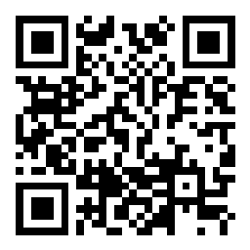
CSE 121 Lesson 9: Conditionals
Elba Garza & Matt Wang
Winter 2024
TAs:
Abby | Aishah | Anju | Annie | Archit | Ayesha | Christian
Hannah | Heather | Hibbah | Jacob | James | Janvi | Jasmine
Jonus | Julia | Lucas | Luke | Maria | Nicole | Shananda
Shayna | Trey | Vidhi | Vivian
sli.do #CSE121-9
Today’s playlist: CSE 121 24wi lecture beats :D

Slide 2
Announcements, Reminders
Creative Project 2 released – due Tuesday, Feb 6th
Note: uses Javadoc!
Also helpful: section problems, + last week’s food for thought
Resubmission Cycle 2 form released
Note: this is the last time C0 is eligible for resubmission!
IPL tips!
Mid-Quarter Formative Feedback with Ken Yasuhara for part of class on Wednesday, Feb 7th

Slide 3
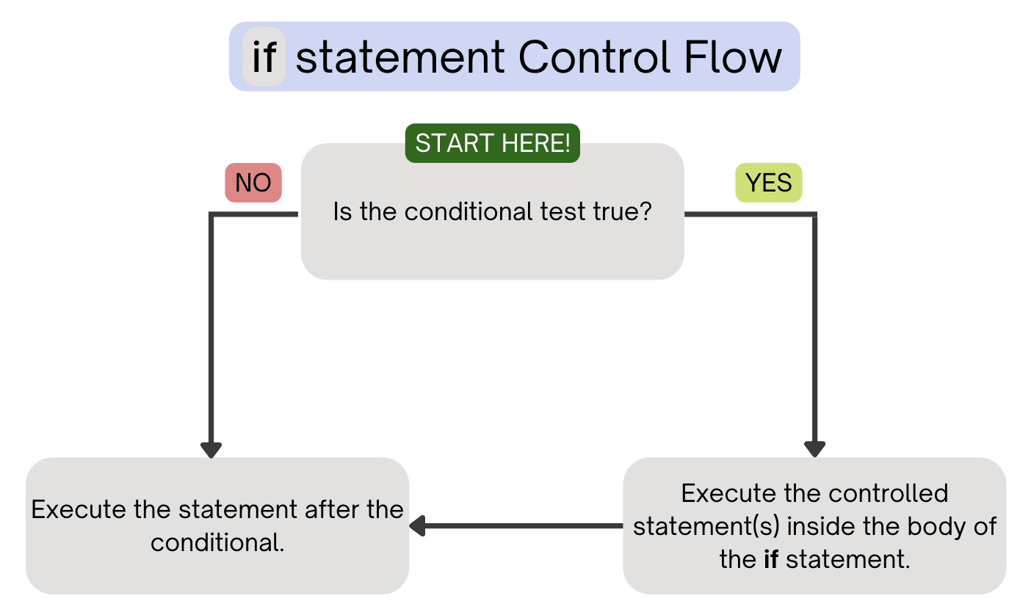
(PCM) Conditionals (1/4)
Executes a block of statements if and only if the test is true

Slide 4
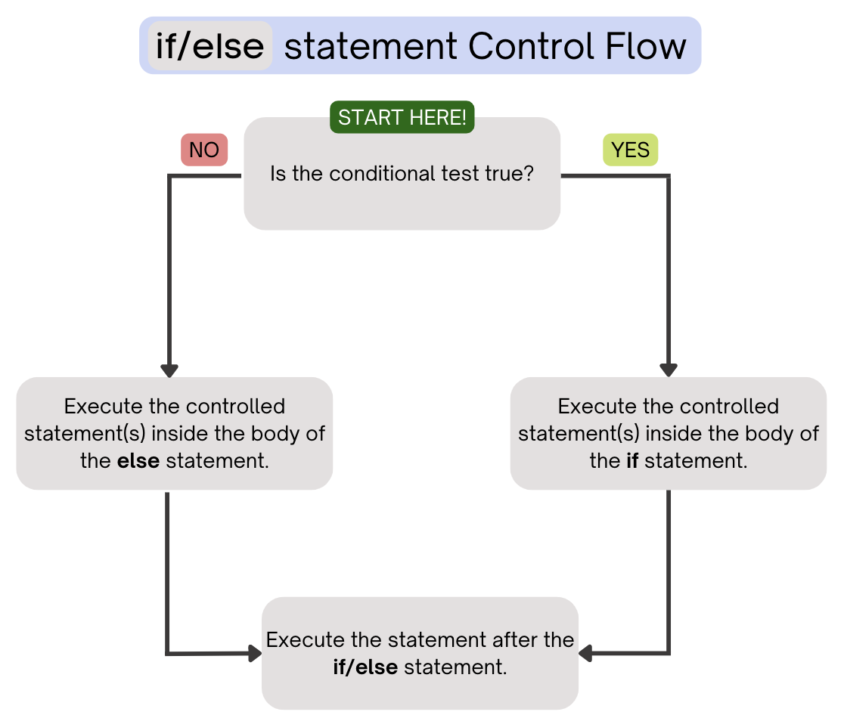
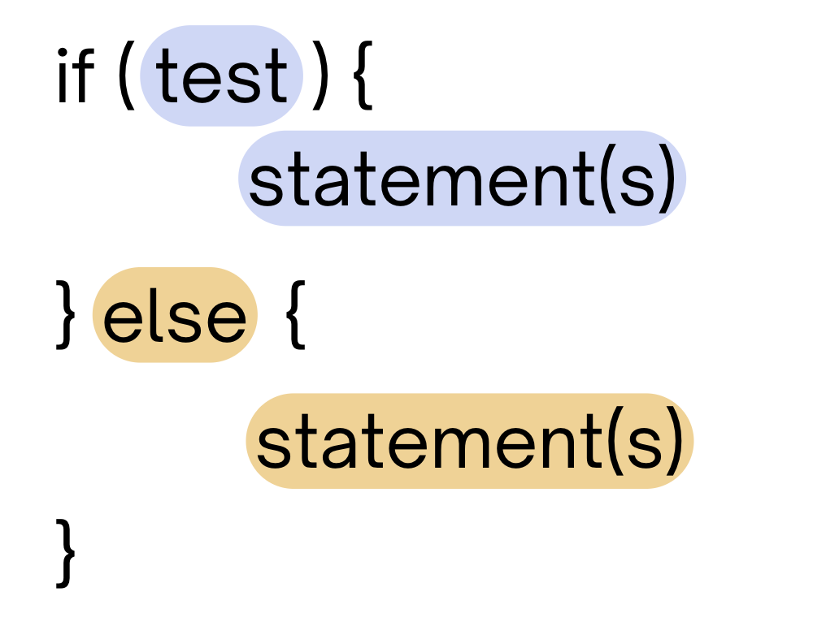
(PCM) Conditionals (2/4)
If the test is true: execute block of statements
If not, execute other block of statements

Slide 5
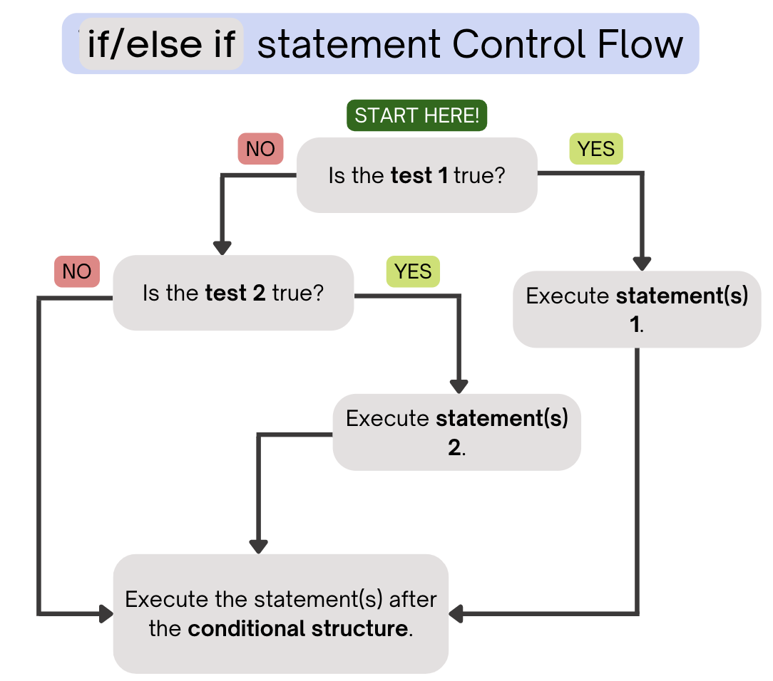
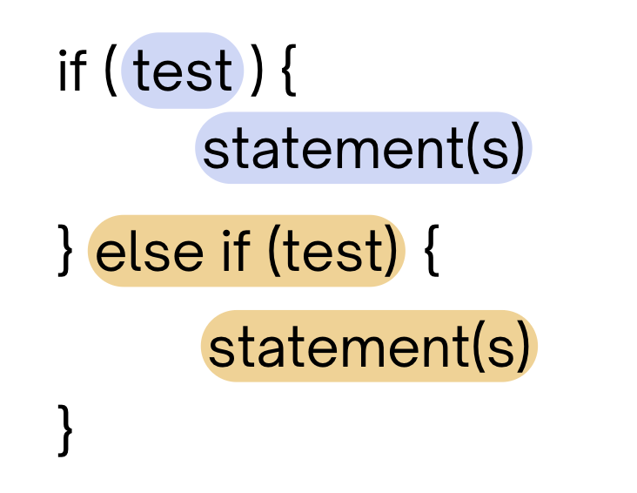
(PCM) Conditionals (3/4)
If the first test is true, execute that block
If not, proceed to the next test, and repeat
If none were true, don’t execute any blocks

Slide 6
(PCM) Conditionals (4/4)
With a large if-else-if-else chain,
if there is an ending else, exactly one block will execute
if there is no ending else, zero or one blocks will execute

Slide 7
public static void main(String[] args) {
for (int i = 1; i <= 3; i++) {
System.out.print(mystery(i));
}
}
public static String mystery(int n) {
if (n % 2 == 1) {
return "odd ";
} else if (n == 1) {
return "one ";
}
return "even ";
}
What does this program output?
A. odd even odd
B. one even odd
C. one even even
D. even even even

Slide 8
public static void main(String[] args) {
for (int i = 1; i <= 3; i++) {
System.out.print(mystery(i));
}
}
public static String mystery(int n) {
if (n % 2 == 1) {
return "odd ";
} else if (n == 1) {
return "one ";
}
return "even ";
}
This else if statement never runs!

Slide 9
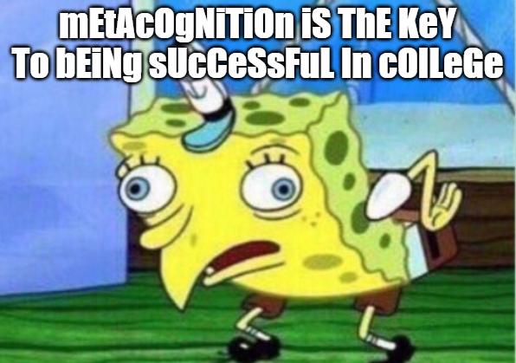

Slide 10
Common Problem-Solving Strategies
Analogy – Is this similar to another problem you've seen?
Brainstorming – Consider steps to solve problem before jumping into code
Try to do an example "by hand" → outline steps
Solve sub-problems – Is there a smaller part of the problem to solve?
Debugging – Does your solution behave correctly?
What is it doing?
What do you expect it to do?
What area of your code controls that part of the output?
Iterative Development – Can we start by solving a different problem that is easier?

Slide 11
Common Problem-Solving Strategies
Analogy – Is this similar to another problem you've seen?
Brainstorming – Consider steps to solve problem before jumping into code
Try to do an example "by hand" → outline steps
Solve sub-problems – Is there a smaller part of the problem to solve?
Debugging – Does your solution behave correctly?
What is it doing?
What do you expect it to do?
What area of your code controls that part of the output?
Iterative Development – Can we start by solving a different problem that is easier?

Slide 12
Common Problem-Solving Strategies
Analogy – Is this similar to another problem you've seen?
Brainstorming – Consider steps to solve problem before jumping into code
Try to do an example "by hand" → outline steps
Solve sub-problems – Is there a smaller part of the problem to solve?
Debugging – Does your solution behave correctly?
What is it doing?
What do you expect it to do?
What area of your code controls that part of the output?
Iterative Development – Can we start by solving a different problem that is easier?

Slide 13
int a = 7;
int b = -1;
int c = 12;
if (a < b) {
a *= 2;
} else if (b < a) {
a /= 2;
} else {
a = c;
}
if (c % 2 == 0) {
c += 1;
}
if (b > 0) {
b *= -1;
} else if (a < 0) {
a *= -1;
}
System.out.print(a + " " + b + " " + c);
What is the output produced by executing this code?
A. 7 -1 12
B. -3 -1 13
C. 3 -1 13
D. 12 1 12
E. -14 1 13

Slide 14
🍓🌮☕ Food for Thought 🥑🍱🧋
A weekly section where I introduce open problems related to our lecture topic(s) of the week.
Goals:
1. give you “conversational familiarity” with CS terminology
2. see how CS interacts with other fields and people!
3. point you in the direction of more CSE (or adjacent) classes
Note: not tested content. Just food for thought :)

Slide 15
Wait … what?
We just learned that methods can call themselves. This is called “recursion”!
Fun fact: this is related to many, many concepts you may have seen in math:
some keywords: “recurrence relation”, “induction”, “fractals”, “differential equation”
Another fun fact: this is normally a CSE 123 topic, though at other schools (who start with different languages), you learn this before loops.
Even funner (?) fact: some programming languages, including some of Matt’s favourites, do not allow variables or loops. You do everything with recursion!

Slide 16
So is this on the test???
Absolutely not.
But…
this is (subtly) one of the fundamental ideas of computer science and repeats itself everywhere. Including with Social Networks :)
if you love thinking about methods calling themselves, CSE (or math!) might be the right major for you!!
and consider taking CSE 311 and CSE 341 :)

