Slide 1
CSE 121 Lesson 5: Nested for loops, Math, Random
Elba Garza & Matt Wang
Winter 2024
TAs:
Abby | Aishah | Anju | Annie | Archit | Ayesha | Christian
Hannah | Heather | Hibbah | Jacob | James | Janvi | Jasmine
Jonus | Julia | Lucas | Luke | Maria | Nicole | Shananda
Shayna | Trey | Vidhi | Vivian
sli.do #CSE121-5
Today’s playlist: CSE 121 24wi lecture beats :D

Slide 2
Announcements, Reminders
Creative Project 1 is out, due Tues Jan 23rd
Resubmission Cycle 0 released yesterday, due Thurs Jan 25th
Eligible for submission: C0 & P0
Even if you're not resubmitting – read your feedback!!
reminder: no code screenshots (accessibility!)

Slide 3
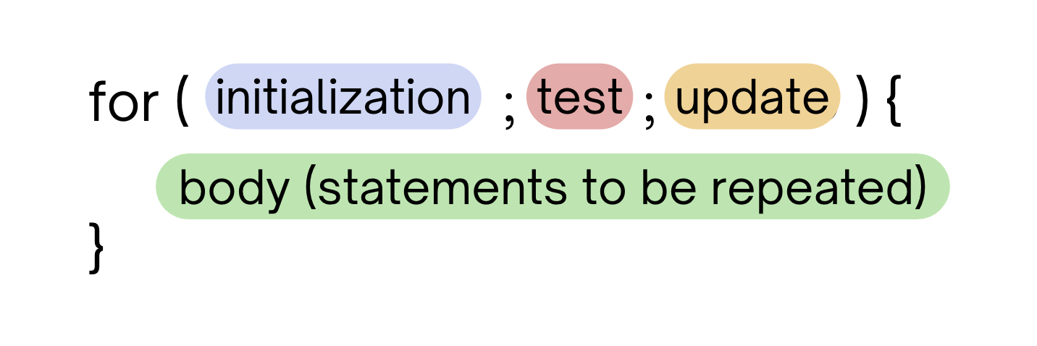
Last time: for loops!
For loops are our first control structure
A syntactic structure that controls the execution of other statements.

Slide 4
Fencepost Pattern
Some task where one piece is repeated n times, and another piece is repeated n-1 times and they alternate
h-u-s-k-i-e-s

Slide 5
Fencepost Pattern
Some task where one piece is repeated n times, and another piece is repeated n-1 times and they alternate
h-u-s-k-i-e-s

Slide 6
(PCM) Nested for loops
for (int outerLoop = 1; outerLoop <= 5; outerLoop++) {
System.out.println("outer loop iteration #" + outerLoop);
for (int innerLoop = 1; innerLoop <= 3; innerLoop++) {
System.out.println(" inner loop iteration #" + innerLoop);
}
System.out.println(outerLoop);
}

Slide 7
What output is produced by the following code?
for (int i = 1; i <= 5; i++) {
for (int j = 1; j <= i; j++) {
System.out.print(i);
}
System.out.println();
}
sli.do #CSE121-5
1
12
123
1234
12345
i
ii
iii
iiii
iiiii
1
22
333
4444
55555
A. B. C.

Slide 8
What code produces the following output?
A.
B.
C.
D.
sli.do #CSE121-5
for (int i = 1; i <= 5; i++) {
for (int j = 1; j <= i; j++) {
System.out.print(i);
}
System.out.println();
}
for (int i = 1; i <= 5; i++) {
for (int j = 1; i <= j; j++) {
System.out.print(j);
}
System.out.println();
}
1
12
123
1234
12345
for (int i = 1; i <= 5; i++) {
for (int j = 1; j <= i; j++) {
System.out.print(j);
}
System.out.println();
}
for (int i = 1; i <= 5; i++) {
for (int j = 1; j <= i; i++) {
System.out.print(j);
}
System.out.println();
}

Slide 9
Pseudo-Randomness
Computers generate numbers in a predictable way using mathematical formulas.
Input may include current time, mouse position, etc.
True randomness is hard to achieve – we rely on natural processes
e.g., atmospheric noise, lava lamps

Slide 10
(PCM) Random
A Random object generates pseudo-random numbers.
The Random class is found in the java.util package
import java.util.*;
We can “seed” the generator to make it behave deterministically (helpful for testing!)
Method | Description
nextInt() | Returns a random integer
nextInt(max) | Returns a random integer in the range [0, max), or in other words, 0 to max-1 inclusive
nextDouble() | Returns a random real number in the range [0.0, 1.0)

Slide 11
Assuming you’ve declared: Random randy = new Random();
Which of these best models picking a random card? (1-13 inclusive)
sli.do #CSE121-5
randy.nextInt()
randy.nextInt(13)
randy.nextInt(13) + 1
randy.nextInt(14)

Slide 12
(PCM) Math
Calling:
Math.<method>(…)
Method | Description
Math.abs(value) | Returns the absolute value of value
Math.ceil(value) | Returns value rounded up
Math.floor(value) | Returns value rounded down
Math.max(value1, value2) | Returns the larger of the two values
Math.min(value1, value2) | Returns the smaller of the two values
Math.round(value) | Returns value rounded to the nearest whole number
Math.sqrt(value) | Returns the square root of value
Math.pow(base, exp) | Returns base raised to the exp power

Slide 13
🍓🌮☕ Food for Thought 🥑🍱🧋
This week’s food for thought is:
one of matt’s favourite areas of computer science
less related to tech & society than the others…
also the most ambitious, so don’t stress about it – sit back, enjoy the ride :)

Slide 14
Wouldn’t it be nice…
We’ve seen that some for loops go on forever:
for (int i = 0; i < 10; i--) {
System.out.println(i);
}
for (;true;) {
}
Wouldn’t it be nice if Java (or “the compiler”) could catch this for us? I mean, the loop “obviously” never ends…

Slide 15
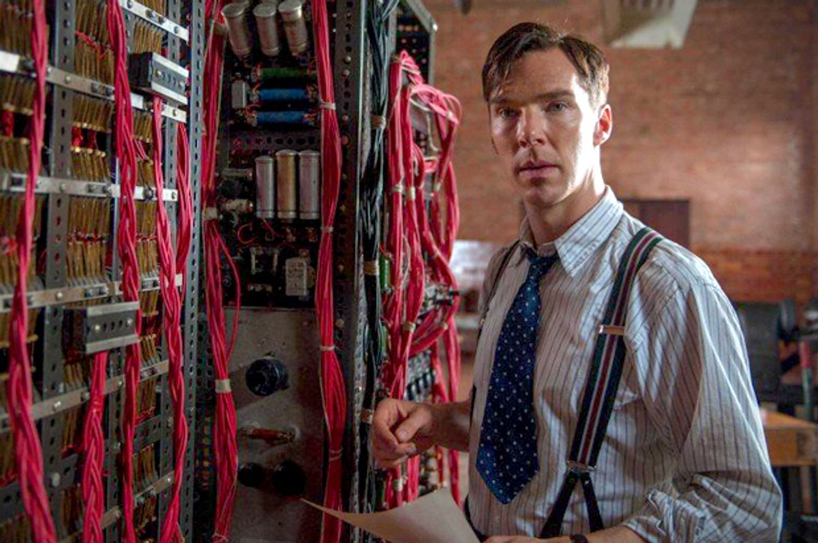
The Halting Problem (1/2)
Benedict Cumberbatch showed that it’s impossible to generally solve this problem.
Regardless of:
how good (big, fast) your computer is
how good your algorithm is
what people come up with the future!
Given a Java program, it is impossible to always know if it eventually stops (or loops infinitely).

Slide 16
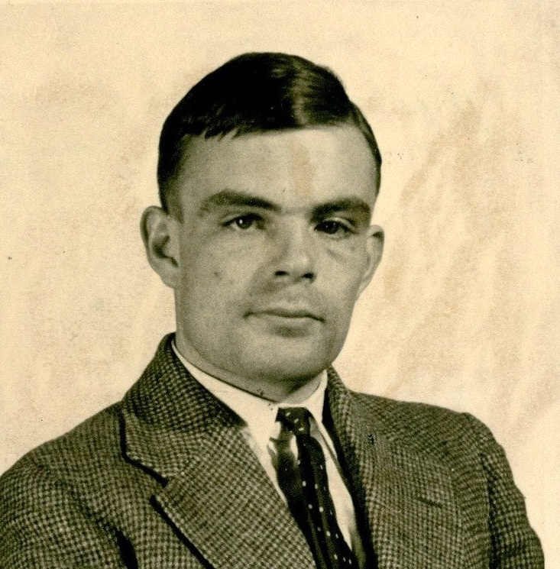
The Halting Problem (2/2)
Benedict Cumberbatch Alan Turing showed that it’s impossible to generally solve this problem.
Regardless of:
how good (big, fast) your computer is
how good your algorithm is
what people come up with the future!
Given a Java program, it is impossible to always know if it eventually stops (or loops infinitely).
Alan Turing at 24 (1936). He had a storied (if also very tragic and short) life.

Slide 17
Many, many problems are unsolvable.
I don’t mean “we currently don’t know how to solve them”.
I mean, “there is no algorithm that will ever solve them”.
Here are some related “undecidable” problems:
given a Java program, are all the types correct?
given a polynomial equation, does it have integer solution(s)?
given any Magic: The Gathering board, does either player have a guaranteed winning strategy?

Slide 18
In search of perfection (1/2)
In fact, there’s an even more concerning result: math itself is inconsistent. There is at least one math statement that we can’t prove true or false.

Slide 19
In search of perfection (2/2)
In fact, there’s an even more concerning result: math itself is inconsistent. There is at least one math statement that we can’t prove true or false.
Yet, we still:
try avoiding infinite loops
type-check our Java programs
play Magic: The Gathering (?)
try to prove things in (and do) math!

Slide 20
Dessert for Thought!
I argue there are two takeaways:
Don’t let perfection be the enemy of the good!
applies to you in CSE 121 and as a programmer :)
fundamental basis of much of computer science
Like thinking about these sorts of problems? This is also computer science! (not all CS is just coding…) See: CSE 311, CSE 417/431

