Slide 1
CSE 121 – Lesson 4
Elba Garza & Matt Wang
Winter 2024
Music: 121 24wi Lecture Beats :D
TAs:
Abby | Aishah | Anju | Annie | Archit | Ayesha | Christian
Hannah | Heather | Hibbah | Jacob | James | Janvi | Jasmine
Jonus | Julia | Lucas | Luke | Maria | Nicole | Shananda
Shayna | Trey | Vidhi | Vivian
sli.do #cse121-4

Slide 2
Announcements, Reminders
C1 releasing later today (due Tuesday, January 23rd)
Feedback for Creative Project 0 released yesterday!
Use the Grade Checker tool to track your grades!
Resubmission form for Resubmission Cycle 0 (R0) releasing tomorrow (due Thursday, January 25th)
Remember – IPL is in person! (For async help, use the message board)
Quiz 0: Thursday, February 1st during your quiz section.
Bring device to take quiz on! (e.g., laptop, surface)

Slide 3
Resubmissions
In general, you may revise resubmit a given Programming Assignment or Creative Project each week based on the feedback you receive with no penalty. The grade of your resubmission will completely replace your previous grades for that assignment.
Logistics:
One resubmission per week
An assignment is only eligible for resubmission the 3 cycles after its feedback is posted
There are 8 resubmission cycles this quarter (all listed on the course calendar)
To use a resubmission, you will need to:
Set the submission you want to be graded as "Final"
Fill out a form listing some information (Name, assignment, what you changed, etc.)

Slide 4
Last Time…
Variables
Container that stores a specific data type
Must declare & initialize!
Manipulate, modify, reuse ♻
Strings
Sequence of characters treated as one, yet can be indexed as individual parts
char, represents a single character
// declare AND initialize
int version = 5;
L | a | u | f | e | y | !
0 | 1 | 2 | 3 | 4 | 5 | 6

Slide 5
🐞 Debugging
We also started to think about debugging with a couple recent activities in class (Duck Heights & BuggyMadLibs.java)
Bugs happen – debugging is a natural part of programming!
Ways to approach debugging?
Notes:
Tracing error messages
Playing "java"
Narrow down the scope of the bug
Println debugging! (more to come on this today)

Slide 6
(PCM) for loops!
For loops are our first control structure
A syntactic structure that controls the execution of other statements.

Slide 7
(PCM) for loops! 2
for (int counter = 1; counter <= 5; counter++) {
System.out.println("I love CSE 121!");
}

Slide 8
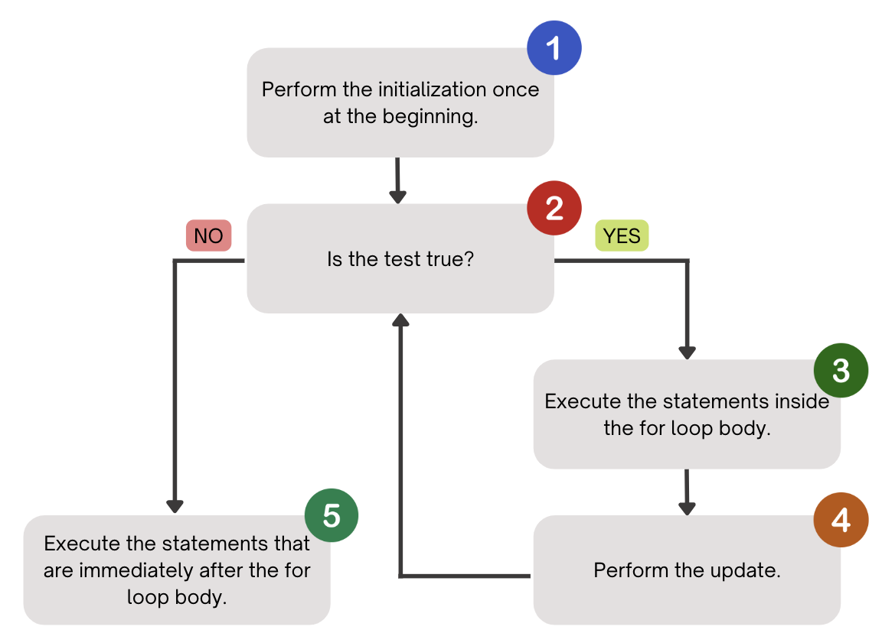
(PCM) for loops! 3

Slide 9
(PCM) for loops! 4
1
2
4
for (int counter = 1; counter <= 5; counter++) {
System.out.println("I love CSE 121!");
}
3
5
counter
I love CSE 121!
1
2
3
4
5
I love CSE 121!
6
I love CSE 121!
I love CSE 121!
I love CSE 121!

Slide 10
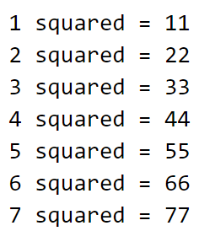
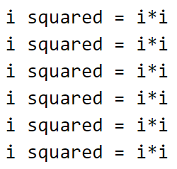
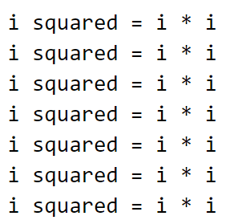
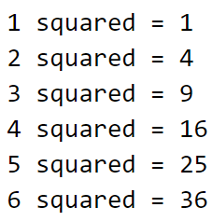
What output does the following code produce?
A. B. C. D.

Slide 11
(PCM) String traversals
// For some String s
for (int i = 0; i < s.length(); i++) {
// do something with s.charAt(i)
}

Slide 12
Fencepost Pattern 1
Some task where one piece is repeated n times, and another piece is repeated n-1 times and they alternate
h-u-s-k-i-e-s

Slide 13
Fencepost Pattern 2
Some task where one piece is repeated n times, and another piece is repeated n-1 times and they alternate
h-u-s-k-i-e-s

