Slide 1
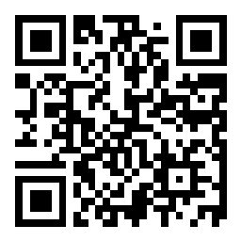
CSE 121 Lesson 3: Variables, Strings, Debugging
Elba Garza & Matt Wang
Winter 2024
TAs:
Abby | Aishah | Anju | Annie | Archit | Ayesha | Christian
Hannah | Heather | Hibbah | Jacob | James | Janvi | Jasmine
Jonus | Julia | Lucas | Luke | Maria | Nicole | Shananda
Shayna | Trey | Vidhi | Vivian
sli.do #CSE121-3
Today’s playlist: CSE 121 24wi lecture beats :D

Slide 2
Announcements, Reminders
P0 was released on Wed and is due Tue, Jan 16
Wed -> Tue will be our typical schedule for assignments!
Website now has extra practice problems for L2+
Glossary created (thanks Hannah & Trey)!
Quiz 0 scheduled for Feb 1st (about 3 weeks away)
More details will be released in the coming week!
IPL closed on Monday (MLK day!)

Slide 3
(PCM) Variables
Now that we know about different types and data, we can learn about how to store it!
Java allows you to create variables within a program. A variable has
A type
A name
(Potentially) a value it is storing
Declaration: int x;
Initialization: x = 30;
Or all in one line:
int x = 30;

Slide 4
(PCM) Variables
Notice – this doesn't really make any mathematical sense!
That's because, in Java, = is assignment, not equality!
They’re made to be manipulated, modified, re-used!
int myFavoriteNumber = 7;
int doubleFV = myFavoriteNumber * 2;
myFavoriteNumber = myFavoriteNumber + 3;
Notes:
declare and initialize
Arithmetic with variables and place into another one
A variable… varies! It can change value.
Use one variable to set another one: it’s possible!

Slide 5
New Operators! (1/3)
myFavoriteNumber = myFavoriteNumber + 3;
This pattern is so common, we have a shorthand for it!
myFavoriteNumber += 3;
Note: this works for both numeric addition and string concatenation!

Slide 6
New Operators! (2/3)
The shorthands -=, *=, /=, and %= exist too!
Take an educated guess: what do you think they do?
myFavoriteNumber /= 3;
Should this work for integers? Doubles? Strings?

Slide 7
New Operators! (3/3)
There are even shorter operators for “incrementing” and “decrementing”!
myFavoriteNumber++; // equal to myFavoriteNumber += 1;
myFavoriteNumber--; // equal to myFavoriteNumber -= 1;
Should this work for integers? Doubles? Strings?

Slide 8
What do a, b, and c hold after this code is executed?
int a = 10;
int b = 30;
int c = a + b;
c -= 10;
a = b + 5;
b /= 2;
sli.do #CSE121-3
10, 30, 40
35, 15, 30
35, 15.5, 30
20, 15, 30

Slide 9
(PCM) Strings and chars
String = sequence of characters treated as one, yet can be indexed to get individual parts
Zero-based indexing 💣
Side note: new data type!
char, represents a single character, so we use single quotes
Strings are made up of chars!
L | a | u | f | e | y | !
0 | 1 | 2 | 3 | 4 | 5 | 6
Notes:
Bomb = indexing issues can be source of many errors! Fence-post life.

Slide 10
(PCM) String Methods Usage: <string variable>.<method>(…)
Method | Description
length() | Returns the length of the string.
charAt(i) | Returns the character at index i of the string
indexOf(s) | Returns the index of the first occurrence of s in the string; returns -1 if s doesn't appear in the string
substring(i, j) or substring(i) | Returns the characters in this string from i (inclusive) to j (exclusive); if j is omitted, goes until the end of the string
contains(s) | Returns whether or not the string contains s
equals(s) | Returns whether or not the string is equal to s (case-sensitive)
equalsIgnoreCase(s) | Returns whether or not the string is equal to s ignoring case
toUpperCase() | Returns an uppercase version of the string
toLowerCase() | Returns a lowercase version of the string
Notes:
Bomb = may get error if indexing int is out of bounds (e.g. negative index, or larger than the length of the string)
Safety guy = should return without error in usual case

Slide 11
Suppose s contains the String "bubble gum". Which option below would result in s containing "Gumball" instead?
sli.do #CSE121-3
s.substring(7) + "ball";
s = s.substring(7, 9) + "ball";
s = s.charAt(7).toUpperCase() + "ball";
s = s.substring(7, 8).toUpperCase() + s.substring(8) + "ball";
b | u | b | b | l | e |  | g | u | m
0 | 1 | 2 | 3 | 4 | 5 | 6 | 7 | 8 | 9

Slide 12
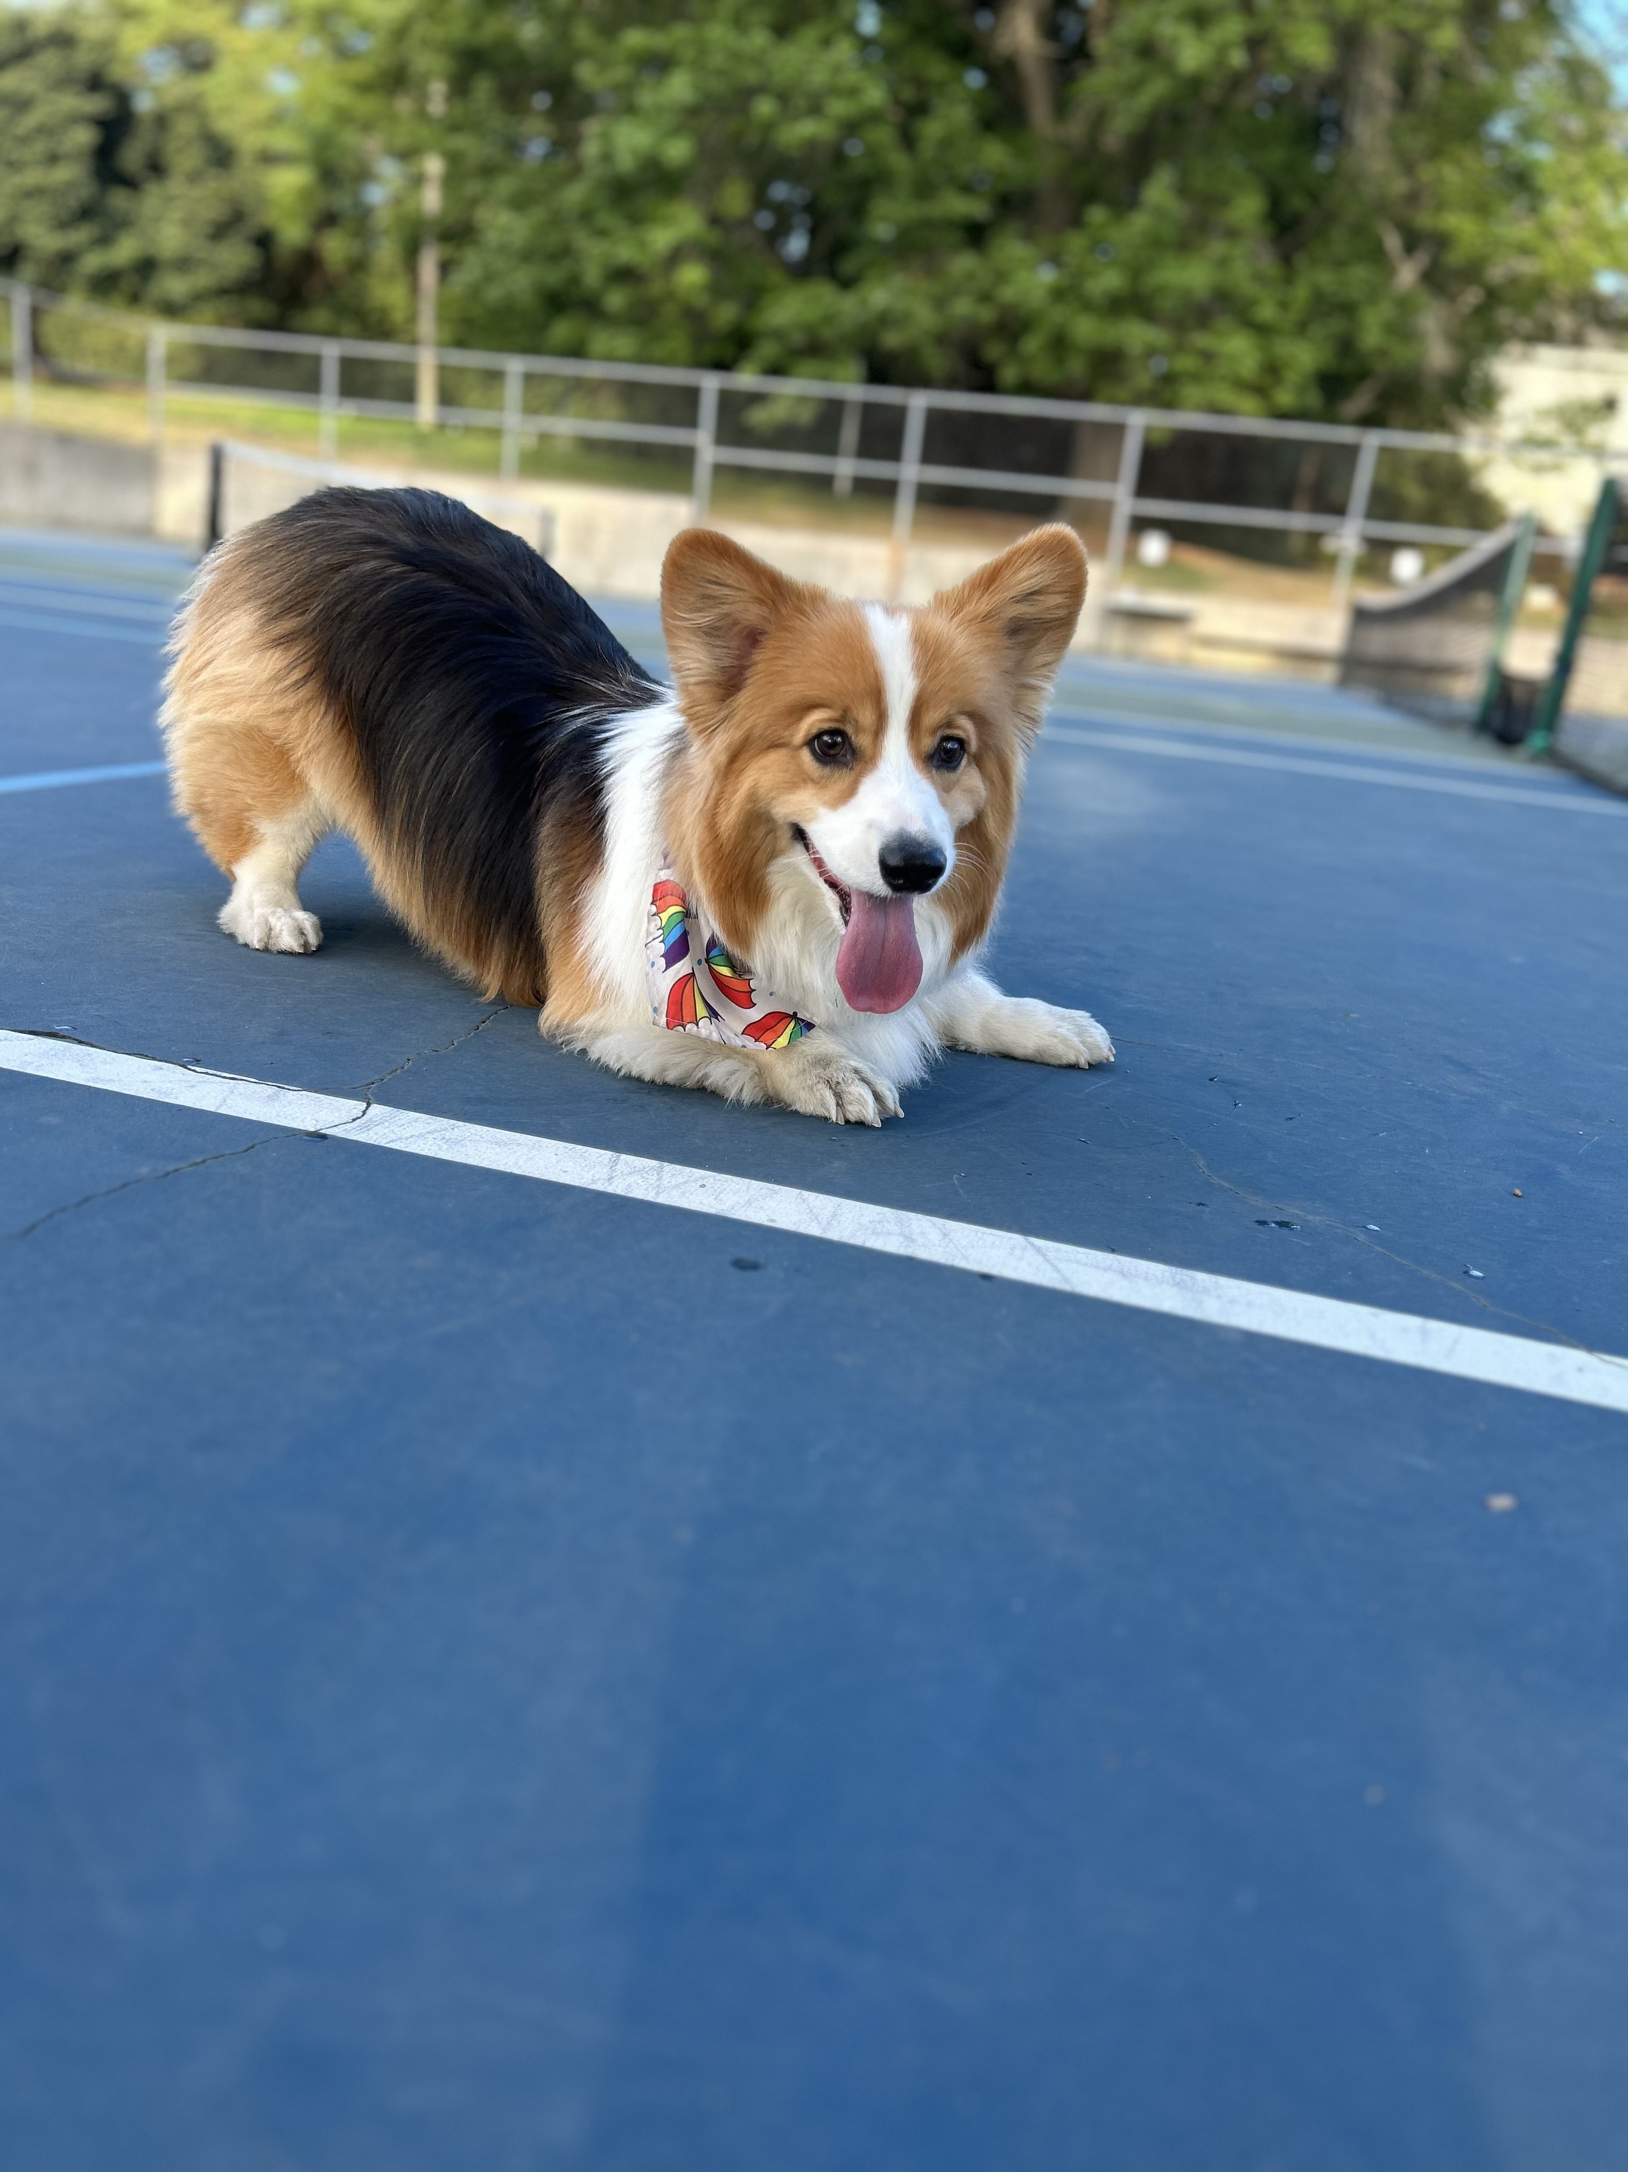
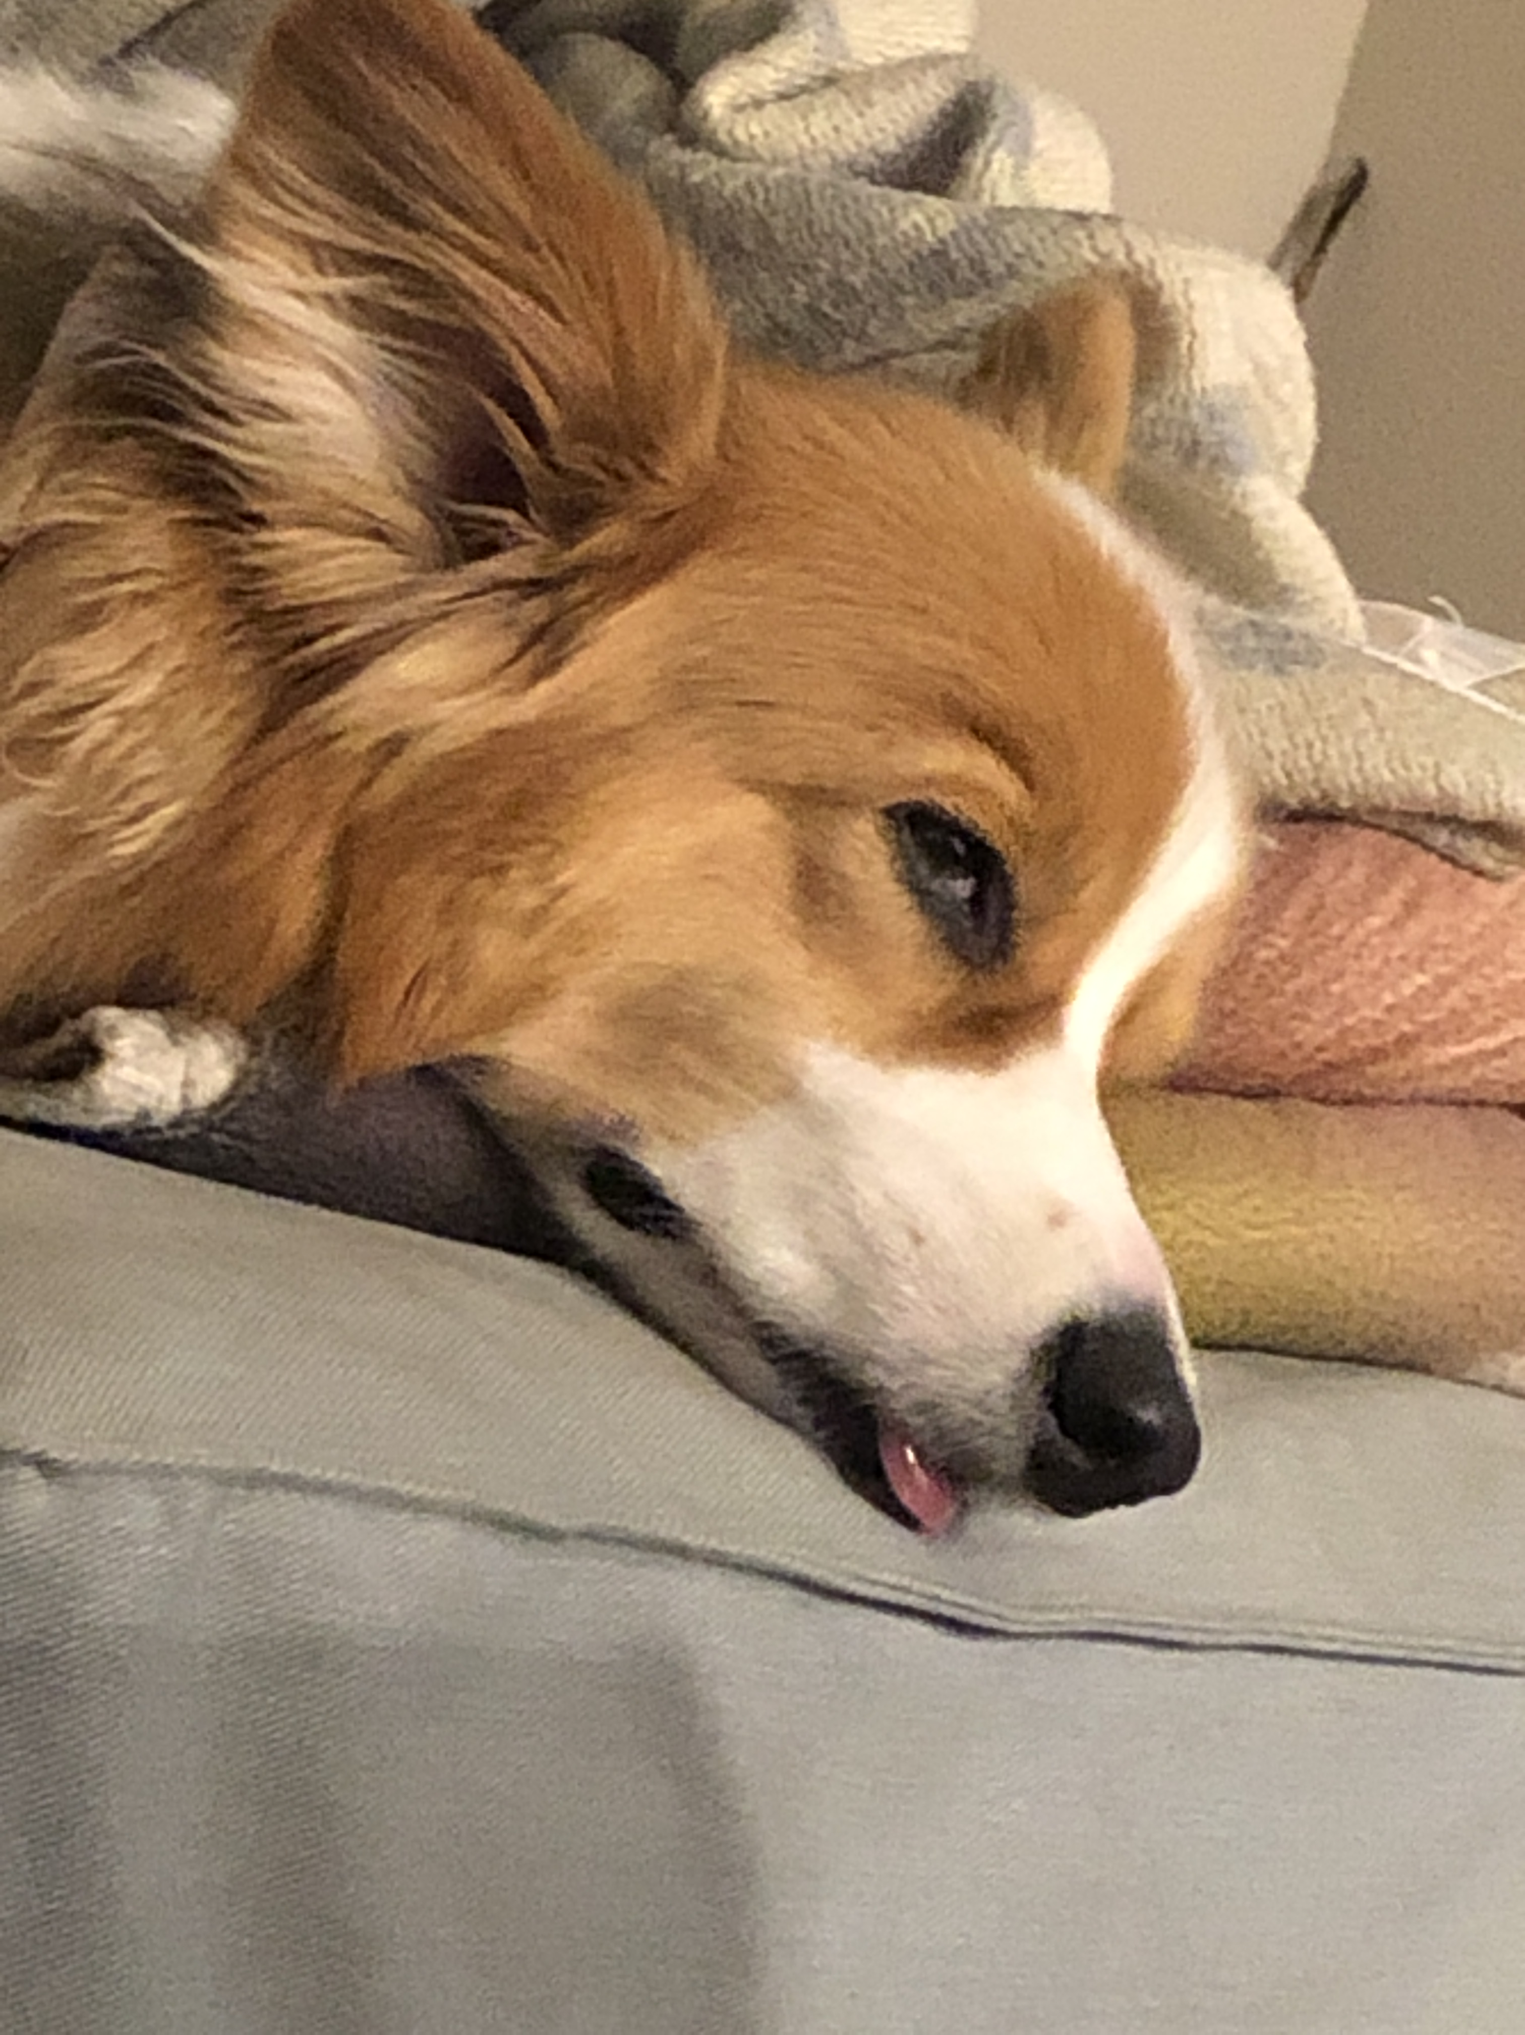
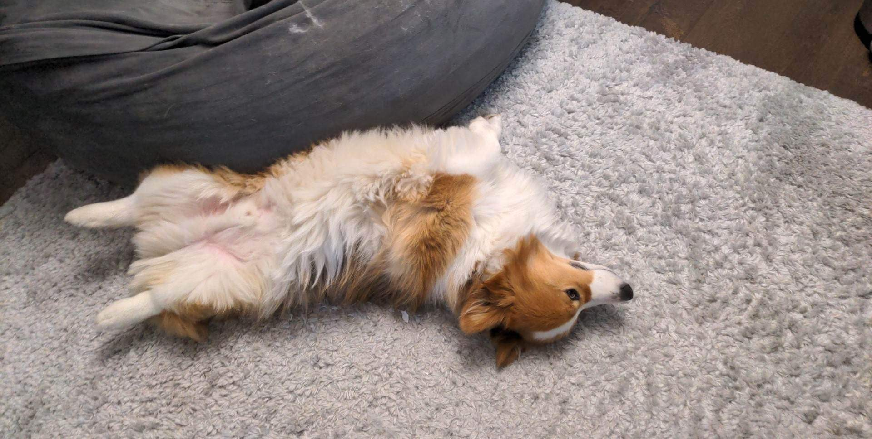
Interlude: Gumball

Slide 13
🍓🌮☕ Food for Thought 🥑🍱🧋
A weekly section where I introduce open problems related to our lecture topic(s) of the week.
Goals:
1. give you “conversational familiarity” with CS terminology
2. see how CS interacts with other fields and people!
3. point you in the direction of more CSE (or adjacent) classes
Note: not tested content. Just food for thought :)

Slide 14
What's in a (variable) name or String?
Switch over to Ed and do some experiments (with a partner)!
Then, report back on sli.do.
What kinds of characters are "allowed" in Strings?
What kinds of characters are "allowed" in variable names?
Are the String lengths what you expect? Why or why not?
sli.do #CSE121-3

Slide 15
Dessert for Thought!
This is the beginning of a very interesting rabbit hole! But also, a decision made by the Java designers.
You will also make decisions like these!
for example, what is a “valid name”?
something to reflect on as you learn more about CS…

