Slide 1
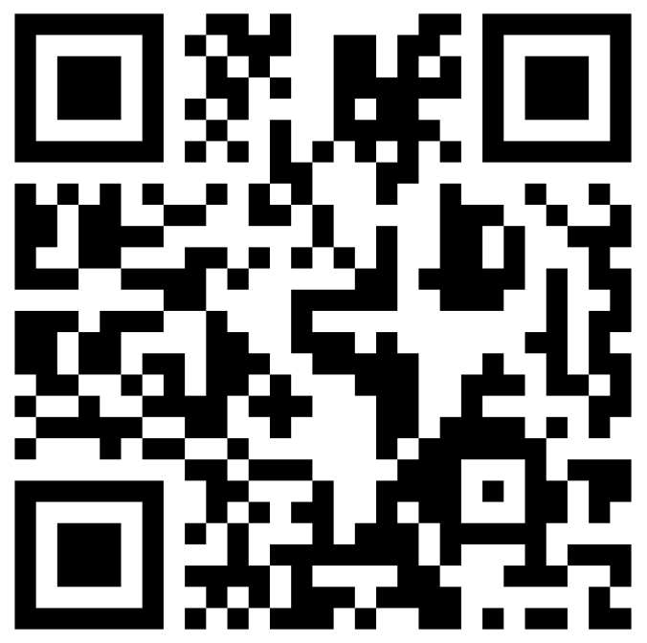
CSE 121 – Lesson 2
Elba Garza & Matt Wang
Winter 2024
TAs:
Abby | Aishah | Anju | Annie | Archit | Ayesha | Christian
Hannah | Heather | Hibbah | Jacob | James | Janvi | Jasmine
Jonus | Julia | Lucas | Luke | Maria | Nicole | Shananda
Shayna | Trey | Vidhi | Vivian
sli.do #cse121-2
Music: I Don’t Live Here Anymore – The War on Drugs

Slide 2
Announcements, Reminders
Creative Project 0 due TONIGHT by 11:59 PM
Programming Assignment 0 releasing later today—due January 16th
IPL is open! - Schedule and instructions can be found on course website.
Just joined CSE 121? Resubmission policy is your friend! See more in syllabus.
Reminder: Pre-Class Work and Section work are not graded! (but you should do them anyway 👀)

Slide 3
PCM Recap: Data Types & Expressions
Types: int, double, String, Boolean
Expressions: Operators
Beware of precedence! (order of operations)

Slide 4
(PCM) Data Types in Java
In programming, you’re dealing with data…
ints (whole numbers)
doubles (real numbers)
Strings
booleans (true or false)

Slide 5
(PCM) Operators (for numerical & String values)
Numerical:
+ Addition
- Subtraction
* Multiplication
/ Division
% Modulo or “Mod”
<, >, <=, >=, ==, !=
Strings:
+ Concatenation
Booleans:
! Logical Not
&& Logical And
|| Logical Or

Slide 6
(PCM) Precedence
Parentheses
Multiplication, Modulo, Division
Addition (and Concatenation), Subtraction
If multiple operators at the same level?
Evaluate subexpressions from left to right!

Slide 7
Example
1 + 2 * 3
(1 + 2) * 3
6
3
7
9

Slide 8
Work on Expressions/Types Practice Problems Part 1
Ed lesson linked from the course calendar
Work with the folks around you!
TAs and I will be walking around to help
5 + 2 * 4
1 + 2 / 3
6 * 5 % 7

Slide 9
Part 1 Walkthrough
5 + 2 * 4
1 + 2 / 3
6 * 5 % 7
8
0
30
13
1
2

Slide 10
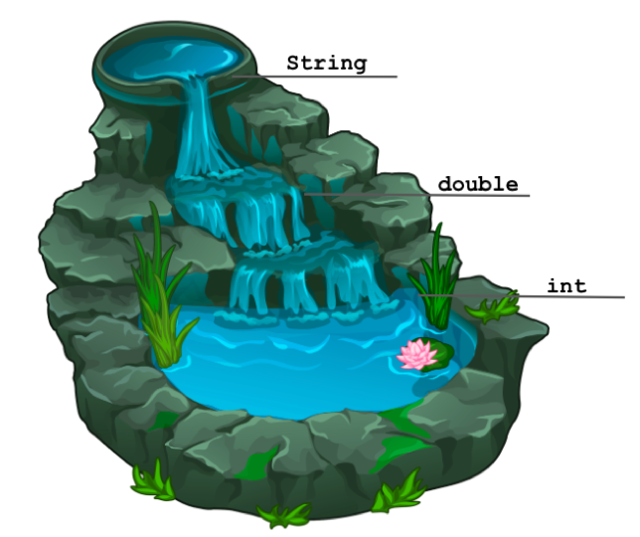
(PCM) Mixing Types 1
When mixing types in an expression, Java will convert one type to the other and then perform the operation “normally”
ints can be converted to doubles
Both ints and doubles can be converted to Strings
How about the other way?...

Slide 11
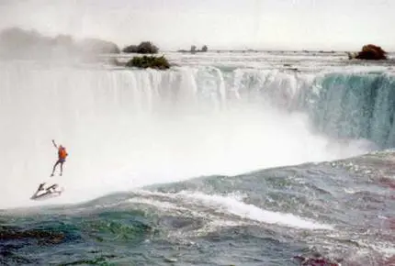
(PCM) Mixing Types 2
When mixing types in an expression, Java will convert one type to the other and then perform the operation “normally”
Can we convert doubles to ints? Strings to doubles? Strings to ints? 🚨Danger: Data loss or incompatibility!🚨
1995: Robert Overcracker going over Niagara Falls.

Slide 12
Example 2
2 + 2 + "hello" + 3 * 5 + 10
“ ”
“ ”
“ ”
4
15
“4hello”
“4hello15”
“4hello1510”

Slide 13
Work on Expressions/Types Practice Problems
Part 2
Ed lesson linked from the course calendar
Work with the folks around you!
TAs and I will be walking around to help
5 * 3 + 1.0
8 / 3 * 2.0
8.0 / 3 * 2
"Hello" + "world"
1 + "2" + 3
1 + 2 + "3"
1 + "2" + (3 + 4)

Slide 14
Part 2 Walkthrough
“Hello” + “world”
“Helloworld”
5 * 3 + 1.0
8 / 3 * 2.0
8.0 / 3 * 2
.0
2
15
.0
2.666…
.0
16.0
4.0
5.333…
1 + “2” + 3
1 + 2 + “3”
1 + “2” + (3 + 4)
“ ”
“ ”
“ ”
“ ”
“12”
“ ”
“12”
7
3
“123”
“33”
“127”

Slide 15
(PCM) Boolean Operators
! Logical Not
< > <= >= Relational Operators
== != Relational Operators (equality)
&& Logical And
|| Logical Or

Slide 16
(PCM) Precedence (updated)
Logical not
Parentheses
Multiplication, Modulo, Division
Addition (and Concatenation), Subtraction
Relational operators
Equality operators
Logical and
Logical or

Slide 17
Example 3
1 + 2 * 3 != (1 + 2) * 3
6
3
1 + 6 != 3 * 3
7
9
7 != 9
true

Slide 18
Work on Expressions/Types Practice Problems
Part 3
Ed lesson linked from the course calendar
Work with the folks around you!
TAs and I will be walking around to help
5 * 3 < 12
10 % 3 == 10 / 3
5 < 9 || (7 != 7)
!(1 + 2 == 3 && 10 % 4 > 2)

Slide 19
Part 3 Walkthrough 1
5 * 3 < 12
10 % 3 == 10 / 3
5 < 9 || (7 != 7)
15
1
false
1 == 10 / 3
15 < 12
5 < 9 || false
false
3
1 == 3
true
true || false
false
true

Slide 20
Part 3 Walkthrough 2
!(1 + 2 == 3 && 10 % 4 > 2)
!(1 + 2 == 3 && 2 > 2)
!( 3 == 3 && 2 > 2)
!( true && 2 > 2)
!( true && false )
!( false )
true

Slide 21
Variables
Now that we know about different types and data, we can learn about how to store it!
Java allows you to create variables within a program. A variable has:
a type,
a name, and
(potentially) a value it is storing
Declaration: int x;
Initialization: x = 30;
Or all in one line:
int x = 30;

