Slide 1
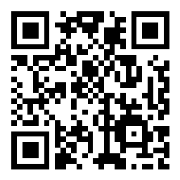
CSE 121 – Lesson 19
Elba Garza & Matt Wang
Winter 2024
TAs:
Abby | Aishah | Anju | Annie | Archit | Ayesha | Christian
Hannah | Heather | Hibbah | Jacob | James | Janvi | Jasmine
Jonus | Julia | Lucas | Luke | Maria | Nicole | Shananda
Shayna | Trey | Vidhi | Vivian
sli.do #cse121-19
Today’s playlist: CSE 121 24wi lecture beats :D

Slide 2
Announcements, Reminders
Resubmission Cycle 7 update: all assignments eligible for resubmission
Closes on Thursday, March 14
Final Exam: Tuesday, March 12th 12:30pm-2:20pm
TA-led Final Review Session Monday, March 11th 4:30pm-6:50pm in SMI 120
Seating charts have been posted!
Bob Bandes TA Award nominations open!
IPL closes Friday, March 8th; Instructor office hours too!
Course evaluations for A and B lecture close Sunday, March 10th
Current response rate: 18%/13% ☹
Gigi (& friends) Visit on Monday, March 11th 1:00pm-3:00pm

Slide 3
Applications of CS
or “What can I do with what I learned?” – outside of just “write code”:
Detect and prevent toxicity online & recognize disinformation
Help deaf & hard-of-hearing people identify sounds
Develop a programming language that celebrates the world’s languages
Build battery-free robots & put them on insects (and... track muder hornets?)
Computational knitting & carpentry
Create an interactive atlas of millions of refugee experiences
Fix Olympic badminton & identify cheating in chess
and so much more!

Slide 4
Future Courses
More 12X!
Course | Overview
CSE 122 | Introduction to Computer Programming II
CSE 123 | Introduction to Computer Programming III
or “What can I do next?”
Non-majors
Course | Overview
CSE 154 | Intro. to web programming (several languages)
CSE 160 | Intro programming, data analysis (Python)
CSE 163 | Intermediate programming, data analysis (Python)
CSE 180 | Introduction to data science (Python)
CSE 373 | Data structures and algorithms (in Java)
CSE 374 | Low-level programming and tools (C/C++)
CSE 412 | Intro to Data Visualization
CSE 416 | Intro. to Machine Learning
Majors
Course | Overview
CSE 311 | Mathematical foundations
CSE 331 | Software design/implementation
CSE 340 | Interaction programming (mobile dev!)
CSE 341 | Programming languages
CSE 351 | Low-level computer organization/abstraction 😉
Other tech-related majors: Informatics, ACMS, HCDE, Electrical & Computer Engineering, …
See: https://www.cs.washington.edu/academics/ugrad/current-students and https://www.cs.washington.edu/academics/ugrad/nonmajor-options/nonmajor-courses

Slide 5
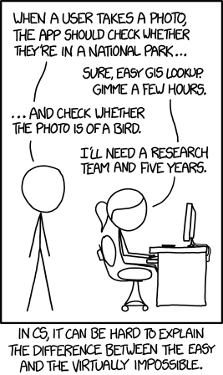
Frequently Asked Questions
How can I get better at programming?
Practice!
How can I learn to X?
Search online, read books, look at examples :)
What should I work on next?
Anything you can think of! (Here are some ideas)
Beware: it’s hard to tell what’s easy and what’s hard.
Should I learn another language? Which one?
That depends–what do you want to do?
What’s the best programming language?
😠 (take CSE 341 or CSE 413)

Slide 6
Aside: Cute Programming Language Logos

Slide 7
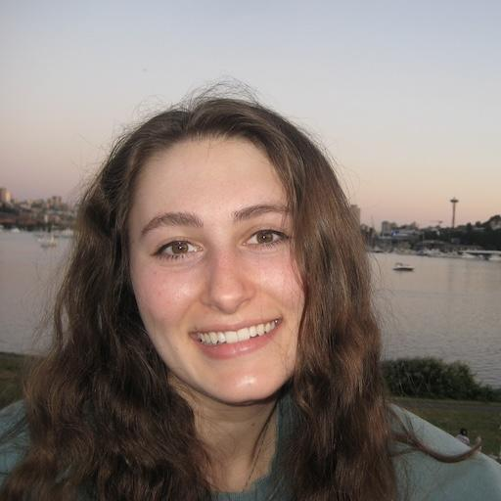
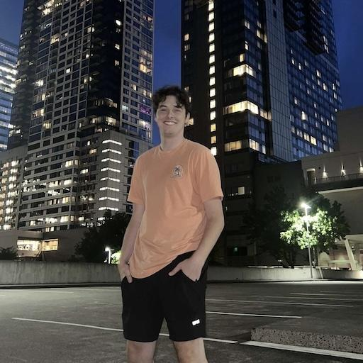
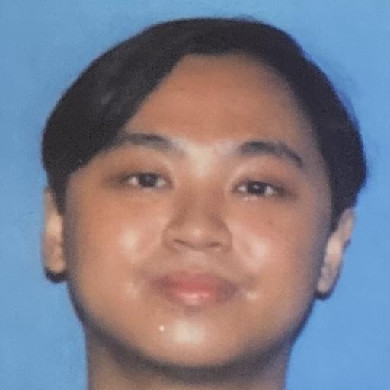
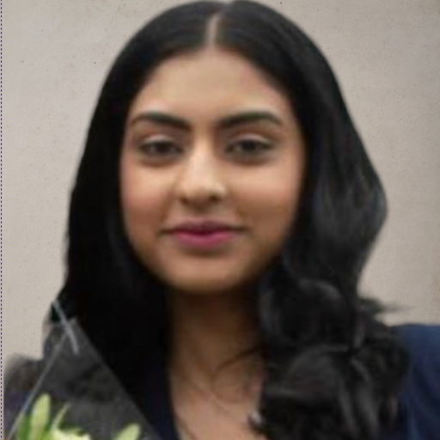
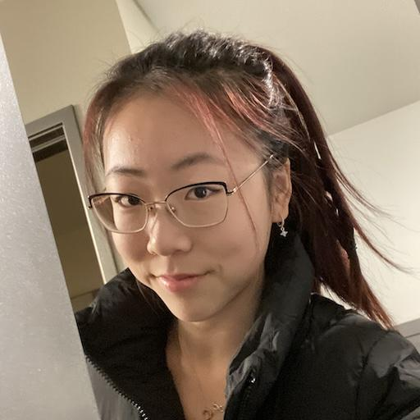
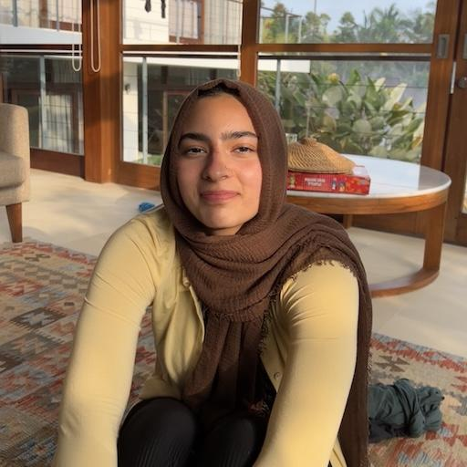
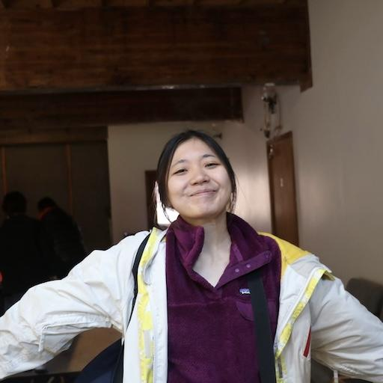
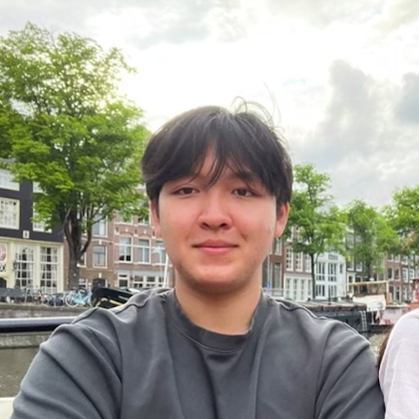
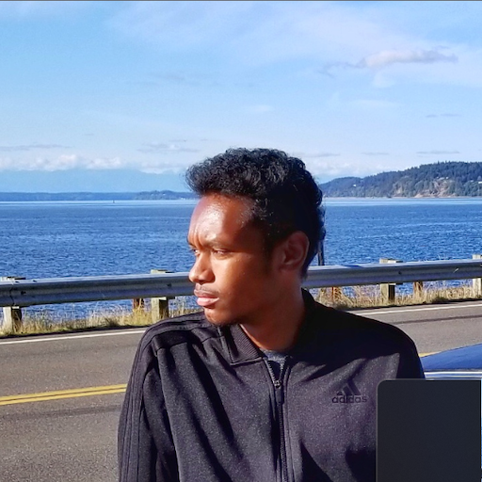
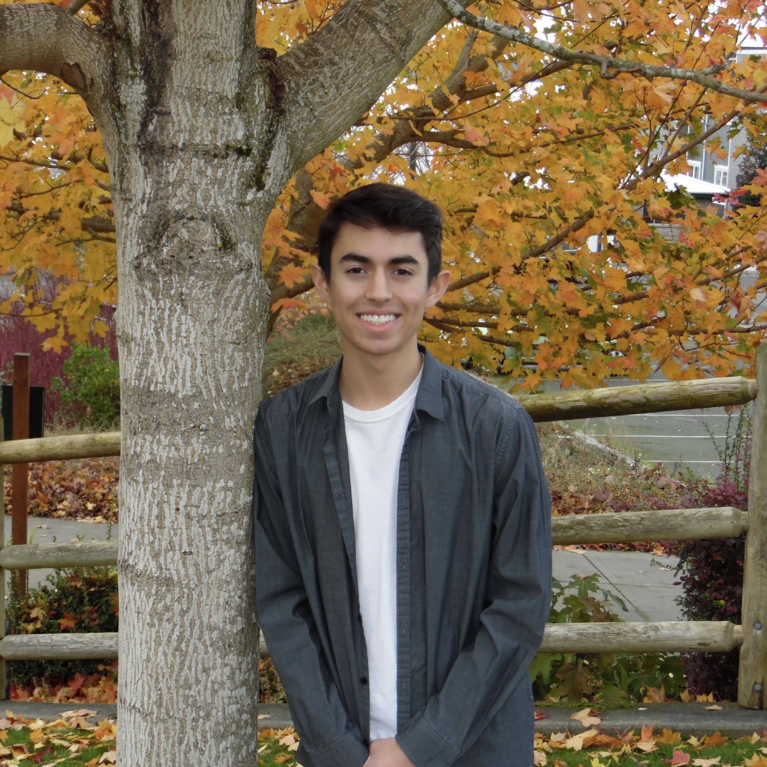
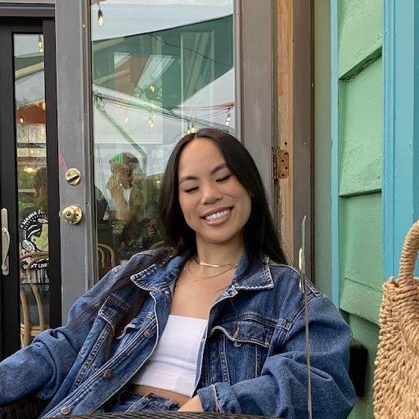
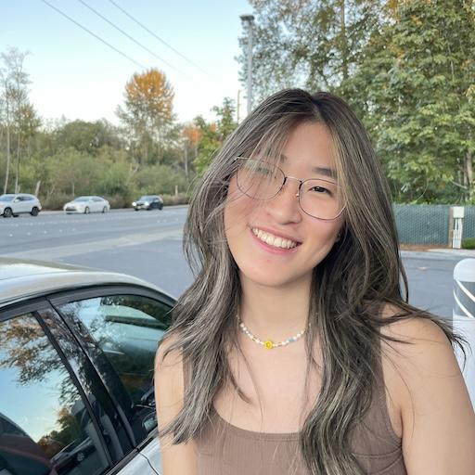
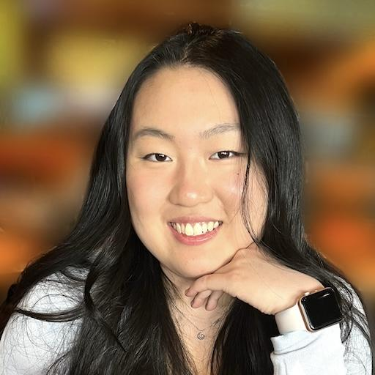
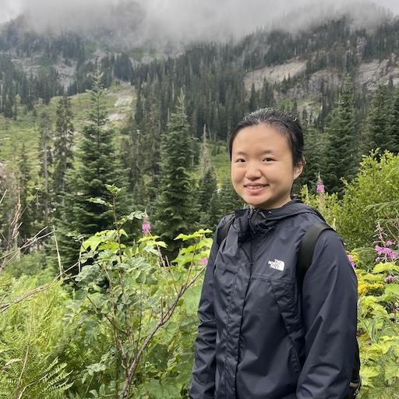
Thank your TAs!!!!

Slide 8
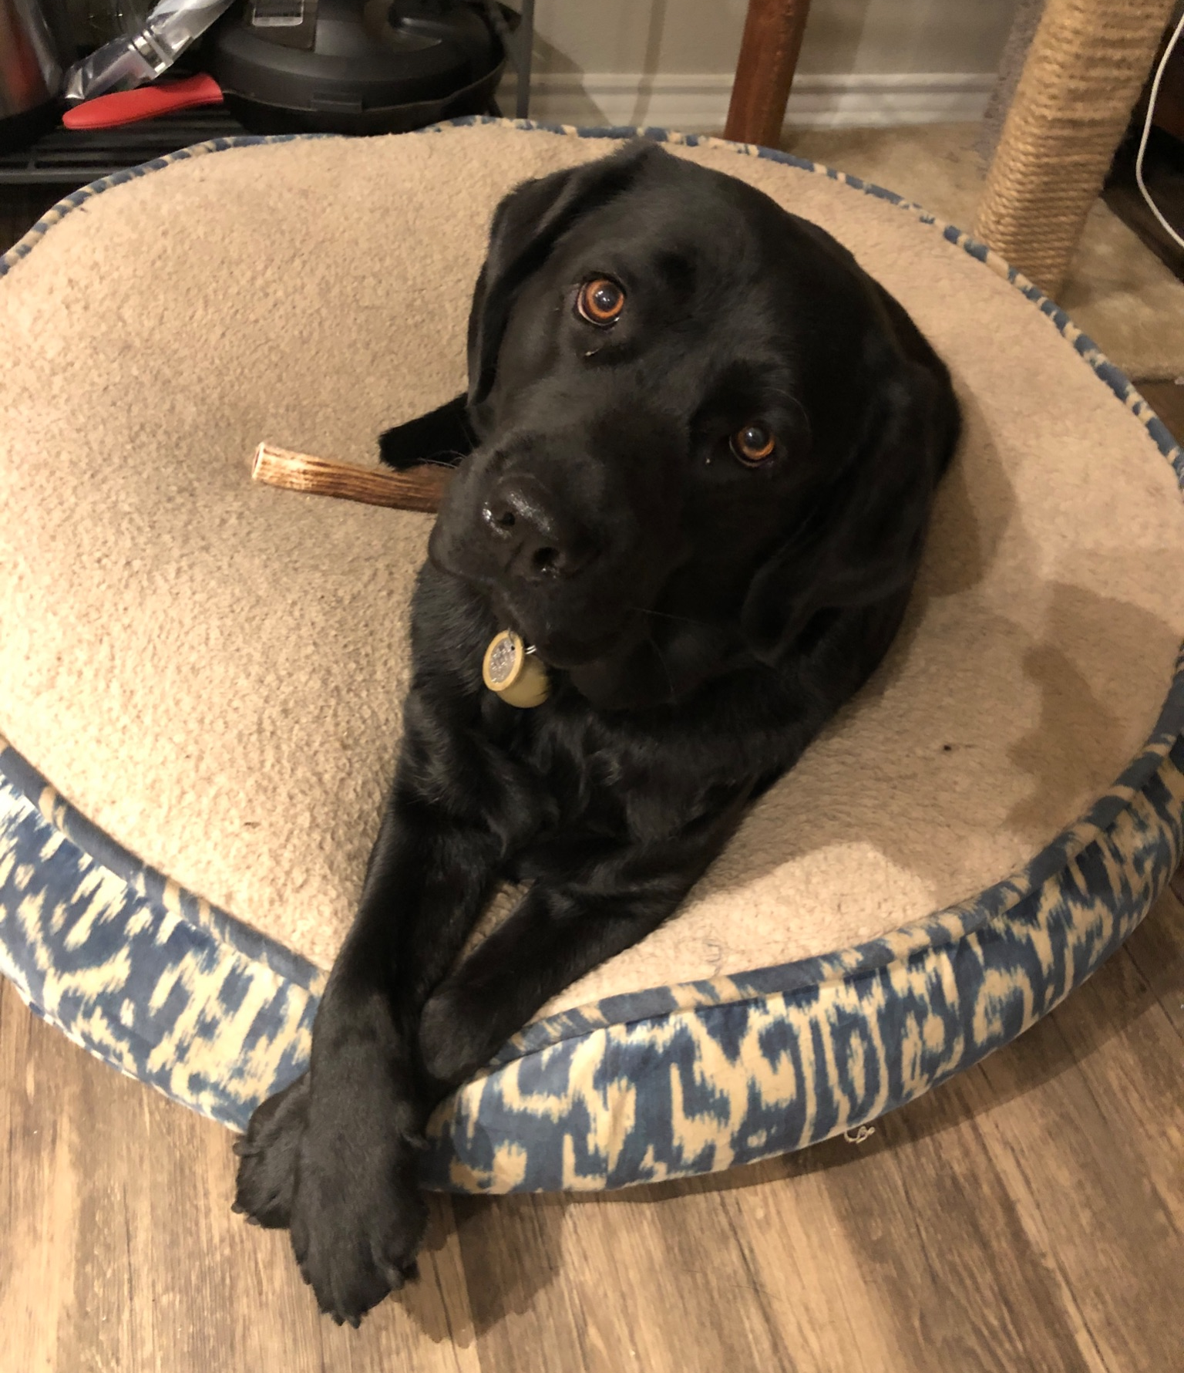
Thank you!
Ask Us (Almost) Anything!
sli.do #cse121-19

