Slide 1
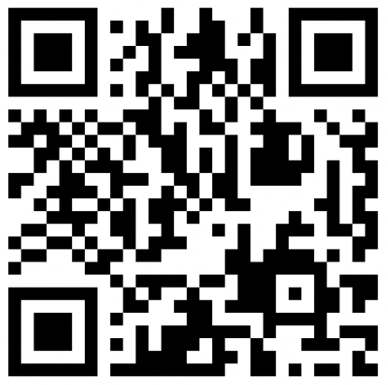
CSE 121 – Lesson 18
Elba Garza & Matt Wang
Winter 2024
TAs:
Abby | Aishah | Anju | Annie | Archit | Ayesha | Christian
Hannah | Heather | Hibbah | Jacob | James | Janvi | Jasmine
Jonus | Julia | Lucas | Luke | Maria | Nicole | Shananda
Shayna | Trey | Vidhi | Vivian
sli.do #cse121-18
Today’s playlist: CSE 121 24wi lecture beats :D

Slide 2
Announcements, Reminders
P3 and R6 due tomorrow (Thursday, March 7th)
R7 out tomorrow, due March 14th— Wild card/free-for-all resub!
Bob Bandes TA Award nominations open!
IPL closes Friday, March 8th; Instructor office hours too!
Course evaluations for A and B lecture close Sunday, March 10th
Please give us feedback! TAs will be collecting feedback in quiz sections too!
Gigi (& friends) Visit on Monday, March 11th 1:00pm-3:00pm
Final Exam: Tuesday, March 12th 12:30pm-2:20pm
TA-led Final Review Session Monday, March 11th 4:30pm-6:50pm in SMI 120

