Slide 1
CSE 121 – Lesson 16
Elba Garza & Matt Wang
Winter 2024
TAs:
Abby | Aishah | Anju | Annie | Archit | Ayesha | Christian
Hannah | Heather | Hibbah | Jacob | James | Janvi | Jasmine
Jonus | Julia | Lucas | Luke | Maria | Nicole | Shananda
Shayna | Trey | Vidhi | Vivian
sli.do #cse121-16
Today’s playlist: CSE 121 24wi lecture beats :D

Slide 2
Announcements, Reminders
Programming Assignment 3 releasing later today – last assignment!
Focused on 2D arrays!
No dedicated resubmission cycle (Feedback will not be released the following Tuesday)
Extending P3's planned deadline to Thursday next week (March 7th)… so you have an additional 2 days to work on it!
Gigi (& friends) Visit on Monday, March 11th 1:00pm-3:00pm
Final Exam: Tuesday, March 12th 12:30pm-2:20pm
Left-Handed Seating Requests Form, closes end-of-day Monday, March 4th

Slide 3
Final Exam Details
Final Exam: Tuesday, March 12th 12:30pm-2:20pm
In-person, on paper, with assigned seating
No collaboration – should be completed individually
You may bring in one 8.5x11-inch sheet of notes, handwritten or typed, double-sided
Focused on behavior (not style)
You should make every attempt to write correct Java syntax
Next week will be focused on Final Exam review and preparation
We are also planning a Final Exam Review Session on Monday of finals week (March 11th)
More details soon on course website!

Slide 4
public static void main(String[] args) {
int x = 0;
int[] a = new int[4];
x++;
mystery(x, a);
System.out.println(x + " " + Arrays.toString(a));
x++;
mystery(x, a);
System.out.println(x + " " + Arrays.toString(a));
}
public static void mystery(int x, int[] a) {
x++;
a[x]++;
System.out.println(x + " " + Arrays.toString(a));
}
Four lines of output would be produced by this code. What would those four lines be?

Slide 5
public static void main(String[] args) {
int x = 0;
int[] a = new int[4];
x++;
mystery(x, a);
System.out.println(x + " " + Arrays.toString(a));
x++;
mystery(x, a);
System.out.println(x + " " + Arrays.toString(a));
}
public static void mystery(int x, int[] a) {
x++;
a[x]++;
System.out.println(x + " " + Arrays.toString(a));
}

Slide 6
(PCM) 2D Arrays
An array of arrays!
The ElementType of the array is another array itself!
Your first example of “nested data structures”
There will be more in CSE 122!
int[][]
String[][]
double[][]
boolean[][]
char[][]

Slide 7
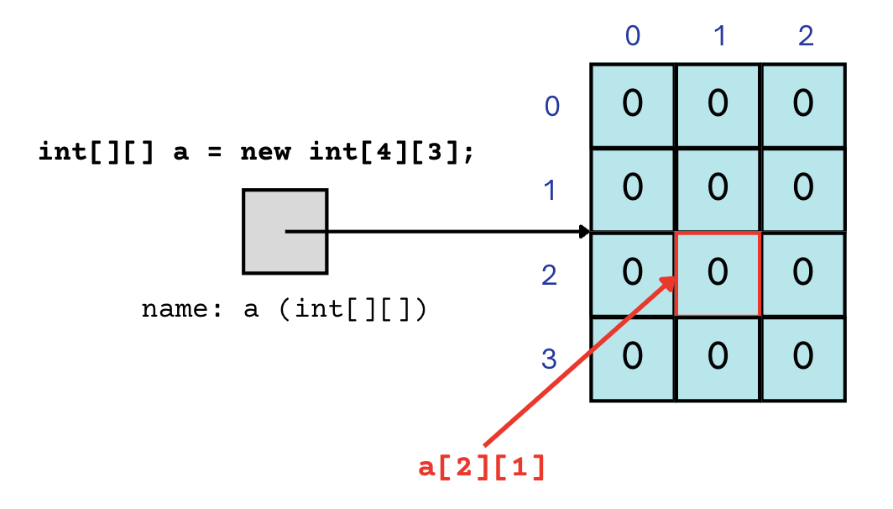
(PCM) 2D Arrays
An array of arrays!
The two dimensions are “rows” and “columns”
0
1
2
0
int[] a = new int[4][3];
1
2
3

Slide 8
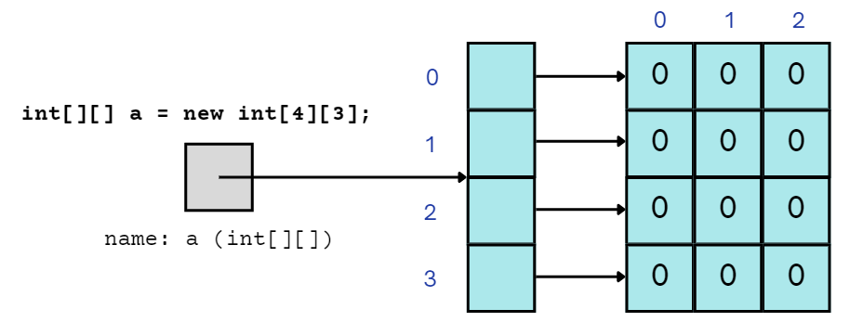
(PCM) 2D Arrays
A slightly more accurate view…
reference semantics
0
1
2
0
int[] a = new int[4][3];
1
2
3

Slide 9
(PCM) 2D Array Traversals
for each row…
for (int i = 0; i < list.length; i++) {
for (int j = 0; j < list[i].length; j++) {
// do something with list[i][j]
}
}
for each element within a row…

Slide 10
Arrays Utility Class
Method | Description
Arrays.toString(array); | Returns a String representing the array, such as "[10, 30, -25, 17]"
Arrays.fill(array, value); | Sets every element to the given value
Arrays.equals(array1, array2); | Returns true if the two arrays contain the same elements in the same order
Arrays.deepToString(array); | Returns a String representing the array; if the array contains other arrays as elements, the String represents their contents, and so on. For example, "[[99, 151], [30, 5]]"
Arrays.deepEquals(array1, array2); | Returns true if the two arrays contain the same elements in the same order; if the array(s) contain other arrays as elements, their contents are tested for equality, and so on.

Slide 11
Applications of 2D Arrays
Matrices
Useful in various applications requiring complex math!
Board games
(e.g., chess/checkerboard, tic tac toe, sudoku)
Representing information in a grid or table
(e.g., scorekeeping, gradebook)
Image processing

Slide 12
matrixAdd
23 | 96 | 18 | 4 | 64
45 | 40 | 18 | 44 | 34
92 | 13 | 77 | 71 | 12
93 | 169 | 84 | 83 | 103
136 | 115 | 91 | 143 | 81
119 | 77 | 98 | 105 | 13
70 | 73 | 66 | 79 | 39
91 | 75 | 73 | 99 | 47
27 | 64 | 21 | 34 | 1

Slide 13
matrixAdd
23 | 96 | 18 | 4 | 64
45 | 40 | 18 | 44 | 34
92 | 13 | 77 | 71 | 12
i: 0
j: 0
93 | 169 | 84 | 83 | 103
136 | 115 | 91 | 143 | 81
119 | 77 | 98 | 105 | 13
70 | 73 | 66 | 79 | 39
91 | 75 | 73 | 99 | 47
27 | 64 | 21 | 34 | 1

Slide 14
matrixAdd
23 | 96 | 18 | 4 | 64
45 | 40 | 18 | 44 | 34
92 | 13 | 77 | 71 | 12
i: 0
j: 0
93 | 169 | 84 | 83 | 103
136 | 115 | 91 | 143 | 81
119 | 77 | 98 | 105 | 13
70 | 73 | 66 | 79 | 39
91 | 75 | 73 | 99 | 47
27 | 64 | 21 | 34 | 1

Slide 15
matrixAdd
23 | 96 | 18 | 4 | 64
45 | 40 | 18 | 44 | 34
92 | 13 | 77 | 71 | 12
i: 0
j: 1
93 | 169 | 84 | 83 | 103
136 | 115 | 91 | 143 | 81
119 | 77 | 98 | 105 | 13
70 | 73 | 66 | 79 | 39
91 | 75 | 73 | 99 | 47
27 | 64 | 21 | 34 | 1

Slide 16
matrixAdd
23 | 96 | 18 | 4 | 64
45 | 40 | 18 | 44 | 34
92 | 13 | 77 | 71 | 12
i: 0
j: 2
93 | 169 | 84 | 83 | 103
136 | 115 | 91 | 143 | 81
119 | 77 | 98 | 105 | 13
70 | 73 | 66 | 79 | 39
91 | 75 | 73 | 99 | 47
27 | 64 | 21 | 34 | 1

Slide 17
matrixAdd
23 | 96 | 18 | 4 | 64
45 | 40 | 18 | 44 | 34
92 | 13 | 77 | 71 | 12
i: 0
j: 3
93 | 169 | 84 | 83 | 103
136 | 115 | 91 | 143 | 81
119 | 77 | 98 | 105 | 13
70 | 73 | 66 | 79 | 39
91 | 75 | 73 | 99 | 47
27 | 64 | 21 | 34 | 1

Slide 18
matrixAdd
23 | 96 | 18 | 4 | 64
45 | 40 | 18 | 44 | 34
92 | 13 | 77 | 71 | 12
i: 0
j: 4
93 | 169 | 84 | 83 | 103
136 | 115 | 91 | 143 | 81
119 | 77 | 98 | 105 | 13
70 | 73 | 66 | 79 | 39
91 | 75 | 73 | 99 | 47
27 | 64 | 21 | 34 | 1

Slide 19
matrixAdd
23 | 96 | 18 | 4 | 64
45 | 40 | 18 | 44 | 34
92 | 13 | 77 | 71 | 12
i: 1
j: 0
93 | 169 | 84 | 83 | 103
136 | 115 | 91 | 143 | 81
119 | 77 | 98 | 105 | 13
70 | 73 | 66 | 79 | 39
91 | 75 | 73 | 99 | 47
27 | 64 | 21 | 34 | 1

Slide 20
matrixAdd
23 | 96 | 18 | 4 | 64
45 | 40 | 18 | 44 | 34
92 | 13 | 77 | 71 | 12
i: 1
j: 1
93 | 169 | 84 | 83 | 103
136 | 115 | 91 | 143 | 81
119 | 77 | 98 | 105 | 13
70 | 73 | 66 | 79 | 39
91 | 75 | 73 | 99 | 47
27 | 64 | 21 | 34 | 1

Slide 21
matrixAdd
23 | 96 | 18 | 4 | 64
45 | 40 | 18 | 44 | 34
92 | 13 | 77 | 71 | 12
i: 1
j: 2
93 | 169 | 84 | 83 | 103
136 | 115 | 91 | 143 | 81
119 | 77 | 98 | 105 | 13
70 | 73 | 66 | 79 | 39
91 | 75 | 73 | 99 | 47
27 | 64 | 21 | 34 | 1

Slide 22
matrixAdd
23 | 96 | 18 | 4 | 64
45 | 40 | 18 | 44 | 34
92 | 13 | 77 | 71 | 12
i: 1
j: 3
93 | 169 | 84 | 83 | 103
136 | 115 | 91 | 143 | 81
119 | 77 | 98 | 105 | 13
70 | 73 | 66 | 79 | 39
91 | 75 | 73 | 99 | 47
27 | 64 | 21 | 34 | 1

Slide 23
matrixAdd
23 | 96 | 18 | 4 | 64
45 | 40 | 18 | 44 | 34
92 | 13 | 77 | 71 | 12
i: 1
j: 4
93 | 169 | 84 | 83 | 103
136 | 115 | 91 | 143 | 81
119 | 77 | 98 | 105 | 13
70 | 73 | 66 | 79 | 39
91 | 75 | 73 | 99 | 47
27 | 64 | 21 | 34 | 1

Slide 24
matrixAdd
23 | 96 | 18 | 4 | 64
45 | 40 | 18 | 44 | 34
92 | 13 | 77 | 71 | 12
i: 2
j: 0
93 | 169 | 84 | 83 | 103
136 | 115 | 91 | 143 | 81
119 | 77 | 98 | 105 | 13
70 | 73 | 66 | 79 | 39
91 | 75 | 73 | 99 | 47
27 | 64 | 21 | 34 | 1

Slide 25
matrixAdd
23 | 96 | 18 | 4 | 64
45 | 40 | 18 | 44 | 34
92 | 13 | 77 | 71 | 12
i: 2
j: 1
93 | 169 | 84 | 83 | 103
136 | 115 | 91 | 143 | 81
119 | 77 | 98 | 105 | 13
70 | 73 | 66 | 79 | 39
91 | 75 | 73 | 99 | 47
27 | 64 | 21 | 34 | 1

Slide 26
matrixAdd
23 | 96 | 18 | 4 | 64
45 | 40 | 18 | 44 | 34
92 | 13 | 77 | 71 | 12
i: 2
j: 2
93 | 169 | 84 | 83 | 103
136 | 115 | 91 | 143 | 81
119 | 77 | 98 | 105 | 13
70 | 73 | 66 | 79 | 39
91 | 75 | 73 | 99 | 47
27 | 64 | 21 | 34 | 1

Slide 27
matrixAdd
23 | 96 | 18 | 4 | 64
45 | 40 | 18 | 44 | 34
92 | 13 | 77 | 71 | 12
i: 2
j: 3
93 | 169 | 84 | 83 | 103
136 | 115 | 91 | 143 | 81
119 | 77 | 98 | 105 | 13
70 | 73 | 66 | 79 | 39
91 | 75 | 73 | 99 | 47
27 | 64 | 21 | 34 | 1

Slide 28
matrixAdd
23 | 96 | 18 | 4 | 64
45 | 40 | 18 | 44 | 34
92 | 13 | 77 | 71 | 12
i: 2
j: 4
93 | 169 | 84 | 83 | 103
136 | 115 | 91 | 143 | 81
119 | 77 | 98 | 105 | 13
70 | 73 | 66 | 79 | 39
91 | 75 | 73 | 99 | 47
27 | 64 | 21 | 34 | 1

Slide 29
matrixAdd
23 | 96 | 18 | 4 | 64
45 | 40 | 18 | 44 | 34
92 | 13 | 77 | 71 | 12
93 | 169 | 84 | 83 | 103
136 | 115 | 91 | 143 | 81
119 | 77 | 98 | 105 | 13
70 | 73 | 66 | 79 | 39
91 | 75 | 73 | 99 | 47
27 | 64 | 21 | 34 | 1

Slide 30
(2D)ays Above Average: readData()
How many days' data would you like to input? 3
Next day's data:
Temperature in Seattle? 44
Temperature in Tacoma? 40
Temperature in Bothell? 43
Next day's data:
Temperature in Seattle? 42
Temperature in Tacoma? 40
Temperature in Bothell? 44
Next day's data:
Temperature in Seattle? 42
Temperature in Tacoma? 41
Temperature in Bothell? 43
…
 | Seattle | Tacoma | Bothell
1 | 44 | 40 | 43
2 | 42 | 40 | 44
3 | 42 | 41 | 43

Slide 31
(2D)ays Above Average: readData()
How many days' data would you like to input? 3
Next day's data:
Temperature in Seattle? 44
Temperature in Tacoma? 40
Temperature in Bothell? 43
Next day's data:
Temperature in Seattle? 42
Temperature in Tacoma? 40
Temperature in Bothell? 44
Next day's data:
Temperature in Seattle? 42
Temperature in Tacoma? 41
Temperature in Bothell? 43
…
 | Seattle | Tacoma | Bothell
1 | 44 | 40 | 43
2 | 42 | 40 | 44
3 | 42 | 41 | 43

Slide 32
(2D)ays Above Average: readData()
How many days' data would you like to input? 3
Next day's data:
Temperature in Seattle? 44
Temperature in Tacoma? 40
Temperature in Bothell? 43
Next day's data:
Temperature in Seattle? 42
Temperature in Tacoma? 40
Temperature in Bothell? 44
Next day's data:
Temperature in Seattle? 42
Temperature in Tacoma? 41
Temperature in Bothell? 43
…
 | Seattle | Tacoma | Bothell
1 | 44 | 40 | 43
2 | 42 | 40 | 44
3 | 42 | 41 | 43

Slide 33
(2D)ays Above Average: readData()
How many days' data would you like to input? 3
Next day's data:
Temperature in Seattle? 44
Temperature in Tacoma? 40
Temperature in Bothell? 43
Next day's data:
Temperature in Seattle? 42
Temperature in Tacoma? 40
Temperature in Bothell? 44
Next day's data:
Temperature in Seattle? 42
Temperature in Tacoma? 41
Temperature in Bothell? 43
…
 | Seattle | Tacoma | Bothell
1 | 44 | 40 | 43
2 | 42 | 40 | 44
3 | 42 | 41 | 43

Slide 34
(2D)ays Above Average: readData()
How many days' data would you like to input? 3
Next day's data:
Temperature in Seattle? 44
Temperature in Tacoma? 40
Temperature in Bothell? 43
Next day's data:
Temperature in Seattle? 42
Temperature in Tacoma? 40
Temperature in Bothell? 44
Next day's data:
Temperature in Seattle? 42
Temperature in Tacoma? 41
Temperature in Bothell? 43
…
 | Seattle | Tacoma | Bothell
1 | 44 | 40 | 43
2 | 42 | 40 | 44
3 | 42 | 41 | 43

Slide 35
(2D)ays Above Average: readData()
How many days' data would you like to input? 3
Next day's data:
Temperature in Seattle? 44
Temperature in Tacoma? 40
Temperature in Bothell? 43
Next day's data:
Temperature in Seattle? 42
Temperature in Tacoma? 40
Temperature in Bothell? 44
Next day's data:
Temperature in Seattle? 42
Temperature in Tacoma? 41
Temperature in Bothell? 43
…
 | Seattle | Tacoma | Bothell
1 | 44 | 40 | 43
2 | 42 | 40 | 44
3 | 42 | 41 | 43

Slide 36
(2D)ays Above Average: readData()
How many days' data would you like to input? 3
Next day's data:
Temperature in Seattle? 44
Temperature in Tacoma? 40
Temperature in Bothell? 43
Next day's data:
Temperature in Seattle? 42
Temperature in Tacoma? 40
Temperature in Bothell? 44
Next day's data:
Temperature in Seattle? 42
Temperature in Tacoma? 41
Temperature in Bothell? 43
…
 | Seattle | Tacoma | Bothell
1 | 44 | 40 | 43
2 | 42 | 40 | 44
3 | 42 | 41 | 43

Slide 37
(2D)ays Above Average: readData()
How many days' data would you like to input? 3
Next day's data:
Temperature in Seattle? 44
Temperature in Tacoma? 40
Temperature in Bothell? 43
Next day's data:
Temperature in Seattle? 42
Temperature in Tacoma? 40
Temperature in Bothell? 44
Next day's data:
Temperature in Seattle? 42
Temperature in Tacoma? 41
Temperature in Bothell? 43
…
 | Seattle | Tacoma | Bothell
1 | 44 | 40 | 43
2 | 42 | 40 | 44
3 | 42 | 41 | 43

Slide 38
(2D)ays Above Average: readData()
How many days' data would you like to input? 3
Next day's data:
Temperature in Seattle? 44
Temperature in Tacoma? 40
Temperature in Bothell? 43
Next day's data:
Temperature in Seattle? 42
Temperature in Tacoma? 40
Temperature in Bothell? 44
Next day's data:
Temperature in Seattle? 42
Temperature in Tacoma? 41
Temperature in Bothell? 43
…
 | Seattle | Tacoma | Bothell
1 | 44 | 40 | 43
2 | 42 | 40 | 44
3 | 42 | 41 | 43

Slide 39
(2D)ays Above Average: readData()
How many days' data would you like to input? 3
Next day's data:
Temperature in Seattle? 44
Temperature in Tacoma? 40
Temperature in Bothell? 43
Next day's data:
Temperature in Seattle? 42
Temperature in Tacoma? 40
Temperature in Bothell? 44
Next day's data:
Temperature in Seattle? 42
Temperature in Tacoma? 41
Temperature in Bothell? 43
…
 | Seattle | Tacoma | Bothell
1 | 44 | 40 | 43
2 | 42 | 40 | 44
3 | 42 | 41 | 43

Slide 40
(2D)ays Above Average: computeAverages()
How many days' data would you like to input? 3
…
The average values for each location were [42.666666666666664, 40.333333333333336, 43.333333333333336]
 | Seattle | Tacoma | Bothell
1 | 44 | 40 | 43
2 | 42 | 40 | 44
3 | 42 | 41 | 43
42.667 | 40.333 | 43.333
Average of Seattle temperatures
(44 + 42 + 42) / 3

