Slide 1
CSE 121 Lesson 15: Arrays & Reference Semantics
Elba Garza & Matt Wang
Winter 2024
TAs:
Abby | Aishah | Anju | Annie | Archit | Ayesha | Christian
Hannah | Heather | Hibbah | Jacob | James | Janvi | Jasmine
Jonus | Julia | Lucas | Luke | Maria | Nicole | Shananda
Shayna | Trey | Vidhi | Vivian
sli.do #CSE121-15
Today’s playlist: CSE 121 24wi lecture beats :D

Slide 2
Reminders & Announcements
C3 released Wednesday, due Tuesday Feb 27th
R5 released yesterday, due Thursday Feb 29th
note: last chance for P1!
Quiz 2 next Thursday, Feb 29th
topics: everything up until Arrays on Wednesday (i.e. not today’s material)
next week: many practice quizzes :)
In the future: Final Exam (Tuesday March 12th at 12:30 – 2:20pm)
more logistical details coming soon!

Slide 3
What would the array a store at the end of this arrayMystery method if {-20, 20, 26, 32, 50, 3} was passed in?
public static void arrayMystery(int[] a) {
for (int i = a.length - 1; i >= 1; i--) {
if (a[i] > a[i - 1] + 10) {
a[i - 1] = a[i - 1] + 5;
}
}
}
{-20, 20, 26, 32, 50, 3}
{-15, 25, 31, 37, 55, 8}
{-15, 25, 31, 37, 50, 3}
{-15, 20, 26, 37, 50, 3}

Slide 4
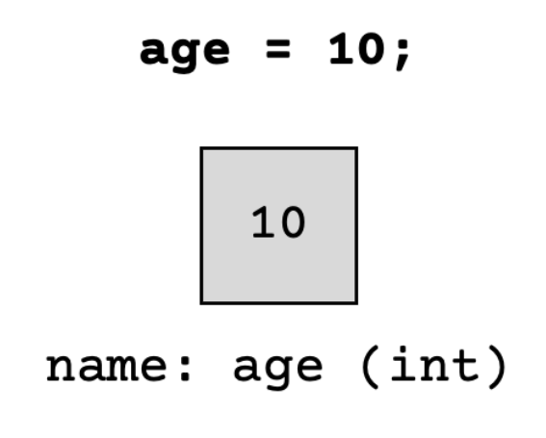
(PCM) Value Semantics vs. Reference Semantics
Applies when working with primitive types
Variables/parameters hold a copy of the actual value
Applies when working with objects
Variables/parameters hold a reference to the object

Slide 5
(PCM) Value Semantics vs. Reference Semantics
int a = 3;
int b = a;
a = 99;
int[] list1 = {4, 8, 15, 16, 23};
int[] list2 = list1;
list1[1] = 99;

Slide 6
Without knowing what someMethod does, what are the possible values of num?
int num = 42;
someMethod(num);
System.out.println(num);
anything!
just 42

Slide 7
Without knowing what anotherMethod does, what are the possible values of nums[0]?
int[] nums = {42, 43, 44};
anotherMethod(nums);
System.out.println(nums[0]);
anything!
just 42

Slide 8
(PCM) Value Semantics vs. Reference Semantics
boolean test = true;
flipValue(test);
public static void flipValue(boolean b) {
b = !b;
}
boolean[] tests =
{true, true, false, true, false, false};
flipValues(tests);
public static void flipValues(boolean[] b) {
for (int i = 0; i < b.length; i++) {
b[i] = !b[i];
}
}

Slide 9
(PCM) null
The absence of a reference!
Sort of like a "zero-equivalent" for references!
Default value for object types
NullPointerExceptions occur when you try to ask a reference “do something”, but there isn't a reference there…it's null!
"do something" such as get an element from an array, or call a method on an object)

Slide 10
public static void main(String[] args) {
int x = 0;
int[] a = new int[4];
x++;
mystery(x, a);
System.out.println(x + " " + Arrays.toString(a));
x++;
mystery(x, a);
System.out.println(x + " " + Arrays.toString(a));
}
public static void mystery(int x, int[] a) {
x++;
a[x]++;
System.out.println(x + " " + Arrays.toString(a));
}
Four lines of output would be produced by this code. What would those four lines be?

