Slide 1
CSE 121 – Lesson 14
Elba Garza & Matt Wang
Winter 2024
TAs:
Abby | Aishah | Anju | Annie | Archit | Ayesha | Christian
Hannah | Heather | Hibbah | Jacob | James | Janvi | Jasmine
Jonus | Julia | Lucas | Luke | Maria | Nicole | Shananda
Shayna | Trey | Vidhi | Vivian
sli.do #cse121-14
Today’s playlist: CSE 121 24wi lecture beats :D

Slide 2
Announcements, Reminders
Creative Project 3 (C3) Releasing later tonight; due February 27th
Resubmission Cycle 4 (R4) due tomorrow, February 22nd
Final opportunity for C1!
Also eligible: P1, C2
Quiz 0 grades hopefully by this weekend! 🤞🏼
Quiz 2 on Thursday, February 29th
Covers everything up to (and including) today’s material!

Slide 3
(PCM) Arrays
Elements (must all be the same type)
Indices (starting at 0)
Must decide size when created!
arr.length to get arr's length
Arrays.toString(arr) to get a nice String version

Slide 4
(PCM) Array Traversal Pattern
for (int i = 0; i < arr.length; i++) {
// do something with arr[i]
}

Slide 5
How can we get the last element of an array arr?
arr[arr.length()]
arr[length()]
arr[arr.length]
arr[arr.length() - 1]
arr[arr.length - 1]

Slide 6
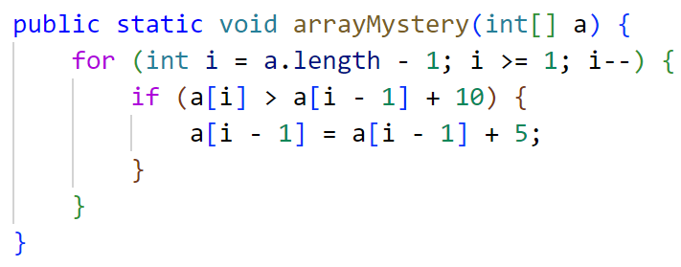
What would the array a store at the end of this arrayMystery method if {-20, 20, 26, 32, 50, 3} was passed in?
{-20, 20, 26, 32, 50, 3}
{-15, 25, 31, 37, 55, 8}
{-15, 25, 31, 37, 50, 3}
{-15, 20, 26, 37, 50, 3}

