Slide 1
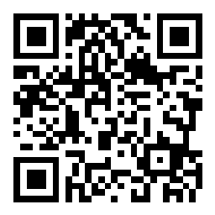
CSE 121 Lesson 13: Putting Even More Together
Elba Garza & Matt Wang
Winter 2024
TAs:
Abby | Aishah | Anju | Annie | Archit | Ayesha | Christian
Hannah | Heather | Hibbah | Jacob | James | Janvi | Jasmine
Jonus | Julia | Lucas | Luke | Maria | Nicole | Shananda
Shayna | Trey | Vidhi | Vivian
sli.do #CSE121-13
Today’s playlist: CSE 121 24wi lecture beats :D

Slide 2
Announcements, Reminders
P2 due Tuesday, February 20th
R4 released!
Long weekend coming up; University holiday on Monday
IPL will be closed on Monday
Ed will still be monitored, but no response times guaranteed
Quiz 2 on Thursday, Feb 29th (Leap Day!)
Covers everything up until (and including) next Wednesday’s lecture (Arrays)

Slide 3
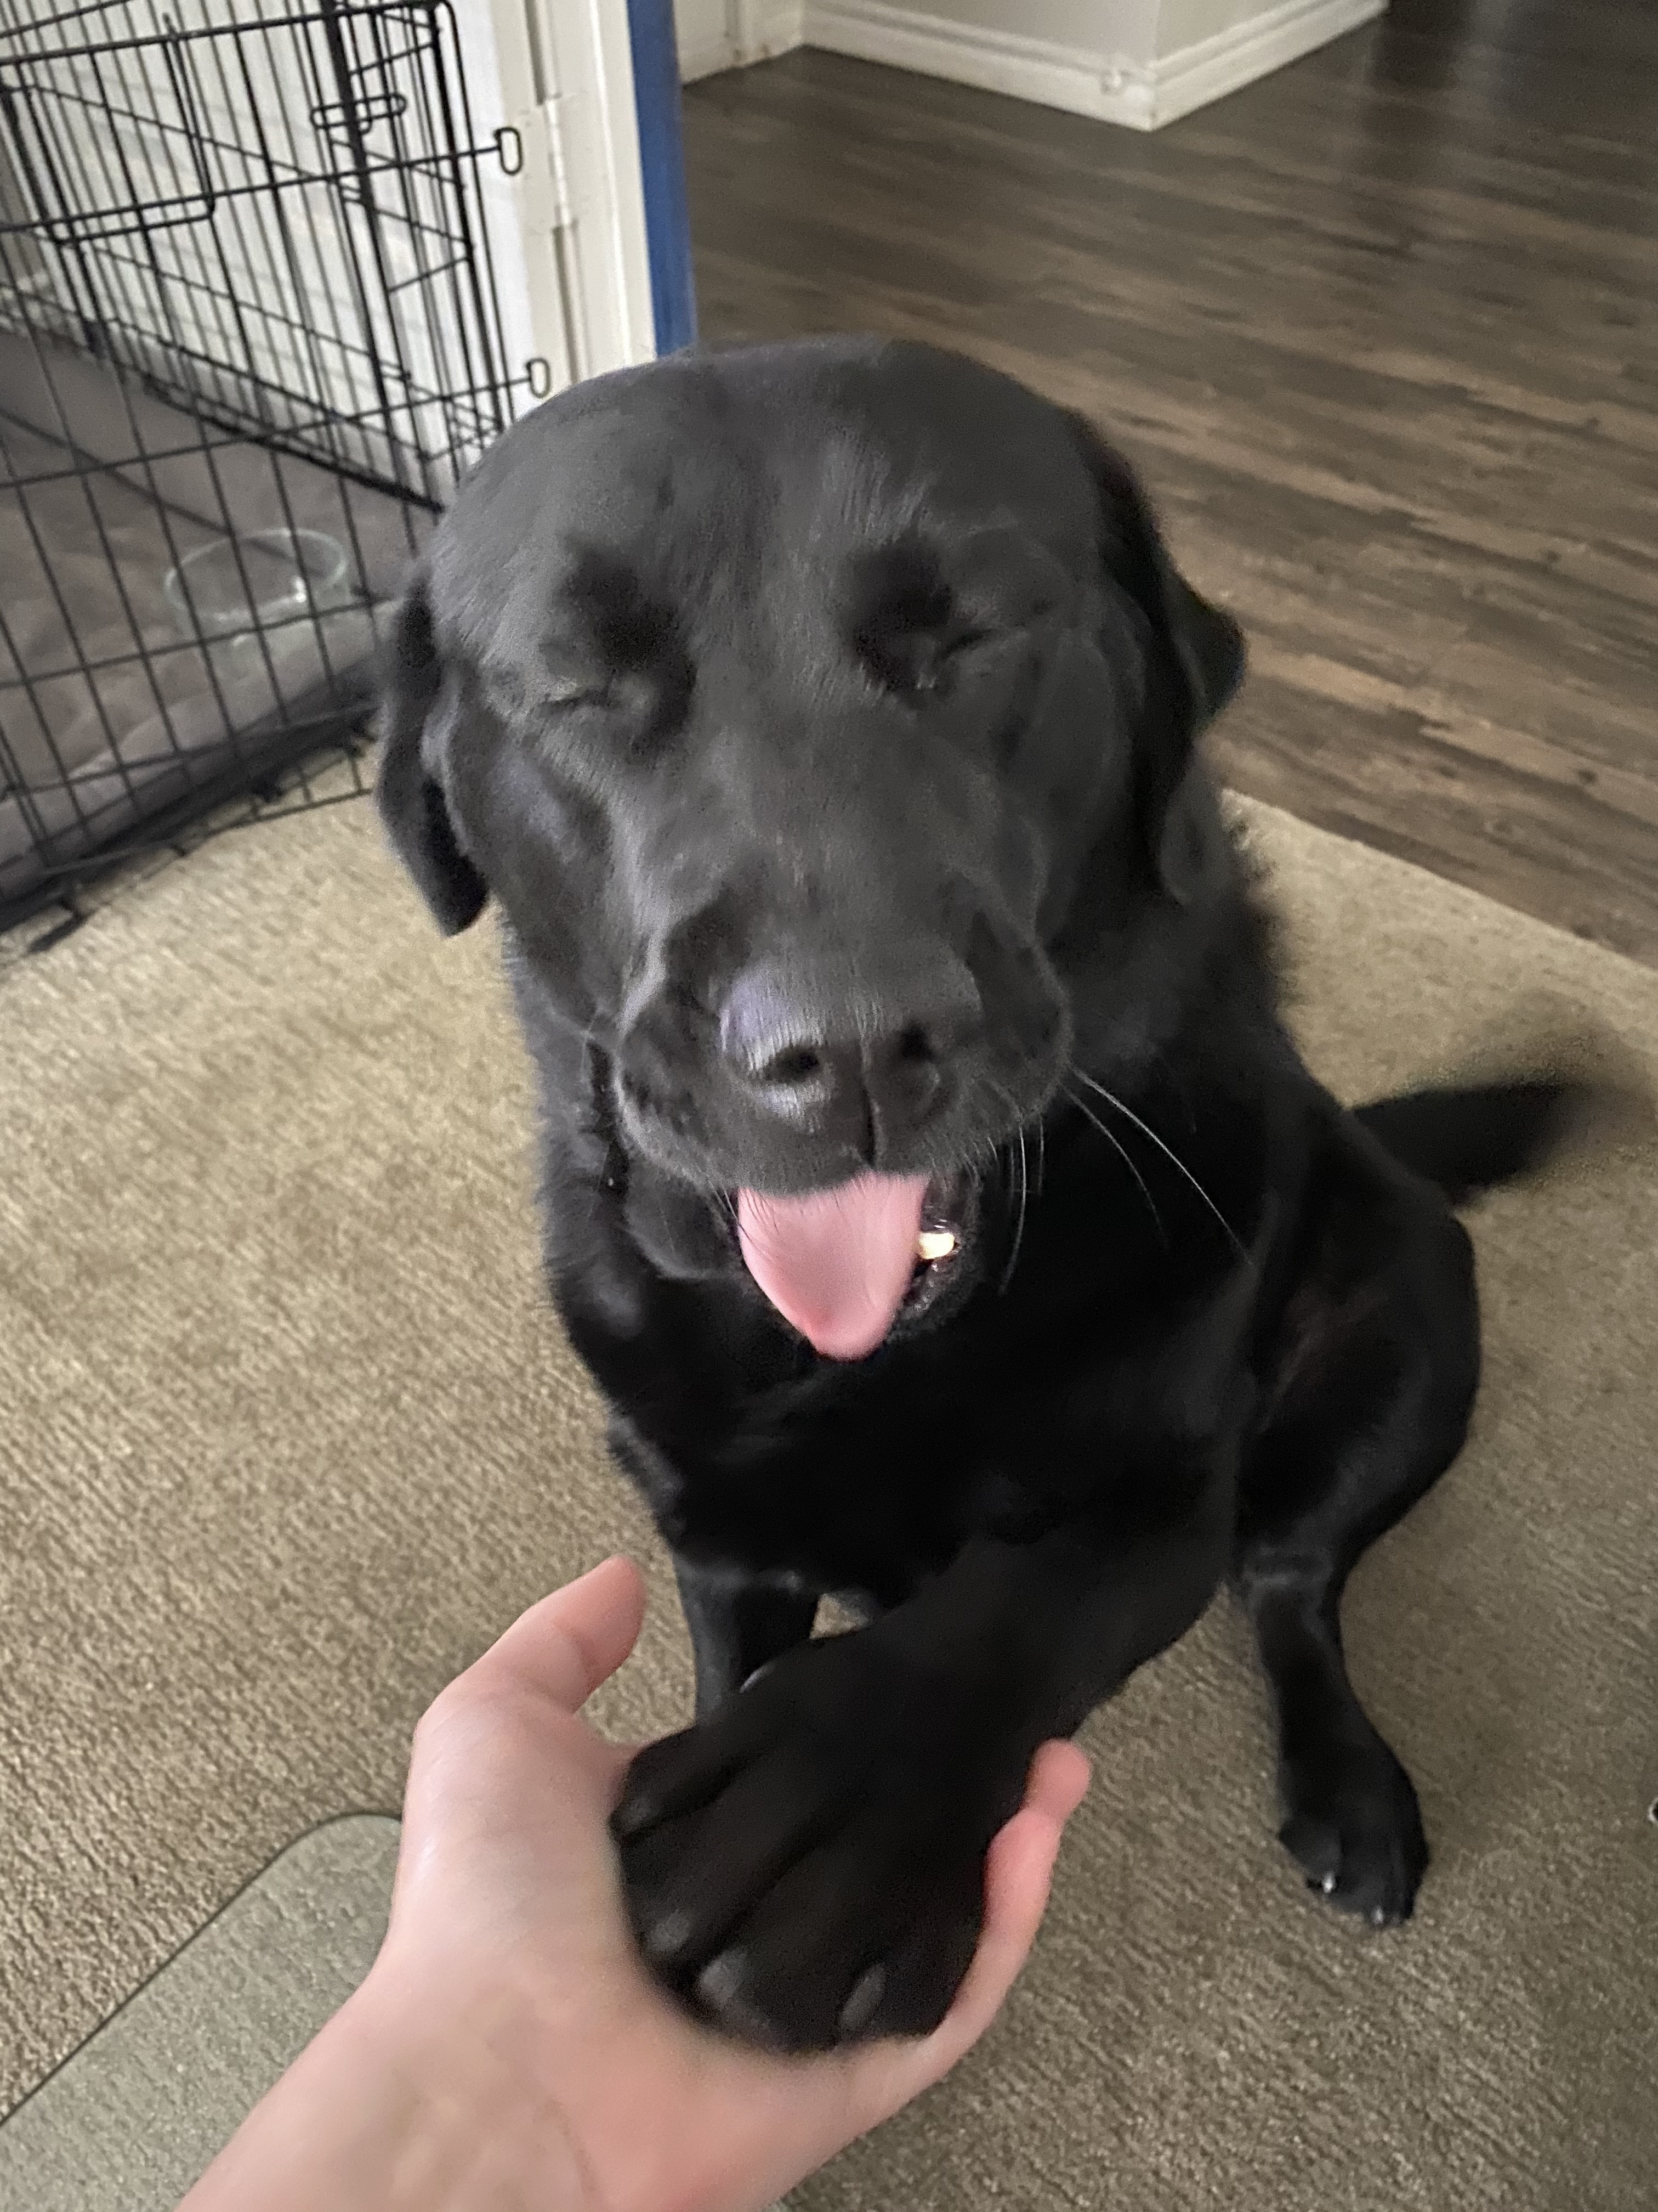
Formative Feedback: Closing the Loop
The Good…
Your TAs :)
Quiz Sections
IPL
In-Class Live Coding & Slido Questions
Ed Discussion
Assignments broken up step-by-step
New: Practice Quizzes

Slide 4
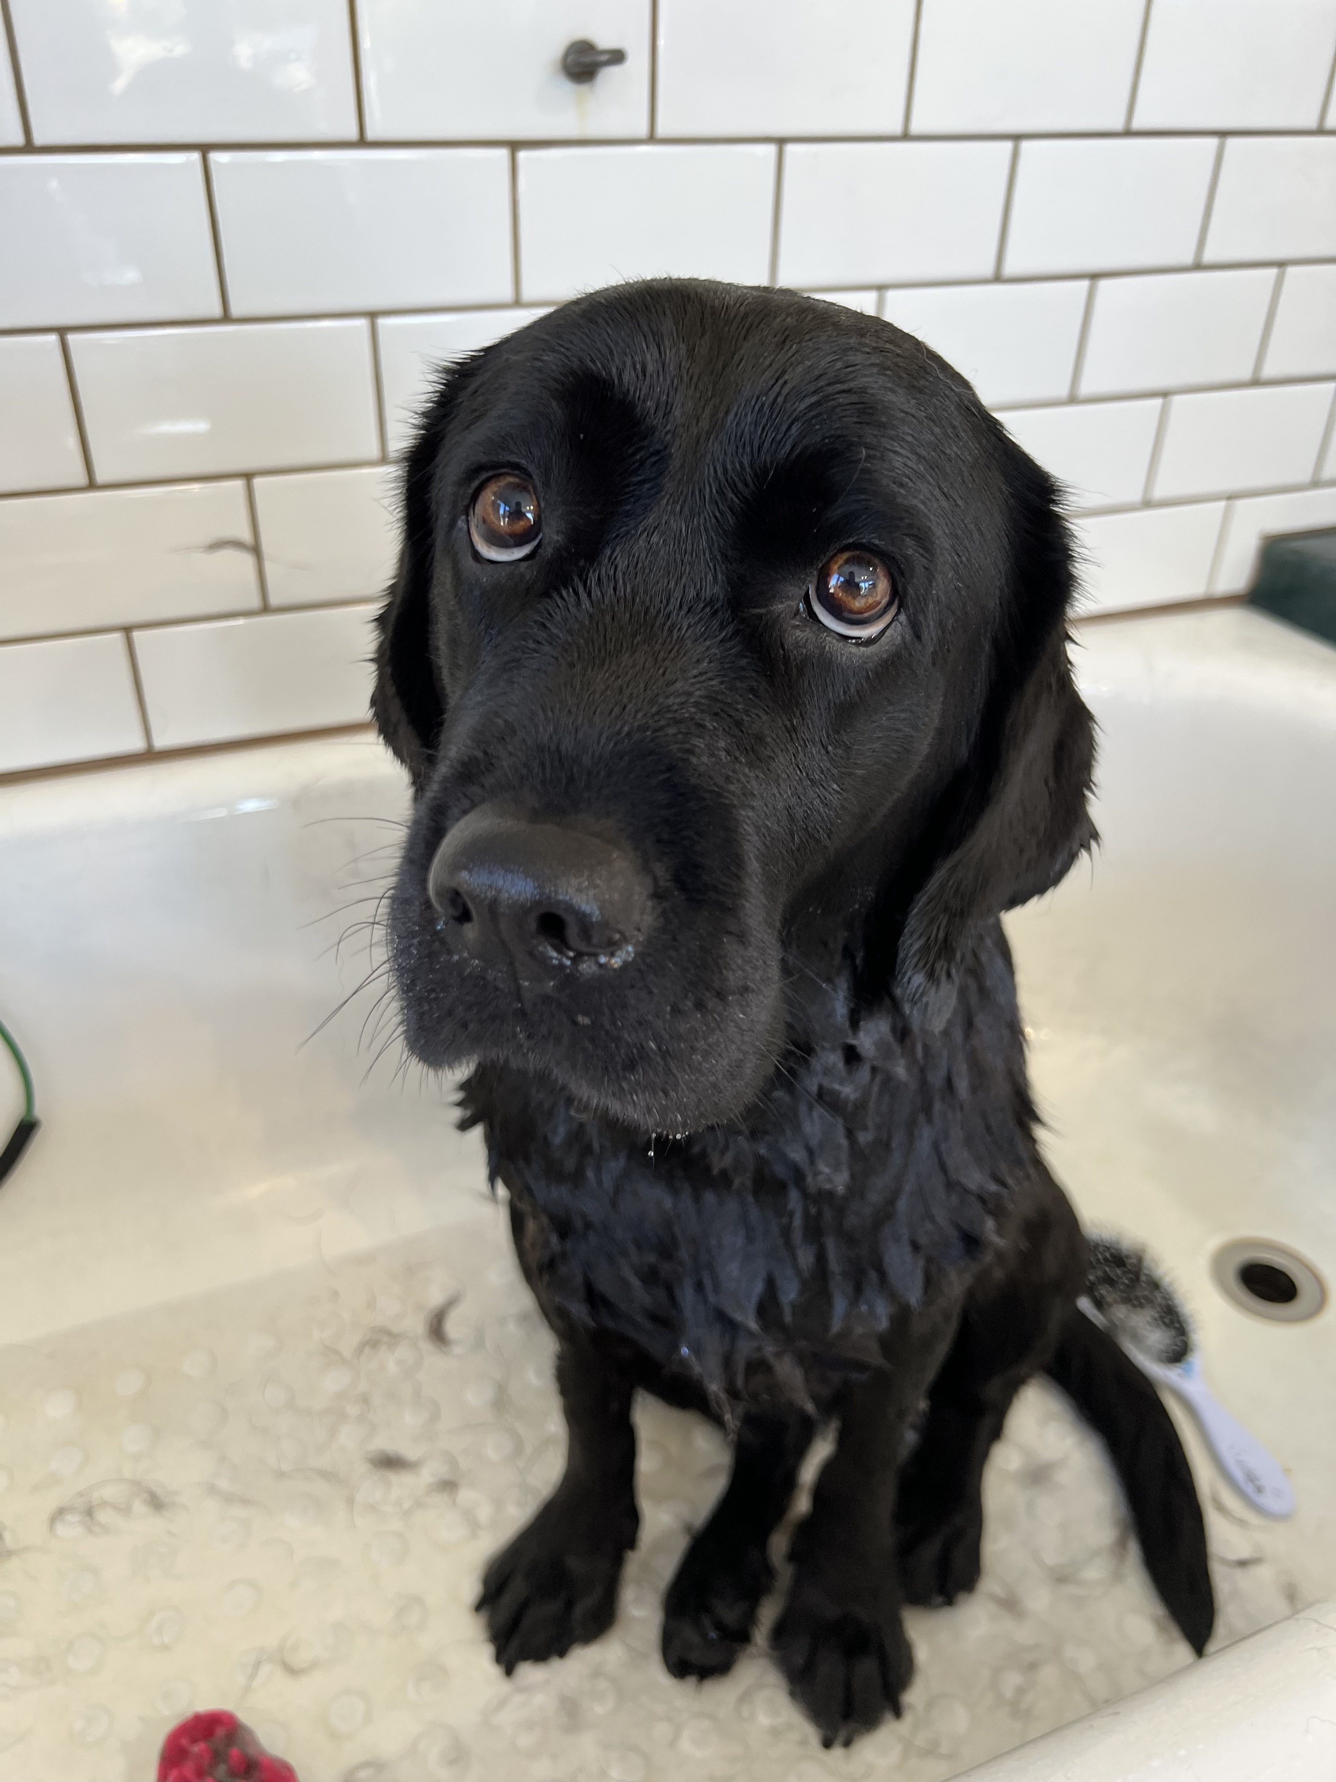
Formative Feedback: Closing the Loop
Suggestions…
Even more practice quizzes (& problems)!
Expect more for Quiz 2 – shoutout TAs!
Assignment spec clarity
We’re working on this!
More examples & exercises in-class
To be honest: hard with time constraints
But, we’ll try!

Slide 5
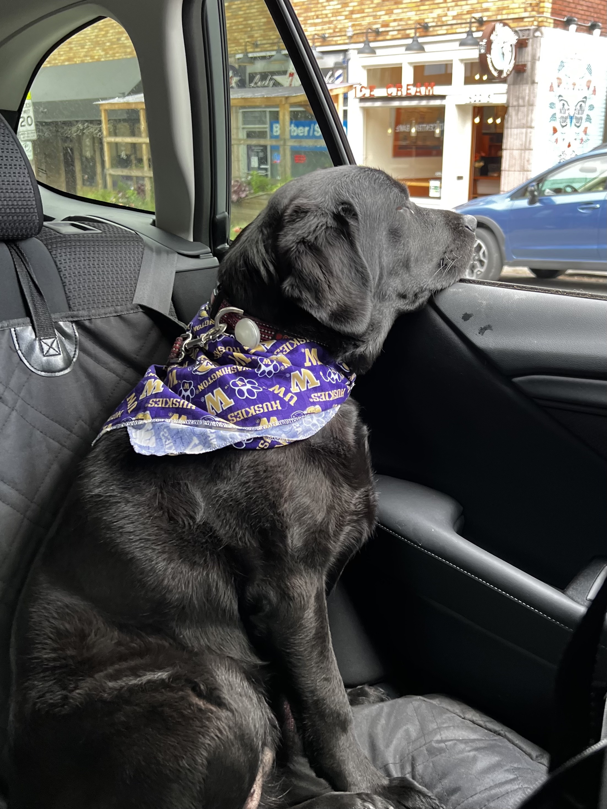
Formative Feedback: Closing the Loop
Reminders & advice…
Practice problems! (in order of relevance)
Section problems with a ⭐ are especially recommended!
General Section materials
Pre-class & Lecture Problems
PracticeIt
Reading specifications carefully is a skill!
Fun fact: Elba & Matt have to read specs all the time too…

