Slide 1
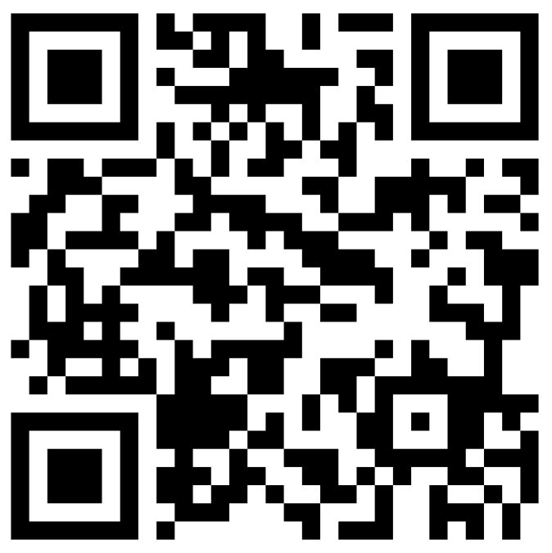
CSE 121 – Lesson 12
Elba Garza & Matt Wang
Winter 2024
TAs:
Abby | Aishah | Anju | Annie | Archit | Ayesha | Christian
Hannah | Heather | Hibbah | Jacob | James | Janvi | Jasmine
Jonus | Julia | Lucas | Luke | Maria | Nicole | Shananda
Shayna | Trey | Vidhi | Vivian
sli.do #cse121-12
Today’s playlist: CSE 121 24wi lecture beats :D

Slide 2
Announcements, Reminders💕
Quiz 1 is tomorrow, February 15th!
Quiz covers up until last Wednesday’s lecture (i.e. includes while loops, but not Scanner)
If you’re sick – please stay home and email Matt & me (before your quiz time)
Resubmission Cycle 3 (R3) is due tomorrow, February 15th
Final opportunity for P0!
Also eligible: C1, P1, C2
Programming Assignment 2 (P2) is ongoing
Due Tuesday, February 20th

Slide 3
Quiz Tips! 💡
Hit run often!
Run, change, run, ... 🔁
Quizzes are graded based on tests that you do or don't pass – make sure your submitted code is able to run!
NOTE: You should be testing your own code – we don't provide test results!
Quizzes are open-note, open-internet
BUT no generative AI (e.g., ChatGPT)
Have relevant PCMs, section problems, etc. open in other tabs!
Grading rubrics on slides – think strategically!
Time budgeting – quizzes are 45 minutes

Slide 4
Edge Cases! (And Testing)
When writing a method, especially one that takes input of some kind (e.g., parameters, user input) it's good to think carefully about the assumptions you can make (or cannot make) about this input.
Edge case: A scenario that is uncommon but possible, especially at the "edge" of an input's valid range.
❔Are we sure that all possible months are handled?
❔Are we sure that all possible days are handled? Leap day?!
❔ Are we sure that all possible combinations of months and days are handled?

