Slide 1
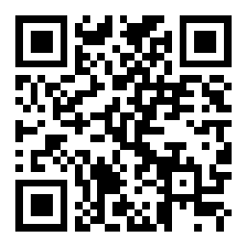
CSE 121 – Lesson 11 User Input (Scanner) & more while loops
Elba Garza & Matt Wang
Winter 2024
TAs:
Abby | Aishah | Anju | Annie | Archit | Ayesha | Christian
Hannah | Heather | Hibbah | Jacob | James | Janvi | Jasmine
Jonus | Julia | Lucas | Luke | Maria | Nicole | Shananda
Shayna | Trey | Vidhi | Vivian
sli.do #cse121-11
Today’s playlist: CSE 121 24wi lecture beats :D

Slide 2
Announcements & Reminders
Quiz 1 is next Thursday, February 15th!
quiz covers up until Wednesday’s lecture (i.e. includes while loops, but not Scanner or next Wednesday’s material)
if you’re sick – please stay home and email Elba & me (before your quiz time)
Programming Assignment 2 will be released later tonight
Due Tuesday, February 20th
No pre-class work for Wednesday :)

Slide 3
How would you describe what the variable x calculates?
public static void mysteryMethod( Random rand, int sides, int lucky ) {
int roll = -1; // priming the loop
int x = -1;
while (roll != lucky) {
roll = rand.nextInt(sides) + 1;
if (x < roll) {
x = roll;
}
}
System.out.println(roll + ": it's my lucky num!");
}
The largest value rolled
The smallest value rolled
The last value rolled
The first value rolled
The sum of all values rolled
Error
-1

Slide 4
How would you describe what the variable x calculates?
public static void mysteryMethod( Random rand, int sides, int lucky ) {
int roll = -1; // priming the loop
int x = -1;
while (roll != lucky) {
roll = rand.nextInt(sides) + 1;
if (x < roll) {
x = roll;
}
}
System.out.println(roll + ": it's my lucky num!");
}
Another way to think about this block of code:
if (roll > x) {
x = roll;
}

Slide 5
How would you describe what the variable x calculates?
public static void mysteryMethod( Random rand, int sides, int lucky ) {
int roll = -1; // priming the loop
int x = -1;
while (roll != lucky) {
roll = rand.nextInt(sides) + 1;
if (x < roll) {
x = roll;
}
}
System.out.println(roll + ": it's my lucky num!");
}
Yet another way to think about this block of code:
x = Math.max(x, roll);

Slide 6
(PCM) Scanner
An object that we can use to read in input
In the java.util “package”!
Methods | Description
nextInt() | Reads the next token from the user as an int and returns it.
nextDouble() | Reads the next token from the user as an double and returns it.
next() | Reads the next token from the user as an String and returns it.
nextLine() | Reads an entire line from the user as an String and returns it.

Slide 7
(PCM) Tokens
A unit of user input, as read by the Scanner
Tokens are separated by whitespace (spaces, tabs, new lines)
23 John Smith
42.0 "Hello world" $2.50 " 19

Slide 8
When calling the following method, which of these user inputs would not cause an error? (choose multiple)
public static void cornbear() {
Scanner console = new Scanner(System.in);
int amt = console.nextInt();
String firstName = console.next();
String secondName = console.next();
double price = console.nextDouble();
}
6 Lucy’s Treats $12.48
3 Oatmilk Latte 16.47
2 The Hunger Games 21.98
4 Gigis 900.24
2 Grammy Awards 90095

Slide 9
Fencepost Pattern
Some task where one piece is repeated n times, and another piece is repeated n-1 times and they alternate
L-a-u-f-e-y-!

Slide 10
Quick Meals for Thought (Names)
What assumptions are we making here?
String firstName = console.next();
String lastName = console.next();
All first and last names have no spaces
All people only have one first or last name
All people have at least one first or last name
Interesting readings: Falsehoods Programmers Believe About Names, For Afghans, Name and Birthdate Census Questions Are Not So Simple

Slide 11
Quick Meals for Thought (Inputs)
Another assumption: all computer users have a keyboard & mouse!
many blind & low-vision users only use keyboards (no mice)
some users cannot use keyboards and use alternatives
e.g. “switch access” – famously used by Stephen Hawking
This isn’t “just” about disability:
your user might be on a phone, tablet, gaming console, or “smart” TV!
your user could be using text-to-speech!
your user’s keyboard or mouse might be broken!

Slide 12
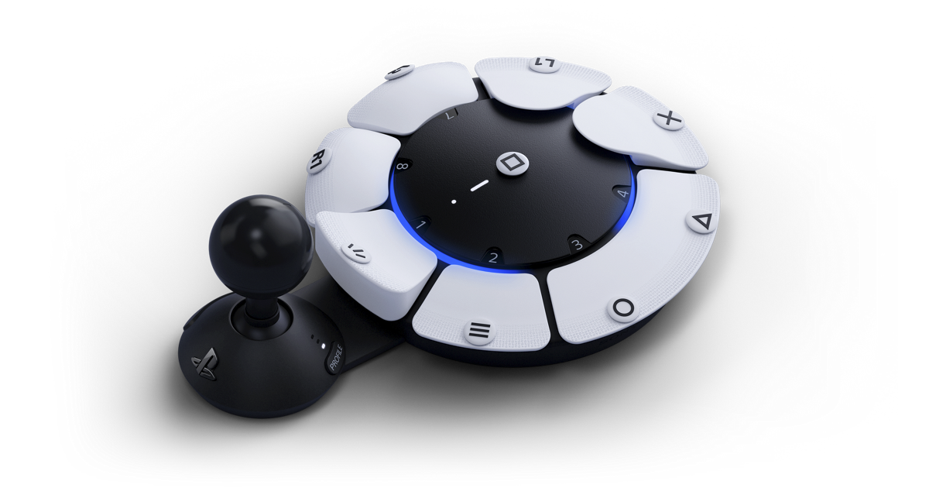
Recent Development: Accessible Controllers

