Slide 1
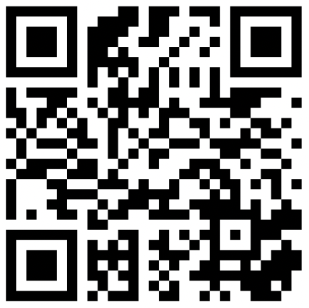
CSE 121 – Lesson 10
Elba Garza & Matt Wang
Winter 2024
TAs:
Abby | Aishah | Anju | Annie | Archit | Ayesha | Christian
Hannah | Heather | Hibbah | Jacob | James | Janvi | Jasmine
Jonus | Julia | Lucas | Luke | Maria | Nicole | Shananda
Shayna | Trey | Vidhi | Vivian
sli.do #cse121-10
Today’s playlist: CSE 121 24wi lecture beats :D

Slide 2
Announcements, Reminders
Creative Project 2 (C2) deadline extended! Due tomorrow, Feb 8th
Note: uses Javadoc!
Resubmission Cycle 2 (R2) form due tomorrow, Feb 8th!
Eligible Assignments: C0, P0, C1, P1
Resubmission Cycle 3 (R3) form releasing tomorrow, Feb 8th
Eligible assignments: P0, C1, P1, C2
Programming Assignment 2 (P2) releasing on Friday (due Feb 20th by 11:59 PM)

Slide 3
(Recall) Conditionals 1
Hey! Want some vanilla ice cream? 🍦
Executes a block of statements if and only if the test is true.

Slide 4
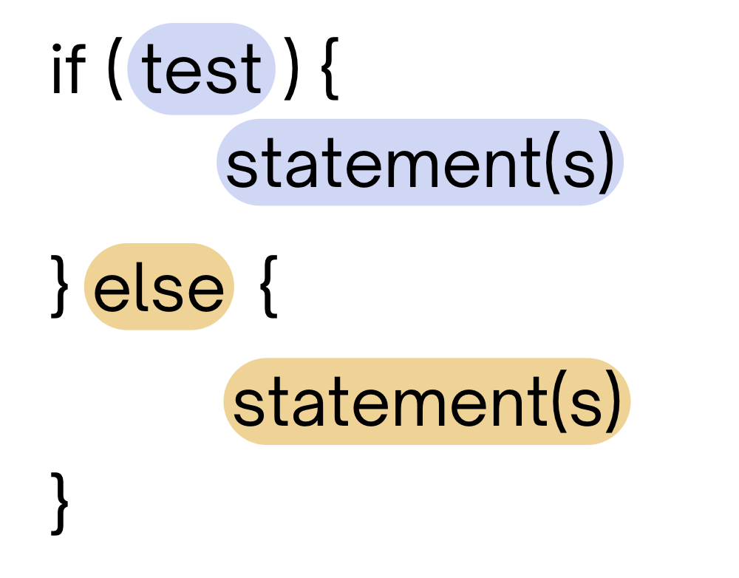
(Recall) Conditionals 2
Hey! Want some vanilla ice cream? 🍦 No? FINE, here’s some chocolate ice cream instead. 🍫
If the test is true: execute block of statements
If not, execute other block of statements

Slide 5
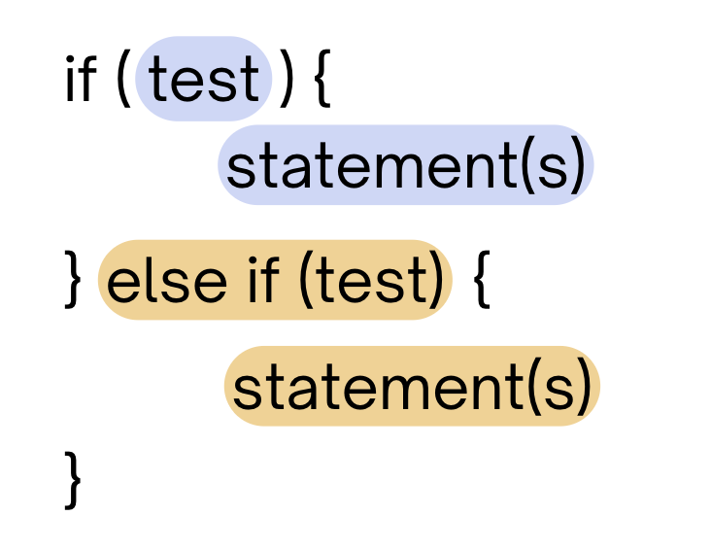
(Recall) Conditionals 3
Hey! Want some vanilla ice cream? 🍦 No? Okay, well… do you want some chocolate ice cream instead? 🍫
If the first test is true, execute that block
If not, proceed to the next test, and repeat
If none were true, don’t execute any blocks

Slide 6
(Recall) Conditionals 4
Hey! Want some vanilla ice cream? 🍦 No? Okay, want some other ice cream instead? Or another? Or another? Or another? Or another? Or another? Or another? Or another?
With a very large if-else-if-else chain,
if there is an ending else, exactly one block will execute
if there is no ending else, zero or one blocks will execute

Slide 7
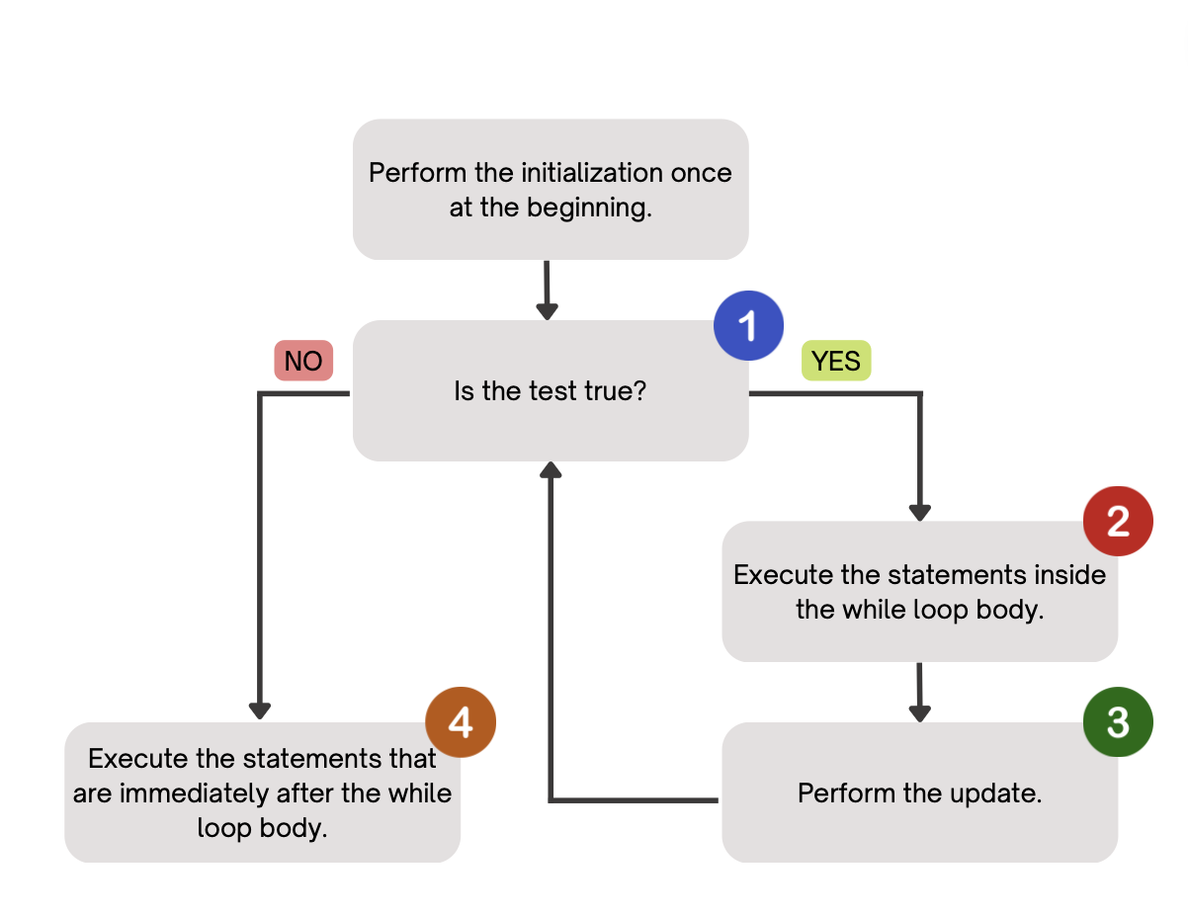
(PCM) While Loops
Repeatedly executes its body as long as the logical test is true.

Slide 8
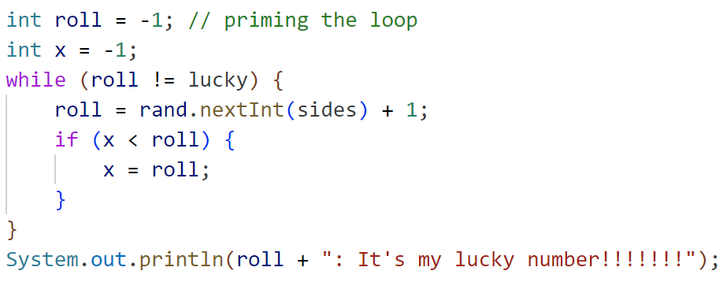
How would you describe what the variable x calculates?
The largest value rolled
The smallest value rolled
The last value rolled
The first value rolled
The sum of all values rolled
Error
-1

