Slide 1
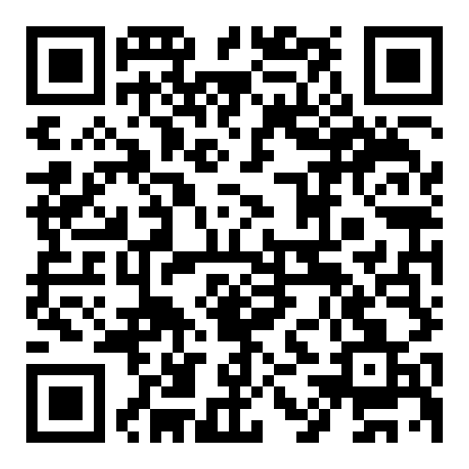
Welcome to CSE 121!
Elba Garza & Matt Wang
Winter 2024
TAs:
Abby | Aishah | Anju | Annie | Archit | Ayesha | Christian
Hannah | Heather | Hibbah | Jacob | James | Janvi | Jasmine
Jonus | Julia | Lucas | Luke | Maria | Nicole | Shananda
Shayna | Trey | Vidhi | Vivian
sli.do #cse121-0
Today’s song: Daft Punk’s Da Funk

Slide 2
Agenda (1/7)
About us
About this course
Learning objectives
Other similar courses
Course components
Our learning model
Tools and resources
Course Website
Ed
Assessment and grading
Collaboration

Slide 3
Agenda (2/7)
About us
About this course
Learning objectives
Other similar courses
Course components
Our learning model
Tools and resources
Course Website
Ed
Assessment and grading
Collaboration

Slide 4
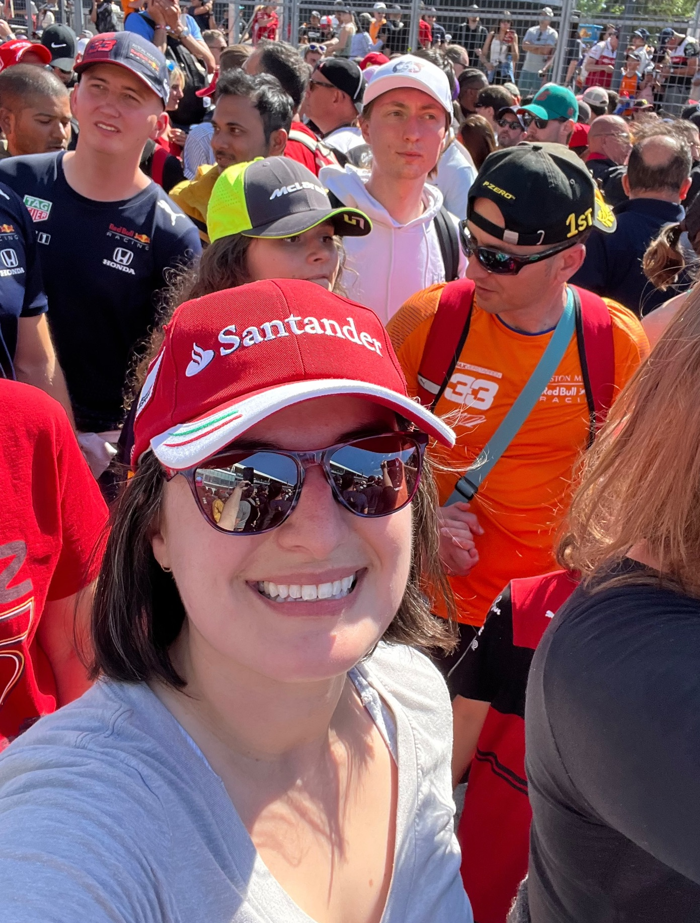
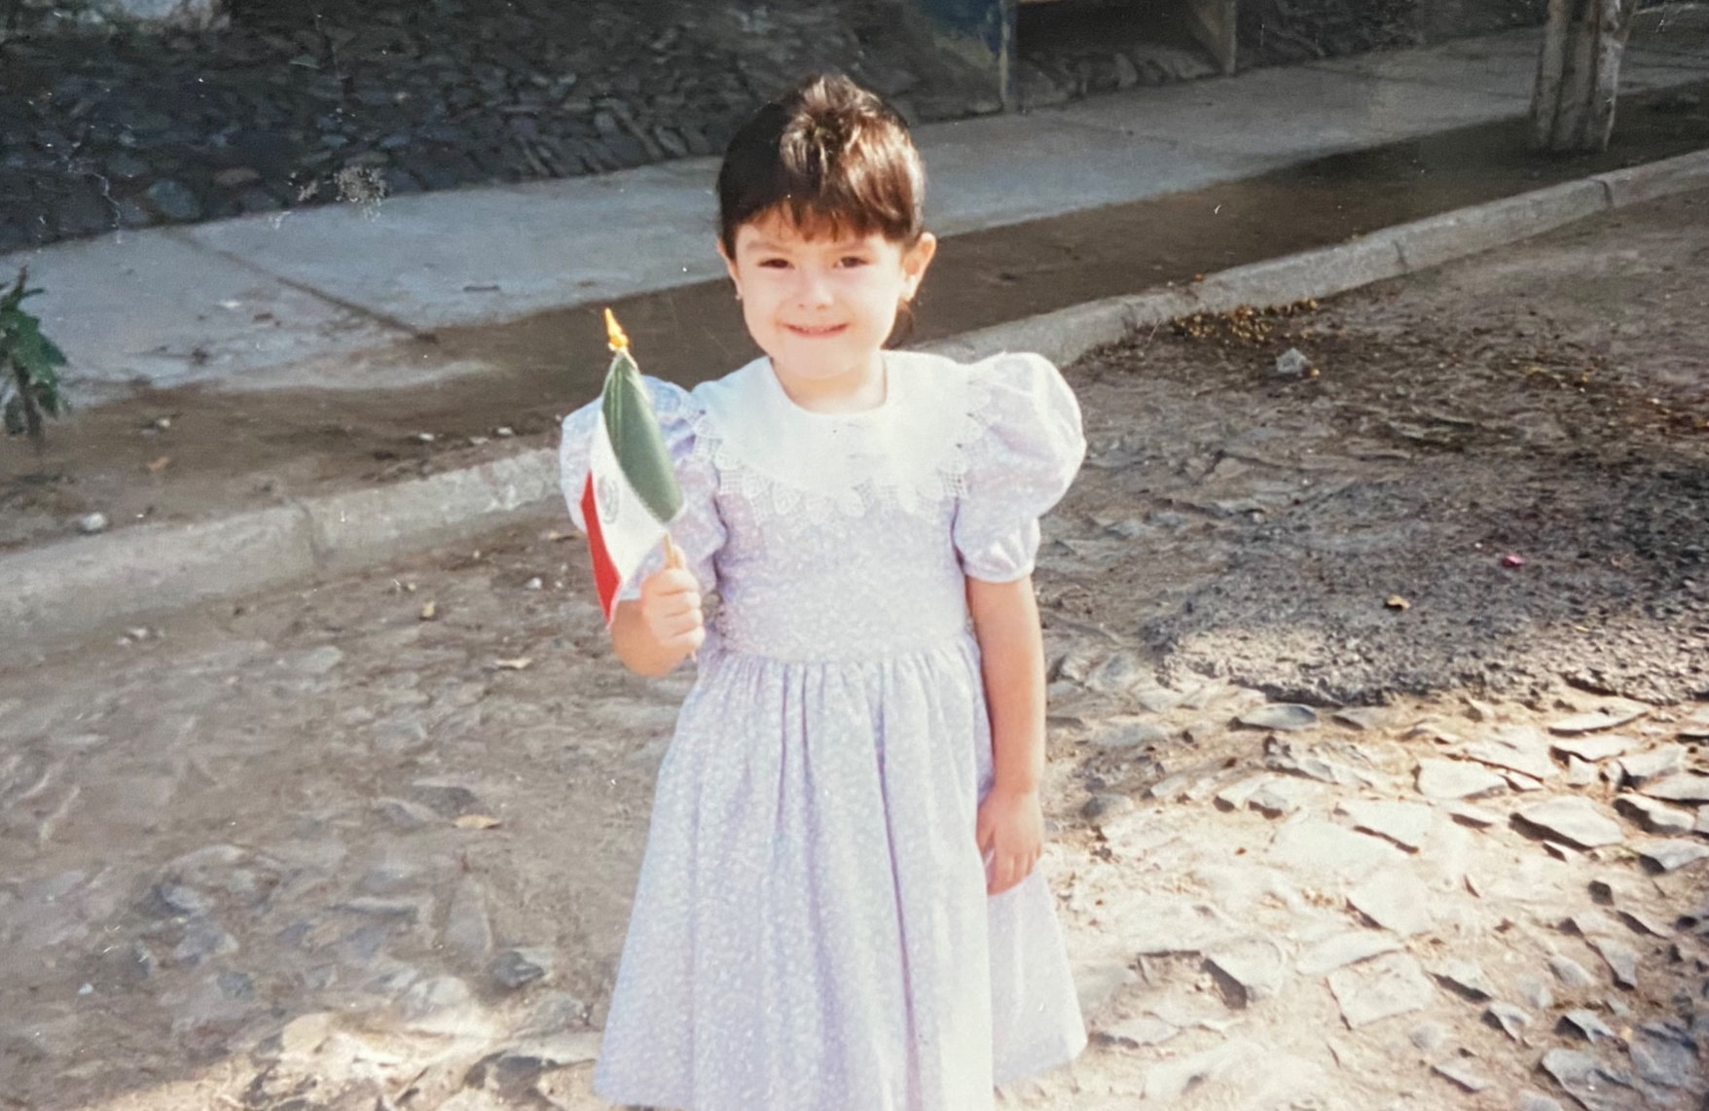
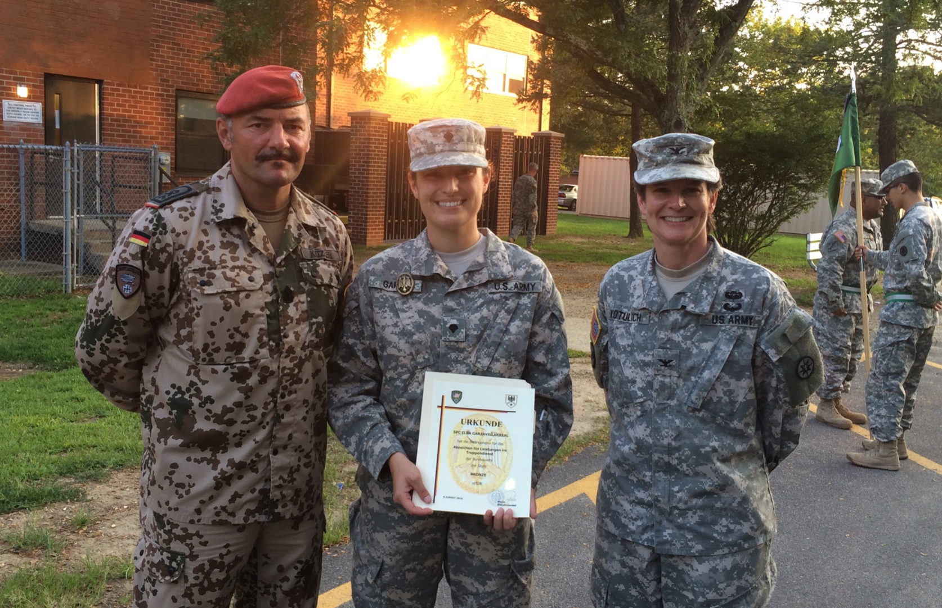
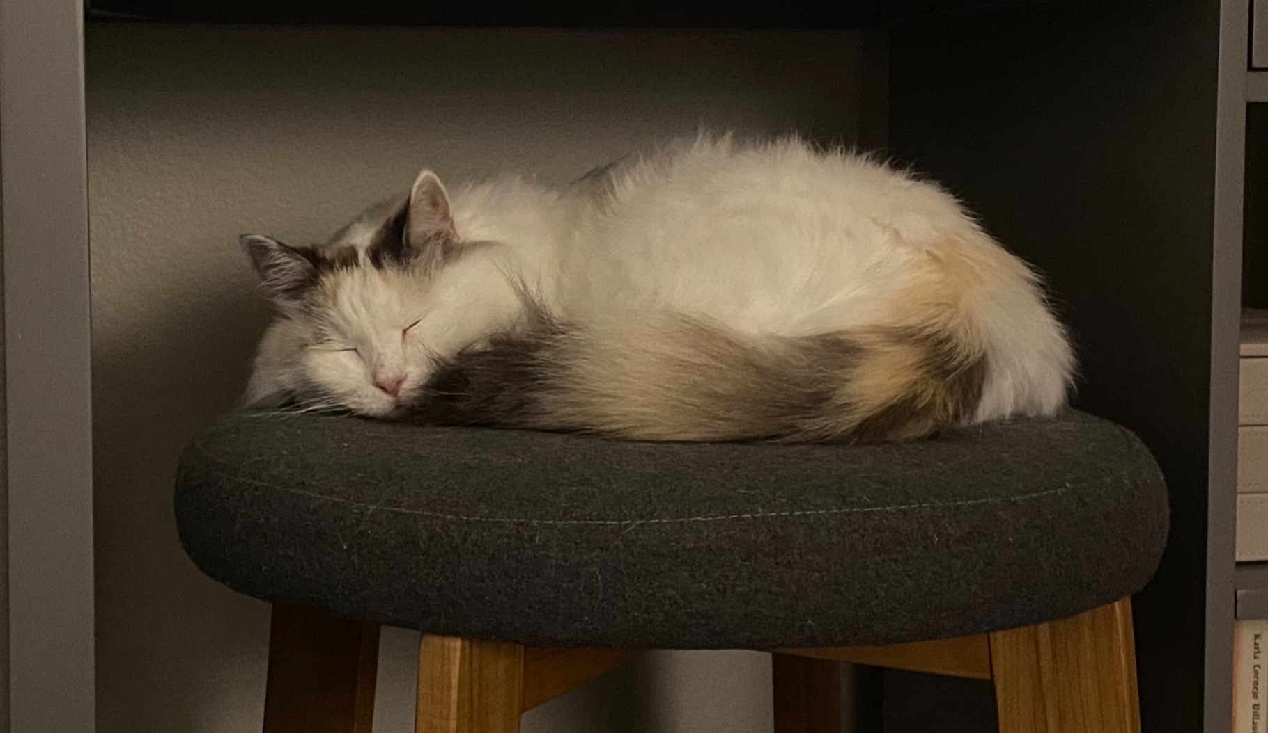
Hi, I’m Elba! (she/her)
Assistant Teaching Professor in the Allen School
Originally from Guadalajara, Mexico and raised in San Antonio, Texas
Education:
BS Columbia University
MSc Princeton University
PhD Texas A&M University
Area of Specialization: Computer Architecture
Out of school: Metal detecting, F1, coin collecting, movies

Slide 5
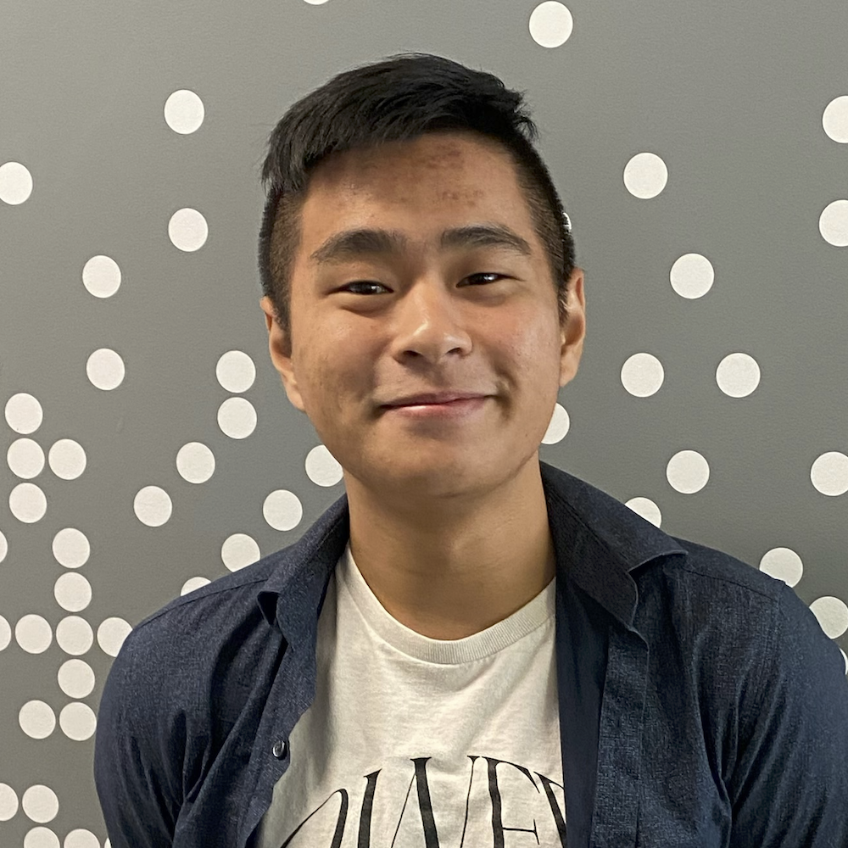
and I’m Matt! (he/him)
(new) Assistant Teaching Professor in the Allen School
grew up mostly in Toronto and sometimes Tokyo!
went to UCLA!
BS & MS in Computer Science
BS in Math-Economics
computer science interests: CS education, “open-source”, programming languages, accessibility
non-CS interests: reading, music (Laufey was my #1 this wrapped), video games, skiing & ice skating!

Slide 6
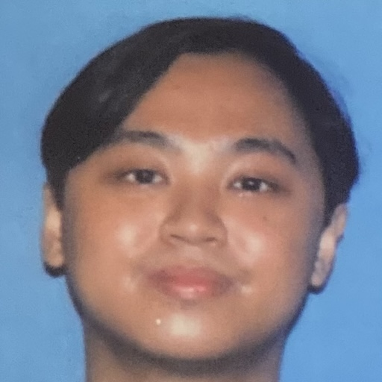
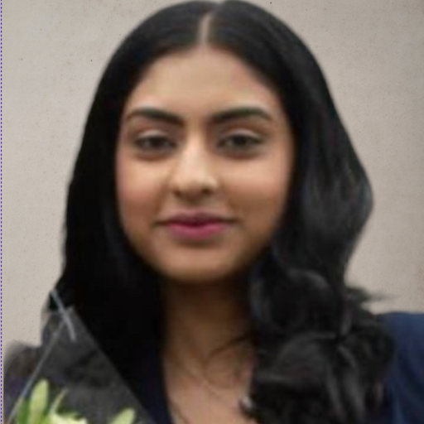
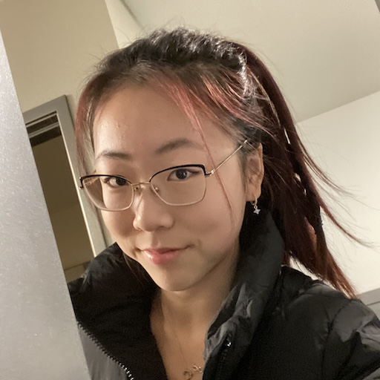
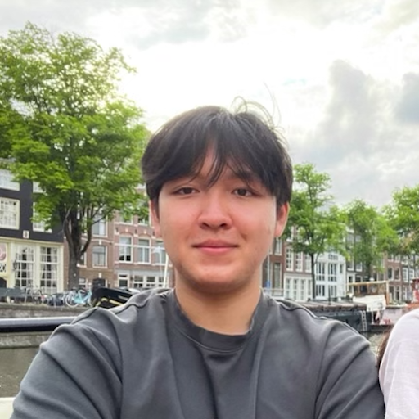
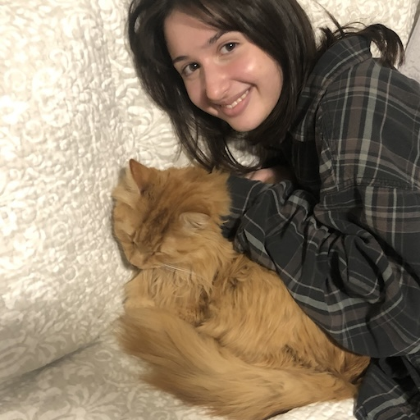
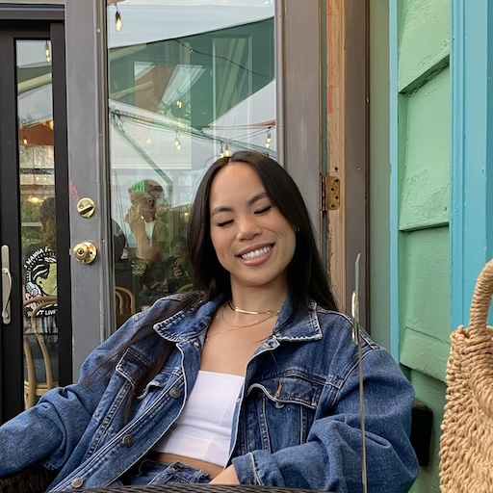
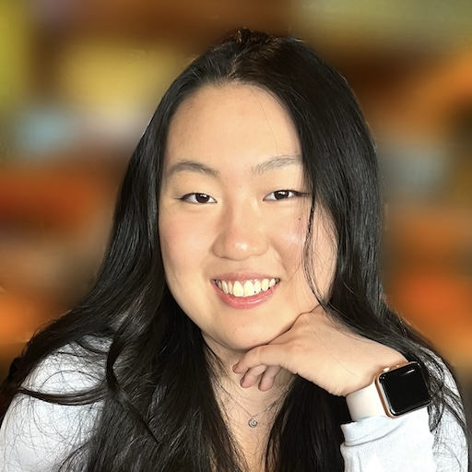
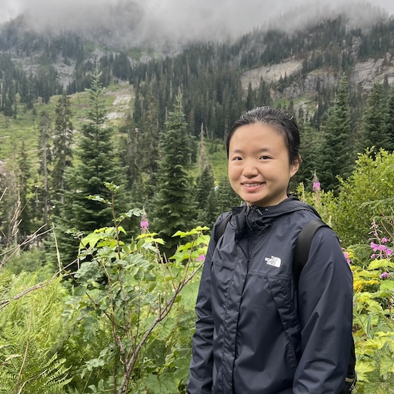
Meet your 25 TAs!

Slide 7
Agenda (3/7)
About us
About this course
Learning objectives
Other similar courses
Course components
Our learning model
Tools and resources
Course Website
Ed
Assessment and grading
Collaboration

Slide 8
Learning Objectives
or, “What will I learn in this class?”
Computational Thinking
Code Comprehension
Code Writing
Communication
Testing
Debugging
Ethics & Societal Impact
Notes:
matt

Slide 9
Other Similar Courses
Course | Good choice if…
CSE 121 | You’ve never programmed before AND You are, or want to be, in a major such as CS, CE, ECE, Info, etc. that requires Java programming
CSE 122 | You’ve done some programming (roughly one course worth) in any programming language AND You are, or want to be, in a major such as CS, CE, ECE, Info, etc. that requires Java programming
CSE 123 | You’ve taken CSE 122 AND You are, or want to be, in a major such as CS, CE, ECE, Info, etc. that requires Java programming
CSE 160 | You’ve never programmed before AND You’re interested in data science and analysis OR You’d rather learn Python than Java* OR You are, or want to be, in a major such as Physics, Bio, Stat, etc. where analyzing data through programming is useful
Other courses of interest: CSE 154, CSE 163
See Guided Self-Placement and Introductory Courses for more info
Notes:
matt

Slide 10
Course Components
Meetings
LECTURES
(x20)
SECTIONS
(x16)
We’re here!
Introduce concepts, practice ideas, discuss applications.
Pre-class materials to prepare for class each day. Due before class.
Held in person
More practice, review, applications
TA advice, how to be an effective student
Preparation for quizzes / exams
Assessments
PROGRAMMING ASSIGNMENTS
(x4)
CREATIVE PROJECTS
(x4)
QUIZZES
(x3)
EXAM
(x1)
Structured assignments
Programming in Java
Applying & implementing course concepts
More open-ended
assignments
Explore new ideas and applications
Taken in quiz section
45 minutes on computer
Culminating exam
Tue March 12th, 12:30-2:20 PM
Notes:
matt

Slide 11
Agenda (4/7)
About us
About this course
Learning objectives
Other similar courses
Course components
Our learning model
Tools and resources
Course Website
Ed
Assessment and grading
Collaboration
10

Slide 13
How Learning Works
Learning requires active participation in the process. It’s not as simple as sitting and listening to someone talk at you!
Requires deliberate practice in learning by doing
Benefits from collaborative learning
Does not work well if you cram everything!
Notes:
matt

Slide 14
Pre-Class Materials (1/3)
Core element of course: pre-class material
prepare for each lecture with readings & practice problems
should take ~30 minutes per lecture (why we don’t have Monday lectures!)
class will start with a brief recap, then pick off where we left off
Notes:
matt

Slide 15
Pre-Class Materials (2/3)
Core element of course: pre-class material
prepare for each lecture with readings & practice problems
should take ~30 minutes per lecture (why we don’t have Monday lectures!)
class will start with a brief recap, then pick off where we left off
Which means…
we can spend lecture diving deeper, answering questions, and think-pair-share
you can ask about pre-lecture material in class or quiz section!
Notes:
matt

Slide 16
Pre-Class Materials (3/3)
Core element of course: pre-class material
prepare for each lecture with readings & practice problems
should take ~30 minutes per lecture (why we don’t have Monday lectures!)
class will start with a brief recap, then pick off where we left off
Which means…
we can spend lecture diving deeper, answering questions, and think-pair-share
you can ask about pre-lecture material in class or quiz section!
Pre-class materials are ungraded, which means…
it’s okay if you find them challenging – that means you’re learning!
but, you should do them, and we will assume you’ve done them
Notes:
matt

Slide 17
Consistent and Active Participation (1/2)
Attendance is not graded. But, it’s strongly encouraged!
lectures & sections are not going to be just us talking at you!
ex: live in-class coding, debugging, think-pair-share, and problem-solving
spreading out ~ 1-2 hours each day over Tuesday – Friday is much more effective than cramming before the assignment is due!
Notes:
matt

Slide 18
Consistent and Active Participation (2/2)
Attendance is not graded. But, it’s strongly encouraged!
lectures & sections are not going to be just us talking at you!
ex: live in-class coding, debugging, think-pair-share, and problem-solving
spreading out ~ 1-2 hours each day over Tuesday – Friday is much more effective than cramming before the assignment is due!
Catching up:
all lectures (A & B sections) are recorded on Panopto; slides are on our website.
section materials are on Ed, but section will not be recorded.
Notes:
matt

Slide 19
Metacognition
Metacognition: asking questions about your solution process.
Examples:
While debugging: explain to yourself why you’re trying this change.
Before running your program: make an explicit prediction of what you expect.
When working: be aware when you’re not making progress, so you can take a break or try a different strategy.
When designing:
Explain the tradeoffs with using a different data structure or algorithm.
If one or more requirements change, how would the solution change as a result?
Reflect on how you ruled out alternative ideas along the way to a solution.
When studying: what is the relationship of this topic to other ideas in the course?
Notes:
matt

Slide 20
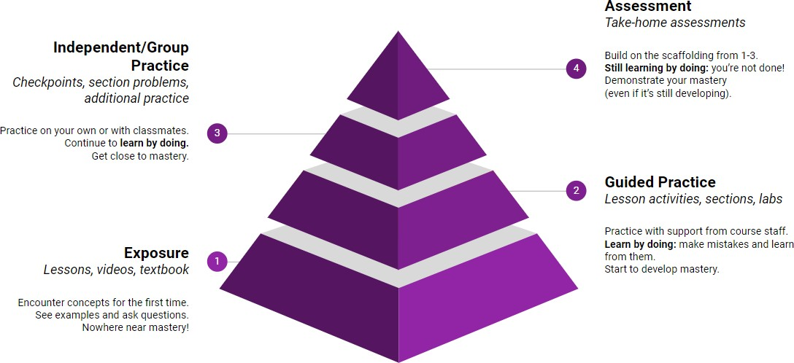
Learning in CSE 121 (or anywhere)
Notes:
matt

Slide 21
Course Culture and Support
Currently 444 students enrolled!
Almost none are CSE majors!
Wide range of backgrounds, interests, and goals
Everyone is new to programming
Support and help each other!
Form study groups
If you have a question, others almost certainly do too
Notes:
elba

Slide 22
Course Culture and Support: Getting Help
Discussion Board
Feel free to make a public or private post on Ed
We encourage you to answer other peoples’ questions! A great way to learn
Introductory Programming Lab (Office Hours)
TAs can help you face to face in office hours, and look at your code
You can go to the IPL with any course questions, not just assignments
Section
Work through related problems, get to know your TA who is here to support you
Notes:
elba

Slide 23
Course Culture and Support: Email
Email
We prefer that all content and logistic questions go on the Ed discussion board (even if you
make them private). 444 of you >>> 27 of us!
For serious personal circumstances, you can email Elba & Matt directly at cse121-instructors@cs.washington.edu. It never hurts to email us, but if it’s a common logistic question, we may politely ask you to post on the discussion board.
Notes:
elba

Slide 24
Course Culture and Support: Reaching Out
Policies designed with flexibility in mind
Resubmissions, lecture recordings, asynchronous discussion board
But, life and the world still happen around us…
Please reach out ASAP if you’re struggling or have circumstances that require extra support
Notes:
elba

Slide 25
The World Around CSE 121
Our goal is to give you a great CSE 121 experience
But CSE 121 does not exist in a vacuum – there’s a lot going on in the world
right now that can impact your education
We’ve designed course policies for maximum flexibility: ability to
resubmit assignments and “drop” some quiz/final problems
But we cannot cover every individual situation
Please reach out if you need accommodations of any kind to deal with these unfamiliar situations
Notes:
elba

Slide 26
Agenda (5/7)
About us
About this course
Learning objectives
Other similar courses
Course components
Our learning model
Tools and resources
Course Website
Ed
Assessment and grading
Collaboration

Slide 27
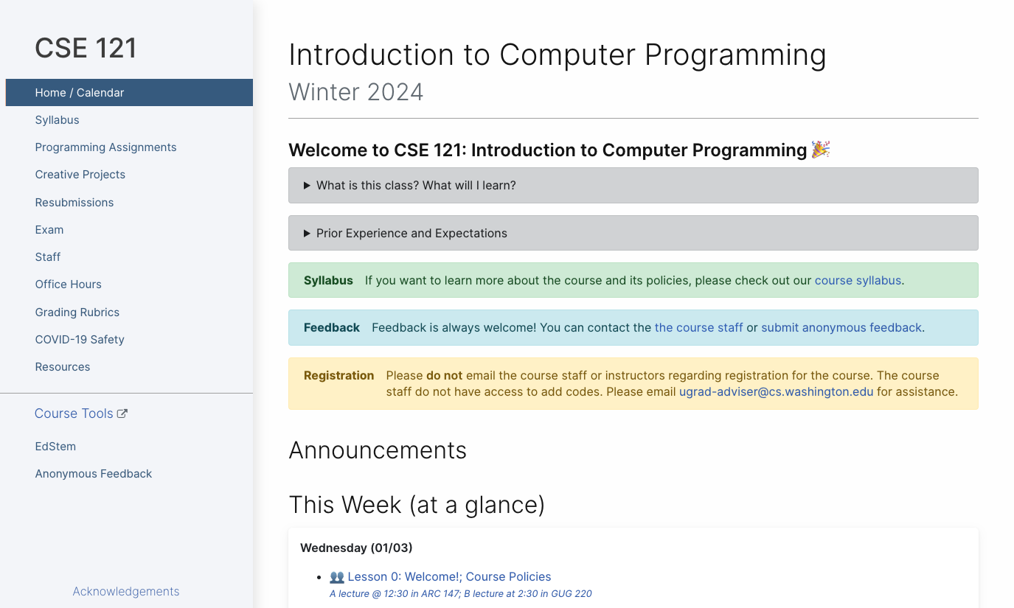
Course Website
cs.uw.edu/121
Primary source of course information (not Canvas)
Calendar will contain links to (almost) all resources
Notes:
matt

Slide 28
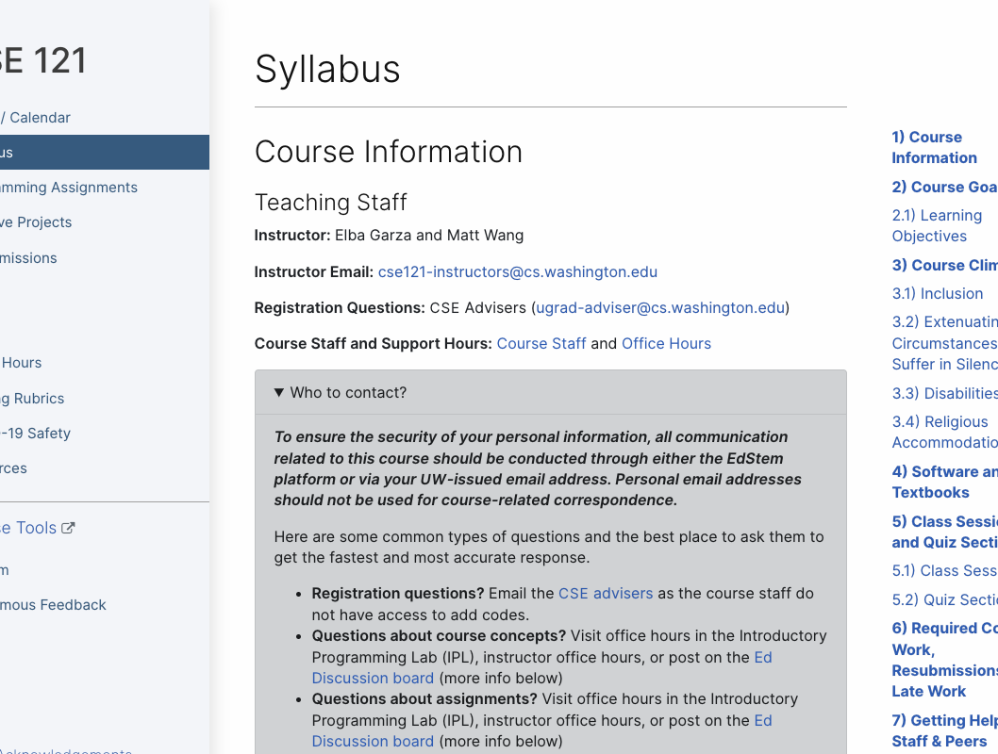
Syllabus (website)
Please review the syllabus ASAP.
Notes:
matt

Slide 29
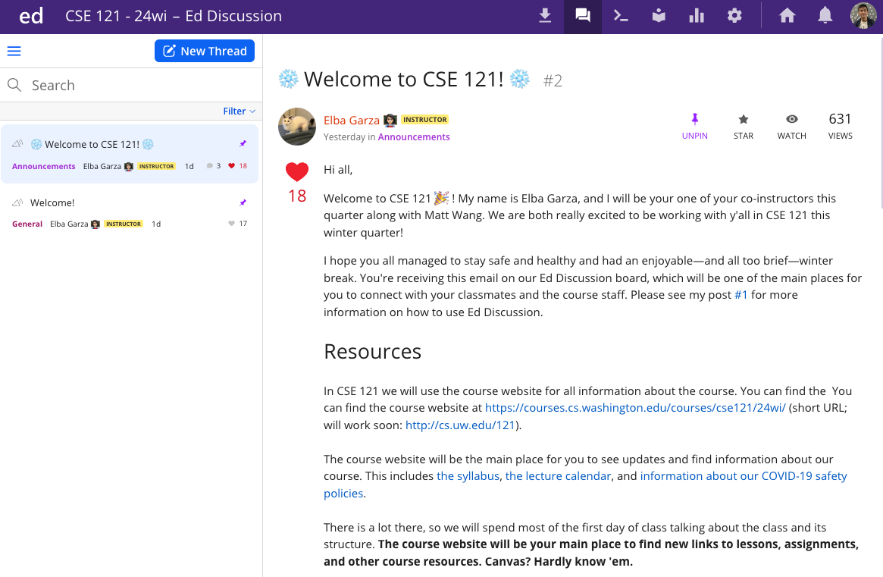
Ed
Our online learning platform
Lessons, sections, quizzes all here
Intro and walkthrough in Section 0
22
Notes:
matt

Slide 30
Other Course Tools
Canvas
My Digital Hand
Queueing in office hours
Lecture recordings
Visual Studio Code
Sli.do
Not strictly necessary!
Develop offline
Debugger Tool
In-class activities (ungraded)
No account needed
Notes:
matt

Slide 31
Agenda (6/7)
About us
About this course
Learning objectives
Other similar courses
Course components
Our learning model
Tools and resources
Course Website
Ed
Assessment and grading
Collaboration

Slide 32
Assessment and Grading
Our goal in the course is for you to gain proficiency of the concepts and skills we teach
We assess your proficiency by asking you to apply the concepts and skills on tasks or problems
By necessity, we are assessing your work as a proxy for your proficiency
25
Notes:
elba

Slide 33
Resubmission
Learning takes time, and doesn’t always happen on the first try!
Each week, one previous Programming Assignment or Creative Project can be resubmitted
Must be accompanied by write up explaining changes.
Grade on resubmission replaces original grade.
An assignment is only eligible for resubmission within the 3 resubmission cycles following its grades being released.
Your lowest 2 quiz problem grades will be dropped from your gradebook (not considered when calculating course grades)
See syllabus for more details
26
Notes:
elba

Slide 34
Grading
Grades should reflect your proficiency in the course objectives
All assignments will be graded
E (Excellent),
S (Satisfactory),
or N (Not yet)
Under certain circumstances, a grade of U (Unassessable) may be assigned
Final grades will be assigned based on the amount of work at each level
See the syllabus for more details
27
Notes:
elba

Slide 35
Agenda (7/7)
About us
About this course
Learning objectives
Other similar courses
Course components
Our learning model
Tools and resources
Course Website
Ed
Assessment and grading
Collaboration
Notes:
elba

Slide 36
Collaboration Policy
Learning is hard, but it’s easier when you learn from each other
You are encouraged to form study groups, work together on practice and review, and discuss your ideas and approaches at a high level
In general, share ideas and work together, but don’t copy work. Never send someone else
your code or solution write up.
If you discuss your ideas with others, you must cite them
All work you submit for grading must be predominantly and substantially your own
There is a dedicated page explaining the policy around use of generative AI tools
Withdrawal policy
See the syllabus for more details
Notes:
elba

Slide 37
Help Us Improve!
CSE 121 is super new!
We worked hard to build a course we think will be effective and supportive and help you succeed
We probably didn’t get it all right!
We appreciate your patience and understanding if we need to make adjustments during the quarter
Please give us lots of feedback!
Post on Ed and/or use the Anonymous Feedback Tool
Notes:
elba

Slide 38
“Homework” for Next Time
First assignment will be released Friday, but there are some things to do in the meantime.
TODOs this week:
Fill out the introductory survey
Go meet your TA and classmates in Thursday’s quiz section
⭐Complete the pre-class material for Friday (see calendar)
Check over syllabus details
Notes:
elba

