Slide 1
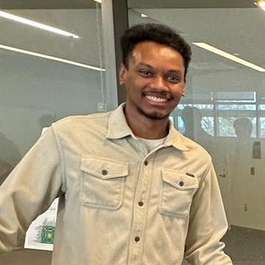
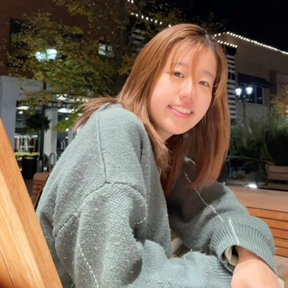
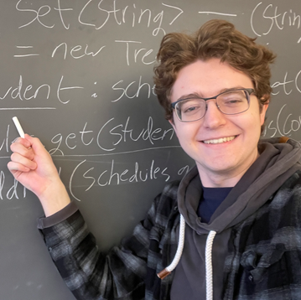
CSE 121 Lesson 9: While Loops
Simon Wu
Summer 2024
TAs:
Trey | Hannah | Mia | Vivian | Jolie | Colton | Ziao
sli.do #cse121

Slide 2
Announcements
P1 Deadline extended to next Tuesday, 7/23 at 11:59 pm
Resubmission Cycle 2 (R2) due tomorrow (7/20) at 11:59 pm
Eligible: C0, P0, C1
R3 opens tomorrow, due next Thursday (7/25); eligible: P0, C1, P1
Programming Assignment 2 releases next Wednesday (7/24), due the following Tuesday after (7/30) at 11:59 pm
Quiz 1 next week in section(7/25); topics include up to conditionals
more practice materials & resources coming soon!
Quiz 0 feedback to be released later tonight

Slide 3
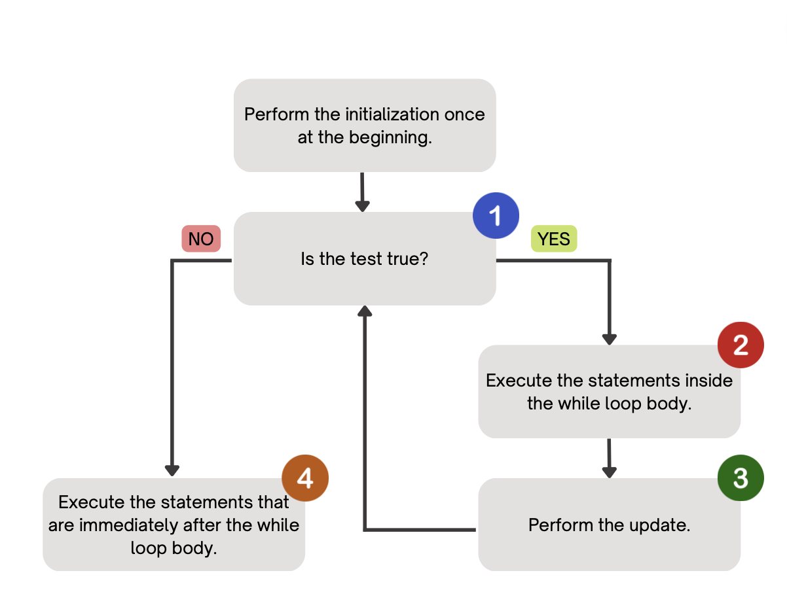
(PCM) While Loops
Repeatedly executes its body as long as the logical test is true.

Slide 4
for loops vs. while loops ⚔️
For loops and while loops are quite similar! This is the first (but certainly not the last) time where you need to decide which to use!
There’s not always a “correct” answer, but some advice:
thinking of definite versus indefinite conditions
phrasing the problem out loud!
“I will do __ X times” or “for each __ I will __” : sounds like a for!
“I will do __ until __” or “while __ is true, do” : sounds like a while!

Slide 5
for loops are while loops!!! (1/2)
for (int i = 0; i < bigYikes; i++) {
// ...
}
int i = 0;
while (i < bigYikes) {
// ...
i++;
}

Slide 6
for loops are while loops!!! (2/2)
for (int i = 0; i < bigYikes; i++) {
// ...
}
int i = 0;
while (i < bigYikes) {
// ...
i++;
}
*as a technical note, these aren’t exactly the same – there are some minor technical details that are different, most notably the scope of i

Slide 7
What will be the output of this program?
num is less than 5! num is less than 5! num is less than 5! num is less than 5! num is less than 5!
(no output)
Compiler Error
Infinite Loop
int num = 0;
while (num < 5) {
System.out.println("num is less than 5!");
}

Slide 8
How would you describe what the variable x calculates?
The largest value rolled
The smallest value rolled
The last value rolled
The first value rolled
The sum of all values rolled
Error
-1
int roll = -1; // "priming" the loop
int x = -1;
while (roll != lucky) {
roll = randy.nextInt(sides) + 1;
if (x < roll) {
x = roll;
}
}
System.out.println(roll + ": my lucky number!");

Slide 9
Culminating Final Reflection
Short (1-2 page) paper on a computing topic of your choice
Create and discuss your own reflection question
Must address at least two of the course’s reflection learning objectives
Full rubric will be released ahead of time
Full spec will be released early next week, due on the last Friday of the quarter (8/16) to Gradescope by 11:59 pm
absolutely no late days allowed
if submitted by 8/5, we will give you feedback by 8/12 and let you to resub
Counted as a single “Exam Grade,” eligible for the lowest drop

Slide 10
Reflection Recap
C0: Hello Bugs
Intro to reflection: why is it important to think critically about technology?
P0: Cornbear Café
The history of English-centric programming languages
Which communities are invited to participate in programming?
C1: Turtle Drawings
Accessibility issues in coding
P1: Election Simulator
The use and impact of technology on non-technical industries and systems
Should technology be used in every situation?

Slide 11
Reflection Learning Objectives
Describe the ethical and social impacts of technology and explain how our choices as programmers can influence these impacts
Challenge dominant assumptions, values, and goals reflected in computing and technology
Analyze the strengths and limitations of using computing and technology to solve various problems
Identify interdisciplinary applications of computing that can be deployed in service of different communities
Understand disparities in access to computing, and explain the consequences of such disparities in technologies we build

Slide 12
We loved your C1 reflections!
I read (skimmed?) all 62 of your responses! Some themes:
generally, learning about how blind people program
“one minor addition and effort into making a program accessible can greatly impact the daily experience of those who need it”
debugging is already hard – debugging without accessible error messages sounds even harder!

Slide 13
… with great points on “accessiblePrinting”
Printing out what the Turtle does is better than nothing.
But, y’all said:
it is a ton of information – especially for complicated drawings
the information provided might not be the “right” type (not precise, not high-level enough, not aware of shapes)
does not describe what the drawing actually is

Slide 14
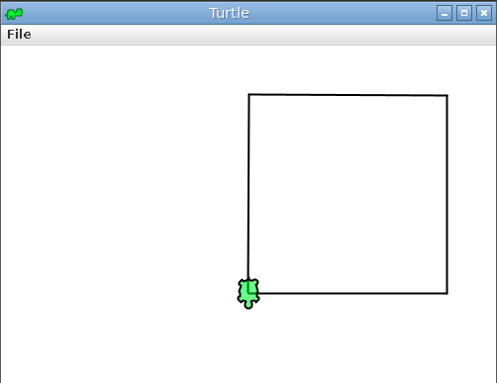
Describing images…
Which of these best describes this image?
A black square drawn by a Turtle
An image with a green cartoon turtle overlapping with a square
A screenshot of the Turtle library; the toolbar says “Turtle” and has a minimize, full-screen, and close buttons. The main canvas has a 200 by 200 square, drawn by a Turtle.
Instruction: MOVE FORWARD 200.0 Current Pos: (200.000, 0.000) …

Slide 15
Describing images requires context
“A black square drawn by a Turtle”
brief overview for someone who knows Turtle, doesn’t care about the art
“An image with a green cartoon turtle overlapping with a square”
short description focused on the core image – no Java-Turtle context assumed
“A screenshot of the Turtle library; the toolbar says “Turtle” and has a minimize, full-screen, and close buttons. The main canvas has a 200 by 200 square, drawn by a Turtle.”
longer caption, perhaps useful in a user design textbook or case study
And, many other reasonable alternative texts & captions!

Slide 16
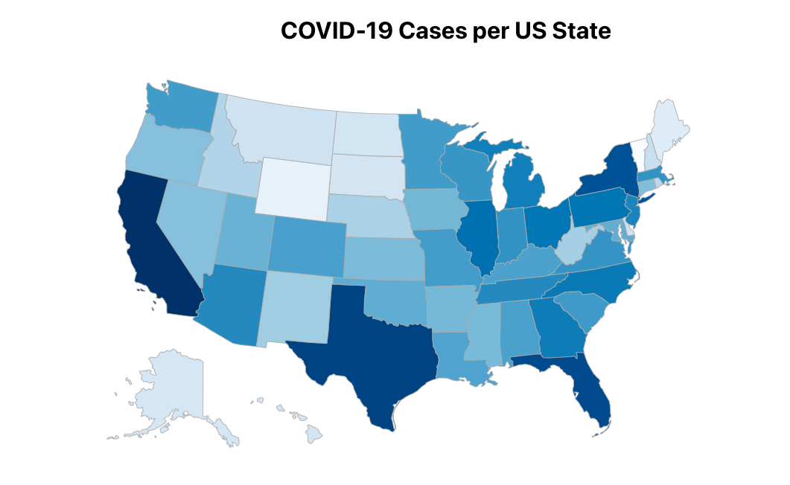
Active research – at UW!
Describing visualizations can be even harder!
How would you describe the visualization shown on the right?
could read out the data as a table – 50 rows!!
could summarize key points – loses data!
from UW CSE + iSchool: let users decide – and ask questions about data (min, max, average)
Paper: VoxLens: Making Online Data Visualizations Accessible with an Interactive JavaScript Plug-In., Ather Sharif, Olivia H. Wang, Alida T. Muongchan, Katharina Reinecke, and Jacob O. Wobbrock. CHI ‘22.

Slide 17
🍰 🍫 🍪 Food for Thought
Interested in accessibility? UW is an amazing place to be!
stellar professors in CSE – e.g. Jen Mankoff, who teaches CSE 493E: Accessibility
amazing folks across campus – e.g. Jacob Wobbrock (iSchool) from the paper!
people here do research, build tools, advocate for policy, and create community!
Many students mentioned that AI could be helpful. It’s … complicated.
“‘Without these tools, I’d be lost’: how generative AI aids in accessibility”
“No, ‘AI’ Will Not Fix Accessibility”

Slide 18
Challenge Question (1/3)
We could attempt to improve the Turtle accessibility feature in various ways, such as using Artificial Intelligence.
However, this will come with tradeoffs:
might make the Turtle library even slower to run
might require more resources on our computer
might require more software developer hours (expensive)!

Slide 19
Challenge Question (2/3)
“Design Decisions” are decisions that programmers make when writing their code. These decisions often take tradeoffs such as runtime, resource use (such as memory), and developer time into consideration.
Design decisions also determine what features and functionality are added to a program. For example, including the option for accessible printing was a design decision made by someone working on the Turtle library.

Slide 20
Challenge Question (3/3)
Programmers often consider the speed, memory use, and implementation efficiency when writing code.
What are other factors that programmers should consider when making design decisions?
(Hint: what would happen if programmers only prioritized writing fast and memory efficient programs? What features might be excluded from their programs?)

