Slide 1
CSE 121 Lesson 8: Conditionals
Simon Wu
Summer 2024
TAs:
Trey | Hannah | Mia | Vivian | Jolie | Colton | Ziao
sli.do #cse121

Slide 2
Announcements, Reminders
Programming Project 1 is due tomorrow (7/18) at 11:59 pm
R2 due this Friday at 11:59 pm
Note: this is the last time C0 is eligible for resubmission!
Your second quiz, Quiz 1, is next week in section
Topics: Math + Random (no Turtle), Methods (including returns and parameters), Conditionals
Quiz 0 grades will be released by this Friday night
We’ll talk more about quiz grading on Friday

Slide 3
Last Time… (1/2)
public static void main(String[] args) {
int x = 9;
int y = 2;
int z = 5;
mystery(z, y, x);
mystery(y, x, z);
}
public static void mystery(int x, int z, int y) {
System.out.println(z + " and " + (y - x));
}
Reminders:
When passing an argument as a parameter, the order that you pass the values (not name) matters
Parameters create a copy* of the value for local method use

Slide 4
Last Time… (2/2)
Scope: The part of a program where a variable exists (and can thus be referenced/modified/used).
From its declaration to the end of the { } braces
Ex: a variable declared in a method exists only in that method!
public static void example() {
System.out.println("hello");
int x = 3;
for (int i = 1; i <= 10; i++) {
System.out.print(x);
}
}
x's scope
i's scope

Slide 5
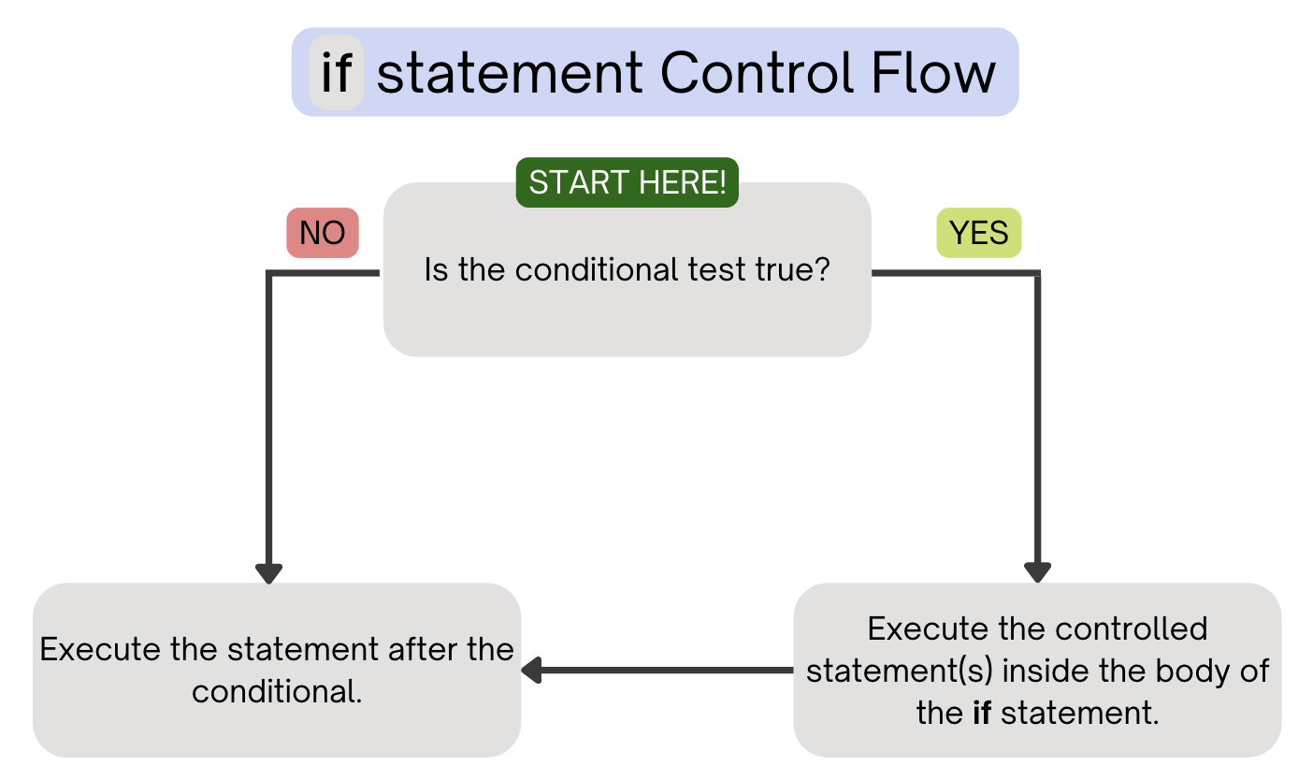
(PCM) Conditionals (1/4)
Executes a block of statements if and only if the test is true

Slide 6
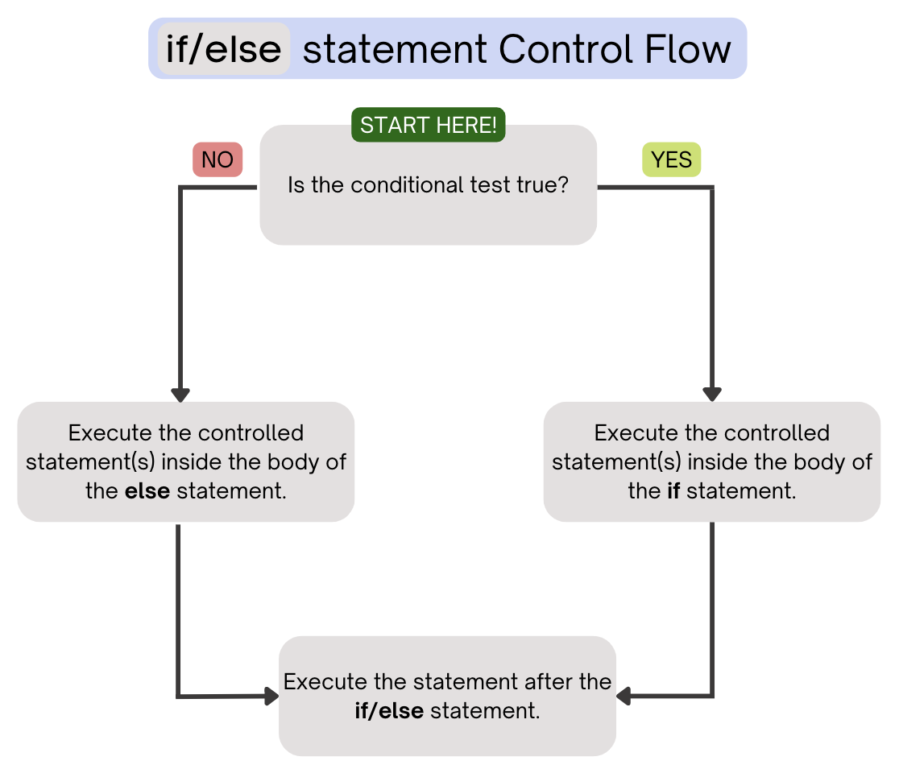
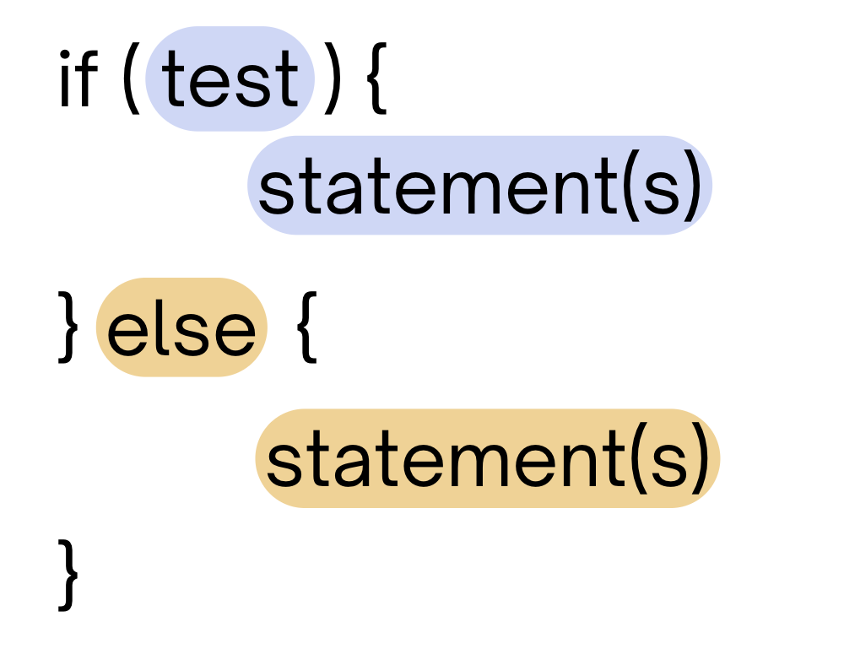
(PCM) Conditionals (2/4)
If the test is true: execute block of statements
If not, execute other block of statements

Slide 7
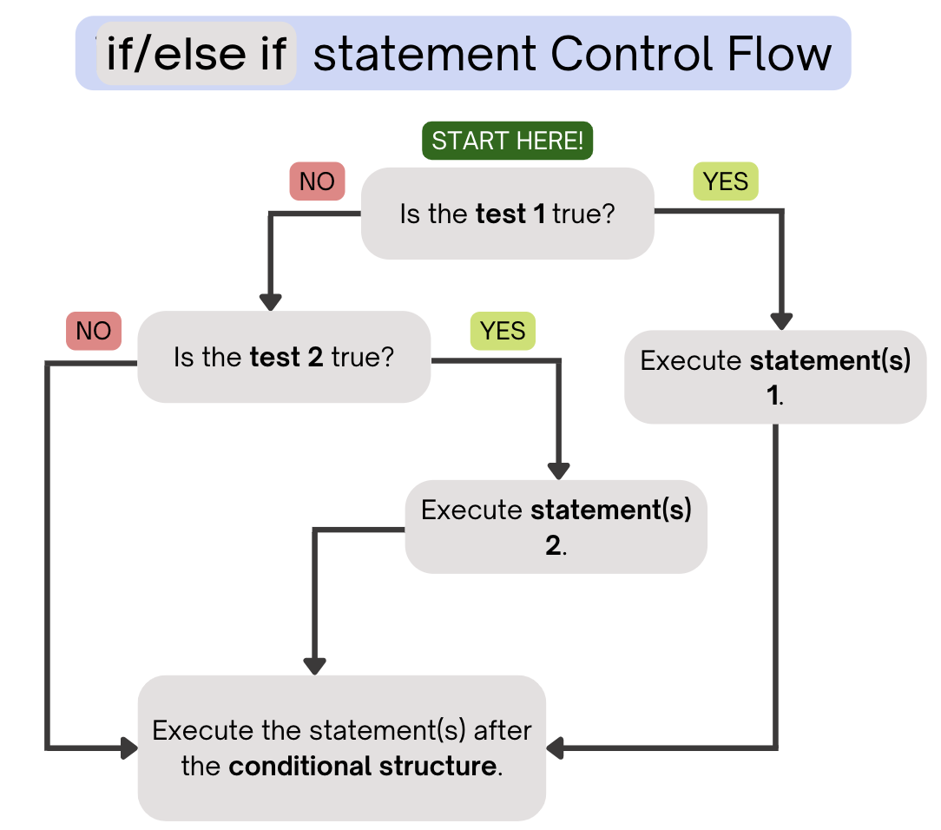
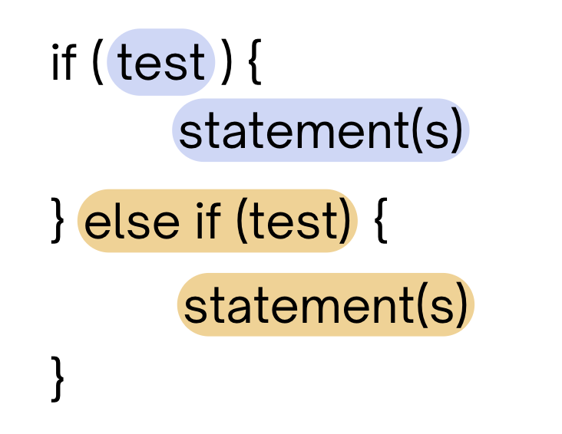
(PCM) Conditionals (3/4)
If the first test is true, execute that block
If not, proceed to the next test, and repeat
If none were true, don’t execute any blocks

Slide 8
(PCM) Conditionals (4/4)
With a large if-else-if-else chain,
if there is an ending else, exactly one block will execute
if there is no ending else, zero or one blocks will execute

Slide 9
Nested Conditionals
if (A) {
if (B) {
// do something
}
}
if (A && B) {
// do something
}

Slide 10
int a = 7;
int b = -1;
int c = 12;
if (a < b) {
a *= 2;
} else if (b < a) {
a /= 2;
} else {
a = c;
}
if (c % 2 == 0) {
c += 1;
}
if (b > 0) {
b *= -1;
} else if (a < 0) {
a *= -1;
}
System.out.print(a + " " + b + " " + c);
What is the output produced by executing this code?
A. 7 -1 12
B. -3 -1 13
C. 3 -1 13
D. 12 1 12
E. -14 1 13

Slide 11
public static void main(String[] args) {
for (int i = 1; i <= 3; i++) {
System.out.print(mystery(i));
}
}
public static String mystery(int n) {
if (n % 2 == 1) {
return "odd ";
} else if (n == 1) {
return "one ";
}
return "even ";
}
What does this program output?
A. odd even odd
B. one even odd
C. one even even
D. even even even

Slide 12
public static void main(String[] args) {
for (int i = 1; i <= 3; i++) {
System.out.print(mystery(i));
}
}
public static String mystery(int n) {
if (n % 2 == 1) {
return "odd ";
} else if (n == 1) {
return "one ";
}
return "even ";
}
This else if statement never runs!

Slide 13
public static void main(String[] args) {
int a = ?;
int b = ?;
if (a > 0 && b < 0) {
if (b < 0) {
System.out.println(“fizz”);
} else if (b >= 0) {
System.out.println(“boop”);
} else {
System.out.println(“pop”);
}
}
}
What value(s) of a and b can output:
“fizz”
“boop”
“pop”

