Slide 1
Java Library
A library is a bunch of code that other people have written, that we may use in our program!
We don’t need to understand how that code was written in order to use it.
Some libraries require imports at the top of our code.

Slide 2
Pseudo-Randomness
Computers generate numbers in a predictable way using mathematical formulas.
Input may include current time, mouse position, etc.
True randomness is hard to achieve – we rely on natural processes
  e.g., atmospheric noise, lava lamps

Slide 3
(PCM) Random
A Random object generates pseudo-random numbers.
  The Random class is found in the java.util package
  import java.util.*;
Method | Description
nextInt() | Returns a random integer
nextInt(max) | Returns a random integer in the range [0, max), or in other words, 0 to max-1 inclusive
nextDouble() | Returns a random real number in the range [0.0, 1.0)

Slide 4
(PCM) Math
Calling:
Math.<method>(…)
Method | Description
Math.abs(value) | Returns the absolute value of value
Math.ceil(value) | Returns value rounded up
Math.floor(value) | Returns value rounded down
Math.max(value1, value2) | Returns the larger of the two values
Math.min(value1, value2) | Returns the smaller of the two values
Math.round(value) | Returns value rounded to the nearest whole number
Math.sqrt(value) | Returns the square root of value
Math.pow(base, exp) | Returns base raised to the exp power

Slide 5
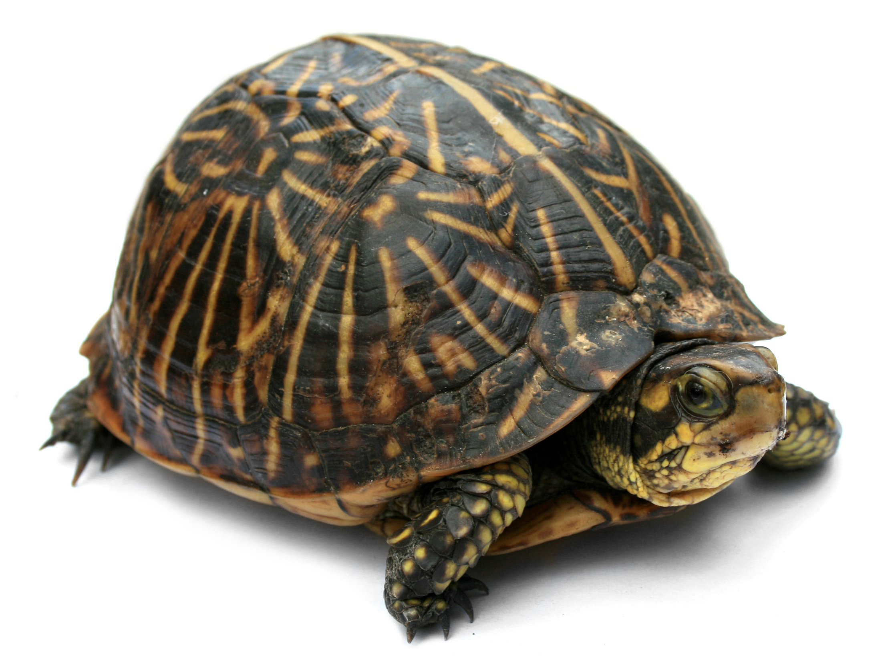
🐢 Turtle Time!
This Photo by Unknown Author is licensed under CC BY-SA

Slide 6
🐢 Turtles!
Turtle donatello = new Turtle();
Method | Description
forward(n) | Moves the turtle forward by n steps
backward(n) | Moves the turtle backward by n steps
right(d) | Turns the turtle right by d degrees
left(d) | Turns the turtle left by d degrees
speed(ms) | Sets the number of milliseconds it takes for the turtle to perform an action (e.g., if ms is 1000, then it will take the turtle 1000 ms = 1 second to perform an action like moving forward or turning).
up() | Picks up the turtle's pen so it doesn’t draw when it moves
down() | Puts the turtle's pen down so it draws when it moves
width(w) | Sets the width of the turtle's pen to w pixels wide
penColor(c) | Sets the color of the turtle's pen to c

