Slide 1
Welcome to CSE 121!
Simon Wu
Summer 2024
Use this QR code as one way to ask questions!
TAs:
Trey | Hannah | Mia | Vivian | Jolie | Colton | Ziao
sli.do #cse121

Slide 2
Reminders for this Week
July 4th tomorrow
No quiz section
R0 will be due on Friday @ 11:59 pm instead
Lecture this Friday will be recorded
Office hours updates
IPL will be closed on July 4th
Simon’s OH will be cancelled this week (email me for apt)
Reminder that we have virtual OH’s available!

Slide 3
Course Updates
We are cutting a Creative Assignment this quarter!
We will be releasing C1 this Friday
Course Calendar updated on Website
Syllabus has changed
Final will now be worth 6 ESN grades, but an additional lowest exam grade will be dropped
Please see the pinned Ed post for more details

Slide 4
Quiz Reminders
First quiz will be next Thursday, 4/11 in section
Email Simon or your TA ASAP if you can’t make it!
Must show up in-person
Quiz will be on paper, timed for 55 minutes
Next Tuesday’s quiz section will be quiz review!
Open (unlimited, printed) note
More info about our quiz on our course website!

Slide 5
Last time: for loops!
For loops are our first control structure
A syntactic structure that controls the execution of other statements.

Slide 6
Fencepost Pattern 1
Some task where one piece is repeated n times, and another piece is repeated n-1 times and they alternate
h-u-s-k-i-e-s

Slide 7
Fencepost Pattern 2
Some task where one piece is repeated n times, and another piece is repeated n-1 times and they alternate
h-u-s-k-i-e-s

Slide 8
(PCM) Nested for loops
for (int outerLoop = 1; outerLoop <= 5; outerLoop++) {
System.out.println("outer loop iteration #" + outerLoop);
for (int innerLoop = 1; innerLoop <= 3; innerLoop++) {
System.out.println(" inner loop iteration #" + innerLoop);
}
System.out.println(outerLoop);
}

Slide 9
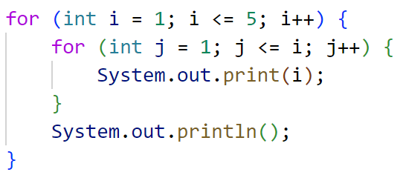
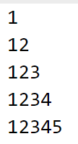
What output is produced by the following code?
sli.do #cse121
A. B. C.

Slide 10
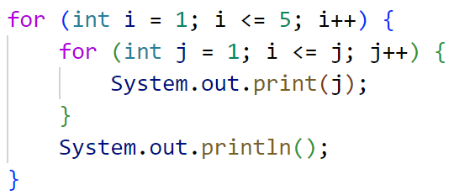
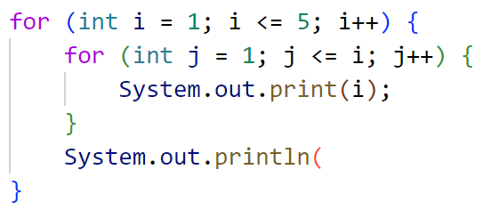
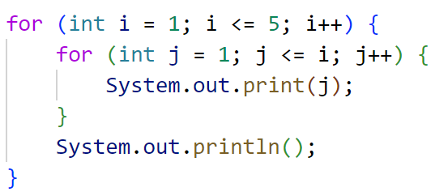
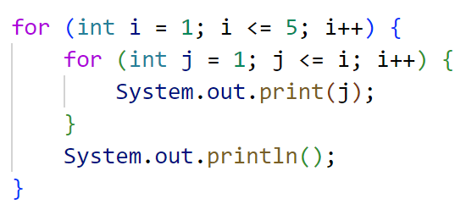
What code produces the following output?
A.
B.
C.
D.
sli.do #cse121
);

Slide 11
Scope
The part of a program where a variable exists.
From its declaration to the end of the { } braces
Ex: a variable declared in a for loop only exists in that loop
Ex: a variable declared in a method exists only in that method
public static void example() {
System.out.println("hello");
int x = 3;
for (int i = 1; i <= 10; i++) {
System.out.print(x);
}
}
i's scope
x's scope

