Slide 1
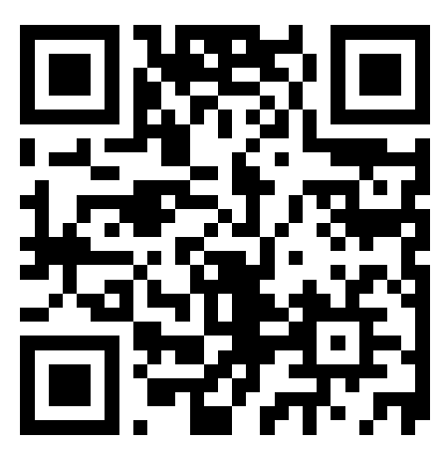
Welcome to CSE 121!
Simon Wu
Summer 2024
Use this QR code as one way to ask questions!
TAs:
Trey | Hannah | Mia | Vivian | Jolie | Colton | Ziao
sli.do #cse121

Slide 2
Announcements, Reminders
P0 was released on Wed and is due Tues, July 2nd
Quiz 0 scheduled for July 11th (about 2 weeks away)
More details will be released in the coming week!
Prep includes practice quizzes, sections, etc.
No July 4th section or in-person class on July 5th!
Enjoy your holiday weekend!
Lecture recording will be posted instead

Slide 3
Announcements, Reminders
Resubmission 0 is out!
R0 is a “free” chance to submit C0 late
Can submit past 3 assignments for each resub
Resubmit the ENTIRE assignment (including reflections!)
New grade REPLACES old grade
Generally, use resubs to implement feedback on the latest assignment, but can be used to turn in late work

Slide 4
(PCM) Precedence (updated)
Parentheses
Logical not
Multiplication, Modulo, Division
Addition (and Concatenation), Subtraction
Relational operators
Equality operators
Logical and
Logical or

Slide 5
(Review) Variables
Now that we know about different types and data, we can learn about how to store it!
Java allows you to create variables within a program. A variable has
A type
A name
(Potentially) a value it is storing
Declaration: int x;
Initialization: x = 30;
Or all in one line:
int x = 30;

Slide 6
(Review) New Operators! (1/3)
myFavoriteNumber = myFavoriteNumber + 3;
This pattern is so common, we have a shorthand for it!
myFavoriteNumber += 3;
Note: this works for both numeric addition and string concatenation!

Slide 7
(Review) New Operators! (2/3)
The shorthands -=, *=, /=, and %= exist too!
myFavoriteNumber /= 3;
Should this work for integers? Doubles? Strings?

Slide 8
(Review) New Operators! (3/3)
There are even shorter operators for “incrementing” and “decrementing”!
myFavoriteNumber++; // equal to myFavoriteNumber += 1;
myFavoriteNumber--; // equal to myFavoriteNumber -= 1;
Should this work for integers? Doubles? Strings?

Slide 9
(PCM) Type Casting in Java
Casting – a way to convert one data type to another!
Implicit casting: integer to double (example: 30 * 1.0 )
Explicit casting: using (typename) syntax:
double pi = 3.14;
int piTrunc = (int) pi; // stores 3

Slide 10
Casting Reminders!
implicit casting can only go from “simpler” data types to more generic data types
e.g. int to double, int or double to String
explicit casting is a “promise” to Java that you know what you’re getting yourself into!
may be used to cast double into an int
can also cast between int and char

Slide 11
(PCM) Strings and chars
String = sequence of characters treated as one, yet can be indexed to get individual parts
Zero-based indexing 💣
Side note: new data type!
char, represents a single character, so we use single quotes
Strings are made up of chars!
S | u | m | m | e | r | !
0 | 1 | 2 | 3 | 4 | 5 | 6
char letter = ‘c’;
char num = ‘1’;
char symbol = ‘%’;
Notes:
Bomb = indexing issues can be source of many errors! Fence-post life.

Slide 12
(PCM) String Methods Usage: <string variable>.<method>(…)
Method | Description
length() | Returns the length of the string.
charAt(i) | Returns the character at index i of the string
indexOf(s) | Returns the index of the first occurrence of s in the string; returns -1 if s doesn't appear in the string
substring(i, j) or substring(i) | Returns the characters in this string from i (inclusive) to j (exclusive); if j is omitted, goes until the end of the string
contains(s) | Returns whether or not the string contains s
equals(s) | Returns whether or not the string is equal to s (case-sensitive)
equalsIgnoreCase(s) | Returns whether or not the string is equal to s ignoring case
toUpperCase() | Returns an uppercase version of the string
toLowerCase() | Returns a lowercase version of the string
Notes:
Bomb = may get error if indexing int is out of bounds (e.g. negative index, or larger than the length of the string)
Safety guy = should return without error in usual case

Slide 13
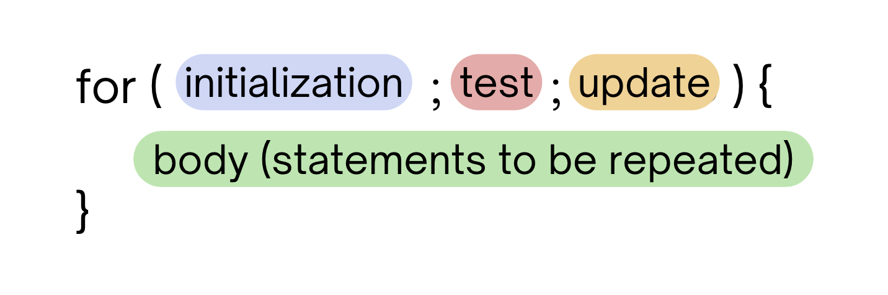
(PCM) for loops!
For loops are our first control structure
A syntactic structure that controls the execution of other statements.

Slide 14
(PCM) for loops! 2
for (int counter = 1; counter <= 5; counter++) {
System.out.println("I love CSE 121!");
}

Slide 15
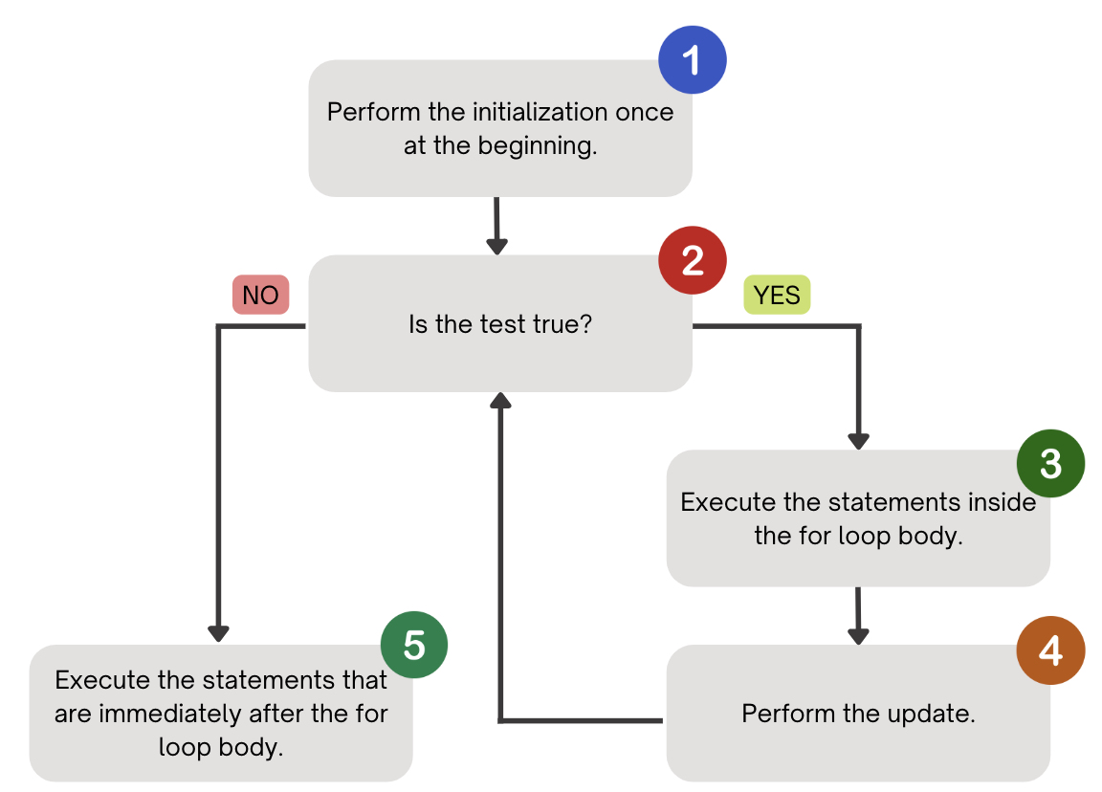
(PCM) for loops! 3

Slide 16
(PCM) for loops! 4
counter
1
2
4
1
2
3
4
5
6
for (int counter = 1; counter <= 5; counter++) {
System.out.println("I love CSE 121!");
}
3
5
I love CSE 121!
I love CSE 121!
I love CSE 121!
I love CSE 121!
I love CSE 121!

Slide 17
What output does the following code produce?
for (int i = 1; i <= 6; i++) {
System.out.println(i + " squared = " + i * i);
}
A.
i squared = i * i
i squared = i * i
i squared = i * i
i squared = i * i
i squared = i * i
i squared = i * i
B.
1 squared = 1
2 squared = 4
3 squared = 9
4 squared = 16
5 squared = 25
6 squared = 36
C.
2 squared = 4
3 squared = 9
4 squared = 16
5 squared = 25
6 squared = 36
7 squared = 49
D.
1 squared = 1
2 squared = 4
3 squared = 9
4 squared = 16
5 squared = 25
6 squared = 36
7 squared = 49

Slide 18
(PCM) String traversals
// For some String s
for (int i = 0; i < s.length(); i++) {
// do something with s.charAt(i)
}

Slide 19
Fencepost Pattern 1
Some task where one piece is repeated n times, and another piece is repeated n-1 times and they alternate
h-u-s-k-i-e-s

Slide 20
Fencepost Pattern 2
Some task where one piece is repeated n times, and another piece is repeated n-1 times and they alternate
h-u-s-k-i-e-s

Slide 21
Reflection Feedback (summarized)
C0 meant to be an introduction to reflections (graded more leniently, and feedback will be provided)
Reflections will be graded on your ideas (critical thinking), not your writing!
Reflection Megathreads (new!) moving forward

Slide 22
Challenge Question
In your own words, please define what an UStopia is, and what that might look like in a computing context. For instance, what types of computing technologies or practices might be challenged in an UStopia? How might communities use technology to empower humans as opposed to harm them?

Slide 23
Challenge Responses (paraphrased)
“an UStopia is a society where technology serves humans instead of profit”
“communities use technology to advocate for their needs, such as organizing the distribution of food and clothing”
“practices like artificial intelligence might be challenged”

Slide 24
Reflection Objectives
Describe the ethical and social impacts of technology and explain how our choices as programmers can influence these impacts
Challenge dominant assumptions, values, and goals reflected in computing and technology
Analyze the strengths and limitations of using computing and technology to solve various problems
Identify interdisciplinary applications of computing that can be in service of different communities
Understand disparities in access to computing, and explain the consequences of such disparities in technologies we build

Slide 25
