Slide 1
Welcome to CSE 121!
Simon Wu
Summer 2024
Use this QR code as one way to ask questions!
TAs:
Trey | Hannah | Mia | Vivian | Jolie | Colton | Ziao
sli.do #cse121

Slide 2
Announcements, Reminders
Creative Project 0 due tonight (June 26) @ 11:59 PM
Programming Assignment 0 released later today (due Tues, July 2)
IPL is open! - Schedule and instructions can be found on course website.
Reminder: please double-check all quiz and exam dates (let Simon know ASAP if you can’t make it!)

Slide 3
PCM Recap: Data Types & Expressions
Types: int, double, String, boolean
Expressions: Operators
Beware of precedence! (order of operations)

Slide 4
(PCM) Data Types in Java
In programming, you’re dealing with data…
ints (whole numbers)
doubles (real numbers)
Strings
booleans (true or false)

Slide 5
(PCM) Operators (for numerical & String values)
Numerical:
+ Addition
- Subtraction
* Multiplication
/ Division
% Modulo or “Mod”
<, >, <=, >=, ==, !=
Strings
+ Concatenation
Booleans
! Logical Not
&& Logical And
|| Logical Or

Slide 6
(PCM) Precedence
Parentheses
Multiplication, Modulo, Division
Addition (and Concatenation), Subtraction
If multiple operators at the same level?
Evaluate subexpressions from left to right!

Slide 7
Example
1 + 2 * 3
(1 + 2) * 3

Slide 8
Work on Expressions/Types Practice Problems Part 1
Ed lesson linked from the course calendar
Work with the folks around you!
TAs and I will be walking around to help
5 + 2 * 4
1 + 2 / 3
6 * 5 % 7

Slide 9
Questions?

Slide 10
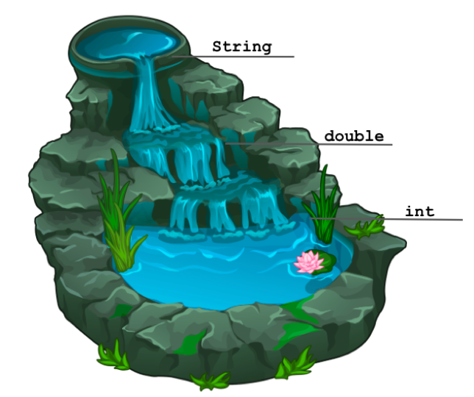
(PCM) Mixing Types
When mixing types in an expression, Java will convert one type to the other and then perform the operation “normally”
ints can be converted to doubles
Both ints and doubles can be converted to Strings

Slide 11
Example 2
2 + 2 + "hello" + 3 * 5 + 10

Slide 12
Work on Expressions/Types Practice Problems
Part 2
Ed lesson linked from the course calendar
Work with the folks around you!
TAs and I will be walking around to help
Can always refer back to PCM!
5 * 3 + 1.0
8 / 3 * 2.0
8.0 / 3 * 2
"Hello" + "world"
1 + "2" + 3
1 + 2 + "3"
1 + "2" + (3 + 4)

Slide 13
Questions?

Slide 14
(PCM) Boolean Operators
! Logical Not
< > <= >= Relational Operators
== != Relational Operators (equality)
&& Logical And
|| Logical Or

Slide 15
(PCM) Precedence (updated)
Parentheses
Logical not
Multiplication, Modulo, Division
Addition (and Concatenation), Subtraction
Relational operators
Equality operators
Logical and
Logical or

Slide 16
Example 3
1 + 2 * 3 != (1 + 2) * 3

Slide 17
Work on Expressions/Types Practice Problems
Part 3
Ed lesson linked from the course calendar
Work with the folks around you!
TAs and I will be walking around to help
Can always refer back to PCM!
5 * 3 < 12
10 % 3 == 10 / 3
5 < 9 || (7 != 7)
!(1 + 2 == 3 && 10 % 4 > 2)

Slide 18
Questions?

Slide 19
(PCM) Variables
Now that we know about different types and data, we can learn about how to store it!
Java allows you to create variables within a program. A variable has
A type
A name
(Potentially) a value it is storing
Declaration: int x;
Initialization: x = 30;
Or all in one line:
int x = 30;

Slide 20
(PCM) Variables
Notice – this doesn't really make any mathematical sense!
That's because, in Java, = is assignment, not equality!
They’re made to be manipulated, modified, re-used!
int myFavoriteNumber = 7;
int doubleFV = myFavoriteNumber * 2;
myFavoriteNumber = myFavoriteNumber + 3;
Notes:
declare and initialize
Arithmetic with variables and place into another one
A variable… varies! It can change value.
Use one variable to set another one: it’s possible!

Slide 21
(PCM) Strings and chars
String = sequence of characters treated as one, yet can be indexed to get individual parts
Zero-based indexing 💣
Side note: new data type!
char, represents a single character, so we use single quotes
Strings are made up of chars!
g | u | m | b | a | l | l
0 | 1 | 2 | 3 | 4 | 5 | 6
Notes:
Bomb = indexing issues can be source of many errors! Fence-post life.

Slide 22
(PCM) String Methods Usage: <string variable>.<method>(…)
Method | Description
length() | Returns the length of the string.
charAt(i) | Returns the character at index i of the string
indexOf(s) | Returns the index of the first occurrence of s in the string; returns -1 if s doesn't appear in the string
substring(i, j) or substring(i) | Returns the characters in this string from i (inclusive) to j (exclusive); if j is omitted, goes until the end of the string
contains(s) | Returns whether or not the string contains s
equals(s) | Returns whether or not the string is equal to s (case-sensitive)
equalsIgnoreCase(s) | Returns whether or not the string is equal to s ignoring case
toUpperCase() | Returns an uppercase version of the string
toLowerCase() | Returns a lowercase version of the string
Notes:
Bomb = may get error if indexing int is out of bounds (e.g. negative index, or larger than the length of the string)
Safety guy = should return without error in usual case

