Slide 1
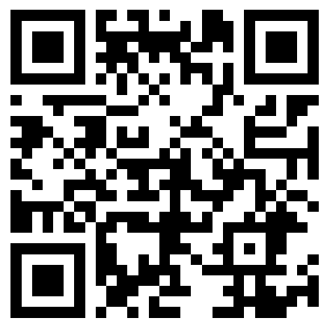
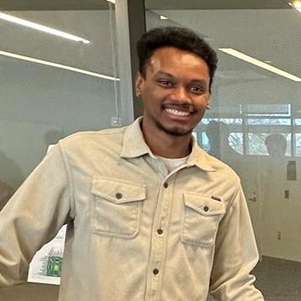
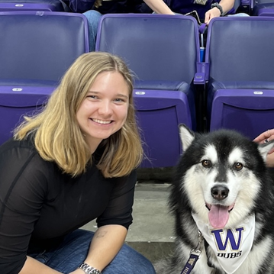
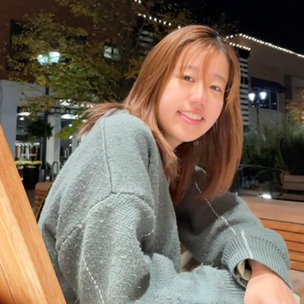
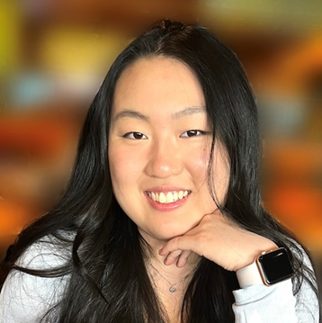
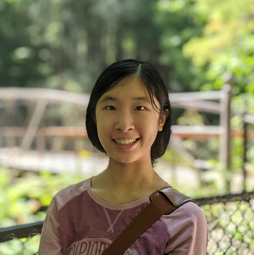
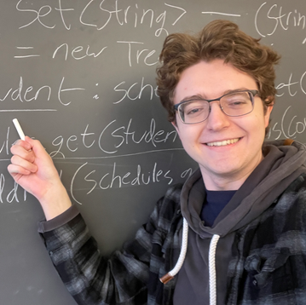
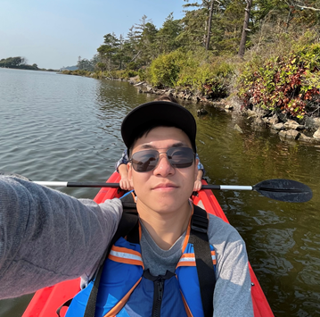
CSE 121 Lesson 16: Victory Lap
Simon Wu
Summer 2024
TAs:
Trey | Hannah | Mia | Vivian | Jolie | Colton | Ziao
sli.do #cse121

Slide 2
Announcements, Reminders
All programming / creative assignments due 8/16 at 11:59 pm
P3 deadline extended
All assignments eligible for both R6 and $7
Tomorrow is the last day for IPL + instructor office hours
Final Exam: Friday, 8/16 from 12:00-1:00 pm in PCAR 290
TA-led Review Session: Today, 8/14 from 4:30-6:00 on Zoom
Will go over practice final 1, give it an attempt before you attend!
Will be recorded, TAs will post link on the Ed board
Review our extensive Exam Resource Bank!

Slide 3
Evaluations and Awards
Course Evals are due Sunday, June 2nd at 11:59 PM
currently just 16% (36/219) – we can do better than that :’)
CERSE survey – please see Dan Grossman’s email!
This is a different kind of feedback from course evals
Bob Bandes TA Award nominations open!

Slide 4
Learning Objectives
or, “What will I learn in this class?”
Computational Thinking
Code Comprehension
Code Writing
Communication
Testing
Debugging

Slide 5
(Reflection) Learning Objectives
Understand and analyze the impacts of technology on society
Identify and challenge predominant norms and assumptions in computing
Understand both the strengths AND limitations of computing (e.g. what kinds of problems can we not solve with computers?)
Identify applications of computing to non-tech fields of study and industries
Identify how we can use computing to serve our communities
Understand disparities in access to computing, and the consequences of these disparities

Slide 6
(Optional) Using String[] args!
String[] args is just a parameter to our main method…but we never call main, so how do we pass anything to args?
When we run our program from the terminal, we can pass "command-line arguments" to the main method, and they become the contents of args
javac MyProgram.java
java MyProgram these 7 words will go in args

Slide 7
Applications of CS
or “What can I do with what I learned?” – outside of just “write code”:
Detect and prevent toxicity online & recognize disinformation
Help deaf & hard-of-hearing people identify sounds
Develop a programming language that celebrates the world’s languages
Build battery-free robots & put them on insects (and... track murder hornets?)
Computational knitting & carpentry
Create an interactive atlas of millions of refugee experiences
Fix Olympic badminton & identify cheating in chess
and so much more!

Slide 8
… including your projects! (1/2)
Computational Biology & Medicine (P2, P3)
fun fact: Matt did some DNA sequencing (P3+++) in grad school at UCLA!
at UW: Chris Thachuk, Linda Shapiro, Sara Mostafavi, Sui-In Lee; BIME & Med!
Turtle (C0, C1)
fun fact: maps well to stitching & embroidery or laser cutting!
at UW: “Cultural-Centric Computational Embroidery”, CSE + iSchool, SIGCSE ’24

Slide 9
… including your projects! (2/2)
Games & Graphics (C1, C3):
fun fact: Foldit (from UW) is a crowd-sourced game for protein folding!
at UW: many labs in CSE and iSchool’s GAMER group
Social Computing (P1, C2):
at UW: Amy Zhang’s Social Futures Lab + so much of iSchool!
and many side quests (in lecture, section, PCM): accessibility (e.g. UW CREATE), weather forecasting, chatbots, software tools, and lots of math

Slide 10
Future Courses
More 12X!
Course | Overview
CSE 122 | Introduction to Computer Programming II
CSE 123 | Introduction to Computer Programming III
or “What can I do next?”
Non-majors
Course | Overview
CSE 154 | Intro. to web programming (several languages)
CSE 160 | Intro programming, data analysis (Python)
CSE 163 | Intermediate programming, data analysis (Python)
CSE 180 | Introduction to data science (Python)
CSE 373 | Data structures and algorithms (in Java)
CSE 374 | Low-level programming and tools (C/C++)
CSE 412 | Intro to Data Visualization
CSE 416 | Intro. to Machine Learning
Majors
Course | Overview
CSE 311 | Mathematical foundations
CSE 331 | Software design/implementation
CSE 340 | Interaction programming (mobile apps)
CSE 341 | Programming languages (!!)
CSE 351 | Low-level computer organization/abstraction
Other tech-related majors: Informatics, ACMS, HCDE, Electrical & Computer Engineering, …
See: https://www.cs.washington.edu/academics/ugrad/current-students and https://www.cs.washington.edu/academics/ugrad/nonmajor-options/nonmajor-courses

Slide 11
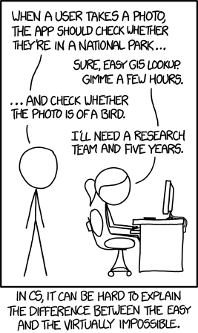
Frequently Asked Questions
How can I get better at programming?
Practice!
How can I learn to X?
Search online, read books, look at examples :)
What should I work on next?
Anything you can think of! (Here are some ideas)
Beware: it’s hard to tell what’s easy and what’s hard.
Should I learn another language? Which one?
That depends–what do you want to do?
What’s the best programming language?
😠 (take CSE 341 or CSE 413)

Slide 12
Aside: Cute Programming Language Logos

Slide 13
Summer Project: Tic Tac Toe (1/2)
Build your own Tic Tac Toe game (and “AI”)!
How would you represent a Tic Tac Toe game in Java? (hint: arrays will be very, very helpful!)
Write a method that tells you if a Tic Tac Toe game is won (or playable).
Write a method that gets input from the user and “makes” a move.
Wrap it all up – into a nice two-player game!

Slide 14
Summer Project: Tic Tac Toe (2/2)
Wait, there’s more!
Make some “AI” that…
just makes a random valid move (you should be able to beat this!)
tries to make a “good” move (~ some if statements)
never loses
Tic Tac Toe is a “solved game”: a perfect player will never lose.
Or, extend this idea to other grid-based games!
similar-ish: connect four, checkers, battleship
much harder: sudoku, chess, go, othello

Slide 15
Thank your AMAZING TAs!!!!!!

Slide 16
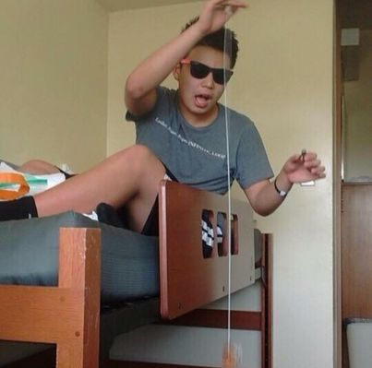
Thank you!
Ask Me (Almost) Anything!
sli.do #cse121
Feel free to leave if you want, no hard feelings!

